Slide 1
WELCOME TO
DATA SCIENCE
Dr. Nik Bear Brown
Northeastern University

Slide 2
LEARNING OBJECTIVES
WELCOME TO DATA SCIENCE
Describe the roles and components of a successful learning environment
Define data science and the data science workflow
Apply the data science workflow to meet your classmates
Setup your development environment and review python basics

Slide 3
DATA SCIENCE
PRE-WORK

Slide 4
PRE-WORK REVIEW
Define basic data types used in object-oriented programming
Recall the Python syntax for lists, dictionaries, and functions
Create files and navigate directories using the command line interface
Review basic probability

Slide 5
Probability
Probability is the measure of the likelihood that an event will occur.
0
1.0
0.5

Slide 6
Probability
Probability is a measure of the likelihood of a random phenomenon or chance behavior. Probability describes the long-term proportion with which a certain outcome will occur in situations with short-term uncertainty.
Probability is expressed in numbers between 0 and 1. Probability = 0 means the event never happens; probability = 1 means it always happens.
The total probability of all possible event always sums to 1.

Slide 7
Assigning Probabilities
Classical approach: make certain assumptions (such as equally likely, independence) about situation.
Relative frequency: assigning probabilities based on experimentation or historical data.
Subjective approach: Assigning probabilities based on the assignor’s judgment. [Bayesian]

Slide 8
Sample Space
Coin Toss ={head,tail}
Two coins S = {HH, HT, TH, TT}
Inspecting a part ={good,bad}
Rolling a die S ={1,2,3,4,5,6}

Slide 9
Probability
The probability of any event E, P(E), must be between 0 and 1 inclusive. That is,
0 < P(E) < 1.
2. If an event is impossible, the probability of the event is 0.
3. If an event is a certainty, the probability of the event is 1.
4. If S = {e₁, e₂, …, e_{n}}, then
P(e₁) + P(e₂) + … + P(e_{n}) = 1.

Slide 10
Independence
Two events A and B are independent in case
Pr(AB) = Pr(A)Pr(B)
A set of events {A_{i}} is independent in case

Slide 11
Conditional Probability
If A and B are events with Pr(A) > 0, the conditional probability of B given A is

Slide 12
Random variables
Random variables assign a real number to each
outcome:
Random variables can be:
Discrete: if it takes at most countably many
values (integers).
Continuous: if it can take any real number.

Slide 13
Random variables
Distribution of a random variable
(i) when
(ii) when
is nondecreasing.
is right-continuous.
when

Slide 14
Random variables
For a random variable, we define
Probability function
Density function,
depending on whether it is discrete or continuous

Slide 15
Random variables
Bernoulli
p
1-p
p
1-p
0 1
0 1

Slide 16
Random variables
Binomial
Successes in n independent Bernoulli trials with
success probability p

Slide 17
Random variables
Geometric
Time of first success in a sequence of independent
Bernoulli trials with success probability p

Slide 18
Random variables
Poisson
X expresses the number of “ rare events”

Slide 19
Random variables
Uniform
F(x)
f(x)
a b
a b
RANDOM VARIABLES
19

Slide 20
Random variables
Exponential
1/β
1
F(x)
f(x)
0 β
RANDOM VARIABLES

Slide 21
Random variables
Normal
f(x)
F(x)
μ

Slide 22
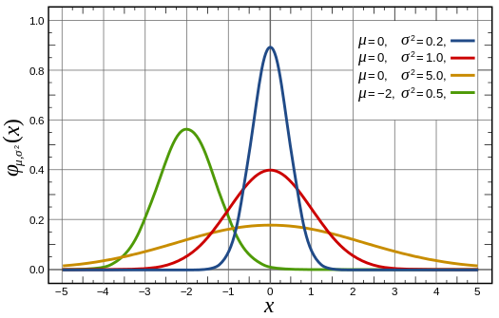
Probability distributions
Normal Distribution

Slide 23
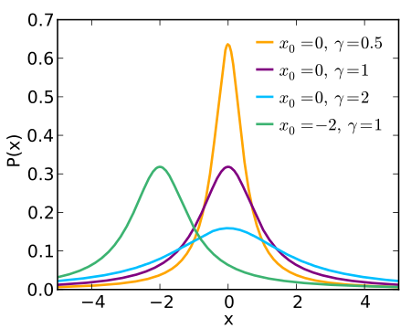
Probability distributions
Cauchy Distribution

Slide 24
DATA SCIENCE
WELCOME TO GA!

Slide 25
WELCOME TO GA!
General Assembly is a global community of individuals empowered to pursue the work we love.
General Assembly’s mission is to build our community by transforming millions of thinkers into creators.

Slide 26

FEEDBACK/SUPPORT
Access to EIRs: office hours, in class support
Exit Tickets
Mid-Course Feedback
End of Course Feedback

Slide 27

GA GRADUATION REQUIREMENTS

Slide 28

FOREVER AND EVER

Slide 29
INTRODUCTION
WHAT IS DATA SCIENCE?

Slide 30
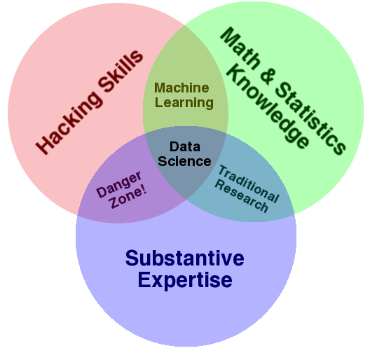
WHAT IS DATA SCIENCE?
A set of tools and techniques for data
Interdisciplinary problem-solving
Application of scientific techniques to
practical problems

Slide 31
So what is Data Science?
Data science is the process of developing optimal or realistic decision recommendations based on insights derived through the application of statistical models and analysis against existing and/or simulated future data – wikipedia

Slide 32
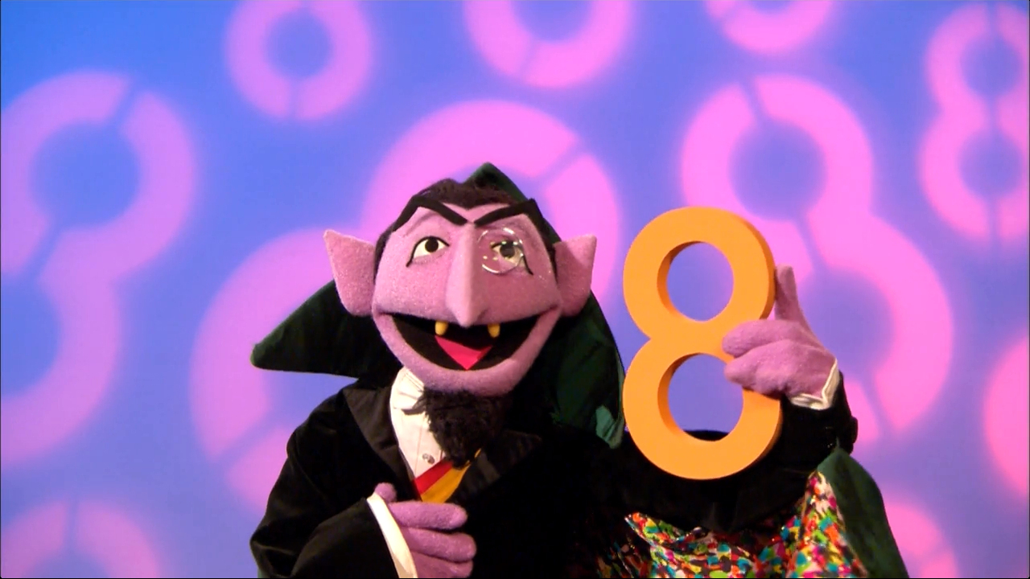
Probability and Statistics

Slide 33
Tom Mitchell’s Definition of Learning
A computer program is said to learn from experience E with respect to some class of tasks T and performance measure P, if its performance at tasks in T, as measured by P, improves with experience E.
Example 1: Learn to play checkers
T: play checkers and win
P: % of games won in the world tournament
E: opportunity to play against self.
Example 2: Learn to detect SPAM
T: Distinguish between SPAM and HAM
P: % of emails correctly classified
E: Labeled emails from your friend Robin
Notes:
TPE gives a way to specify learning tasks, what if we wanted to train a computer to recognize handwriting, what would T, P and E be?
T: recognize and classify hand-written words within images
P: % words correctly classified
E: a database of handwritten words with characters labeled.
Simon’s definition of ML: Learning denotes changes in the system that are adaptive in the sense that they enable the system to do the same task or tasks drawn from the SAME POPULATION more effectively next time”

Slide 34
Learning from Data
Supervised Learning: each example has a label (discrete or continuous)
Reinforcement Learning: feedback after a sequence of actions/decisions
Unsupervised Learning: no feedback, goal is to group data into similar groups

Slide 35
Supervised Learning: Classification
Given a set of examples (training data), each described by a set of attributes, and labeled with a class
Find a model for the class attribute as a function of the values of other attributes
Goal: classify previously unseen data accurately
Notes:
Data

Slide 36
Classification Applications
Fraud Detection: Predict fraudulent cases in credit card transactions for a particular account
Training data: previous transactions of a particular account holder
Attributes: time of purchase, product type, cost, location, etc
Class: Label transactions as fraud or fair
Telephone Operator Support: determine whether and arbitrary caller said “yes” or “no”.
Training data: Signal of caller’s voice accepting or declining an offer
Attributes: features computed from the signal
Class: Label each signal as “yes” or “no”
Notes:
Why do we need to learn a model per customer?

Slide 37
Supervised Learning: Regression
Predict a value of a given continuous valued variable based on the values of the attributes
Well studied in statistics, neural networks, recent focus in Machine Learning is on non-linear models using SVMs
Examples:
Predicting sales amounts of new product based on advertising expenditure
Predicting your score on Netflix
Time series prediction of stock market indices
Notes:
Data

Slide 38
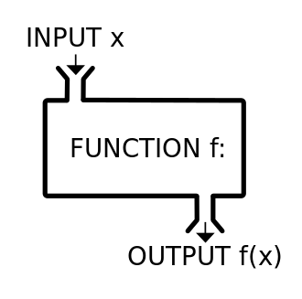
Modeling
What is a Model?

Slide 39
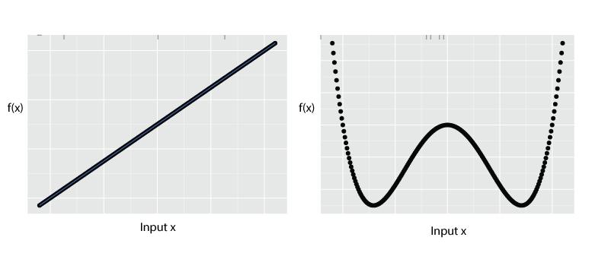
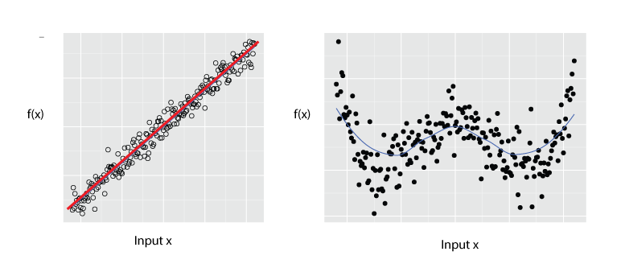
Modeling

Slide 40
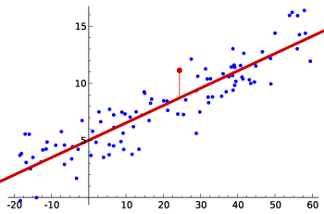
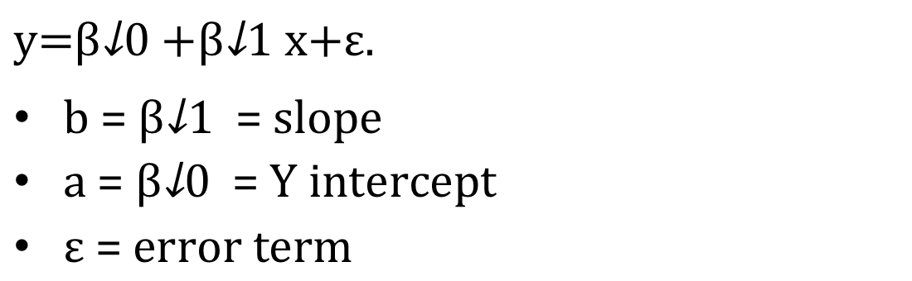
Modeling - Linear Models
= = slope
= = intercept
= error term

Slide 41
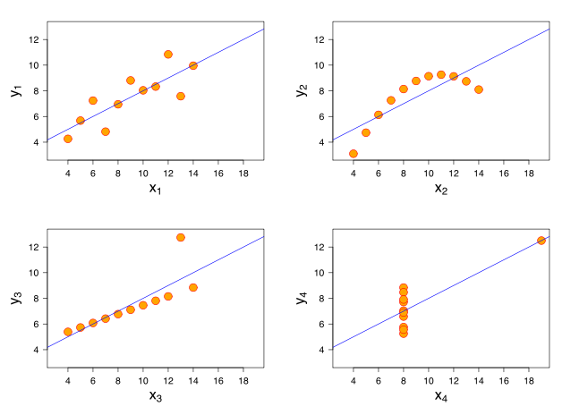
Modeling
Anscombe's quartet

Slide 42
Unsupervised Learning: Clustering
Given a set of data points, each described by a set of attributes, find clusters such that:
Inter-cluster similarity is
maximized
Intra-cluster similarity is
minimized
Requires the definition of a similarity measure
F1
x
x
x
x
x
x
x
x
xx
x
x
x
x
x
x
xx
x
F2
Notes:
Data

Slide 43
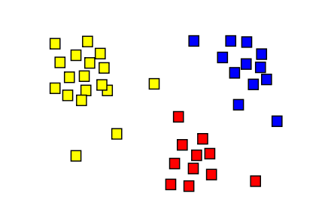
Clustering

Slide 44





WHO USES DATA SCIENCE?

Slide 45
WHO USES DATA SCIENCE?
Can you think of others?

Slide 46
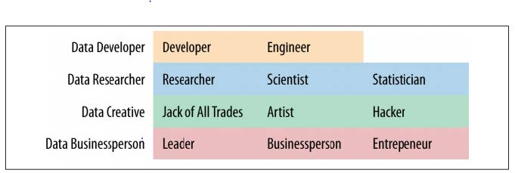
WHAT ARE THE ROLES IN DATA SCIENCE?
Data Science involves a variety of roles, not just one.

Slide 47
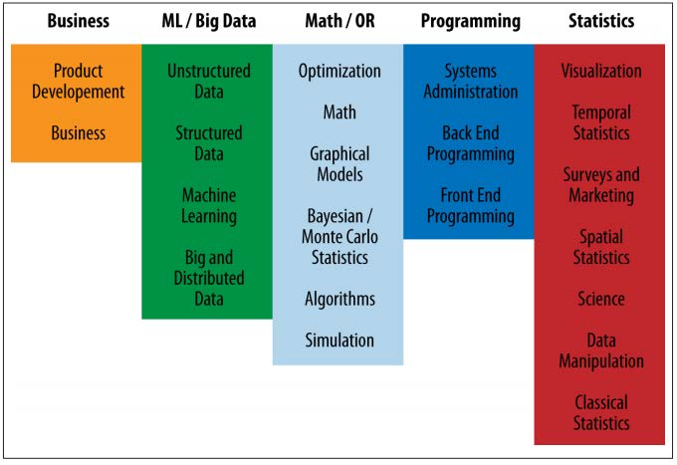
WHAT ARE THE ROLES IN DATA SCIENCE?
Data Science involves a variety of skill sets, not just one.

Slide 48
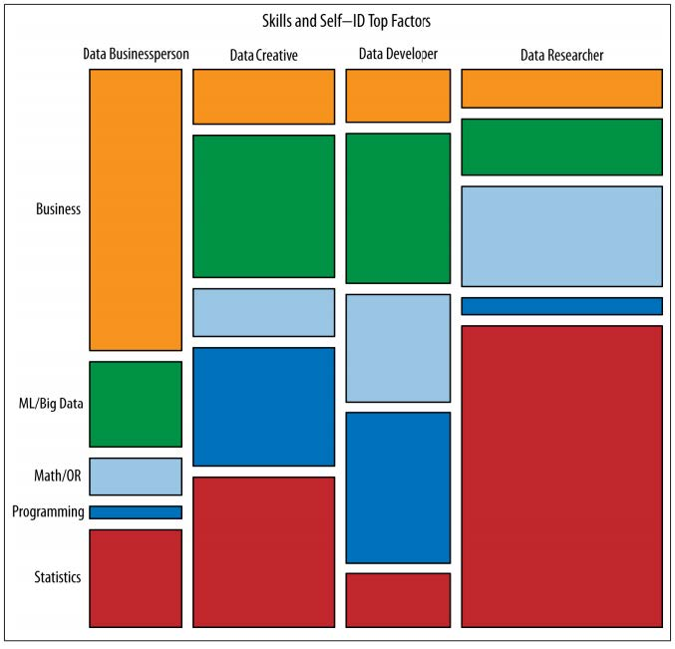
WHAT ARE THE ROLES IN DATA SCIENCE?
These roles prioritize different skill sets.
However, all roles involve some part of each skillset.
Where are your strengths and weaknesses?

Slide 49
QUIZ
DATA SCIENCE BASELINE

Slide 50

ACTIVITY: DATA SCIENCE BASELINE QUIZ
DIRECTIONS (10 minutes)
EXERCISE
Form groups of three.
Answer the following questions.
True or False: Gender (coded male=0, female=1) is a continuous variable.
According to the table on the next slide, BMI is the _____
Outcome
Predictor
Covariate
Draw a normal distribution
True or False: Linear regression is an unsupervised learning algorithm.
What is a hypothesis test?

Slide 51
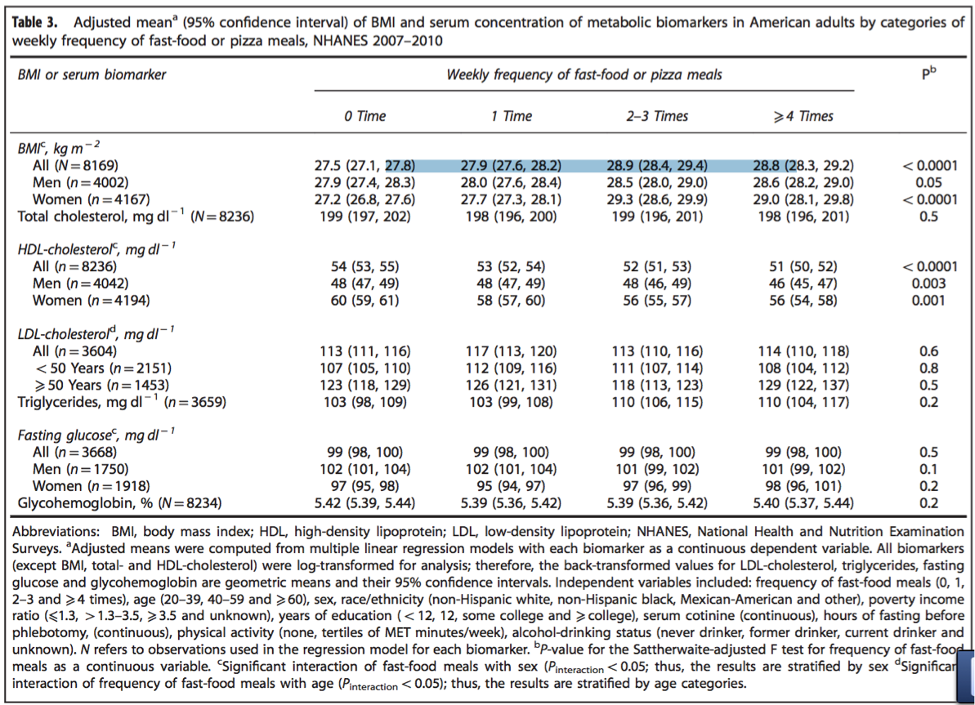
ACTIVITY: DATA SCIENCE BASELINE QUIZ
EXERCISE

Slide 52
INTRODUCTION
THE DATA SCIENCE WORKFLOW

Slide 53
OVERVIEW OF THE DATA SCIENCE WORKFLOW
A methodology for doing Data Science
Similar to the scientific method
Helps produce reliable and reproducible results
Reliable: Accurate findings
Reproducible: Others can follow your steps and get the same results

Slide 54
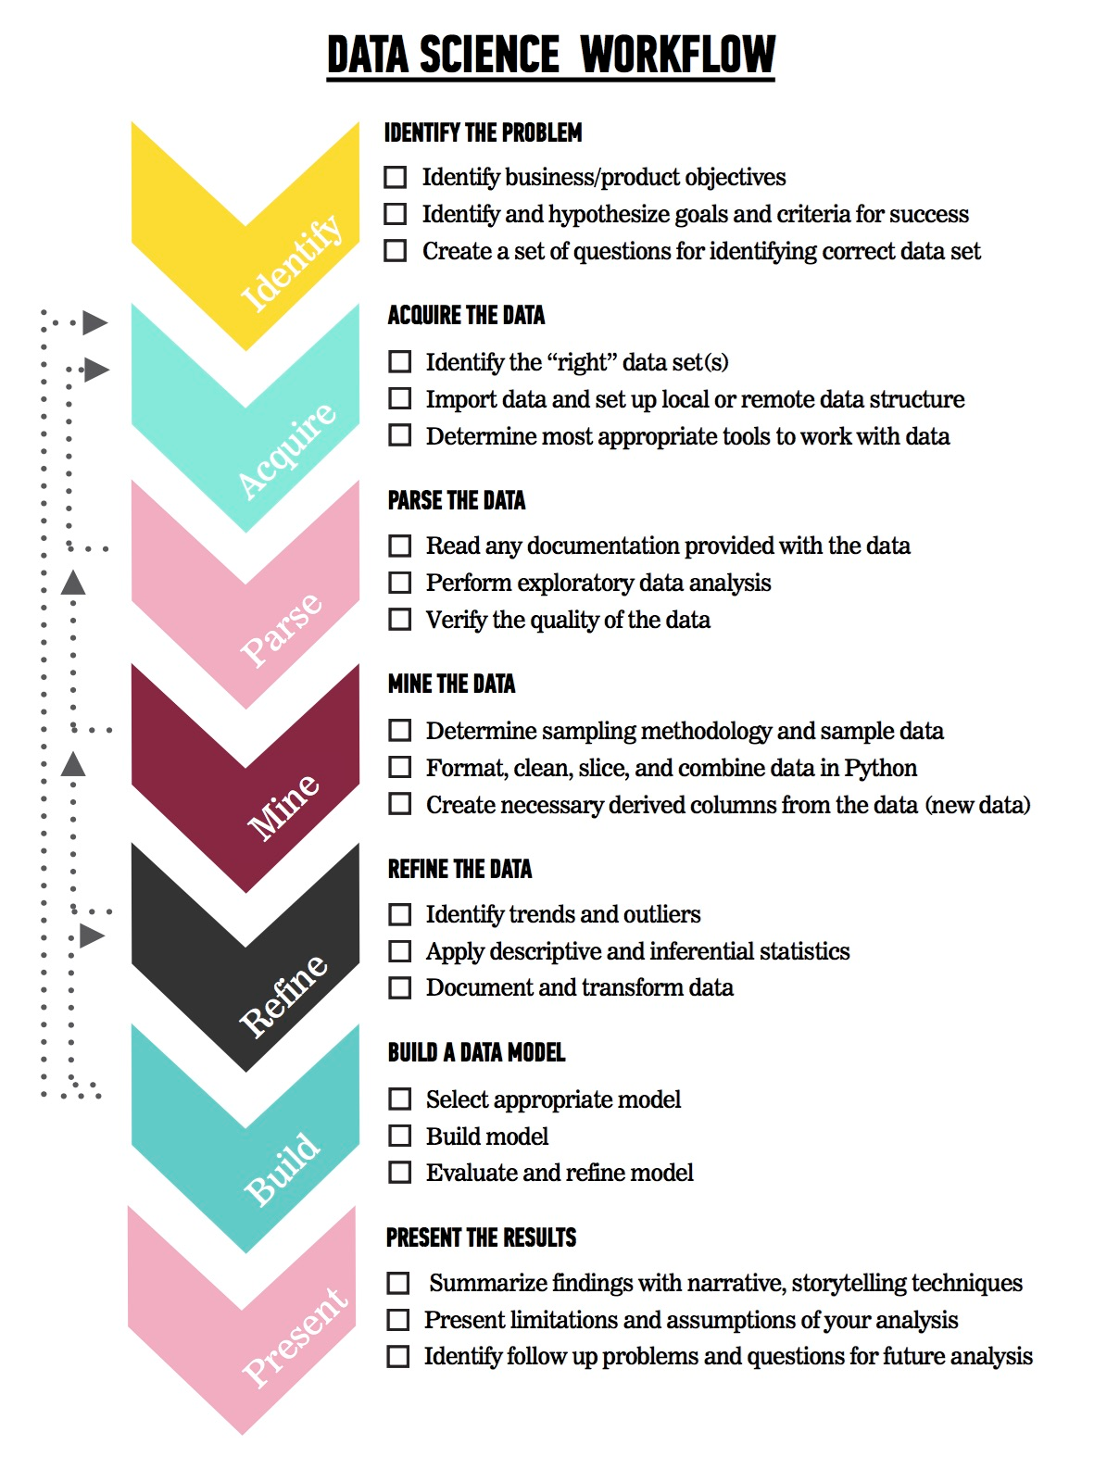
OVERVIEW OF THE DATA SCIENCE WORKFLOW
The steps:
Identify the problem
Acquire the data
Parse the data
Mine the data
Refine the data
Build a data model
Present the results

Slide 55
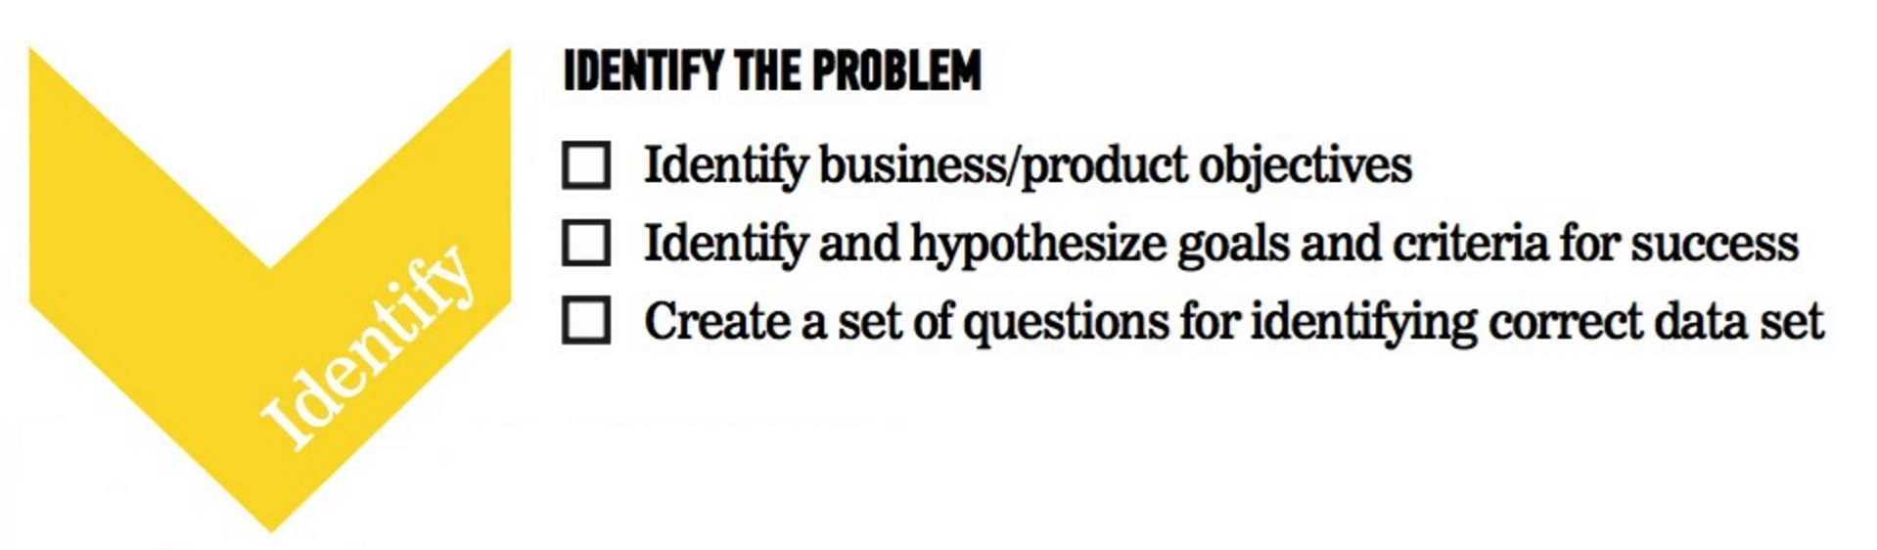
OVERVIEW OF THE DATA SCIENCE WORKFLOW

Slide 56
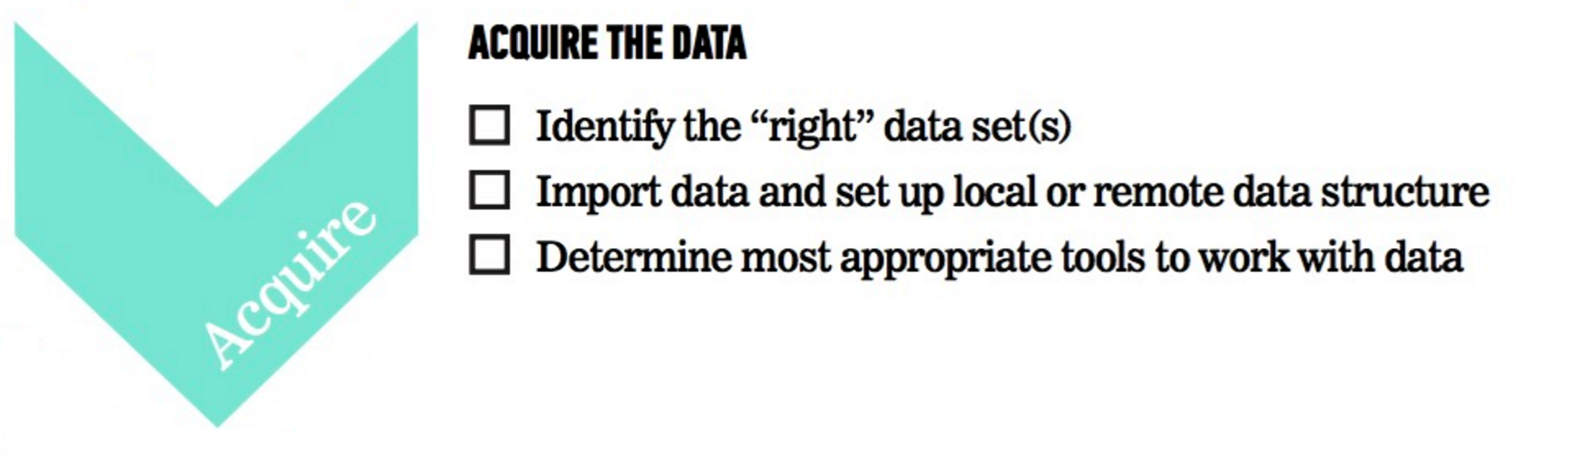
OVERVIEW OF THE DATA SCIENCE WORKFLOW

Slide 57

OVERVIEW OF THE DATA SCIENCE WORKFLOW

Slide 58
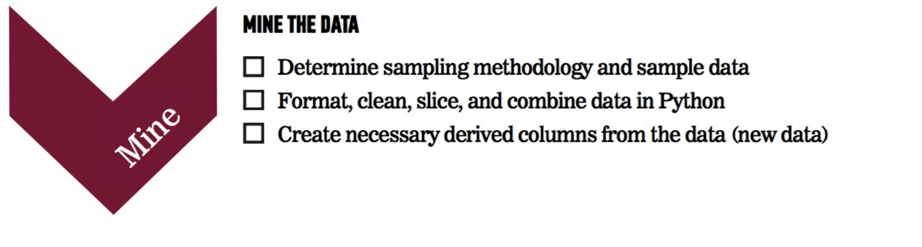
OVERVIEW OF THE DATA SCIENCE WORKFLOW

Slide 59
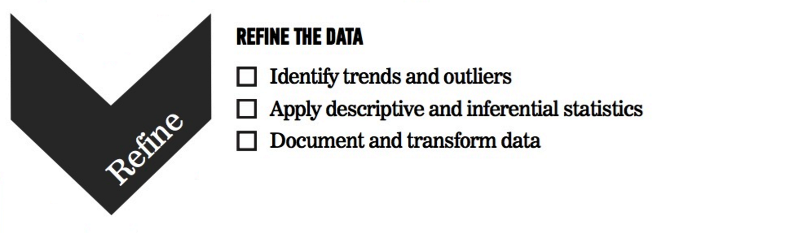
OVERVIEW OF THE DATA SCIENCE WORKFLOW

Slide 60

OVERVIEW OF THE DATA SCIENCE WORKFLOW

Slide 61

OVERVIEW OF THE DATA SCIENCE WORKFLOW

Slide 62

FUTURAMA EXAMPLE
Problem Statement: “Using Planet Express customer data from January 3001-3005, determine how likely previous customers are to request a repeat delivery using demographic information (profession, company size, location) and previous delivery data (days since last delivery, number of total deliveries).”
We can use the Data Science workflow to work through this problem.

Slide 63
FUTURAMA EXAMPLE: IDENTIFY THE PROBLEM
Identify the business/product objectives.
Identify and hypothesize goals and criteria for success.
Create a set of questions to help you identify the correct data set.

Slide 64
FUTURAMA EXAMPLE: ACQUIRE THE DATA
Ideal data vs. data that is available
Learn about limitations of the data.
What data is available for this example?
What kind of questions might we want to ask about the data?

Slide 65
FUTURAMA EXAMPLE: ACQUIRE THE DATA
Questions to ask about the data
Is there enough data?
Does it appropriately align with the question/problem statement?
Can the dataset be trusted? How was it collected?
Is this dataset aggregated? Can we use the aggregation or do we need to get it pre-aggregated?

Slide 66
FUTURAMA EXAMPLE: PARSE THE DATA
Secondary data = we didn’t directly collect it ourselves
Example data dictionary
Variable | Description | Type of Variable
Profession | Title of the account owner | Categorical
Company Size | 1- small, 2- medium, 3- large | Categorical
Location | Planet of the company | Categorical
Days Since Last Delivery | Integer | Continuous
Number of Deliveries | Integer | Continuous

Slide 67
FUTURAMA EXAMPLE: PARSE THE DATA
Questions to ask while parsing
Is there documentation for the data? Is there a data dictionary?
What kind of filtering, sorting, or simple visualizations can help understand the data?
What information is contained in the data?
What data types are the variables?
Are there outliers? Are there trends?

Slide 68
FUTURAMA EXAMPLE: MINE THE DATA
Think about sampling
Get to know the data
Explore outliers
Address missing values
Derive new variables (i.e. columns)

Slide 69
FUTURAMA EXAMPLE: MINE THE DATA
Common steps while mining the data
Sample the data with appropriate methodology
Explore outliers and null values
Format and clean the data
Determine how to address missing values
Format and combine data; aggregate and derive new columns

Slide 70
FUTURAMA EXAMPLE: REFINE THE DATA
Use statistics and visualization to identify trends
Example of basic statistics
Variable | Mean (STD) or Frequency (%)
Number of Deliveries | 50.0 (10)
Earth | 50 (10%)
Amphibios 9 | 100 (20%)
Bogad | 100 (20%)
Colgate 8 | 100 (20%)
Other | 150 (30%)

Slide 71
FUTURAMA EXAMPLE: REFINE THE DATA
Descriptive stats help refine by
Identifying trends and outliers
Deciding how to deal with outliers
Applying descriptive and inferential statistics
Determining visualization techniques for different data types
Transforming data

Slide 72
FUTURAMA EXAMPLE: CREATE A DATA MODEL
Select a model based upon the outcome
Example model statement: “We completed a logistic regression using Statsmodels v. XX. We calculated the probability of a customer placing another order with Planet Express.”
Steps for model building

Slide 73
FUTURAMA EXAMPLE: CREATE A DATA MODEL
The steps for model building are
Select the appropriate model
Build the model
Evaluate and refine the model
Predict outcomes and action items

Slide 74
FUTURAMA EXAMPLE: PRESENT THE RESULTS
You have to effectively communicate your results for them to matter!
Ranges from a simple email to a complex web graphic.
Make sure to consider your audience.
A presentation for fellow data scientists will be drastically different from a presentation for an executive.

Slide 75
FUTURAMA EXAMPLE: PRESENT THE RESULTS
Key factors of a good presentation include
Summarize findings with narrative and storytelling techniques
Refine your visualizations for broader comprehension
Present both limitations and assumptions
Determine the integrity of your analyses
Consider the degree of disclosure for various stakeholders
Test and evaluate the effectiveness of your presentation beforehand

Slide 76
FUTURAMA EXAMPLE: PRESENT THE RESULTS
Example presentations and infographics
512 Paths to the White House
Who Old Are You?
2015 NFL Predictions

Slide 77
GUIDED PRACTICE
DATA SCIENCE WORK FLOW

Slide 78
ACTIVITY: DATA SCIENCE WORKFLOW
DIRECTIONS (25 minutes)
EXERCISE
Divide into 4 groups, each located at a whiteboard.
IDENTIFY: Each group should develop 1 research question they would like to know about their classmates. Create a hypothesis to your question. Don’t share your question yet! (5 minutes)
ACQUIRE: Rotate from group to group to collect data for your hypothesis. Have other students write or tally their answers on the whiteboard. (10 minutes)
PRESENT: Communicate the results of your analysis to the class. (10 minutes)
Create a narrative to summarize your findings.
Provide a basic visualization for easy comprehension.
Choose one student to present for the group.
DELIVERABLE
Presentation of the results

Slide 79
DEMO
ENVIRONMENT SETUP

Slide 80
DEV ENVIRONMENT SETUP
Brief intro of tools
Environment setup
Create a Github account
Install Python 2.7 and Anaconda
Practice Python syntax, Terminal commands, and Pandas
iPython Notebook test and Python review

Slide 81
DEV ENVIRONMENT SETUP
Test your new setup using the lesson 1 starter code available at /lessons/lesson-1/code/starter-code/lesson1-starter-code.ipynb in the Github repo
Ask your classmates and instructor for help if you have problems!

Slide 82
CONCLUSION
REVIEW

Slide 83
CONCLUSION
You should now be able to answer the following questions:
What is Data Science?
What is the Data Science workflow?
How can you have a successful learning experience at GA?

Slide 84
DATA SCIENCE
BEFORE NEXT CLASS

Slide 85
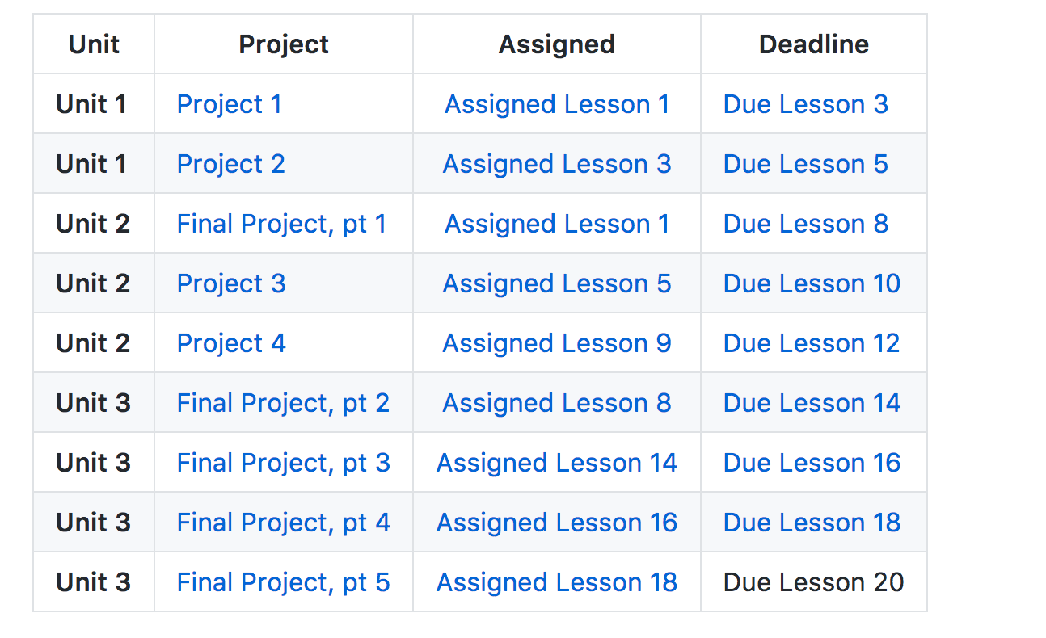
Projects Timeline

Slide 86
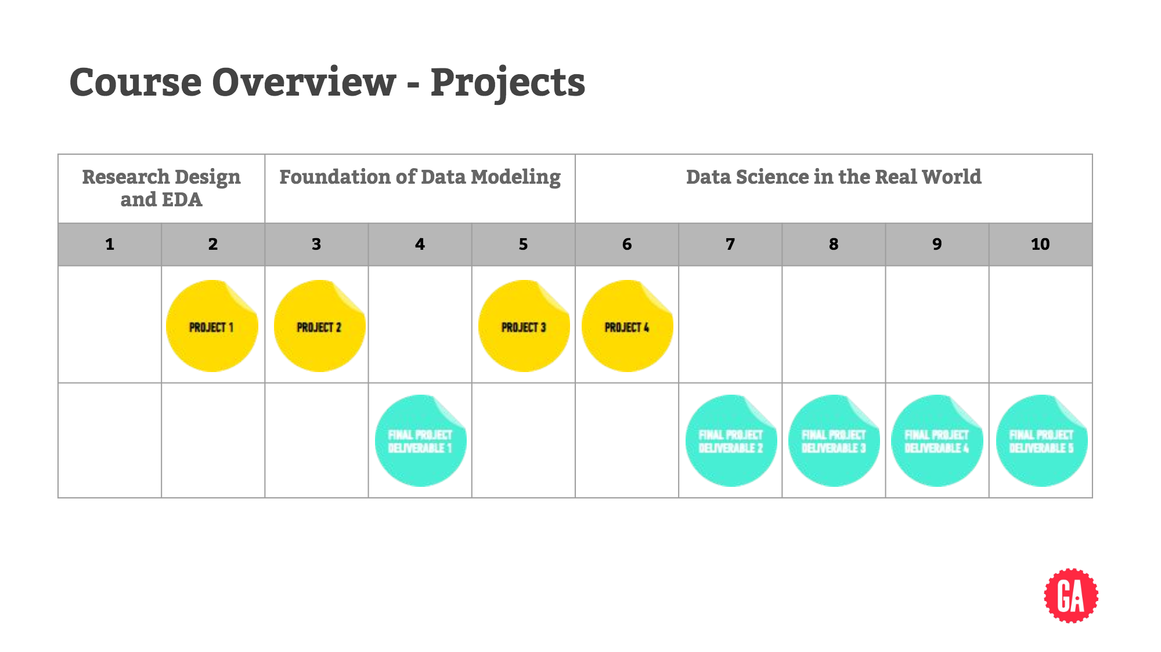
Projects Timeline

Slide 87
Project 1
Project: Begin work on Project 1
Look at Project 1 iPython notebook

Slide 88
DUE DATE
BEFORE NEXT CLASS
Project: Begin work on Project 1

Slide 89
WELCOME TO DATA SCIENCE
Q & A

Slide 90
WELCOME TO DATA SCIENCE
EXIT TICKET
DON’T FORGET TO FILL OUT YOUR EXIT TICKET

