Slide 1
EXPERIMENTAL DESIGN AND PANDAS
Nik Bear Brown
Northeastern University

Slide 2
LEARNING OBJECTIVES
EXPERIMENTAL DESIGN AND PANDAS
Define a problem and types of data
Identify data set types
Define the data science workflow
Apply the data science workflow in the pandas context
Create an iPython Notebook to import, format, and clean using the Pandas library

Slide 3
COURSE
PRE-WORK

Slide 4
PRE-WORK REVIEW
Create and open an iPython Notebook
Complete the Python pre-work

Slide 5
OPENING
EXPERIMENTAL DESIGN AND PANDAS

Slide 6
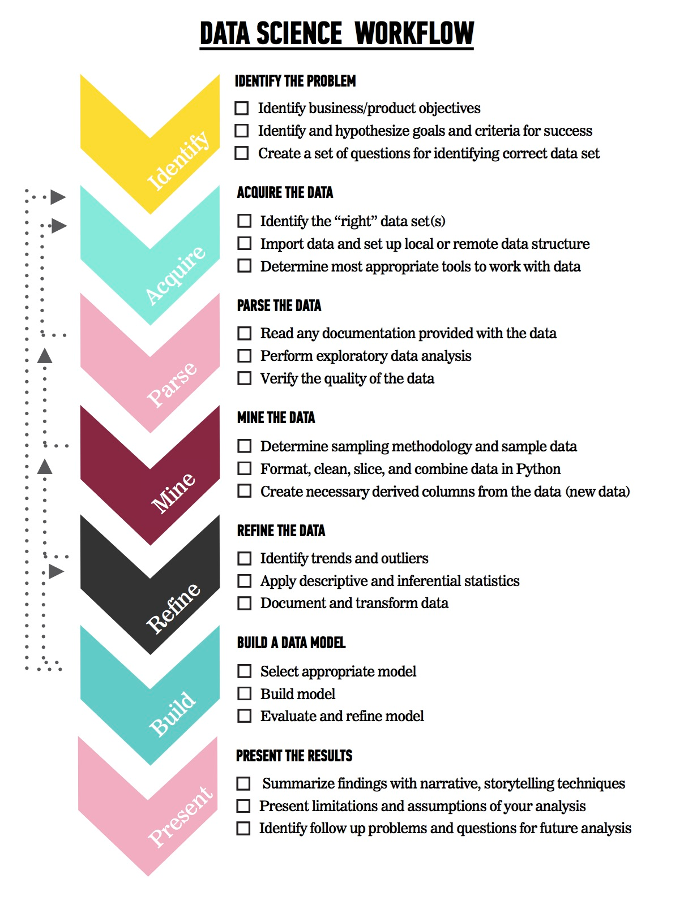
LET’S REVIEW THE DATA SCIENCE WORKFLOW
The steps:
Identify the problem
Acquire the data
Parse the data
Mine the data
Refine the data
Build a data model
Present the results

Slide 7
TODAY
We’re going to focus on steps 1-2 (Identify the Problem and Acquire the Data).
We’ll cover steps 3-5 in the next few classes

Slide 8
INTRODUCTION
ASKING A GOOD QUESTION

Slide 9
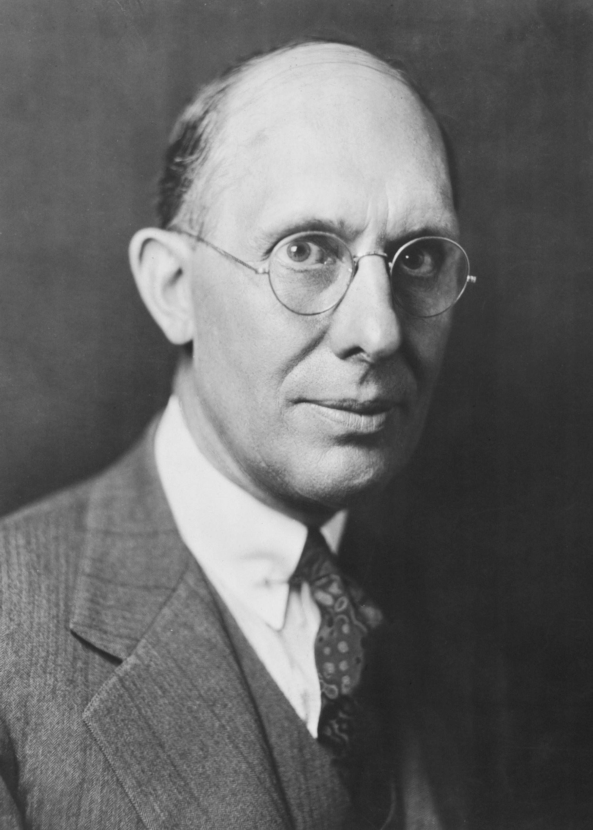
WHY DO WE NEED A GOOD QUESTION?
“A problem well stated is half solved.” -Charles Kettering
Sets yourself up for success as you begin analysis
Establishes the basis for reproducibility
Enables collaboration through clear goals

Slide 10
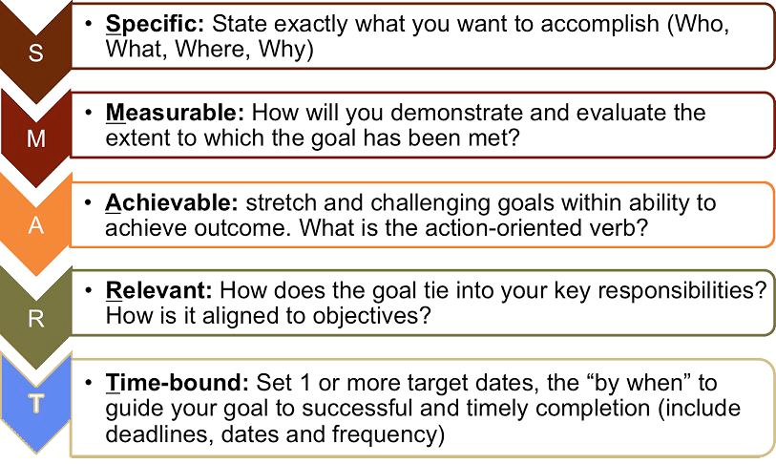
WHAT IS A GOOD QUESTION?
Goals are similar to the SMART Goals Framework.
S: specific
M: measurable
A: attainable
R: reproducible
T: time-bound

Slide 11
WHAT IS A GOOD QUESTION?
Specific: The dataset and key variables are clearly defined.
Measurable: The type of analysis and major assumptions are articulated.
Attainable: The question you are asking is feasible for your dataset and is not likely to be biased.
Reproducible: Another person (or future you) can read and understand exactly how your analysis is performed.
Time-bound: You clearly state the time period and population for which this analysis will pertain.

Slide 12
WHAT IS A GOOD QUESTION?

Slide 13
DEMO
DIAGRAMMING AN AIM

Slide 14
EXAMPLE AIM
Determine the association of foods in the home with child dietary intake. Using one 24-hour recall from the cross-sectional NHANES 2007-2010 we will determine the factors associated with food available in the homes of American children and adolescents. We will test if reported availability of fruits, dark green vegetables, low fat milk or sugar sweetened beverages available in the home increases the likelihood that children and adolescents will meet their USDA recommended dietary intake for that food.

Slide 15

HYPOTHESIS
Children will be more likely to meet the USDA recommended intake level when food is always available in their home compared to rarely or never.

Slide 16
SPECIFIC
How data was collected:
24-hour recall, self-reported
What data was collected:
Fruits, dark green vegetables, low fat milk or sugar sweetened beverages, always vs. rarely available
How data will be analyzed:
Using USDA recommendations as a gold-standard to measure the association
The specific hypothesis & direction of the expected associations:
Children will be more likely to meet their recommended intake level

Slide 17
MEASURABLE
Determine the association of foods in the home with child dietary intake.
We will test if the reported availability of certain foods increases the likelihood that children and adolescents will meet their USDA recommended dietary intake for food.

Slide 18
ATTAINABLE
Cross-sectional data has inherent limitations; one of the most common is that causal inference is typically not possible.
Note that we are determining association, not causation.

Slide 19
REPRODUCIBLE
With all the specifics, it would be straightforward to pull the data from NHANES and reproduce the analysis.

Slide 20
TIME BOUND
Using one 24-hour recall from NHANES 2007-2010, we will determine the factors associated with food available in the homes of American children and adolescents.

Slide 21
CONTEXT IS IMPORTANT
The previous example laid out research goals.
In a business setting, you will need to articulate business objectives.
Example: Success for the Netflix recommendation engine may be if 70% of customers over the age of 18 select a movie from the recommended queue during Q3 of 2015.
Regardless of setting, start your question with the SMART framework to help achieve your objectives.

Slide 22

ACTIVITY: KNOWLEDGE CHECK
ANSWER THE FOLLOWING QUESTIONS (5 minutes)
EXERCISE
Which of the following uses the SMART framework? Why? What is missing?
I am looking to see if there is an association with number of passengers with carry on luggage and delayed take-off time.
Determine if the number of passengers on JetBlue, Delta and United domestic flights with carry-on luggage is associated with delayed take-off time using data from flightstats.com from January 2015- December 2015.
DELIVERABLE
Answers to the above questions

Slide 23
WHY DATA TYPES MATTER
Different data types have different limitations and strengths.
Certain types of analyses aren’t possible with certain data types.

Slide 24
CROSS-SECTIONAL DATA
All information is determined at the same time; all data comes from the same time period.
Issues: There is no distinction between exposure and outcome
Cross-sectional data, or a cross section of a study population, in statistics and econometrics is a type of data collected by observing many subjects (such as individuals, firms, countries, or regions) at the same point of time, or without regard to differences in time.

Slide 25
CROSS-SECTIONAL DATA
Strengths
Often population based
Generalizability
Reduce cost compared to other types of data collection methods
Weaknesses
Separation of cause and effect may be difficult (or impossible)
Variables/cases with long duration are over-represented

Slide 26
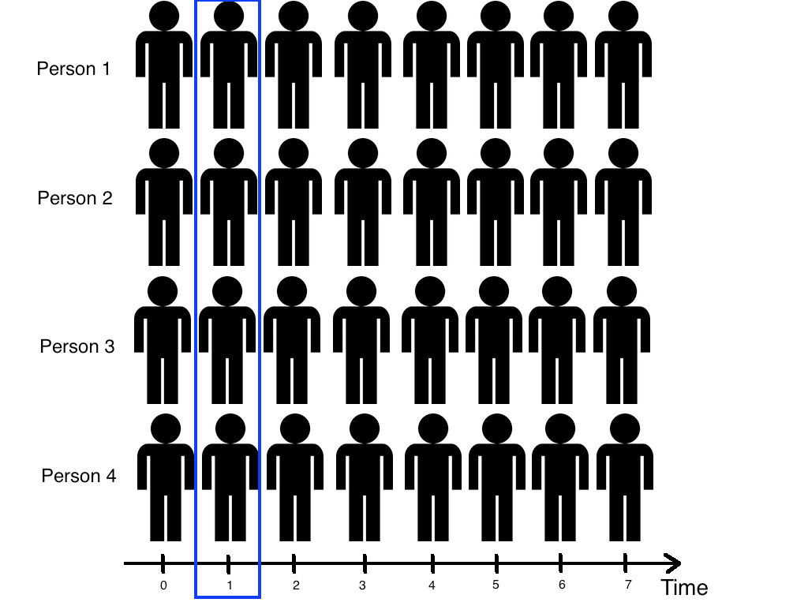
CROSS-SECTIONAL DATA

Slide 27
TIME SERIES/LONGITUDINAL DATA
A time series is simple a sequence of data points spaced out over time, usually with regular time intervals.
Stock prices
Monthly employment and unemployment
A longitudinal series is more specific, keeping the same sample for each observation over time.
Weight of a set of individuals over years
The effect of diet, exercise on long term health

Slide 28
TIME SERIES/LONGITUDINAL DATA
The information is collected over a period of time
Strengths
Unambiguous temporal sequence - exposure precedes outcome
Multiple outcomes can be measured
Weaknesses
Expense
Takes a long time to collect data
Vulnerable to missing data

Slide 29
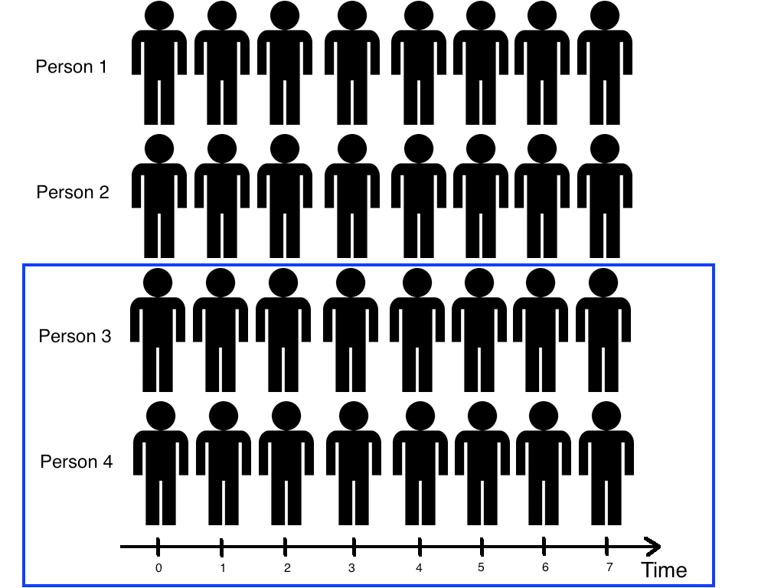
TIME SERIES/LONGITUDINAL DATA

Slide 30
ACTIVITY: KNOWLEDGE CHECK
ANSWER THE FOLLOWING QUESTIONS (5 minutes)
EXERCISE
What type of data is the flightstats data?
Determine if the number of passengers on JetBlue, Delta and United domestic flights with carry-on luggage is associated with delayed take-off time using data from flightstats.com from January 2015- December 2015.
Can you create a cross-sectional analysis from a longitudinal data collection? How?
DELIVERABLE
Answers to the above questions

Slide 31
GUIDED PRACTICE
WRITE A RESEARCH QUESTION WITH RAW DATA

Slide 32
ACTIVITY: WRITE A RESEARCH QUESTION WITH RAW DATA
DIRECTIONS (10 minutes)
EXERCISE
Individually, look at the data from Kaggle’s Titanic competition and write a high quality research question.
Make sure you answer the following questions:
What type of data is this, cross-sectional or longitudinal?
What will we be measuring?
What is the SMART aim for this data?
When finished, split into pairs and share your answers with each other.
DELIVERABLE
Research Question

Slide 33
REVIEW
SMART

Slide 34
SMART REVIEW
The SMART framework covers the “Identify” step of the data science workflow.
Types of datasets: cross-sectional vs. time series/longitudinal
Questions?

Slide 35
INTRODUCTION
DATA SCIENCE WORKFLOW: ACQUIRE & PARSE

Slide 36
DATA SCIENCE WORKFLOW: ACQUIRE & PARSE
For the remainder of class, we’ll talk about steps 2 & 3 of the data science workflow: acquire and parse
We’ll be using iPython Notebook
First a demo, then a codealong
Finally, some hands on practice in a lab

Slide 37
DEMO
WALKTHROUGH ACQUIRE & PARSES WITH PANDAS

Slide 38
ACQUIRE
Where we determine if we have the “right” dataset for our problem
Questions to ask:
What type of data is it, cross-sectional or longitudinal?
How well was the data collected?
Is there much missing data?
Was the data collection instrument validated and reliable?
Is the dataset aggregated?
Do we need pre-aggregated data?

Slide 39
LOGISTICS OF ACQUIRING YOUR DATA
Data can be acquired through a variety of sources
Web (Google Analytics, HTML, XML)
File (CSV, XML, TXT, JSON)
Databases (SQL, NOSQL, etc)
Today, we’ll use a CSV (comma separated file)

Slide 40
PARSE: UNDERSTANDING YOUR DATA
You need to understand what you’re working with.
To better understand your data
Create or review the data dictionary
Perform exploratory surface analysis
Describe data structure and information being collected
Explore variables and data types

Slide 41
INTRO TO DATA DICTIONARIES AND DOCUMENTATION
Data dictionaries help judge the quality of the data.
They also help understand how it’s coded.
Does gender = 1 mean female or male?
Is the currency dollars or euros?
Data dictionaries help identify any requirements, assumptions, and constraints of the data.
They make it easier to share data.

Slide 42
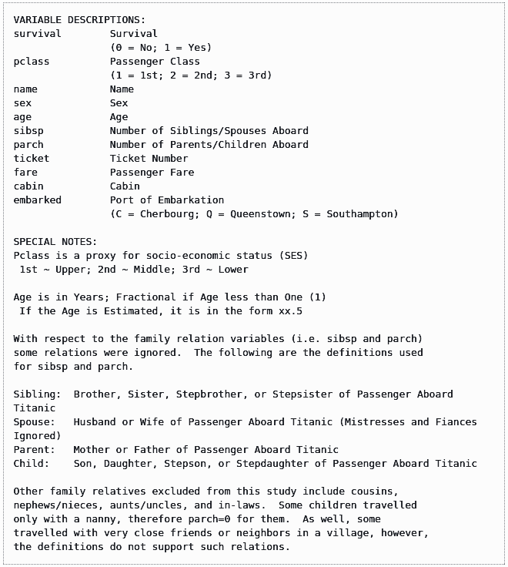
DATA DICTIONARY EXAMPLE: KAGGLE TITANIC DATA

Slide 43
CODEALONG
NUMPY AND PANDAS INTRO

Slide 44
NUMPY AND PANDAS INTRO
What are Numpy and Pandas? Python packages
Pands is built on Numpy.
Numpy uses arrays (lists) to do basic math and slice and index data.
Pandas uses a data structure called a Dataframe.
Dataframes are similar to Excel tables; they contain rows and columns.

Slide 45
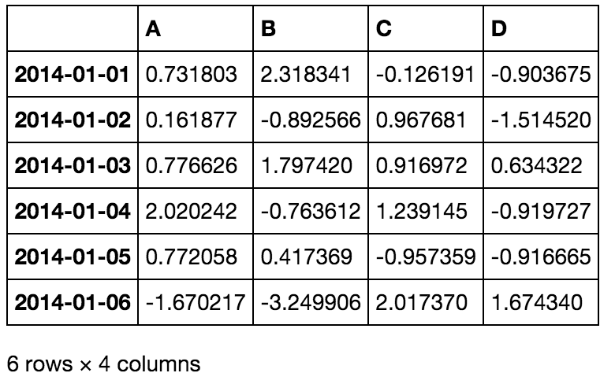
NUMPY AND PANDAS INTRO

Slide 46
NUMPY AND PANDAS INTRO
With these packages, you can select pieces of data, do basic operations, calculate summary statistics.
Follow along and code along as we learn about Numpy and Pandas.

Slide 47
NUMPY AND PANDAS INTRO
We often have to merge data together, correct missing data, and plot our findings.
Once again, follow and code along.

Slide 48
DEMO
LAB WALKTHROUGH

Slide 49
LESSON 2 LAB WALKTHROUGH
In this lab, you will merge two datasets: ozone and data.
By the end of the lab, you will:
Merge datasets
Check basic features of the data
Find and drop missing values
Find basic stats like mean and max

Slide 50
CONCLUSION
TOPIC REVIEW

Slide 51
REVIEW
Let’s go through the lab. Any questions?
Today, we’ve talked about
Defining a problem
Types of data
Acquiring and parsing data
Using Pandas

Slide 52
COURSE
BEFORE NEXT CLASS

Slide 53
DUE DATE
BEFORE NEXT CLASS
Project: Unit 1

Slide 54
LESSON
Q & A

Slide 55
LESSON
EXIT TICKET
DON’T FORGET TO FILL OUT YOUR EXIT TICKET

Slide 56
THANKS!
Nik Bear Brown
Body Level One
Body Level Two
Body Level Three
Body Level Four
Body Level Five
Body Level One
Body Level Two
Body Level Three
Body Level Four
Body Level Five
Northeastern University
nikbearbrown@gmail.com

