Slide 1
STATISTICS FUNDAMENTALS
Nik Bear Brown
Northeastern University
nikbearbrown@gmail.com

Slide 2
LEARNING OBJECTIVES
STATISTICS FUNDAMENTALS
Use NumPy and Pandas libraries to analyze datasets using basic summary statistics: mean, median, mode, max, min, quartile, inter-quartile range, variance, standard deviation, and correlation
Create data visualizations - including: line graphs, box plots, and histograms- to discern characteristics and trends in a dataset
Identify a normal distribution within a dataset using summary statistics and visualization
ID variable types and complete dummy coding by hand

Slide 3
COURSE
PRE-WORK

Slide 4
PRE-WORK github
Create and open an iPython Notebook
Complete the Python pre-work

Slide 5
PRE-WORK github
Upload your HW to DAT-BOS-16
git clone https://github.com/ga-students/DAT-BOS-16
git add . from DAT-BOS-16
or cd to projects/unit-projects/project-1/project_hw1
git add unit-project-1-bear.ipynb
git commit -m "commit msg"
git push

Slide 6
OPENING
STATISTICS FUNDAMENTALS

Slide 7
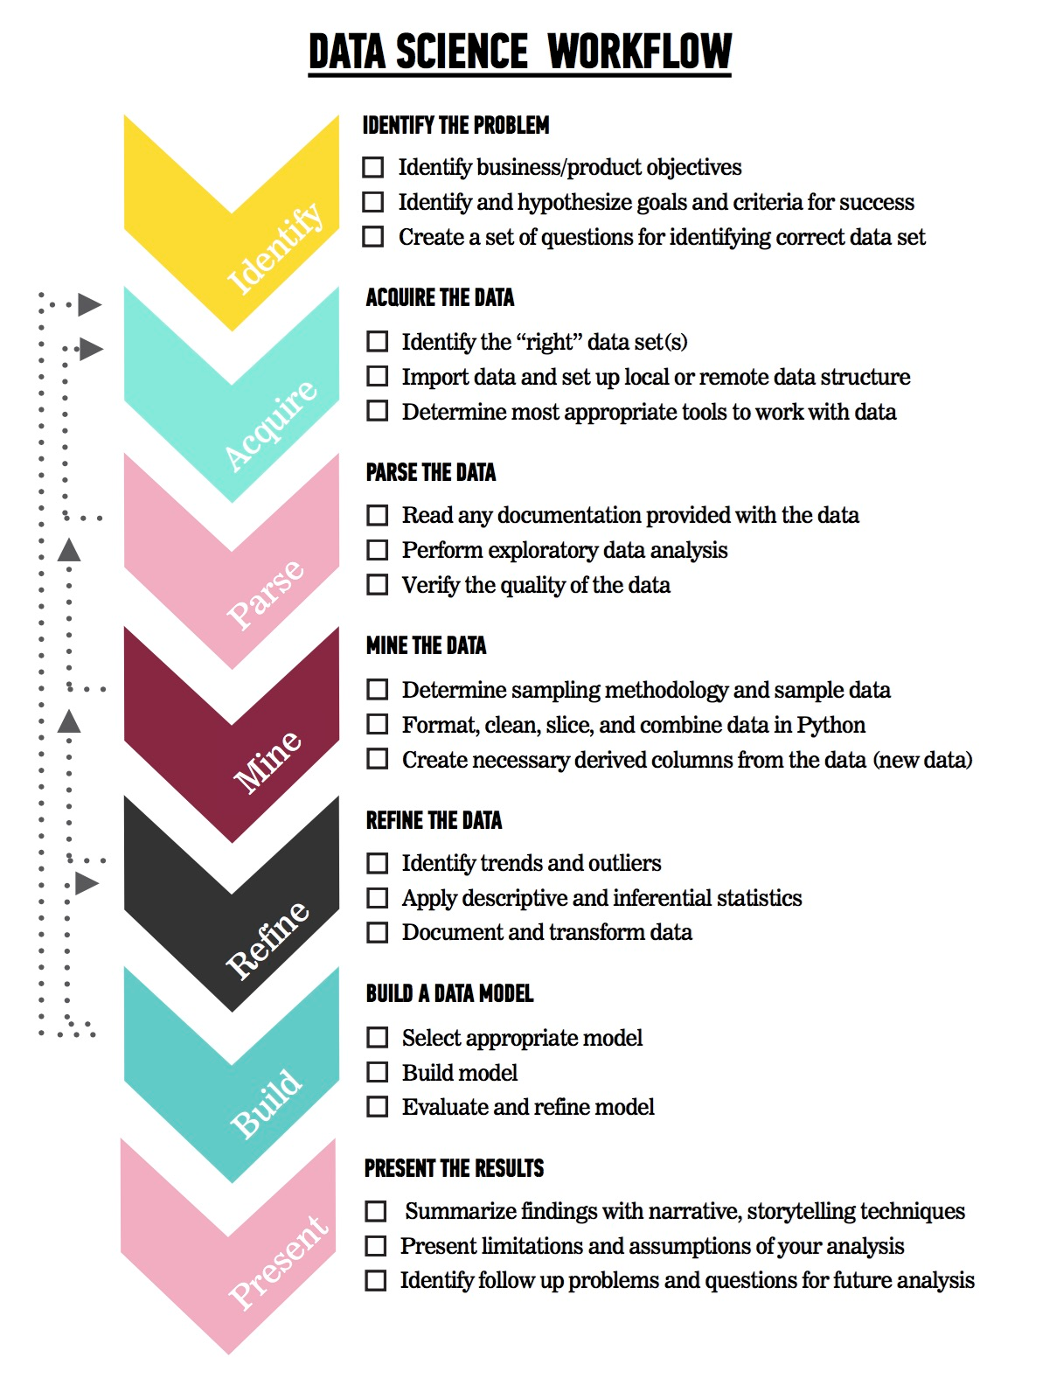
LET’S REVIEW THE DATA SCIENCE WORKFLOW
The steps:
Identify the problem
Acquire the data
Parse the data
Mine the data
Refine the data
Build a data model
Present the results

Slide 8
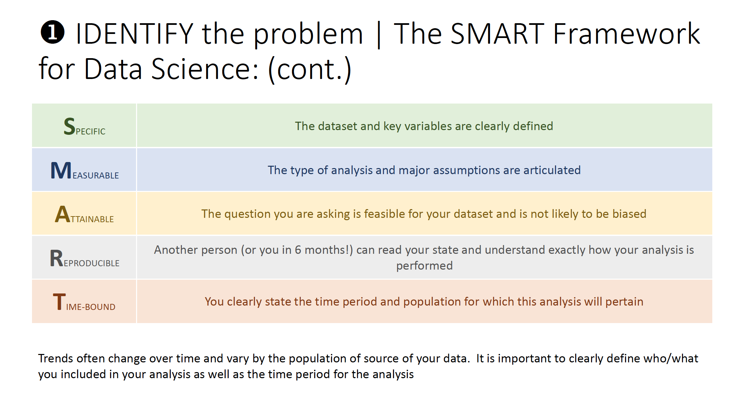
SMART

Slide 9
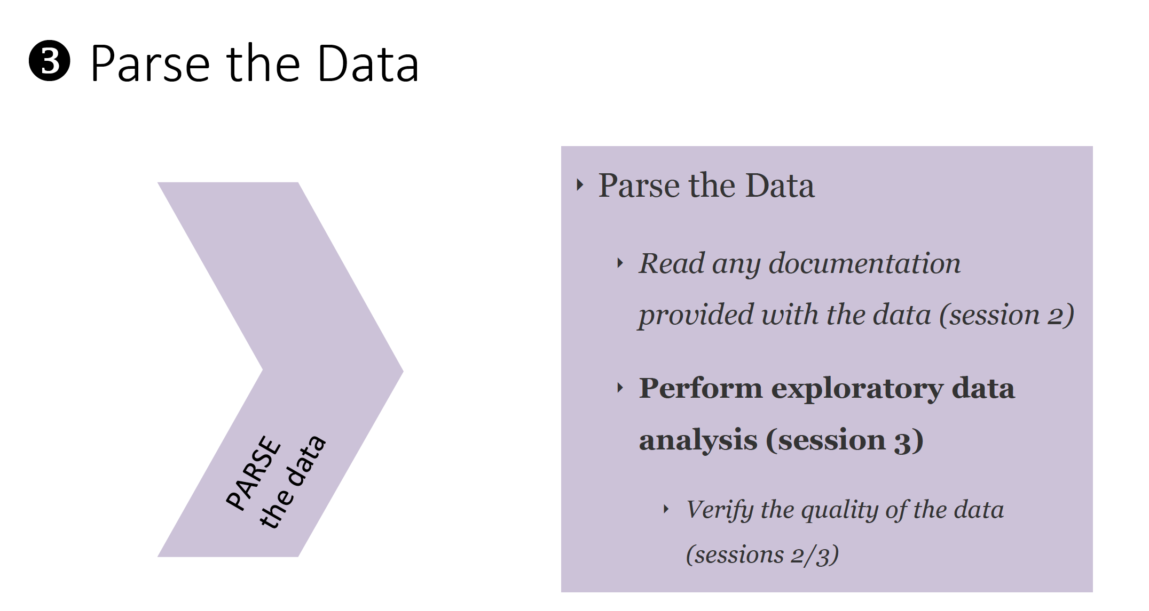
SMART

Slide 10
TODAY
We’re going to begin to talk about step 3: Parsing the Data
We’ll begin to talk about the fundamentals of Statistics

Slide 11
INTRODUCTION
LAYING THE GROUND WORK

Slide 12
WE’RE GOING TO COVER SEVERAL TOPICS
Mean
Median
Mode
Max
Min
Quartile
Interquartile Range
Variance
Standard Deviation
Correlation

Slide 13
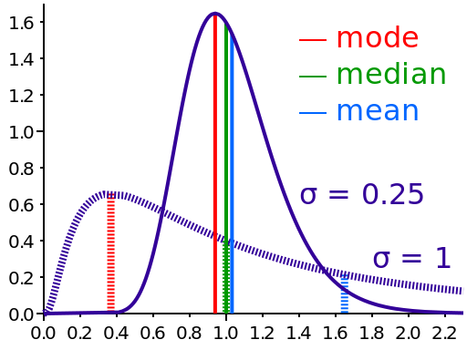
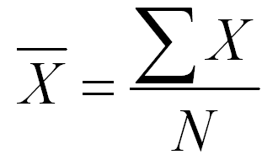
MEAN
The mean of a set of values is the sum of the values divided by the number of values. It is also called the average.

Slide 14
MEAN EXAMPLE
Find the mean of 19, 13, 15, 25, and 18.

Slide 15
MEAN EXAMPLE
Find the mean of 19, 13, 15, 25, and 18.
19 + 13 + 15 + 25 + 18 90
--------------------------- = ----- = 18
5 5

Slide 16
MEDIAN
The median refers to the midpoint in a series of numbers.
To find the median
Arrange the numbers in order smallest to
largest.
If there is an odd number of values, the
middle value is the median.
If there is an even number of values, the
average of the middle two values is the
median.

Slide 17
MEDIAN EXAMPLE
Find the median of 19, 29, 36, 15, and 20.

Slide 18
MEDIAN EXAMPLE
Find the median of 19, 29, 36, 15, and 20.
Ordered Values:
15, 19, 20, 29, 36
20 is the median

Slide 19
MEDIAN EXAMPLE
Find the median of 67, 28, 92, 37, 81, 75.

Slide 20
MEDIAN EXAMPLE
Find the median of 67, 28, 92, 37, 81, 75.
Ordered Values:
28, 37, 67, 75, 81, 92
67 and 75 are the middle values.
67 + 75 142
---------- = ------ = 71
2 2
71 is the median.

Slide 21
MODE
The mode of a set of values is the value that occurs most often.
A set of values may have more than one mode or no mode.

Slide 22
MODE EXAMPLE
Find the mode of 15, 21, 26, 25, 21, 23, 28, and 21.

Slide 23

MODE EXAMPLE
Find the mode of 15, 21, 26, 25, 21, 23, 28, and 21.
15 21 23 25 26 28
21 is the mode because it occurs most frequently

Slide 24
MODE EXAMPLE
Find the mode of 12, 15, 18, 26, 15, 9, 12, and 27.

Slide 25
MODE EXAMPLE
Find the mode of 12, 15, 18, 26, 15, 9, 12, and 27.
9 12 15 18 26 27
12 and 15 are the modes since the both occur twice.

Slide 26
MODE EXAMPLE
Find the mode of 4, 8, 15, 21, and 23.

Slide 27
MODE EXAMPLE
Find the mode of 4, 8, 15, 21, and 23.
4 8 15 21 23
There is no mode since all values occur the same number of times.

Slide 28

ACTIVITY: KNOWLEDGE CHECK
For the following groups of numbers, calculate the mean, median and mode by hand. Also determine the min and max.
18, 24, 17, 21, 24, 16, 29, 18
75, 87, 49, 68, 75, 84, 98, 92
55, 47, 38, 66, 56, 64, 44, 39
ANSWER THE FOLLOWING QUESTIONS (5 minutes)
EXERCISE
DELIVERABLE
Answers to the above questions

Slide 29
Exploratory Data Analysis (EDA)
Goal: get a general sense of the data
means, medians, quantiles, histograms, boxplots
You should always look at every variable - you will learn something!
data-driven (model-free)
Think interactive and visual
Humans are the best pattern recognizers
You can use more than 2 dimensions!
x,y,z, space, color, time….
especially useful in early stages of data mining
detect outliers (e.g. assess data quality)
test assumptions (e.g. normal distributions or skewed?)
identify useful raw data & transforms (e.g. log(x))
Bottom line: it is always well worth looking at your data!

Slide 30
Summary Statistics
not visual
sample statistics of data X
mean: μ = ∑_{i} X_{i} / n
mode: most common value in X
median: X=sort(X), median = X_{n/2} (half below, half above)
quartiles of sorted X: Q1 value = X_{0.25n} , Q3 value = X_{0.75 n}
interquartile range: value(Q3) - value(Q1)
range: max(X) - min(X) = X_{n} - X₁
variance: σ² = ∑_{i} (X_{i} - μ)² / n
skewness: ∑_{i} (X_{i} - μ)³ / [ (∑_{i} (X_{i} - μ)²)^{3/2} ]
zero if symmetric; right-skewed more common (what kind of data is right skewed?)
number of distinct values for a variable (see unique() in R)

Slide 31
Types of Variables
Continuous variables:
Always numeric
Can be any number, positive or negative
Examples: age in years, weight, blood pressure readings, temperature, concentrations of pollutants and other measurements
Categorical variables:
Information that can be sorted into categories
Types of categorical variables – ordinal, nominal and dichotomous (binary)
Notes:
Before delving into analysis, let’s take a moment to discuss variables. This may seem a trivial topic to those with analysis experience, but variables are not a trivial matter. Much like people, variables come in many different sizes and shapes. Most field epidemiology, however, relies on garden-variety continuous and categorical variables.
Continuous variables are always numeric and theoretically can be any number, positive or negative (in reality, this depends upon the variable). Examples of continuous variables are age in years, weight, blood pressure readings, indoor and outdoor temperature, concentrations of pollutants in the air or water, and other measurements.
Categorical variables contain information that can be sorted into categories, rather like sorting information into bins. Every piece of information belongs in one—and only one—bin. There are several types of categorical variables: ordinal, nominal, and dichotomous or binary.

Slide 32
Categorical Variables: Ordinal Variables
Ordinal variable—a categorical variable with some intrinsic order or numeric value
Examples of ordinal variables:
Education (no high school degree, HS degree, some college, college degree)
Agreement (strongly disagree, disagree, neutral, agree, strongly agree)
Rating (excellent, good, fair, poor)
Frequency (always, often, sometimes, never)
Any other scale (“On a scale of 1 to 5...”)
Notes:
An ordinal variable is any categorical variable with some intrinsic order or numeric value. For example, we might categorize information on the educational status of a group of people into a variable called EDUCATION. One person may not have graduated from high school, another might have graduated from high school but received no further education, a third could have some college education or have received some other post-secondary training, and another might have graduated from college. The education levels of all members of the group will fit neatly into these categories, and the categories have an intrinsic order. A college graduate has more education than a high school graduate, and a high school graduate has more education than someone who did not graduate from high school. Thus as the categories go from 1 to 5, the level of education increases. Other examples of ordinal variables are:
agreement (for example, strongly disagree, disagree, neutral, agree, strongly agree)
rating (for example, excellent, good, fair, poor)
frequency (for example, always, often, sometimes, never)
or any other scale (for example, “On a scale of 1 to 5, how much do you like peanuts?”)

Slide 33
Categorical Variables: Nominal Variables
Nominal variable – a categorical variable without an intrinsic order
Examples of nominal variables:
Where a person lives in the U.S. (Northeast, South, Midwest, etc.)
Sex (male, female)
Nationality (American, Mexican, French)
Race/ethnicity (African American, Hispanic, White, Asian American)
Favorite pet (dog, cat, fish, snake)
Notes:
A nominal variable is a categorical variable without any intrinsic order. For example, say we have a variable called RESIDE that characterizes the part of the United States in which a person lives—the Northeast, the South, the Midwest, the Southwest, or the Northwest. The categories of this variable have no numeric value or order. Residence in the Northwest has no quantitative value compared to the Northeast. Other examples of nominal variables include sex (male, female), nationality (American, Mexican, French), race/ethnicity (African American, Hispanic, White, Asian American), or favorite pet (dog, cat, fish, snake).

Slide 34
Categorical Variables: Dichotomous Variables
Dichotomous (or binary) variables – a categorical variable with only 2 levels of categories
Often represents the answer to a yes or no question
For example:
“Did you attend the church picnic on May 24?”
“Did you eat potato salad at the picnic?”
Anything with only 2 categories
Notes:
A dichotomous, or binary variable is a categorical variable that has only 2 levels or categories. Many dichotomous variables represent the answer to a yes or no question. For example, “Did you attend the church picnic on May 24?” or “Did you eat potato salad at the picnic?” A variable does not have to be a yes/no variable to be dichotomous–it just has to have only 2 categories, such as sex (male/female).

Slide 35
Understanding Data Via Descriptive Analysis
Measures of central tendency: used to report a single piece of information that describes the most typical response to a question
Measures of variability: used to reveal the typical difference between the values in a set of values

Slide 36
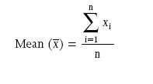
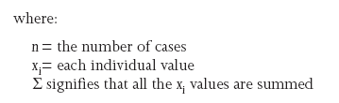
Understanding Data Via Descriptive Analysis
Mode: the value in a string of numbers that occurs most often
Median: the value whose occurrence lies in the middle of a set of ordered values
Mean: sometimes referred to as the “arithmetic mean”; the average value characterizing a set of numbers

Slide 37
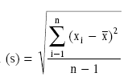
Understanding Data Via Descriptive Analysis
Measures of Variability:
Frequency distribution reveals the number (percent) of occurrences of each number or set of numbers
Range identifies the maximum and minimum values in a set of numbers
Standard deviation indicates the degree of variation in a way that can be translated into a bell-shaped curve distribution

Slide 38
Types of Variables
Types of variables indicate which estimates you can calculate and which statistical tests you should use
Continuous variables:
Always numeric
Generally calculate measures such as the mean, median and standard deviation
Categorical variables:
Information that can be sorted into categories
Field investigation – often interested in dichotomous or binary (2-level) categorical variables
Cannot calculate mean or median but can calculate risk
Notes:
Before starting any data analysis, it is important to know what types of variables you are working with. The types of variables tell you which estimates you can calculate, and later, which types of statistical tests you should use. Remember, continuous variables are numeric (such as age in years or weight) while categorical variables (whether yes or no, male or female, or something else entirely) are just what the name says—categories.
For continuous variables, we generally calculate measures such as the mean (average), median and standard deviation to describe what the variable looks like. We use means and medians in public health all the time; for example, we talk about the mean age of people infected with E. coli, or the median number of household contacts for case-patients with chicken pox.
In a field investigation, you are often interested in dichotomous or binary (2-level) categorical variables that represent an exposure (ate potato salad or did not eat potato salad) or an outcome (had Salmonella infection or did not have Salmonella infection). For categorical variables, we cannot calculate the mean or median, but we can calculate risk. Remember, risk is the number of people who develop a disease among all the people at risk of developing the disease during a given time period. For example, in a group of firefighters, we might talk about the risk of developing respiratory disease during the month following an episode of severe smoke inhalation.

Slide 39
Univariate Data Analysis
Univariate data analysis-explores each variable in a data set separately
Serves as a good method to check the quality of the data
Inconsistencies or unexpected results should be investigated using the original data as the reference point
Frequencies can tell you if many study participants share a characteristic of interest (age, gender, etc.)
Graphs and tables can be helpful
Notes:
Univariate Data Analysis
Univariate data analysis is important for many reasons. Looking at each variable alone, we learn a lot about the information collected. Also, univariate analysis is a good method of checking the quality of the data. Inconsistencies or unexpected results should always be investigated, using the original data as the reference point.
Simple frequencies can tell you whether most cases are young, or whether most cases are female, or whether many study participants share some other characteristic in which you are interested. First, examine the univariate (one variable) distribution. Graphs and tables can give you a good idea of what your variables look like, and can also help you find some of the data cleaning problems noted above.

Slide 40
Univariate Data Analysis
Examining continuous variables can give you important information:
Do all subjects have data, or are values missing?
Are most values clumped together, or is there a lot of variation?
Are there outliers?
Do the minimum and maximum values make sense, or could there be mistakes in the coding?
Notes:
Continuous Variables
An initial look at continuous variables can give you several important pieces of information:
Do all subjects have data, or are values missing?
Are most values clumped together, or is there a lot of variation? (Figures 1a and 1b)
Are there outliers?
Do the minimum and maximum values make sense, or could there be mistakes in the coding?

Slide 41
Univariate Data Analysis
Commonly used statistics with univariate analysis of continuous variables:
Mean – average of all values of this variable in the dataset
Median – the middle of the distribution, the number where half of the values are above and half are below
Mode – the value that occurs the most times
Range of values – from minimum value to maximum value
Notes:
We can also conduct a univariate analysis of continuous variables to gain valuable information. Commonly used statistics include these:
Mean – average of all values of this variable in the dataset.
Median – the middle of the distribution, the number where half of the values are above and half are below.
Mode – the value that occurs most.
Range of values – from minimum value to maximum value.

Slide 42
Standard Deviation
Figure left: narrowly distributed age values (SD = 7.6)
Figure right: widely distributed age values (SD = 20.4)
Notes:
Another statistic used is standard deviation
Standard deviation is a measure of how variable the data are. In the figure on the right, the standard deviation is 20.4; in the figure on the left, it is 7.6. A large standard deviation compared to the values of the variable indicates that the data are widely distributed. Standard deviations can be calculated most easily with a software program, although they can be calculated by hand.

Slide 43
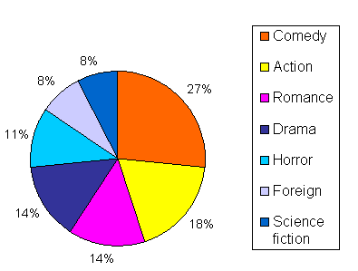
Pie Chart

Slide 44
Distribution and Percentiles
Distribution curves for variable AGE
25th Percentile
(4 years)
Distribution – whether most values occur low in the range, high in the range, or grouped in the middle
Percentiles – the percent of the distribution that is equal to or below a certain value
25th Percentile
(6 years)
Notes:
Additional statistics include:
Distribution – shows whether most values occur low in the range, high in the range, or grouped in the middle.
Percentiles – the percent of the distribution that is equal to or below a certain value. In the top figure the 25th percentile occurs at 4 years because 25% of the total number of respondents are 4 years or younger while in the bottom figure the 25th percentile occurs at 6 years. The top figure is a “bell-shaped” distribution while the bottom figure is a skewed distribution.

Slide 45
1-D (Univariate) Data
Representations
7
5
3
1
Tukey box plot
low
Middle 50%
high
Mean
0
20
Histogram

Slide 46
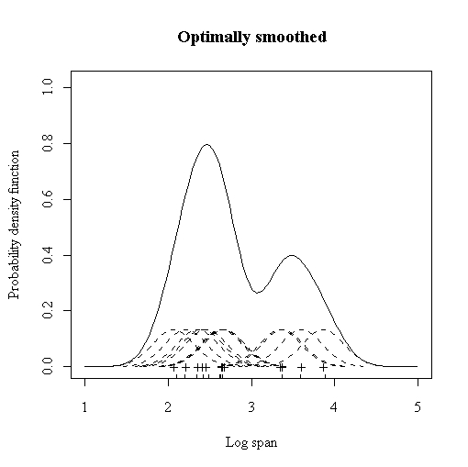
Smoothed Histograms - Density Estimates
Kernel estimates smooth out the contribution of each datapoint over a local neighborhood of that point.
h is the kernel width
Gaussian kernel is common:

Slide 47
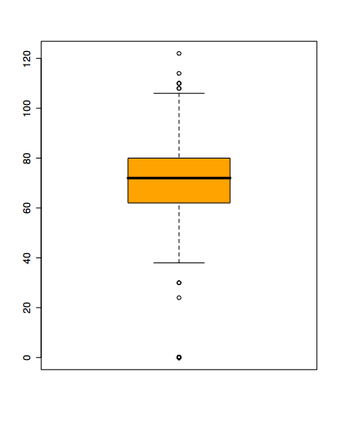
Boxplots
Shows a lot of information about a variable in one plot
Median
IQR
Outliers
Range
Skewness
Negatives
Overplotting
Hard to tell distributional shape
no standard implementation in software (many options for whiskers, outliers)

Slide 48
2D Analysis
- Scatter-Plot
- Linear Regression
- Correlation Coefficients
- Box-Plot

Slide 49
2-D (Bivariate) Data
Scatter plot, …
price
mileage

Slide 50
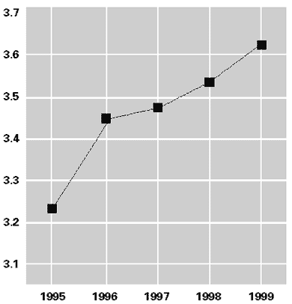
Line graphs

Slide 51
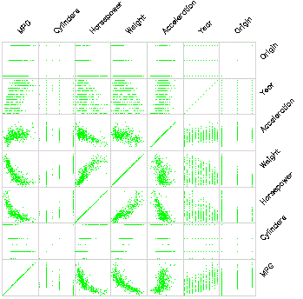
Scatterplot Matrix
Represent each possible
pair of variables in their
own 2-D scatterplot
(car data)
Q: Useful for what?
A: linear correlations
(e.g. horsepower & weight)
Q: Misses what?
A: multivariate effects

Slide 52
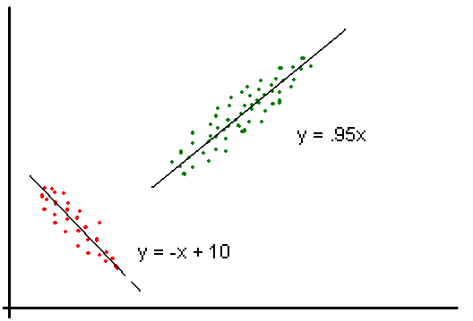
Scatter Plot with Regression Lines

Slide 53
Populations and Samples
Population: The entire group about which information is desired.
Sample: A proportion or part of the population - usually the proportion from which information is gathered.

Slide 54
Selecting a Sample
Haphazard Sample: Haphazard samples are constructed arbitrarily.
Random Sample: Random samples select such that each member of the population has an equal chance of being selected into the sample.

Slide 55
Population vs. The Sample
Population
Sample

Slide 56
CODEALONG
SUMMARY STATISTICS IN PANDAS

Slide 57
CODEALONG: SUMMARY STATISTICS IN PANDAS
Open the starter-code notebook located in lessons/lesson-03/code/starter-code of the class repo.

Slide 58
CODEALONG PART 1: BASIC STATS
We can use Pandas to calculate the mean, median, mode, min, and max.
Methods available include: .min() - Compute minimum value .max() - Compute maximum value .mean() - Compute mean value .median() - Compute median value .mode() - Compute mode value .count() - Count the number of observations

Slide 59
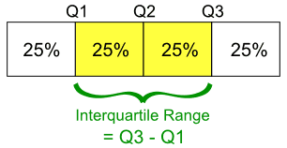
QUARTILES AND INTERQUARTILE RANGE
Quartiles divide a rank-ordered data set into four equal parts.
The values that divide each part are called first, second, and third quartiles, denoted Q1, Q2, and Q3, respectively.
The interquartile range (IQR) is Q3 - Q1, a measure of variability.

Slide 60
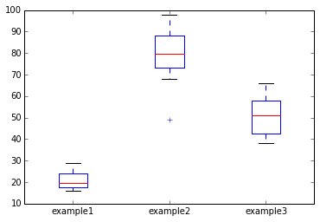
CODEALONG PART 2: BOX PLOT
Box plots give a nice visual of min, max, mean, median, and the quartile and interquartile range.

Slide 61
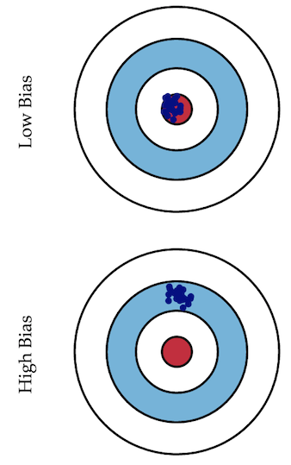
BIAS VS. VARIANCE
a.k.a., Systematic vs. Random errors
Error due to bias is calculated at the difference between the expected prediction of our model and the correct value we are trying to predict.
Imagine creating multiple models on various datasets. Bias measures how far off in general models’ predictions are from the correct value.

Slide 62
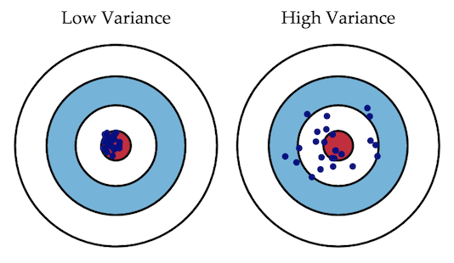
BIAS VS. VARIANCE
Error due to variance is taken as the variability of a model prediction for a given point.
Imagine creating multiple models on various datasets. The variance is how much the predictions for a given point vary between different realizations of the model.

Slide 63
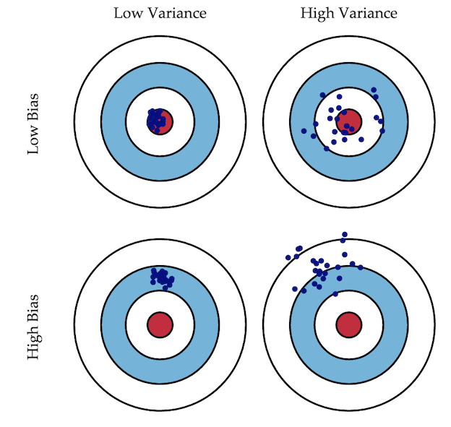
BIAS VS. VARIANCE

Slide 64

Bias-Variance Decomposition
The distance
from f
Variance of the
predictions
Independent
of predictor

Slide 65
Bias vs Variance (Systematic vs. Random errors)
Bias Problem
The hypothesis space made available by a particular classification method does not include the true hypothesis
Variance Problem
The hypothesis space is “too large” for the amount of training data – thus selected hypothesis may be inaccurate on unseen data

Slide 66
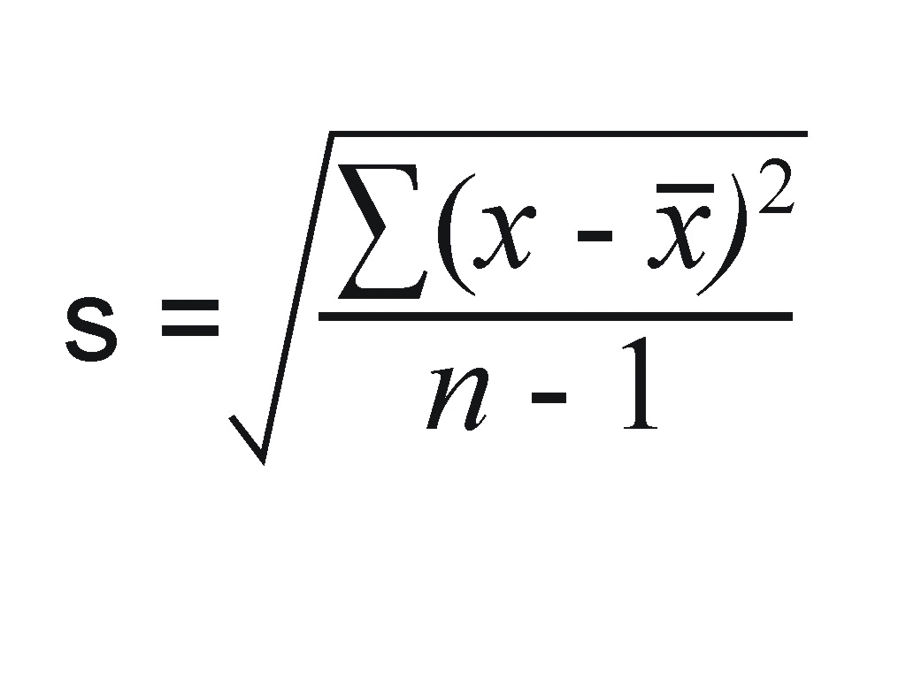
STANDARD DEVIATION
Standard deviation (SD, σ for population, s for sample) is a measure that is used to quantify the amount of variation or dispersion of a set of data values.
Standard deviation is the square root of variance.

Slide 67
STANDARD ERROR
The standard error of the mean (SEM) quantifies the precision of the mean.
It is a measure of how far your sample mean is likely to be from the true population mean.
It generally increases with the size of an estimate, meaning a large standard error may not indicate the estimate of the mean is unreliable.
It’s often better to compare the error in relation to the size of the estimate.

Slide 68
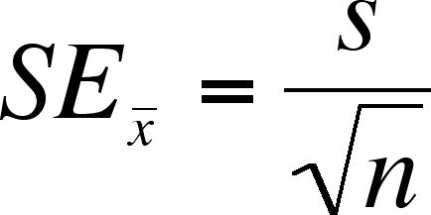
STANDARD ERROR

Slide 69
CODEALONG PART 3: STANDARD DEVIATION & VARIANCE
You can calculate variance and standard deviation easily in Pandas.
Methods include: .std() - Compute Standard Deviation .var() - Compute variance .describe() - short cut that prints out count, mean, std, min, quartiles, max

Slide 70
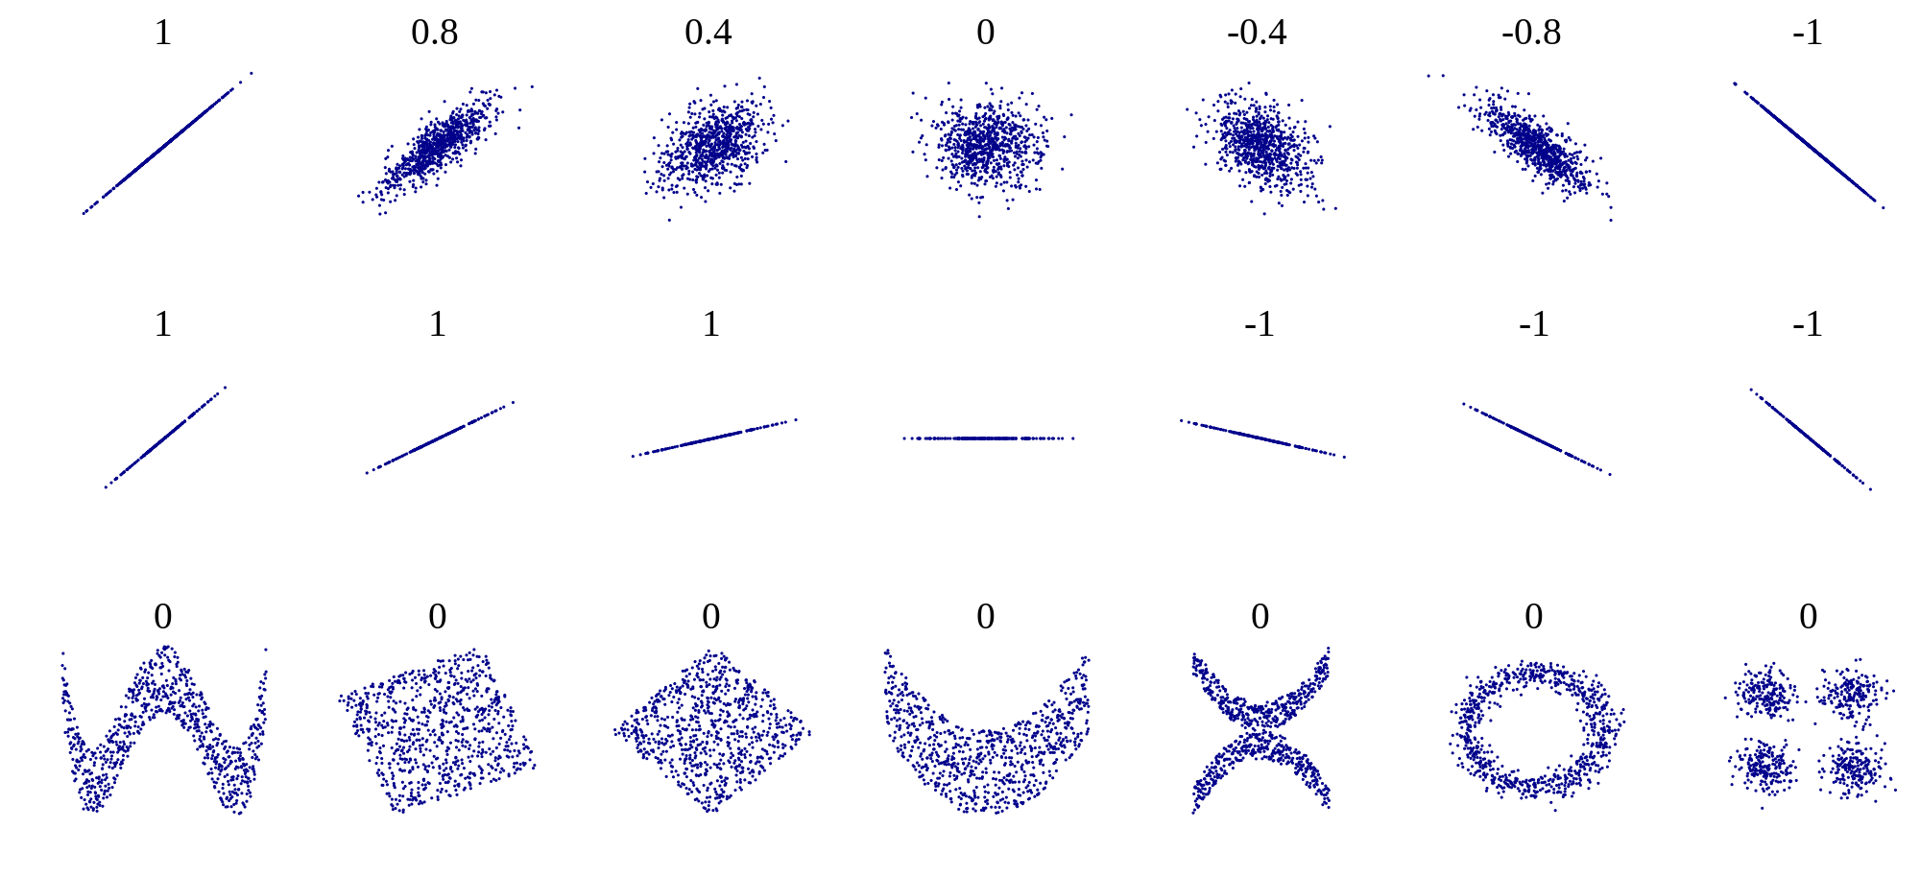
CORRELATION
The correlation measures the extent of interdependence of variable quantities.
Example correlation values

Slide 71
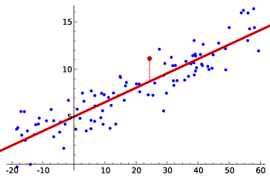
CORRELATION
Is there a correlation?

Slide 72
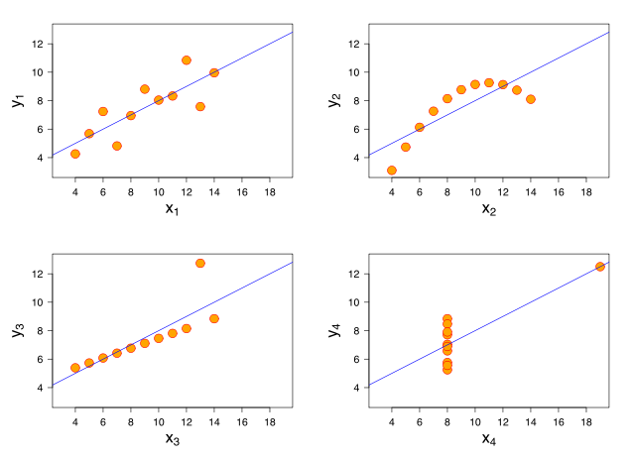
CORRELATION
The correlation measures for the following plots are all identical.
Anscombe's quartet

Slide 73
CONTEXT
For most projects, descriptive stats will come first. These help you get to know your dataset better.
Sometimes, descriptive stats may be all you need to answer your question.

Slide 74
INTRODUCTION
IS THIS NORMAL?

Slide 75
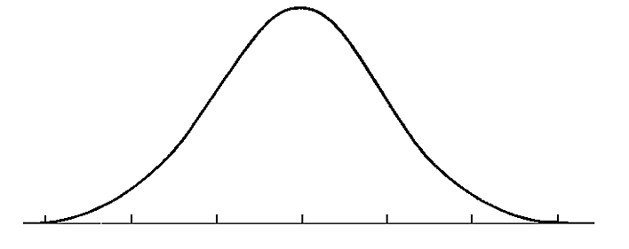
THE NORMAL DISTRIBUTION
A normal distribution is often a key assumption to many models.
The normal distribution depends upon the mean and the standard deviation.
The mean determines the center of the distribution. The standard deviation determines the height and width of the distribution.

Slide 76
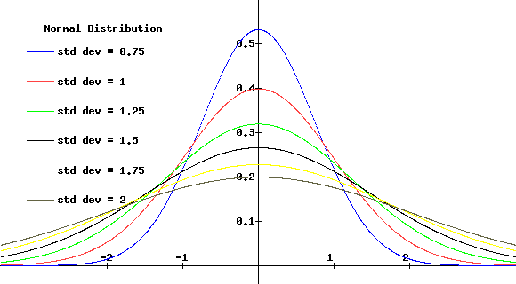
THE NORMAL DISTRIBUTION
Normal distributions are symmetric, bell-shaped curves.
When the standard deviation is large, the curve is short and wide.
When the standard deviation is small, the curve it tall and narrow.

Slide 77
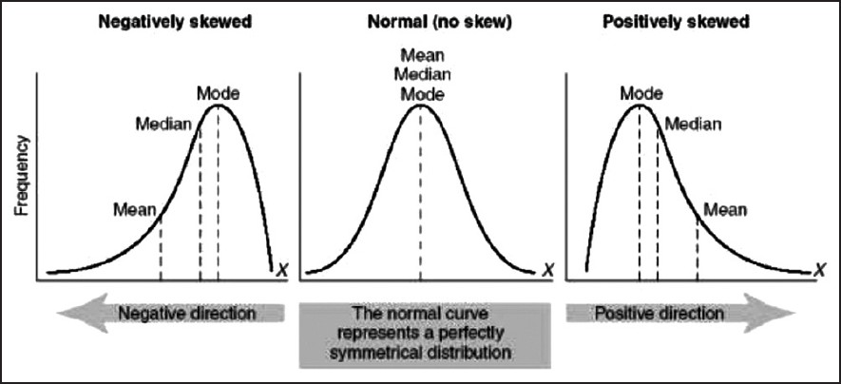
SKEWNESS
Skewness is a measure of the asymmetry of the distribution of a random variable about its mean.
Skewness can be positive or negative, or even undefined.

Slide 78
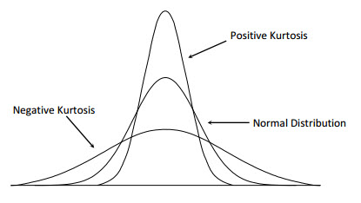
KURTOSIS
Kurtosis is a measure of whether the data are peaked or flat relative to a normal distribution.
Datasets with high kurtosis tend to have a distinct peak near the mean, decline rather rapidly, and have heavy tails.

Slide 79
Random variables
For a random variable, we define
Probability function
Density function,
depending on whether it is discrete or continuous

Slide 80
Random variables
Probability function
verifies

Slide 81
Random variables
Probability density function
verifies
We have
RANDOM VARIABLES
81

Slide 82
Random variables
completely determines the distribution
of a random variable.

Slide 83
Discrete Random Variables
Random variables (RVs) which may take on only a countable number of distinct values
E.g. the total number of tails X you get if you flip 100 coins
X is a RV with arity k if it can take on exactly one value out of {x₁, …, x_{k}}
E.g. the possible values that X can take on are 0, 1, 2, …, 100

Slide 84
Probability of Discrete RV
Probability mass function (pmf): P(X = x_{i})
Easy facts about pmf
Σ_{i} P(X = x_{i}) = 1
P(X = x_{i}∩X = x_{j}) = 0 if i ≠ j
P(X = x_{i} U X = x_{j}) = P(X = x_{i}) + P(X = x_{j}) if i ≠ j
P(X = x₁ U X = x₂ U … U X = x_{k}) = 1

Slide 85
Probability of Continuous RV
Properties of pdf
Probability can be obtained by taking the integral of pdf
E.g. the probability of X being between 0 and 1 is

Slide 86
Random variables
Bernoulli
p
1-p
p
1-p
0 1
0 1

Slide 87
Random variables
Binomial
Successes in n independent Bernoulli trials with
success probability p

Slide 88
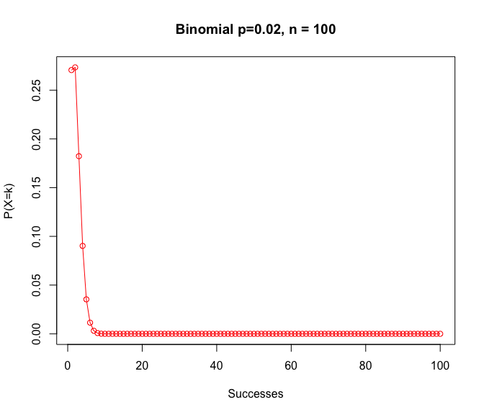
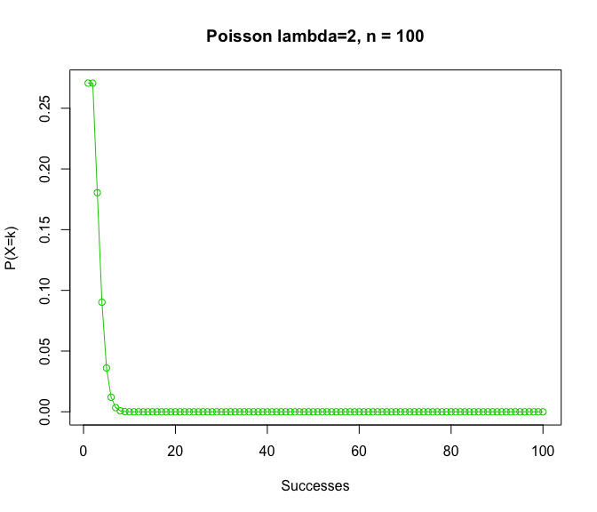
Probability distributions
Poisson approximation to the Binomial

Slide 89
Random variables
Geometric
Time of first success in a sequence of independent
Bernoulli trials with success probability p

Slide 90
Random variables
Poisson
X expresses the number of “ rare events”

Slide 91
Random variables
Uniform
F(x)
f(x)
a b
a b
RANDOM VARIABLES
91

Slide 92
Random variables
Exponential
1/β
1
F(x)
f(x)
0 β
RANDOM VARIABLES

Slide 93
Random variables
Normal
f(x)
F(x)
μ

Slide 94
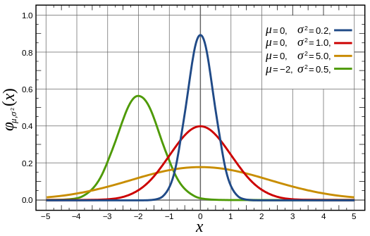
Probability distributions
Normal Distribution

Slide 95
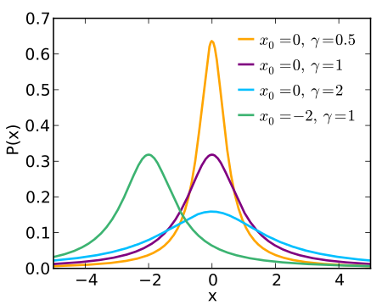
Probability distributions
Cauchy Distribution

Slide 96
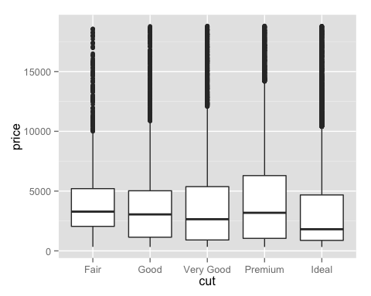
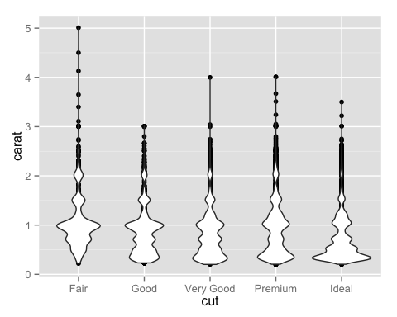
Exploratory Data Analysis

Slide 97
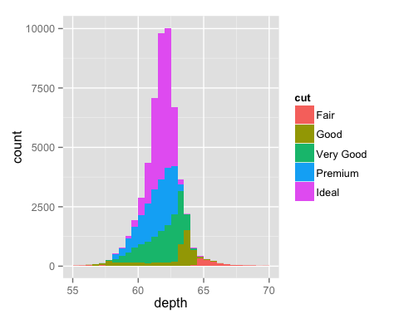
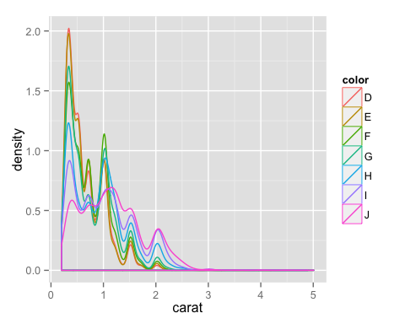
Exploratory Data Analysis

Slide 98
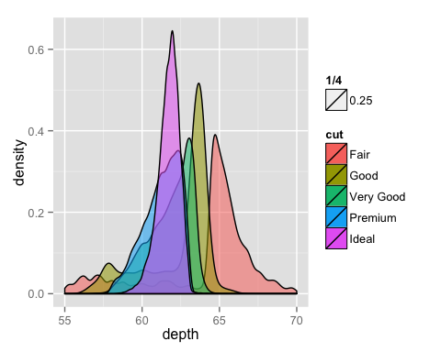
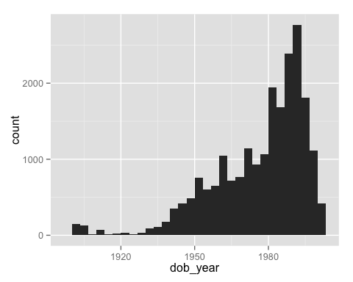
Exploratory Data Analysis

Slide 99
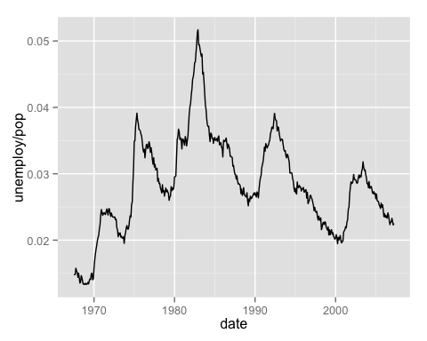
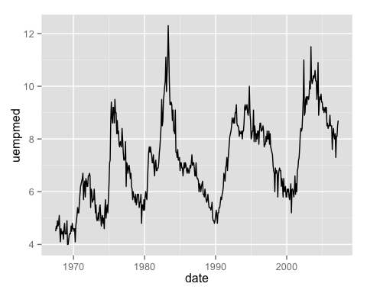
Exploratory Data Analysis

Slide 100
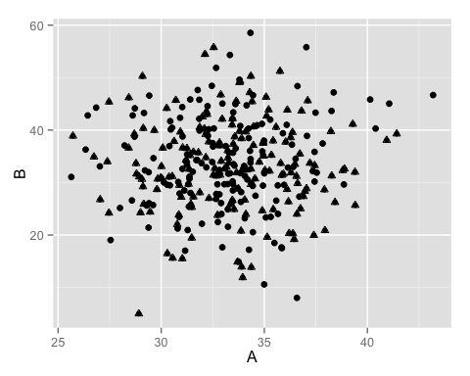
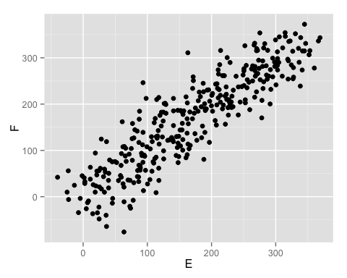
Exploratory Data Analysis

Slide 101
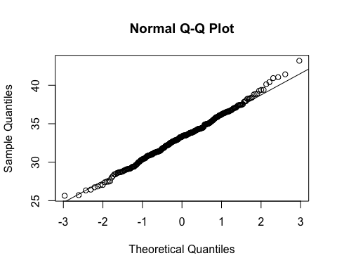
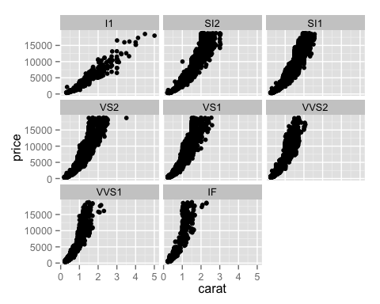
Exploratory Data Analysis

Slide 102
DEMO
DETERMINING THE DISTRIBUTION OF YOUR DATA

Slide 103
DETERMINING THE DISTRIBUTION OF YOUR DATA
Follow along as we walk through this in an iPython Notebook.

Slide 104
GUIDED PRACTICE
IS THIS SKEWED?

Slide 105
ACTIVITY: IS THIS SKEWED?
DIRECTIONS (10 minutes)
EXERCISE
We’re going to walk through several images of datasets.
For each image, vote on whether the image is:
Normal
Positively, negatively, or not skewed
Has positive, negative, or zero kurtosis
Determine how you would correct the issue with each dataset to return it to the normal distribution.

Slide 106
INTRODUCTION
VARIABLE TYPES

Slide 107
VARIABLE TYPES
Numeric variables can take on a large range of non-predetermined, quantitative values. These are things such as height, income, etc.
Categorical variables can take on a specific set of variables. These are things such as race, gender, paint colors, movie titles, etc.

Slide 108
DEMO
CLASSES

Slide 109
CLASS/DUMMY VARIABLES
Let’s say we have the categorical variable area, which takes on one of the following values: rural, suburban, and urban.
We need to represent these numerically for a model. So how do we code them?

Slide 110
CLASS/DUMMY VARIABLES
Dummy variables are discrete variables taking a value of ‘0’ or ‘1’. They are often called ‘on’ ‘off’ variables, being ‘on’ when they are 1.
Dummy variables can be used either as explanatory variables or as the dependent variable.
They provide a method for “quantifying” a “qualitative” variable. The variable V = 1 if yes, V = 0 if no.
It doesn’t matter which category gets the 0 or 1.

Slide 111
CLASS/DUMMY VARIABLES
If the dummy variable is the only independent variable:
Y_{t} = β₁ + β₂D_{t} + e_{t}
If D = 0 → Y_{t} = β₁ + e_{t}
If D = 1 → Y_{t} = (β₁ + β₂) + e_{t}
Least squares regression will produce a β₁ and β₂ values such that
β₁ = the mean of the Y_{t} values for the D = 0
(β₁ + β₂) = the mean of the Y_{t} values for the D = 1

Slide 112
CLASS/DUMMY VARIABLES
How about 0=rural, 1=suburban, and 2=urban?

Slide 113
CLASS/DUMMY VARIABLES
But this implies an ordered relationship - is urban twice suburban? That doesn’t make sense.
However, we can represent this information by converting the one area variable into two new variables: area_urban and area_suburban.

Slide 114
CLASS/DUMMY VARIABLES
We’ll draw out how categorical variables can be represented without implying order.
First, let’s choose a reference category. This will be our “base” category.
It’s often good to choose the category with the largest sample size and a criteria that will help model interpretation. If we are testing for a disease, the reference category would be people without the disease.

Slide 115
CLASS/DUMMY VARIABLES
Step 1: Select a reference category. We’ll choose rural as our reference category.
Step 2: Convert the values urban, suburban, and urban into a numeric representation that does not imply order.
Step 3: Create two new variables: area_urban and area_suburban.

Slide 116
CLASS/DUMMY VARIABLES
Why do we need only two dummy variables?
We can derive all of the possible values from these two. If an area isn’t urban or suburban, we know it must be rural.
In general, if you have a categorical feature with k categories, you need to create k-1 dummy variable to represent all of the information.
rural | urban | suburban

Slide 117
CLASS/DUMMY VARIABLES
Let’s see our dummy variables.
As mentioned before, if we know area_urban=0 and area_suburban=0, then the area must be rural.
 | area_urban | area_suburban
rural | 0 | 0
suburban | 0 | 1
urban | 1 | 0

Slide 118
CLASS/DUMMY VARIABLES
We can do this for a gender variable with two categories: male and female.
How many dummy variables need to be created?

Slide 119
CLASS/DUMMY VARIABLES
# of categories - 1 = 2 -1 = 1

Slide 120
CLASS/DUMMY VARIABLES
We will make female our reference category. Thus, female=0 and male=1.
This can be done in Pandas with the get_dummies method.
 | gender_male
female | 0
male | 1

Slide 121
INDEPENDENT PRACTICE
DUMMY COLORS

Slide 122
ACTIVITY: DUMMY COLORS
It’s important to understand the concept before we use the Pandas function get_dummies to create dummy variables. So today, we’ll create our dummy variables by hand.
Draw a table like the one on the white board.
Create dummy variables for the variable “colors” that has 6 categories: blue, red, green, purple, grey, and brown. Use grey as the reference.
DIRECTIONS (15 minutes)
EXERCISE
DELIVERABLE
Dummy variables table for colors

Slide 123
CONCLUSION
TOPIC REVIEW

Slide 124
REVIEW
Let’s go through the process for creating dummy variables for “colors”.
We talked about several different types of summary statistics, what are they?
We covered several different types of visualizations; which ones?
We talked about the normal distribution; how do we determine your data’s distribution?
Any other questions?

Slide 125
COURSE
BEFORE NEXT CLASS

Slide 126
DUE DATE
BEFORE NEXT CLASS
Project: Unit Project 2

Slide 127
LESSON
Q & A

Slide 128
LESSON
EXIT TICKET
DON’T FORGET TO FILL OUT YOUR EXIT TICKET

