Slide 1
STATISTICS FUNDAMENTALS, PART 2
Nik Bear Brown
Northeastern University
nikbearbrown@gmail.com

Slide 2
LEARNING OBJECTIVES
STATISTICS FUNDAMENTALS, PART 2
Explain the difference between causation and correlation
Test a hypothesis within a sample case study
Validate your findings using statistical analysis (p-values, confidence intervals)

Slide 3
COURSE
PRE-WORK

Slide 4
PRE-WORK REVIEW
Explain the difference between variance and bias
Use descriptive statistics to understand your data

Slide 5
OPENING
STATISTICS FUNDAMENTALS, PART 2

Slide 6
LAST SESSION
Any questions from last class?
Exit tickets

Slide 7

DATA SOURCE
Today, we’ll use advertising data from an example in An Introduction to Statistical Learning.

Slide 8
INTRODUCTION
CAUSATION AND CORRELATION

Slide 9
CAUSATION AND CORRELATION
If an association is observed, the first question to ask should always be… is it real?
Think of various examples you’ve seen in the media related to food.

Slide 10
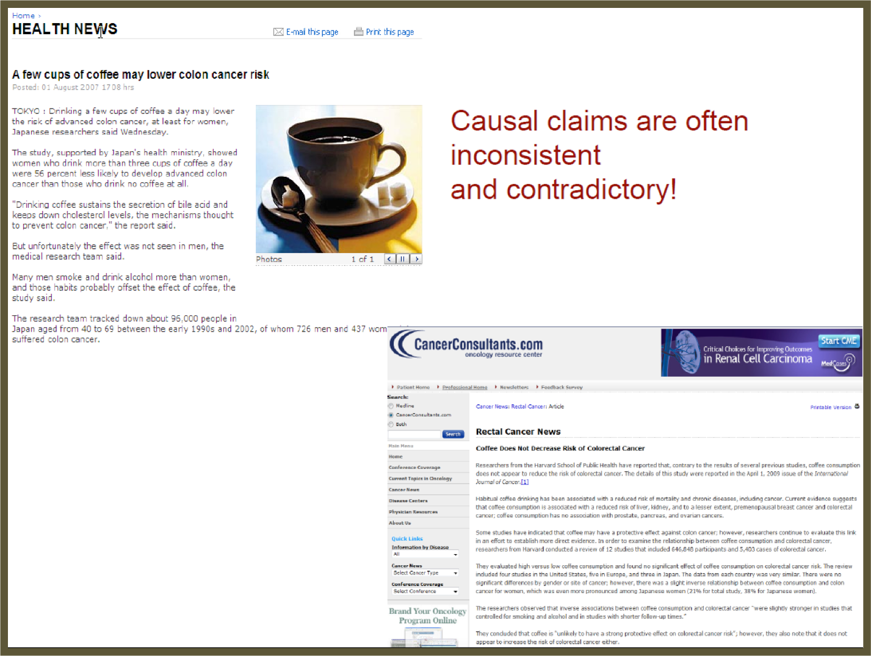

Slide 11
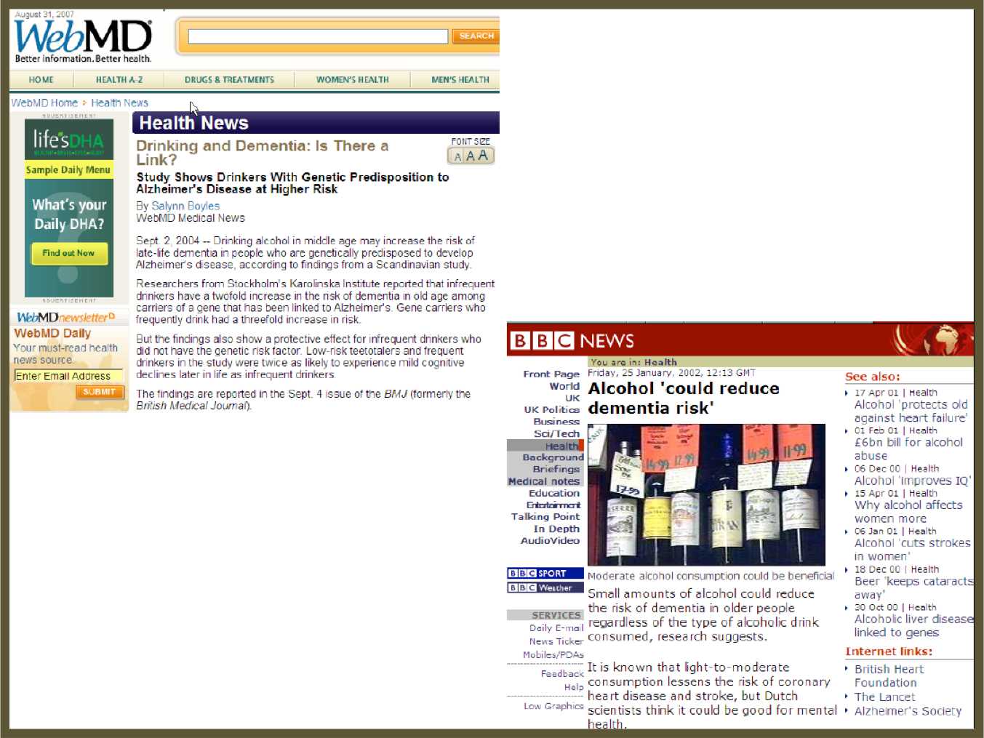

Slide 12
CAUSATION AND CORRELATION
Why is this?
Sensational headlines?

Slide 13
CAUSATION AND CORRELATION
There is neglect of a robust data analysis.

Slide 14
CAUSATION AND CORRELATION
There is also often a lack of understanding of the difference between causation and correlation.
Understanding this difference is critical in the data science workflow, especially when Identifying and Acquiring data.
We need to fully articulate our question and use the right data to answer it, including any confounders.

Slide 15
CAUSATION AND CORRELATION
Additionally, this comes up when we Present our results to stakeholders.
We don’t want to overstate what our model measures.
Be careful not to say “caused” when you really mean “measured” or “associated”.

Slide 16
LECTURE
CAUSATION VS CORRELATION

Slide 17
CAUSAL CRITERIA
Causal criteria is one approach to assessing causal relationships.
However, it’s very hard to define universal causal criteria.
One attempt that is commonly used in the medical field is based on work by Bradford Hill.

Slide 18
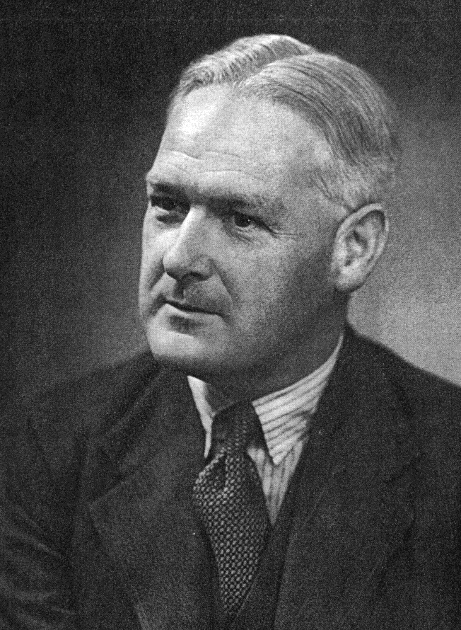
CAUSAL CRITERIA
He developed a list of “tests” that an analysis must pass in order to indicate a causal relationship:
Strength of association
Consistency
Specificity
Temporality
Biological gradient
Plausibility
Coherence
Experiment
Analogy

Slide 19
CAUSAL CRITERIA
This is not an exhaustive checklist, but it’s useful for understanding that your predictor/exposure must have occurred before your outcome.
For example, in order for smoking to cause cancer, one must have started smoking prior to getting cancer.

Slide 20
CAUSAL CRITERIA
Most commonly, we find an association between two variables. This means there is an observed correlation between the variables.
We may not fully understand the causal direction (e.g. does smoking cause cancer or does cancer cause smoking?).
We also might not understand other factors influencing the association.

Slide 21

ACTIVITY: KNOWLEDGE CHECK
ANSWER THE FOLLOWING QUESTIONS
EXERCISE
What is the difference between causation and association?
DELIVERABLE
Answers to the above questions

Slide 22
INTRODUCTION
CONFOUNDING AND DAGS

Slide 23
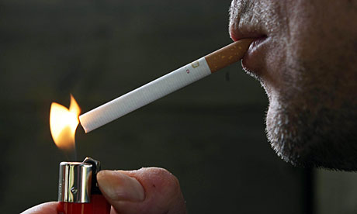
CONFOUNDING
Often times, associations may be influenced by another confounding factor.
Let’s say we did an analysis to understand what causes lung cancer.
We find that people who carry cigarette lights are 2.4 times more likely to contract lung cancer as people who don’t
carry lighters.
Does this mean that the lighters are causing
cancer?

Slide 24
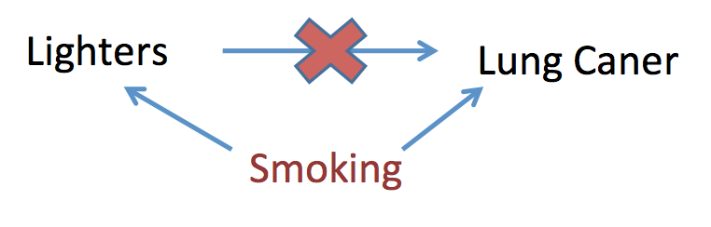
CONFOUNDING
No!

Slide 25
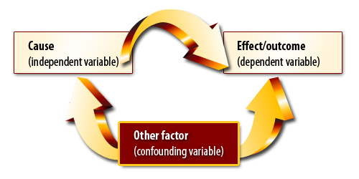
CONFOUNDING
Confounding variables often hide the true association between causes and outcomes.

Slide 26
ACTIVITY: KNOWLEDGE CHECK
ANSWER THE FOLLOWING QUESTIONS
EXERCISE
What factors are missing from this model?
How might we measure for these?
DELIVERABLE
Answers to the above questions

Slide 27
DIRECTED ACYCLIC GRAPH
A Directed Acyclic Graph (DAG) can help determine which variables are most important for your model. It helps visually demonstrate the logic of your models.
A DAG always includes at least one exposure/predictor and one outcome.

Slide 28
DIRECTED ACYCLIC GRAPH
Suppose we have the following output from a model:

Slide 29
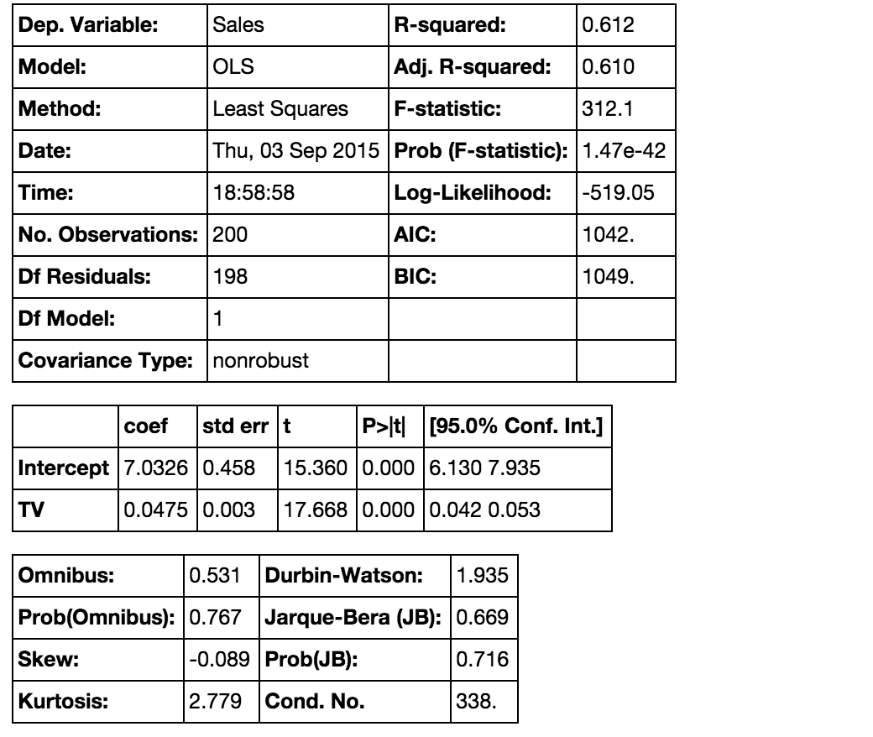

Slide 30
DIRECTED ACYCLIC GRAPH
The exposure/predictor is TV ads, associated with the outcome: sales.
We can measure the strength to demonstrate a strong association.
What other factors may increase sales?
What other types of ads?

Slide 31
DIRECTED ACYCLIC GRAPH
The DAG for this might look like the following:
TV Ads
Sales
Google Ads

Slide 32
THINK, PAIR, SHARE
DAGS

Slide 33
ACTIVITY: DAGS
DIRECTIONS
EXERCISE
Let’s say we want to evaluate which type of ad is associated with higher sales.
Break small groups.
Draw a basic DAG on your table or on the board. This DAG should show the relationship between ads and higher sales.
Discuss your DAGs in small groups and be ready to share one or two examples with the class.
DELIVERABLE
Insert Deliverable

Slide 34
SEASONALITY
Suppose TV ads were run in November/December (peak buying season) while Google ads were run during February/March (low buying season).
If we compare the two, we’re likely to reach the wrong conclusion! Seasonal trends are affecting our associations.
This is an example of bias and confounding. It isn’t that TV ads are better than Google ads; it’s that November/December is a better buying season than February/March, an inherent bias.

Slide 35
SEASONALITY
Let’s take a look at the association between TV Ads and Sales while taking into account seasonality (recurring regular patterns over time).
What are some examples of seasonality with relation to sales?

Slide 36
SEASONALITY
A DAG incorporating seasonality might look like this.
Sales and seasonality
Sales
TV Ads and seasonality
TV

Slide 37
ACTIVITY: KNOWLEDGE CHECK
ANSWER THE FOLLOWING QUESTIONS
EXERCISE
What is bias?
What is confounding?
What could we do differently in this example to avoid these elements?
DELIVERABLE
Answers to the above questions

Slide 38
A FEW KEY TAKEAWAYS
It is important to have deep subject area knowledge to be aware of biases in your field. This knowledge supplements statistical techniques.
A DAG can be a useful tool for thinking through the logic of your model.
There is a difference between causation and correlation. Statistics usually show correlation, not causation (remember our smoking example).
Good data is important. Your analysis is only as good as your understanding of the problem and the data you have to work with.

Slide 39
INTRODUCTION
HYPOTHESIS TESTING

Slide 40
HYPOTHESIS TESTING
How can we tell the difference between two groups of observations (e.g. smokers vs. non-smokers)?
Imagine we are testing the health of smokers vs. non-smokers. At a cursory glance, our results may show that smokers are marginally healthier than non-smokers.
Are they healthier due to random chance or is there a statistically significant difference? Maybe we happened to assemble a strange group of smoking triathletes and a group of non-smoking couch potatoes.
This is where hypothesis testing can help.

Slide 41
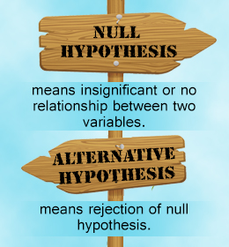
HYPOTHESIS TESTING STEPS
First, you need a hypothesis to test, referred to as the null hypothesis. The opposite of this would be the alternative hypothesis.

Slide 42
HYPOTHESIS TESTING STEPS
For example, if we want to test the relationship between gender and sales, we may have the following hypotheses.
Null hypothesis: There is no relationship between Gender and Sales.
Alternative hypothesis: There is a relationship between Gender and Sales.

Slide 43
HYPOTHESIS TESTING STEPS
Once you have your hypotheses, you can check whether the data supports rejecting the null hypothesis or failing to reject the hypothesis.
Note: Failing to reject the null is NOT the same as accepting the alternate. While the alternative hypothesis might be true, we don’t have enough data to support that claim specifically.
Keep this in mind so you don’t overstate your findings.

Slide 44
DEMO
HYPOTHESIS TESTING CASE STUDY

Slide 45
HYPOTHESIS TESTING CASE STUDY
We’re going to walk through Part 1 of the guided-demo-starter-code notebook in the class repo for lesson 4.
There are several questions to answer. We’ll answer those questions in small groups and then discuss with the class.

Slide 46
ACTIVITY: KNOWLEDGE CHECK
ANSWER THE FOLLOWING QUESTIONS
EXERCISE
What is the null hypothesis?
Why is this important to use?
DELIVERABLE
Answers to the above questions

Slide 47
INTRODUCTION
VALIDATE YOUR FINDINGS

Slide 48
VALIDATE YOUR FINDINGS
We know how to carry out a hypothesis test, but how do we tell if the association we found is statistically significant?
Statistical significance is the likelihood that a result or relationship is caused by something other than random chance.
Statistical hypothesis testing is traditionally employed to determine if a result is statistically significant or not.

Slide 49
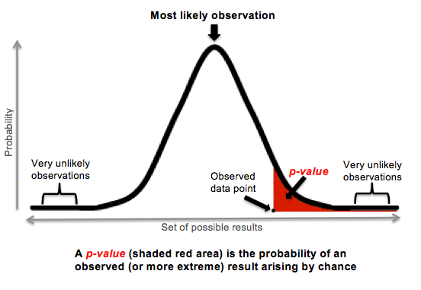
VALIDATE YOUR FINDINGS
Typically, a cut point of 5% is used. This means that we say something is statistically significant if there is a less than a 5% chance that our finding was due to random chance alone.

Slide 50
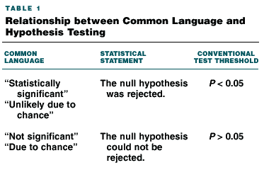
VALIDATE YOUR FINDINGS

Slide 51
VALIDATE YOUR FINDINGS
When we present results, we say we found something significant using this criteria.
We will use an example to dive further into this and understand p-values and confidence intervals.

Slide 52
DEMO
P-VALUES AND CONFIDENCE INTERVALS CASE STUDY

Slide 53
P-VALUES AND CONFIDENCE INTERVALS CASE STUDY
We’re now going to walk through Part 2 of the guided-demo-starter-code notebook in the class repo for lesson 4.
There are several questions to answer. We’ll answer those questions in small groups and then discuss with the class.

Slide 54
ACTIVITY: KNOWLEDGE CHECK
ANSWER THE FOLLOWING QUESTIONS
EXERCISE
What does a 95% confidence interval indicate?
DELIVERABLE
Answers to the above questions

Slide 55
INDEPENDENT PRACTICE
INTERPRETING RESULTS

Slide 56
ACTIVITY: INTERPRETING RESULTS
DIRECTIONS (35 minutes)
EXERCISE
Using the lab-start-code-4, you will look through a variety of analyses and interpret the findings.
You will be presented with a series of outputs and tables from a published analysis.
Read the outputs and determine if the findings are statistically significant or not.
DELIVERABLE
Answers to the questions in the notebook

Slide 57
CONCLUSION
LAB REVIEW

Slide 58
LAB REVIEW
Let’s review the answers to the questions in the labs.
Any other questions?

Slide 59
COURSE
BEFORE NEXT CLASS

Slide 60
DUE DATE
BEFORE NEXT CLASS
Project: Unit Project 2

Slide 61
LESSON
Q & A

Slide 62
LESSON
EXIT TICKET
DON’T FORGET TO FILL OUT YOUR EXIT TICKET

