Slide 1
Clustering: K-Means
Unsupervised Learning
Unsupervised Learning

Slide 2
Agenda
Time | Activity
10 min | Unsupervised Learning
30 min | Introduction to Clustering and K-Means
50 min | Practical Implementation and Exercises

Slide 3
Announcements
XXXXXXXXX

Slide 4
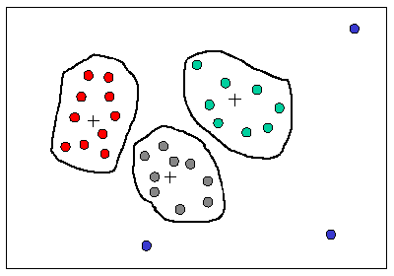
What is Clustering ?
Helps users understand the natural grouping or structure in a data set
Cluster:
a collection of data objects that are “similar” to one another and thus can be treated collectively as one group
but as a collection, they are sufficiently different from other groups
Clustering
unsupervised classification
no predefined classes
Notes:
Ask how containerization differs from virtualization

Slide 5
Basic Steps to Develop a Clustering Task
Feature selection / Preprocessing
Distance/Similarity measure
Clustering criterion
Clustering algorithms
Validation of the results
Interpretation of the results with applications
Notes:
Ask how containerization differs from virtualization

Slide 6



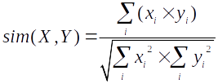
Distance or Similarity Measures
Common Distance Measures:
Manhattan distance:
Euclidean distance:
Cosine similarity:
Notes:
Ask how containerization differs from virtualization

Slide 7




More Similarity Measures :In vector-space model many similarity measures can be used in clustering
Simple Matching
Cosine Coefficient
Dice’s Coefficient
Jaccard’s Coefficient

Slide 8
More Similarity Measures :In vector-space model many similarity measures can be used in clustering
A good clustering method will produce high quality clusters
high intra-class similarity: cohesive within clusters
low inter-class similarity: distinctive between clusters
The quality of a clustering method depends on
the similarity measure used
its implementation, and
Its ability to discover some or all of the hidden patterns

Slide 9
The K-Means Clustering Method
Given the number of desired clusters k, the k-means algorithm follows four steps:
Randomly assign objects to create k nonempty initial partitions (clusters)
Compute the centroids of the clusters of the current partitioning (the centroid is the center, i.e., mean point, of the cluster)
Assign each object to the cluster with the nearest centroid (reallocation step)
Go back to Step 2, stop when the assignment does not change

Slide 10
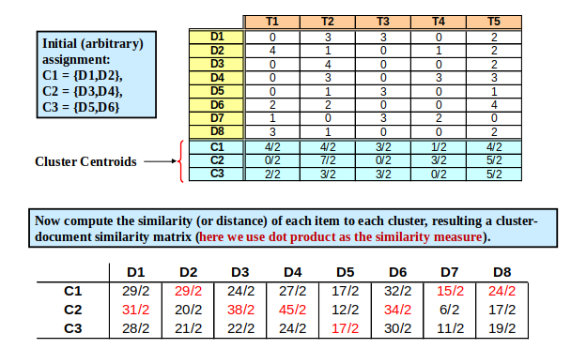
K-Means Example: Document Clustering

Slide 11
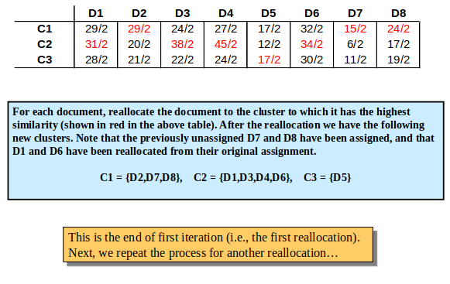
Example (Continued)

Slide 12
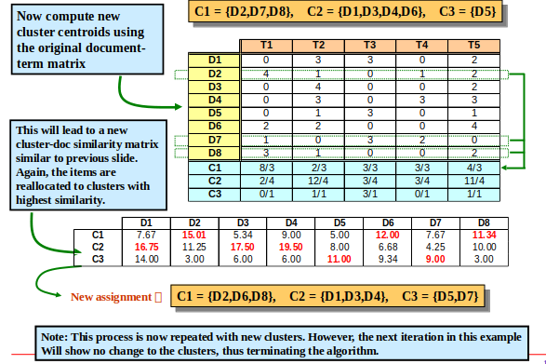
Example (Continued)

Slide 13
K-Means Algorithm
Strength of the k-means:
Relatively efficient: O(tkn), where n is # of objects, k is # of clusters, and t is # of iterations. Normally, k, t << n
Often terminates at a local optimum
Weakness of the k-means:
Applicable only when mean is defined; what about categorical data?
Need to specify k, the number of clusters, in advance
Unable to handle noisy data and outliers
Variations of K-Means usually differ in:
Selection of the initial k means
Distance or similarity measures used
Strategies to calculate cluster means

Slide 14
50 min
Practical Implementations
Notes:
Make students watch this 5 minute and make them take notes as they watch the video

Slide 15
k-means text clustering
Given text documents, we can group them automatically: text clustering. We’ll use KMeans which is an unsupervised machine learning algorithm.
In our example, documents are simply text strings that fit on the screen. In a real world situation, they may be big files.
Notes:
Debrief the video watched using the questions provided. Ideally make other students answer the questions other students had about the video

Slide 16
Documents
documents = ["This little kitty came to play when I was eating at a restaurant.", "Merley has the best squooshy kitten belly.", "Google Translate app is incredible.", "If you open 100 tab in google you get a smiley face.", "Best cat photo I've ever taken.", "Climbing ninja cat.", "Impressed with google map feedback.", "Key promoter extension for Google Chrome."]
Notes:
Debrief the video watched using the questions provided. Ideally make other students answer the questions other students had about the video

Slide 17
Feature extraction
K-Means normally works with numbers only: we need to have numbers.
The feature we’ll use is TF-IDF, a numerical statistic. This statistic uses term frequency and inverse document frequency.
TF(t) = (Number of times term t appears in a document) / (Total number of terms in the document).
IDF(t) = log_e(Total number of documents / Number of documents with term t in it).
The method TfidfVectorizer() implements the TF-IDF algorithm
Notes:
Debrief the video watched using the questions provided. Ideally make other students answer the questions other students had about the video

Slide 18
Text clustering
After we have numerical features, we initialize the K-Means algorithm with K=2.
We give a new document to the clustering algorithm and let it predict its class
Notes:
Debrief the video watched using the questions provided. Ideally make other students answer the questions other students had about the video

Slide 19
Libraries
from sklearn.feature_extraction.text import TfidfVectorizer
from sklearn.cluster import KMeans
from sklearn.metrics import adjusted_rand_score
Notes:
Debrief the video watched using the questions provided. Ideally make other students answer the questions other students had about the video

Slide 20
Cont
documents = ["This little kitty came to play when I was eating at a restaurant.", "Merley has the best squooshy kitten belly.", "Google Translate app is incredible.", "If you open 100 tab in google you get a smiley face.", "Best cat photo I've ever taken.", "Climbing ninja cat.", "Impressed with google map feedback.", "Key promoter extension for Google Chrome."]
Notes:
Debrief the video watched using the questions provided. Ideally make other students answer the questions other students had about the video

Slide 21
Cont
vectorizer = TfidfVectorizer(stop_words='english')
X = vectorizer.fit_transform(documents)
true_k = 2
model = KMeans(n_clusters=true_k, init='k-means++', max_iter=100, n_init=1)
model.fit(X)
print("Top terms per cluster:")
order_centroids = model.cluster_centers_.argsort()[:, ::-1]
terms = vectorizer.get_feature_names()
Notes:
Debrief the video watched using the questions provided. Ideally make other students answer the questions other students had about the video

Slide 22
for i in range(true_k):
print("Cluster %d:" % i),
for ind in order_centroids[i, :10]:
print(' %s' % terms[ind]),
print("\n")
print("Prediction")
Y = vectorizer.transform(["chrome browser to open."])
prediction = model.predict(Y)
print(prediction)
Y = vectorizer.transform(["My cat is hungry."])
prediction = model.predict(Y)
print(prediction)
Notes:
Students should build this on their own

Slide 23
Why Clusters change on every run
The simple reason is that K-Means intentionally distributes cluster centers randomly at the start
K-Means will very likely converge differently on different runs ("local optima" if you would want to call them such) which might change your naming completely
Notes:
Debrief the video watched using the questions provided. Ideally make other students answer the questions other students had about the video

Slide 24
Exercise
Find any documents/records that you can cluster based on similarity of text.
Notes:
Debrief the video watched using the questions provided. Ideally make other students answer the questions other students had about the video

Slide 25
Q & A

Slide 26
Up Next!

Slide 27
“Byeeeeeeeee!”

