Slide 1
Ensemble Learning
AI
Ensemble Learning

Slide 2
Agenda
Time | Activity
60 min | Ensemble Learning
60 min | Boosting
60 min | Experiments

Slide 3
Announcements
XXXXXXXXXXXXXXX
XXXXXXXXXXXXXXX

Slide 4
Ensemble Learning
Suppose you ask a complex question to thousands of random people, then aggregate their answers. In many cases you will find that this aggregated answer is better than an expert’s answer.
This is called the wisdom of the crowd.
Similarly, if you aggregate the predictions of a group of predictors (such as classifiers or regressors), you will often get better predictions than with the best individual predictor.
A group of predictors is called an ensemble; thus, this technique is called Ensemble Learning, and an Ensemble Learning algorithm is called an Ensemble method.

Slide 5
Ensemble Learning
you can train a group of Decision Tree classifiers, each on a different random subset of the training set. To make predictions, you just obtain the predictions of all individual trees, then predict the class that gets the most votes
Such an ensemble of Decision Trees is called a Random Forest, and despite its simplicity, this is one of the most powerful Machine Learning algorithms available today.
you will often use Ensemble methods near the end of a project, once you have already built a few good predictors, to combine them into an even better predictor.
In fact, the winning solutions in Machine Learning competitions often involve several Ensemble methods (most famously in the Netflix Prize competition).

Slide 6
Voting Classifiers
Suppose you have trained a few classifiers, each one achieving about 80% accuracy. You may have a Logistic Regression classifier, an SVM classifier, a Random Forest classifier, a K-Nearest Neighbors classifier, and perhaps a few more
A very simple way to create an even better classifier is to aggregate the predictions of each classifier and predict the class that gets the most votes. This majority-vote classifier is called a hard voting classifier

Slide 7
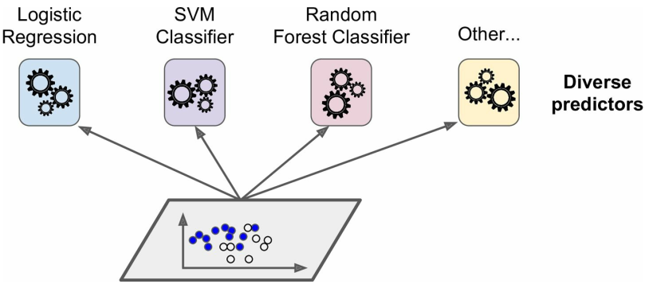

Slide 8
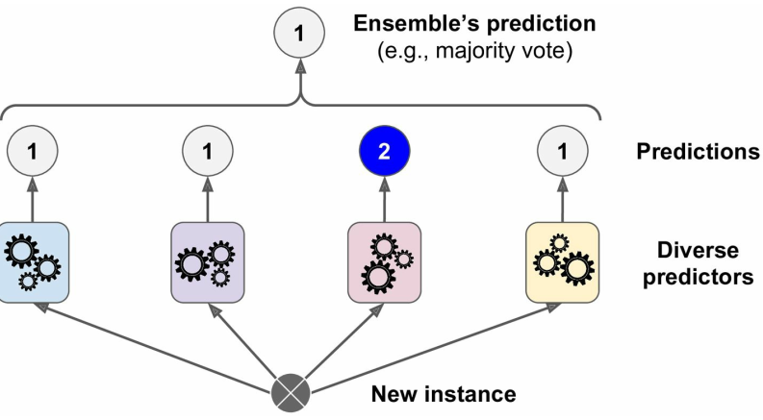

Slide 9
Voting Classifiers
Somewhat surprisingly, this voting classifier often achieves a higher accuracy than the best classifier in the ensemble.
In fact, even if each classifier is a weak learner (meaning it does only slightly better than random guessing), the ensemble can still be a strong learner (achieving high accuracy), provided there are a sufficient number of weak learners and they are sufficiently diverse.

Slide 10
Voting Classifiers
sklearn.ensemble import RandomForestClassifier
sklearn.ensemble import VotingClassifier
sklearn.linear_model import LogisticRegression
sklearn.svm import SVC
log_clf = LogisticRegression()
rnd_clf = RandomForestClassifier()
svm_clf = SVC()
voting_clf = VotingClassifier( estimators=[('lr', log_clf), ('rf', rnd_clf), ('svc', svm_clf)], voting='hard')
voting_clf.fit(X_train, y_train)

Slide 11
Voting Classifiers
>>> from sklearn.metrics import accuracy_score
>>> for clf in (log_clf, rnd_clf, svm_clf, voting_clf):
>>> clf.fit(X_train, y_train)
>>> y_pred = clf.predict(X_test)
>>> print(clf.__class__.__name__, accuracy_score(y_test, y_pred))

Slide 12
Voting Classifiers
If all classifiers are able to estimate class probabilities (i.e., they have a predict_proba() method), then you can tell Scikit-Learn to predict the class with the highest class probability, averaged over all the individual classifiers.
This is called soft voting. It often achieves higher performance than hard voting because it gives more weight to highly confident votes.
All you need to do is replace voting="hard" with voting="soft" and ensure that all classifiers can estimate class probabilities.

Slide 13
Bagging and Pasting
One way to get a diverse set of classifiers is to use very different training algorithms
Another approach is to use the same training algorithm for every predictor, but to train them on different random subsets of the training set.
When sampling is performed with replacement, this method is called bagging (short for bootstrap aggregating)
When sampling is performed without replacement, it is called pasting
both bagging and pasting allow training instances to be sampled several times across multiple predictors, but only bagging allows training instances to be sampled several times for the same predictor

Slide 14
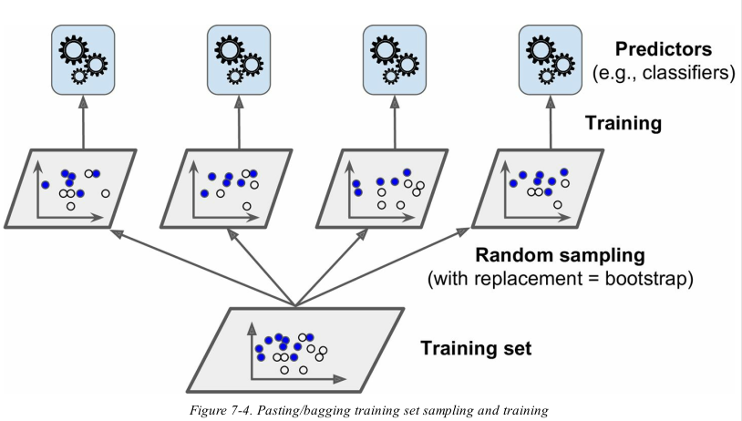

Slide 15
Bagging and Pasting
Once all predictors are trained, the ensemble can make a prediction for a new instance by simply aggregating the predictions of all predictors.
The aggregation function is typically the statistical mode (i.e., the most frequent prediction, just like a hard voting classifier) for classification, or the average for regression.
Each individual predictor has a higher bias than if it were trained on the original training set, but aggregation reduces both bias and variance.
Generally, the net result is that the ensemble has a similar bias but a lower variance than a single predictor trained on the original training set.
Predictors can all be trained in parallel, via different CPU cores or even different servers. Similarly, predictions can be made in parallel. This is one of the reasons why bagging and pasting are such popular methods: they scale very well.

Slide 16
Random Forests
Random Forest is an ensemble of Decision Trees, generally trained via the bagging method (or sometimes pasting), typically with max_samples set to the size of the training set.
Instead of building a BaggingClassifier and passing it a DecisionTreeClassifier , you can instead use the RandomForestClassifier class, which is more convenient and optimized for Decision Trees (similarly, there is a RandomForestRegressor class for regression tasks).
The following code trains a Random Forest classifier with 500 trees (each limited to maximum 16 nodes), using all available CPU cores:

Slide 17
Random Forests
from sklearn.ensemble import RandomForestClassifier
rnd_clf = RandomForestClassifier(n_estimators=500, max_leaf_nodes=16, n_jobs=-1)
rnd_clf.fit(X_train, y_train)
y_pred_rf = rnd_clf.predict(X_test)
With a few exceptions, a RandomForestClassifier has all the hyperparameters of a DecisionTreeClassifier (to control how trees are grown), plus all the hyperparameters of a BaggingClassifier to control the ensemble itself
The Random Forest algorithm introduces extra randomness when growing trees; instead of searching for the very best feature when splitting a node it searches for the best feature among a random subset of features.

Slide 18
Feature Importance
If you look at a single Decision Tree, important features are likely to appear closer to the root of the tree, while unimportant features will often appear closer to the leaves (or not at all)
It is therefore possible to get an estimate of a feature’s importance by computing the average depth at which it appears across all trees in the forest.
Scikit-Learn computes this automatically for every feature after training. You can access the result using the feature_importances_ variable.
For example, the following code trains a RandomForestClassifier on the iris dataset and outputs each feature’s importance.
It seems that the most important features are the petal length (44%) and width (42%), while sepal length and width are rather unimportant in comparison (11% and 2%, respectively):

Slide 19
Feature Importance
If you look at a single Decision Tree, important features are likely to appear closer to the root of the tree, while unimportant features will often appear closer to the leaves (or not at all)
It is therefore possible to get an estimate of a feature’s importance by computing the average depth at which it appears across all trees in the forest.
Scikit-Learn computes this automatically for every feature after training. You can access the result using the feature_importances_ variable.
For example, the following code trains a RandomForestClassifier on the iris dataset and outputs each feature’s importance.
It seems that the most important features are the petal length (44%) and width (42%), while sepal length and width are rather unimportant in comparison (11% and 2%, respectively):

Slide 20
Feature Importance
>>> from sklearn.datasets import load_iris
>>> iris = load_iris()
>>> rnd_clf = RandomForestClassifier(n_estimators=500, n_jobs=-1)
>>> rnd_clf.fit(iris["data"], iris["target"])
>>> for name, score in zip(iris["feature_names"], rnd_clf.feature_importances_):
>>>print(name, score)

Slide 21
Boosting
Boosting (originally called hypothesis boosting) refers to any Ensemble method that can combine several weak learners into a strong learner.
The general idea of most boosting methods is to train predictors sequentially, each trying to correct its predecessor.
There are many boosting methods available, but by far the most popular are AdaBoost (short for Adaptive Boosting) and Gradient Boosting.
This is done by building a model from the training data, then creating a second model that attempts to correct the errors from the first model.
Models are added until the training set is predicted perfectly or a maximum number of models are added.

Slide 22
Adaboost
AdaBoost was the first really successful boosting algorithm developed for binary classification.
Modern boosting methods build on AdaBoost, most notably stochastic gradient boosting machines
One way for a new predictor to correct its predecessor is to pay a bit more attention to the training instances that the predecessor underfitted.
This results in new predictors focusing more and more on the hard cases. This is the technique used by AdaBoost.
For example, to build an AdaBoost classifier, a first base classifier (such as a Decision Tree) is trained and used to make predictions on the training set

Slide 23
Cont’
A second classifier is trained using the updated weights and again it makes predictions on the training set, weights are updated, and so on
The next diagram show AdaBoost sequential training with instance weight updates

Slide 24
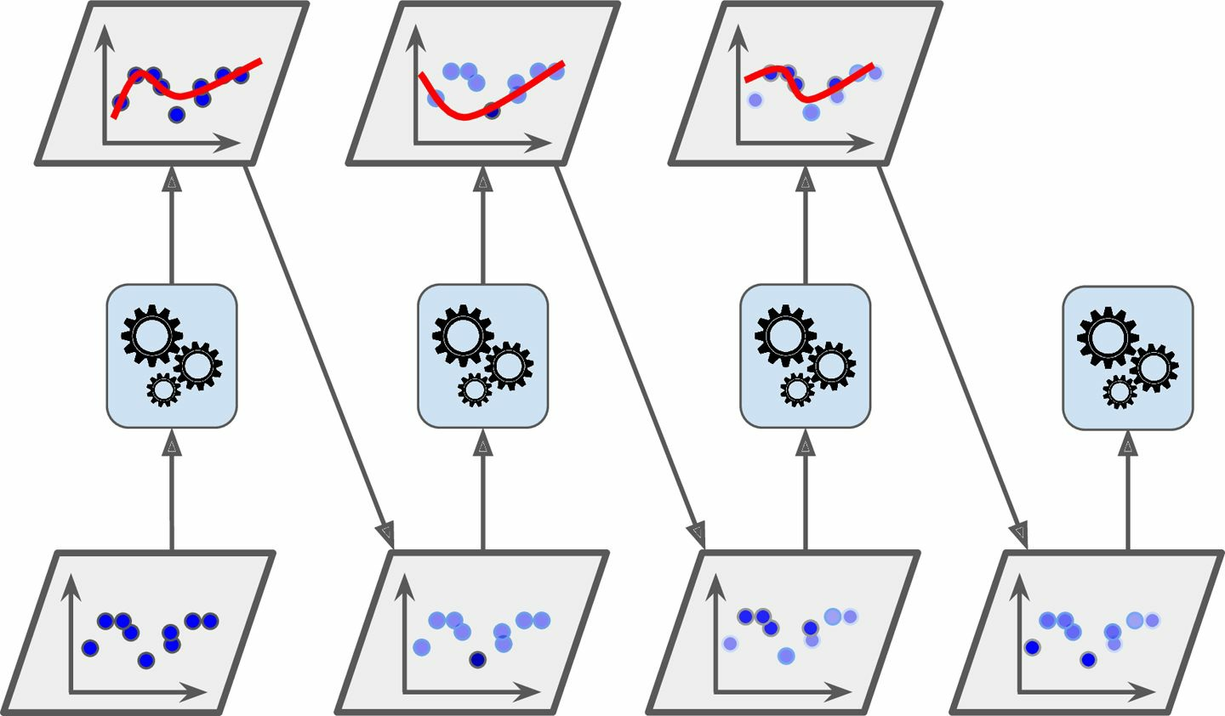

Slide 25
Learning an Adaboost model from Data
AdaBoost is best used to boost the performance of decision trees on binary classification problems
Weak models are added sequentially, trained using the weighted training data. The process continues until a pre-set number of weak learners have been created (a user parameter) or no further improvement can be made on the training dataset.

Slide 26
Making Predictions
Predictions are made by calculating the weighted average of the weak classifiers.
For a new input instance, each weak learner calculates a predicted value as either +1.0 or -1.0
The predicted values are weighted by each weak learners stage value.
The prediction for the ensemble model is taken as a the sum of the weighted predictions. If the sum is positive, then the first class is predicted, if negative the second class is predicted.
For example, 5 weak classifiers may predict the values 1.0, 1.0, -1.0, 1.0, -1.0.
From a majority vote, it looks like the model will predict a value of 1.0 .

Slide 27
Preparing Data for Adaboost
Quality Data: Because the ensemble method continues to attempt to correct misclassification’s in the training data, you need to be careful that the training data is of a high-quality.
Outliers: Outliers will force the ensemble down the rabbit hole of working hard to correct for cases that are unrealistic. These could be removed from the training dataset.
Noisy Data: Noisy data, specifically noise in the output variable can be problematic. If possible, attempt to isolate and clean these from your training dataset.

Slide 28
How does it work
Initially, Adaboost selects a training subset randomly.
It iteratively trains the AdaBoost machine learning model by selecting the training set based on the accurate prediction of the last training.
Also, It assigns the weight to the trained classifier in each iteration according to the accuracy of the classifier. The more accurate classifier will get high weight
This process iterate until the complete training data fits without any error or until reached to the specified maximum number of estimators.

Slide 29
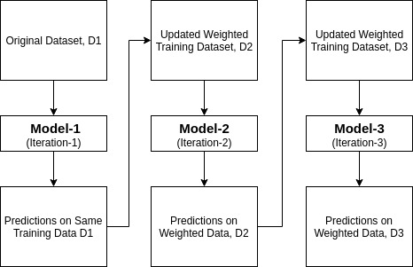

Slide 30
Building Model in Python
# Load libraries
from sklearn.ensemble import AdaBoostClassifier
from sklearn import datasets
# Import train_test_split function
from sklearn.model_selection import train_test_split
#Import scikit-learn metrics module for accuracy calculation
from sklearn import metrics

Slide 31
Cont’
This dataset comprises 4 features (sepal length, sepal width, petal length, petal width) and a target (the type of flower)
This data has three types of flower classes: Setosa, Versicolour, and Virginica.
The dataset is available in the scikit-learn library, or you can also download it from the UCI Machine Learning Library.
# Load data
iris = datasets.load_iris()
X = iris.data
y = iris.target

Slide 32
COnt’
# Split dataset into training set and test set
X_train, X_test, y_train, y_test = train_test_split(X, y, test_size=0.3) # 70% training and 30% test
# Create adaboost classifer object
abc = AdaBoostClassifier(n_estimators=50, learning_rate=1)
# Train Adaboost Classifer
model = abc.fit(X_train, y_train)
#Predict the response for test dataset
y_pred = model.predict(X_test)

Slide 33
Cont’
The most important parameters are base_estimator, n_estimators, and learning_rate."
base_estimator: It is a weak learner used to train the model. It uses DecisionTreeClassifier as default weak learner for training purpose. You can also specify different machine learning algorithms.
n_estimators: Number of weak learners to train iteratively.
learning_rate: It contributes to the weights of weak learners. It uses 1 as a default value.

Slide 34
Evaluate Model
# Model Accuracy, how often is the classifier correct?
print("Accuracy:",metrics.accuracy_score(y_test, y_pred))
When you got an accuracy of 88.88%, considered as good accuracy

Slide 35
Use different Base Learners
You can use any ML learner as base estimator if it accepts sample weight such as Decision Tree, Support Vector Classifier.

Slide 36
# Load libraries
from sklearn.ensemble import AdaBoostClassifier
# Import Support Vector Classifier
from sklearn.svm import SVC
#Import scikit-learn metrics module for accuracy calculation
from sklearn import metrics
svc=SVC(probability=True, kernel='linear')
# Create adaboost classifer object
abc =AdaBoostClassifier(n_estimators=50, base_estimator=svc,learning_rate=1)
# Train Adaboost Classifer
model = abc.fit(X_train, y_train)
#Predict the response for test dataset
y_pred = model.predict(X_test)
# Model Accuracy, how often is the classifier correct?
print("Accuracy:",metrics.accuracy_score(y_test, y_pred))

Slide 37
Pros
AdaBoost is easy to implement. It iteratively corrects the mistakes of the weak classifier and improves accuracy by combining weak learners. You can use many base classifiers with AdaBoost. AdaBoost is not prone to overfitting.

Slide 38
Cons
AdaBoost is sensitive to noise data. It is highly affected by outliers because it tries to fit each point perfectly. AdaBoost is slower compared to XGBoost.

Slide 39
Gradient Boost
Just like AdaBoost, Gradient Boosting works by sequentially adding predictors to an ensemble, each one correcting its predecessor.
However, instead of tweaking the instance weights at every iteration like AdaBoost does, this method tries to fit the new predictor to the residual errors made by the previous predictor.
Let’s go through a simple regression example using Decision Trees as the base predictors (of course Gradient Boosting also works great with regression tasks).
This is called Gradient Tree Boosting, or Gradient Boosted Regression Trees (GBRT). First, let’s fit a DecisionTreeRegressor to the training set (for example, a noisy quadratic training set):

Slide 40
Gradient Boost
from sklearn.tree import DecisionTreeRegressor
tree_reg1 = DecisionTreeRegressor(max_depth=2)
tree_reg1.fit(X, y)
Now train a second DecisionTreeRegressor on the residual errors made by the first predictor:
y2 = y - tree_reg1.predict(X)
tree_reg2 = DecisionTreeRegressor(max_depth=2)
tree_reg2.fit(X, y2)
Then we train a third regressor on the residual errors made by the second predictor:

Slide 41
Gradient Boost
y3 = y2 - tree_reg2.predict(X)
tree_reg3 = DecisionTreeRegressor(max_depth=2)
tree_reg3.fit(X, y3)
Now we have an ensemble containing three trees. It can make predictions on a new instance simply by adding up the predictions of all the trees:
y_pred = sum(tree.predict(X_new) for tree in (tree_reg1, tree_reg2, tree_reg3))

Slide 42
Gradient Boost
A simpler way to train GBRT ensembles is to use Scikit-Learn’s GradientBoostingRegressor class. Much like the RandomForestRegressor class, it has hyperparameters to control the growth of Decision Trees (e.g., max_depth , min_samples_leaf , and so on), as well as hyperparameters to control the ensemble training, such as the number of trees ( n_estimators )
from sklearn.ensemble import GradientBoostingRegressor
gbrt = GradientBoostingRegressor(max_depth=2, n_estimators=3, learning_rate=1.0)
gbrt.fit(X, y)

Slide 43
Exercise
Find a dataset where you can apply any one of the ensemble classifiers with different base classifiers and experiment its performance.
Notes:
Ask how containerization differs from virtualization

Slide 44
Debrief
What were your key takeaways from the session?

Slide 45
Q & A

Slide 46
“Byeeeeeeeee!”

