Slide 1
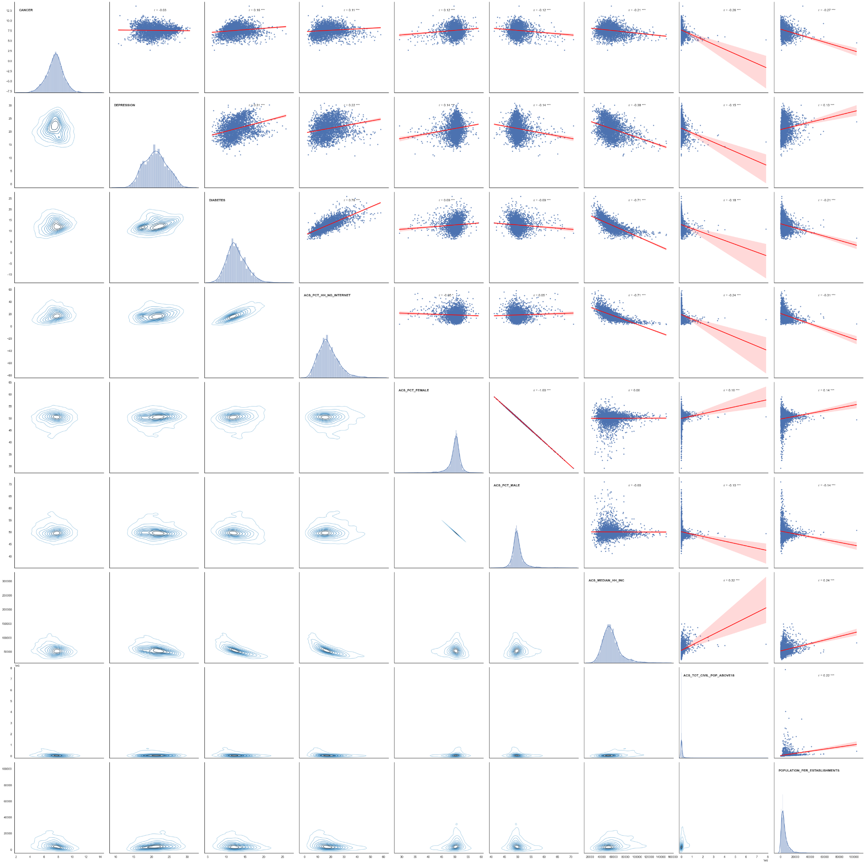
R = -0.21
R = -0.26
R = -0.27
R = -0.38
R = -0.15
DIABETES DEPRESSION CANCER
R = 0.13 ***
R = -0.71
R = -0.18
R = -0.21
MEDIAN HOUSEHOLD INCOME TOTAL POPULATION ABOVE 18 YRS POP. PER LIQUOR ESTABLISHMENT

Slide 2
R = 0.11
R = 0.12
R = -0.12
R = 0.22
R = 0.14
R = -0.14
DIABETES DEPRESSION CANCER
R = 0.76
R = 0.09
R = -0.09
NO INTERNET PERCENT FEMALE PERCENT MALE

