Slide 1


Slide 2
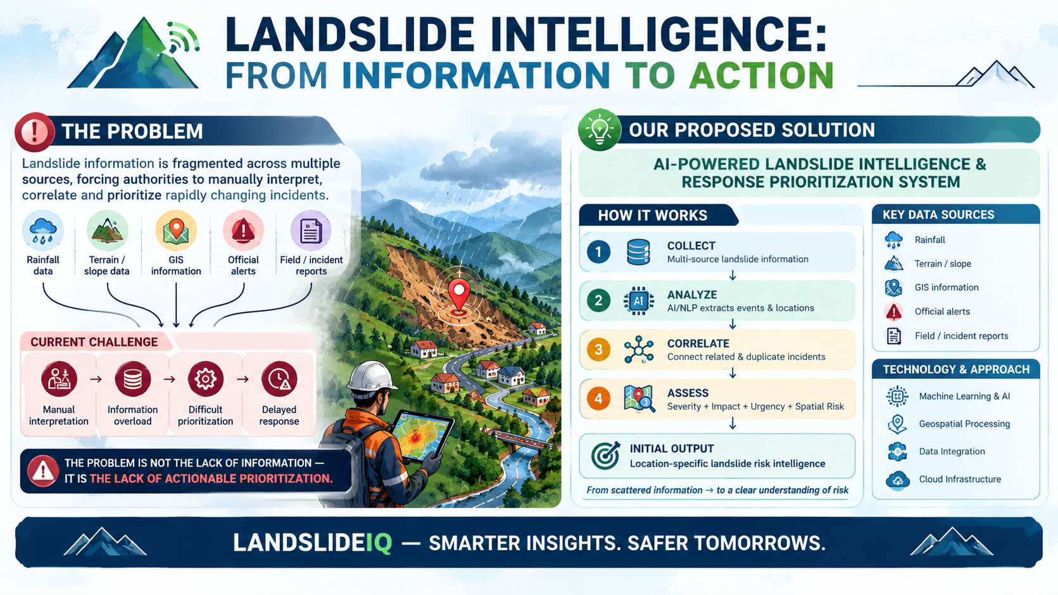

Slide 3
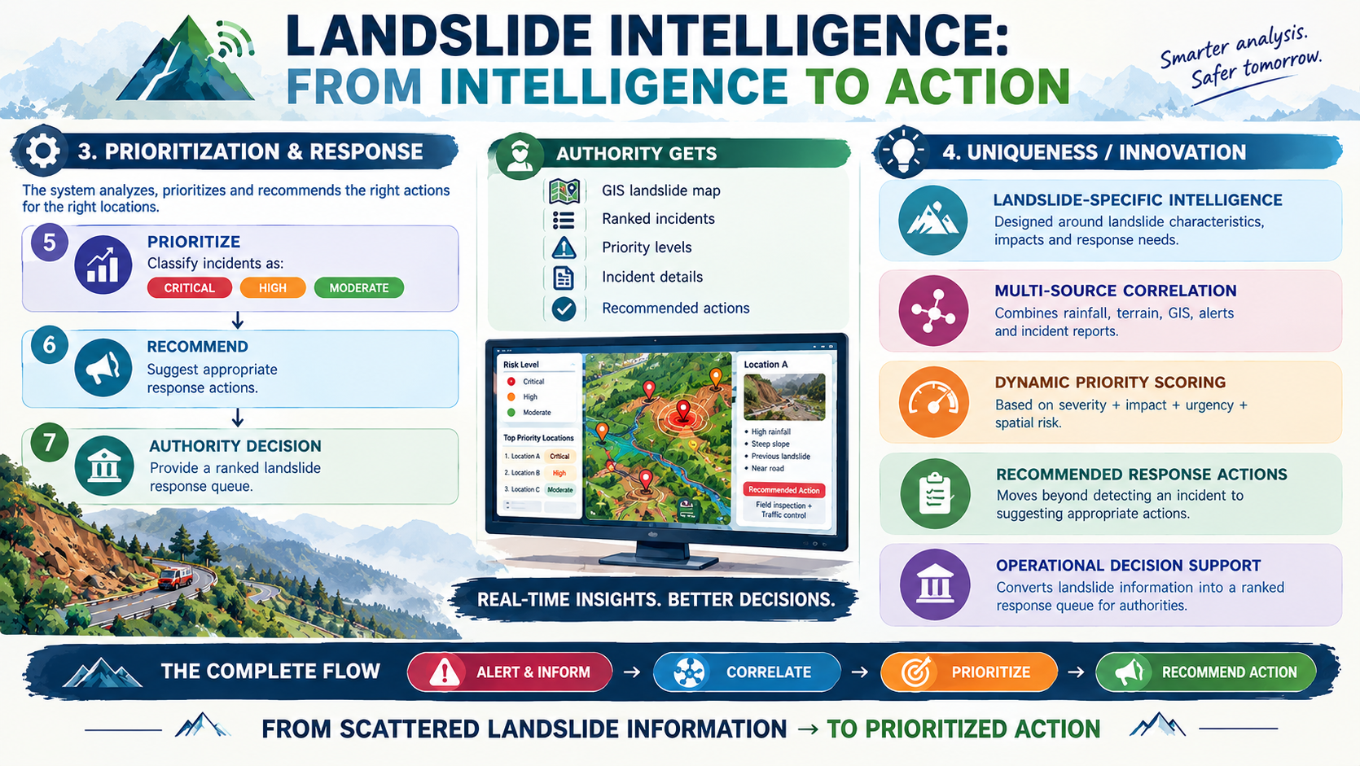

Slide 4
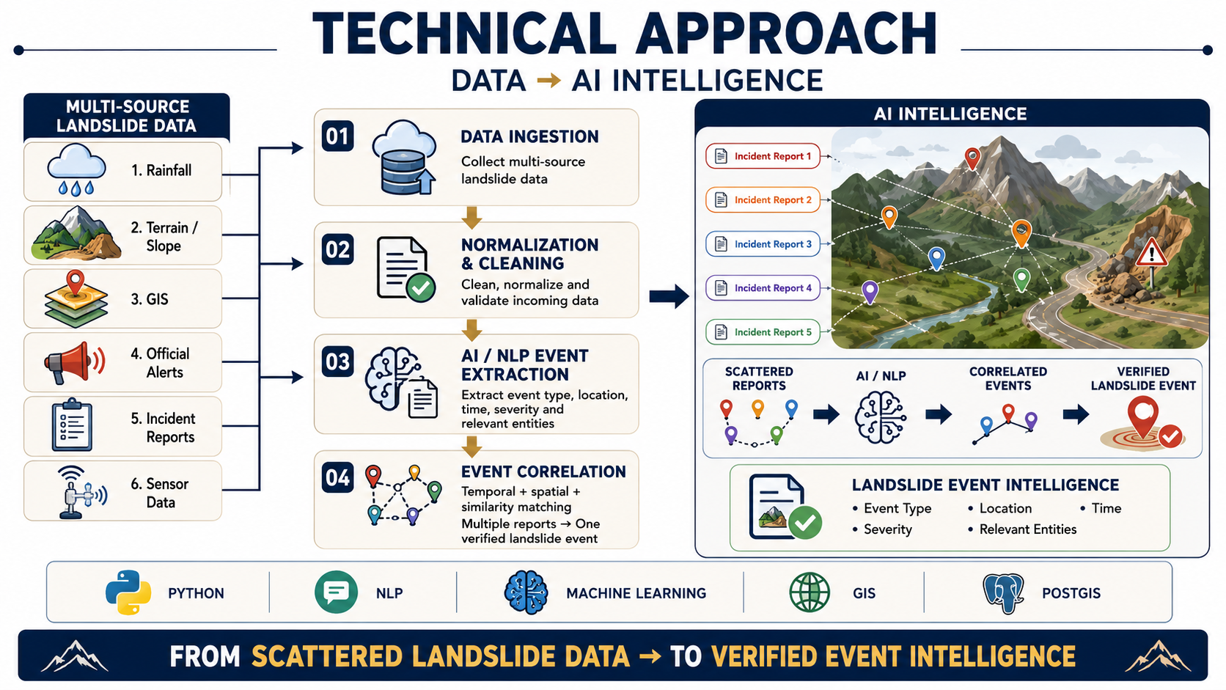

Slide 5
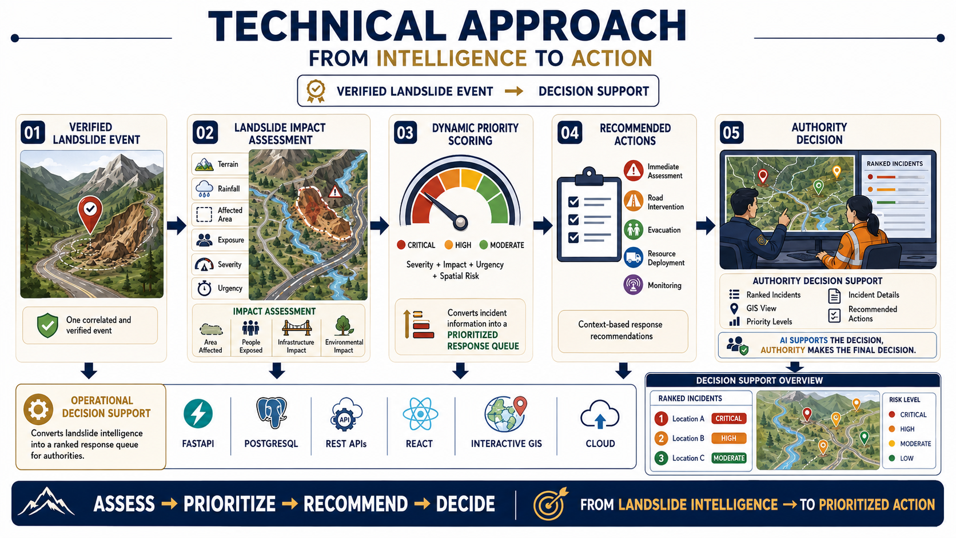

Slide 6
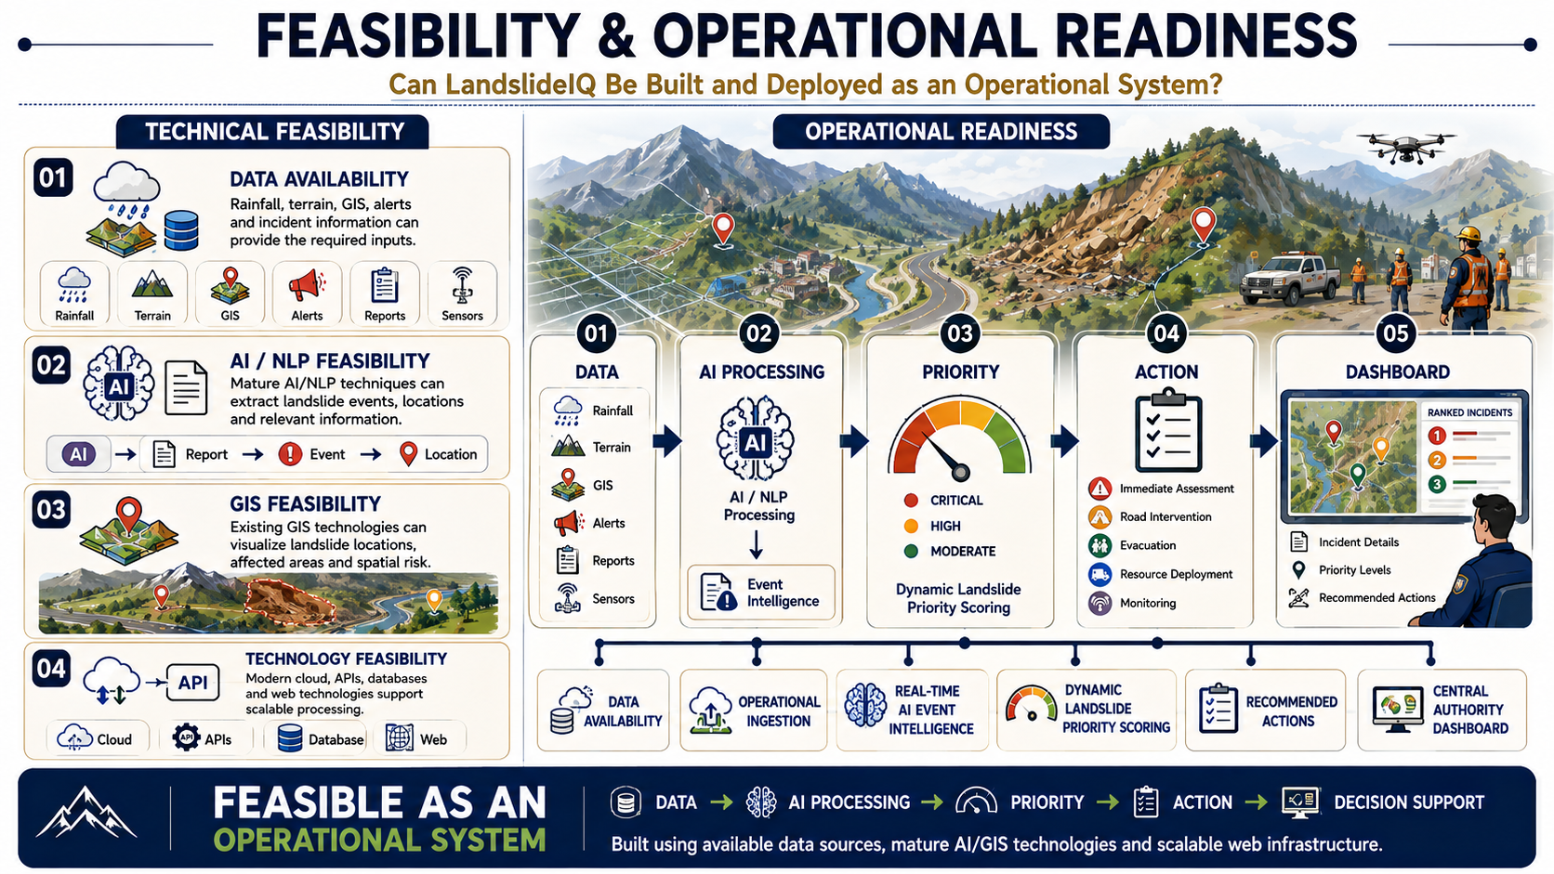

Slide 7
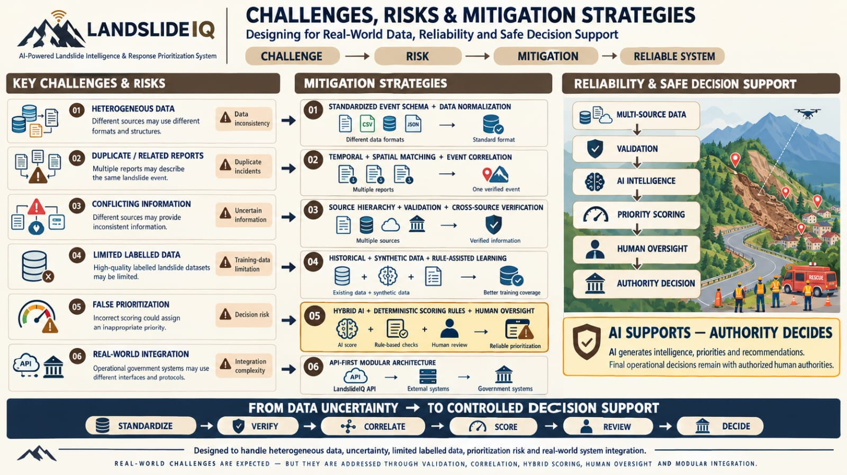

Slide 8
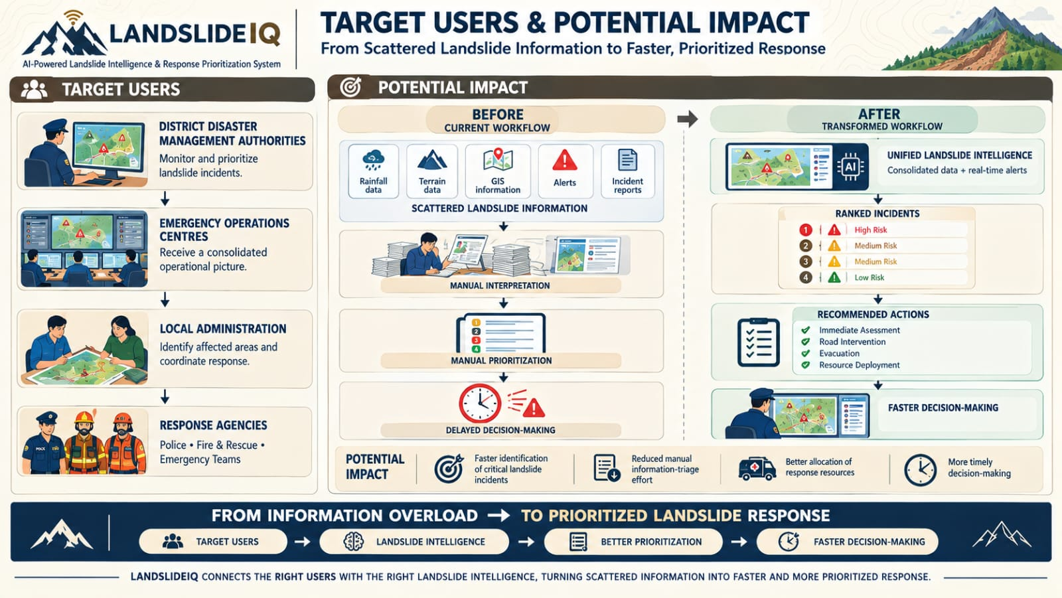

Slide 9
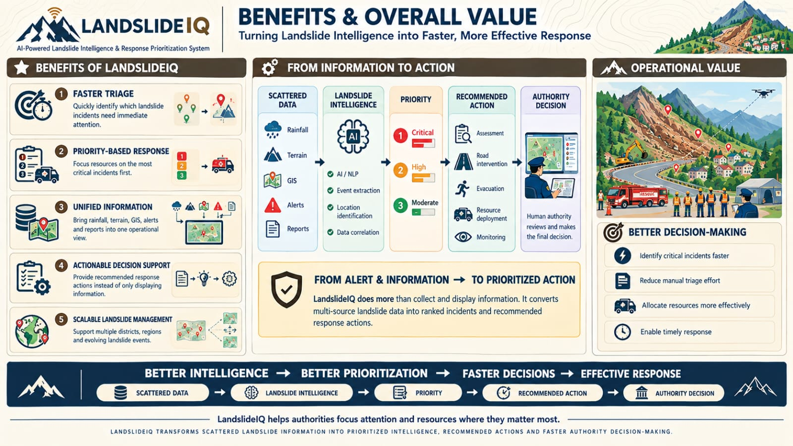

Slide 10





RESEARCH AND REFERENCES
References / Research Sources:
NDMA – SACHET
ISRO – National Database for Emergency Management (NDEM)
Yan et al. (2009) – Disaster Rescue & Time-Critical Decision Making
Qiu et al. (2024) – Manual Analysis & Earthquake Emergency Decision-Making
Chan & Tsai (2019) – Data Overload & Emergency Decision Support

