Slide 1

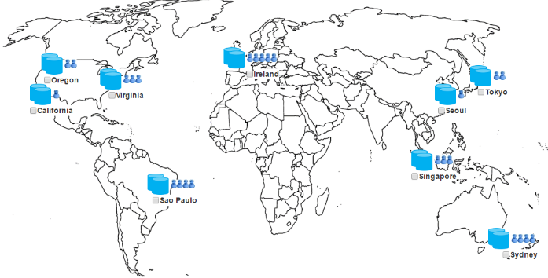
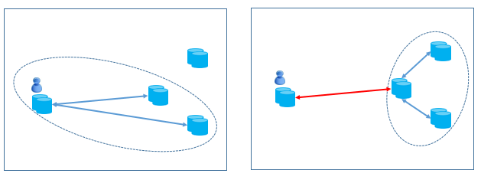

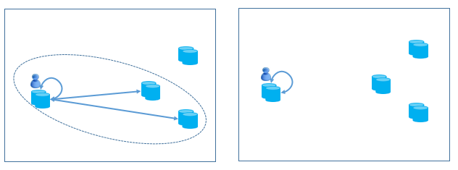
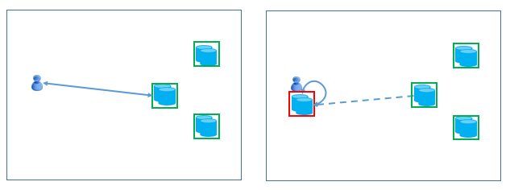
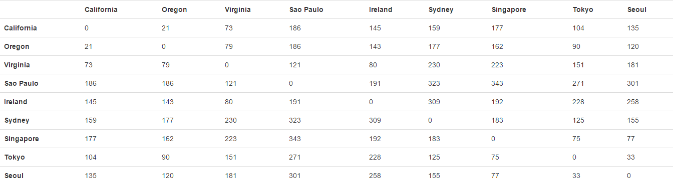
DB-Risk: The Game of Global Database Placement
Victor Zakhary Faisal Nawab Divyakant Agrawal Amr El Abbadi
Motivation
Commit Handoff
Commit can be handed off to a replica closer to a quorum
Can achieve better latency
Where?
Optimistic Read
Application requirements:
Serializable transaction support
Aggregated workload per site
Fault tolerance
[Cost, political constraints, etc]
Outputs:
Deployment plan (which datacenters to have replicas)
Execution plan (which datacenter should serve a client request)
Read from one replica instead of a quorum
Validate at the commit time
System Model
Passive Replica
Reads can be served from an asynchronously updated cached replicas
Passive replicas don’t affect the commit latency
Placement Expert List
Can you find a placement that achieves lower latency than our automatic placement generator? ☺ cs.ucsb.edu/~victorzakhary/demo/demo.html
Id | Expert Name | Score
Average Round Trip Time (RTT) in ms between Amazon datacenters

