Slide 1
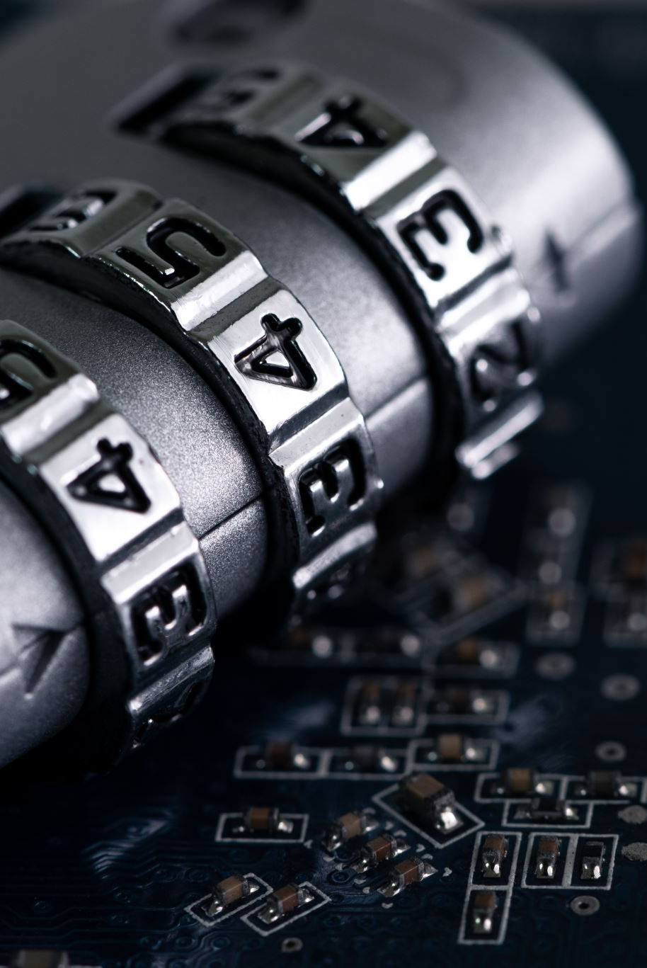
Password manager

Slide 2
Introduction
Advanced Security: Protect your digital assets with cutting-edge encryption.
Convenience: Seamlessly manage all your passwords in one secure location.
Peace of Mind: Rest easy knowing your sensitive information is safe and accessible only to you.

Slide 3

Features
Utilizes AES-GCM encryption to safeguard passwords locally, ensuring maximum security before transmission.
Seamlessly generate highly secure passwords using robust cryptographic methods.
All passwords securely stored in a PostgreSQL database inside docker network.
Flexible user management system allowing multiple users to securely access and manage their passwords within the platform.
Intuitive React Interface.
Built-in measures to prevent SQL injection attacks.

Slide 4
Security
Master password is only known to the user which is salted and hashed before uploating to ther server.
HTTPS connection to ensure secure and encrypted data transfer.
Usage of docker network allows only the server to communicate with the database.
Passwords are encrypted on the client side using AES-GCM.
Derived key is created from master password using PBKDF2 which is used as encryption/decryption key.

Slide 5
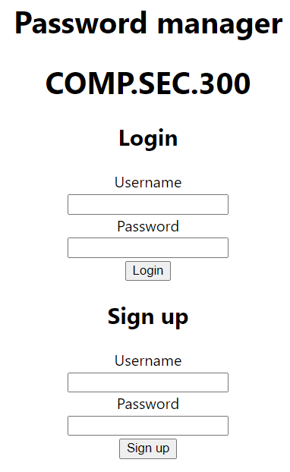
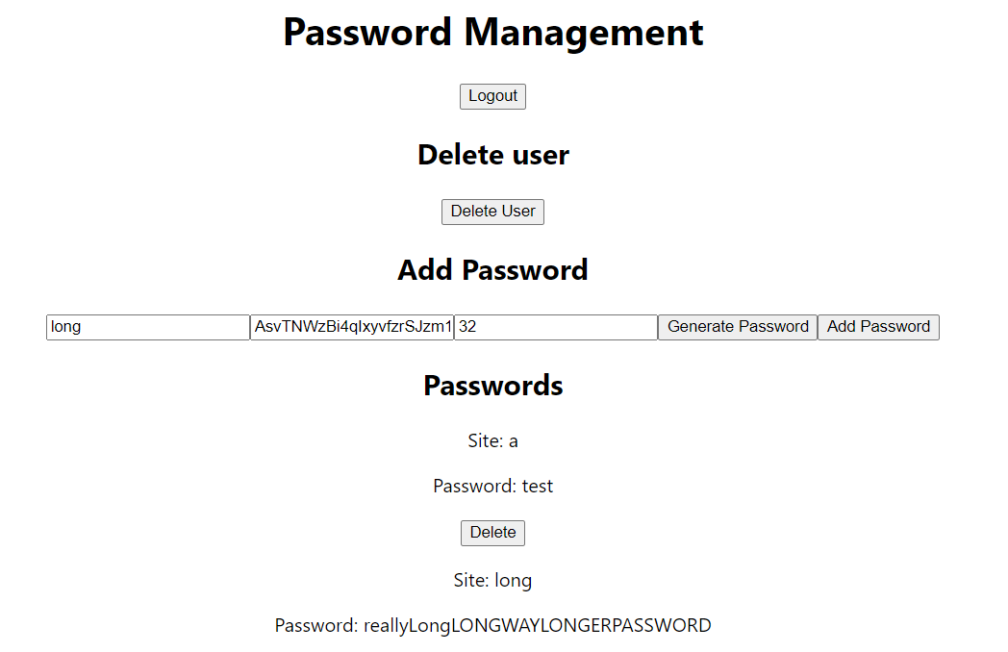
Usage

Slide 6

Questions

