Slide 1
CS534 Final Presentation
Machine Learning in Algorithm Trading:
An Example of Recurrent Reinforcement Learning
Yupu Song & Kartik Shetty
April 28, 2016

Slide 2
Introduction
Research Outline:
Analyzed the market data
Inspired by the data features, chose some relevant machine learning algorithms for further exploration
Deep research. Compared the feasibility and decided one for coding
Coding and implementation. Try to make improvement after evaluation.
Conclusion & Future Work

Slide 3

Introduction
Motivation
We are inspired by the industry trend. However they never disclose such money-making method.
So let’s make it on our own!

Slide 4
Background
Machine Learning:
Develop the computer’s ability of learning without explicitly programmed
E.g. Facebook face recognition
Algorithm Trading:
The trading strategies are programmed and implemented by computers
Previous work: Emerging from 1980s, predictive math models, statistical arbitrage, event-driven system have been using for decades
Machine Learning in Algorithm Trading:
Industry trend: hedge funds like Bridgewater, Two Sigma, and investment banks like J.P. Morgan have been using ML in trading.
r

Slide 5
Related Work
Support Vector Machines
K. Kim (2003), used SVM to forecast financial time series
Hidden Markov Model
P. Idvall and C. Jonsson (2008) implemented HMM on high frequency foreign exchange data
Reinforcement Learning
J. Moody and M. Saffell (2001) proposed a new approach in reinforcement learning, and V. Leemans (2006) improved the algorithm with risk control mechanism, and implemented it on forex trading
r

Slide 6
Recurrent Reinforcement Learning (RRL)
Reinforcement Learning
Example: Chess game learning
Model Components:
Environment states {S_{i}}_{n}
Actions {A_{i}}_{n}
Transition Model: How does the state change from step i to step i+1? e.g. weather change model, transitional probability matrix
Reward {R_{i}}_{n} : immediate step reward
Utilities: A goal function regarding total rewards
r

Slide 7
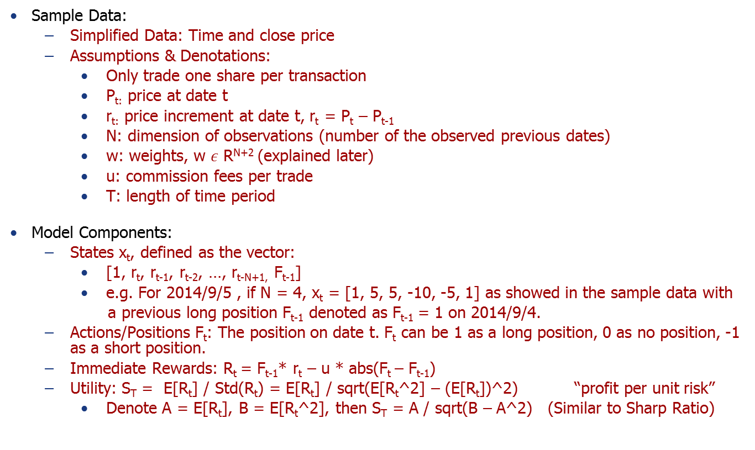
RRL: Initialization
Sample Data:
Simplified Data: Time and close price
Assumptions & Denotations:
Only trade one share per transaction
P_{t:} price at date t
r_{t:} price increment at date t, r_{t} = P_{t} – P_{t-1}
N: dimension of observations (number of the observed previous dates)
w: weights, w $ε$ R^{N+2} (explained later)
u: commission fees per trade
T: length of time period
Model Components:
States x_{t}, defined as the vector:
[1, r_{t}, r_{t-1}, r_{t-2}, …, r_{t-N+1,} F_{t-1}]
e.g. For 2014/9/5 , if N = 4, x_{t} = [1, 5, 5, -10, -5, 1] as showed in the sample data with
a previous long position F_{t-1} denoted as F_{t-1} = 1 on 2014/9/4.
Actions/Positions F_{t}: The position on date t. F_{t} can be 1 as a long position, 0 as no position, -1 as a short position.
Immediate Rewards: R_{t} = F_{t-1}* r_{t} – u * abs(F_{t} – F_{t-1})
Utility: S_{T} = E[R_{t}] / Std(R_{t}) = E[R_{t}] / sqrt(E[R_{t}^2] – (E[R_{t}])^2) “profit per unit risk”
Denote A = E[R_{t}], B = E[R_{t}^2], then S_{T} = A / sqrt(B – A^2) (Similar to Sharp Ratio)
2014/9/1 | 10740
2014/9/2 | 10735
2014/9/3 | 10725
2014/9/4 | 10730
2014/9/5 | 10735
r

Slide 8
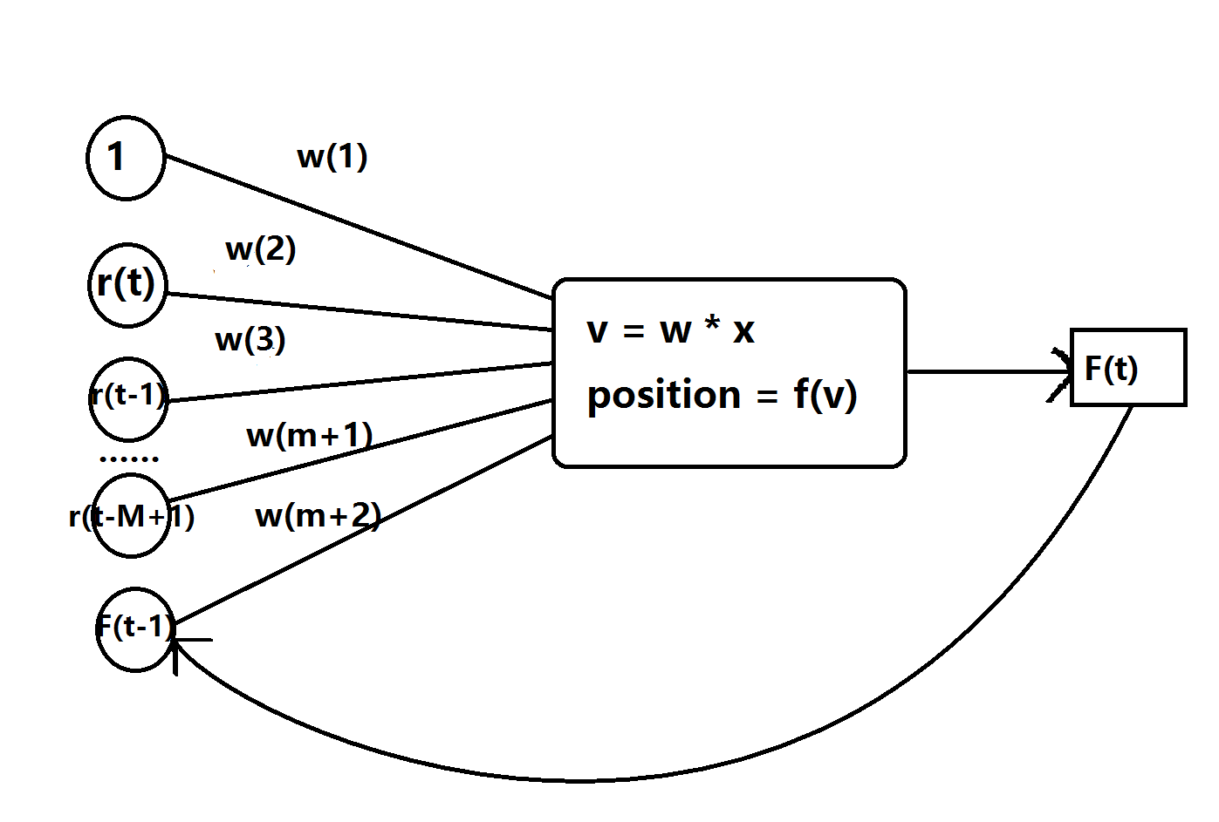
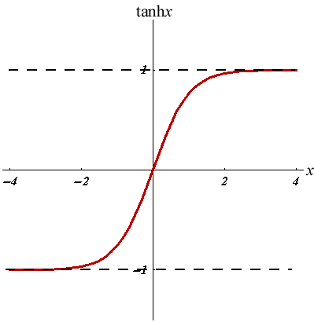
RRL: Model Desciption
Neuro Structure:
Input: v = w^{T}* x = w₁+w₂r_{t}+w₃r_{t-1}+…+w_{N+1}r_{t-M+1}+w_{N+2}F_{t-1}
f(v) = tanh(v) = e^{x}-e^{-x} / e^{x}+e^{-x} (Hyperbolic Tangent)
r

Slide 9
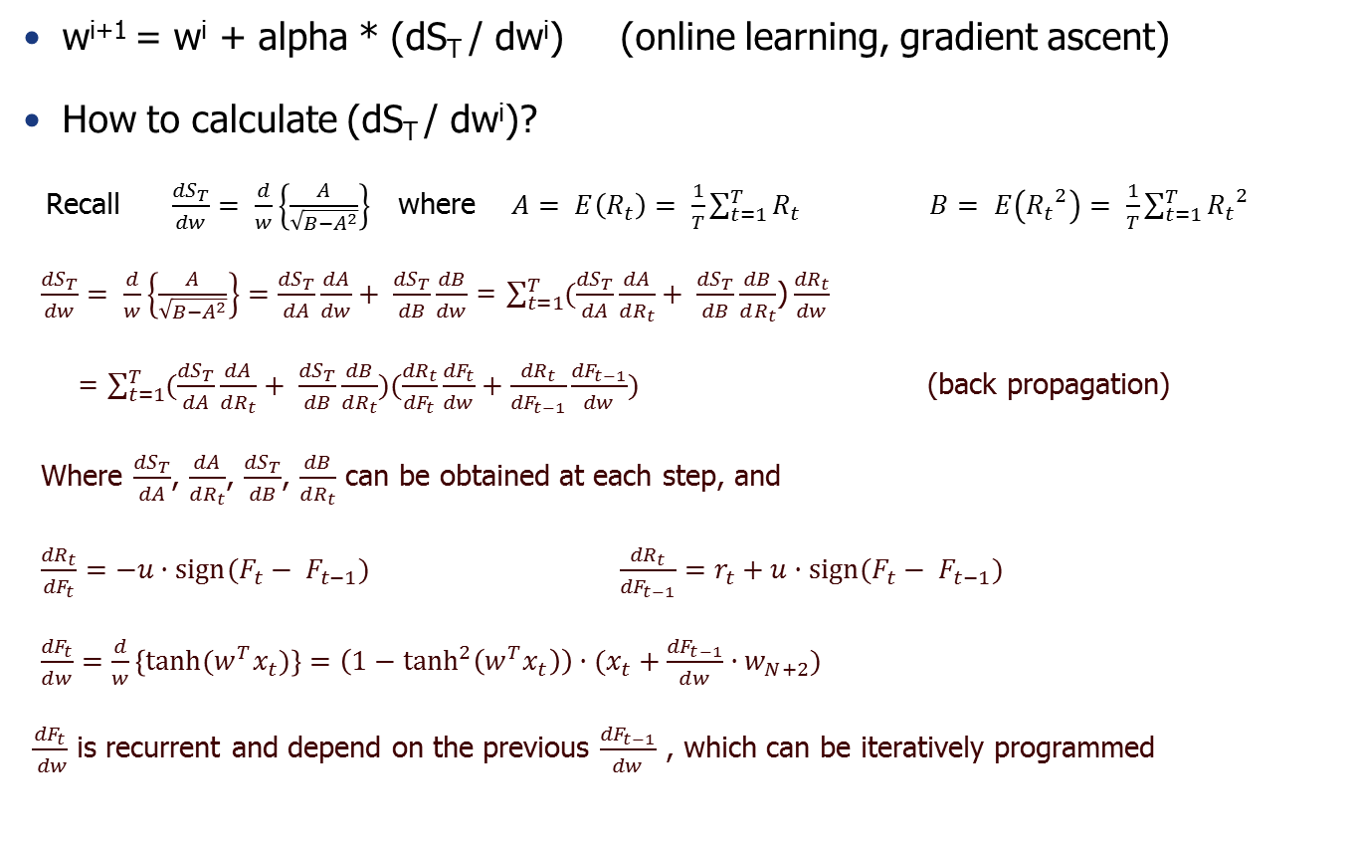
RRL: Mathematical Principle
w^{i+1} = w^{i} + alpha * (dS_{T} / dw^{i}) (online learning, gradient ascent)
How to calculate (dS_{T} / dw^{i})?
Recall $\frac{{dS}_{T}}{dw}= \frac{d}{w}\left\{\frac{A}{\sqrt{B−A^{2}}}\right\}$ where $A= E\left(R_{t}\right)= \frac{1}{T}\sum_{t=1}^{T}{R_{t}} B= E\left({R_{t}}^{2}\right)= \frac{1}{T}\sum_{t=1}^{T}{{R_{t}}^{2}}$
$\frac{{dS}_{T}}{dw}= \frac{d}{w}\left\{\frac{A}{\sqrt{B−A^{2}}}\right\}=\frac{{dS}_{T}}{dA}\frac{dA}{dw}+ \frac{{dS}_{T}}{dB}\frac{dB}{dw}$ = $\sum_{t=1}^{T}{(\frac{{dS}_{T}}{dA}\frac{dA}{dR_{t}}+ \frac{{dS}_{T}}{dB}\frac{dB}{dR_{t}}}$)$\frac{{dR}_{t}}{dw}$
= $\sum_{t=1}^{T}{(\frac{{dS}_{T}}{dA}\frac{dA}{dR_{t}}+ \frac{{dS}_{T}}{dB}\frac{dB}{dR_{t}}})(\frac{{dR}_{t}}{{dF}_{t}}\frac{{dF}_{t}}{dw}+\frac{{dR}_{t}}{{dF}_{t−1}}\frac{{dF}_{t−1}}{dw})$ (back propagation)
Where $\frac{{dS}_{T}}{dA}$, $\frac{dA}{dR_{t}}$, $\frac{{dS}_{T}}{dB}$, $\frac{dB}{dR_{t}}$ can be obtained at each step, and
$\frac{{dR}_{t}}{{dF}_{t}}=−u·sign(F_{t}− F_{t−1})$ $\frac{{dR}_{t}}{{dF}_{t−1}}=r_{t}+u·sign(F_{t}− F_{t−1})$
$\frac{{dF}_{t}}{dw}=\frac{d}{w}\left\{tanh(w^{T}x_{t})\right\}=\left(1−\tanh^{2}\left(w^{T}x_{t}\right)\right)·(x_{t}+\frac{{dF}_{t−1}}{dw}·w_{N+2})$
$\frac{{dF}_{t}}{ dw}$ is recurrent and depend on the previous $\frac{{dF}_{t−1}}{dw}$ , which can be iteratively programmed
r

Slide 10
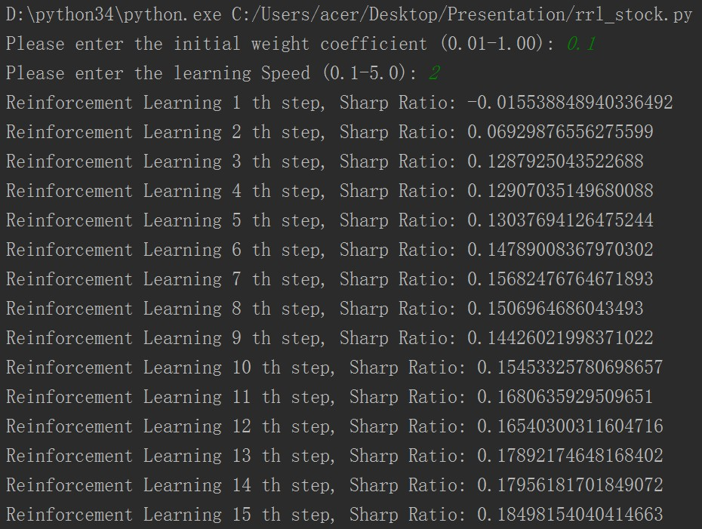
RRL: Implementation
Implementation:
Split historical data into training and test set
Using training data to determine the optimal weight
Apply the weight on test set and observe the performance
Assume trade only one share per transaction
As the learning steps increases, the “Sharp Ratio” increases
r

Slide 11
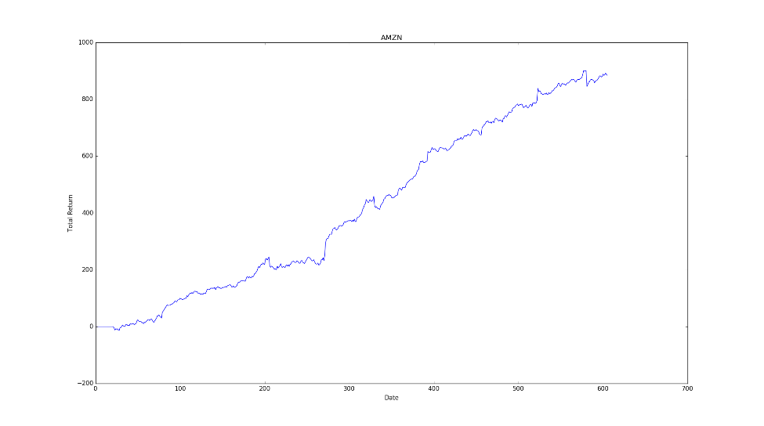
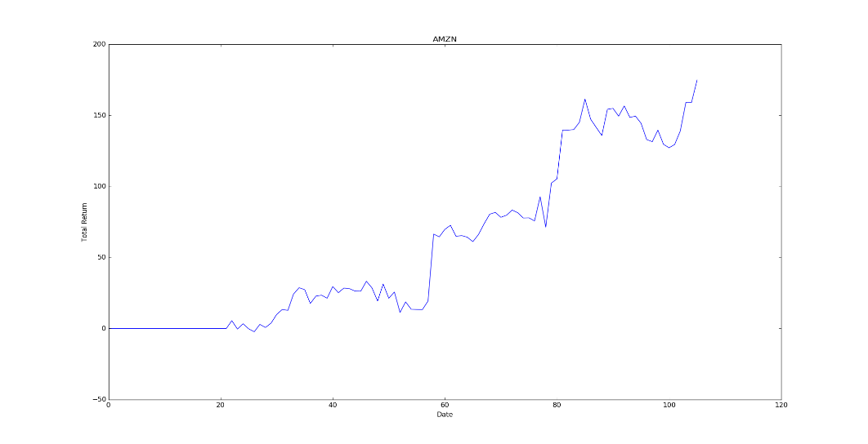
RRL: Implementation on Stocks
AMZN, Day-Granularity, no loss limit control, using 21 days price:
Training Data: 2013/1/2 – 2015/5/29, 606 days
Test Data: 2015/6/1 – 2015/9/30, 86 days
Training natural net return 171.08, test natural net return (nnt) 80.97
Initial weight 0.02, learning speed 0.3, commission 0.05, steps 1000
Training: net return around 850, 500% nnt
Test: net return around 220, 270% nnt
If only hold long position net return 140, 170% nnt
r

Slide 12
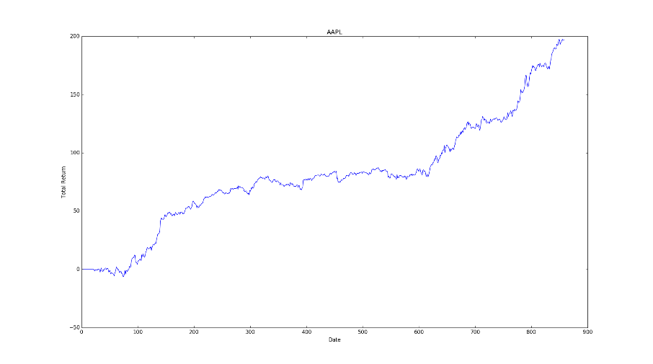
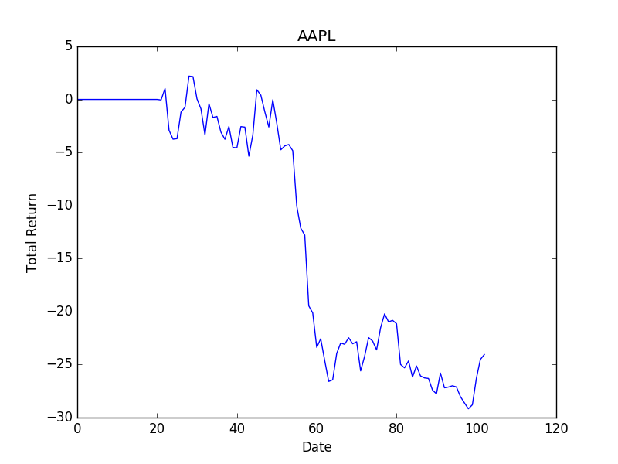
RRL: Implementation on Stocks
AAPL, Day-Granularity, no loss limit control, using 21 days price:
Training Data: 2012/7/2 – 2015/11/30, 859 days
Test Data: 2015/12/1 – 2016/3/31, 83 days
Training natural net return 33.65, test natural net return -12.24
Initial weight 0.1, learning speed 1.0, commission 0.05, steps 1000
Training: net return around 197.0, 600% nnt
Test: net return around -25.0, 200% nnt (loss)
Biggest drawback happened at the second half of Jan, 2016, when the stock price was bumpy
r

Slide 13
RRL: Implementation on Futures
China PE(L) Futures, Minute-Granularity
Point value 5, Commission fee 3 per share
Assume no slippage (but can be included by raising commission fee)
Simplified data, only use close price
Training Data: 2013/1/4 – 2014/8/29, 90224 tuples
Test Data: 2014/9/1 – 2014/11/28, 13275 tuples
More control: decrease risk exposure by lowering trading times and forbid overnight positions, cut loss by setting absolute loss limit
Trading Period: 9:30 A.M. – 2:30 P.M. Overnight not allowed
Loss limit control: e.g. cut when sum loss greater than 200 in 3 bars
Lower trading frequency: Hold same position for at least 5 bars
r

Slide 14
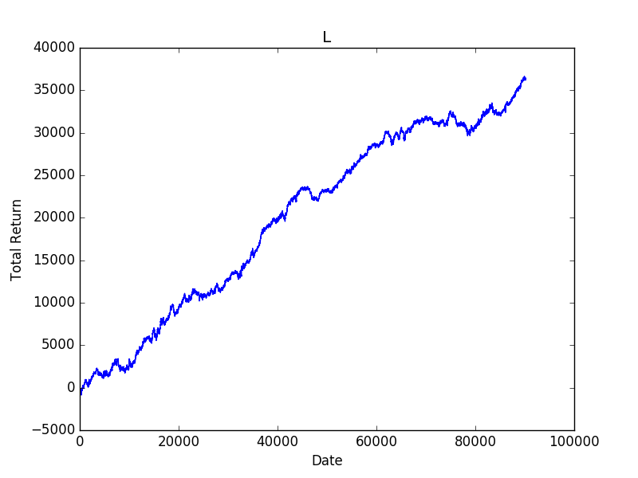
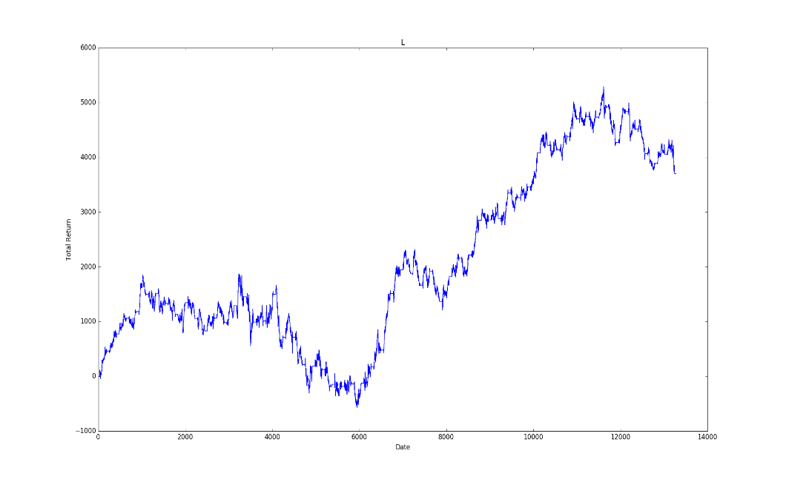
RRL: Implementation on Futures
Performance
Initial weight 0.03, learning speed 0.5, steps 200, #bars 21, loss limit 200
Training: Net profit 36409.0, 820% the original margin; Trading times 9114, around 24 transactions per day (still too high)
Test: Net profit 3702.0, 86% the original margin; Trading times 1357, around 20 transactions per day
r

Slide 15
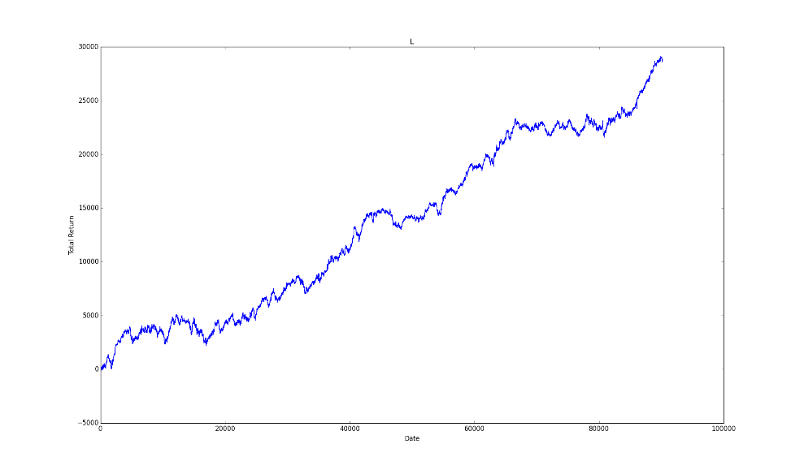
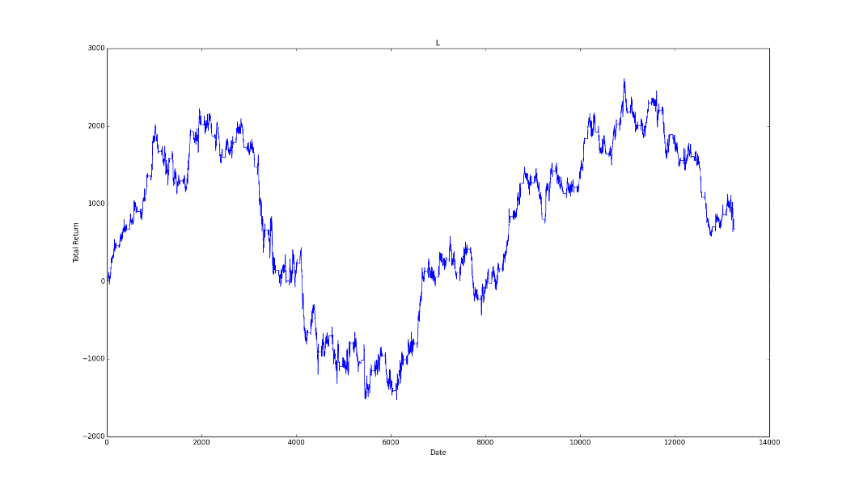
RRL: Implementation on Futures
Performance
Initial weight 0.02, learning speed 0.8, steps 300, #bars 30, loss limit 175
Training: Net profit 28783.0, 650% the original margin; Trading times 9427, around 25 transactions per day (still too high)
Test: Net profit 673.0, 15% the original margin; Trading times 1392, around 20 transactions per day, significant drawback
r

Slide 16
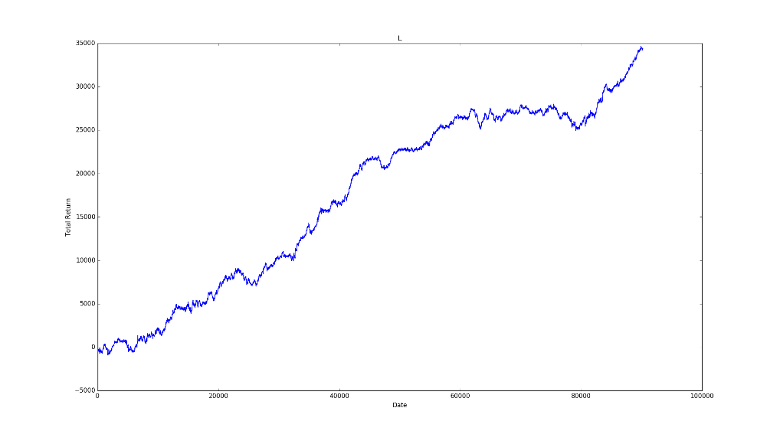
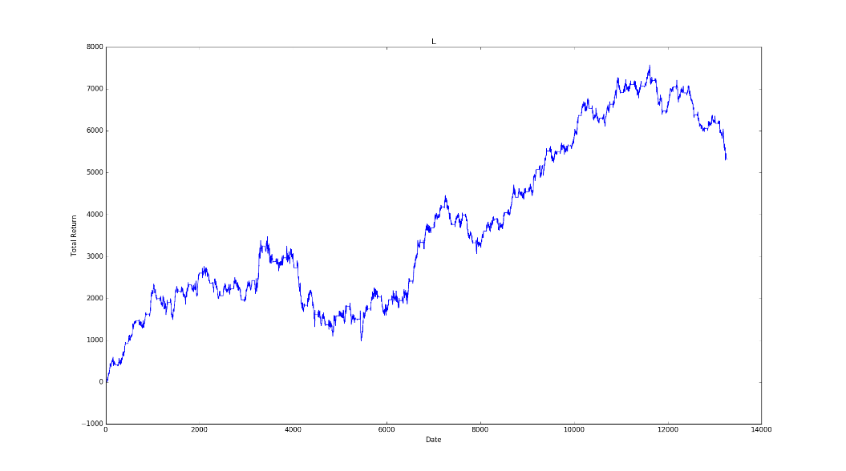
RRL: Implementation on Futures
Performance
Initial weight 0.1, learning speed 1.0, steps 300, #bars 14, loss limit 150
Training: Net profit 34424.0, 650% the original margin; Trading times 9096, around 24 transactions per day (still too high)
Test: Net profit 5331.0, 124% the original margin; Trading times 1349, around 20 transactions per day
r

Slide 17
Conclusion
Conclusion
Training by RRL, the utility function (S_{T}) can be considerably optimized
The raw algorithm shows promising result on test data, generally it will perform better than the natural return
The strategy developed by RRL is likely to be a trend following strategy, for it performs worse when it is bumpy, and much better when there is a good trend
The style of the strategy on higher frequency data is like “hit and run”, very swift and sensitive. Under minute-granularity, we have to filter the trading signals to lower the trading frequency, thus avoiding slippage.
The strategy with such trading style may perform better on even higher frequency data, e.g. High frequency trading on Forex under tick-level.
r

Slide 18
Future Work
Future Work
Improve loss control mechanism (e.g. trailing stop loss limit)
Use cross validation to split, train, and test.
Optimize the parameters other than weight. e.g. #bars
Revise the benchmark metrics, include in more factors. e.g. Trading times
Test the feasibility on tick-level forex trading
r

Slide 19

CS534 Artificial Intelligence
THANK YOU!
r

