Slide 1
Interviewing
Insights in the interviewing process for a Software Tech job
Notes:
Home many kind of files? Text, music, video. Word documents, Power point documents. Zip files.
What can you do with a file: reading, playing, uncompressing, deleting, copying, moving.
What errors can you encounter: can't find file (when opening). Can't delete file (protected?). Can't read file (wrong format – can't play a song from a txt document).

Slide 2
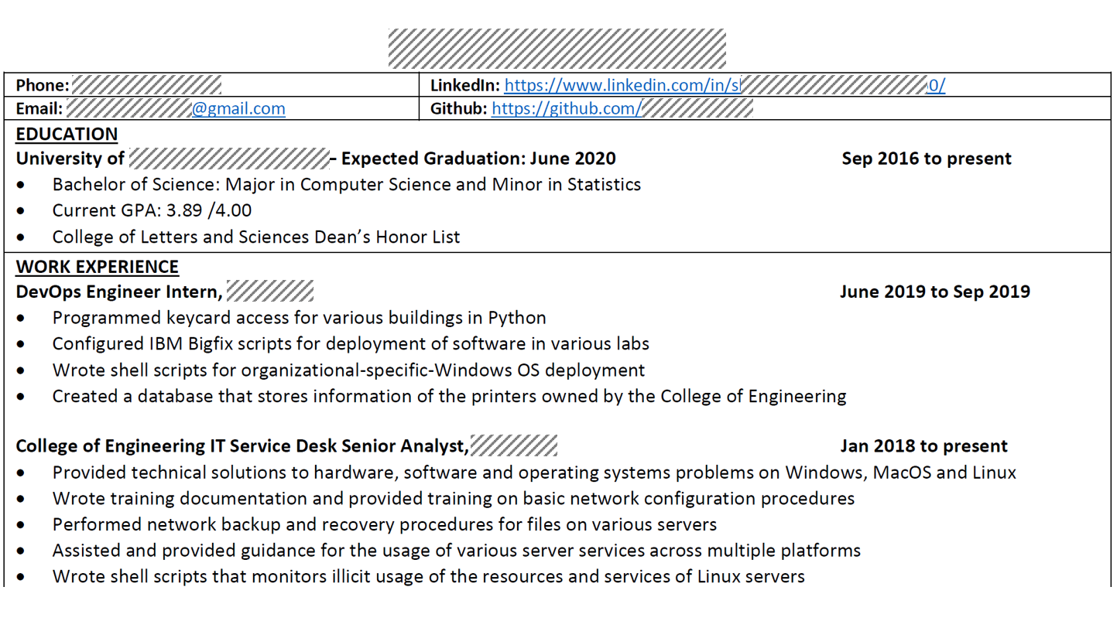

Slide 3
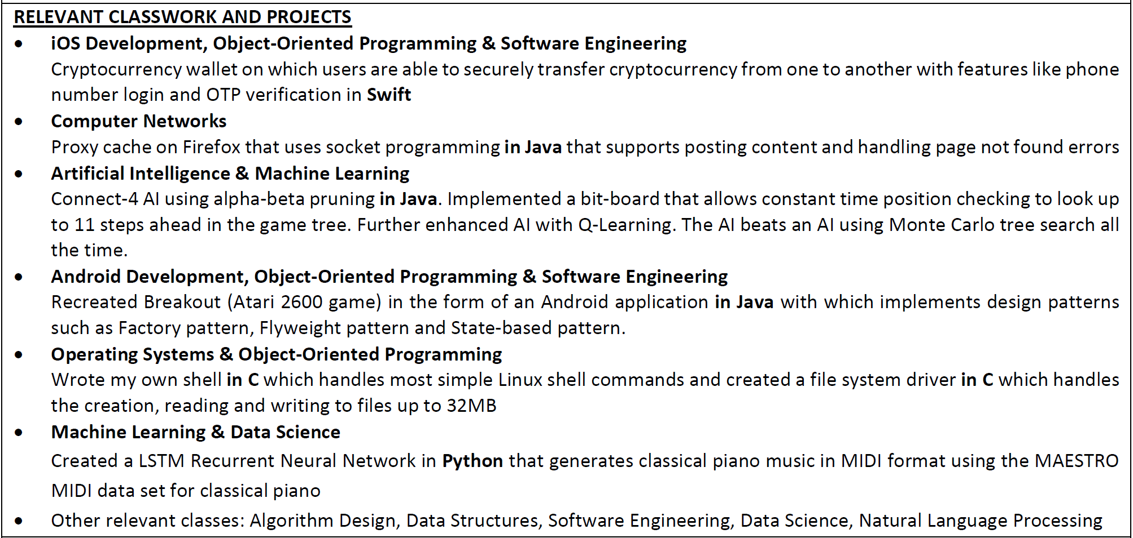

Slide 4
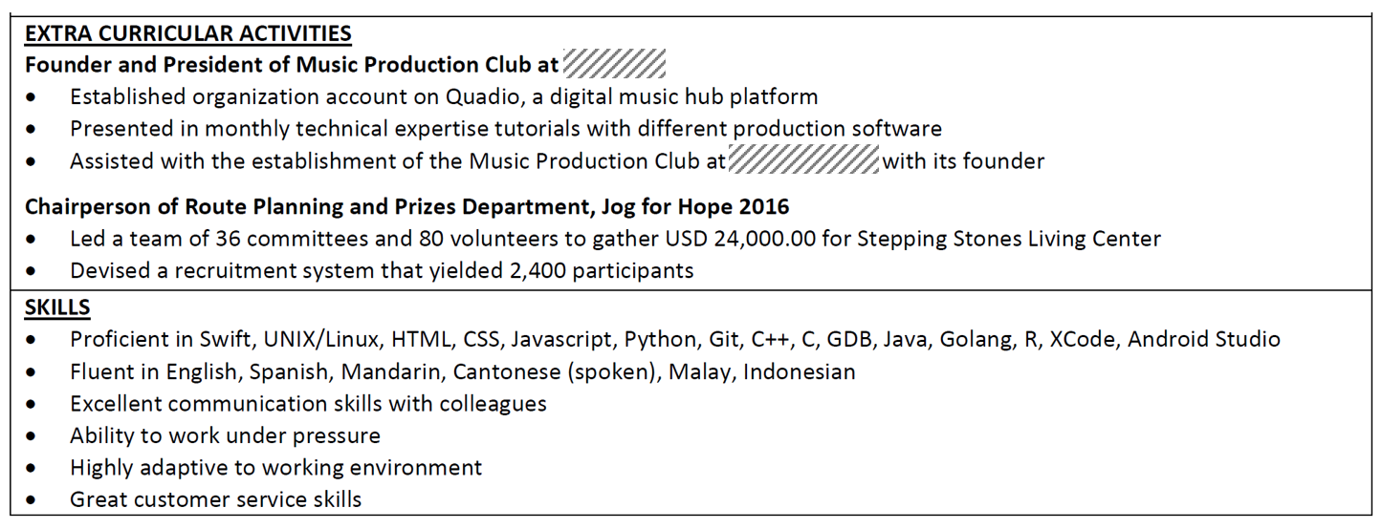

Slide 5
Write a method taking 3 string parameters as input (word, prefix, suffix) and returning a split version of word, based on how prefix and suffix are matching its beginning, respectively ending.
word: "ornament"
prefix: "or"
suffix: "ment"
Returns: "or na ment"
word: "orbiter"
prefix: "orbit"
suffix: "iter"
Returns: chose one from these options
1) prefix priority: "orbit er"
2) suffix priority: "orb iter"
3) original word: "orbiter"
4) around the overlap: "orb it er"

Slide 6
Write a program which is iterating over a very long stream of one-word strings and is extracting the prefix / suffix common across all of them (if any). How would you design that program? How would you implement the logic?
Stream: {"doser", "donner", "doer", "doctor"}
Should produce: {prefix: "do", suffix "r“}

Slide 7
The world can be modeled as a 2D plane, with Cartesian coordinates: X range (-180, 180), Y range (90, -90). We create a "quad tiling" system over this representation, by dividing it into 4 quads, and assign a TileID to each quadrant in the form of digit "0" (top left), "1" (top right), "2" (bottom left), "3" (bottom right).
For a greater level of detail, we divide each quadrant in four, each of the new, smaller tiles are assigned a TileID made from the concatenation of the "parent" TileID and one additional "0", "1", "2" and "3" digit like in the example below:
90
+----+----+--------+
|00 |01 |1 |
| | | |
+----+----+ |
|02 |03 | |
| | | |
-180 +----+----+--------+ 180
|2 |3 |
| | |
| | |
| | |
| | |
+----+----+--------+
-90
Can you write a method
bool LatLongInTile( double latitude, double longitude, String tileID)
{
// returns true if the lat/long
// point is within the area covered by
// the given tile
// returns false otherwise
}

Slide 8
The world can be modeled as a 2D plane, with Cartesian coordinates: X range (-180, 180), Y range (90, -90). We create a "quad tiling" system over this representation, by dividing it into 4 quads, and assign a TileID to each quadrant in the form of a digit "0" (top left), "1" (top right), "2" (bottom left), "3" (bottom right).
For a greater level of detail, we divide each quadrant in four, each of the new, smaller tiles are assigned a TileID made from the concatenation of the "parent" TileID and one additional "0", "1", "2" and "3" digit like in the example below:
90
+----+----+--------+
|00 |01 |1 |
| | | |
+----+----+ |
|02 |03 | |
| | | |
-180 +----+----+--------+ 180
|2 |3 |
| | |
| | |
| | |
| | |
+----+----+--------+
-90
Can you write a method
String LatLongToTile(
double latitude,
double longitude,
int level)
{
// returns the TileID for
// the tile containing
// the given lat/long point,
// at the given level of detail
}

Slide 9
The world can be modeled as a 2D plane, with Cartesian coordinates: X range (-180, 180), Y range (90, -90). We create a "quad tiling" system over this representation, by dividing it into 4 quads, and assign a TileID to each quadrant in the form of a digit "0" (top left), "1" (top right), "2" (bottom left), "3" (bottom right).
For a greater level of detail, we divide each quadrant in four, each of the new, smaller tiles are assigned a TileID made from the concatenation of the "parent" TileID and one additional "0", "1", "2" and "3" digit like in the example below:
90
+----+----+--------+
|00 |01 |1 |
| | | |
+----+----+ |
|02 |03 | |
| | | |
-180 +----+----+--------+ 180
|2 |3 |
| | |
| | |
| | |
| | |
+----+----+--------+
-90
Can you write a method which, given a TileID string calculates the ground-points given as latitude/longitude of the bounding box for that tile? What would the signature of that method be?

Slide 10
A simplified regular expression definition is based on the following characters:
Write a method which is returning true/false based on how a given text string parameter is matching a given regex string parameter.
For instance:
simpleMatch("abcdef", "ab.def") --> true
simpleMatch("abcdef", "abc?def") --> true
simpleMatch("abcdef", "*cdef?") --> true
simpleMatch("abcdef", "*cdef.") --> false
simpleMatch("abcdef", "abc.def*") --> false
simpleMatch("abcdef", "?abcde.f") --> false
. | matches exactly one single character
? | matches zero or one character
* | matches zero or more characters

Slide 11
Implement a website testing program having the following inputs: a URLTemplate and a dictionary/map of taggedParams.
Example:
URLTemplate: "http://www.contoso.com?p1={0}&p2={1}"
taggedParams:
"{0}" --> {"abc", "def"}
"{1}" --> {"xy", "uv", "yz"}
The program should produce a list of all possible variants of the URL by replacing the specific tags from the template with any unique combination of parameter values. For the example above, the program should generate:
"http://www.contoso.com?p1=abc&p2=xy"
"http://www.contoso.com?p1=abc&p2=uv"
"http://www.contoso.com?p1=abc&p2=yz"
"http://www.contoso.com?p1=def&p2=xy"
"http://www.contoso.com?p1=def&p2=uv"
"http://www.contoso.com?p1=def&p2=yz"
Simplification: produce all combinations of elements in a set of sets. To each combination, each set contributes with one element only.

Slide 12

Question1 (opener): Implement a method comparing two strings and returning true if the strings are
equal and false otherwise. Do not use any string comparing methods available in JDK/SDK (like equals/strcmp, etc) boolean areEqual(String s1, String s2);
Question 2: Extend the method from above to return true or false if the strings have an edit-distance of 1:
Two strings have an edit-distance of 1 if removing, adding or changing at most one character from any string
would cause the resulting (edited) strings to be identical.
boolean areEqualAt1(String s1, String s2);
Examples:
areEqualAt1("ping", "pong") -> true
areEqualAt1("do", "dog") -> true
areEqualAt1("aants", "ants") -> true
areEqualAt1("tinker", "tender") -> false
areEqualAt1("pan", "pants") -> false
areEqualAt1(“crushed", "crash") -> false

Slide 13
Write a method that takes two string parameters and determines the longest sequence of characters common between them. That sequence may be positioned in the strings at different indices.
Example:
("OneLongString", "ThisStringIsShorter") --> "String"
("NothingFits", "Xyz") --> ""
Extra challenge: determine the two indices where the longest sequence occurs in their respective strings.

Slide 14
Given a list of non-overlapping intervals, write a method to insert another interval into this list. Merge intervals as needed such that in the end the list remains of non-overlapping intervals.
Examples:
insert [5, 6] in [1, 3][8, 9] --> [1, 3][5, 6][8, 9]
insert [3, 6] in [1, 5][8, 9] --> [1, 6][8, 9]
insert [3, 8] in [1, 5][7, 9] --> [1, 9]
Extra challenge: Extend your code with a remove method removing a given interval from the list. Split existent intervals as needed such that in the end the list remains of non-overlapping intervals.

Slide 15
Given a jagged array of numbers write a method returning the count of columns in strictly increasing order.
A column with one element only is strictly increasing.
A jagged array is a two-dimensional array where rows may have different count of elements.
Example 1:
[0] 3 1 5 2 2
[1] 4 3 5
[2] 6 0 5 7 2 3
[3] 7 3 8 9
----^-----^---^
Count = 3
Example 2:
[0] 3 5 8
[1]
[2] 4 0 8
[3] 2 9
---------
Count = 0

