Slide 1

SEOUL
BIKE
RENTING
by Victor WEILL

Slide 2
THE DATASET
Link : https://archive.ics.uci.edu/ml/datasets/Seoul+Bike+Sharing+Demand
Here are the informations given by the hosting website
Description : « Currently Rental bikes are introduced in many urban cities for the enhancement of mobility comfort. It is important to make the rental bike available and accessible to the public at the right time as it lessens the waiting time. Eventually, providing the city with a stable supply of rental bikes becomes a major concern. The crucial part is the prediction of bike count required at each hour for the stable supply of rental bikes. The dataset contains weather information (Temperature, Humidity, Windspeed, Visibility, Dewpoint, Solar radiation, Snowfall, Rainfall), the number of bikes rented per hour and date information. »

Slide 3
THE DATASET
Attributes :
Date : year-month-day Rented Bike count - Count of bikes rented at each hour Hour - Hour of he day Temperature-Temperature in Celsius Humidity - % Windspeed - m/s Visibility - 10m Dew point temperature - Celsius Solar radiation - MJ/m2 Rainfall - mm Snowfall - cm Seasons - Winter, Spring, Summer, Autumn Holiday - Holiday/No holiday Functional Day - NoFunc(Non Functional Hours), Fun(Functional hours)

Slide 4
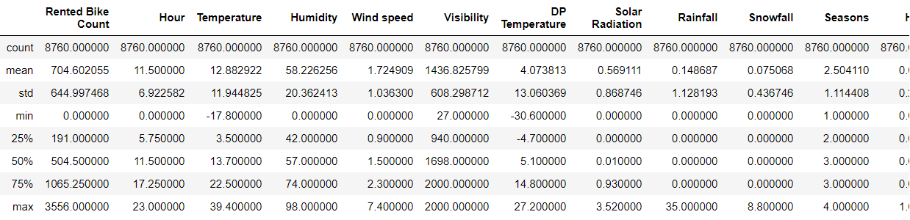
DATASET EXPLORATION
Attributes : here is the output of the df.describe() on Python
The data is clean, there is no missing value and we can think that there are not much outliers from this description.

Slide 5
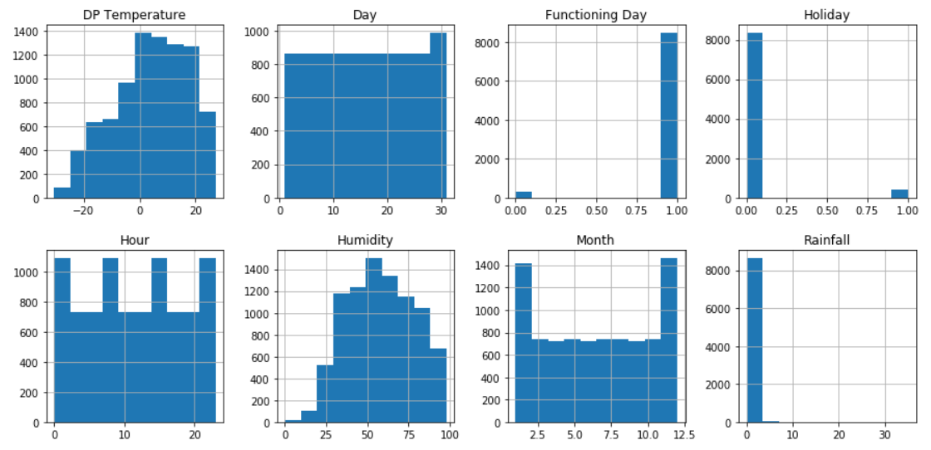
DATASET EXPLORATION
Here we can look at histograms of each attribute of this dataset :

Slide 6
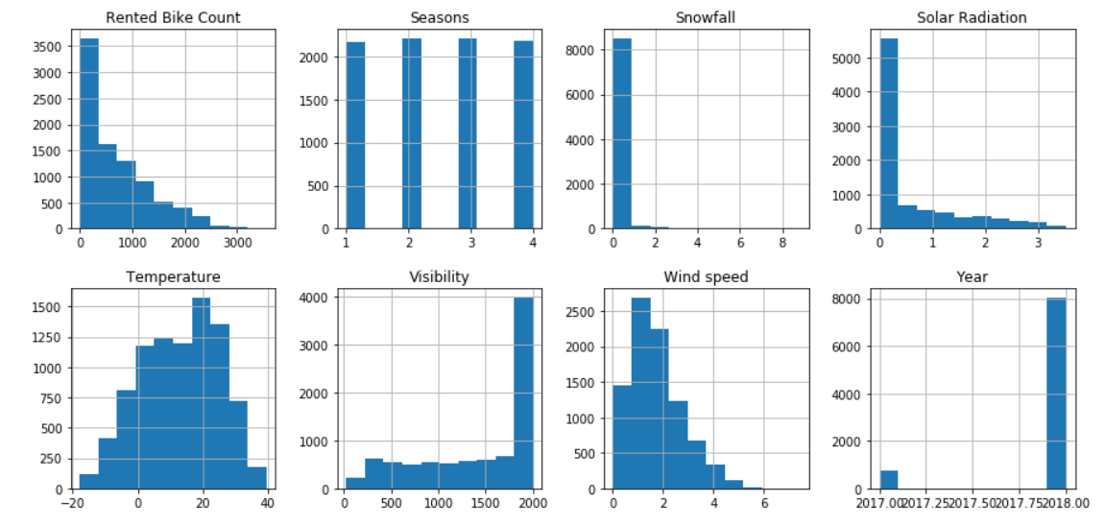
DATASET EXPLORATION
Here we can look at histograms of each attribute of this dataset :

Slide 7
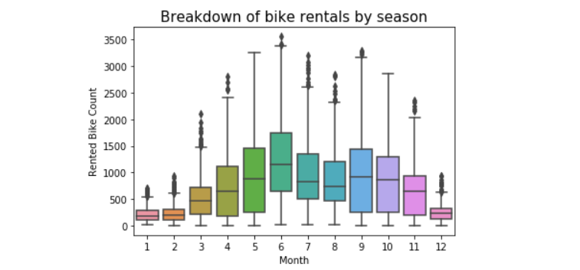
CLEAN THE DATASET
To get significant and accurate results, we must clean the data, even if it seemed good at the beginning. We have 8760 lines, it should not be a problem to remove some outliers. We can visualize the outliers with boxplots, they are shown by the points outside the limits of the boxplot :

Slide 8
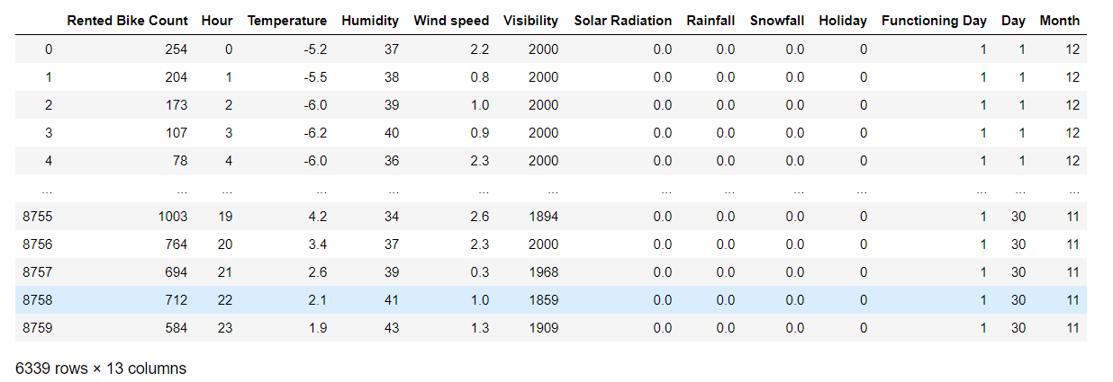
CLEAN THE DATASET
We used the IQR function to delete values that are above 0.75 or under 0,25 (interquartile). After deleting the outliers we still have 6339 rows of clean data.

Slide 9
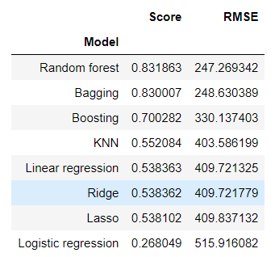
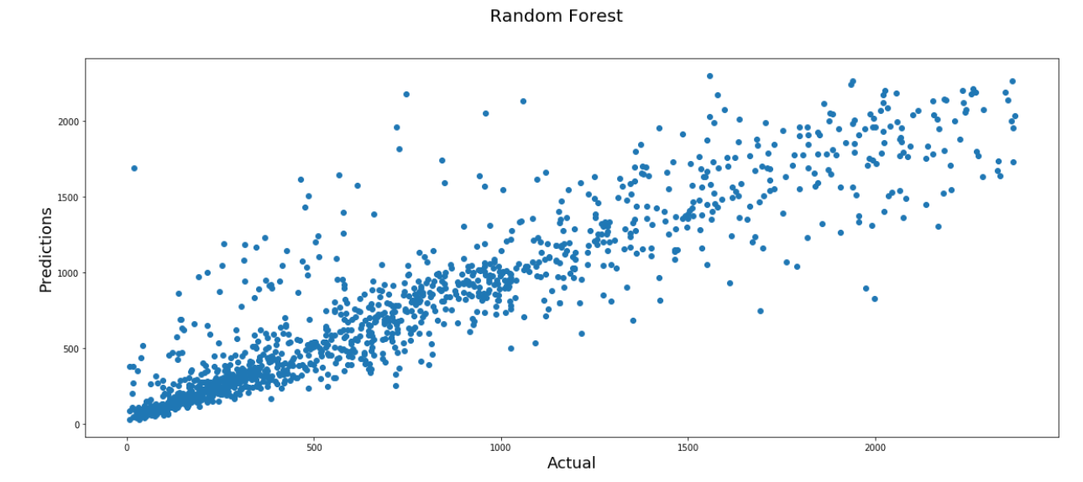
TESTING MODELS
To make a prediction, we need to use a model already made in Python. So I imported several models and tested it on a splitted dataset. I used 80% of the dataset for the training and 20% for the testing. Then, I computed each model and compared them all with the R² and the RMSE, here are the results :

Slide 10
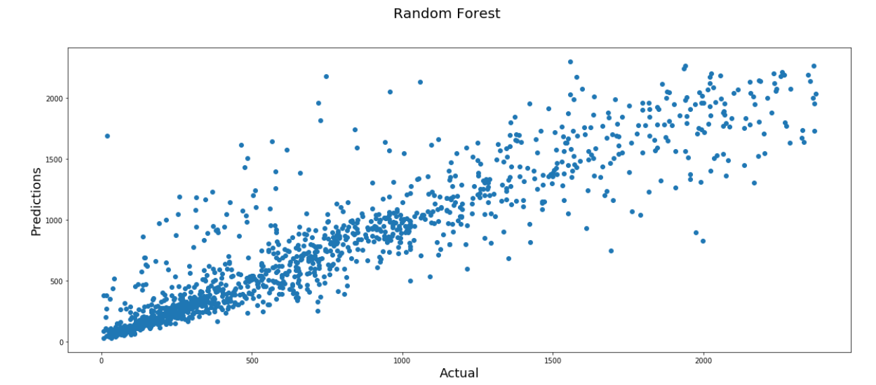

IMPROVING THE MODEL
I choosed the random forest model because on the average it’s the one that ends at the highest scores. To go even further we could try to implement a lot of parameters and pick the best ones to optimize the model. I did a grid search for that, and we end with these results :

Slide 11
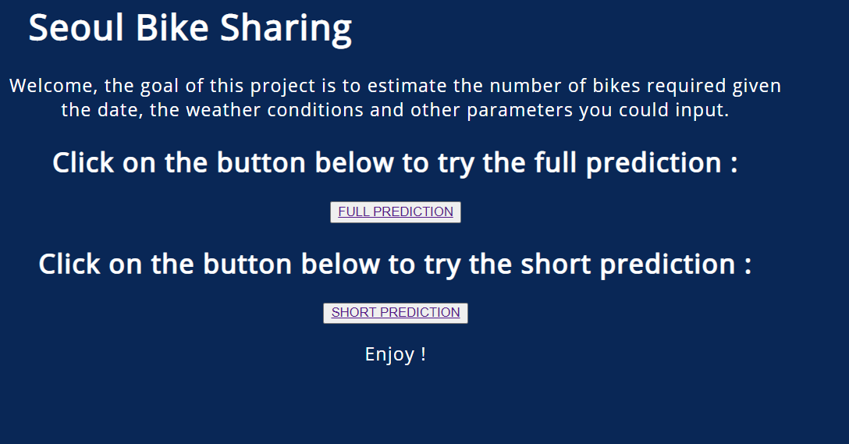
IMPLEMENT IT ON FLASK
To make a more user-friendly application, I used flask, a simple module to create an API with html pages. The user could input parameters on 2 pages : a complete input with all the variables of a shorter review that uses the mean of all ‘missing’ variables. Then, the user get the result of bikes needed to supply the city.
I don’t know why the css style doesn’t want to work, it worked perfectly before…

Slide 12
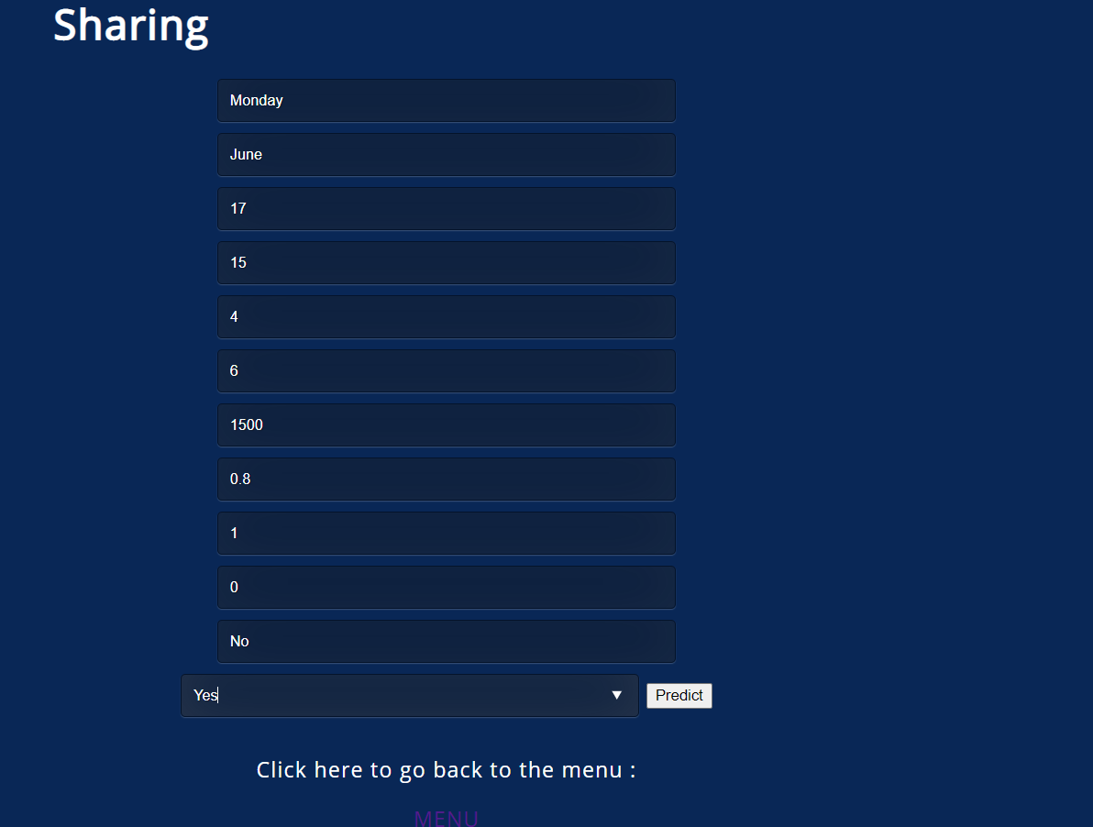
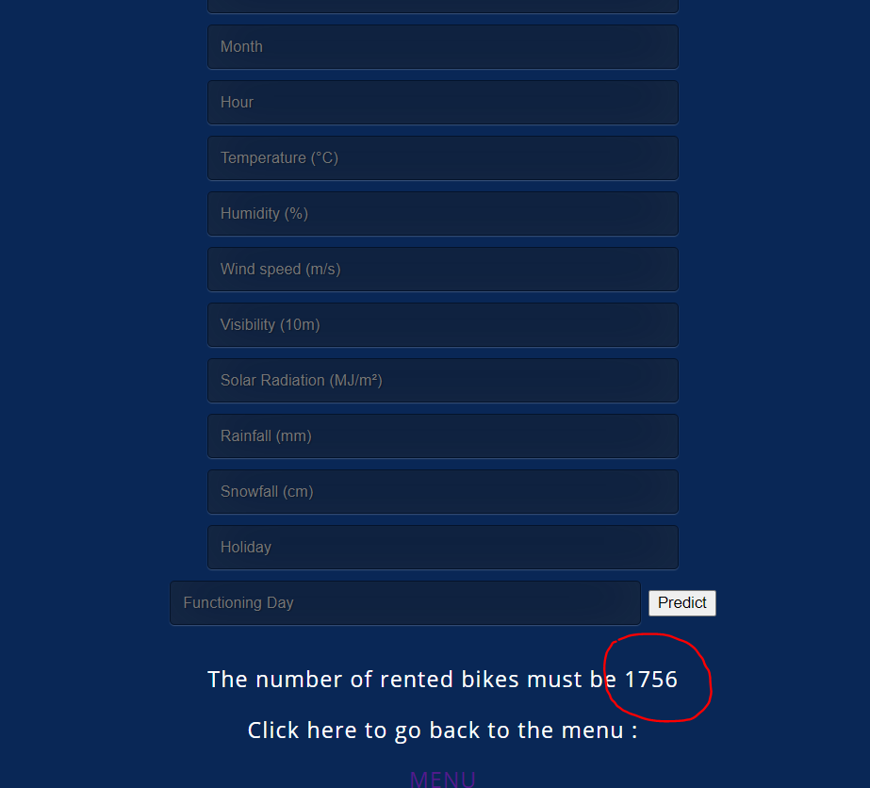
IMPLEMENT IT ON FLASK
Before and after the inputs

Slide 13
THANK YOU
by Victor WEILL

