Slide 1

BUILD APPLICATION CALL MOTORBIKE SERVICE
DANANG UNIVERSITY
DANANG UNIVERSITY OF TECHNOLOGY
INFORMATION TECHNOLOGY FACULTY
SENIOR PROJECT DEFENSE
PROJECT NAME:
Student : LE TRUNG VI
Class: 10T1
Instructor: PhD. NGUYEN TAN KHOI

Slide 2
Contents
Introduction
1
Goal of Project
Solution
3
Implementation
4
Conclusion

Slide 3
Introduction
OBJECTIVE
SCOPE OF PROJECT
EXPECTED RESULTS

Slide 4
Goal of Project
Create Itinerary
Tracking
Call Driver
Windows Phones App
Report
Managemnet

Slide 5
Process
Requirement
Design
Analysis
System
Database
Coding
Testing

Slide 6

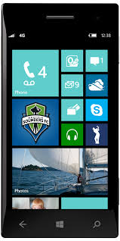

Solution
Request
Response
Database

Slide 7
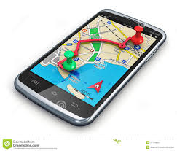

Solution
GPS
SignalR

Slide 8
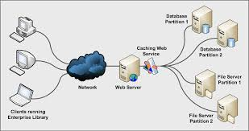
Solution
WebService

Slide 9
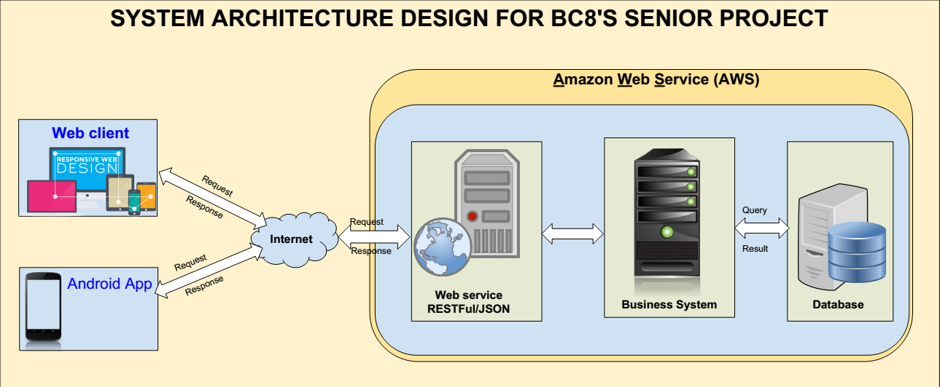
Implementation

Slide 10
Conclusion
Conclusion
ACHIEVED RESULT
Finish App on Windows Phone
Finish Website for Admin
FUTURE WORK
Develop App on Android
Increase Speed

Slide 11
Thank you !

