Slide 1
Deep Generative Models Probabilistic PCA
Fall Semester 2025
René Vidal
Director of the Center for Innovation in Data Engineering and Science (IDEAS), Rachleff University Professor, University of Pennsylvania Amazon Scholar & Chief Scientist at NORCE

Slide 2
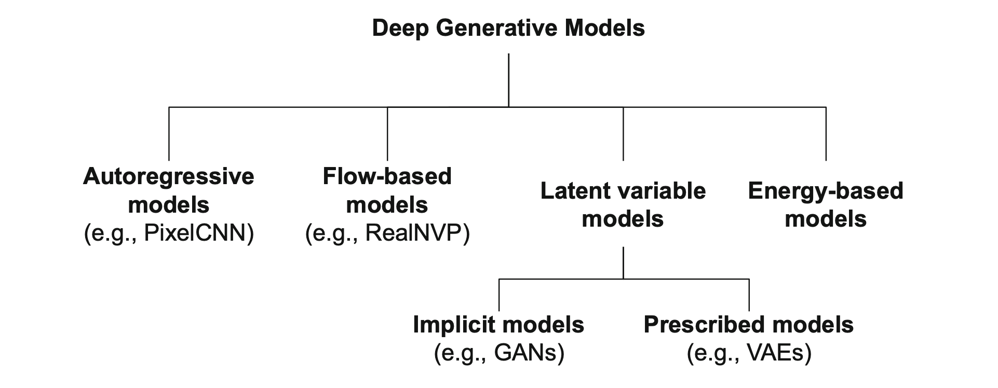
Taxonomy of Generative Models

Slide 3
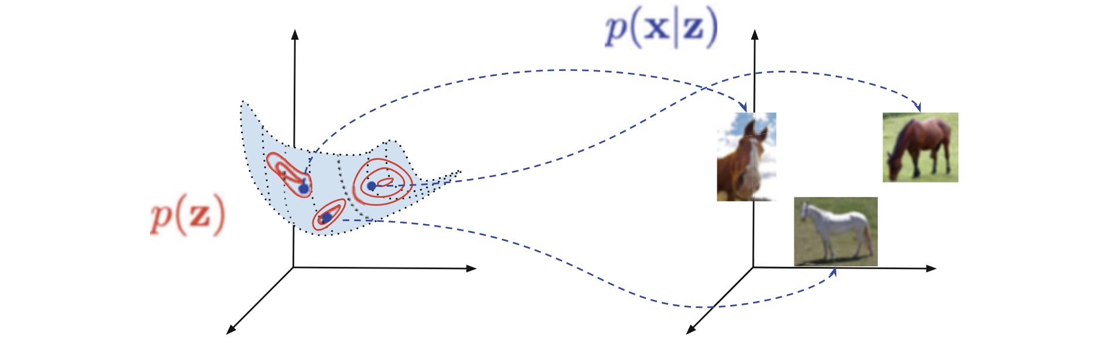
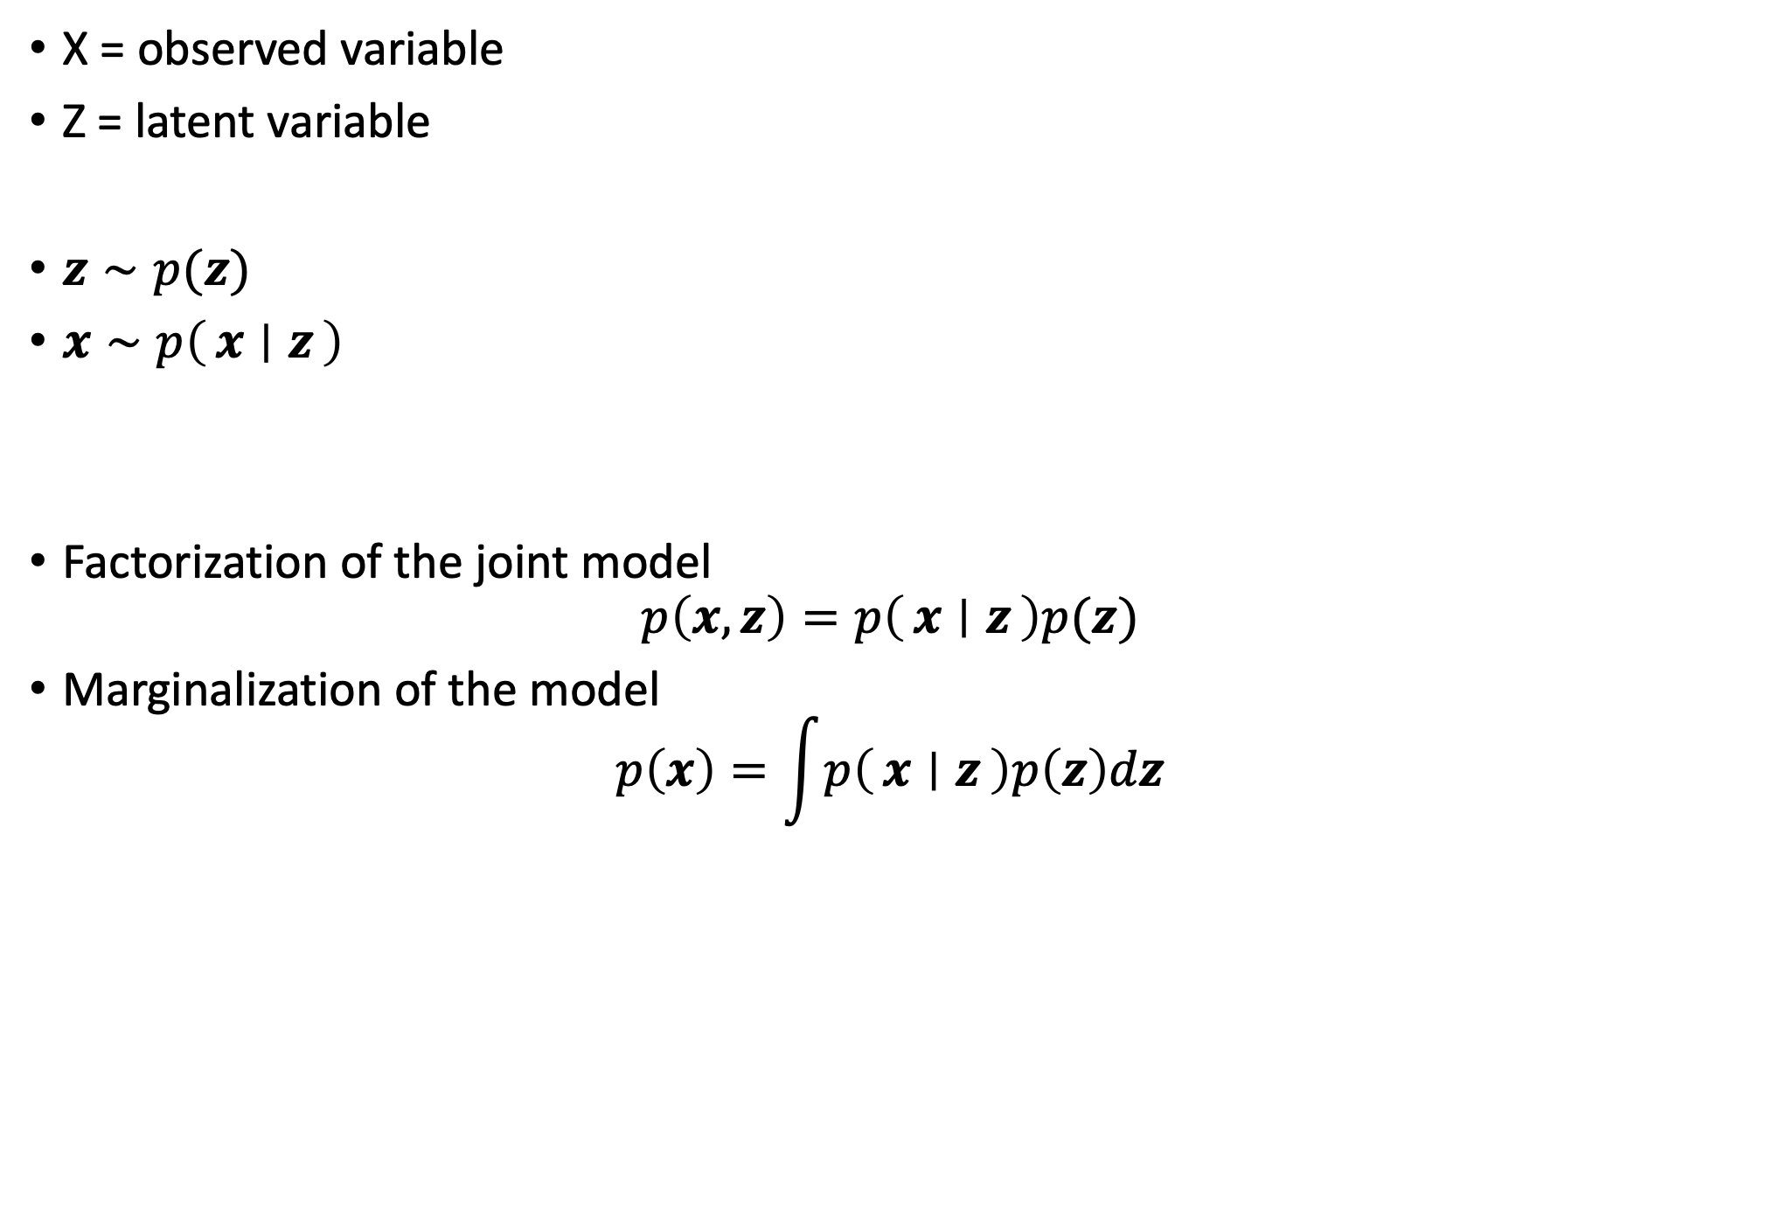
Latent Variable Models
X = observed variable
Z = latent variable
$z∼p(z)$
$x∼p\left(x ∣ z\right)$
Factorization of the joint model
$$p\left(x,z\right)=p\left(x ∣ z\right)p(z)$$
Marginalization of the model
$$p\left(x\right)=\int{p\left(x ∣ z\right)p\left(z\right)dz}$$
A latent variable model and a generative process. Note the low-dimensional manifold (here 2D) embedded in the high-dimensional space (here 3D)

Slide 4
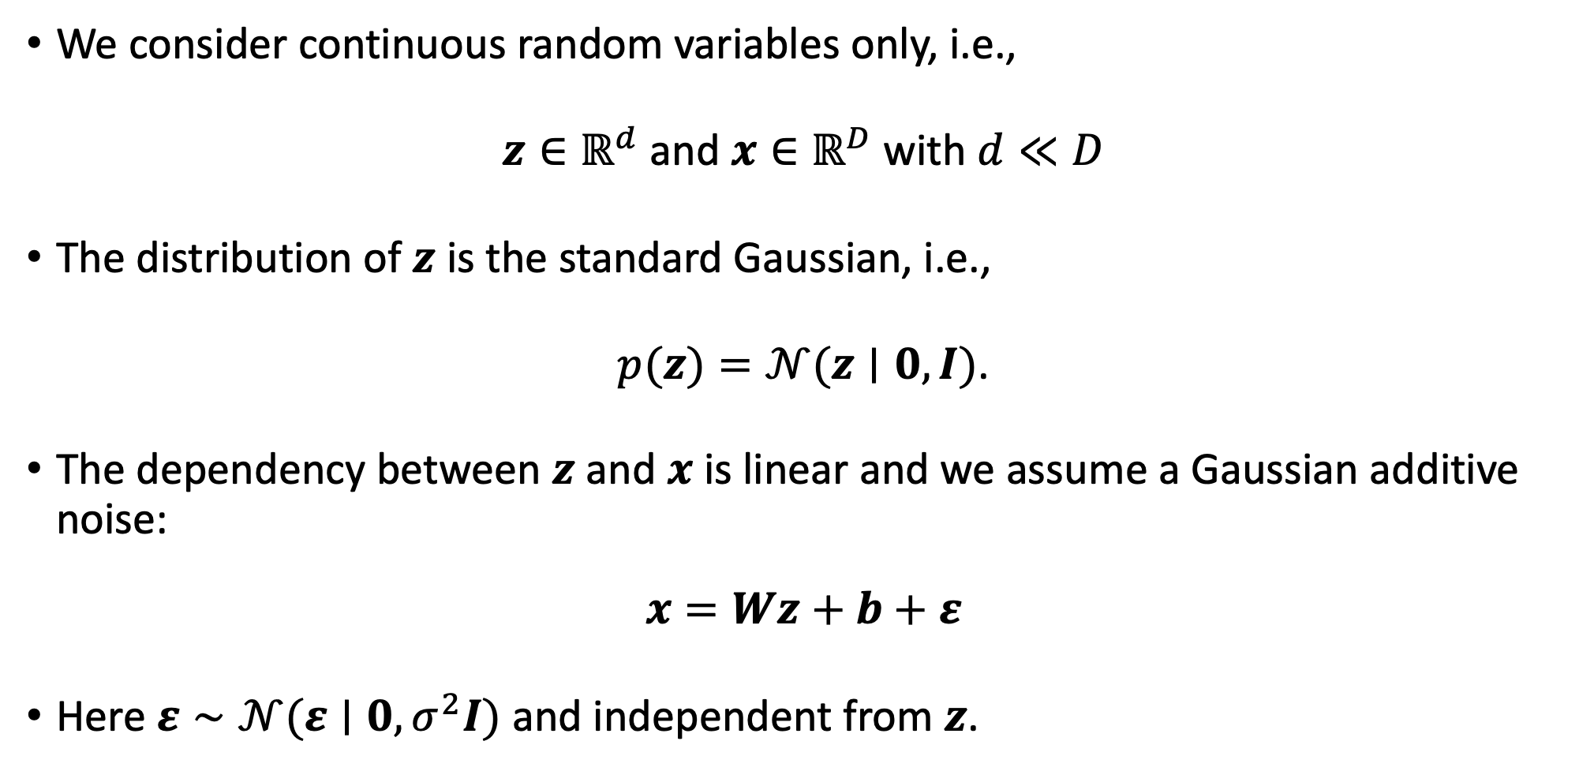
Probabilistic Principal Component Analysis: Model
We consider continuous random variables only, i.e.,
$z∈ℝ^{d}$ and $x∈ℝ^{D}$ with $d≪D$
The distribution of $z$ is the standard Gaussian, i.e.,
$p(z)=𝒩(z∣0, I)$.
The dependency between $z$ and $x$ is linear and we assume a Gaussian additive noise:
$$x=Wz+b+ε$$
Here $ε∼𝒩(ε∣0,σ^{2}I)$ and independent from $z$.

Slide 5
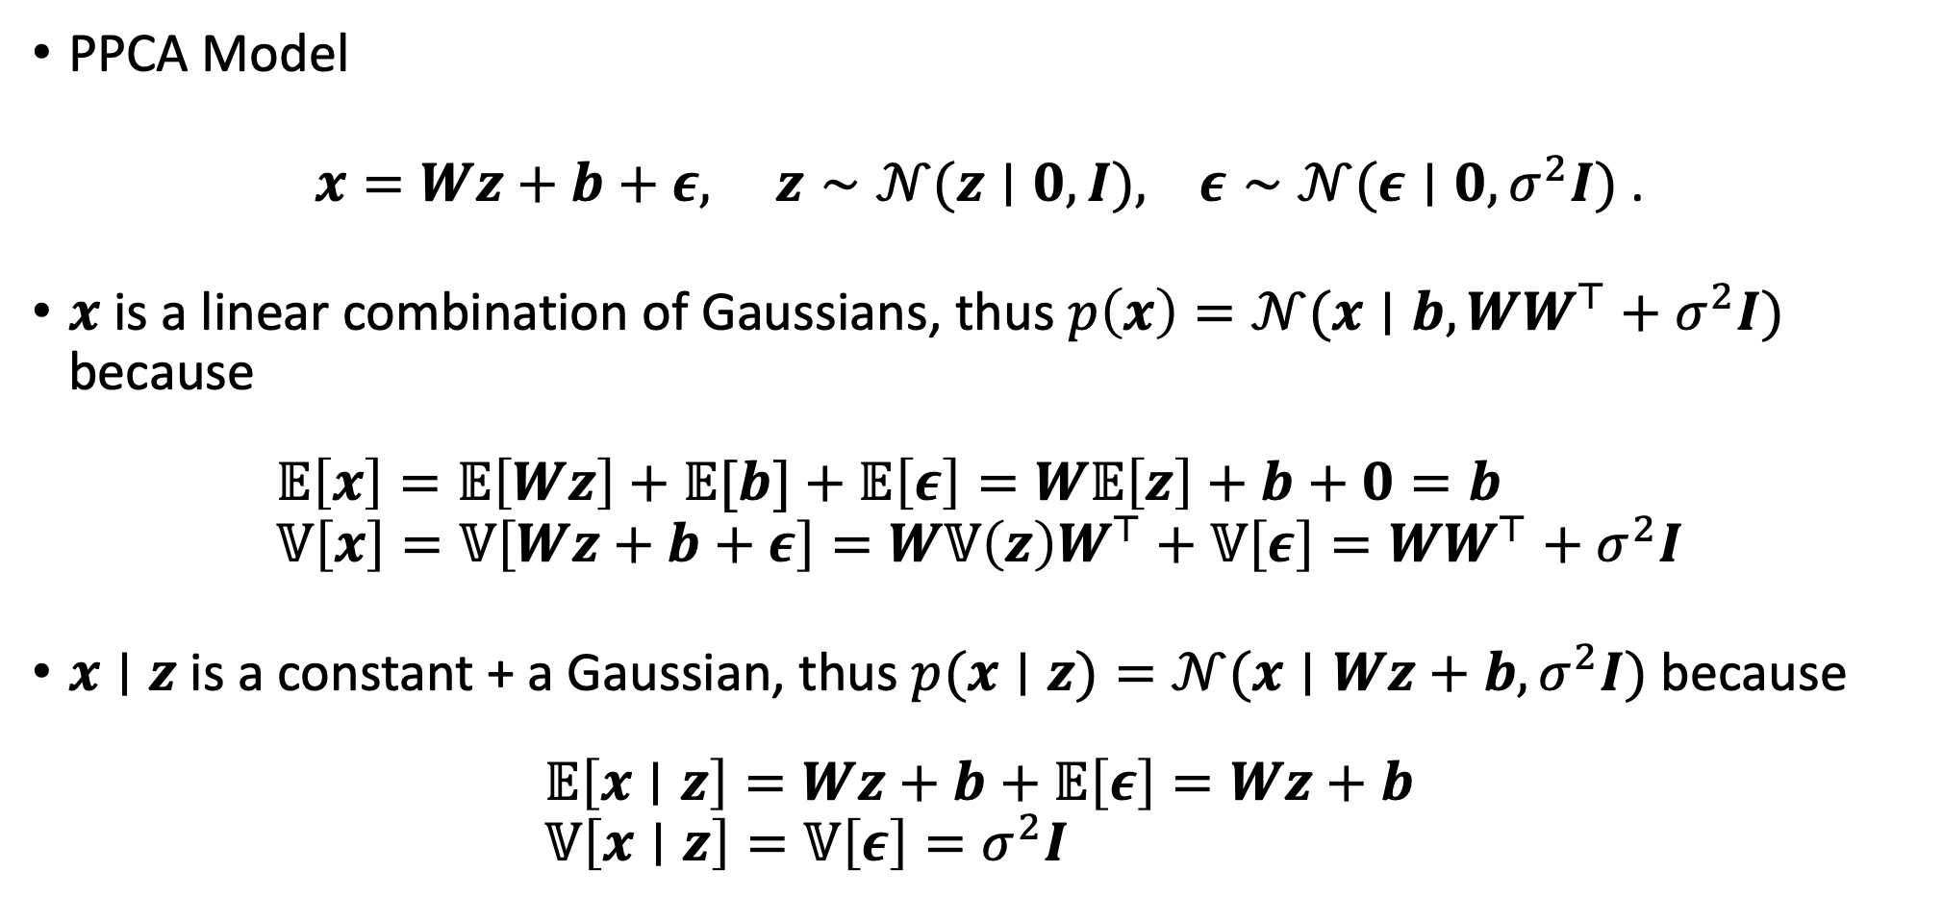
Probabilistic Principal Component Analysis: Model
PPCA Model
$x=Wz+b+ε, z∼𝒩(z∣0, I), ε∼𝒩(ε∣0,σ^{2}I)$.
$x$ is a linear combination of Gaussians, thus $p\left(x\right)=𝒩(x∣b,WW^{⊤}+σ^{2}I)$ because
$$𝔼\left[x\right]=𝔼\left[Wz\right]+𝔼[b]+𝔼\left[ε\right]=W𝔼\left[z\right]+b+0=b \\ 𝕍\left[x\right]=𝕍\left[Wz+b+ε\right]=W𝕍\left(z\right)W^{⊤}+𝕍\left[ε\right]=WW^{⊤}+σ^{2}I$$
$x∣z$ is a constant + a Gaussian, thus $p(x∣z)=𝒩(x∣Wz+b,σ^{2}I)$ because
$$𝔼\left[x∣z\right]=Wz+b+𝔼\left[ε\right]=Wz+b \\ 𝕍\left[x∣z\right]=𝕍\left[ε\right]=σ^{2}I$$

Slide 6
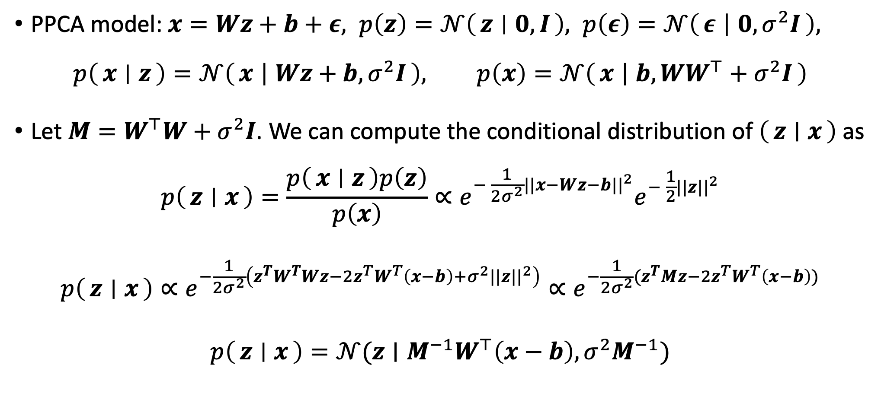
Probabilistic Principal Component Analysis: Model
PPCA model: $x=Wz+b+ε, p\left(z\right)=𝒩\left(z ∣ 0, I\right), p\left(ε\right)=𝒩\left(ε ∣ 0,σ^{2}I\right),$
$$p\left(x ∣ z\right)=𝒩\left(x ∣ Wz+b,σ^{2}I\right), p\left(x\right)=𝒩\left(x ∣ b,WW^{⊤}+σ^{2}I\right)$$
Let $M=W^{⊤}W+σ^{2}I$. We can compute the conditional distribution of $\left(z ∣ x\right)$ as
$$p\left(z ∣ x\right)=\frac{p\left(x ∣ z\right)p\left(z\right)}{p\left(x\right)}∝e^{− \frac{1}{2σ^{2}}||x−Wz−b||^{2}}e^{− \frac{1}{2}||z||^{2}}$$
$$p\left(z ∣ x\right)∝e^{−\frac{1}{2σ^{2}}\left(z^{T}W^{T}Wz−{2z}^{T}W^{T}\left(x−b\right)+σ^{2}||z||^{2}\right)}{∝e}^{−\frac{1}{2σ^{2}}(z^{T}Mz−{2z}^{T}W^{T}\left(x−b\right))}$$
$$p\left(z ∣ x\right)=𝒩{(z∣M}^{−1}W^{⊤}\left(x−b\right),σ^{2}M^{−1})$$

Slide 7
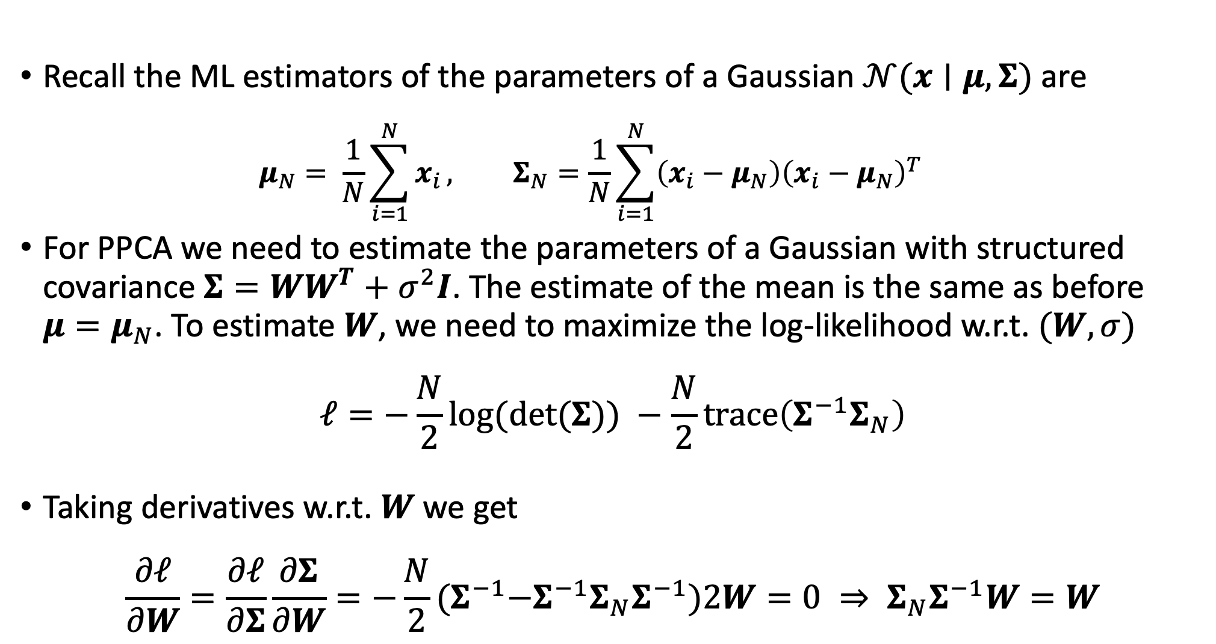
Probabilistic Principal Component Analysis: Learning
Recall the ML estimators of the parameters of a Gaussian $𝒩(x∣μ, Σ)$ are
$$μ_{N}= \frac{1}{N}\sum_{i=1}^{N}{x_{i}}, Σ_{N}=\frac{1}{N}\sum_{i=1}^{N}{\left(x_{i}−μ_{N}\right){\left(x_{i}−μ_{N}\right)}^{T}}$$
For PPCA we need to estimate the parameters of a Gaussian with structured covariance $Σ=WW^{T}+σ^{2}I$. The estimate of the mean is the same as before $μ=μ_{N}$. To estimate $W$, we need to maximize the log-likelihood w.r.t. $(W, σ)$
$$ℓ=−\frac{N}{2}log⁡(\det{(Σ)) −\frac{N}{2}\operatorname{trace}\left(Σ^{−1}Σ_{N}\right)}$$
Taking derivatives w.r.t. $W$ we get
$$\frac{∂ℓ}{∂W}=\frac{∂ℓ}{∂Σ}\frac{∂Σ}{∂W}=−\frac{N}{2}{(Σ}^{−1}−Σ^{−1}Σ_{N}Σ^{−1})2W=0 ⇒ Σ_{N}Σ^{−1}W=W$$
Notes:
Sigma_N vs S (from the Gaussian)

Slide 8
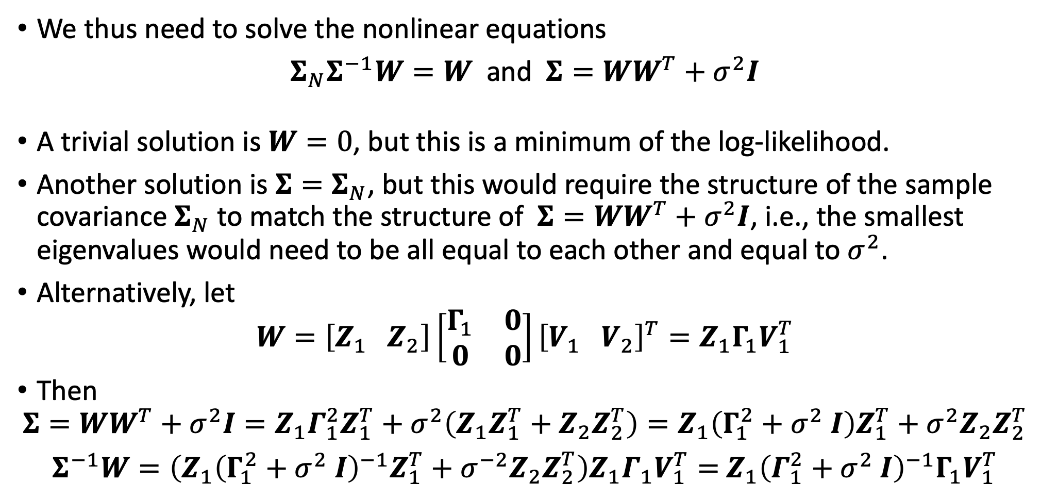
Probabilistic Principal Component Analysis: Learning
We thus need to solve the nonlinear equations
$Σ_{N}Σ^{−1}W=W$ and $Σ=WW^{T}+σ^{2}I$
A trivial solution is $W=0$, but this is a minimum of the log-likelihood.
Another solution is $Σ=Σ_{N}$, but this would require the structure of the sample covariance $Σ_{N}$ to match the structure of $Σ=WW^{T}+σ^{2}I$, i.e., the smallest eigenvalues would need to be all equal to each other and equal to $σ^{2}$.
Alternatively, let
$$W=\left[Z_{1} Z_{2}\right]\left[\begin{matrix}Γ_{1} & 0 \\ 0 & 0\end{matrix}\right]{\left[V_{1} V_{2}\right]}^{T}=Z_{1}Γ_{1}V_{1}^{T}$$
Then
$$Σ=WW^{T}+σ^{2}I=Z_{1}Γ_{1}^{2}Z_{1}^{T}+σ^{2}\left(Z_{1}Z_{1}^{T}+Z_{2}Z_{2}^{T}\right)=Z_{1}\left(Γ_{1}^{2}+σ^{2} I\right)Z_{1}^{T}+σ^{2}Z_{2}Z_{2}^{T}$$
$Σ^{−1}W=\left(Z_{1}{\left(Γ_{1}^{2}+σ^{2} I\right)}^{−1}Z_{1}^{T}+σ^{−2}Z_{2}Z_{2}^{T}\right)Z_{1}Γ_{1}V_{1}^{T}=$ $Z_{1}{\left(Γ_{1}^{2}+σ^{2} I\right)}^{−1}{Γ_{1}V}_{1}^{T}$

Slide 9
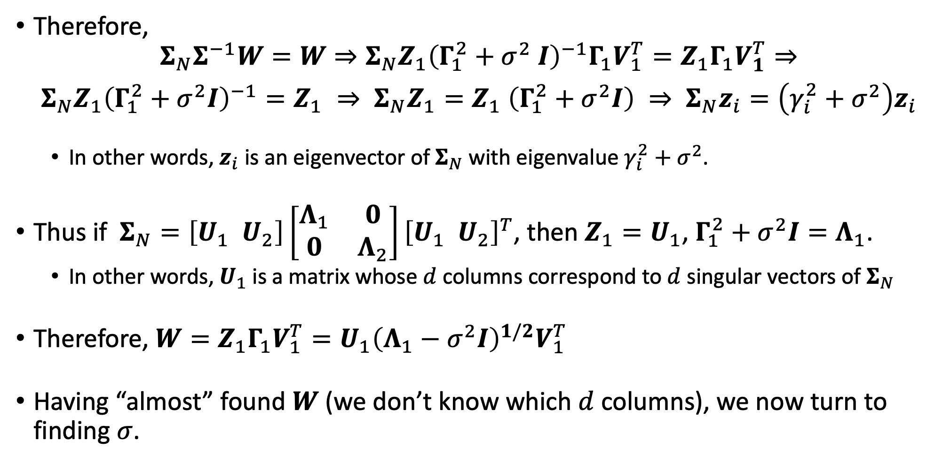
Probabilistic Principal Component Analysis: Learning
Therefore,
$$Σ_{N}Σ^{−1}W=W⇒{Σ_{N}Z}_{1}{\left(Γ_{1}^{2}+σ^{2} I\right)}^{−1}{Γ_{1}V}_{1}^{T}=Z_{1}Γ_{1}V_{1}^{T}⇒$$
${Σ_{N}Z}_{1}{\left(Γ_{1}^{2}+σ^{2}I\right)}^{−1}=Z_{1} ⇒ {Σ_{N}Z}_{1}=Z_{1}$ $\left(Γ_{1}^{2}+σ^{2}I\right) ⇒ Σ_{N}z_{i}=\left(γ_{i}^{2}+σ^{2}\right)z_{i}$
In other words, $z_{i}$ is an eigenvector of $Σ_{N}$ with eigenvalue $γ_{i}^{2}+σ^{2}$.
Thus if $Σ_{N}=\left[U_{1} U_{2}\right]\left[\begin{matrix}Λ_{1} & 0 \\ 0 & Λ_{2}\end{matrix}\right]{\left[U_{1} U_{2}\right]}^{T}$, then $Z_{1}=U_{1}$, $Γ_{1}^{2}+σ^{2}I=Λ_{1}$.
In other words, $U_{1}$ is a matrix whose $d$ columns correspond to $d$ singular vectors of $Σ_{N}$
Therefore, $W=Z_{1}Γ_{1}V_{1}^{T}=U_{1}{\left(Λ_{1}−σ^{2}I\right)}^{1/2}V_{1}^{T}$
Having “almost” found $W$ (we don’t know which $d$ columns), we now turn to finding $σ$.

Slide 10
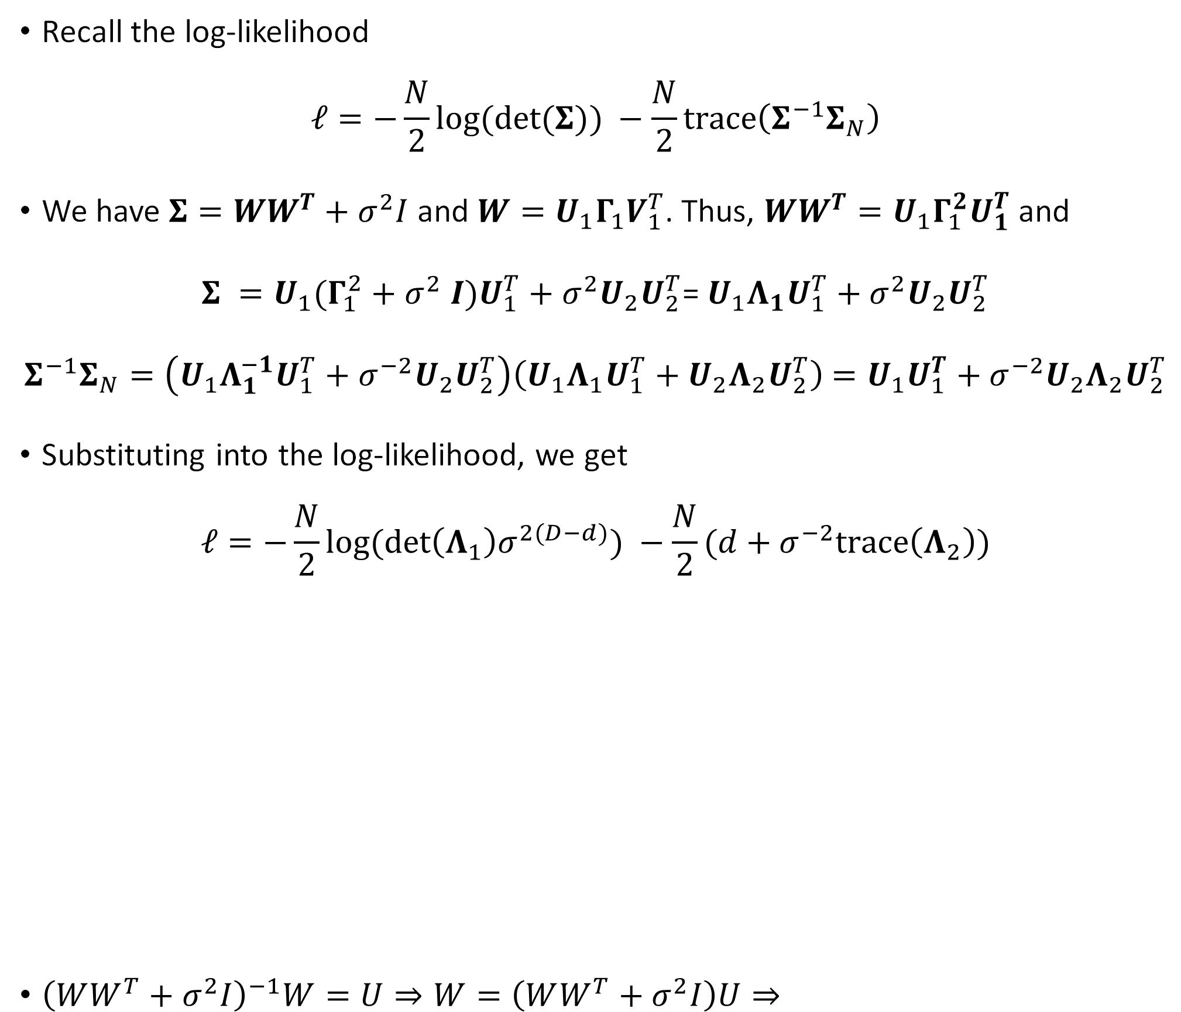
Probabilistic Principal Component Analysis: Learning
Recall the log-likelihood
$$ℓ=−\frac{N}{2}log⁡(\det{(Σ)) −\frac{N}{2}\operatorname{trace}\left(Σ^{−1}Σ_{N}\right)}$$
We have $Σ=WW^{T}+σ^{2}I$ and $W=U_{1}Γ_{1}V_{1}^{T}$. Thus, $WW^{T}=U_{1}Γ_{1}^{2}U_{1}^{T}$ and
$Σ =U_{1}(Γ_{1}^{2}+σ^{2} I)U_{1}^{T}+σ^{2}U_{2}U_{2}^{T}$= $U_{1}Λ_{1}U_{1}^{T}+σ^{2}U_{2}U_{2}^{T}$
$Σ^{−1}Σ_{N}=\left(U_{1}Λ_{1}^{−1}U_{1}^{T}+σ^{−2}U_{2}U_{2}^{T}\right)\left(U_{1}Λ_{1}U_{1}^{T}+U_{2}Λ_{2}U_{2}^{T}\right)$ $=U_{1}U_{1}^{T}+σ^{−2}U_{2}Λ_{2}U_{2}^{T}$
Substituting into the log-likelihood, we get
$$ℓ=−\frac{N}{2}log⁡(\det{{\left(Λ_{1}\right)σ}^{2(D−d)}) −\frac{N}{2}(d+σ^{−2}trace\left(Λ_{2}\right))}$$
${\left(WW^{T}+σ^{2}I\right)}^{−1}W=U⇒W=\left(WW^{T}+σ^{2}I\right)U⇒$

Slide 11
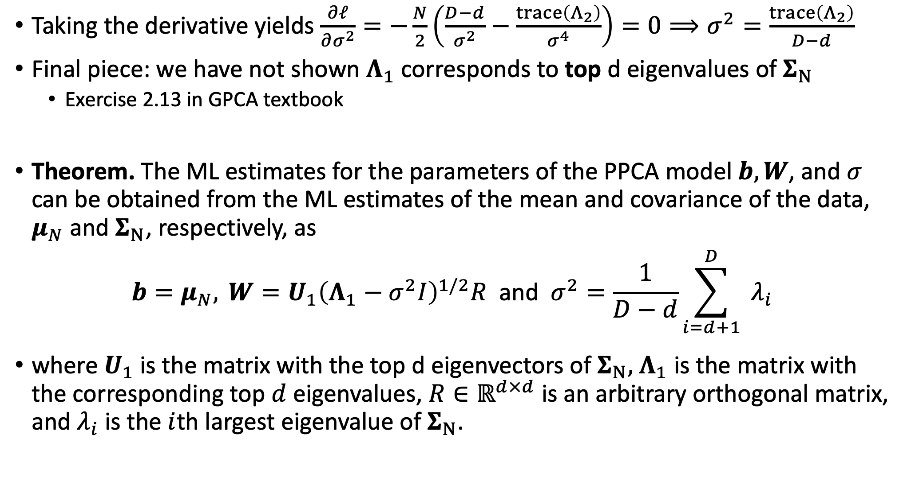
Probabilistic Principal Component Analysis: Learning
Taking the derivative yields $\frac{∂ℓ}{∂σ^{2}}=−\frac{N}{2}\left(\frac{D−d}{σ^{2}}−\frac{\operatorname{trace}\left(Λ_{2}\right)}{σ^{4}}\right)=0⟹σ^{2}=\frac{\operatorname{trace}\left(Λ_{2}\right)}{D−d}$
Final piece: we have not shown $Λ_{1}$ corresponds to top d eigenvalues of $Σ_{N}$
Exercise 2.13 in GPCA textbook
Theorem. The ML estimates for the parameters of the PPCA model $b,W$, and $σ$ can be obtained from the ML estimates of the mean and covariance of the data, $μ_{N}$ and $Σ_{N}$, respectively, as
$$b=μ_{N}, W=U_{1}{\left(Λ_{1}−σ^{2}I\right)}^{1/2}R \text{and} σ^{2}=\frac{1}{D−d}\sum_{i=d+1}^{D}{ }λ_{i}$$
where $U_{1}$is the matrix with the top d eigenvectors of $Σ_{N},$ $Λ_{1}$ is the matrix with the corresponding top $d$ eigenvalues, $R∈ℝ^{d×d}$ is an arbitrary orthogonal matrix, and $λ_{i}$ is the $i$th largest eigenvalue of $Σ_{N}$.

Slide 12
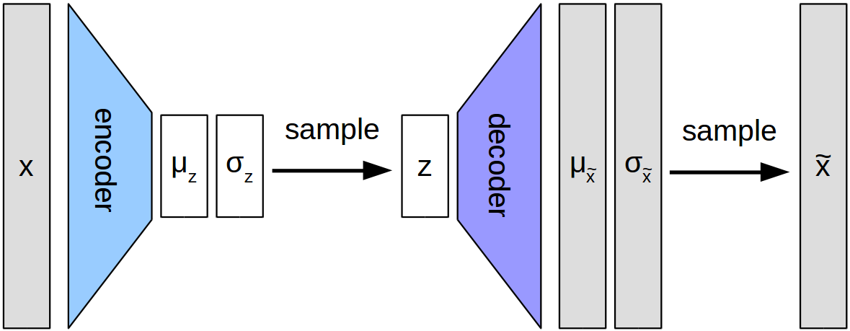

PPCA as an Encoder Decoder Architecture
$p\left(z | x\right)=𝒩{(z∣M}^{−1}W^{⊤}\left(x−b\right),σ^{−2}M) p\left(x | z\right)=𝒩\left(x | Wz+b,σ^{2}I\right)$

Slide 13
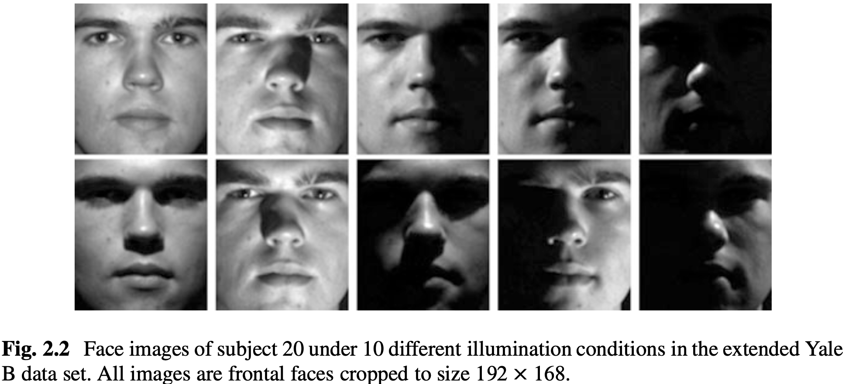
Application of PPCA to Generating Face Images

Slide 14
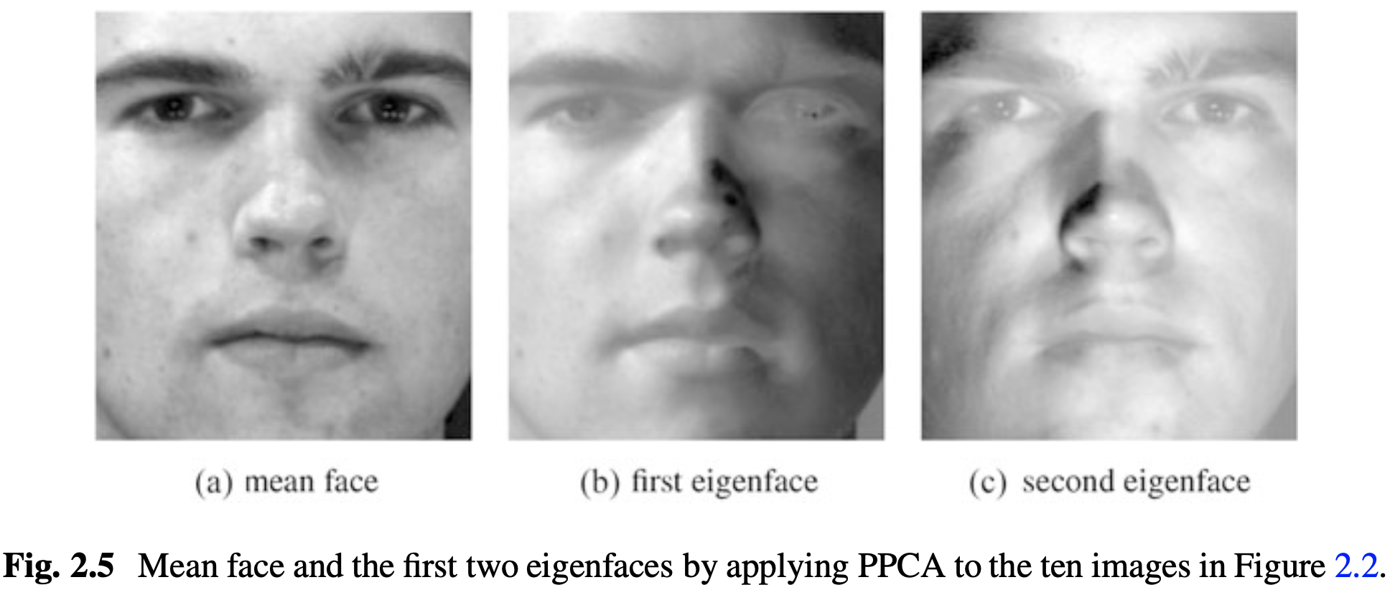
Application of PPCA to Generating Face Images

Slide 15
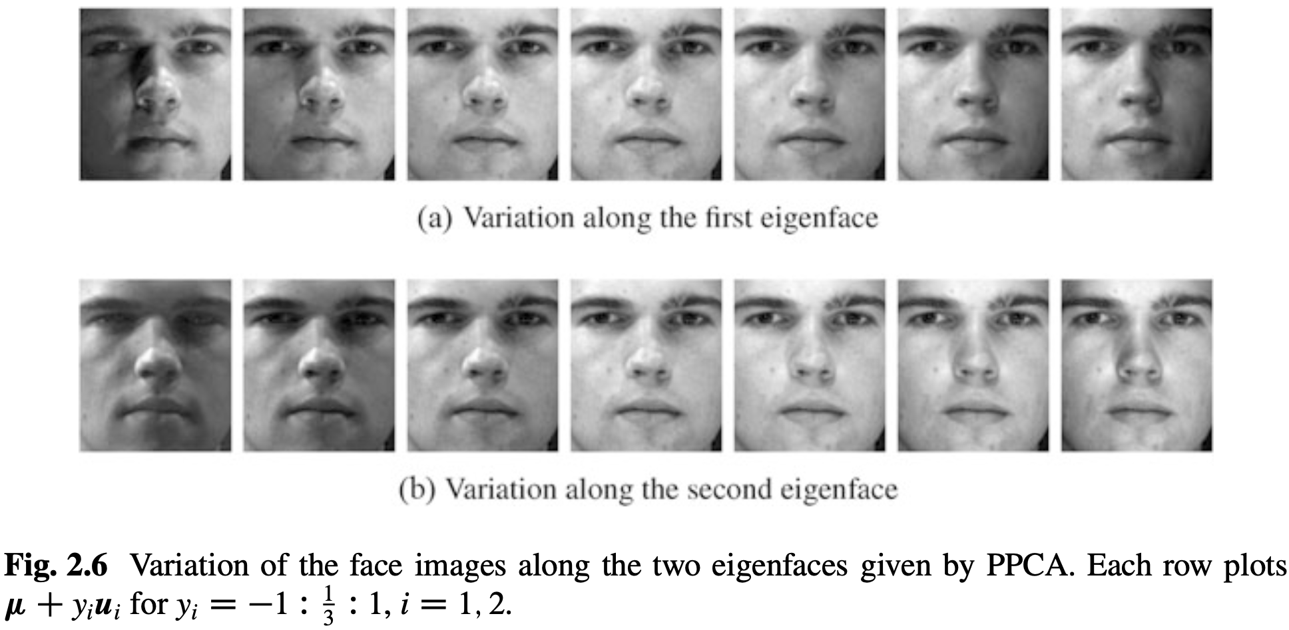
Application of PPCA to Generating Face Images

Slide 16
More reading
https://www.analyticssteps.com/blogs/3-difference-between-pca-and-autoencoder-python-code

