Slide 1

Alzheimer's Dementia Classification through Spontaneous Speech and MRI Dataset
INT 500- INTERNSHIP 4
FINAL REVIEW
Supervisor
Dr.Pitchumani Angayarkanni
Associate Professor
Machine Learning, Image Processing and Data Science
SRIHER(DU)
SRIHER (DU)
Vidarshana Govilesh - E0119067 B.Tech CSE (AI & ML)
Aswin G - E0119062 B.Tech CSE (AI & ML)
Nimalesh.E - E0119055 B.Tech CSE (AI & ML)

Slide 2
CONTENTS
Introduction
Literature Survey
Challenges
Objective
Tools and Techniques
Methodology
Experimental Results
Conclusion
References
Appendix
Work log

Slide 3
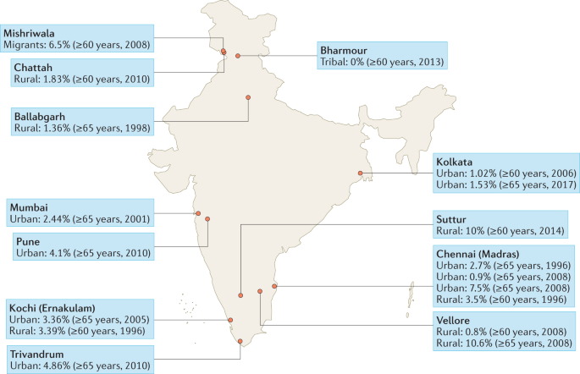
INTRODUCTION
Alzheimer’s disease is a brain disorder that slowly destroys memory and thinking skills and, eventually, the ability to carry out the simplest tasks.
People with Alzheimer’s also experience changes in behavior and personality.
Alzheimer's changes typically begin in the part of the brain that affects learning.
The method of diagnosis usually includes:
Cognitive and neuropsychological tests
(Mini-Mental State Examination (MMSE),
the Montreal Cognitive Assessment (MoCA)
Brain scans (CT / MRI)
cerebrospinal fluid or blood tests
Genetic Testing

Slide 4
PROBLEM STATEMENT
To build an efficient model to perform the classification of Alzheimer’s dementia through Imaging and Speech Data. Both image and speech data can be collected in a non-invasive way.
There is growing evidence that changes in speech and language patterns can occur in the early stages of Alzheimer's disease, even before clinical symptoms appear. Similarly, brain imaging techniques can detect changes in brain structure and function before symptoms appear.

Slide 5
OBJECTIVE
The main objective of the project is to make the diagnosis of the disease by utilizing spontaneous speech and MRI images.
Analyzing the image dataset available and using pre-trained algorithms to classify the data efficiently.
Perform Exploratory Data Analysis on meta data of speech
Work with speech dataset and classify the data into demented and non-demented by using the machine learning algorithm.

Slide 6
LITERATURE SURVEY
[1] Sharma, S., Gupta, S., Gupta, D., Altameem, A., Saudagar, A. K. J., Poonia, R. C., & Nayak, S. R. (2022). HTLML: Hybrid AI Based Model for Detection of Alzheimer’s Disease. Diagnostics, 12(8), 1833
It uses a hybrid-based AI-based model that includes the combination of both transfer learning (TL) and permutation-based machine learning (ML) voting classifier in terms of two basic phases.
In the first phase of implementation, it comprises two TL-based models: namely, DenseNet-121 and Densenet-201 for features extraction, whereas in the second phase of implementation, it carries out three different ML classifiers like SVM, Naïve base and XGBoost for classification purposes.
The final classifier outcomes are evaluated by means of permutations of the voting mechanism. The proposed model achieved accuracy of 91.75%, specificity of 96.5%, and an F1-score of 90.25.

Slide 7
LITERATURE SURVEY
[2] Haulcy, R'mani, and James Glass. "Classifying Alzheimer's disease using audio and text-based representations of speech." Frontiers in Psychology 11 (2021): 624137.
In this paper, the ADReSS dataset, a dataset balanced by gender and age, was used to automatically classify AD from spontaneous speech
The performance of five classifiers, as well as a convolutional neural network and long short-term memory network, was compared when trained on audio features and text features.
The same audio and text features were used to train five regression models to predict the Mini-Mental State Examination score for each patient, a score that has a maximum value of 30
The top-performing classification models were the support vector machine and random forest classifiers trained on BERT embeddings, which both achieved an accuracy of 85.4% on the test set.
The performance on both tasks illustrates the feasibility of using speech to classify AD and predict neuropsychological scores.

Slide 8
LITERATURE SURVEY
[3] Luz, S., Haider, F., de la Fuente, S., Fromm, D., & MacWhinney, B. (2020). Alzheimer's dementia recognition through spontaneous speech: The ADReSS challenge. arXiv preprint arXiv:2004.06833.
This paper aims to do the AD recognition task which performs a binary classification of speech samples into AD and non-AD classes; The segmented dataset contains 1,955 speech segments from 78 non-AD subjects and 2,122 speech segments from 78AD subjects.
Feature extraction was performed on the speech segments using the openSMILEv2.1toolkit
Linear Discriminant Analysis(LDA), Random Forests(RF), Support Vector Machines, and leave-one-subject out(LOSO) cross-validation, KNN setting was adopted. The classifiers were trained and tested to predict whether a speech segment was uttered by a non-AD or AD patient where it was found that DT gave the highest and most stable accuracy and features gave a higher accuracy of 0.625 for acoustic features.

Slide 9
DATASET
SPEECH DATASET:
Source: Dementia Bank
License : Becker, J. T., Boller, F., Lopez, O. L., Saxton, J., & McGonigle, K. L. (1994). The natural history of Alzheimer's disease: description of study cohort and accuracy of diagnosis. Archives of Neurology, 51(6), 585-594.
NIA AG03705 and AG05133
Full_wave_enhanced_audio (contains the audio recordings after noise removal.)
- cc (non-AD)
- cd (AD )
Normalised_audio-chunks (contains the .wav files which are extracted from the audio recordings after applying voice activity detection.)
cc_meta_data.txt(age, gender and MMSE score.)
MRI BRAIN IMAGE DATASET: The Data is hand collected from various websites with each and every labels verified.
Source: Kaggle
License Database: Open Database
THE 4 CLASSES:
VERY MILD DEMENTIA:2240
MILD-DEMENTIA: 896
MODERATE DEMENTIA: 64
NON DEMENTIA: 3200
IMAGE SHAPE: 128X128X3
NO OF ROWS: 6400

Slide 10
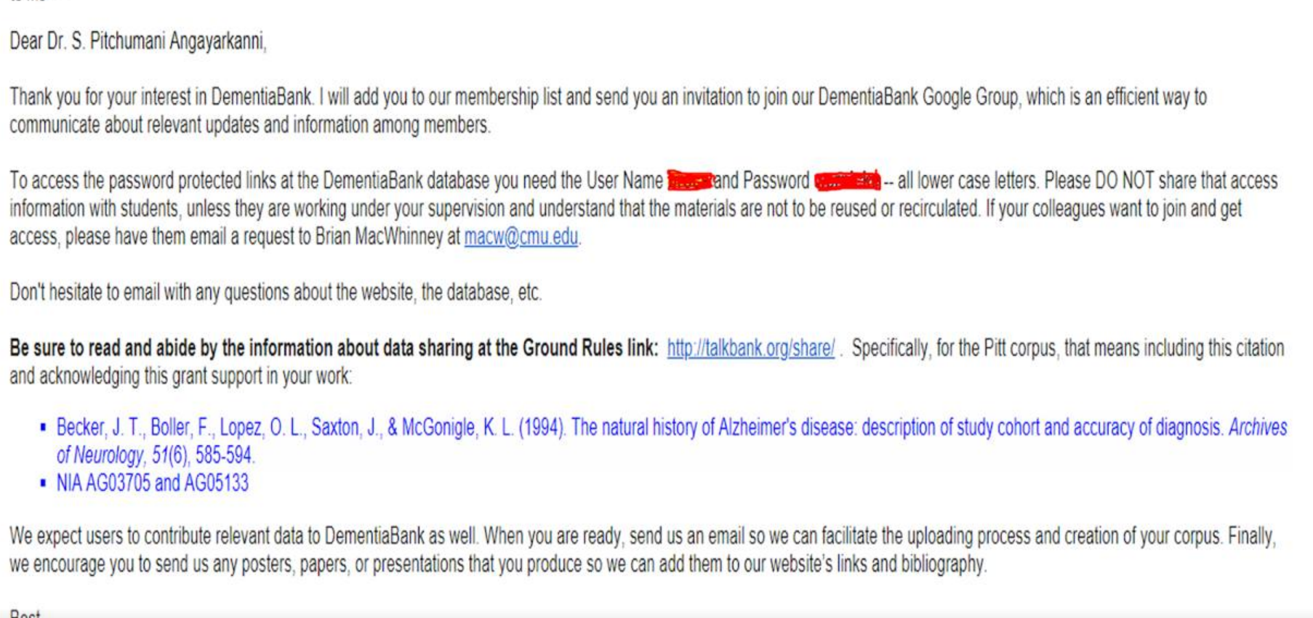
LICENSE : Speech Data

Slide 11
CHALLENGES
The spontaneous speech dataset is limited.
Special techniques and libraries have to be utilized in order to make the speech data trainable for machine learning models.
The image dataset is unbalanced, that is the 4 different classes do not have equal distribution of data. Therefore it will affect the accuracy of the deep learning models.
The data we have utilized is not real time data.

Slide 12
TOOLS AND TECHNOLOGIES
Deep Learning – Python:-
Python Libraries:
sklearn, matplotlib, TensorFlow, pandas, numpy, librosa
Pre-processing Technique:
EDA(exploratory Data Analysis)
Data Augmentation
Standardization
Feature Extraction
Evaluation metrics:
Accuracy
Precision
Recall
AUC

Slide 13
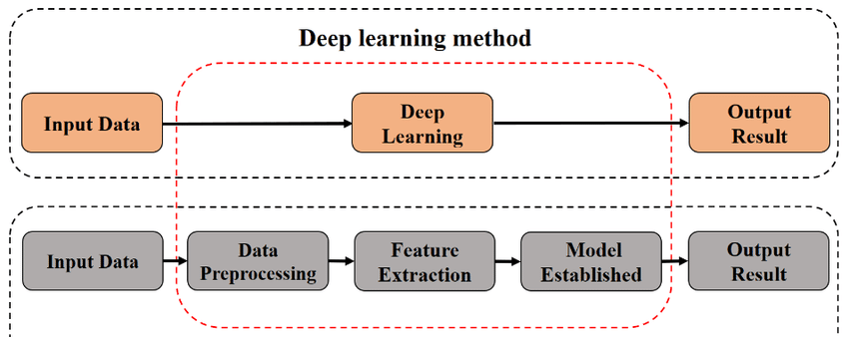
WORKFLOW
Machine learning method

Slide 14
IMAGE PRE - PROCESSING
Pre-processing is just as important in deep learning as it is in other areas of machine learning and data analysis. In fact, it can be argued that it is even more critical in deep learning due to the complexity of the models and the large amount of data typically involved.
Data augmentation is a technique of artificially increasing the training set by creating modified copies of a dataset using existing data. It includes making minor changes to the dataset or using deep learning to generate new data points. Techniques include resizing, zoom, rotating, cropping, padding, etc. It helps to address issues like overfitting and data scarcity, and it makes the model robust with better performance.

Slide 15
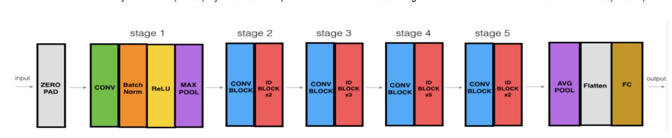
MODELS
Resnet50
Deep residual networks like the popular ResNet-50 model is a convolutional neural network (CNN) that is 50 layers deep.
A residual neural network (ResNet) is an artificial neural network (ANN) of a kind that stacks residual blocks on top of each other to form a network.
It can work with different input size and designed to overcome problem of vanishing gradient by using residual connections.
Architecture includes
It contains a initial convolutional layer, followed by a max pooling layer.
Four sets of convolutional layers, with each set containing several residual blocks.
A global average pooling layer.
A fully connected layer with a softmax activation function.

Slide 16
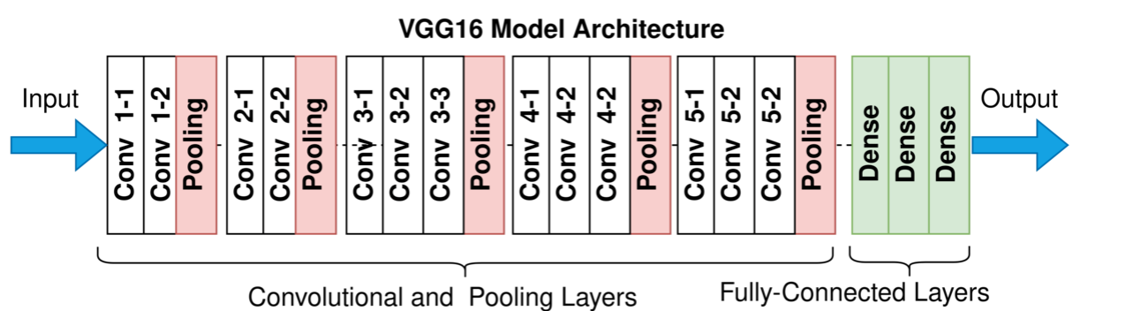
VGG16
VGG Net is a Convolutional Neural Network architecture proposed by Karen Simonyan and Andrew Zisserman from the University of Oxford in 2014.
Focuses on the effect of the convolutional neural network depth on its accuracy
The famous paper “Very Deep Convolutional Networks for Large-Scale Image Recognition” made the term deep viral.
It was the first study that provided undeniable evidence that simply adding more layers increases the performance.

Slide 17
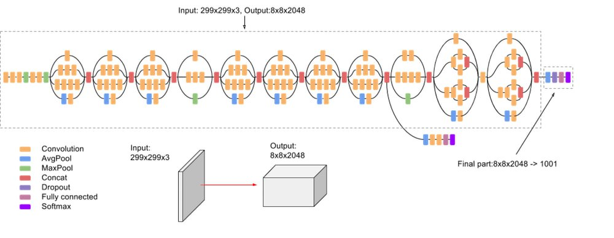
INCEPTION V3
Inception-v3 is a pre-trained convolutional neural network that is 48 layers deep, which is a version of the network already trained on more than a million images from the ImageNet database. This pre-trained network can classify images into 1000 object categories, such as keyboard, mouse, pencil, and many animals.
As a result, the network has learned rich feature representations for a wide range of images. The model extracts general features from input images in the first part and classifies them based on those features in the second part.

Slide 18
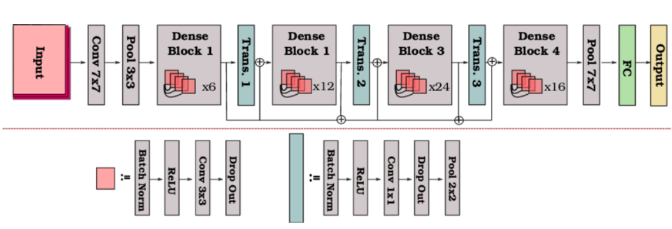
DENSENET169
DenseNet-169 was chosen because despite having a depth of 169 layers it is relatively low in parameters compared to other models, and the architecture handles the vanish gradient problem well.
For each layer, the feature maps of all preceding layers are used as inputs, and its own feature-maps are used as inputs into all subsequent layers. DenseNets have several compelling advantages: they alleviate the vanishing-gradient problem, strengthen feature propagation, encourage feature reuse, and substantially reduce the number of parameters.

Slide 19
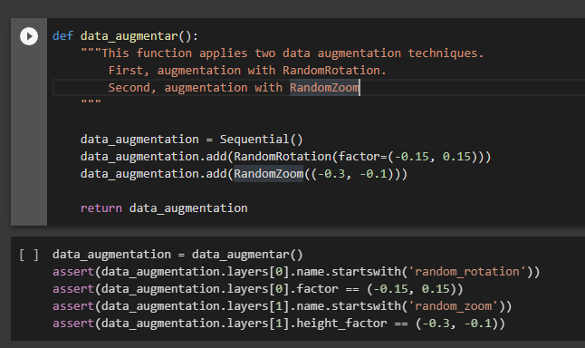
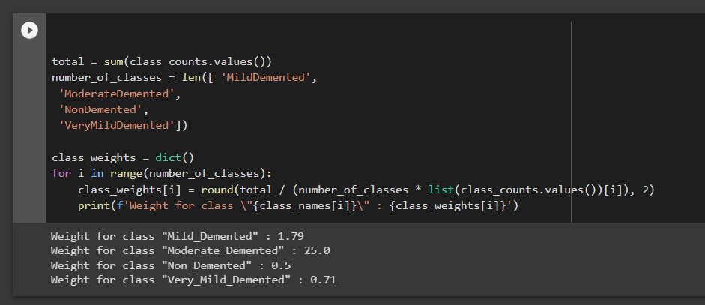
APPENDIX
PREPROCESSING

Slide 20
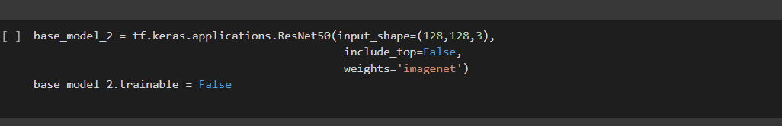
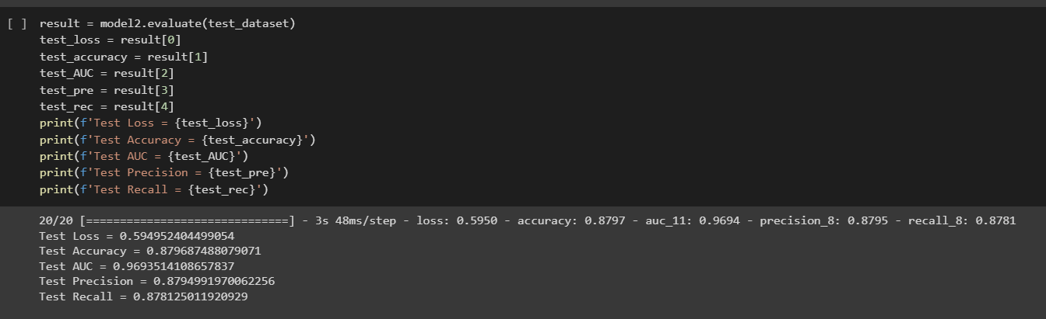
RESNet50

Slide 21
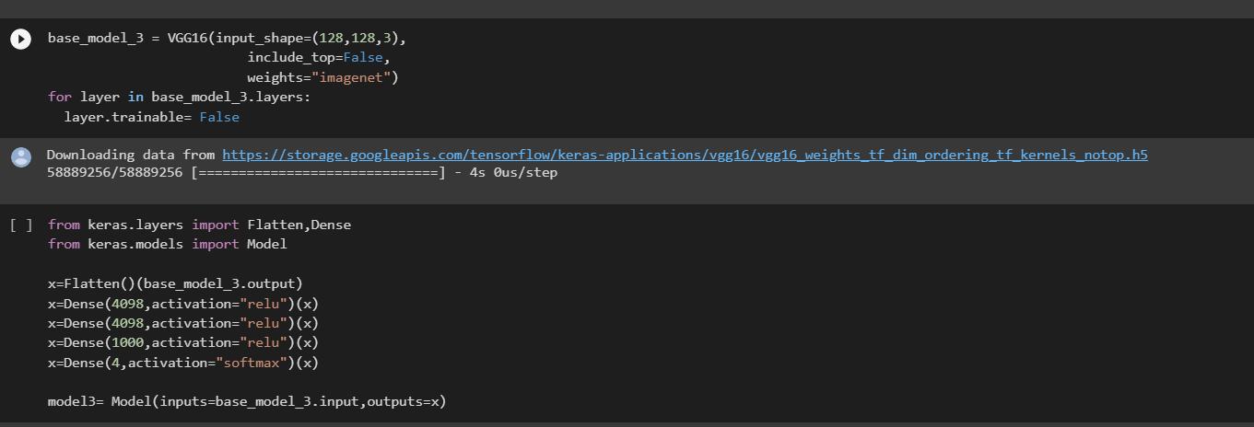
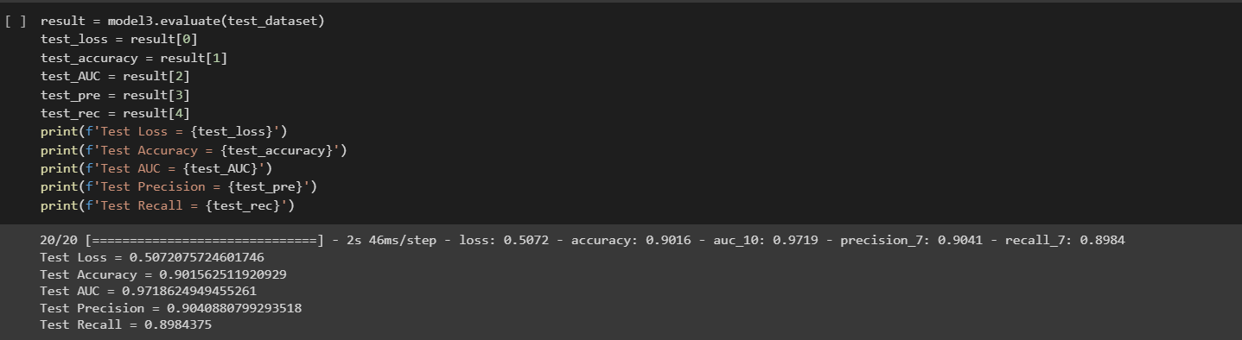
VGG16

Slide 22
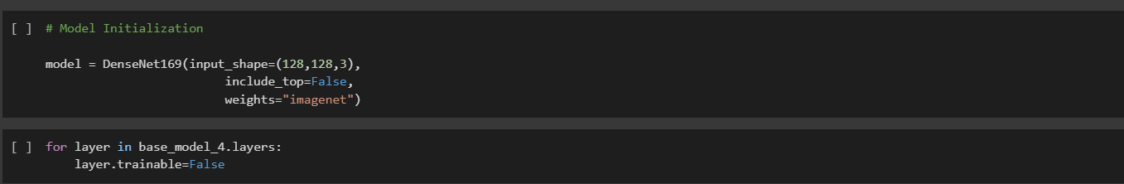
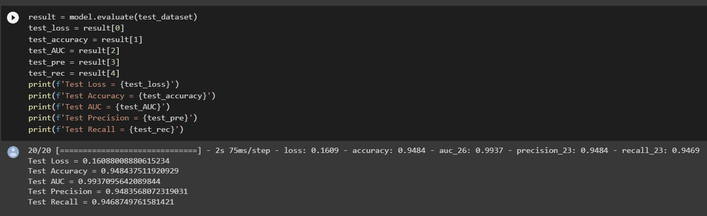
DenseNet169

Slide 23
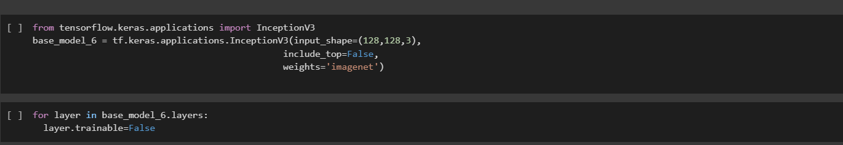
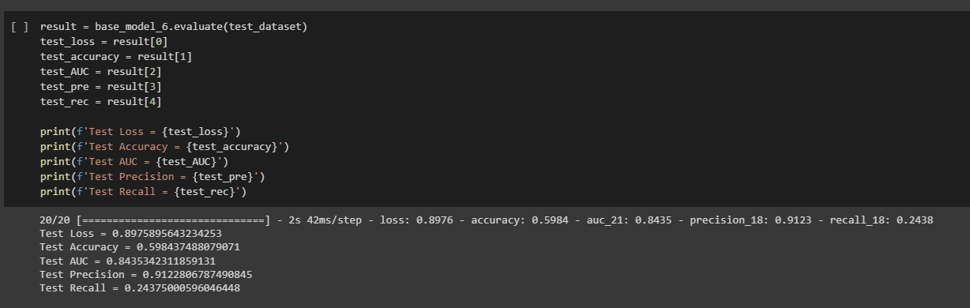
Inception V3

Slide 24
AUDIO PRE - PROCESSING
Explanatory Data Analysis:
Exploratory Data Analysis refers to the critical process of conducting initial research on data
to discover patterns, detect anomalies, and check assumptions with the help of summary
statistics and graphical representations.
Feature Extraction:
Using the Librosa package, we were able to extract the Mel-Frequency Cepstrum Coefficients (MFCC) feature from the speech data which was in the .wav format. It is observed that extracting features from the audio signal and using it as input to the base model will produce much better performance than directly considering raw audio signal as input. MFCC is the widely used technique for extracting the features from the audio signal.
Data Scaling:
It involves scaling the features of the data so that they have a mean of zero and a standard deviation of one. Standardization is useful when the features of the data have different ranges, and it can help to avoid biases in the model that may occur when some features have larger values than others.

Slide 25
Classification Algorithms:
We split the dataset into two parts—training set and test set. The training set consisting of 80% of the
data will be used to train the classification model. The remaining 20% of the data will be reserved for
testing the accuracy and effectiveness of the model on unseen data and will be referred to as the testing data set.
Classification models:
After having performed data preprocessing, we apply five classification models, namely
Random Forest
Support Vector Machine
K-Nearest Neighbor
Decision Tree
Naïve Bayes
Ensemble Model
Evaluation:
For assessing the performance of all these models, the accuracy,precision,recall, F1 score, recall of the model are calculated. The model with the highest accuracy score is considered as the best model.

Slide 26
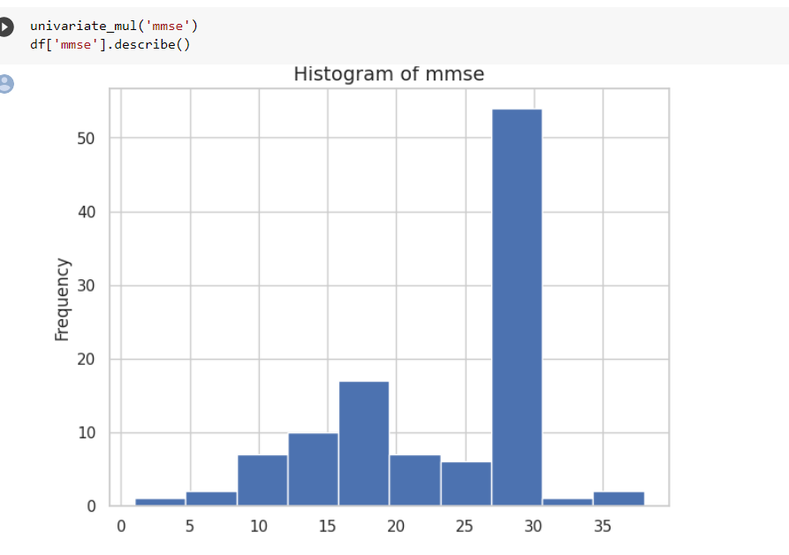
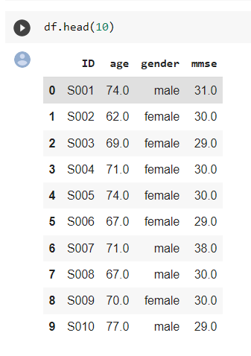
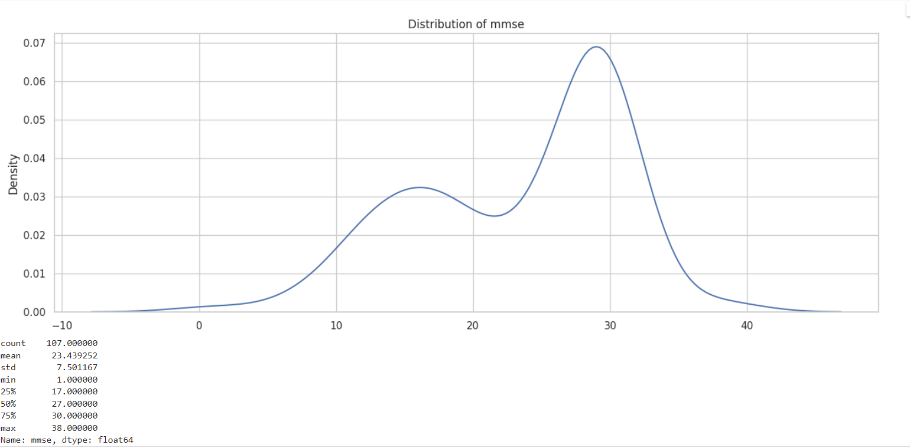
SPEECH DATA-EDA

Slide 27
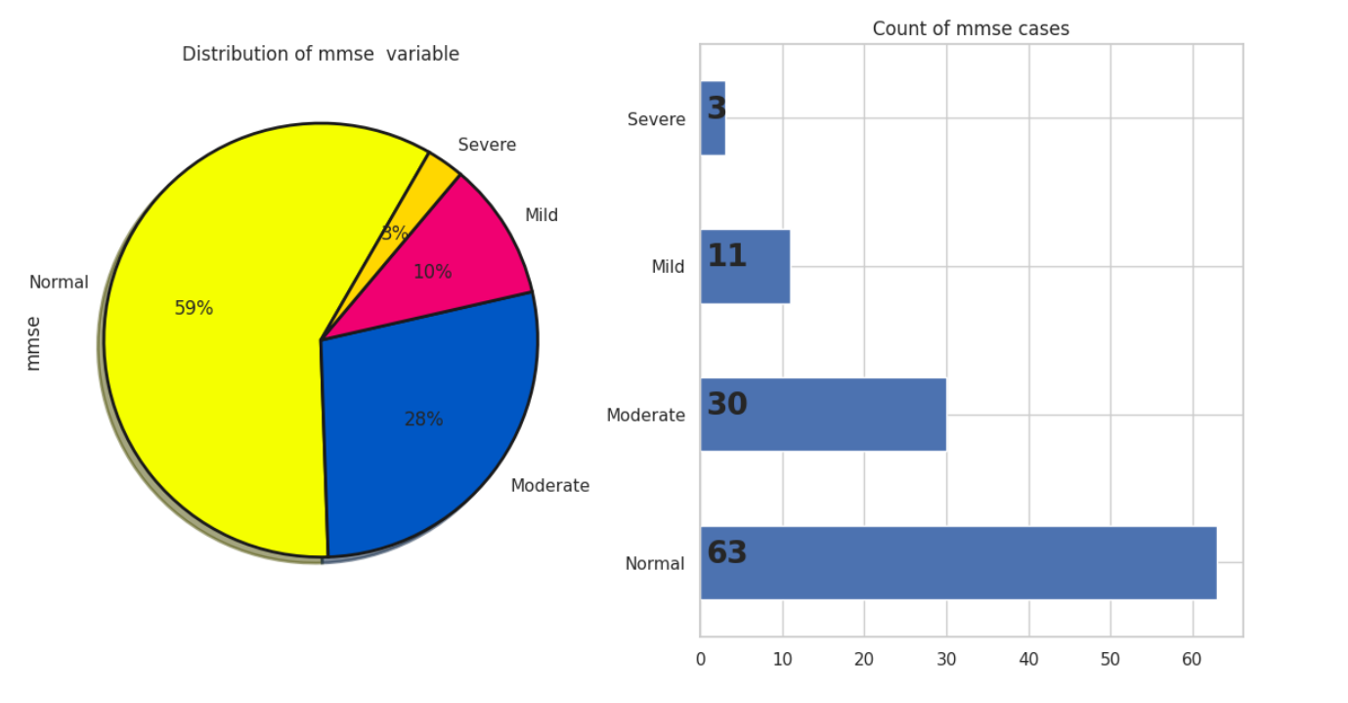
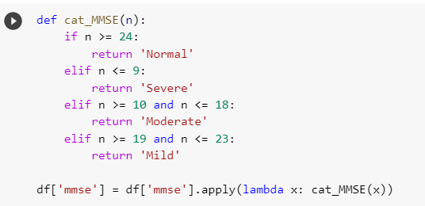

Slide 28
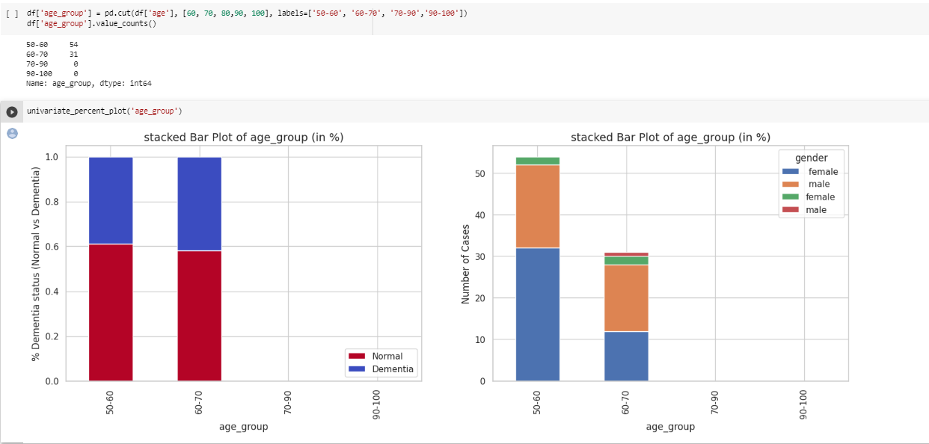

Slide 29
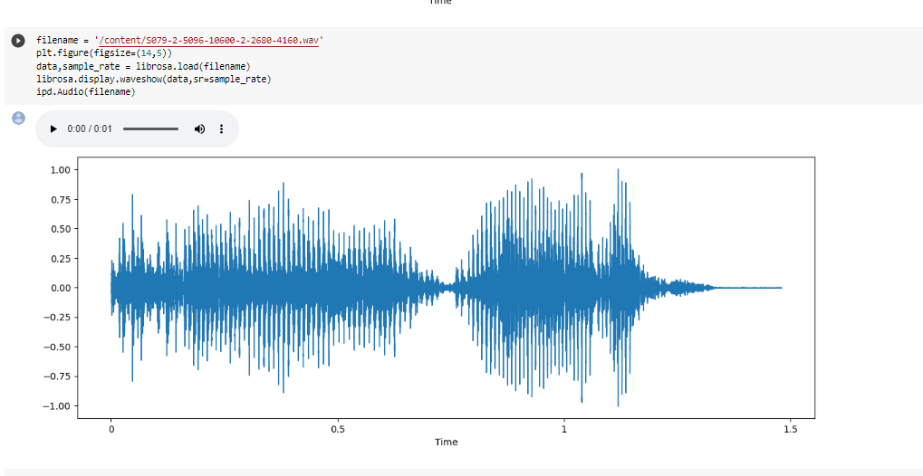
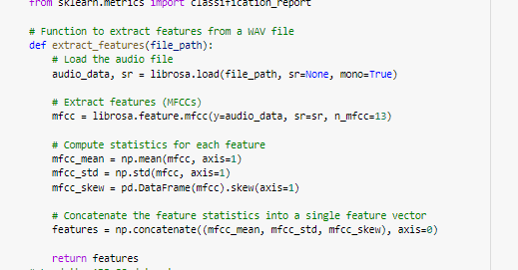

Slide 30
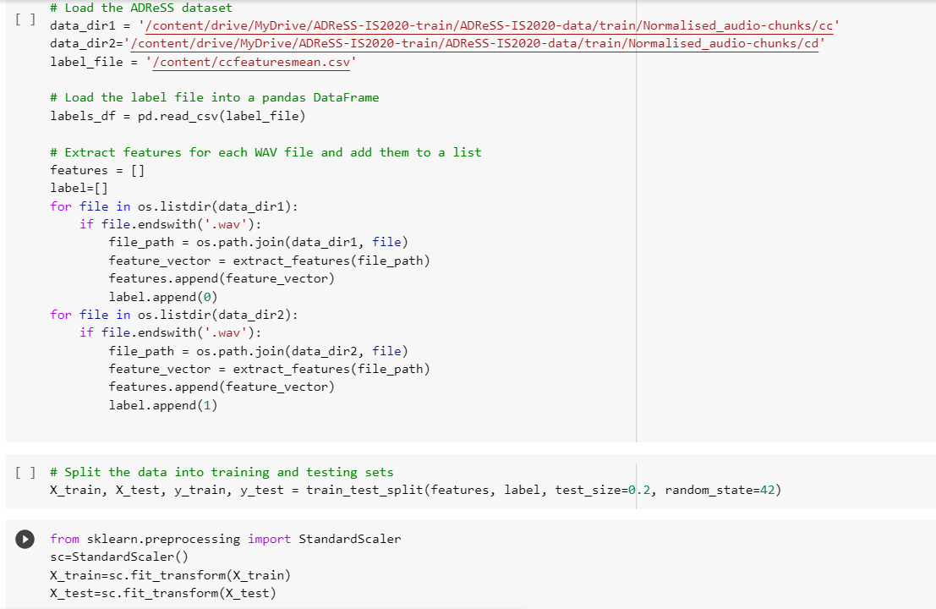

Slide 31
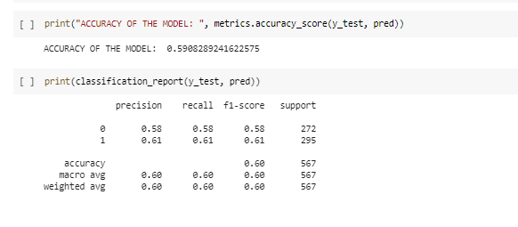
Decision Tree
Decision tree is a supervised machine-learning algorithm that is commonly used for classification and regression tasks.
It is a type of predictive modeling algorithm that makes predictions by learning simple decision rules from the input features of the training data(by recursively splitting training data into subsets based on input features).
The decision tree algorithm is easy to interpret and visualize, and it can handle both numerical and categorical data.
However, decision trees are prone to overfitting, techniques such as pruning, ensemble methods and regularization can be used to improve the performance and generalization of the decision tree algorithm.

Slide 32
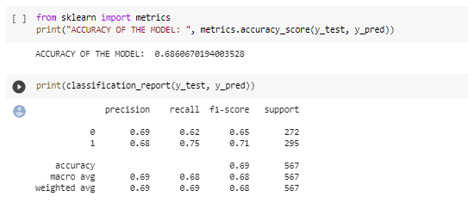
Random Forest
Random Forest is an ensemble learning algorithm that is commonly used for classification and regression tasks in machine learning.
Random Forest algorithm is based on probability.
To make a prediction on new data, the random forest algorithm first runs each data point through each of the individual decision trees in the forest, and then takes the majority vote of the predicted class (in classification tasks) or the average prediction (in regression tasks).
This aggregation of the results from multiple trees helps to reduce overfitting and improve the accuracy of the predictions.

Slide 33
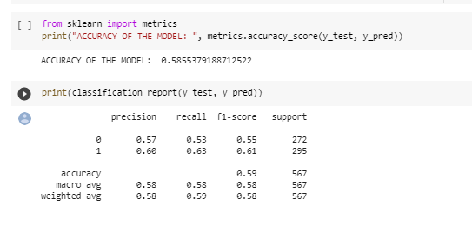
Support Vector Classifier (SVC)
Support Vector Machines (SVMs) are a type of supervised learning algorithm used for classification and regression tasks. The basic idea behind SVMs is to find a hyperplane or a set of hyperplanes in a high-dimensional space that can best separate the data into different classes.
In the case of classification, SVMs aim to find a decision boundary that maximizes the margin between the classes.

Slide 34
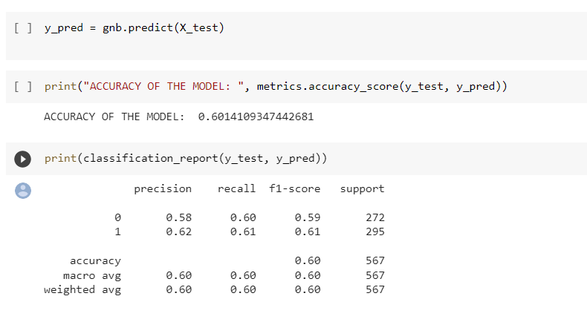
Naive Bayes
Naive Bayes is a type of probabilistic machine learning algorithm that is commonly used for classification tasks. It is based on the Bayes' theorem, which provides a way to calculate the probability of a hypothesis (in this case, a class label) given the evidence (in this case, the features of an instance). To train a Naive Bayes classifier, the algorithm first calculates the prior probabilities of each class based on the training data. Then, for each feature, it calculates the conditional probability of that feature given each class. Finally, it applies Bayes' theorem to calculate the posterior probabilities of each class given the evidence (the features of the instance).

Slide 35
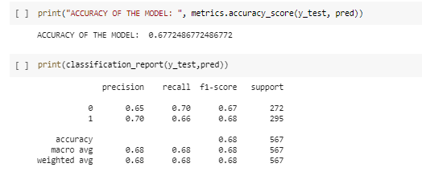
KNN - K nearest neighbor
KNN is a simple yet effective algorithm that does not make any assumptions about the underlying distribution of the data. The algorithm works by calculating the distance between the test example and each training example in the feature space. K-Nearest Neighbors (KNN) is a type of supervised machine learning algorithm that is used for both classification and regression tasks. The value of K is a hyperparameter that needs to be tuned for each specific problem, and a larger value of K will result in a smoother decision boundary but may also introduce more bias.

Slide 36
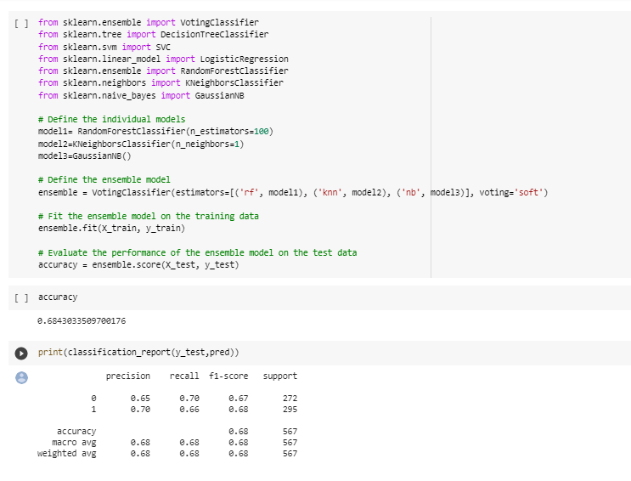
Ensemble Model

Slide 37
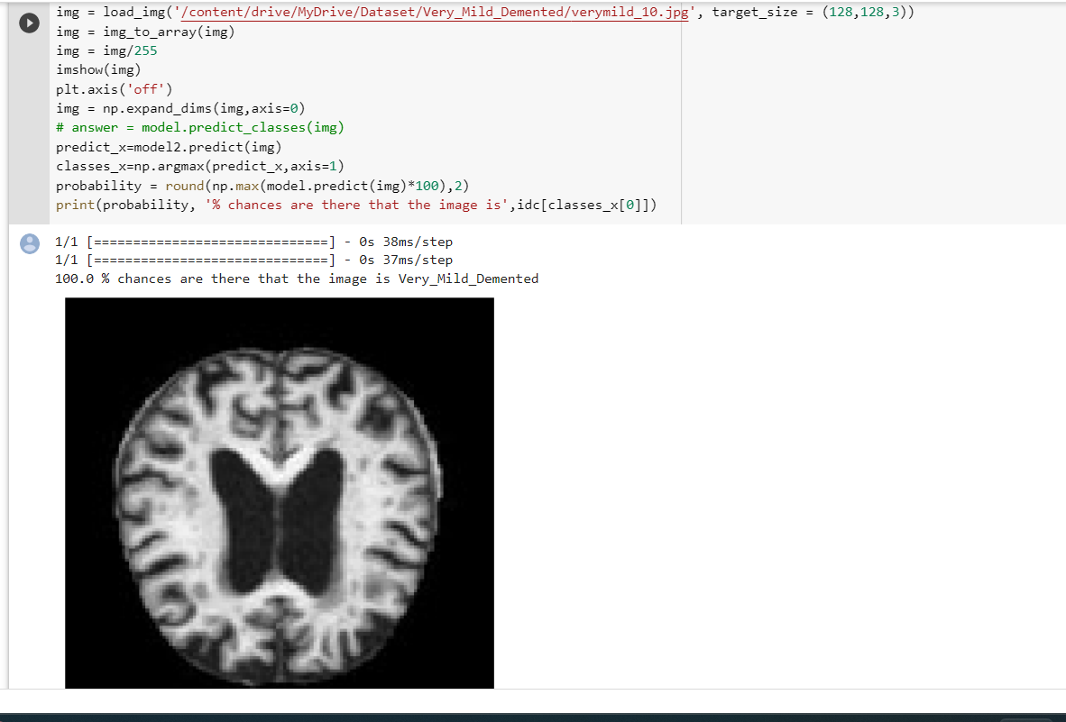
RESULTS FOR IMAGE CLASSIFICATION
When classifying the MRI scans into 4 classes, the best results are found to be from DenseNet169. This could be because its dense connectivity pattern and feature reuse mechanisms allow for efficient use of network parameters, leading to improved performance and reduced overfitting.
InceptionV3 gave less accuracy and there could be many factors that may have affected the performance of InceptionV3, such as preprocessing techniques, model architecture modifications, or specific characteristics of the data.
MODEL | ACCURACY
DenseNet169 | 94%
ResNet50 | 87%
VGG16 | 89%
InceptionV3 | 60%

Slide 38
RESULTS FOR SPEECH CLASSIFICATION
Model results are much lower than necessary for clinical use, but prove that machine learning models are successful in learning the difference in the audio of AD patients.
Given the limited size of the dataset, results are lower than what can be expected from a larger, more standardized dataset.
Ensemble Model using Random Forest, Naive Bayes and KNN gives the highest accuracy
MODEL | ACCURACY
Random Forest | 68%
Decision Tree | 59%
Support Vector Machine | 58%
Naïve Bayes | 60%
K nearest Neighbour | 67%
Ensemble Model | 68%

Slide 39
CONCLUSION
In conclusion, the classification of dementia using speech and MRI scans shows promising results. Both modalities provide complementary information for the accurate detection and diagnosis of different types of dementia.
Speech analysis allows for the identification of subtle changes in language patterns, while MRI scans provide information on structural and functional brain changes.
The integration of these two modalities can improve diagnostic accuracy and enable early detection of dementia, allowing for timely intervention and management.
However, further research is needed to improve the specificity and sensitivity of these classification methods, as well as to evaluate their practicality and applicability in clinical settings.

Slide 40
REFERENCES
https://luzs.gitlab.io/adresso-2021/
https://www.isca-speech.org/archive_v0/Interspeech_2020/pdfs/2571.pdf
https://www.ncbi.nlm.nih.gov/pmc/articles/PMC9406825/
https://devpost.com/software/classification-of-alzheimer-s-disease-from-speech-data
https://www.analyticsvidhya.com/blog/2021/06/mfcc-technique-for-speech-recognition/#:~:text=It%20is%20observed%20that%20extracting,features%20from%20the%20audio%20signal.

Slide 41
WORKLOG
DATE | WORK DONE
April 26- April 30 | PROJECT DISCUSSION AND TITLE FINALIZING
May 1- May 7 | SEARCHING FOR STUDY MATERIALS REFERENCES
MAY 8- MAY 12 | GOING THROUGH RESEARCH JOURNALS
MAY 13- MAY 17 | DATA COLLECTION ANDEXPLORATORY DATA ANALYSIS
MAY 18 – MAY 27 | PREPROCESSING AND OVERSAMPLING
MAY 29 – JUNE 3 | CLASSIFICATION MODELS AND BUILDING HYPERPARAMETER TUNING
JUNE 5 – JUNE 10 | NOVEL HYBRID APPROACH TECHNIQUE
JUNE 10-JUNE 20 | BUILDING MACHINE LEARNING MODEL AND CONCLUDING

Slide 42
THANK YOU

