Slide 1
Client
Cafe chain that is located onsite and caters only to universities
Would like to go online
Has asked us to get it started

Slide 2
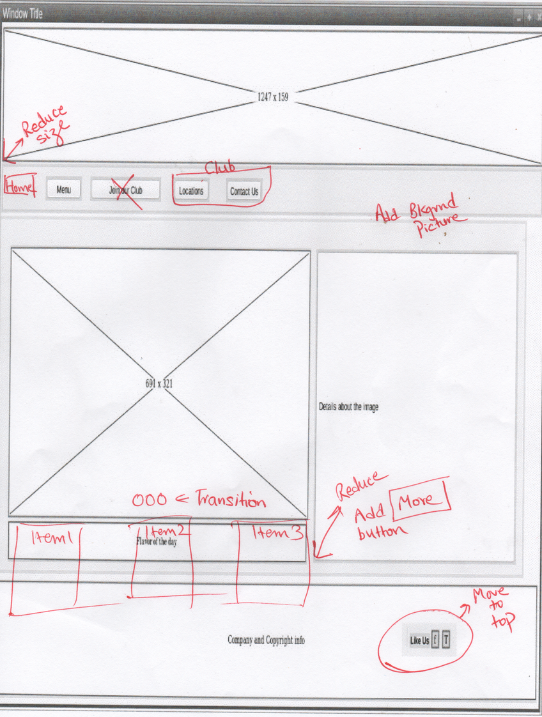
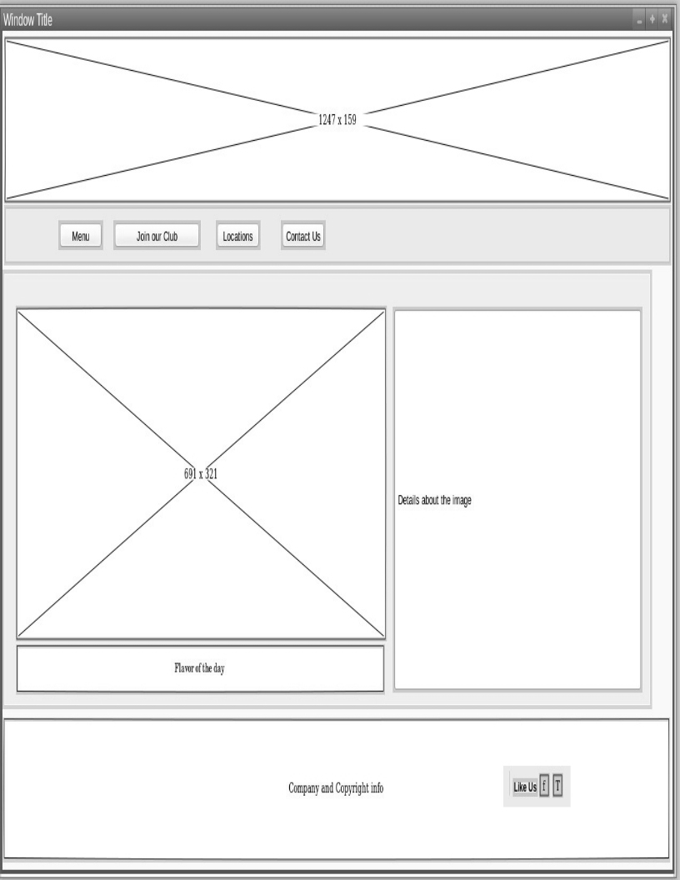
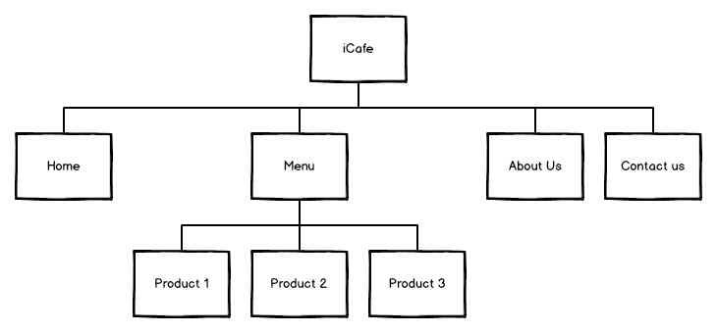
Wireframes v.1.0
Came up with a layout for the site
Got feedback from client
Drew up a site map

Slide 3
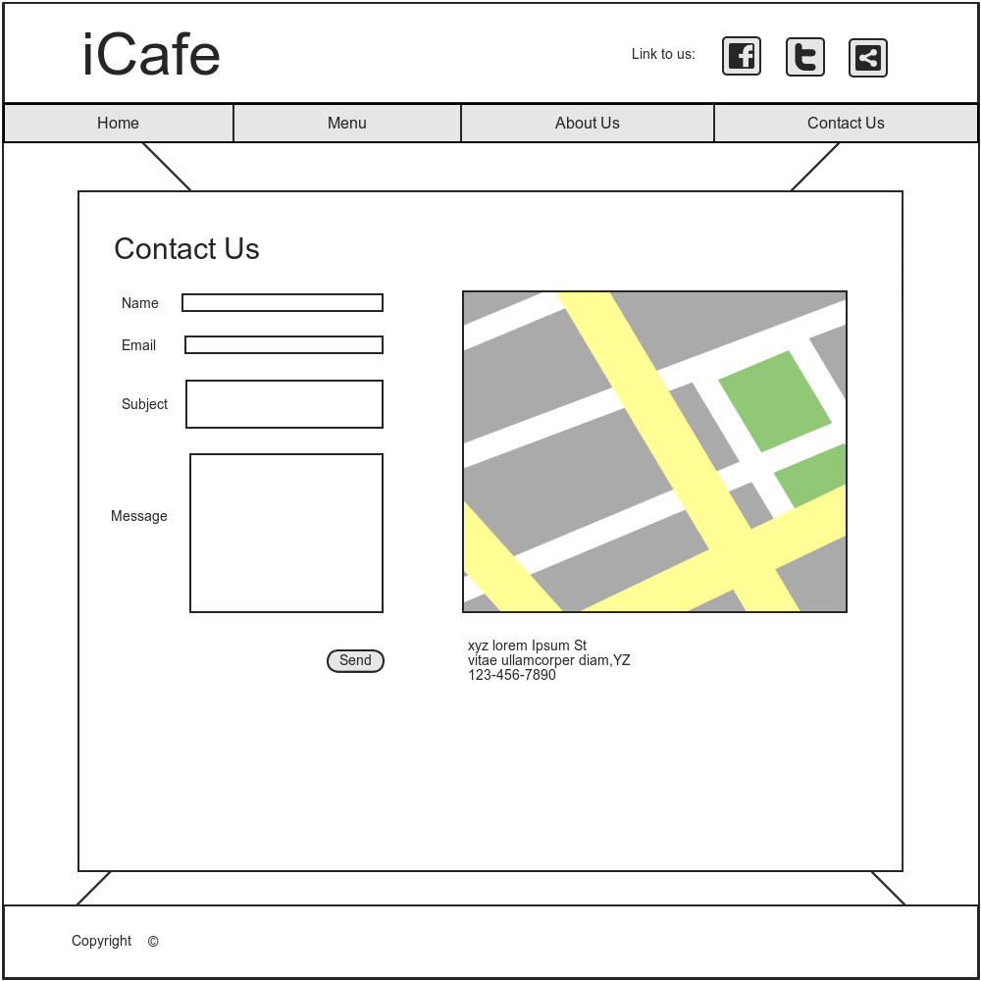
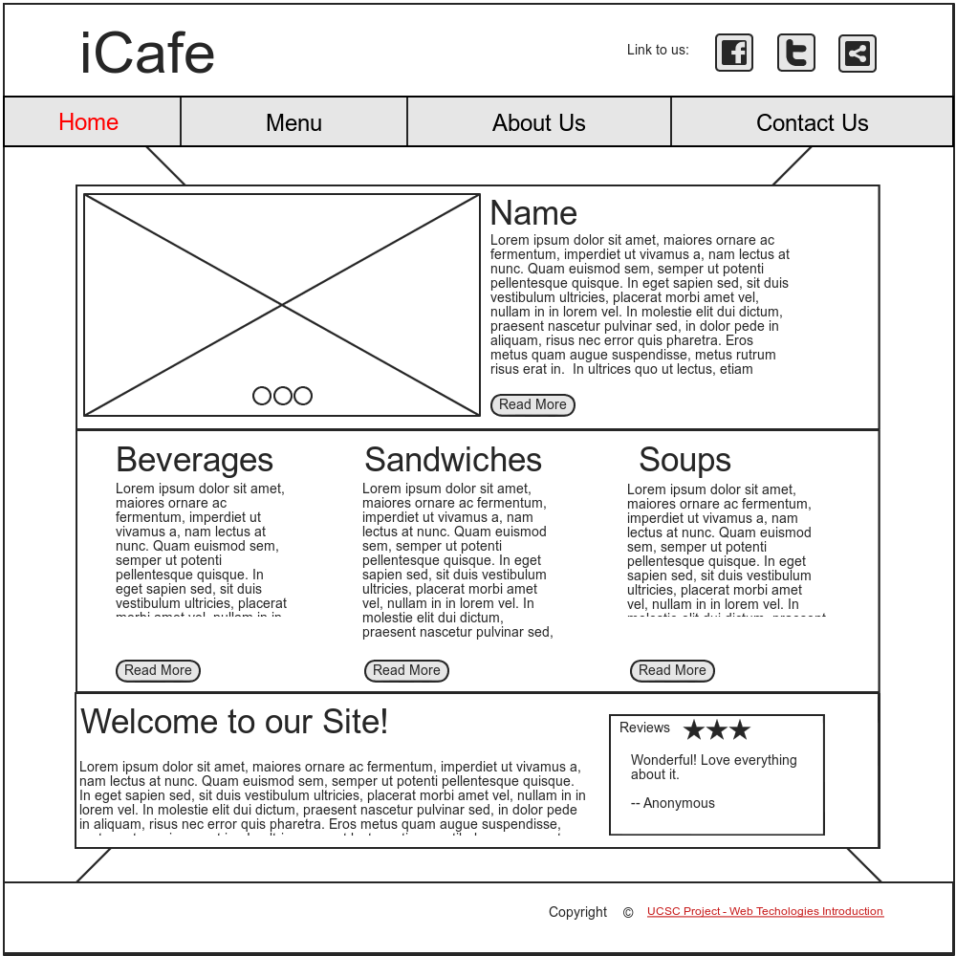
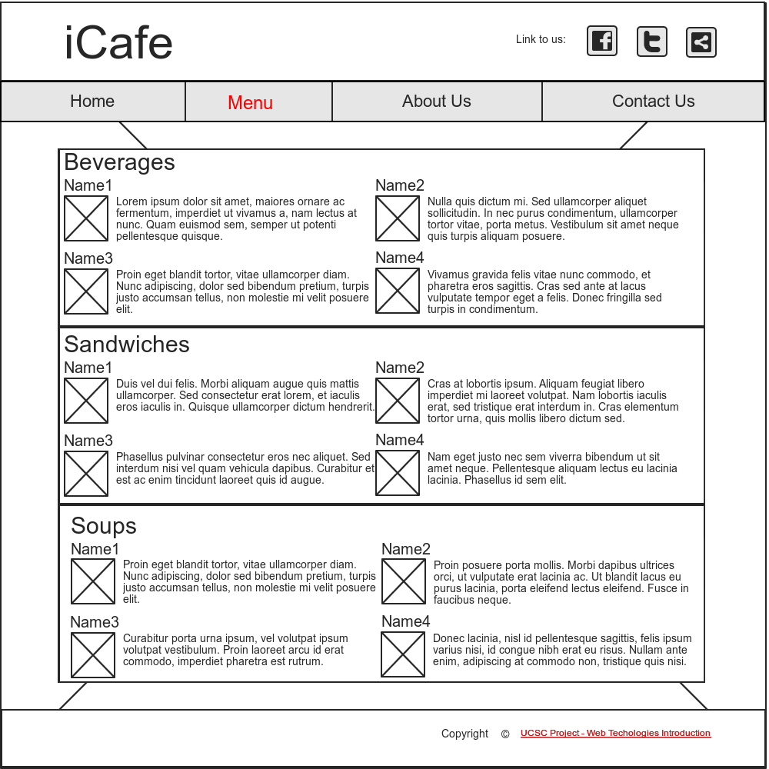
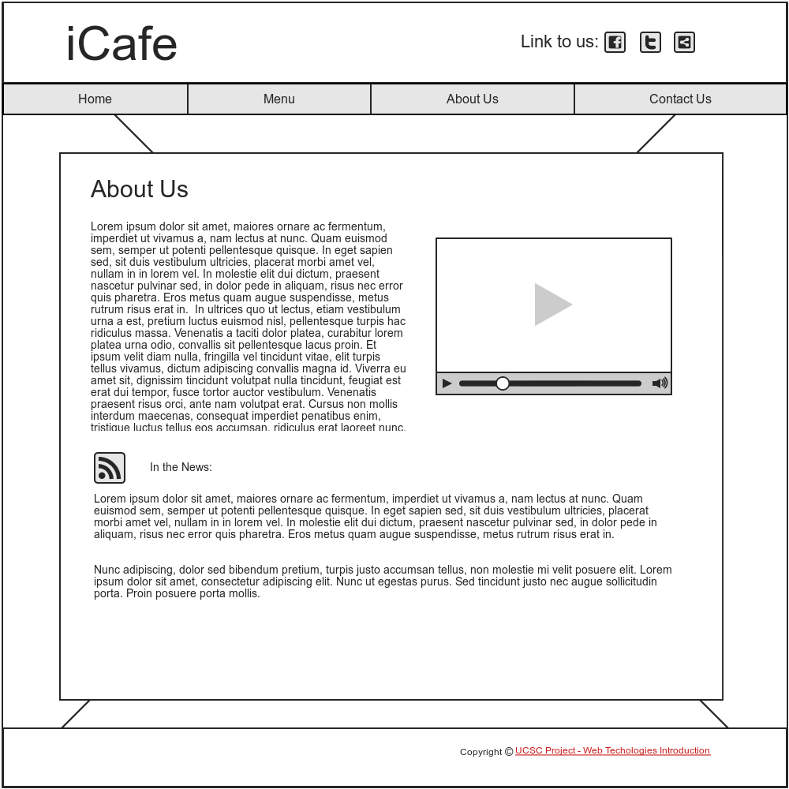
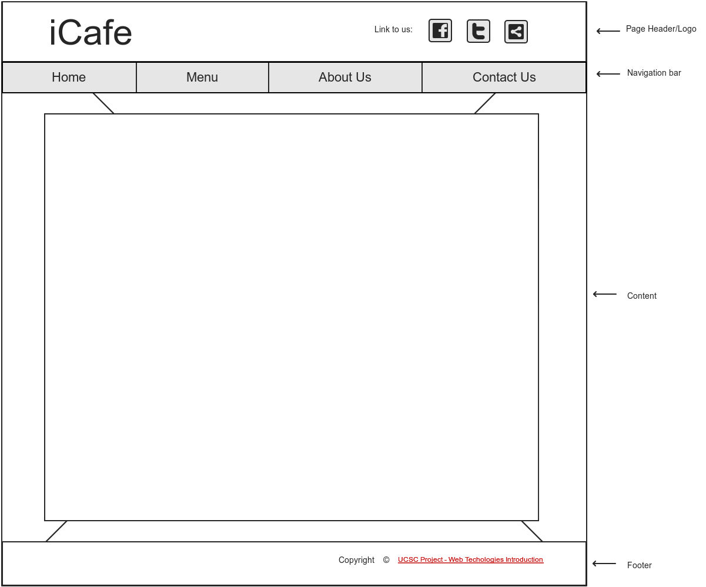
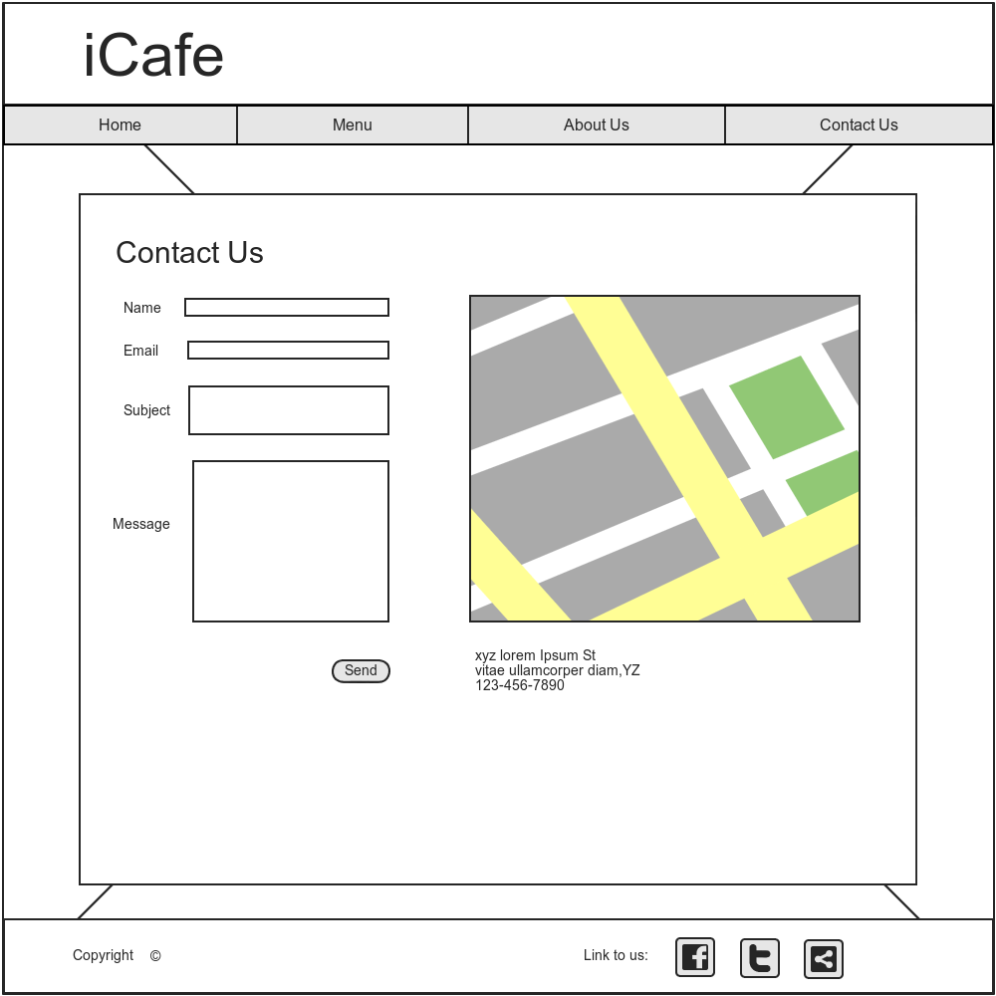
Wireframes v.2.0
Page Layout components
Home Page
Based on the sitemap and feedback, came up with the page layout and new wireframes
Menu Page
About Us Page
Contact Us Page

Slide 4
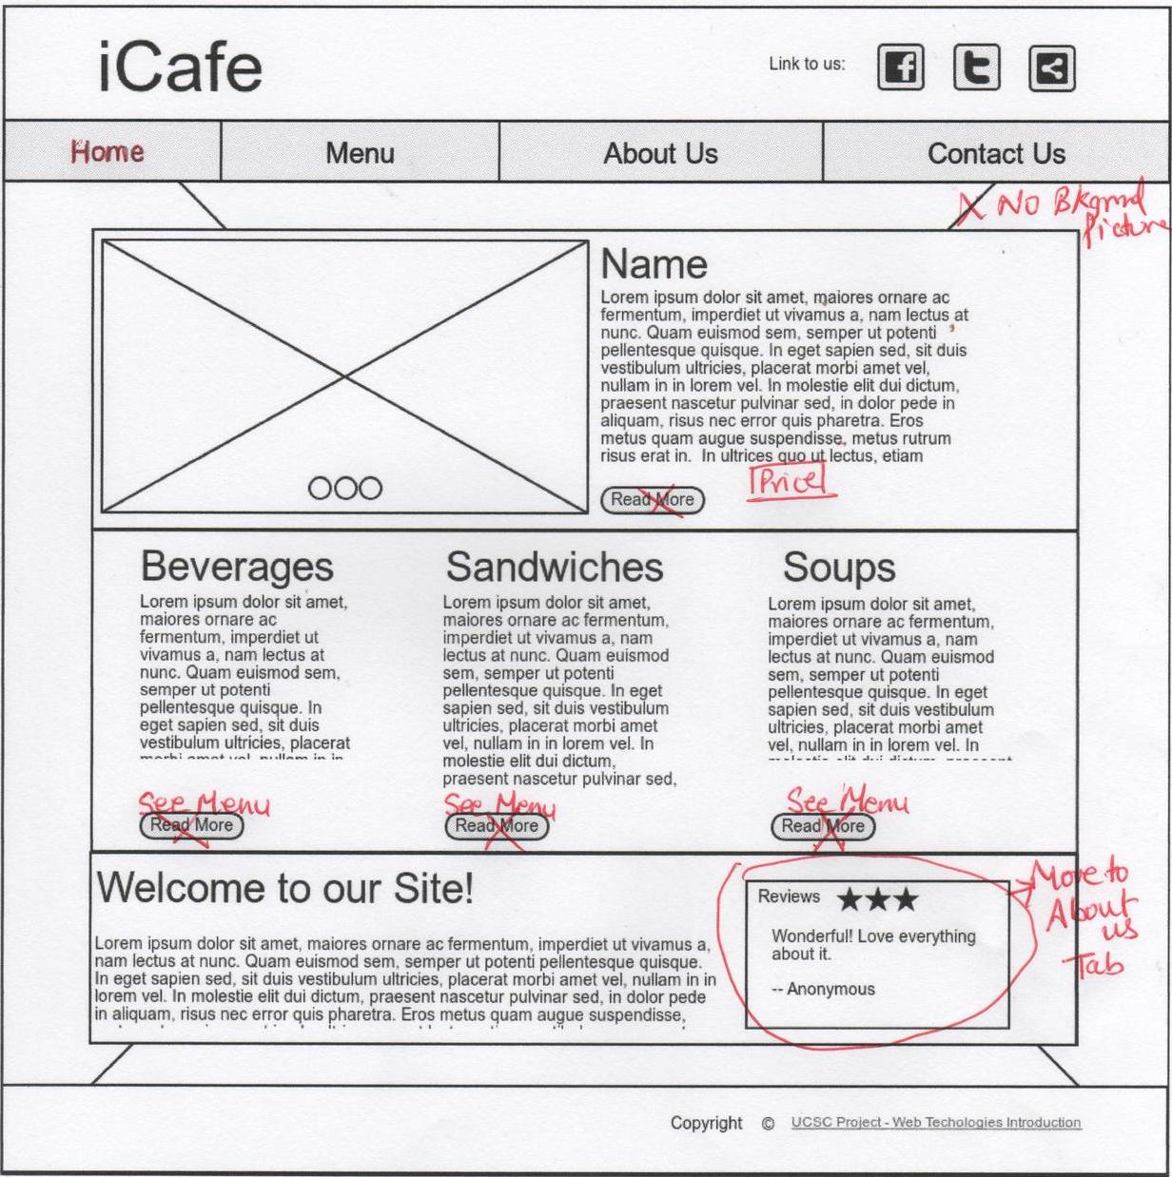
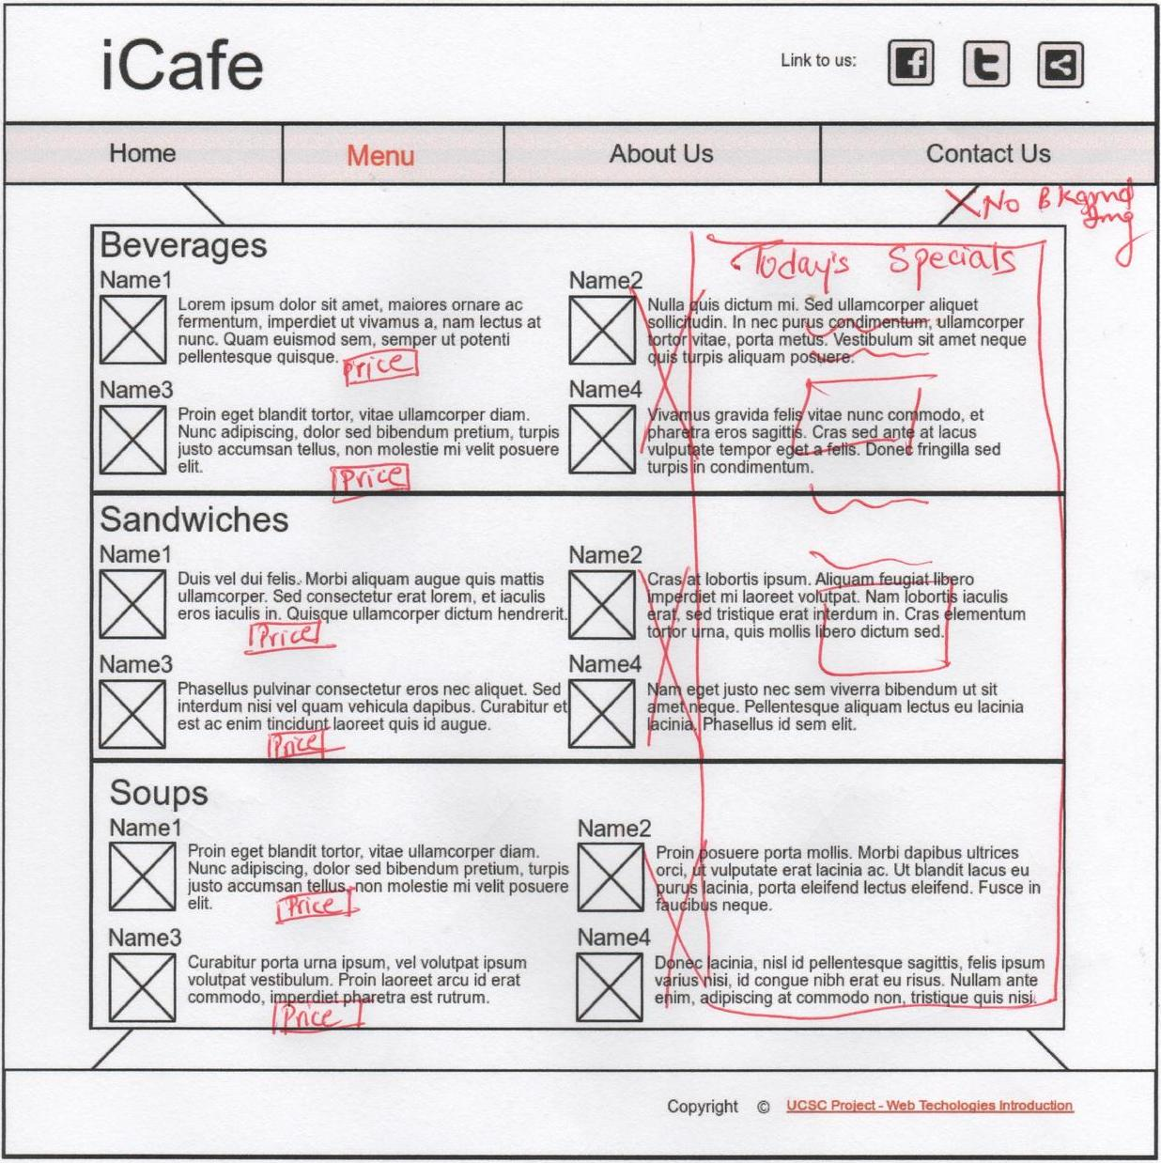
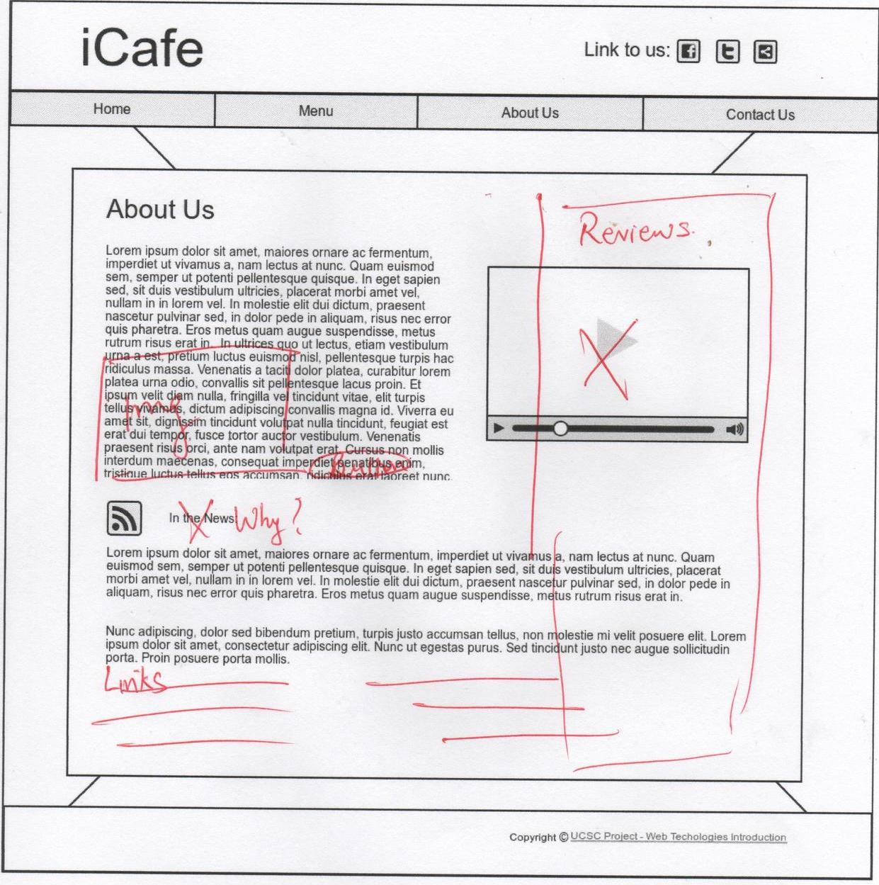
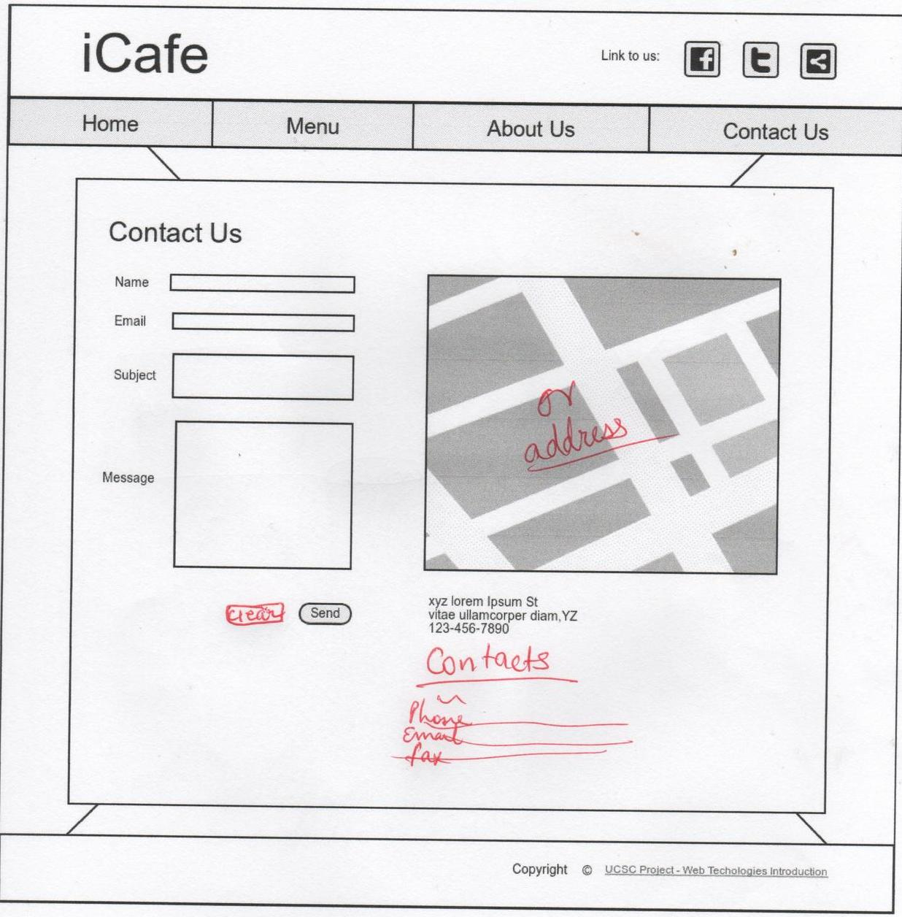
Feedback on Wireframes v.2.0
Home Page
Menu Page
About Us Page
Got feedback on the wireframes from the client
Contact Us Page

Slide 5
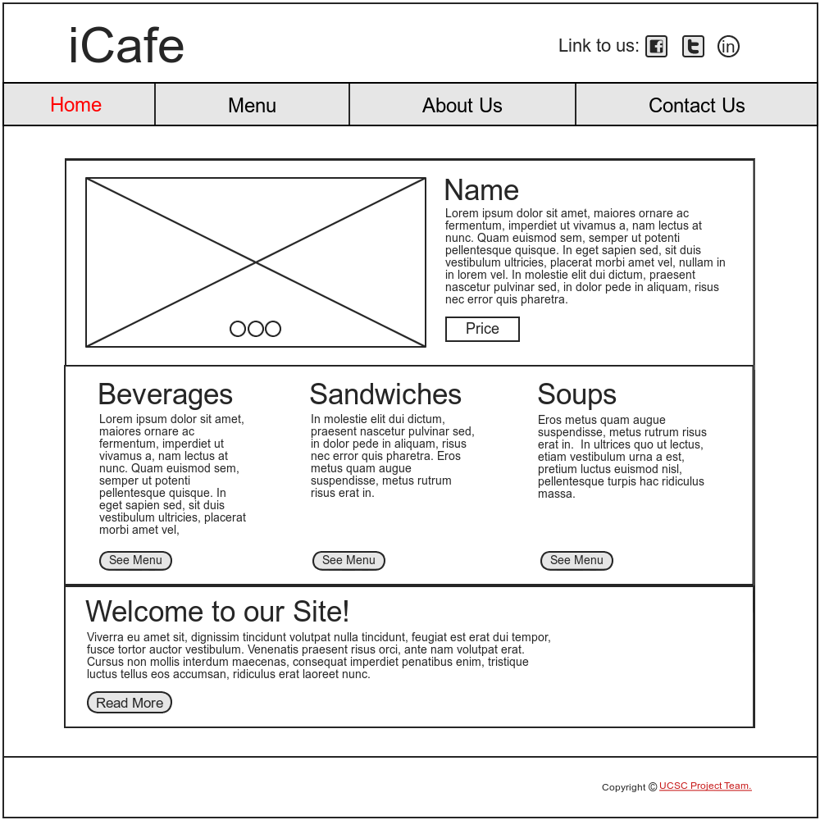
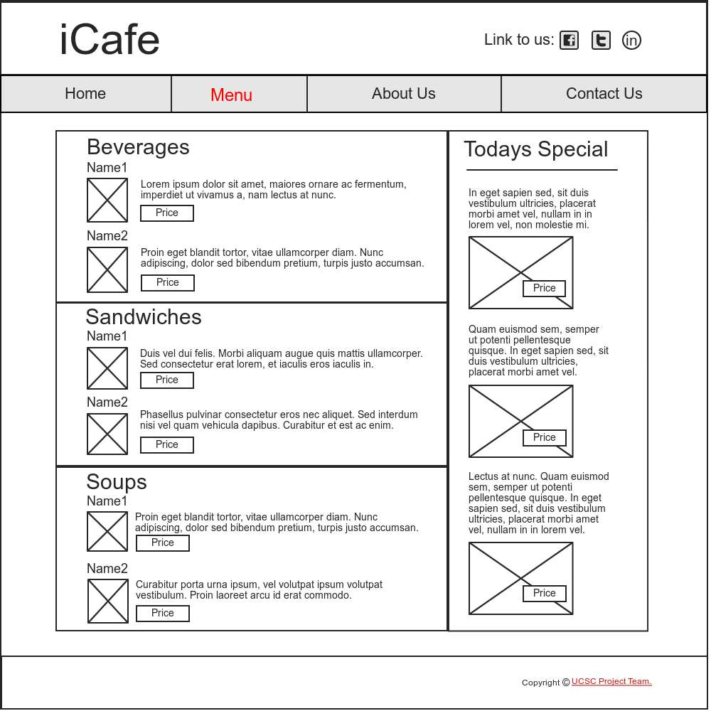
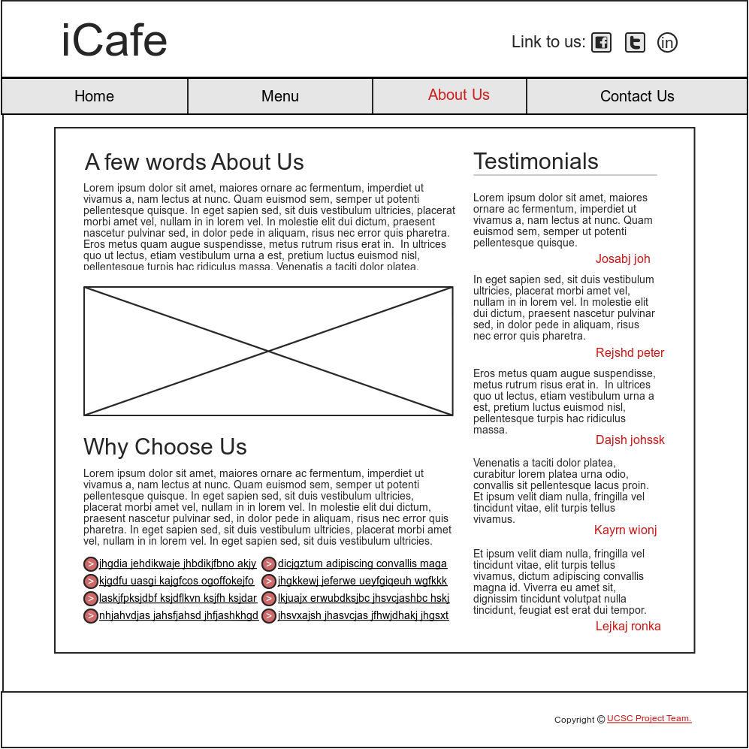
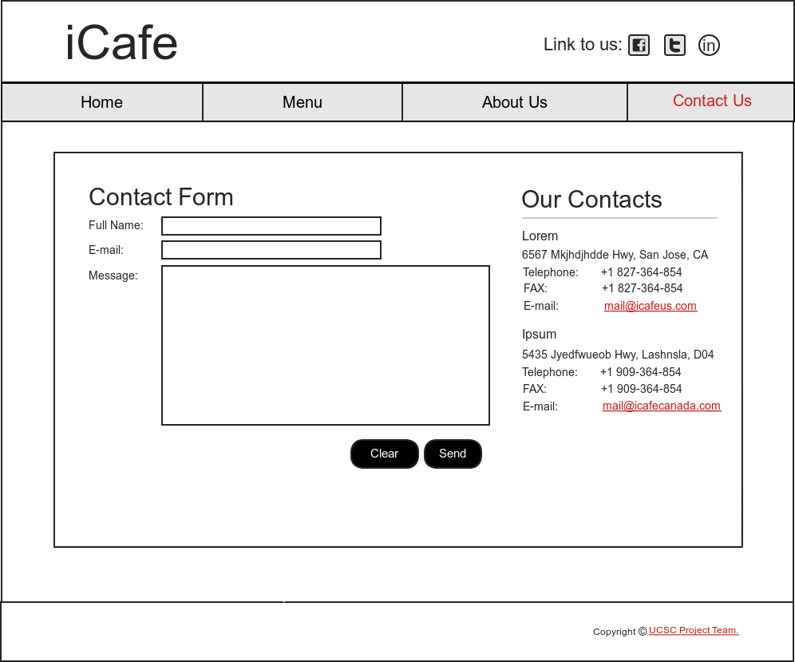
Wireframe v.3.0
Made changes to the wireframes again

