Slide 1
Point-in-Polygon (PiP) Search Acceleration Using GPU-Based Quadtree Framework

Slide 2
Problem Definition
Point-in-polygon (PIP) is a point location problem that determines whether a given point in the plane lies inside, outside, or on the boundary of a polygon.
Point location problems have various applications in areas that deal with processing geometrical data, such as computer graphics, computer vision, geographical information systems (GIS), motion planning, and CAD.
Notes:
Importance of Range search

Slide 3
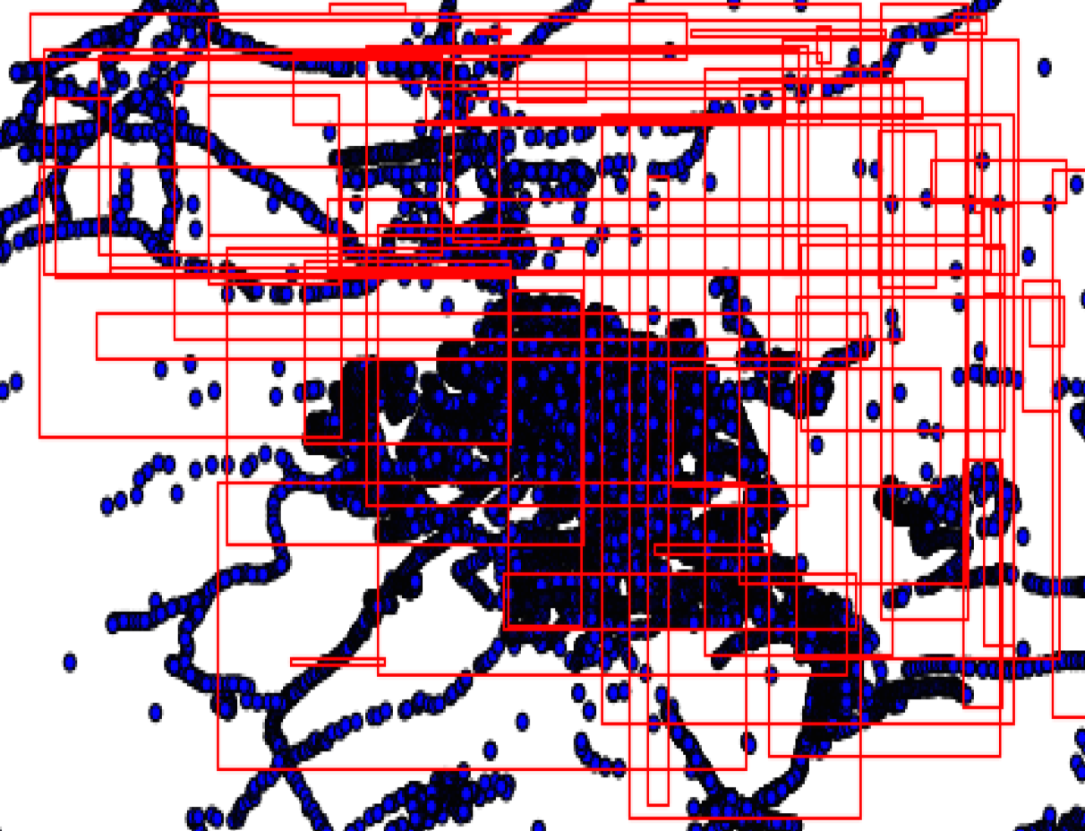
Motivation
Problem : List the points inside each polygon.
Solution : Check if each of these points are within a polygon. And repeat this step for all polygons.
Notes:
There are millions of points and hundreds of polygons need to be queried. This brute force search method is inefficient.
Some polygons are densely populated and some polygons do not have any points at all. In brute force the effort spent on finding the points inside all the polygons is the same.

Slide 4
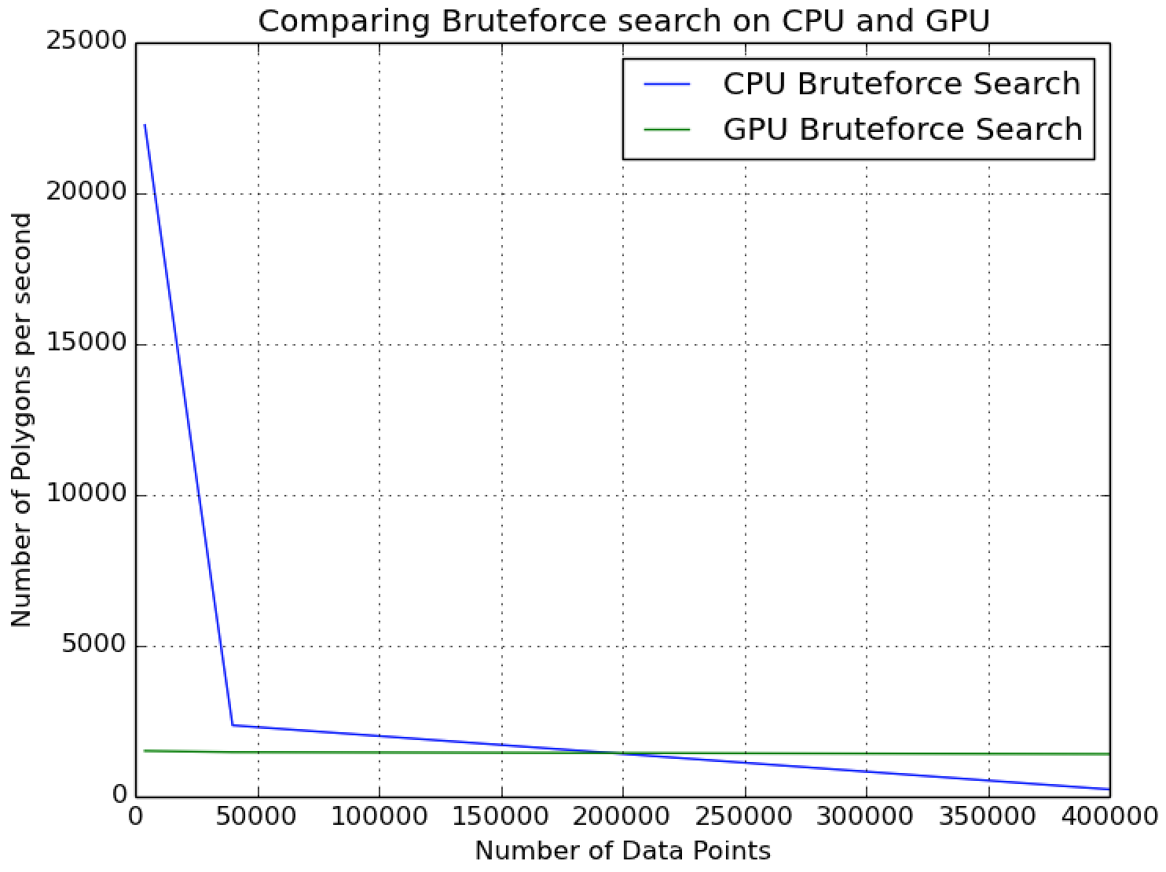
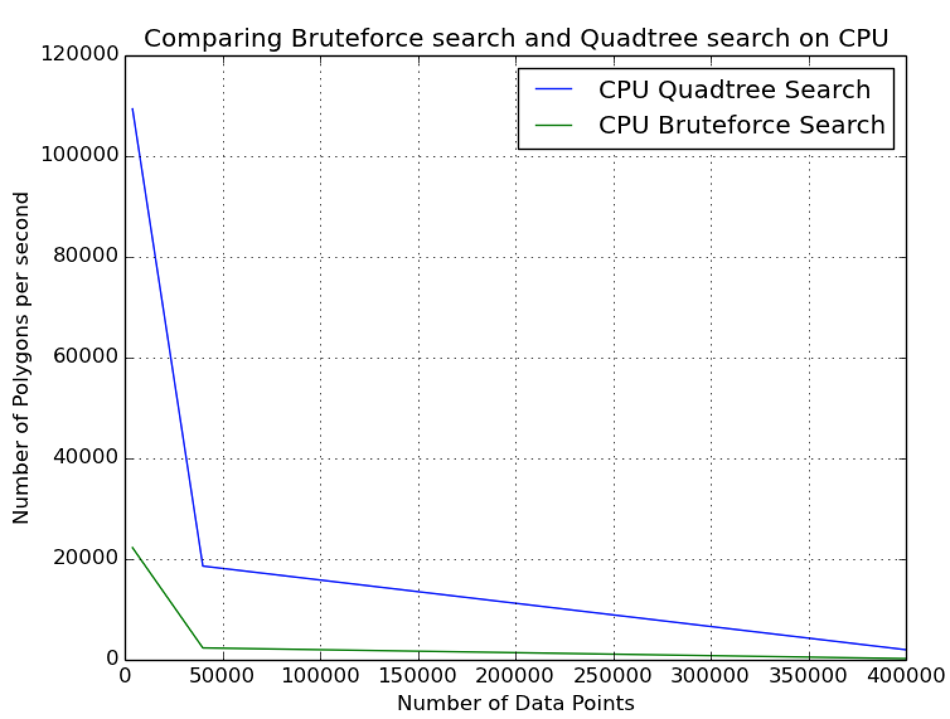
Motivation
Notes:
Brute force- GPU is better for large data. But brute force GPU sill provides lower performance than CPU with quadtree implementation.

Slide 5
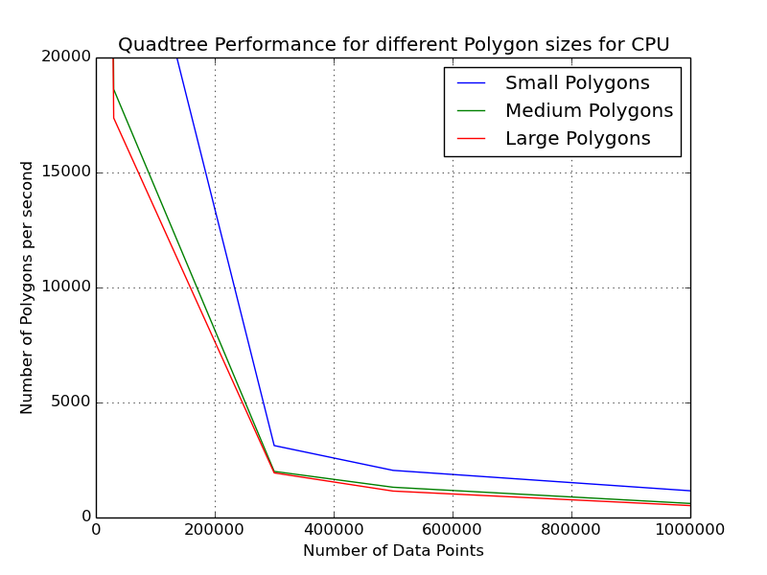
Quadtree Background
Notes:
Quadree performs better for smaller polygons. The reason for it.

Slide 6
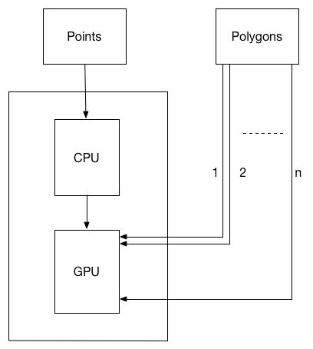
GPU Design
Points are stored in Quadtree
Quadtree is transferred to
GPU from the CPU.
Any number of Polygons can
be queried from the GPU.

Slide 7
GPU Background
Challenges in GPU implementation.
The quadtree is an irregular data structure.
Traversal of a quadtree built using pointers results in lot of pointer-chasing memory operations.
Typical recursive traversal in GPU is not preferred.
Transferring a pointer based quadtree to a gpu proves to be a challenge.
Notes:
Reason for each points listed in the slide.

Slide 8
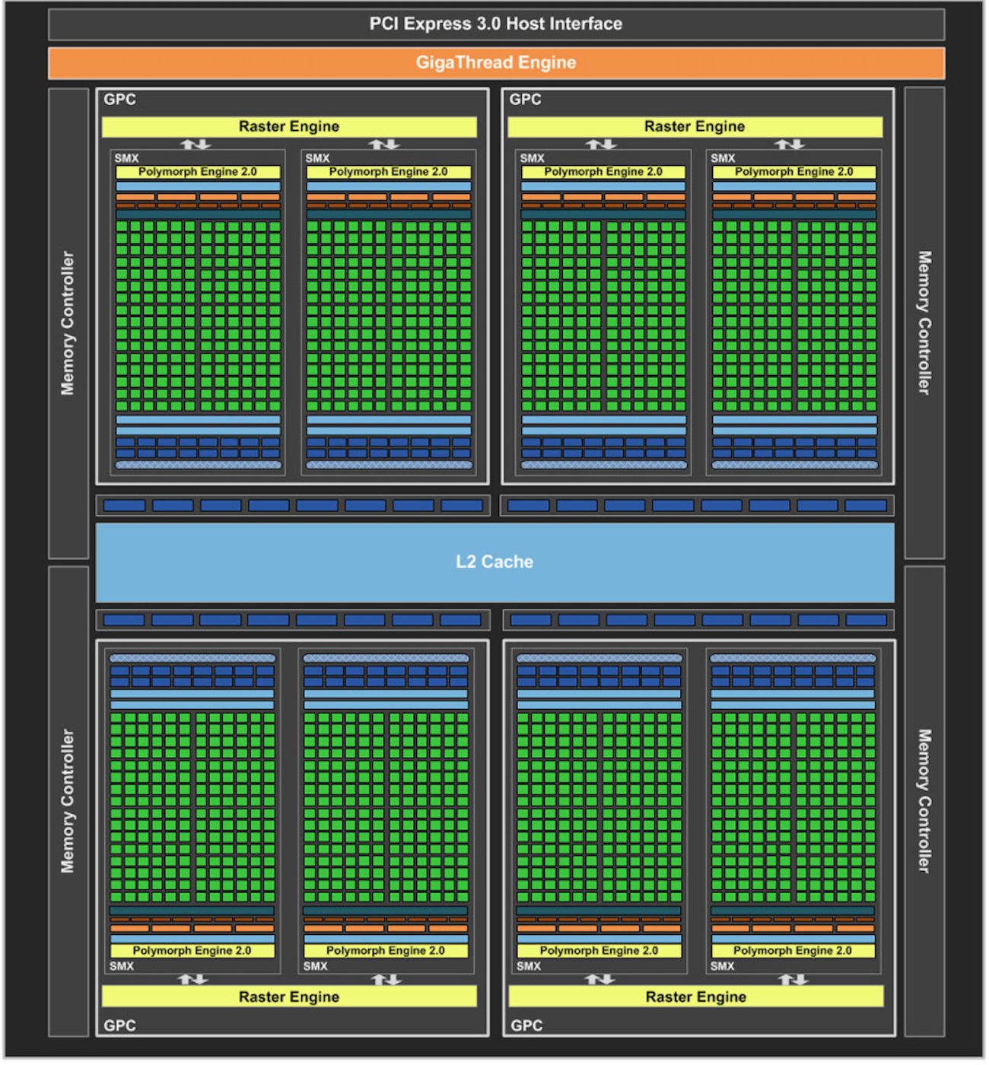
GPU Architecture
8 SMX
4 GPCs
1536 CUDA cores
512KB L2 Cache
Notes:
Explain cuda enabled GPU architecture

Slide 9
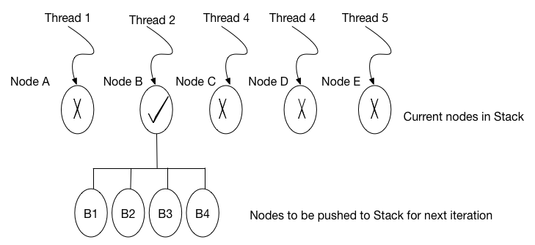
GPU Implementation
Iterative BFS is implemented on the GPU
A polygon is assigned to a warp.
A thread in a warp is assigned to node
Nodes that overlap the polygon are
pushed on to the stack and iteration
continues till level 4.
At level 4, nodes are classified and the
points inside the node that are within
the polygon boundary are stored.
Notes:
Explain stack based BFS implementation on GPUs

Slide 10
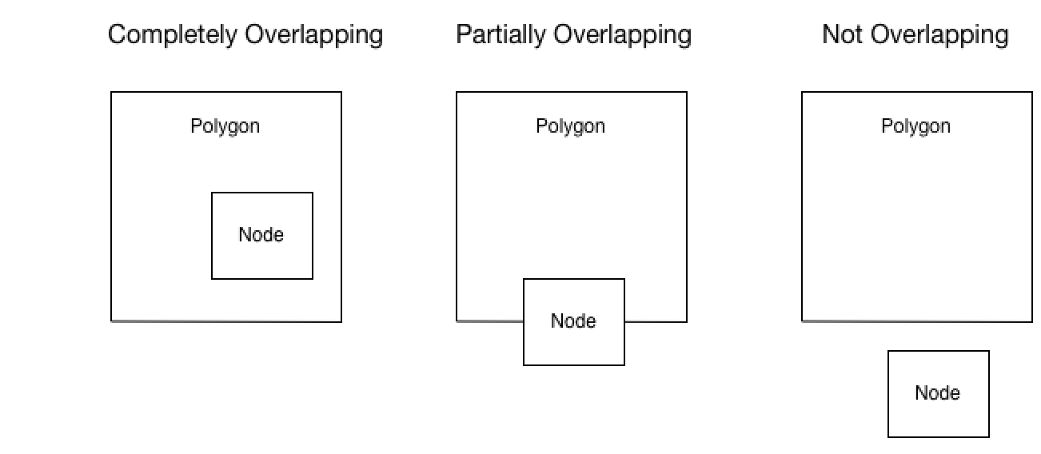
Reading Data Points from Leaf Node
The leaf nodes are classified based on the kind of overlap and the data points are read accordingly.
Notes:
The kind of overlap determines the way data from the node is read and stored.

Slide 11
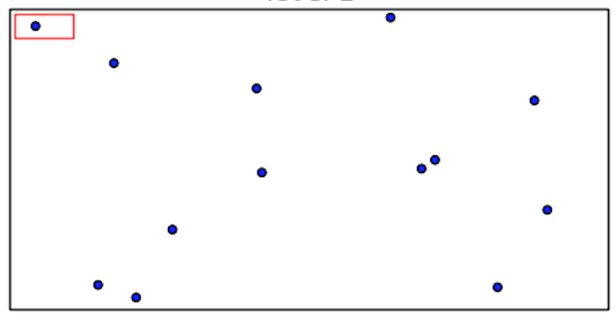

Scenario : Polygon in Leaf Node
Polygon inside a leaf node – Level 1
In this scenario, the Polygon boundary falls into a single leaf node
Notes:
Best case scenario

Slide 12
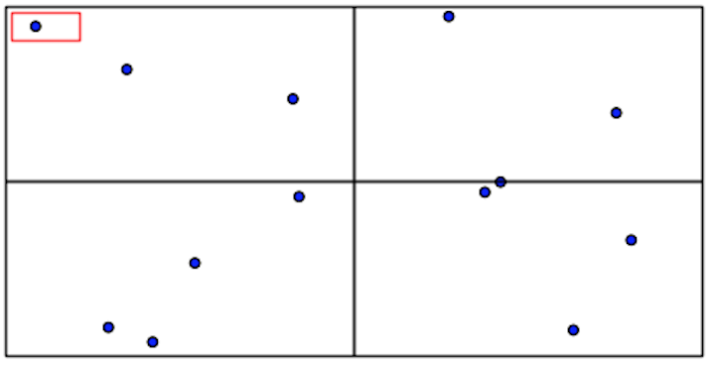
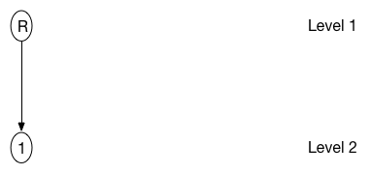
Scenario : Polygon in Leaf Node
Polygon inside a leaf node – Level 2
At level 2 , the algorithm isolates one quadrant (first child of the root node)and ignores all other quadrants, thus bringing down the number of quadrants to be processed to 1 from 4(4 is the total number of nodes at this level).

Slide 13
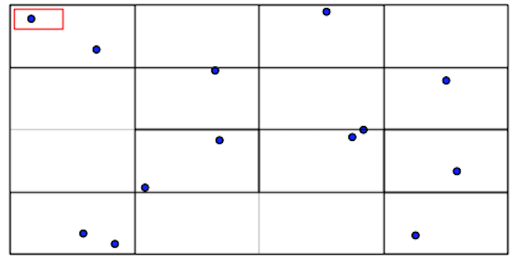
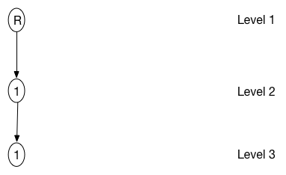
Scenario : Polygon in Leaf Node
Polygon inside a leaf node – Level 3
At level 3, the algorithm again isolates one quadrant which is the first child of the quadrant from level 1.
This step reduces the number of quadrants to be processed to 1 from 3(3 is the total number of children of the quadrant output from level 1).

Slide 14
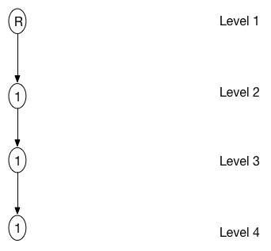
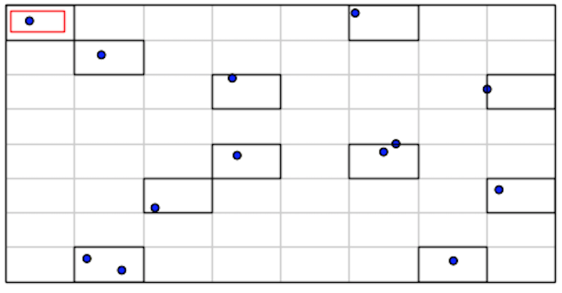
Scenario : Polygon in Leaf Node
Polygon inside a leaf node – Level 4
At level 4, the algorithm isolates one quadrant which is the first child of the quadrant from level 3.
This step reduces the number of quadrants to be processed to 1 from 2(2 is the total number of children of the quadrant output from level 3).
Finally only one quadrant at level 4 needs to be processed in order to get the points inside the polygon in this case.

Slide 15
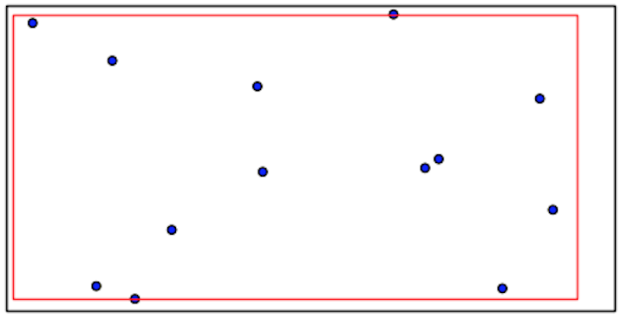
Scenario : Polygon Overlap All Nodes
Polygon overlapping all leaf nodes – Level 1
The last scenario demonstrates a condition where the polygon contains maximum number of quadrants at level 4 of the quadtree and the algorithm provides a least performance compared to all other scenarios.
Notes:
Worst case scenario for quadtree as polygon is overlapping all nodes

Slide 16
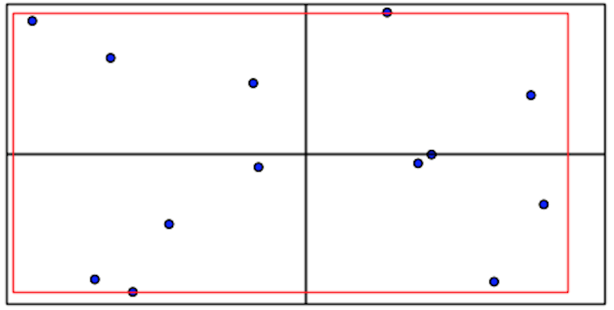
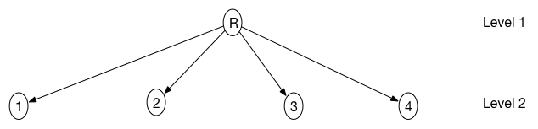
Scenario : Polygon Overlap All Nodes
Polygon overlapping all leaf nodes – Level 2
At level 2 , the algorithm isolates all four children of the root node.

Slide 17
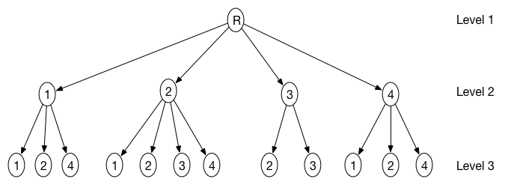
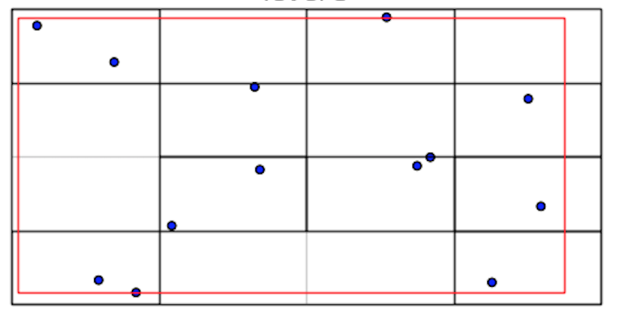
Scenario : Polygon Overlap All Nodes
Polygon overlapping all leaf nodes – Level 3
At level 3, the algorithm isolates all 12 quadrants at this level.The maximum possible number of nodes at this level is 16 but four of those nodes are null nodes (it does not contain any points) and these four nodes are ignored even though these nodes lie within the polygon.

Slide 18
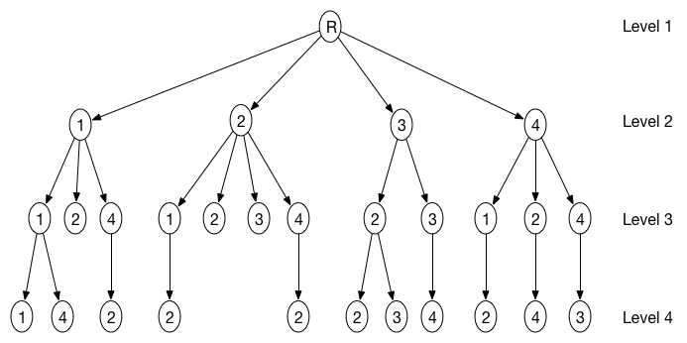
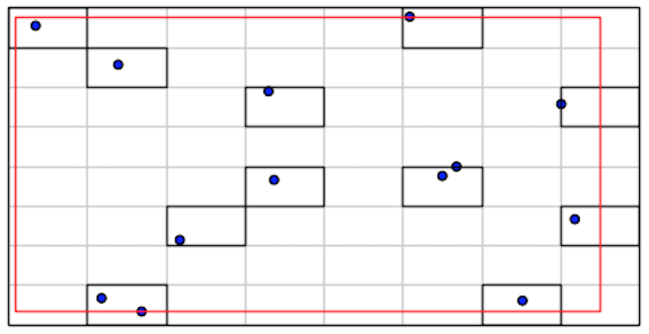
Scenario : Polygon Overlap All Nodes
Polygon overlapping all leaf nodes – Level 4
At level 4, the algorithm isolates all the 11 quadrants at this level.The maximum possible number of nodes at this level is 64 but 53 of those nodes are null nodes (it does not contain any points) and so these 53 nodes are ignored even though these nodes lie within the polygon.

Slide 19
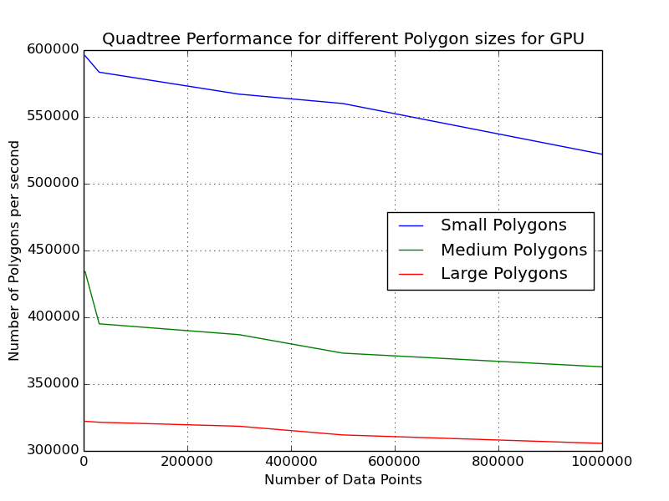
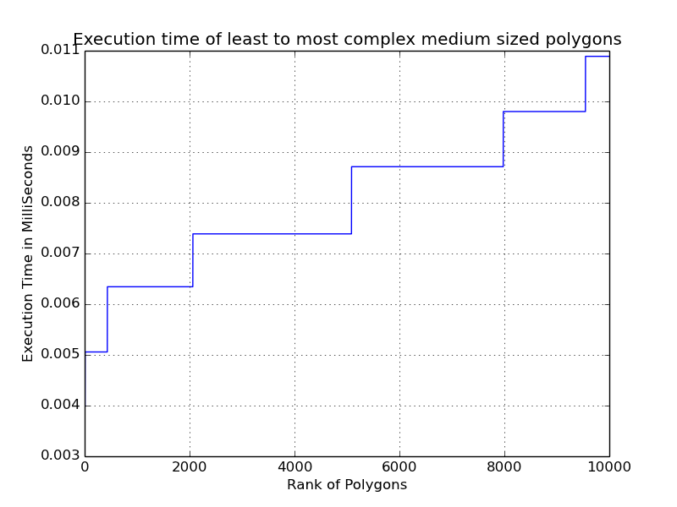
Results : GPU for different Polygon sizes
.
Notes:
Number of partial nodes determine the execution time for PIP search.

Slide 20
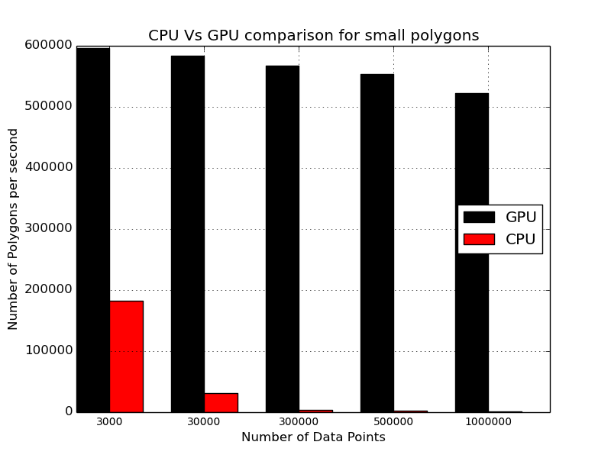
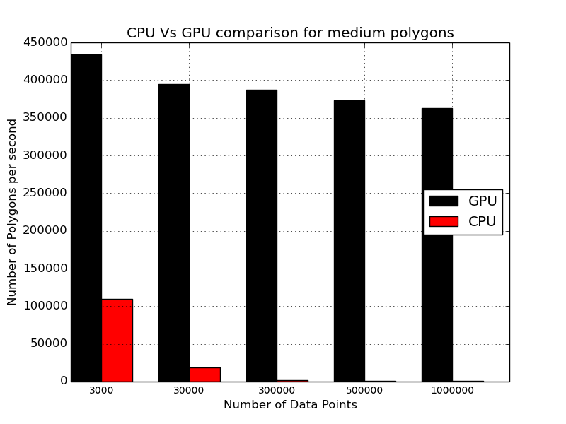
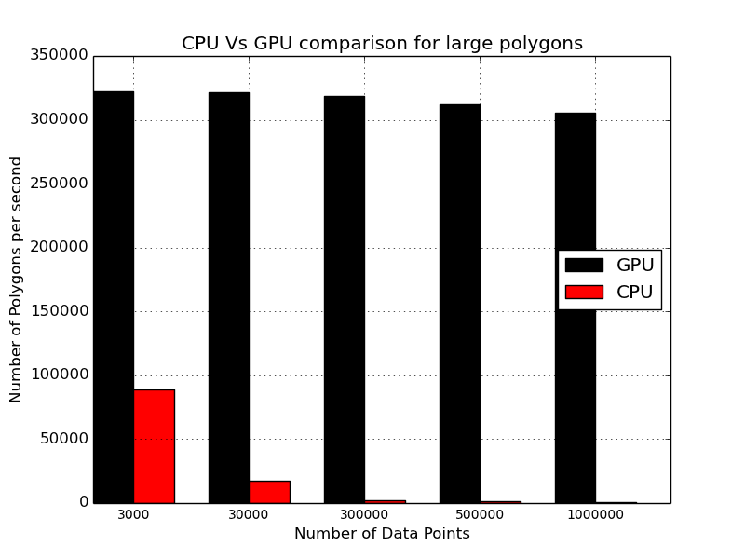
GPU Vs CPU Comparison

Slide 21
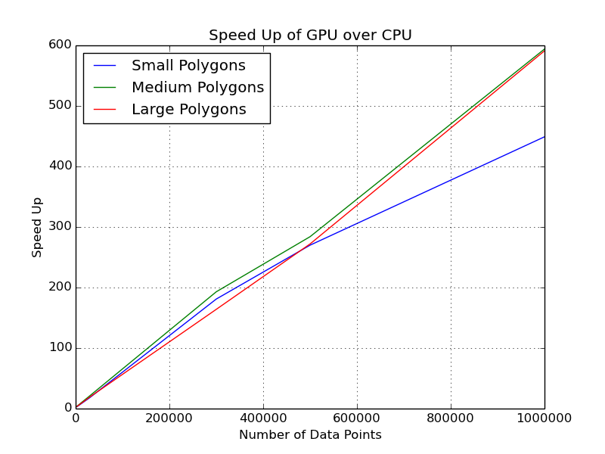
Speed Up of GPU over CPU
Small Polygons – 3.2x to 449x
Medium Polygons -4x to 594x
Large Polygons -3.6x to 591x
Notes:
Medium & Large polygon shows maximum perfromance gain and has optimum work load.

