Slide 1

EGFR-MYO1D receptor modeling update
Membrane-compatible
EGFR dimer receptor
model 구축 및 clustering
후속 MYO1D PPI 분석 전, EGFR receptor input을 +10° model과 final 200 ns MD validation 기준으로 정리
receptor modeling
MD validation
clustering
Scope: PPI docking, pocket discovery, compound docking은 이번 발표에서 결과로 다루지 않음
01 / 09
Generated cover is conceptual; scientific claims use local files and logs.

Slide 2
Modeling logic
Why receptor model first?
MYO1D PPI docking 전에 EGFR receptor frame을 먼저 고정해야 downstream 해석이 흔들리지 않는다.
01
→
02
→
03
→
04
→
05
EGFR receptor input 확정
MYO1D docking
EGFR-side PPI patch
Pocket discovery
Compound docking
next work after receptor decision
interface residues and contact logic
PPI-aware pocket hypothesis
future output, not current claim
+10° model + final 200 ns MD validation
이번 deck에서 다루는 확정 범위
이번 deck에서 결과로 주장하지 않는 범위
template assembly provenance: TM/JM/KD composite model construction
MYO1D docking result는 아직 미수행/미정리
orientation scan: +10° selected among available parsed metrics
EGFR-side PPI patch, pocket discovery는 future work
final receptor pair: +10 no-water 200 ns trajectory identity confirmed
compound docking은 receptor representative 확정 후 시작
02 / 09
Source: reports/EGFR_modeling_clustering_PPT_data_package.md

Slide 3
Composite construction
TM-JM-KD inactive dimer model assembly
2M0B TM dimer, 2M20 JM-A reference, 3GT8 inactive KD dimer, MODELLER gap filling을 조합해 EGFR receptor frame을 구성했다.
Component
Source
Role in model
Caveat
Construction workflow
transmembrane dimer anchor; local script retained 634-670
2M0B TM dimer alignment
TM dimer
2M0B
mmCIF maps 634-677; local selection is shorter
anchor membrane-spanning dimer geometry
exact coordinate-generation execution path remains caveated
2M20 JM-A reference
JM-A reference
2M20
membrane-proximal JM-A orientation reference
orient membrane-proximal JM-A segment
3GT8 inactive KD dimer placement
inactive KD dimer
3GT8
symmetric inactive kinase-domain dimer placement
PDB numbering and working model numbering differ
retain inactive symmetric KD context
MODELLER gap filling
modeled gaps
MODELLER
JM-B 684-704 and A-loop 862-876 were filled
modeled coordinates, not template-derived
JM-B and A-loop modeled gaps
five rotational variants
-20°, -10°, 0°, +10°, +20° for scan
Structure render to add later: reports/assets/slide6_plus10_side_view.png or use 03_receptor_pack/figures/EGFR_plus10_domain_coloring.pml
03 / 09
Sources: 1.align/*, 01_numbering_provenance/template_model_mapping.csv

Slide 4
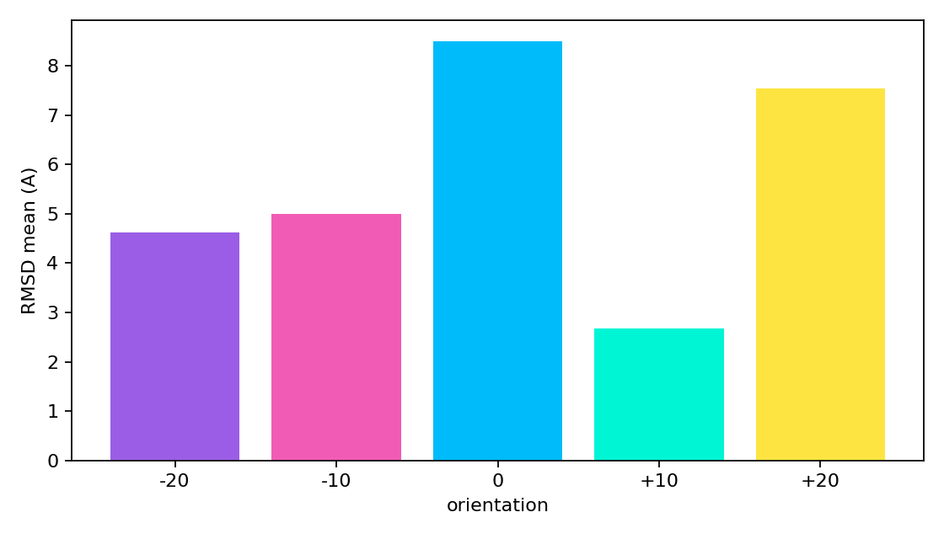
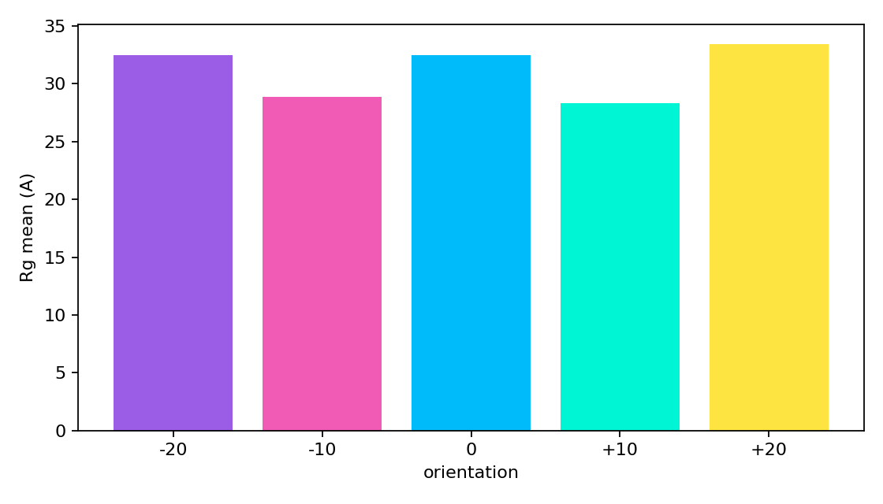
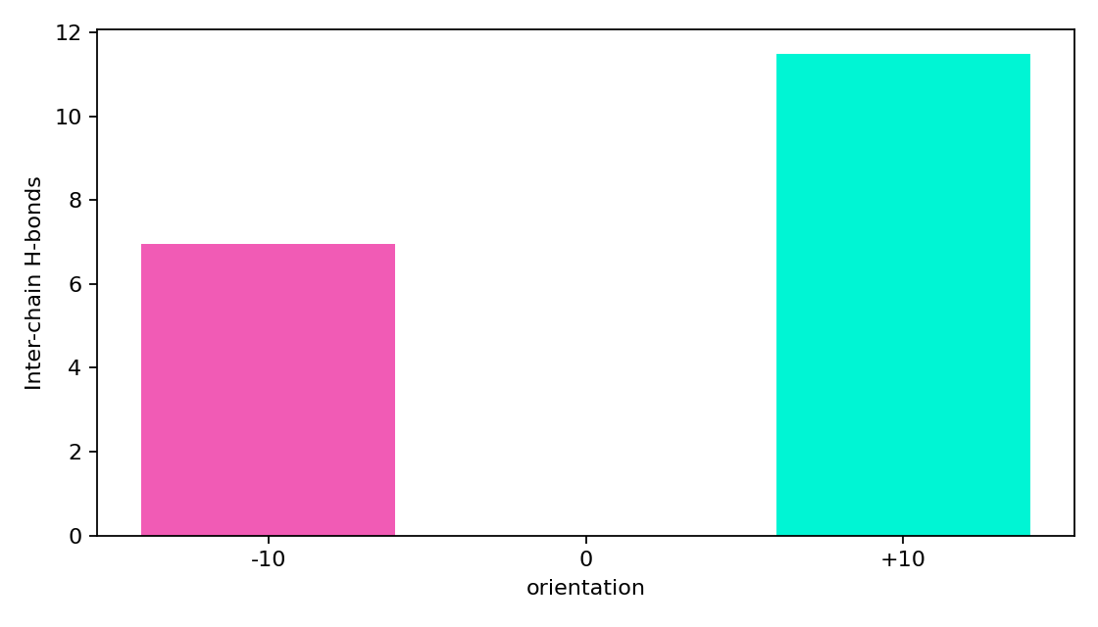
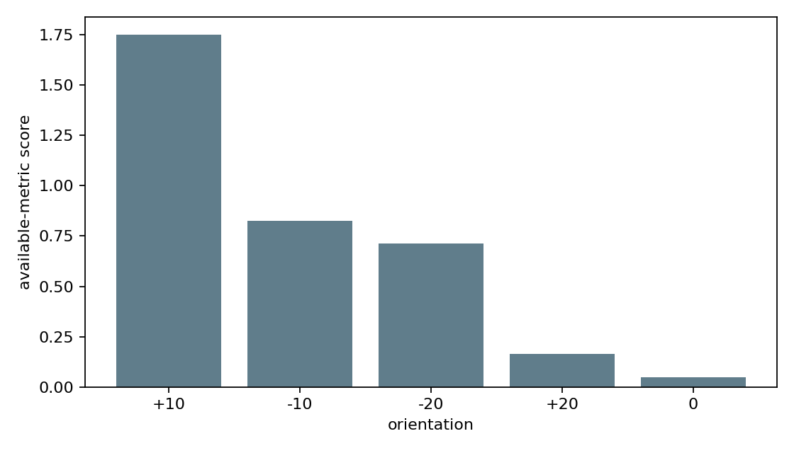
Orientation scan
Five TM-KD rotations screened; +10° ranked best
Available parsed metrics support +10° as the working EGFR receptor orientation, with scan-level caveats.
+10° selected metric snapshot
RMSD mean
2.68 Å
±0.39; lowest among parsed scan metrics
Rg mean
28.31 Å
RMSD by orientation
Radius of gyration by orientation
±0.12; compact/stable relative frame
Inter-chain H-bond
11.49
±3.11 where available
Caveat: orientation-wide membrane/contact metrics are incomplete, so this is an available-metric ranking rather than a complete biological stability score.
Inter-chain H-bond count where available
Available-metric orientation score
04 / 09
Sources: 02_orientation_metrics/orientation_comparison_table.csv and figures/

Slide 5
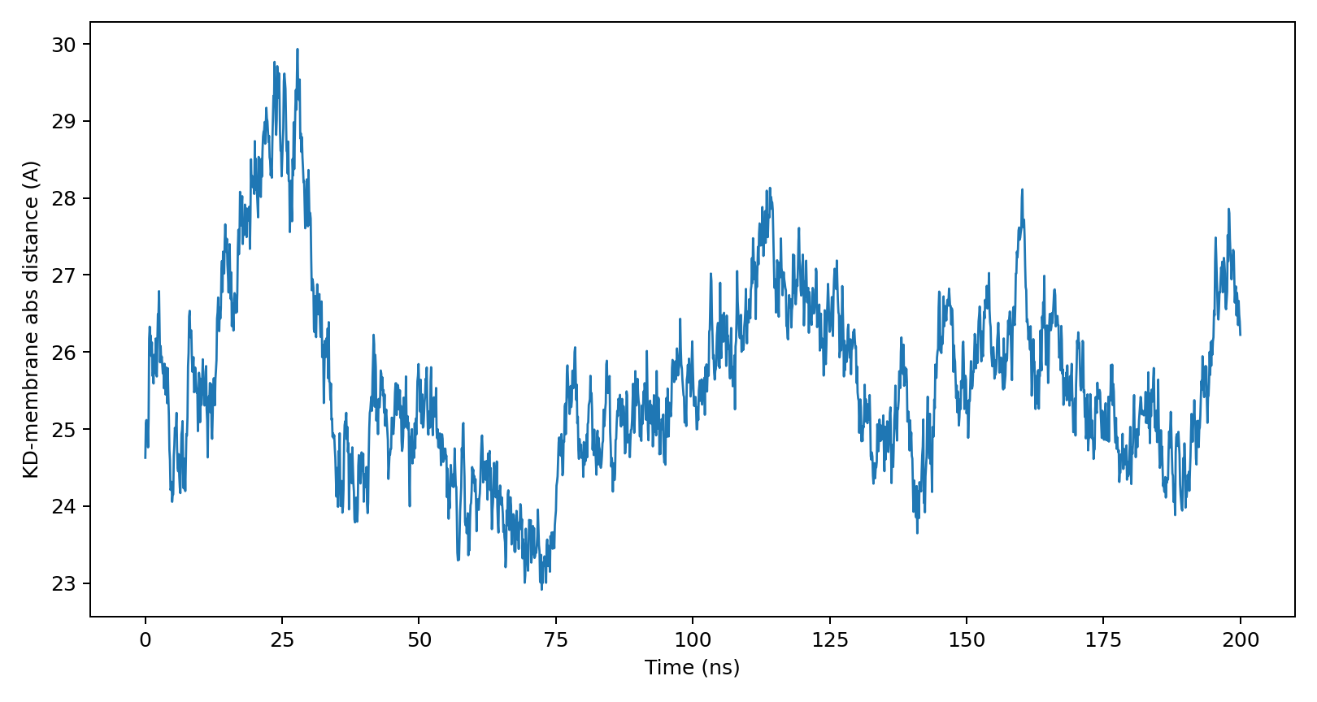
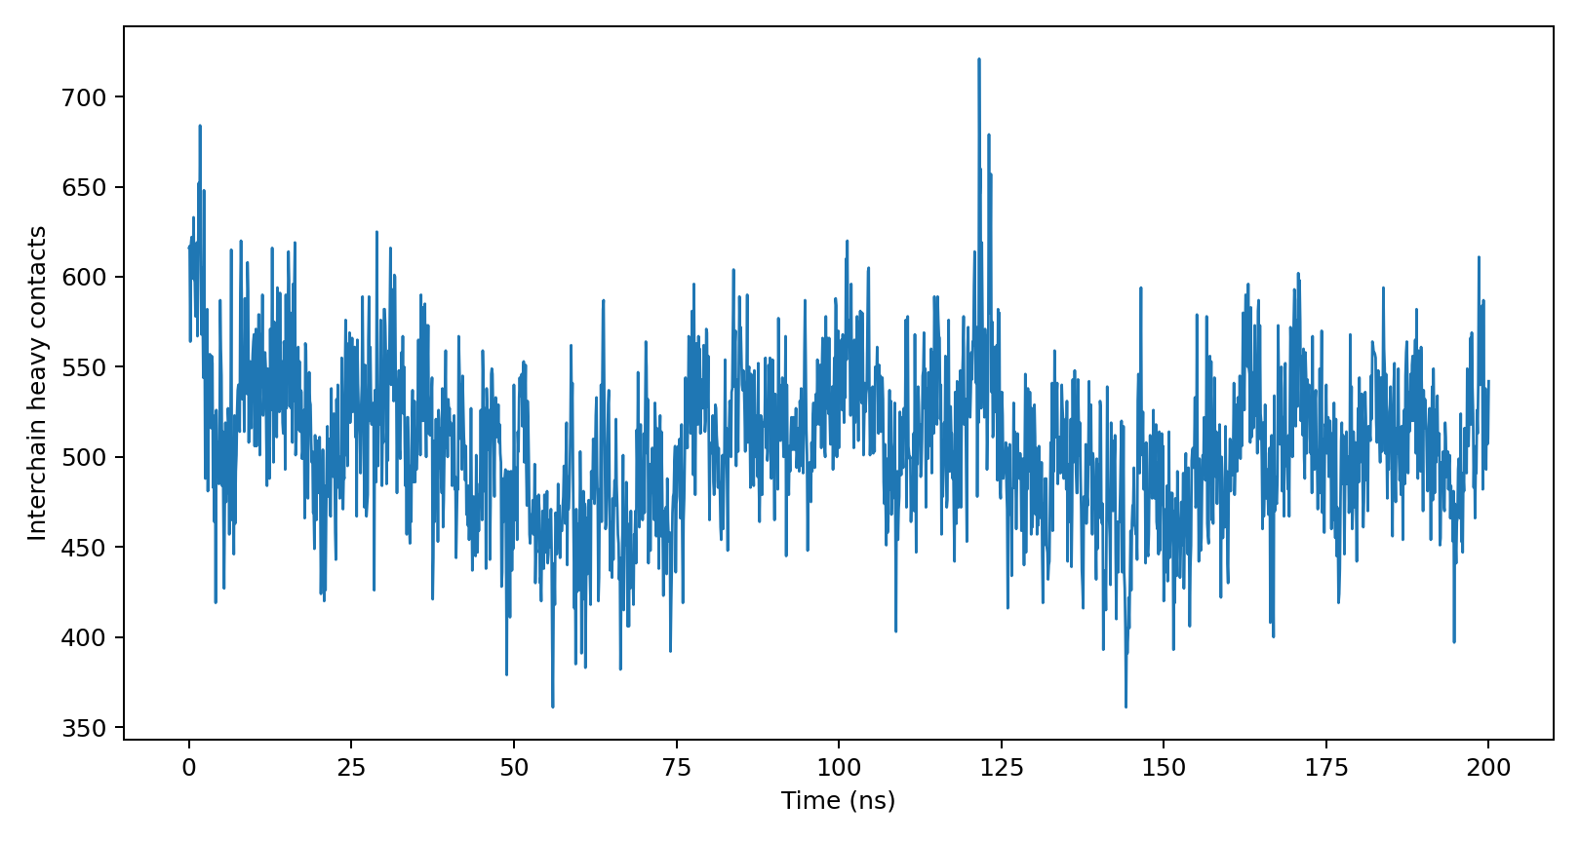
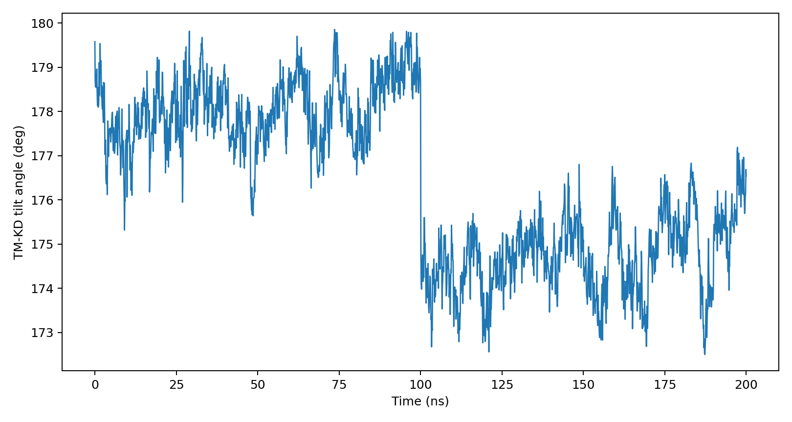
MD validation
Final +10 no-water 200 ns trajectory is identified
Final pair: EGFR_plus10_step7_production_nw.gro + EGFR_plus10_step7_200ns_nw.xtc
gmx_check atoms
coordinate frames
time span
analysis status
49,854
2,001
0-200 ns
OK
final no-water system
100 ps output interval
0-200,000 ps
final-pair metric rows
KD-to-membrane absolute distance across final 200 ns
Inter-protomer heavy contacts within 4.5 Å
TM-KD vector angle relative to membrane normal
Boundary note: 3.rotate_EGFR/10/full_200ns.xtc is not used as final evidence; final claim uses the packaged receptor/trajectory pair and uploaded gmx_check log.
05 / 09
Sources: 03_receptor_pack/metadata/gmx_check_EGFR_plus10_step7_200ns_nw.txt and trajectory_metrics/

Slide 6
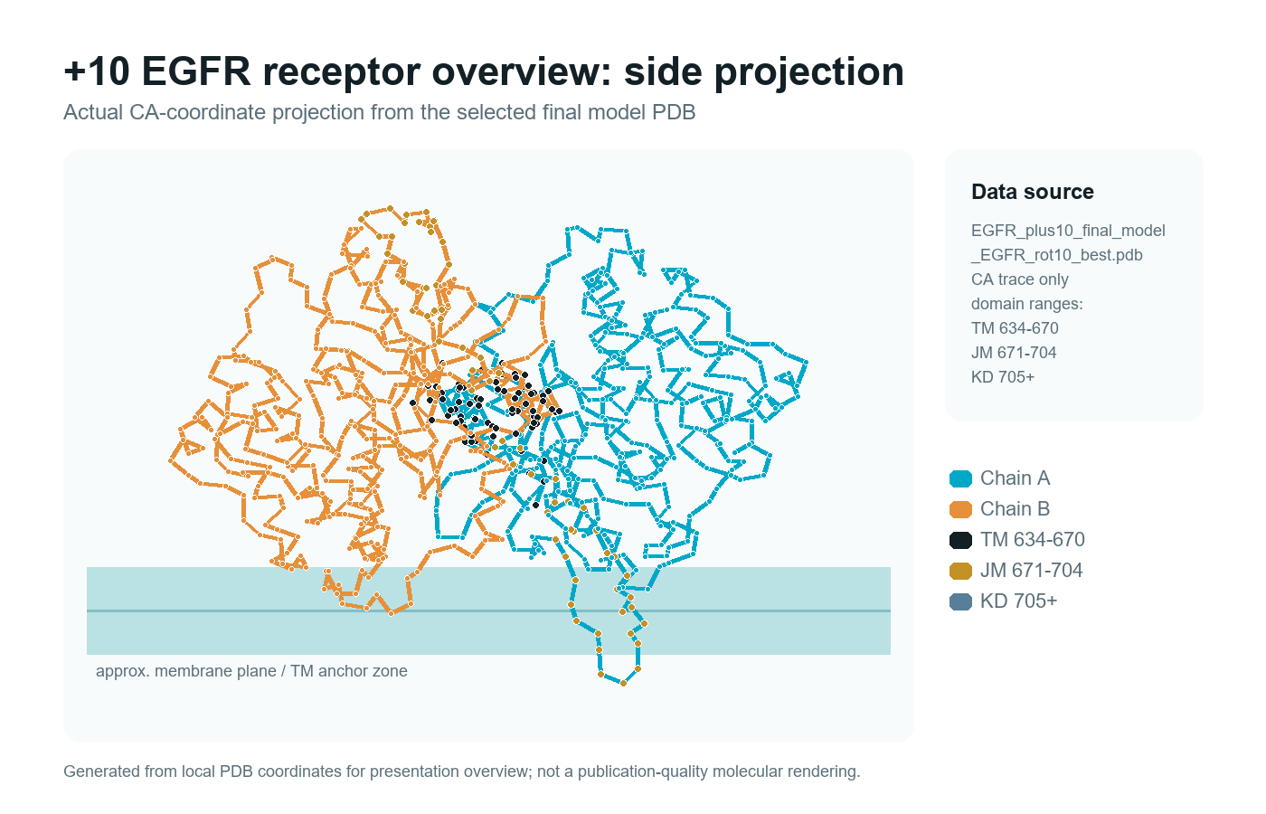
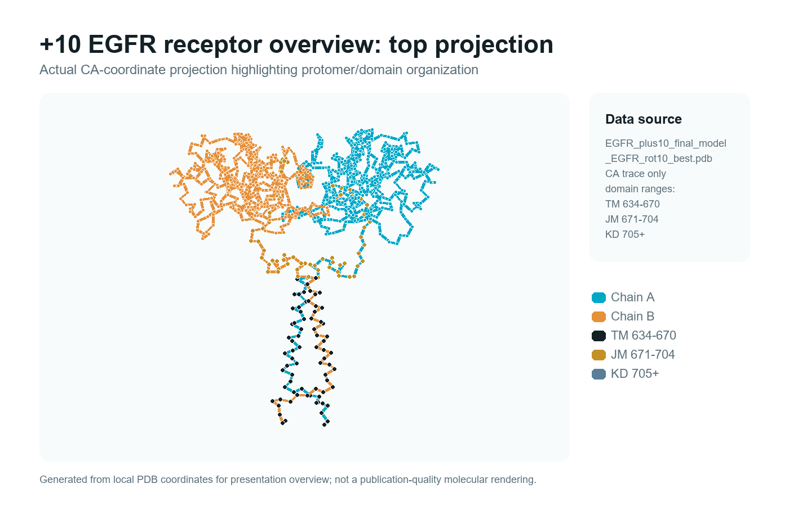
Structural interpretation
+10° receptor frame is the downstream input candidate
현재 단계에서는 membrane-compatible inactive dimer frame으로 해석하되, 구조 render는 실제 PDB/GRO에서 생성해야 한다.
Interpretation
+10° model preserves a membrane-proximal inactive TM-JM-KD dimer frame.
Final 200 ns metrics support using this receptor frame as the next input candidate.
150-200 ns KD distance
25.66 Å
±0.86 from final-pair analysis
150-200 ns contacts
505.28
±38.10 heavy contacts within 4.5 Å
Caveats: GRO lacks chain IDs, so protomers are split by residue order; residue labels 689/692/713/715 are not all lysines in the final topology.
Side view: membrane plane + EGFR dimer
Top view: dimer interface orientation
06 / 09
Sources: final +10 PDB/GRO, membrane_stability_*_mdanalysis.csv, domain coloring scripts

Slide 7
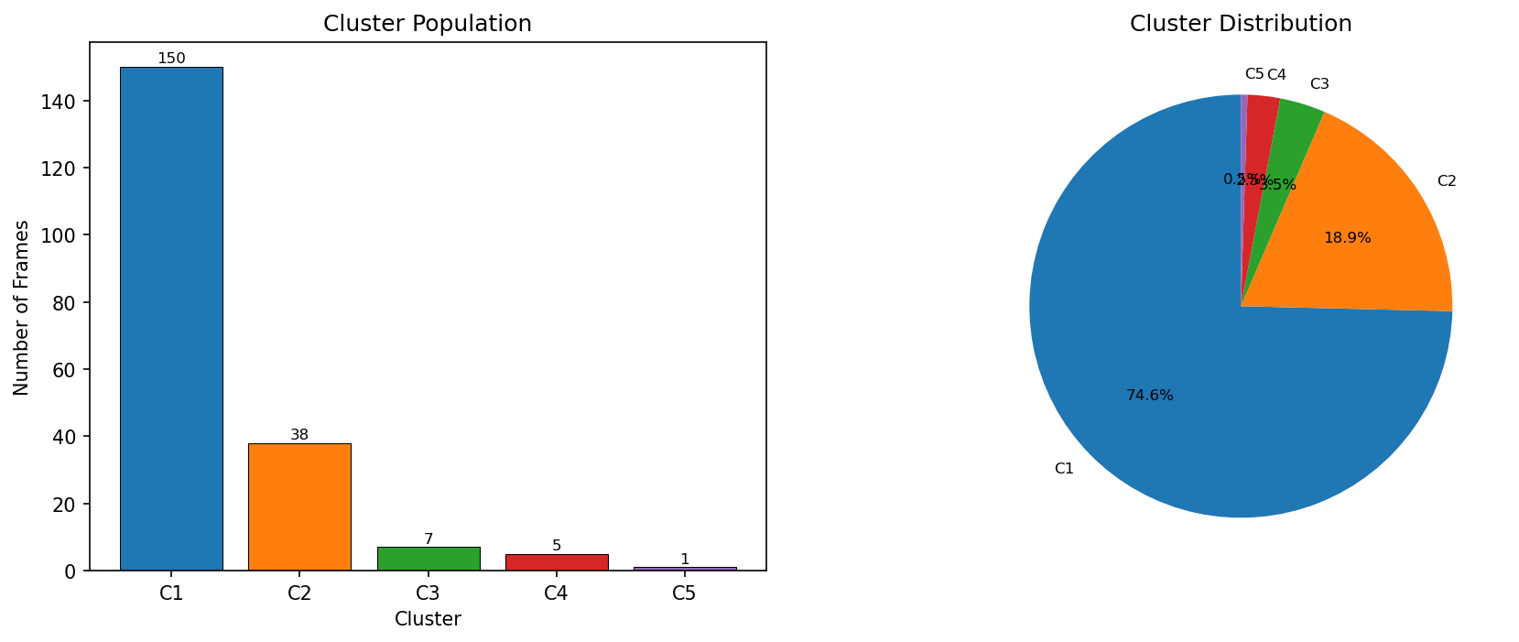
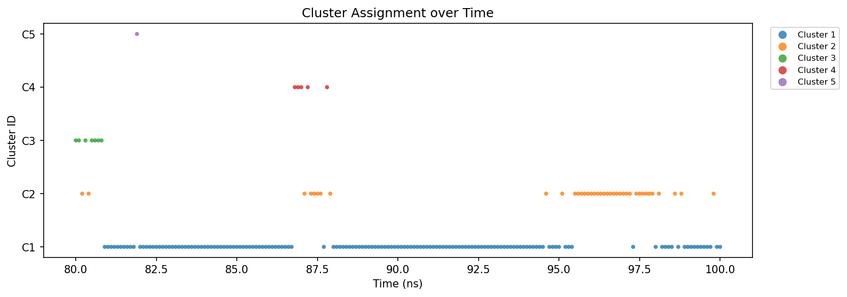
Trajectory clustering
Older representative exists; final-window reps need confirmation
80-100 ns clustering can support context, but requested 160-185 / 170-200 ns representatives are not confirmed by surrounding summaries.
Representative status
80-100 ns C1
found: C1 150/201 frames, representative 84.0 ns
supporting only
160-185 ns C1
confirmed clustering summary not found
missing
170-200 ns C1/C2
confirmed clustering summaries not found
missing
80-100 ns cluster population; C1 = 150/201 frames (74.6%)
EGFR_160-185.pdb
file exists under 60-85 ns result folder
ambiguous
EGFR_170-200.pdb
file exists under 70-100 ns result folder
ambiguous
PPT wording rule: do not present the ambiguous PDB filenames as final 160-200 ns representatives until a matching summary/log confirms the interval.
80-100 ns cluster timeline; representative C1 frame time = 84.0 ns
07 / 09
Sources: 4.+10_clustering/cluster_results/80-100ns_cut0.15 and clustering audit reports

Slide 8
Current status
Separate confirmed receptor evidence from unresolved work
현 단계에서 claim 가능한 receptor-modeling/MD validation 범위와, 확인 후 진행해야 할 downstream work를 분리한다.
Confirmed now
Needs confirmation
Future work only
EGFR TM-JM-KD inactive dimer composite model was constructed.
Requested 160-185 / 170-200 ns representatives need matching clustering summaries.
MYO1D docking and consensus interface analysis.
EGFR-side PPI patch extraction.
+10° is the current receptor input candidate among available parsed orientation metrics.
Ambiguous EGFR_160-185.pdb and EGFR_170-200.pdb must not be used as confirmed final-window reps.
PPI-adjacent pocket discovery.
Compound docking after receptor representative is finalized.
Final no-water trajectory identity is confirmed: 49,854 atoms, 2,001 frames, 0-200 ns.
Publication-quality side/top structure renders still need to be generated from actual PDB/GRO.
Final-pair membrane-stability metrics are available with OK rows.
JM-A coordinate-generation provenance remains a caveat.
Presentation rule: receptor model and MD validation are current results; MYO1D/PPI/pocket/compound outputs remain future work until new evidence is added.
08 / 09
Sources: reports/EGFR_modeling_clustering_PPT_data_package.md and reports/다음할일.md

Slide 9
Next decision
Confirm receptor representative, then start MYO1D PPI work
교수님께 final receptor state와 clustering window 사용 여부를 확인받고, downstream 분석을 순차적으로 진행한다.
Sequential next work
Feedback request
1
Confirm representative receptor state
Which receptor state should become the MYO1D docking input?
professor decision + clustering window
2
Run / finalize MYO1D docking
TH1 beta-meander focused receptor-PPI input
Pre-MD final +10 PDB vs final 200 ns coordinate vs confirmed cluster representative.
3
Extract EGFR-side PPI patch
consensus interface residues and contact logic
Use 150-200 ns, 160-200 ns, or another final-window clustering interval?
4
Identify PPI-adjacent pocket
Redefine positive-patch residue labels using final topology residue identity.
non-ATP pocket hypothesis after interface mapping
Data to add later if selected: confirmed final-window clustering summary/PDB, side/top structural render PNGs, updated decision log.
5
Compound docking
only after receptor/PPI pocket evidence is fixed
09 / 09
Next-work details are documented in reports/다음할일.md

