Slide 1
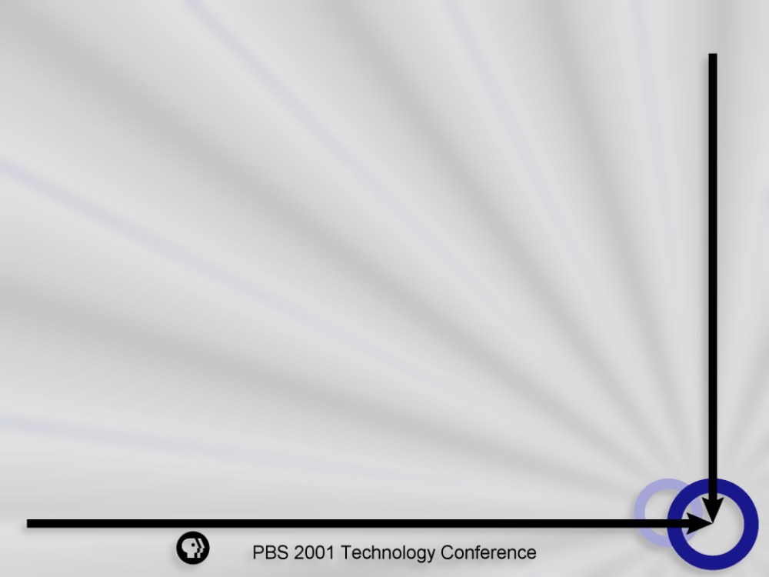
Welcome!
  PBS Technology Conference 2001
  and the
  NAB 2001 Annual Convention

Slide 2
Technology & Operations Strategic Plan
  Edward P. Caleca
  Sr. Vice President
  Technology & Operations

Slide 3
Evolution of an Entertainment Medium
Act I
Act II
Act III
Broadcast Television, Birth – 70s
Cable Television, 70s – 2000
DTH – DBS
Your Television, 2000 – Beyond
“Consumer Television”

Slide 4
What is public broadcasting doing to prepare for consumer television?
Creatively converting all local stations to digital
Developing local and national multicast services to support and enhance its mission
Expanding and enhancing local and national web sites
Developing the interactive TV landscape
Building relationships with cable to ensure carriage of our digital services

Slide 5
How is PBS Technology & Operations supporting your digital mandate?
Providing leadership on critical DTV standards, FCC rulemaking, developmental issues and funding support
Re-designing the organization to support the 3-year plan and associated capital and operating expense budget
Researching, analyzing and planning for the next generation of interconnection
Developing a 3-year strategy plan: public broadcasting, anytime, anywhere, 24/7

Slide 6
Public Broadcasting:
Anytime, Anywhere, 24/7
Strategic Imperatives:
Ensure carriage on all platforms: digital broadcast, digital cable, DBS, satellite/interconnection, interactive television, internet and wireless
Ensure 99% reliability across all platforms
Ensure that PBS member stations transition to digital by 2003
Participate in application trials and analysis for emerging technologies

Slide 7
PBS T&O Objectives
FY2002 - 2004
Control operational cost and increase efficiencies
Broaden the relationship between PBS and member stations
Achieve excellence in teaming across PBS business units

Slide 8
PBS T&O Objectives
FY2002 - 2004
Add value by leveraging the ability to deliver the broadest set of offers: technology, consulting, professional development, solutions, etc.
Achieve “Best in Class” customer satisfaction
Grow interconnection asset supported revenues
Maintain high reliability across all distribution platforms

Slide 9
Business Assumptions
FY2002 - 2004
Business Environment
Analog Television will continue to be public broadcasting’s core business
Existing multicast/SDTV packaged services will not greatly expand
Online will continue to support and complement programming and promotional platforms

Slide 10
Business Assumptions
FY2002 - 2004
Business Environment
E-commerce/B2B activity will be minimal
There will be no breakthrough datacasting application
Consumer acceptance of digital TV will take significantly longer than anticipated; analog spectrum return: 2008 earliest

Slide 11
Business Assumptions
FY2002 - 2004
Business Environment
With launch of new satellite capacity, sales revenue will continue to be suppressed
Digital technology sets up a distribution/control shift to decentralized model
- Asset Management
- ADDE

Slide 12
Business Assumptions
FY2002 - 2004
Cable and DBS subscriber base will grow by 3-5 million households
Wireless applications will grow

Slide 13
Operating Expense & Capital Budget, FY2002 - 2004
Investment Priorities
Reliability
DTV Transition (Stations and Braddock Place)
Next Generation Interconnection
Asset Management/Archiving
Videostreaming

Slide 14
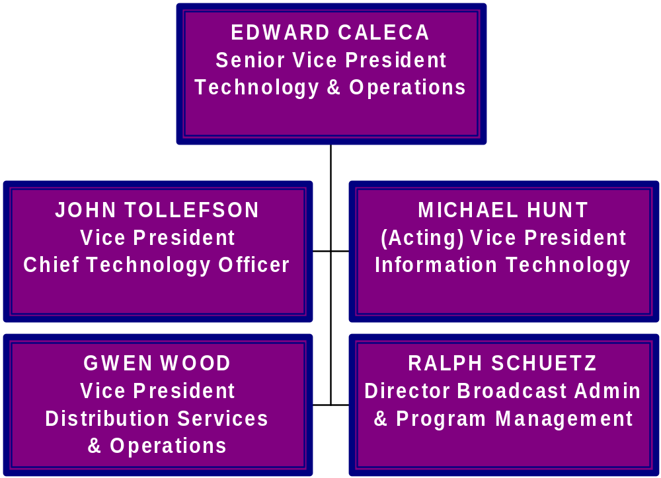
Technology & Operations
Organization Design

Slide 15
PBS T&O Organization Design
Vice President – Chief Technology Officer
Broadcast engineering
DTV Planning
Strategic technology plan
DTV professional development
MSO/DBS technical support
Equipment & funding consultation
DTV transition station support
Interconnection, current & future

Slide 16
PBS T&O Organization Design
Vice President – Distribution Services &
Operations
Broadcast operations & Technical Services Engineering
Satellite sales & services
Channel management
Interconnection asset and revenue opportunities

Slide 17
PBS T&O Organization Design
Vice President – Information Technology
Enterprise platform
I.T. strategic plan
Broadband technology platform
Application/solutions support
Communication/desktop platform

Slide 18
PBS T&O Organization Design
Director – Program Management &
Administration
Interconnection agreement/contract
Budget management
Station communications
Technology Conference support
Engineering committee liaison

Slide 19
DTV Life Cycle
Fast Growth
Slow Growth
Acceptance
2002-2005
Remediation
1999-2002
Introduction
Nov 1998
Birth
15 years

Slide 20
DTV Life Cycle – Slow Growth
Death
Decline - 2057
50 years
Renewal
Maturity - 2025
20 years
Early Maturity - 2015
10 years

Slide 21
DTV Life Cycle - Fast Growth
Death
Decline - 2055
50 years
Renewal
Maturity - 2020
15 years
Early Maturity - 2010
5 years

Slide 22
Thank You!

