Slide 1

www.CE.org

Slide 2
PBS Technology Conference
Las Vegas, Nevada
April 20, 2001
Gary Shapiro
President & CEO
Consumer Electronics Association
www.CE.org

Slide 3

DTV is
Doing Well

Slide 4
Annual Unit Sales for Quarter Ending
(thousands of units)
900
800
700
600
500
400
300
200
100
0
4th 1st 2nd 3rd 4th 1st 2nd 3rd 4th 1st
98 99 99 99 99 00 00 00 00 01

Slide 5
Annual Dollar Sales for Quarter Ending
(millions of dollars)
1800
1600
1400
1200
1000
800
600
400
200
0
4th 1st 2nd 3rd 4th 1st 2nd 3rd 4th 1st
98 99 99 99 99 00 00 00 00 01

Slide 6
Consumer Investment in Digital TV Equipment
5,000
4,000
3,000
2,000
1,000
0
(millions of dollars)
By the End of 2001
Consumers Will Have
Invested Nearly
$5 Billion in
DTV Equipment
1999
2000
2001

Slide 7
Comparable Consumer Investment in
CE Products During First Four Years*
millions of dollars
O 1,000 2,000 3,000 4,000 5,000
Digital TV
Computers
VCRs
CD Players
Analog TV
* adjusted for inflation. includes 2001 forecast for digital tv.

Slide 8
Average Annual DTV Price for Quarter Ending
3500
3000
2500
2000
1500
1000
500
0
40% Drop Since 1998
4th 1st 2nd 3rd 4th 1st 2nd 3rd 4th 1st
98 99 99 99 99 00 00 00 00 01

Slide 9
Breakdown of TV Market
Sales per Dollar
20
cents
80 cents
Analog
Digital

Slide 10
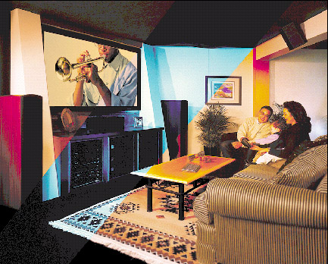
46% of
Big Screen
Market is Digital

Slide 11

16 x 9 is Big

Slide 12
www.CE.org

