Slide 1
A Tale of Two Interfaces
DVB/ASI – SMPTE 310
Andy Butler
Sr. Director – Engineering

Slide 2
Today’s Presentation
Brief Review of Each Standard
Strengths and Weaknesses Analyses
Practical Implementation Tips
Sources for Additional Information
Q&A

Slide 3
DTV Interface/Transport Summary
Full Bandwidth 1.5 gbit HD
Full Bandwidth 270 mbit SD
Lightly Compressed HD 330 mbit
Transport Stream – MPEG-2/ATSC
  SMPTE 310 M
  ASI/DVB

Slide 4
DVB/ASI Family of Standards
SPI - Synchronous Parallel Interface
SSI-C - Synchronous Serial Interface on Coaxial Cable
SSI-O - Synchronous Serial Interface on Optical Fibre
ASI-C - Asynchronous Serial Interface on Coaxial Cable
ASI-O - Asynchronous Serial Interface on Optical Fibre

Slide 5
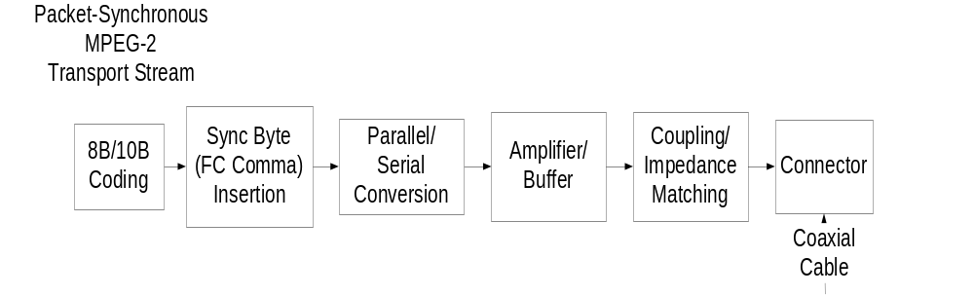
ASI – C - TRANSMIT

Slide 6
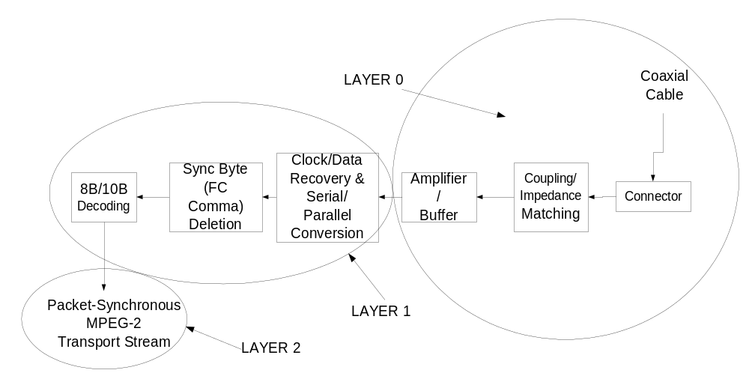
ASI – C - RECEIVE

Slide 7
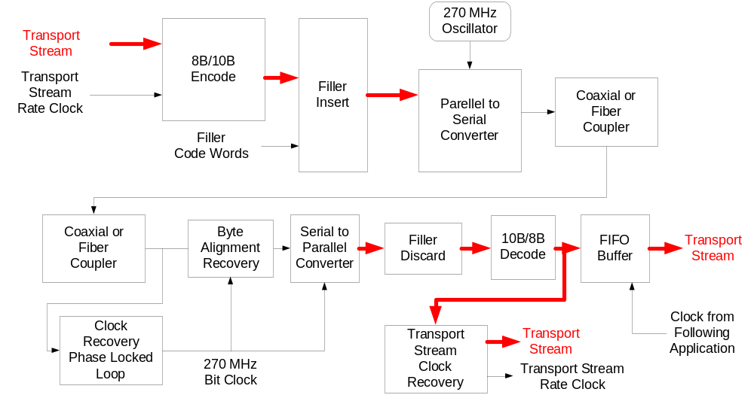
ASI Clocking Options

Slide 8
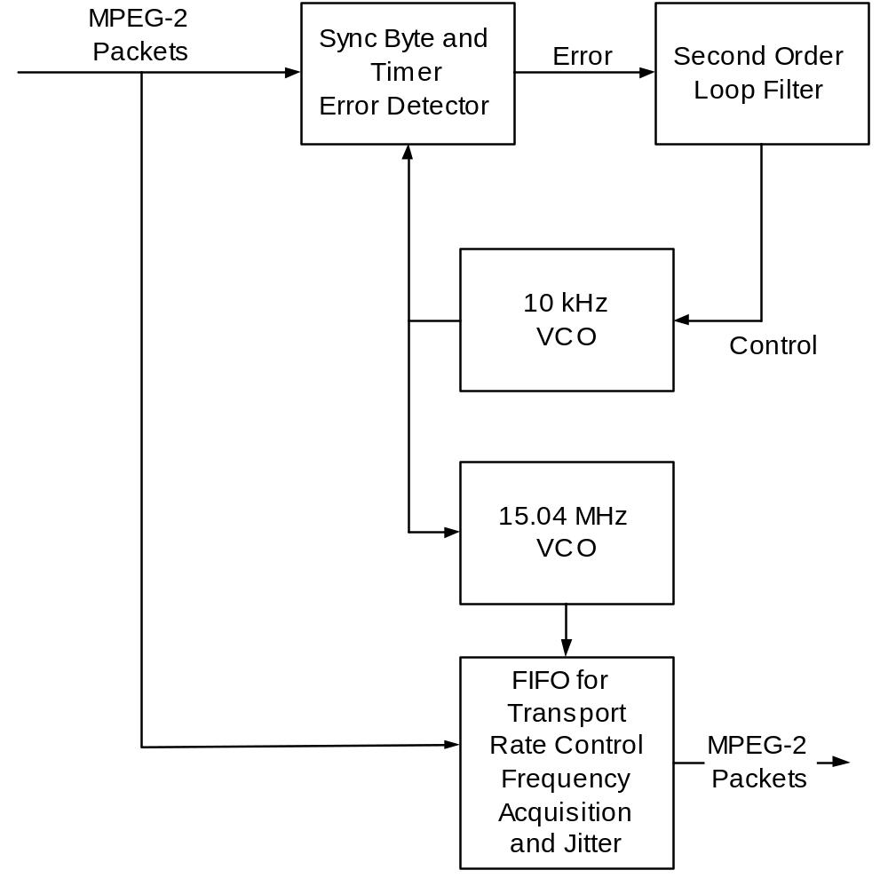
ASI PLL for Clock Generation

Slide 9
Summary of Characteristics
Fixed Transport Rate – Flexible Payload Rate
Robust Error Correction
Deterministic Jitter – 10%
Random Jitter – 8%
Output Voltage – 800 mV (p-p)

Slide 10
ATSC Transmitter System Block Diagram
Video
Encoder
SMPTE
310M
Audio
Encoder
Transport
Encoder/
Mux &
(SMPTE Tx)
Fiber or
μwave
STL
(SMPTE Rx)
(SMPTE Tx)
Clock
Re-
Synchronizer
VSB
Modulator
&
(SMPTE Rx)
Aux Data
Encoder

Slide 11
SMPTE 310M DTV Transmitter Interface
Synchronous Serial Interface for MPEG-2 Digital Transport Stream
For 8T-VSB (19.3 Mb/s) and 16-VSB (38.6 Mb/s)
No error correction (for low noise environments)
Self-clocking bi-phase mark modulation (MSB first)
Unbalanced 0.8 Vpp centered at 0 Vdc
Single 75 Ω coax with (50 Ω) BNC connectors
Transport clock frequencies:
  F_{TRANSPORT} = N * (188/208) * (312/313) * F_{SYMBOL}
  8T-VSB: 19.39265846 Mbits/sec (N = 2)
  16-VSB: 38.78531692 Mbits/sec (N = 4)
  Clock frequencies within ± 2.8 ppm (same as F_{sym})

Slide 12
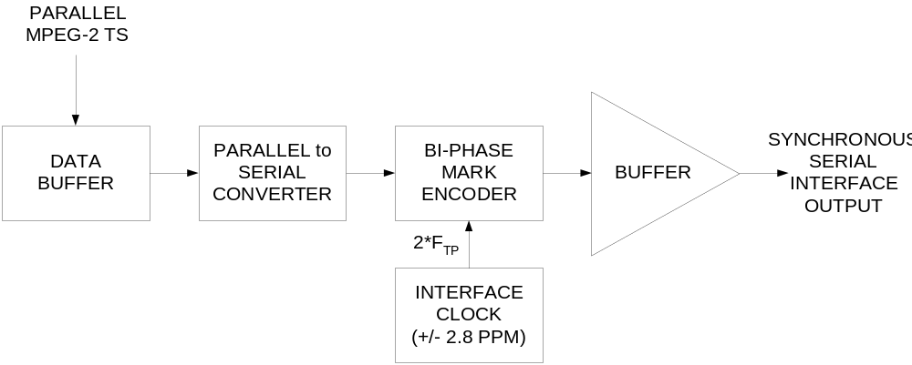
SMPTE 310M TRANSMIT

Slide 13
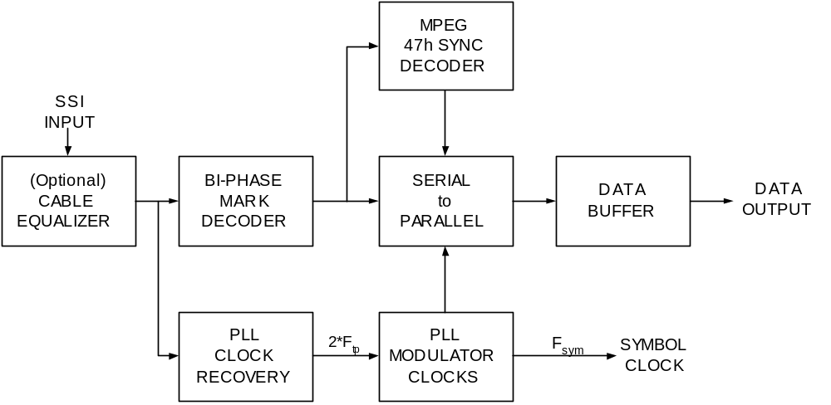
SMPTE 310M RECEIVER

Slide 14
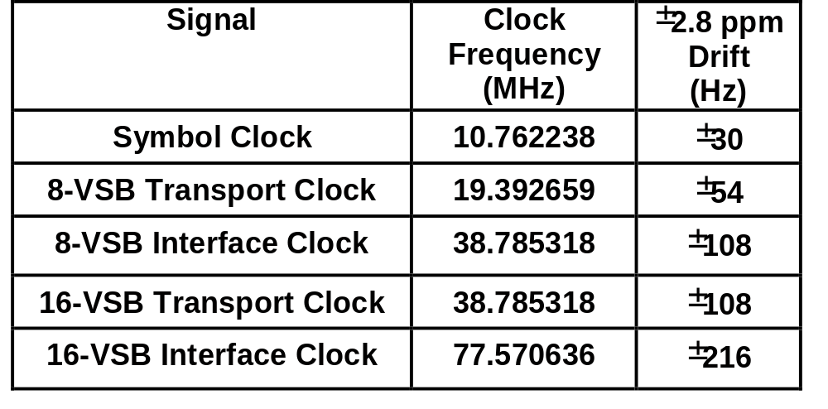
SMPTE 310M Clock Frequencies
F_{INT} = 2*F_{tp} = 2*N*(188/208)*(312/313)*F_{SYM}
N = 2 for 8T-VSB (2 data bits/symbol)
N = 4 for 16-VSB (4 data bits/symbol)

Slide 15
Symbol Clock Tests
Measure SMPTE 310M signal directly
  Clock frequency
    Easy to measure with current test equipment (e.g. frequency counter)
    Drift tolerance < 2.8 ppm; drift rate < 0.028 ppm/sec
  Clock (edge) jitter (nsec, p-p)
    Need good piece of test equipment to measure this (e.g. high speed scope or specialized unit)
    Signal transitions < 2 nsec, p-p
Measure SMPTE 310M signal indirectly
  Transmission symbol clock phase sidebands
  Reference receiver SNR @ white noise threshold

Slide 16
Current Difficulties
Currently, SMPTE 310M clock issues have been observed in couple of cities doing DTV field testing
Not a problem with standard, just implementation
Two issues:
  Clock frequency tolerance
  Clock jitter tolerance
Effect:
  Reduction of effective white noise threshold in receivers
  Bursty performance
  Not noticeable on Agilent 89441 or RFA300 test equipment

Slide 17
Symbol Clock Jitter
Can creep into system anywhere
  Transport (video) encoder
  Any STL link (fiber, microwave)
  SMPTE 310M interfaces
  VSB modulator
Symptoms: bursty errors at receiver
  Moderate problem: near white noise threshold
  Severe problem: even at strong signal levels
Still looking for convenient way to measure jitter
Currently only have indirect methods
  Reference Rx white noise threshold degradation
  Symbol clock modulation sidebands

Slide 18
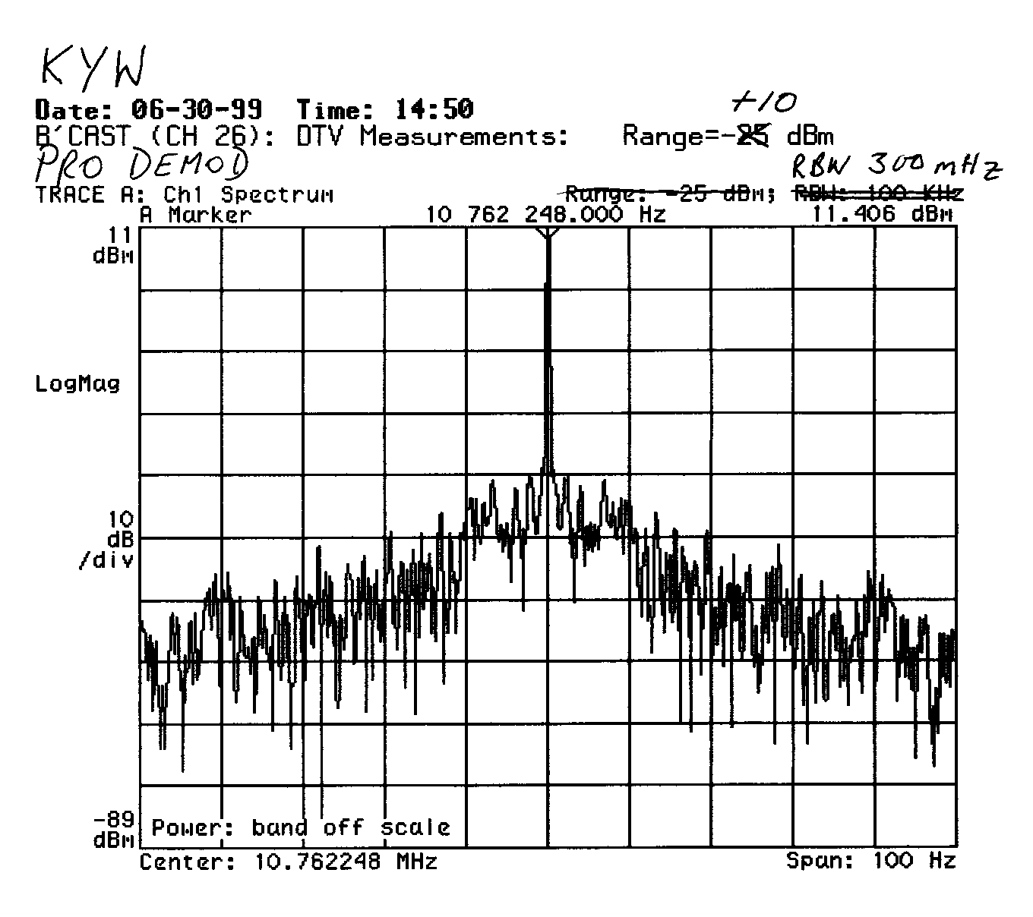
Symbol Clock Spectrum - No Jitter
Res BW = 300 mHz

Slide 19
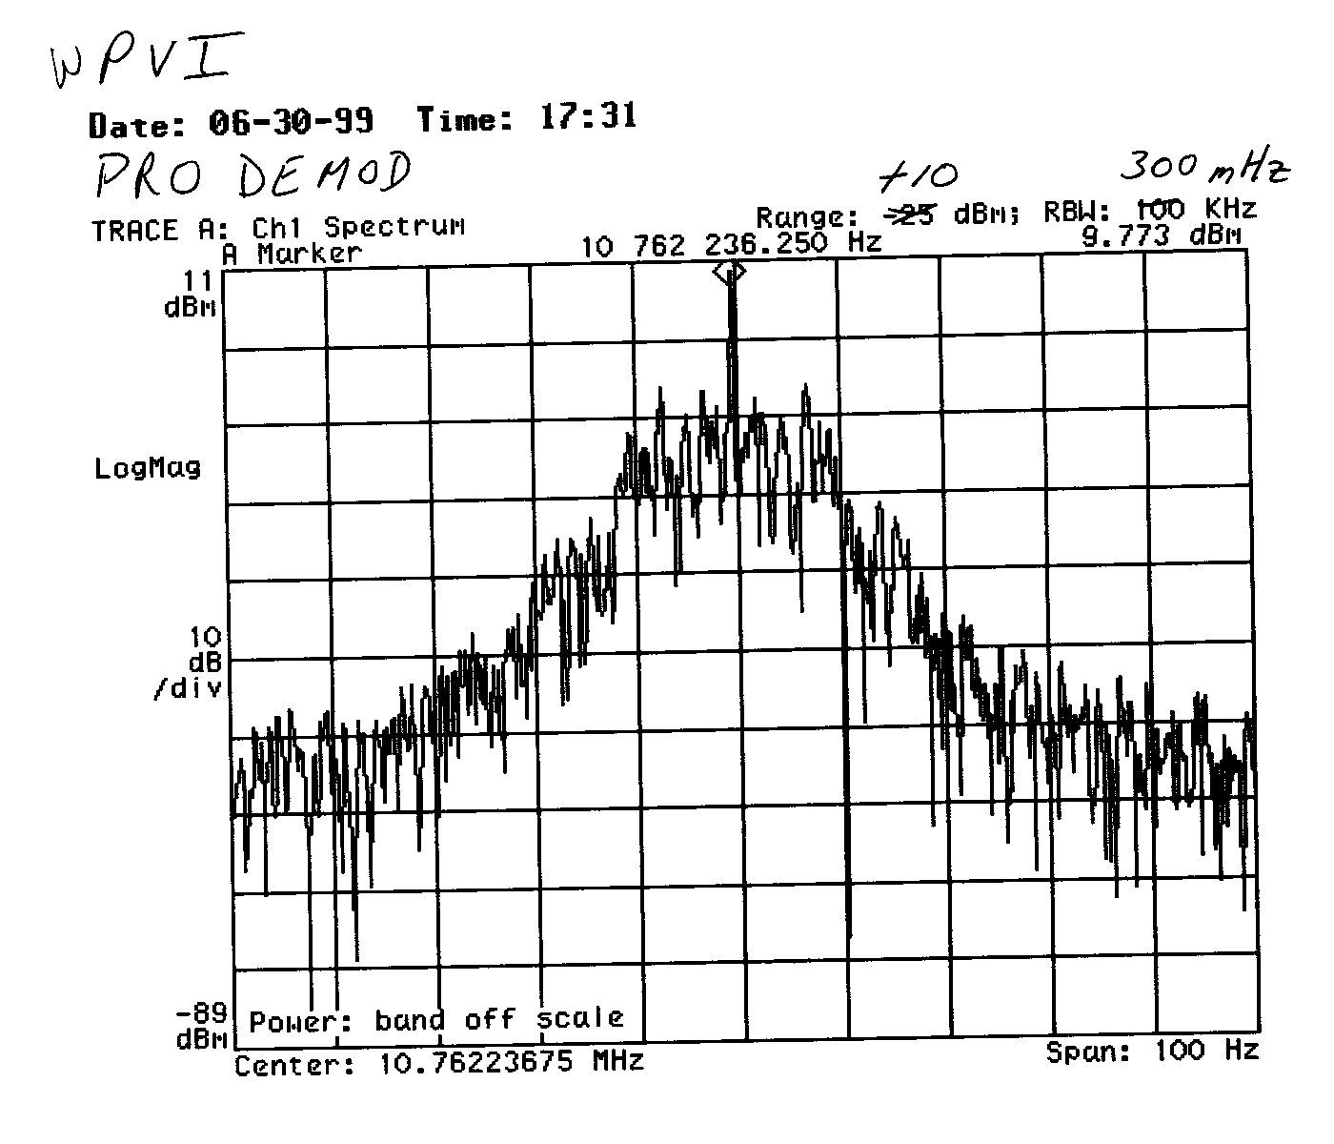
Symbol Clock Spectrum - With Jitter
Res BW = 300 mHz

Slide 20
SMPTE 310M Pluses
Self Clocking
Polarity Insensitive
Low Component Count
Relatively Inexpensive
Bandwidth Efficient in RF Implementation

Slide 21
DVB ASI Pluses
Mature Standard – Widely Implemented
Robust Error Correction
Includes Sync Byte
Accepts a Variety of Bit Rates
Electrically Identical to SDI (CCIR 601)

Slide 22
SMPTE 310M Minuses
Uses NRZ Coding
No Error Correction
No Sync Bytes
Jitter Sensitive
Fixed Bit Rate once Implemented
Limited Design and Field Experience

Slide 23
DVB ASI Minuses
Polarity Sensitive
Requires Wider Bandwidth in RF Implementations
Higher Component Count
Higher Cost to Implement

Slide 24
Practical Uses for DVB-ASI
  Decoder Output
  Intra-Facility Routing
  Localized Switching
  Input/Output of Storage Devices
  Input/Output of Bit Stream Manipulators
  Public Network Transport

Slide 25
Practical Uses for SMPTE 310M
RF Transport
  Over the air Broadcast
  STL
  RPU/ENG
Efficient Bit Stream Storage

Slide 26
More Information
DVB/ASI – DVB Document A010
Interfaces for CATV/SMATV Headends and
Similar Professional Equipment
SMPTE 310M-1998
Synchronous Serial Interface for MPEG-2 Digital
Transport Stream

Slide 27
Acknowledgements
Gary Sgrignoli – Zenith Corporation
David Horowitz – Horowitz Television Technology
Jim Kutzner – Advanced Television Technology Center
Ed Williams – PBS DTV Strategic Services Group
Gregory Forbes – PBS Engineering
Rudy Pruitt – PBS Engineering Lab

Slide 28
Great Training Opportunity
ATSC
VSB Transmission System
Tutorials
Zenith – SBE – State Broadcast Associations
Private Companies

Slide 29
YOUR TURN
Questions?
Discussion?
Debate?

