Slide 1
DTV ATSC 8-VSB
Standard Review
April 20, 2001
Michael Isnardi
Sarnoff Corporation

Slide 2
Outline
Original Requirements
What the RF channel can support
ATSC Channel Coding
8-VSB Scorecard
New Requirements
The future

Slide 3
Original Requirements
Must replicate NTSC Grade B service area
Must support HDTV programming
Must work in the presence of
  thermal (white) and impulse noise
  co-channel and adjacent channel interference
Reception must be highly reliable for fixed receivers using suitable antennas

Slide 4
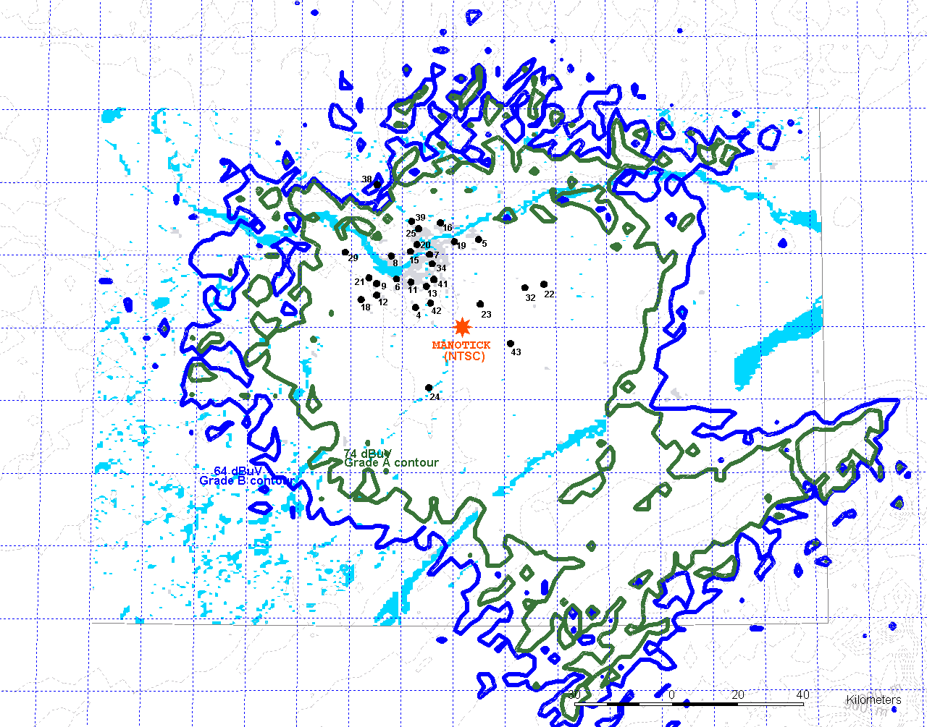
Service Areas
Grade
B
Grade
A
Courtesy
Dr. Yiyan Wu, CRC

Slide 5
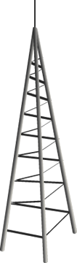
The Cliff Effect
Analog
“noise”
Digital
Digital “Cliff” Effect
Quality
Analog
Distance from Transmitter

Slide 6
Service Quality
NTSC
Service
Area
DTV
Service
Area
NTSC
Grade B
Contour
DTV
No
Reception

Slide 7
The RF Channel
Symbol Rate = 10.76 Msymbols/sec
5.38 MHz
6 MHz
Excess bandwidth = 11.25%

Slide 8
What’s A Symbol?
An independent amplitude event that can carry information
VSB modulation has a bandwidth efficiency of 2 symbols/cycle.

Slide 9
Symbols and Bits
1 bit/symbol
2 bits/symbol
3 bits/symbol
10.76 Mb/s
21.52 Mb/s
32.28 Mb/s

Slide 10

Bit Rate and HDTV
1 bit/symbol
2 bits/symbol
3 bits/symbol
10.76 Mb/s
21.52 Mb/s
32.28 Mb/s

Slide 11
C/N Threshold
4-VSB
2 bits/symbol
8T-VSB
3 bits/symbol
Without
Trellis
Coding
With
Trellis
Coding
21.52 Mb/s
C/N = 16.1 dB
32.28 Mb/s
C/N = 15 dB
Trellis coding extends
reception threshold

Slide 12
Source and Channel Coding
Source Coding
Channel Coding
27 MHz System Clock
Sampling
Clocks
Time
Stamps
PCR
Video
FEC,
Trellis
Coding,
Sync
Insertion
A/D
MPEG-2
Encoder
f_{TP}
f_{sym}
8-VSB
Modulator
RF
out
Trans-
port
Mux
Audio
AC-3
Encoder
A/D
PSI & PSIP
MPEG-2 Packets

Slide 13
Related Rates
684 ATSC Symbols
One NTSC Line
Eases the ability to reject NTSC interference

Slide 14
ATSC Channel Coding
Two Vestigial Sideband (VSB) Modulation Modes
  8-VSB (Terrestrial)
  16-VSB (Cable - not used in practice)
8-VSB is focus of this talk
Data
Random-
izer
Reed-
Solomon
Encoder
Data
Inter-
leaver
Trellis
En-
coder
Mux
Pilot
Inser-
tion
VSB
Modu-
lator
RF
Up-
con-
verter
Segment Sync
Field Sync

Slide 15
Data Randomizer
Randomizes data payload within a Transport Packet
Flattens RF spectrum, even when no signal is present
Data
Random-
izer
Reed-
Solomon
Encoder
Data
Inter-
leaver
Trellis
En-
coder
Mux
Pilot
Inser-
tion
VSB
Modu-
lator
RF
Up-
con-
verter
Segment Sync
Field Sync

Slide 16
Data Randomizer
1
0
time
1
0
time

Slide 17
Reed-Solomon Encoding
A type of Forward Error Correction (FEC) coding
Appends 20 parity bytes to every 188-byte Transport Packet
Can correct up to 10 byte errors/packet
Data
Random-
izer
Reed-
Solomon
Encoder
Data
Inter-
leaver
Trellis
En-
coder
Mux
Pilot
Inser-
tion
VSB
Modu-
lator
RF
Up-
con-
verter
Segment Sync
Field Sync

Slide 18

Reed-Solomon Encoding

Slide 19
Data Interleaver
Shuffles bytes among 52 data segments (data segment = transport packet + FEC)
Spreads burst errors out over time
Increases efficiency of FEC
Data
Random-
izer
Reed-
Solomon
Encoder
Data
Inter-
leaver
Trellis
En-
coder
Mux
Pilot
Inser-
tion
VSB
Modu-
lator
RF
Up-
con-
verter
Segment Sync
Field Sync

Slide 20
Data Interleaver
Read in
by rows.
Write out by columns.

Slide 21
Data Interleaver

Slide 22
Trellis Encoder
Another layer of error correction coding
Extends reception threshold
Adds an extra bit to each pair of bits (2/3 rate)
Every 3 bits mapped to 8 distinct levels at output
Data
Random-
izer
Reed-
Solomon
Encoder
Data
Inter-
leaver
Trellis
En-
coder
Mux
Pilot
Inser-
tion
VSB
Modu-
lator
RF
Up-
con-
verter
Segment Sync
Field Sync

Slide 23
Trellis Encoder
+7
Trellis
Encoder
+5
+3
Bytes
In
+1
-1
-3
-5
-7
Each pair of input bits
mapped into one
of eight levels

Slide 24


Trellis Encoder
Forces dependency
between symbols
+7
+5
Trellis decoder
checks each symbol
against past history
to determine which
values are allowed
+3
+1
-1
-3
-5
-7

Slide 25
Data & Sync Mux
Syncs are 2-level patterns that can be recovered at SNR’s as low as 0 dB.
4-symbol Segment Sync replaces Transport Sync byte
Field Sync contains training signals
Data
Random-
izer
Reed-
Solomon
Encoder
Data
Inter-
leaver
Trellis
En-
coder
Mux
Pilot
Inser-
tion
VSB
Modu-
lator
RF
Up-
con-
verter
Segment Sync
Field Sync

Slide 26
Segment Sync
Data
Segment
Sync
Data
Segment
Sync
3 bits/
symbol
+7
111
+7
+5
110
+5
+3
101
+3
+1
100
+1
-1
011
Data + FEC
-1
-3
010
-3
-5
001
-5
-7
000
-7
4
Symbols
828 Symbols (207 Bytes)
Data Segment
832 Symbols (208 Bytes)
Courtesy
Gary Sgrignoli, Zenith

Slide 27
Field Sync
832 Symbols
+7
+7
+5
+5
+3
+3
+1
PN511
PN63
PN63
(+/-)
PN63
2/4/8/16
Level ID
Reserved
+1
-1
-1
-3
-3
-5
-5
-7
-7
92
12
4
Symbols
511
Symbols
63
Symbols
63
Symbols
63
Symbols
24
Symbols
104
Symbols
Can be used by receivers to
adaptively equalize channel
Courtesy
Gary Sgrignoli, Zenith

Slide 28
Data Frame
Segment
Sync
Field
Sync
312 Data
Segments
•••
312 Data
Segments
•••

Slide 29
The Transport Rate
188
208
312
313
f_{transport} = 2 . . . f_{symbol}
19.39 Mbits/sec
10.76 Msymbols/sec

Slide 30
Pilot Insertion
Achieved by adding a 1.25 offset to the output levels
Only adds about 0.3 dB to average power
Data
Random-
izer
Reed-
Solomon
Encoder
Data
Inter-
leaver
Trellis
En-
coder
Mux
Pilot
Inser-
tion
VSB
Modu-
lator
RF
Up-
con-
verter
Segment Sync
Field Sync

Slide 31
Pilot Insertion
+8.25
+7
+6.25
+5
+4.25
+3
+2.25
+1
+0.25
0
-1
-1.75
-3
-3.75
-5
-5.75
-7
Before Pilot
Insertion
After Pilot
Insertion
+1.25

Slide 32
VSB Modulator &
RF Upconverter
The 10.76 Msymbols/s, 8-level signal is suppressed-carrier modulated and lower sideband removed
Resulting spectrum is flat, except for 620 kHz band edges having square-root raised cosine responses
Data
Random-
izer
Reed-
Solomon
Encoder
Data
Inter-
leaver
Trellis
En-
coder
Mux
Pilot
Inser-
tion
VSB
Modu-
lator
RF
Up-
con-
verter
Segment Sync
Field Sync

Slide 33
8-VSB RF Spectrum
Pilot
Square-Root
Raised Cosine
Rolloff
6 MHz
10
dB/div
Courtesy
Gary Sgrignoli, Zenith
18 MHz Span

Slide 34
NTSC vs ATSC RF Spectra
Excess BW = 11.5%
Flat, Noise-like
1.0
ATSC
8-VSB
0.7
0
Pilot
F
5.38
.31
.31
Narrowband Carriers
NTSC
Visual
Carrier
Chroma
Carrier
Aural
Carrier
F
1.25
3.58
0.92
Frequencies in MHz
Courtesy
Gary Sgrignoli, Zenith

Slide 35
Transmitter Requirements
High SNR
High Linearity
High Frequency Stability
Low Phase Noise
FCC Mask Compliance
Some manufacturers pre-correct for linear and nonlinear distortions

Slide 36
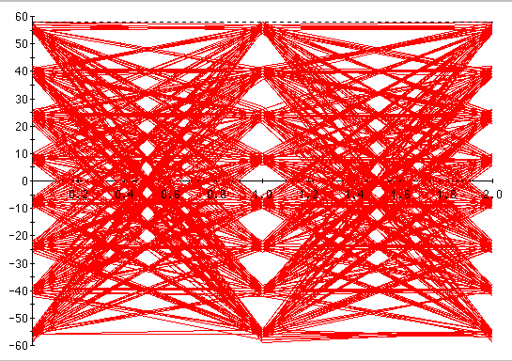

8-VSB Analyzers
…a sampling based on Web search...
Agilent Technologies
Harris
Leader Instruments
Tektronix
Triveni Digital
Rohde & Schwarz
Videotek

Slide 37
Reception Issues
Antenna gain and location
  Directional antennas a must in certain areas
  Indoor reception introduces 10-25 dB loss
Noise figure
  FCC planning uses 10 dB
Adjacent and co-channel rejection
Multipath requires adaptive equalization

Slide 38
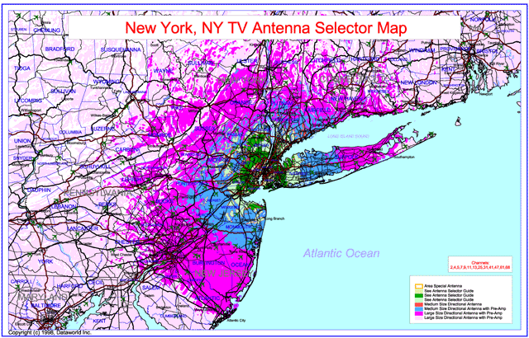
Antenna Maps

Slide 39
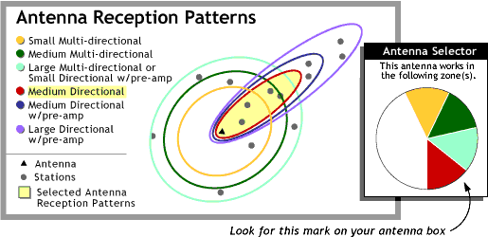
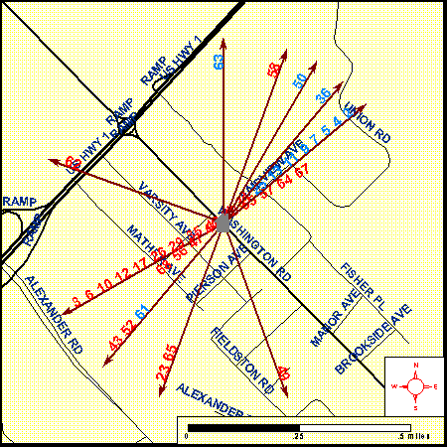

antennaweb.org
Enter location,
select channel...
…out pops antenna
needed to receive
that channel

Slide 40
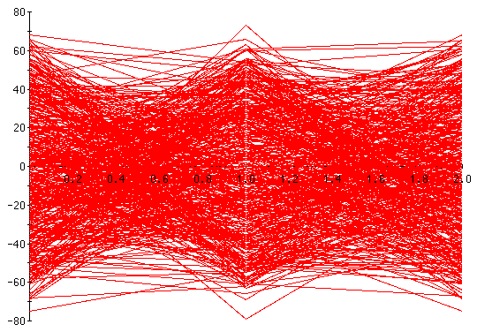
Adaptive Equalization
35μs Static Multipath
256-Tap Equalizer (ATSC Baseline)
An Advanced Equalizer

Slide 41
COFDM
6, 7 or 8 MHz
Thousands of carriers, each carrying a low
data-rate digital signal containing temporal
guard band intervals.

Slide 42
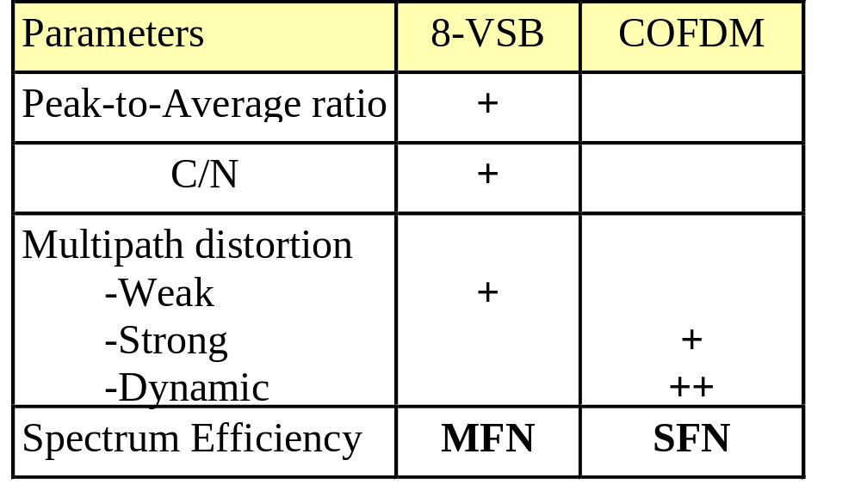
8-VSB vs COFDM
Courtesy
Dr. Yiyan Wu, CRC

Slide 43
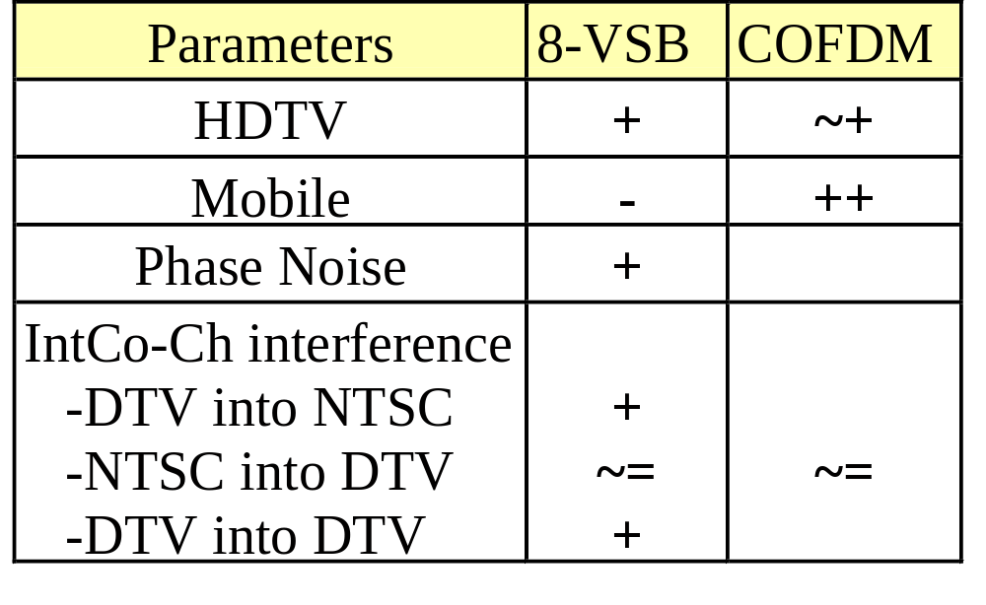
8-VSB vs COFDM
Courtesy
Dr. Yiyan Wu, CRC

Slide 44


8-VSB: Ain’t Broke
…but could be better...
NAB/MSTV reaffirmed support for 8-VSB based on field tests
FCC also reconfirmed 8-VSB for ATSC transmission
...but poor indoor reception and inability to meet new service requirements are forcing a second look

Slide 45

Some New Requirements
Portable Reception
Pedestrian Reception
Mobile Reception
Multi-Mode Operation
On-Channel Repeaters

Slide 46

DTV Tradeoffs
HDTV
Some new applications
may require changes
to 8-VSB moduation
Mobile
Reception
On-Channel
Repeaters
Courtesy
Dr. Yiyan Wu,
CRC

Slide 47

The Future
8-VSB
Receiver technology will continue to improve, but some new services may require transmission enhancements
ATSC has issued an RFP for potential revisions
  Preference given to compatible 8-VSB enhancements

Slide 48

T3/S9 Work Plan
T3/S9 = ATSC Specialist Group on RF Transmission
Milestones
  Responses to RFP due April 2, 2001
  Selection of technology September 14, 2001
  Field tests begin November 14, 2001
  Review of field tests January 15, 2002
  New standard or revision January 31, 2002

Slide 49
Conclusions
8-VSB has largely met original performance goals
NAB/MSTV and FCC have all reaffirmed this
New requirements may force a revision to the standard
Work is in progress…stay tuned!

Slide 50


Acknowledgements
Gary Sgrignoli (Zenith)
Dr. Yiyan Wu (CRC)
Thank you

