Slide 1
There Is Plenty of Room at the Bottom !
André V. Mendes
Chief Operations Officer
Pluvita Corporation

Slide 2
In remembrance of:
Doug Huber
PBS Video

Slide 3
Disclaimer
My opinions!
Like it or not!
Caveat emptor!
No direct operational value!

Slide 4
Beware of “expert opinions”
"Unlike with other famous bubbles ... the Internet bubble is riding on rock-solid fundamentals, perhaps stronger than any the market has seen before. Underlying the crazy price increases are the foundations of what could become the early 21st century's leading growth companies.... Just because the Internet stock phenomenon looks like a bubble, it isn't a given that the bubble will burst.“
Henry Blodget, Leading Internet Analyst, Oppenheimer Funds 3/5/2000
March 10th, 2000 Nasdaq at 5,048

Slide 5
Nasdaq crashes !! Web is dead !!
Surprised? Don’t be!!!
Open economies are cyclical
  Kondratiev cycles
  Market forces
    Supply, demand, capital investment, employment, inflation, stability and productivity
What is different?
  Lengths and height of expansions
  Lengths and depths of recession
    Middle ages lasted 400 years
    1929 crash lasted a decade
    Late 70’s lasted 4 years
    Early 90’s a mere 2 years
    2001 recession* might not happen at all

Slide 6
How it all started!
1995 – Netscape goes public
  Against very strong advice
  IPO is wildly successful despite:
    Never having made a penny
    Having no idea when it would
    Giving away most of it’s products
Why ?
  Jim Clark needed to make a payment on a yacht or risk losing it!
The rest is history…

Slide 7
How crazy was it, you ask?
Pixelon raises $45M privately
  Spends $27M in a launch party
  Closed two months later
Pets.com - Bag of dog food
  Costs $15 and weights 55 pounds
  Costs $29.80 to ship
  Sock puppet was cute
  Super Bowl commercial cost millions
DEN.com – Sitcoms/series on the Web
  Costs the same to produce
  Requires big pipe
  Requires large ad revenue

Slide 8
Why did it last so long?
Basic premise is good
Mob mentality of:
  Traders
  Investors
  Public at large
Rapid information:
    Dissemination
    Analysis
    Reaction
Stewed in it’s own juices of technological evolution

Slide 9
Dynamics of Technological Evolution
Technology curve
Short term overestimation
Long term underestimation
Inevitability
  If it can happen….
  It will happen!

Slide 10
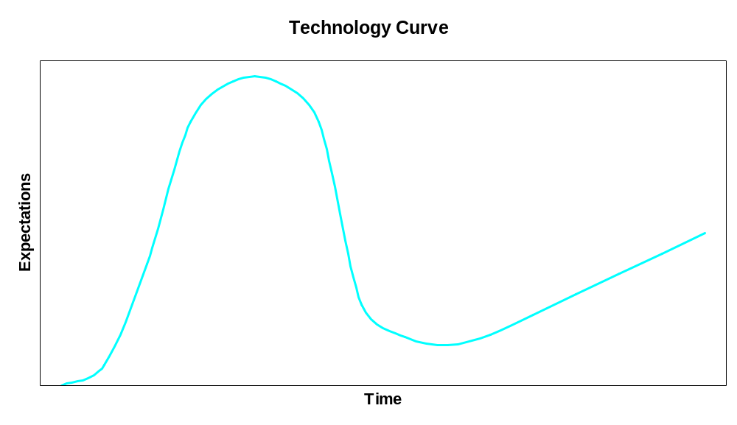
Technology Curve

Slide 11
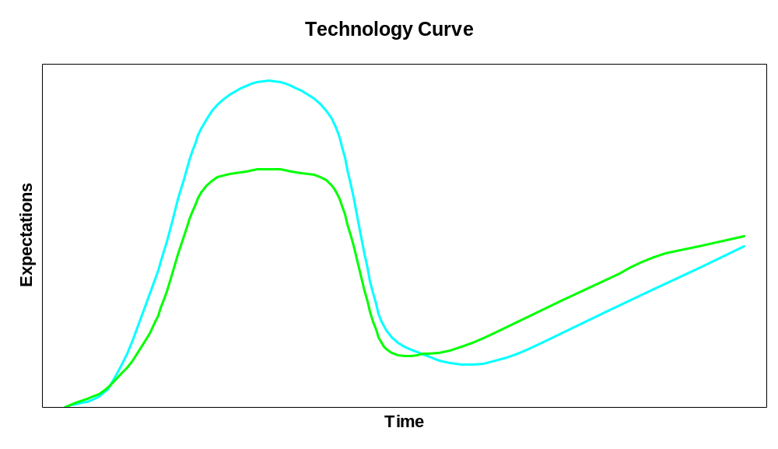
Technology Curve

Slide 12
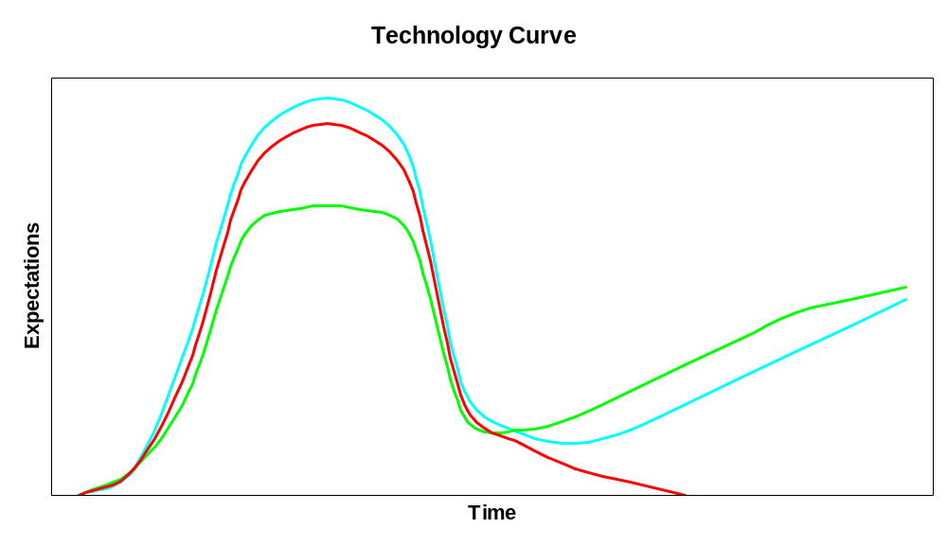
Technology Curve

Slide 13
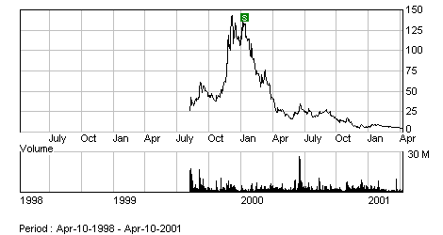
Technology Curve - Red Hat

Slide 14
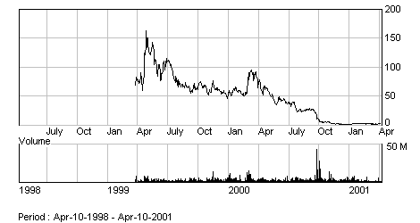
Technology Curve - Priceline

Slide 15
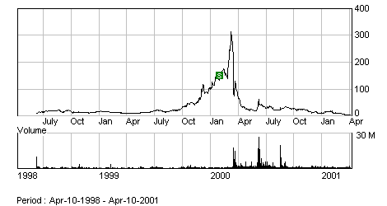
Technology Curve - MicroStrategy

Slide 16
Short Term Overestimation
We tend to overestimate the impact of new technologies over a 2 year time span
  Web retail expectations
  Broadband penetration
  ASP model
  WAP/Wireless adoption
  Speech recognition
  Wearable computing

Slide 17
Long Term Underestimation
We tend to substantially underestimate the impact of technological changes over the long haul (10+ years)
  Personal computer
  Internet
  Biotechnology
  Pervasive computing

Slide 18
If it can happen…it will happen!
Is it physically possible ?
Does it fulfill a basic human need/want?
Is there money to be made from it?
It will happen…. faster & faster
“It will take over 100 years before we decode the entire human genome” Bottstein, MIT 1975
“It will take us another 3 or 4 decades before we finish the whole thing” Ridley, CIT & MIT 1992
“Done” J. CraigVenter, Celerra Genomics & Francis Collins, Human Genome Project June 2000

Slide 19
“There is plenty of room at the bottom!”
Richard Feinman
12/12/59

Slide 20
There’s plenty of room at the bottom!
The next several waves of technological evolution are hitting the shore
They are being driven by the marriage of Information Technology and:
  Physical Sciences:
    Optics
    Micro
    Nano
  Life Sciences
    Genomics
    Proteomics
    Medicine

Slide 21
Physical Sciences
Optics
Micro Engineering
Nanotechnology

Slide 22

Optics – Let there be light….
DWDM live & carrying data
Siemens/WorldCom (3/13)
  Dallas area live system
  3.2 Tb/s for a whole month trial
Alcatel – 10.2 Tb/s (3/22)
  256 Wavelengths @ 40 Gb/s
  100 Km (62.5 miles)
NEC – 10.9 Tb/s (3/22)
  273 wavelengths @ 40 Gb/s
  117 Km (73.125 miles)
150 million simultaneous calls

Slide 23
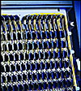
Now that’s a fire hose!
Optical Switching
Ciena
  Multiwave Core Director (MCD)
    640 Gb/s per bay
    Granular to STS-1
Corvis
  Optical Switch (OS)
    2.4 Tb/s
    3200 Km (2000 miles)

Slide 24
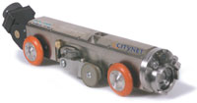
Fiber to the door (of your bathroom?)
CityNet raises $275M in funding
  Sewer robots bring fiber to buildings
  No need to tear up the streets
  95% of households have sewer system
  Projects in:
    Omaha, NE
    Albuquerque, NM
    Indianapolis, IN
  Negotiating with 28 other cities
New homes built with fiber ports

Slide 25
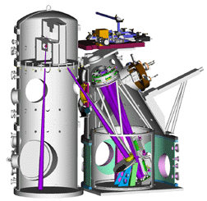
Micro Engineering
EUV Lithography announced 4/11/01
Partnership in late 1997
  Intel, AMD, Motorola, IBM
  Gov. labs (sandia, Berkeley, Livermore
Current microprocessor circuits are lithographed onto chips
  Intel Pentium 4 – 1.5 GHZ (.18 Micron)
  Lithography expected limit (.1)
  1/1000 of width of human hair
Extreme Ultraviolet Lithography
  EUV expected limit (.03)
  10 GHz by 2005-2006
  10 Gigabyte memory chips

Slide 26
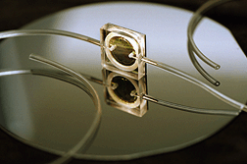
Nanotechnology – Size does matter!
Computer evolution:
  Electronic gates etched on silicon
  Carbyne molecular switches
  Quantum mechanical effects
Tool evolution
  Hacksaw
  Scalpel
  Smart scalpel
  Intra-cell computers

Slide 27
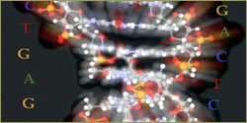
Life Sciences – Unraveling life
Genomics
Proteomics
Medicine

Slide 28
Genomics – The fun has just begun
Human Genome
  Mendel to Watson/Crick in 100 years
  Watson/Crick to genome 40 years
  First draft completed June 2000
  About 32,000 genes
Potential uses
  Personalized medicine/lifestyle
    Genetic propensities/deficiencies
    Allergies
  DNA Chips will detect personal variations
    P-glycoprotein and chemoterapy
  Pre-Implantation Diagnosis
    Jack and Lisa Nash and Fanconi’s anemia

Slide 29
Genomics – Telomeres/Telomerase
Sets of TTAGGG sequences at ends of chromosomes
As cell divides they wear off
When they are done, cells stop dividing
These cells show altered gene expressions
Possibly giving rise to chronic degeneration
Enzyme Telomerase can restore telomeres
Telomerase can immortalize a cell
Need I say more…..

Slide 30
Proteomics - Simple to mind bogling
Protein therapeutic agents
  Erythropoetin – Over $3B/year
    Single protein treatment for anemia
  Recombinant Factor IX
    Type B hemophilia treatment through gene therapy
Protein to Protein interactions
  Key to more intricate systems
  Complex feedback cycles
  Huge computational requirements
  13x10²¹ FPO to fold a single protein

Slide 31
Medicine – Pluripotent Stem Cells
Primitive, self-renewing cells that can develop into all cells and tissues in the body
Express Telomerase at high constant level in their undifferentiated stage
Originally harvested from embrionic tissue
Recently harvested from fat cells
Differentiation can be precipitated by different enzymatic combinations
Tissue regeneration
Eventually:
  Limb and organ regrowth
  CNS function regeneration

Slide 32
Medicine - Life extension
Dr. Francis Collins (HGP):
  2020 gene base designer drugs
  2030 all ageing genes catalogued
  Routine personal genomic sequence
  Taking charge of human evolution
Consider this:
  Today 135 days every year
  In 10 years we could double that
  Then what?
  77 + (135*29/365) = 88
  39+29 = 68

Slide 33
Will it happen ?
Is it physically possible ?
Does it fulfill a basic human need/want?
Is there money to be made from it?
It will happen…. faster & faster

Slide 34
Should it happen?
Genetic diagnosis with no cure
Human cloning
Human genetic engineering
Immortality
“The human race will rapidly evolve in the near future. It may not be in accord with democratic and egalitarian principles, but then again Darwinian evolution has never been politically correct” Stephen Hawking Ph.D.

Slide 35
In summary:
For the foreseeable future, technological evolution combined with scientific advances will create an environment propitious to massive societal change where many basic tenets of our culture will be tested, questioned and possibly eliminated

Slide 36
IT is at the crux of this evolution
All science is computer science
  Physics modeling
  Mathematical simulations
  Biotechnology research
    From in vivo to
    in vitro to
    in silico
All business is IT driven
Good IT will make and/or break companies

Slide 37
IT within Public Broadcasting
Effectively, and for each entity in the Public Broadcasting universe, the soundness of technological decisions and deployments will spell the difference between extinction and survival, mediocrity and success.

Slide 38
What is our challenge then?
Energize ourselves with the fundamental nature of our role within our station
Share that vision with our staff
Sell that vision to our management
Aim to the highest goals…
And we shall achieve them!

Slide 39
Because remember….
There is plenty of room at the top too!

Slide 40
Questions?

