Slide 1
An IC Manufacturer’s Perspective on Digital TV
  Digital Broadcast Issues
  Product History
  Technology
  Outlook

Slide 2

The Wireless Problem
Problem:
Wireless broadcast signal robustness and coverage area depends on noise, reflections, weather and terrain effects.
Notes:
All wireless transmissions (voice, TV, data) suffer from the same issues outlined here.
Point here is to draw commonality between problems that Oren currently offers solutions for and the new market we want to enter.

Slide 3

Product History
1998 - Digital demodulators
  Introduced Oren’s first 8-VSB digital TV demodulator according to ATSC
  Oren OR51210 8-VSB demodulator is recognized as a top competitor at ATTC
  For HD set-tops, Satellite/HD, iDTV, PC add-in cards, and datacasting applications
1997 - Analog ghost canceling
  Applied filtering and equalizer to analog multi-path image processing
  Cross Licensing of Patents with Philips
  Currently shipping fourth generation
  to all major Japanese
  TV manufacturers
1995 - Digital filter, DSP, and equalizer technology
  Company founded on
  auto-tracking technology
  for military applications
Total of 11 patents granted or pending
All algorithms and VLSI developed in-house
Notes:
1995- Digital filter, DSP, and equalizer technology
Company founded on auto-tracking technology for military applications
1997- Analog Ghost Canceling
Applied filtering and equalizer to analog multi-path image processing
Cross Licensing of Patents with Philips
Currently Shipping Fourth Generation to all major Japanese TV manufacturers
1998- Digital Demodulators
Introduced Oren’s first 8-VSB digital TV demodulator according to ATSC
Oren OR51210 8-VSB demodulator is recognized as a top competitor at ATTC
For HD set-tops, Satellite/HD, iDTV, PC add-in cards, and datacasting applications

Slide 4
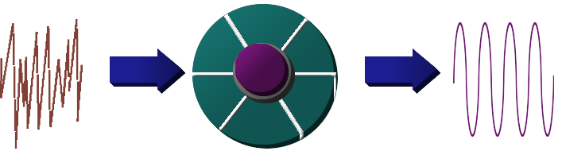
Basic VSB demodulation
Known Series of digital bits used to ‘train’ the chip
In strong multipath, blind or predictive equalization used to train the chip
Equalizer acts like a Taylor series multiplier, iterating coefficients toward a final solution using an LMS algorithm
Data is deinterleaved and further corrected in the Forward Error Correction Circuitry
Slicer
FFT
Mult.
Acc.
DSP
Filter
OTE
Correlator
Notes:
TOTALLY CUSTOM DSP, not a TI DSP or another off the shelf DSP
CUSTOMIZED for wireless applications
ALL DSPs have commands like ‘MULTIPLY’, ‘Add’, ‘JUMP’. However, ours has SPECIAL commands for wireless..’FFT’, ‘Filter’, ‘Correlate’

Slide 5
Demodulation Technology
8-VSB IF in and MPEG-2 Transport out
8-VSB Demodulator
MPEG Demux/Decoder
Tuner
Low IF or
Direct IF
MPEG TS
A/V Output

Slide 6

Block Diagram
FFT
Data
RAM
Work
RAM
From
Tuner
A/D
Interpolator
De -
Match
filter
modulator
DSP
corr
Registers
From
Tuner
Equalizer
Analog
Video
A/D
Audio core
I2S
Output
to IF
section
IFAGC
control
control
FEC
To
Tuner
Rfgain
control
Bit
deinterleaver
Byte
deinterleaver
MPEG2ts
Output
Viterbi
decoder
RS decoder
To
Tuner
Audio
AGC
control
De
reandomizer
Output
pins
IIC
interface
IIC
control
Input
pins
I/O pins

Slide 7
Integrated Circuit Development Team
Marketing: Interviews Customers to understand high level requirements. Work with system engineering on spec.
Systems Engineering: Have knowledge of entire system, including transmitter side. Generate top level spec for chip. Involved in Field testing the device
Algorithms: Write code that runs IC. Have knowledge of the various communications schemes..QAM, VSB, COFDM
VLSI Engineering: In charge of circuit design and simulation inside the IC itself.
Hardware Engineers: Develop circuit schematics that connect the chip to surrounding ICs
Product Engineering: Develop test programs and life tests

Slide 8
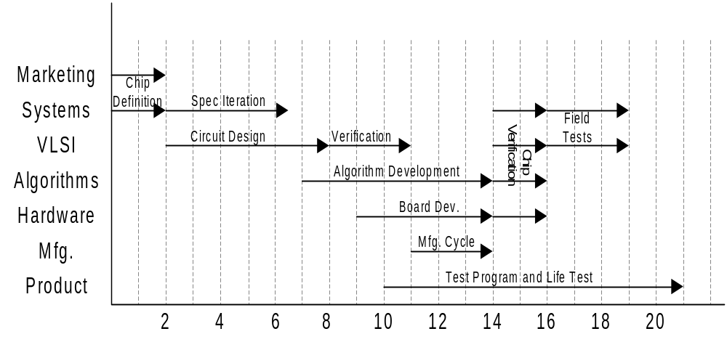
Design Flow
months

Slide 9
Summary of Design Flow
1) Marketing and Systems Engineering Develop Product Spec
2) VLSI Engineering generates actual IC from this spec
3) Hardware Engineering develops a board for the IC
4) Algorithms generate the ‘software’ that drives the IC
5) Systems Engineering takes the board and software for test
    Lab testing against ATTC benchmarks
    Field testing both indoor and outdoor
    Alpha Customer Testing
6) Product Engineering puts the chip into production

Slide 10
Integration Development of “Cascade”
Cascade OR51300 series demodulators for:
  ATSC: 8-VSB (with FFT enhanced performance)
  DVB-T: COFDM (2k and 8k hierarchical)
  Cable: 64/256-QAM (ITU-T j.83 Annex A/B/C)
  DVB-S/DSS: QPSK (Satellite)
  Analog Video: NTSC/PAL/SECAM demodulation
    Adds ClearCast ghost cancellation to analog video output
  Analog Audio: NTSC/PAL/SECAM demodulation
    NTSC audio is also decoded by OR51300, eliminating the
    need for a discrete BTSC decoder for mono, stereo, SAP, dBx
Process: 0.18μ, 5M, 3P TSMC
Notes:
Cascade OR51300 series demodulators for:
ATSC: 8-VSB (with FFT enhanced performance)
DVB-T: COFDM (2k and 8k hierarchical)
Cable: 64/256-QAM (ITU-T j.83 Annex A/B/C)
DVB-S/DSS: QPSK (Satellite)
Analog Video: NTSC/PAL/SECAM demodulation
Adds ClearCast ghost cancellation to analog video output
Analog Audio: NTSC/PAL/SECAM demodulation
NTSC Audio is also decoded by OR51300, eliminating the need for a discrete BTSC decoder for mono, stereo, SAP, dBx

Slide 11
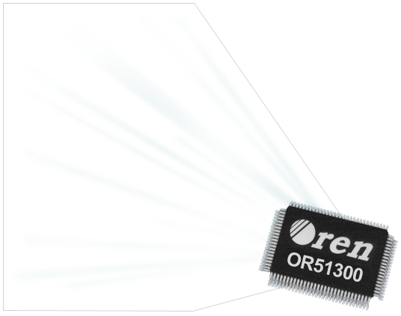
Simplified Front End Design
BTSC Audio
Decoder
I2S output
NTSC/PAL/SECAM
Demodulator
Display
Processor
VSB or COFDM
Front End
(Terrestrial)
Transport
Decoder
Video,
Audio
Decoder
Tuner
QAM Front End
(Cable)
Dish
Tuner
QPSK Front End
(Satellite)
Oren Cascade replaces five chips

Slide 12
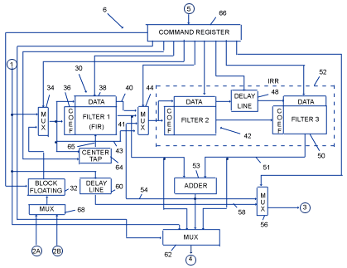
Cascade Patented VSB Enhancement
Use of FFT enables improvements in VSB performance
Replaces current LMS algorithm
FFT allows:
  Real time channel snapshot
  Dynamic allocation of FIR and IIR filter taps
  Accurate channel model

Slide 13
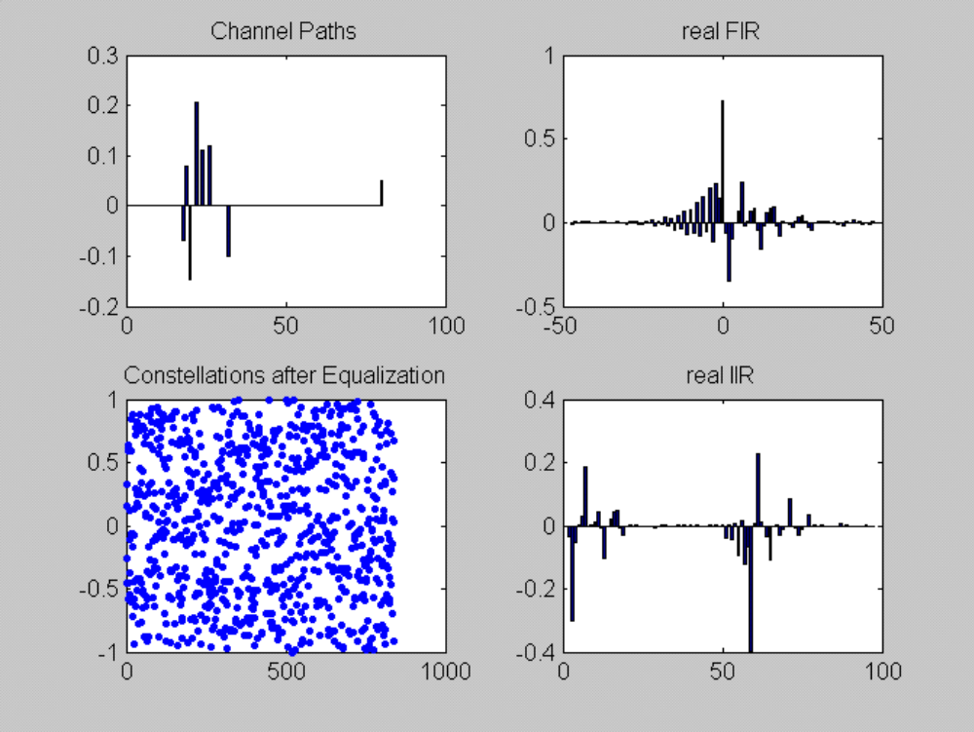
FFT Hardware Benefits
Strong short ghosts with traditional receiver “LMS” equalization
Notes:
K_{factor_in} = -2.3 dB.
The channel contains one cluster around the main path (taps n=-4 to 10), which is followed by one additional post ghost (tap n=80).
SNR after Equalization = 15.3 db
K_{factor_out} = 16.3 db
K_{factor_out} - K_{factor_in} = 18.6 db
Background:
2 test cases recorded RF from San Diego area. Both equalizers are build from feed forward section (FIR) of 96taps (–47 to +48) and feed back section (IIR) of 96 taps (1 to 96).

Slide 14
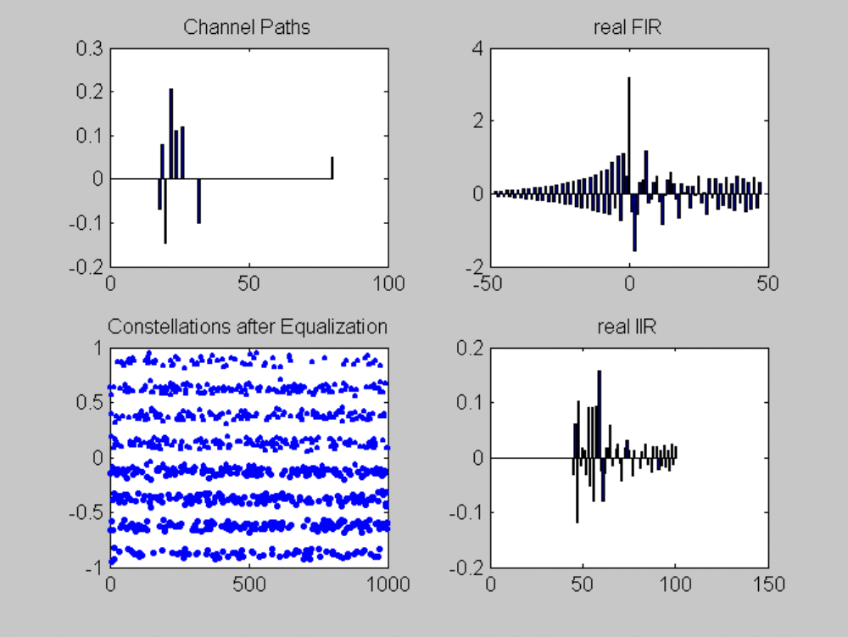
FFT Enhancement
Same test with FFT equalization
Notes:
SNR after Equalization = 24.9 db
K_{factor_out} = 25.2 db
K_{factor_out} - K_{factor_in} = 28.5 db

Slide 15
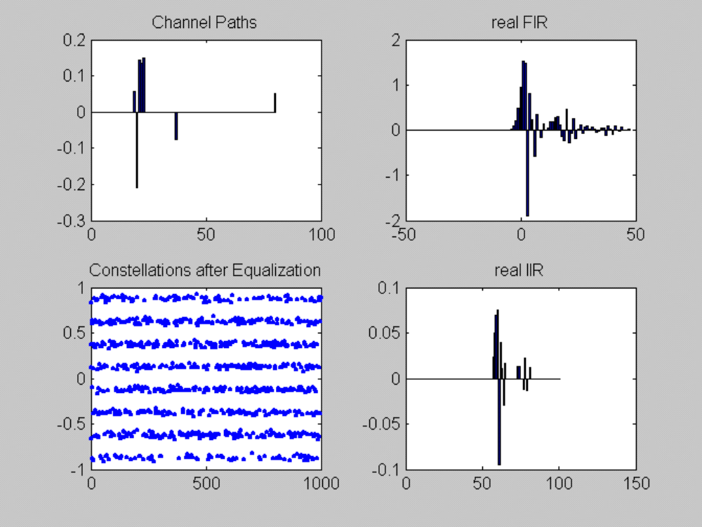
FFT Enhancement
Case 2: traditional receiver failed to lock, but achieved great performance with FFT equalizer (see notes)
Notes:
K_{factor_in} = -6.2 dB.
The channel contains very strong ghosts around the main path (taps n=-2 to 2), with two additional post ghosts (around taps 35 and 80).
In this test case the LMS algorithm didn’t converge at all.
SNR after Equalization = 28.6 db
K_{factor_out} = 29.7 db
K_{factor_out} - K_{factor_in} = 35.9 db

Slide 16
Summary
Collaboration between IC makers and Broadcasters
Innovation takes time
There is Hope!!!

