Slide 1
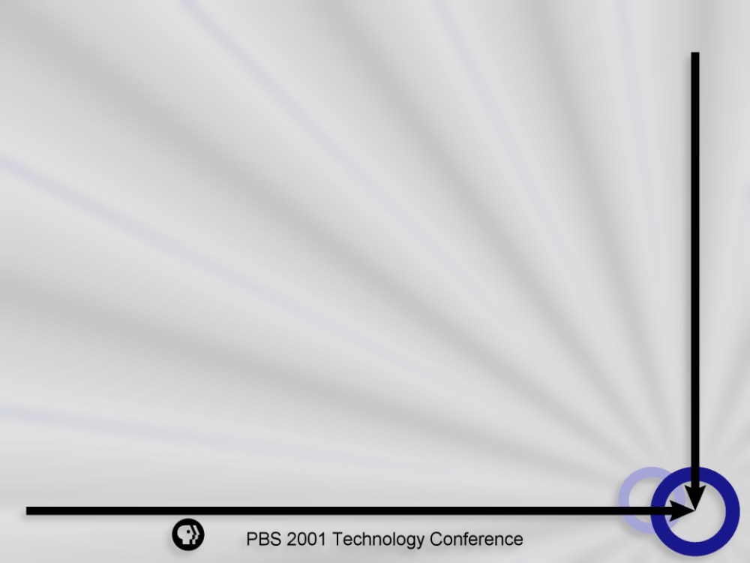
IT Projects - Measuring and Maximizing Return on Investment (ROI)
  Tony Myers
  Senior Manager, Information Technology
  Corporation for Public Broadcasting

Slide 2
Conclusions
  ROI measurements can help IT managers validate and prioritize projects
  Maximizing ROI occurs when you consider all costs and all benefits
  Project approval is achieved by matching project type with an organization’s technology adoption profile

Slide 3
What is Return on Investment (ROI)?
  ROI is commonly expressed as a percentage derived from dividing revenue by investment
  ROI is an estimate of the financial benefit (the “return”) on money spent (the “investment”) on a particular project

Slide 4
Why is ROI important?
Evaluate competing projects
Provide metrics for business case
Measure managerial effectiveness

Slide 5
Costs and Benefits
Costs
(Investment)
Direct Costs
Known, expected costs
Indirect Costs
Less identifiable, usually distributed costs

Slide 6
Costs and Benefits
Benefits
(Revenue)
Hard Benefits
Easier to measure and quantify in actual dollars
Soft Benefits
Harder to quantify in actual dollars even if they can be measured

Slide 7
Cost Calculation Factors
Direct Costs
- Acquisition
Development
Operation and maintenance
Implementation
Training
- Staffing
- Conversion
Indirect Costs
- Utilities
- Rent
- Communications
- Management

Slide 8
Benefit Calculation Factors
Hard Benefits
Increased revenue
- Reduced expenses
Soft Benefits
Customer and employee
satisfaction
- Improved decision-making

Slide 9


IT Project Types
Invention
Improvement
Focus on efficiency
Focus on creating new processes, products, markets

Slide 10

Improvement Projects
Example:
The acquisition and implementation of a new off-the-shelf application to improve contracts management

Slide 11

Improvement Projects
Example:
The acquisition and rollout of desktop printers

Slide 12

Invention Projects
Example:
The development and implementation of an e-business initiative to manage grants processing

Slide 13
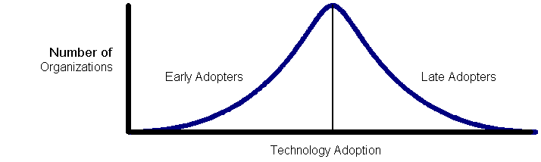
Technology Adoption Profiles

Slide 14
Early Adopters
- Aggressive (high risk)
Focus on creating new processes, products and markets
- Emphasize soft benefits

Slide 15
Late Adopters
- Cautious (low risk)
- Focus on efficiency
- Emphasize hard benefits

Slide 16

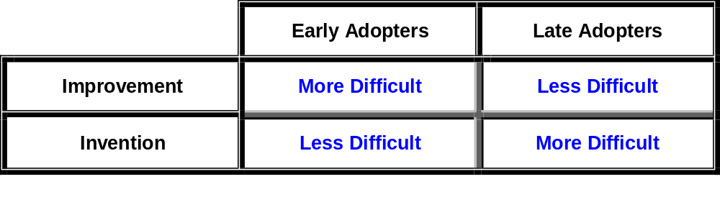
Project Approval
Adoption Profile
Project
Type

Slide 17
Project Approval
Effectively Communicating ROI
- Explain costs and benefits clearly
- Hard benefits first, soft benefits second
- Numbers, numbers, numbers!

Slide 18
Conclusions
  ROI measurements can help IT managers validate and prioritize projects
  Maximizing ROI occurs when you consider all costs and all benefits
  Project approval is achieved by matching project type with an organization’s technology adoption profile

Slide 19
ROI Mailing List
http://mailman.cpb.org/mailman/listinfo/roi

