Slide 1
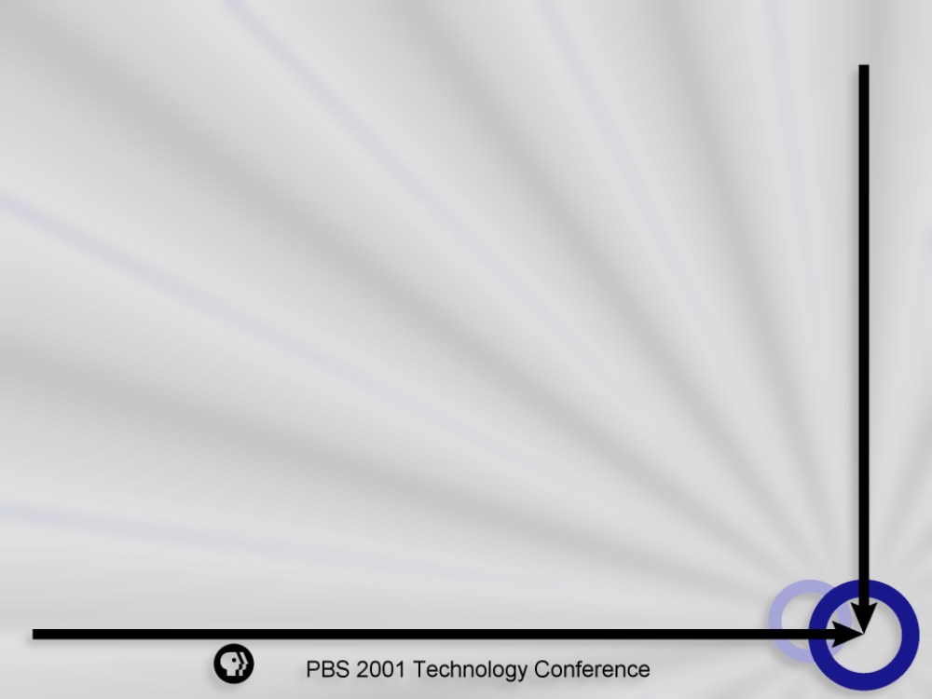
How Do You Spell Relief? C-M-S!

Slide 2

Goals of the CMS and Personalization Initiative
- CMS - Content Management System - CMS - Content Management System
Reduce Administrative Burden
Increase Exposure to Local Content
Open Standards
Architecture
Scalability
PBS Selection Strategy
Ease of Use
“Best of Breed”
Web Based
Interface
Publication to Multiple Platforms
Provide Targeted Content through Personalization
Notes:
Focus on Standards
Separating content from presentation
Java Using an object oriented approach to dynamically serve content
Technology: XML
Enable Dynamic Content
Reuse Content for multiple Devices

Slide 3
What is a Content Management System?
Separate content from presentation
Organize and search content by multiple attributes
- CMS - Content Management System - CMS - Content Management System
Secure Personal Workspaces
Checking files In and Out
Reusable
Objects
Repository
“Locking” Files In Use
Apply templates
Library
Services
Administration
Scheduling notifications
Control Deployment
Workflow
Tagging
Quality Assurance
Associate Metadata at the object level
Automation of update processes

Slide 4
Achieving Localization/Personalization
- CMS - Personalization - CMS - Localization
Provide personalized view of Online content
Prompt user for input
Allow a user to provide preferences
Extend current localization Strategy
Dynamic Page Assembly Based on user preferences
Move toward a “My PBS” Experience
Publish to multiple platforms
(COPE)

Slide 5



Best of Breed Approach
- CMS - Content Management System - CMS - Content Management System
Any HTML
Editor
Content
Management
System
ATG
Personalization
Library
services
Personalization through rules engine
Content creation through third party tools
Repository
Administration
Workflow
Tagging
- CMS - Personalization - CMS - Localization
Personalization
Dynamic Page Assembly Based on user preferences
ATG
Dynamo
Apache
Page
Assembly through app server
Publishing through Web Server

Slide 6
Goals of the CMS and Personalization Initiative
Reduce Administrative Burden
- CMS - Content Management System - CMS - Content Management System
Increase Exposure to Local Content
Reusable
Objects
Repository
Library
Services
Administration
Workflow
Publication to Multiple Platforms
Tagging
Provide Targeted Content through Personalization

Slide 7
Demonstration Time

Slide 8
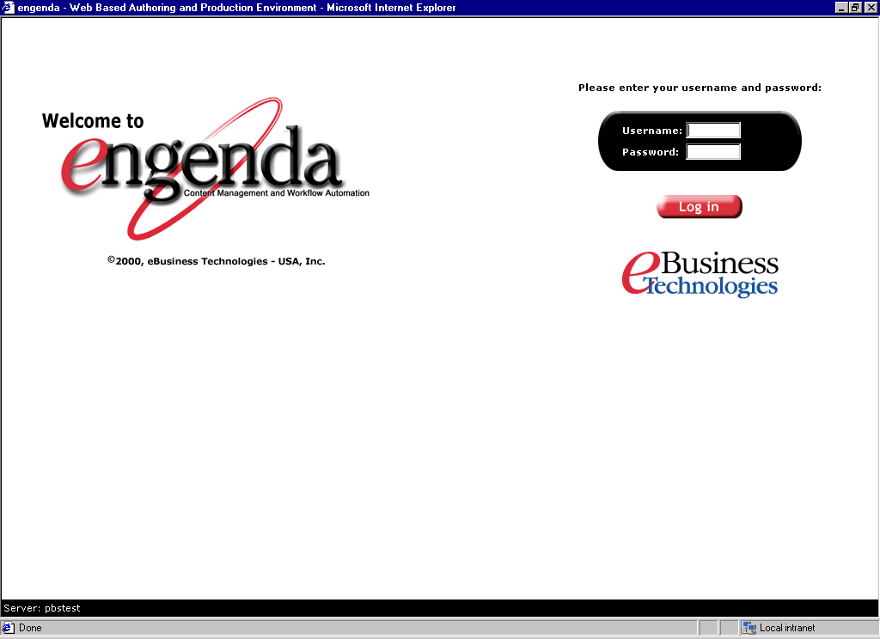
Log In
Notes:
The PBS CMS is a web based system allowing producers and editors to log in, and either retrieve or submit content.

Slide 9
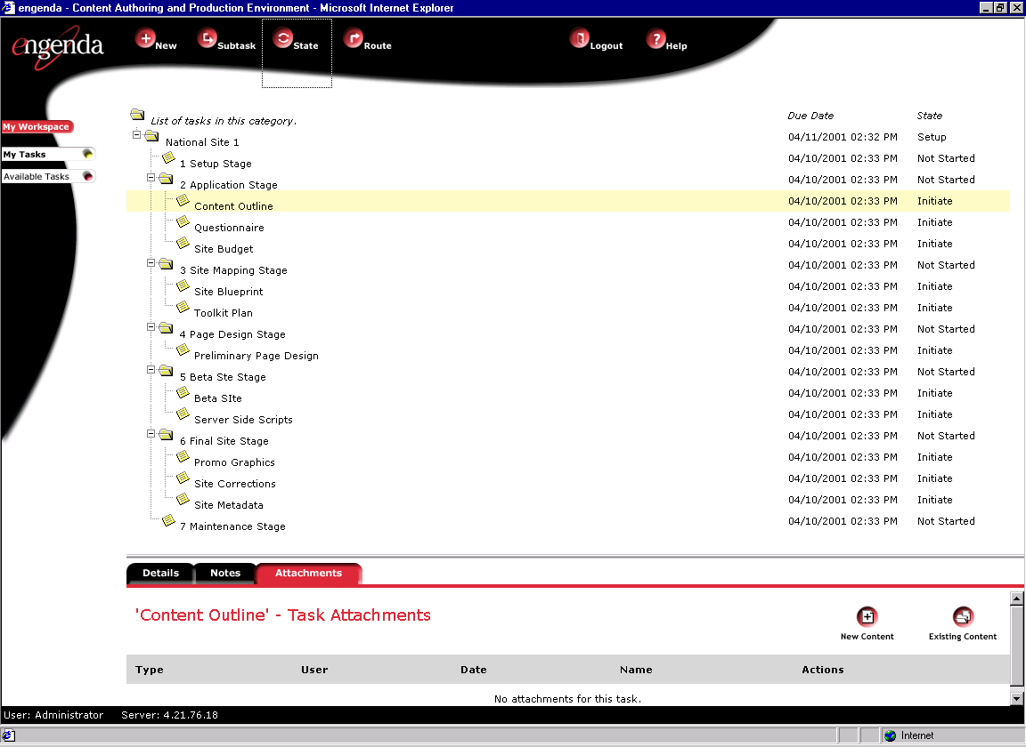
Task Driven Workflow
Notes:
The task driven workflow established for the production of national site introduces an additional capability of managing the development of a site from conceptual design to the site’s launch.

Slide 10
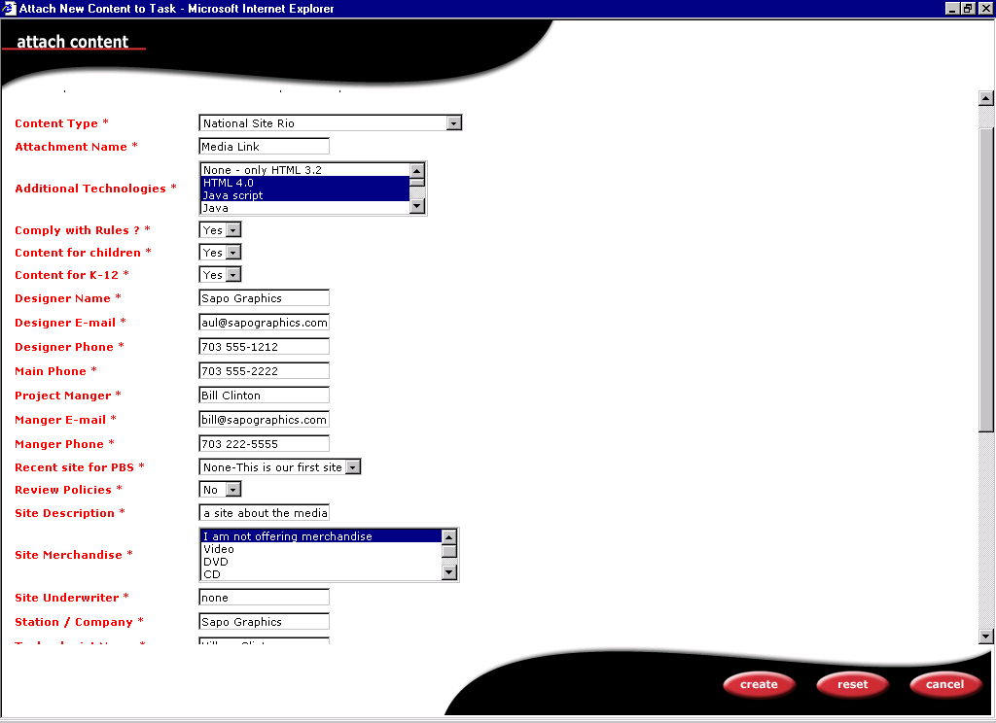
Site Questionnaire
Notes:
Information associated with the site (metadata) is captured through a form and stored in XML.

Slide 11
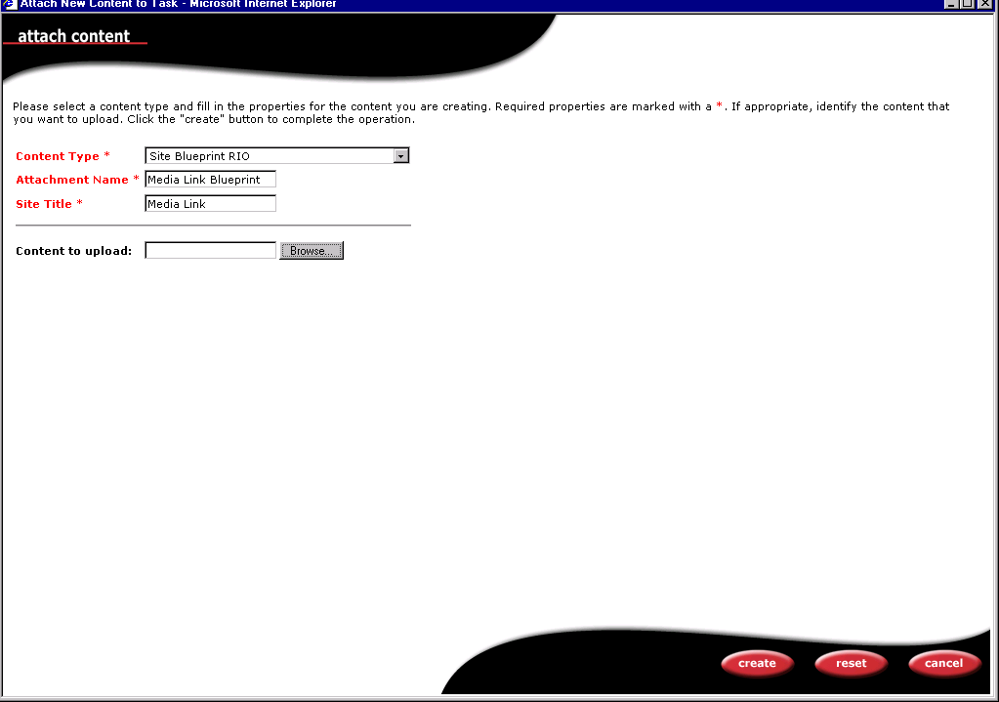
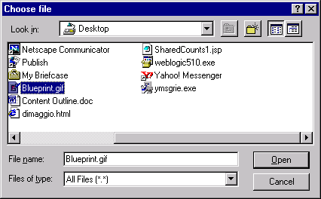
Uploading Deliverables

Slide 12
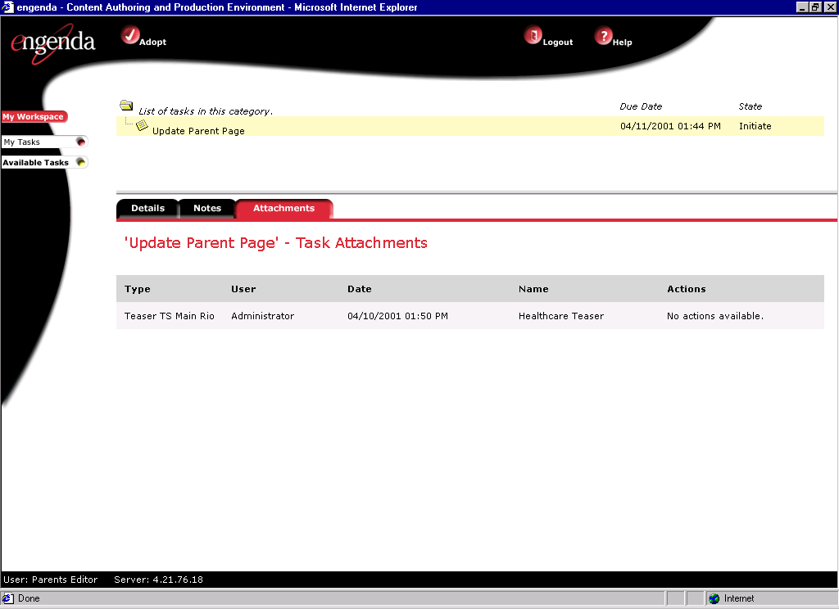
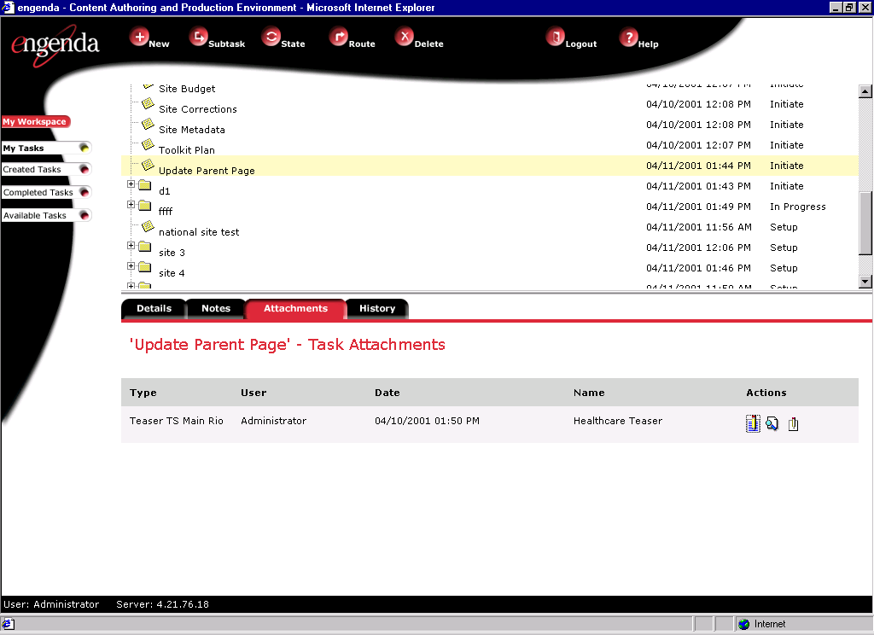
Site Maintenance

Slide 13
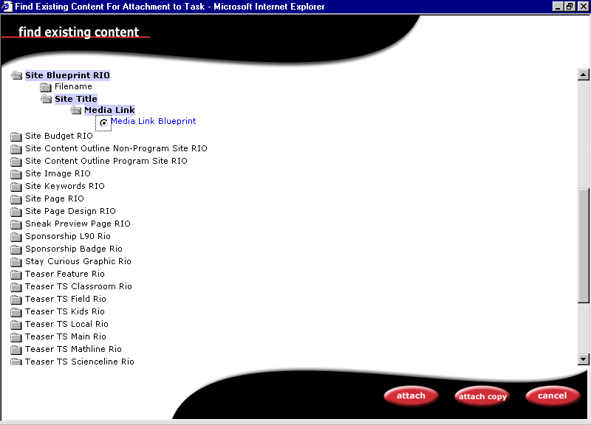
Retrieving Content
Notes:
Content can be easily retrieved by browsing the metadata entered for the objects.

Slide 14
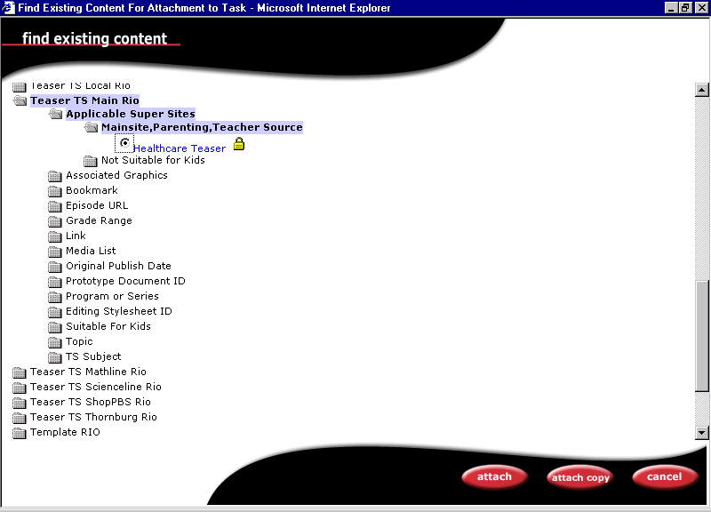
Library Services
Notes:
A lock icon indicates that the teaser has already in use by another user.

Slide 15
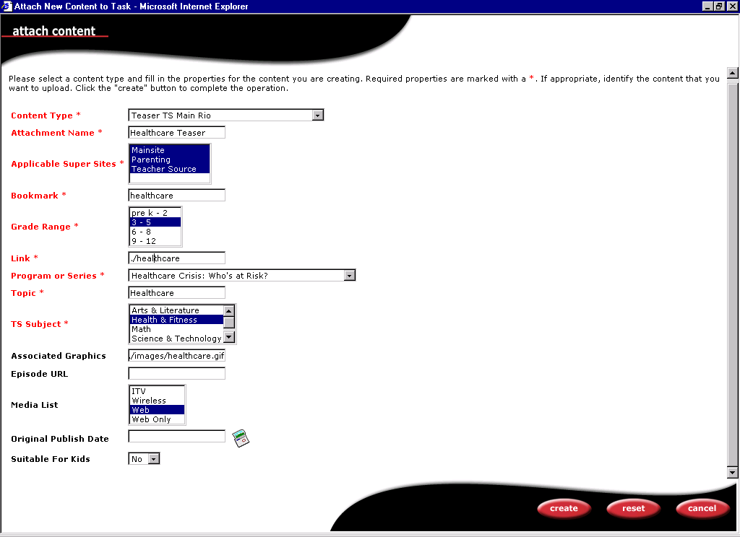
Entering Teaser Metadata

Slide 16
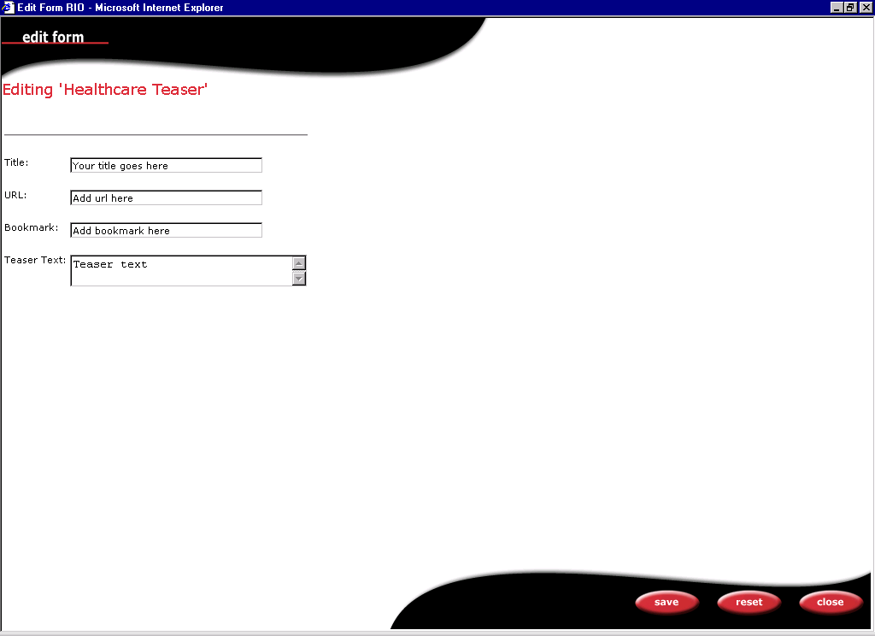
Entry Form

Slide 17

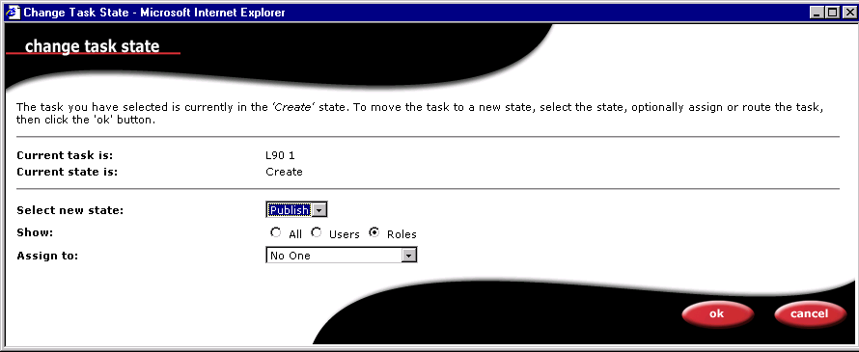
Changing the “State” of an Object
Notes:
The state of an object indicates the step of a production workflow. Several workflows have been established for PBS. The simplest workflow which may be used allows an object to be created and then published. A more complex workflow involves creation, review, approval, and then publish.

Slide 18
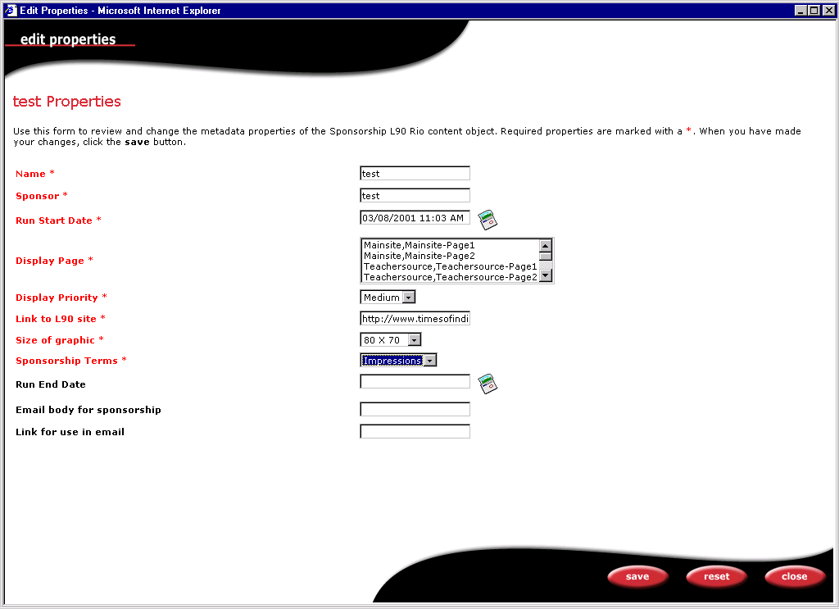
Controlling the Publishing of Content
Notes:
Content publishing is controlled by associating information about the object such as display page and start date. Once the object has changed state to “Publish”, the metadata will dictate the actual display of the content.

Slide 19
Key Technologies

Slide 20
Architecture
CMS – Engenda
Maintained
XML,HTML, Graphics…
File System /
Relational Database
Published
ATG
App Server
JHTML (HTML with embedded Java Beans
Apache Web Server
(Unix)
Personalized on Delivery

Slide 21
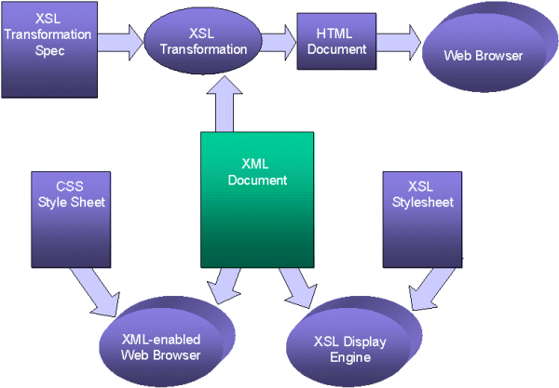
Options for displaying XML

Slide 22
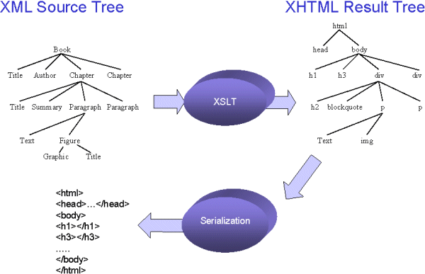
XML to HTML

Slide 23
JHTML
The .jhtml page looks something like this:
<HTML> <HEAD>
<TITLE>New Dynamo Server Page</TITLE>
</HEAD>
<BODY BGCOLOR="#FFFFFF">
<TABLE>
<droplet bean="/pbs/com/pbs/servlets/PBSDynamoServlet">
<param name="displayArea" value="mainsite">
<param name="displayPage" value="mainsite1">
<param name="currentDate" value="12/12/2002">
</droplet>
</TABLE></BODY> </HTML>

Slide 24
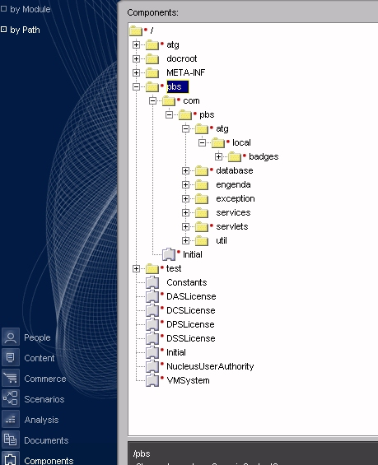
Java Development Environment

Slide 25
Implementation
I
II
III
IV
Phase
Functionality by Phase
Reduction of Administrative Burden
Increased Exposure of Local Station Content
Content Publication for Multiple Devices
Targeted Content Exposure through Personalization
1
Architecture
2
Core Repositories
X
X
3
Core Workflow
X
X
4
Initial Personalization
X
X
X
X
5
Localization
X
X
X
X
6
Parents
X
X
7
Content Sharing
X
X
X

Slide 26
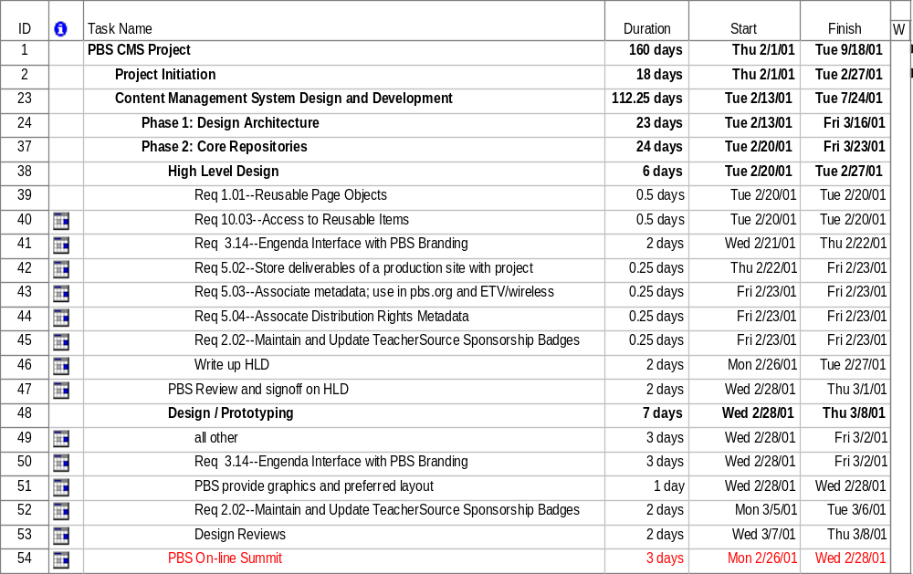
Project Schedule

Slide 27
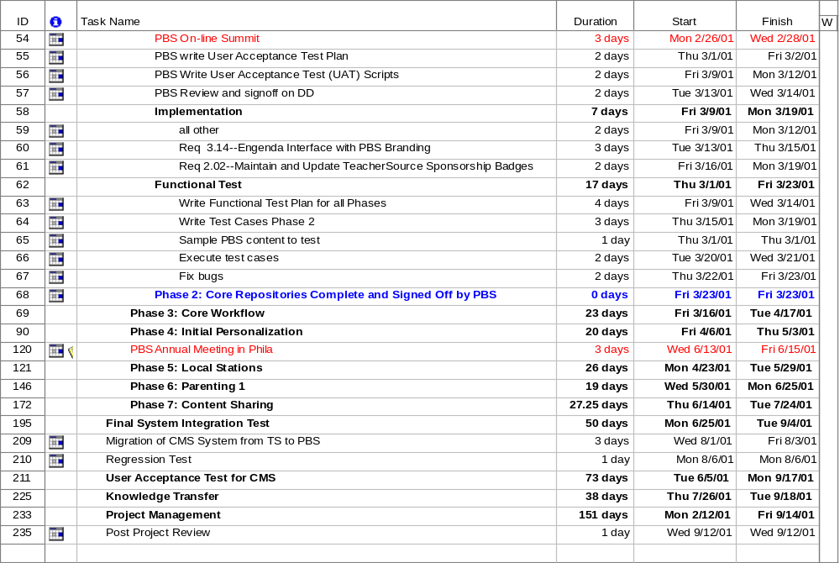
Project Schedule Continued

Slide 28
Questions and Answers

