Slide 1
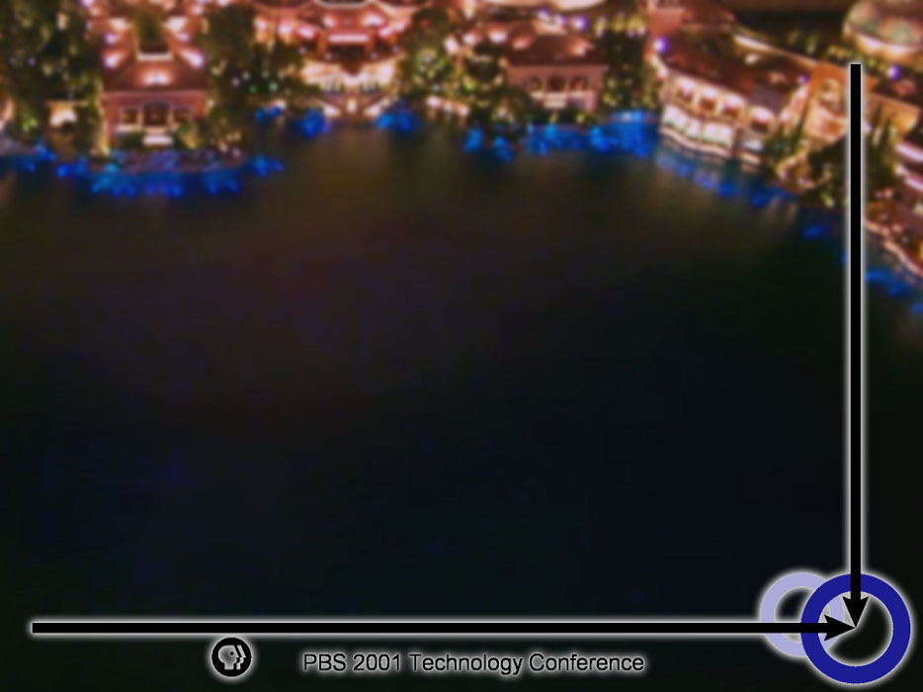
Navigating Wireless/Mobile
Devices and Applications Today

Slide 2
Devices/OS
Palm
Handspring Visor
Casio Cassiopeia
Compaq iPaq
Hewlett-Packard Jornada
Blackberry
WAP devices
Samsung Yopy
Apple Newton
Palm OS
Windows CE/PPC
Embedded Linux
Newton

Slide 3
Mobile vs. Wireless
Mobile = You can get information, then take it with you when you are in motion
Wireless = You can get information while you are in motion

Slide 4
Advantages of Mobility
Adds flexibility to a lifestyle
  Schedule
  Contacts
Keep content with you
Tote large amounts of reference material

Slide 5
Advantages of Wireless
Real-time interaction with applications
True on-demand eliminates need for forethought

Slide 6
Applications and Content Available Today
Yellow/White Pages
Driving Directions
Movie Listings
Encyclopedias and dictionaries
Financial Info
Email and IM
Amazon
Yahoo!
MSN
Weather Channel
ESPN
AvantGo
eBay

Slide 7
Funky New Low Real Estate Space
Test the platforms you want to support
PDA browser support for HTML is inconsistent
Akin to building for the Web of ’93-’95
This “HTML Lite” is almost HTML 3.0, but not quite.
Best use of images

Slide 8
Wireless PBS AvantGo channel
Sign-up Process
Content
Back End

Slide 9
Sign-up Process
Orientation
Select Content
Choose Favorite Local Member Station
Create AvantGo Account or Confirm changes to existing AvantGo account
Return to PBS.org

Slide 10
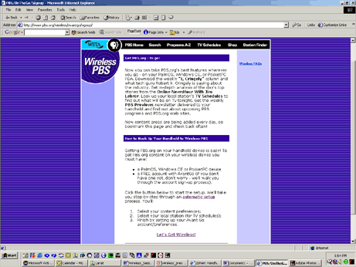
Sign-up: Orientation

Slide 11
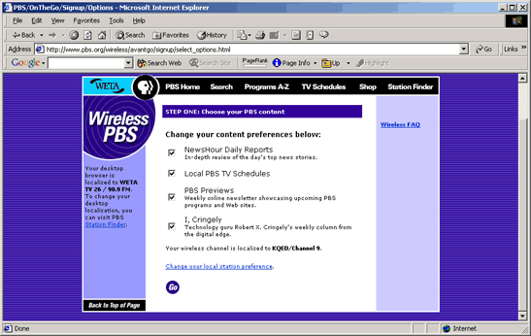
Sign-up: Select Content

Slide 12
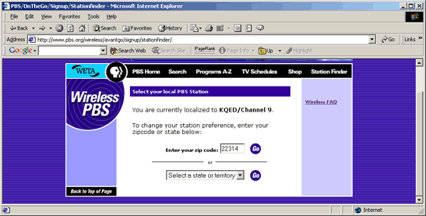
Sign-up: What Area of the Country?

Slide 13
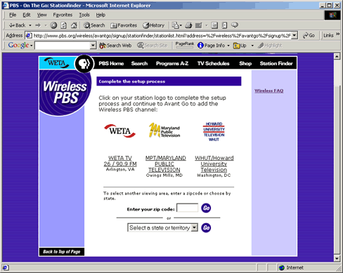
Sign-up: Choose Station

Slide 14
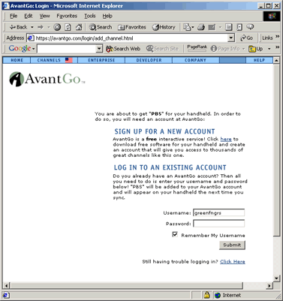
Sign-up: AvantGo

Slide 15
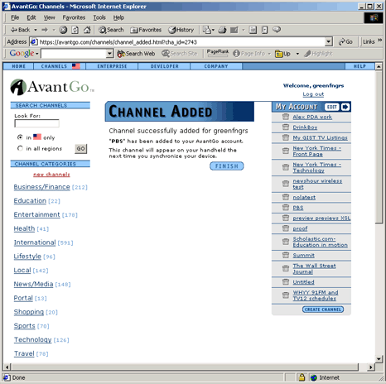
Sign-up: AvantGo Finish

Slide 16
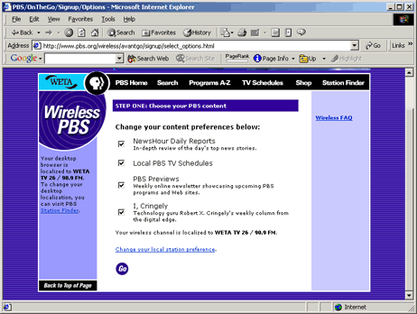
Sign-up: Return to PBS.org

Slide 17
Wireless PBS Content
NewsHour Previews and Reports
Local TV Schedules
PBS Previews
I, Cringely
Other?

Slide 18
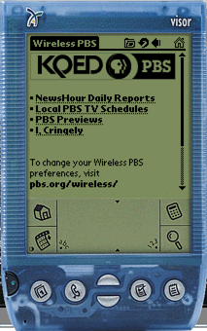
Wireless PBS

Slide 19

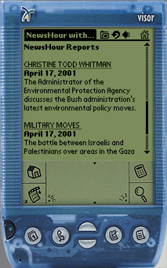
Wireless PBS: NewsHour

Slide 20
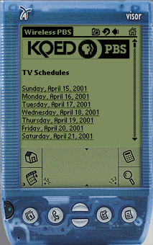

Wireless PBS: TV Schedules

Slide 21
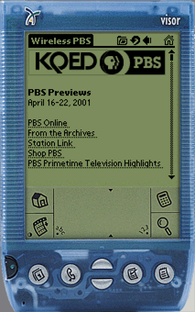
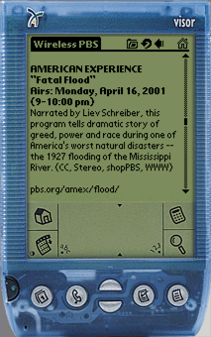
Wireless PBS: Previews

Slide 22
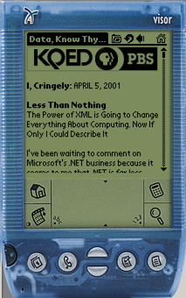
Wireless PBS: I, Cringely

Slide 23
Local Content
Local Community Events
Local News
Other Member Station Content?

Slide 24
Publishing of PBS Wireless Content
Form Based submission using XML/XSL
  Ease of Management
  XML Parser, XSL interpreter for Solaris or Linux
  XSL translations
Template based submission of HTML
  More flexibility for station
  Less manageable
  File sizes (how to control given device storage limitations)

Slide 25
Wireless PBS
pbs.org/wireless/

Slide 26
Navigating Wireless/Mobile
Directions of Devices and Applications

Slide 27
A Wireless Future
Digital Terrestrial Television
  DTV signal has room for large amounts of data
    19.39 Mbps
      1 HD Channel + general data
      4 SD Channels + data for each + general data
    SAF DTV/iTV trials sending 500 Kbps
      Standard Definition 4:3 / 4-way multicast
    Space for data can grow with encoder technology
  Transition frees ‘analog’ spectrum for data applications/devices

Slide 28
Digital Terrestrial iTV (continued)
  Types of Data
    Data casting (program independent)
      Commercial payloads
      Mission-critical corporate data
    Enhanced programming (program synchronous)
  Robust applications with web-like functionality
    Based on web technologies (HTML, JavaScript, etc)
    Movement from HTML toward XHTML to XML
  Unidirectional / move to bi-directional
  Reception devices
    Set Top Boxes
    Desktop PCs
    Handheld PCs
    Tablets

Slide 29
Wireless PDAs
  Two-way connectivity paves way to robust, real-time interactive applications
  User experience/content converges with web
  Ultimately devices merely another access device to singular content

Slide 30
Future wireless devices
  PDAs to PADs (Personal Access Devices)
  LAWN Tablets
    Schools
    Work environments
  PrAWN
    Banks
    Secure environments
  Dick Tracy wristwatch

Slide 31
Thank You
Jeremy Roberts
Broadband and Streaming Media Evangelist
Chris Atienza
Associate Director of Technology
PBS Interactive

