Slide 1
Understanding Adaptive Equalization for Digital Television Transmitters
Presented to -
PBS Technology Conference
Presented by -
Dan Dickey - April. 21, 2001

Slide 2

Adaptive Digital Equalization
What is it?
Why do you need it?
How does it work in the real world?
What can you do to make it work the best?
Notes:
Thank you for having me here this morning. I hope you weren't expecting my presentation to be a substitute for a good shot of caffiene to start your day.
This morning I want to talk about Adaptive Digital Equalization. Without resorting to complex mathematical models I will try to explain what it is, why you need it, how it works and some things you can do within your own transmission plant to make adaptive systems work better.
After this presentation you should be able to easily recognize the source of different kinds of distortion simply by looking at a constellation diagram on an 8VSB signal analyzer. Some DTV exciters produce constellation diagrams either directly on the exciter or through a serial connection using a separate PC.

Slide 3
What is Adaptive Equalization?
System for monitoring and compensating for linear and nonlinear distortion in the transmission system
Maintains low distortion 8VSB signal
Works even when you’re not at the transmitter so changes in RF system performance are tracked and equalization adjustments are automatically made
Notes:
Adaptive Equalization monitors the quality of the transmitted signal for a specific parameter, in our case signal to noise ratio, and attempts to compensate for linear and nonlinear distortion in the RF system.
By making continuous adjustments to the modulation system the adaptive equalization process maintains a low distortion 8VSB signal.
Adaptive systems generally work 100% of the time so even when you are not at the transmitter the system is constantly making small adjustments as conditions change.
Adaptive equalization systems have been around almost as long as digital modulation systems have been in use. Since each modulation system has its own idiosynchroncies it has generally been the case that specialized hardware and software must be developed to automatically correct for distortion in a particular digital modualation systems. There are however, several references in the literature to adaptive equalization systems that attempt to correct for distortion regardless of the type of modulation. Most 8VSB engineers will agree that such a system is not optimum for DTV transmitters. That may be all that the various transmitter designers will agree on however.

Slide 4
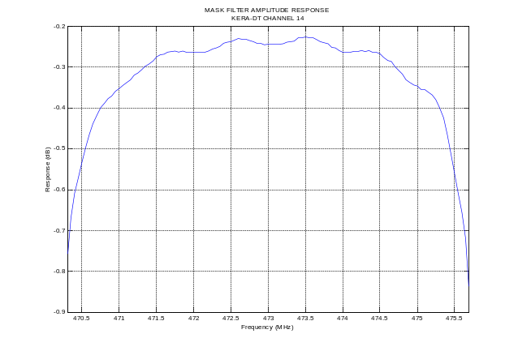
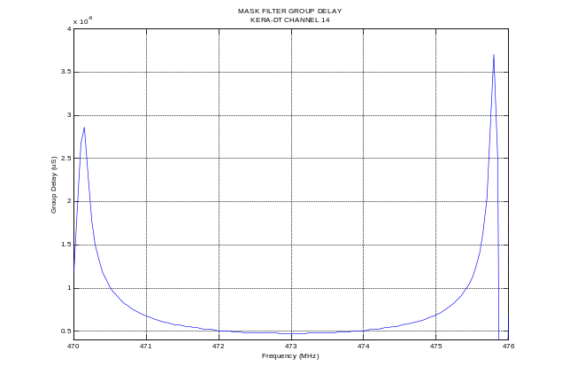
What is Linear Distortion?
Linear distortion exists when a system does not have the following characteristics:
  Constant amplitude vs. frequency
  Linear phase vs. frequency (i.e. constant group delay)
Notes:
Linear distortion is caused by imperfections in the frequency response of the transmission system. Specifically, a distortionless system will have constant amplitude vs. frequency and linear phase vs. frequency. Another way of saying linear phase is to say the group delay is constant vs. frequency.
Here we see a frequency reponse and group delay measurement if a transmission system with severe linear distortion. This system is so badly distorted that without adaptive equalization no 8VSB receiver we tested could demodulate the transmitted signal. In fact, we have found no 8VSB signal analyzer that could demodulate a signal from this system either. Without adaptive equalization techniques we could not even measure how bad the 8VSB distortion is.

Slide 5
The Most Common Causes of Linear Distortion in 8VSB
Tuned circuits:
  Mask filter
  Cavity amplifiers
  Antennas
VSWR
  Antenna icing
  Imperfect transmission line
Notes:
Linear distortion is produced by elements of the transmission system that either intentionally or out of necessity alter the frequency reponse of the signal. Tuned circuits are by far the most common cause of linear distortion. Tuned circuits are found in mask filter, cavity amplifiers and antennas. Another source of linear distortion is VSWR. VSWR can produce reflections that cause significant changes in the frequency response of the system. In analog television we have all seen or heard of ghosts created by reflections along a transmission line. The same thing happens in digital television but the ghost causes an increase in digital noise.
For a few specific types of amplifiers, adaptive equalization techniques are not very good at fixing the distortion caused by VSWR. In fact, the presence of VSWR can confuse an adaptive system into making bad decisions about what corrections should be applied to the signal. I will talk about this in some detail when we come to the nonlinear adaptive equalization portion of this presentation.

Slide 6
Why is Linear Distortion Bad?
Linear distortion eats up the signal to noise margin of digital systems
  Receiver equalizer must work harder to remove transmission system distortion
  Linear distortion due to reflections at transmission site are harder for receiver to correct
  Reduces coverage area
Notes:
Linear distortion chews up signal to noise margin in the digital realm. Most 8VSB receivers can compensate for a significant amount of linear distortion. Even so, they do not have an infinite capacity to compensate due to the available number of taps in their digital equalizer and the available number of bits in the digital processing system employed. Each receiver is different in this regard but all recievers have a limit as to how much linear distortion they can handle. Linear distortion introduced at the point of transmission adds linearly to the distortion due to the over the air channel and makes the 8VSB receiver work that much harder.
Reflections due to VSWR within the RF system generally are shorter in length than the typically multipath reflections that most receivers are expecting. Generally, multipath type reflections are on the order of microseconds apart from the main signal. Reflections due to VSWR can be on the order of hundreds of nanoseconds. It is very difficult to build an equalizer into the reciever that is equally good at killing short reflections and long reflections so receivers are optimized for longer reflections. When presented with a very short echo they may not equalize it properly if at all.
The bottom line is that linear distortion reduces the effective coverage area of a DTV signal.

Slide 7
How to Recognize Linear Distortion ?
Linear distortion causes random noise in the complex domain thus increasing EVM
  Noise is independent of signal amplitude
  Constellation diagram will be 8 fat lines instead of 8 skinny lines
Notes:
When we say that linear distortion is caused by imperfections in the amplitude and phase response we might think that direct measurement of these parameters would be a good way to verify if linear distortion is causing a problem or not. But the best measurement is to actually determine the noise component due to linear distortion and adjust the precorrection to optimize system noise.
In the complex domain we measure noise visually be examining a constellation diagram. A system with significant linear distortion will have 8 fat lines instead of 8 skinny lines. The lines will still be straight because the noise is independent of signal amplitude.
In a few moments we will show some examples of linear distortion in both the complex domain and the magnitude/phase domain. But first we need to understand the tool we will be using.

Slide 8
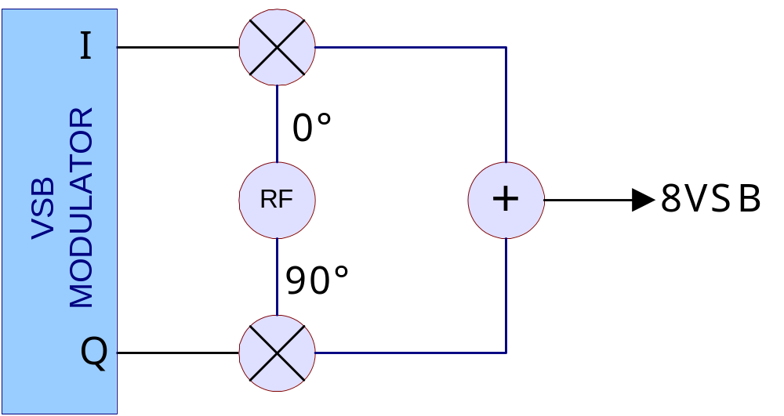
Understanding Vector Modulation
Notes:
A constellation diagram is a good way to visualize digital modulation systems. Here we see a typical vector modulator used in dozens of digital systems including 8VSB. A constellation diagram displays the amplitude of the I and Q components of the digital signal for every symbol within a certain time period. Thus we can see the source of noise and distortion whether it comes from the I channel or the Q channel or both.
By convention the I channel amplitude is shown along the X axis and the Q channel along the Y axis. So if we see deviation from ideal in the X direction we know it is I channel distortion. If we see deviation from the ideal in the Y direction we know it is Q channel distortion.
The vector sum of the I and Q channel is the RF amplitude of the signal or just the envelope component. The vector angle of the I and Q channel is the instantaneous phase of the RF signal.
So you can see that from a constellation diagram we can see all forms of distortion (phase modulation, amplitude modulation, I channel noise and Q channel noise). The I channel is most important to us in 8VSB because the digital data is found entirely in the I channel.
So now that we know where a constellation diagram comes from we can look at some 8VSB constellations and learn what is causing the distortion.

Slide 9
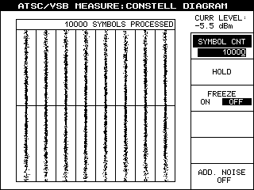
Understanding Vector Modulation
Notes:
A constellation diagram is a good way to visualize digital modulation systems. Here we see a typical vector modulator used in dozens of digital systems including 8VSB. A constellation diagram displays the amplitude of the I and Q components of the digital signal for every symbol within a certain time period. Thus we can see the source of noise and distortion whether it comes from the I channel or the Q channel or both.
By convention the I channel amplitude is shown along the X axis and the Q channel along the Y axis. So if we see deviation from ideal in the X direction we know it is I channel distortion. If we see deviation from the ideal in the Y direction we know it is Q channel distortion.
The vector sum of the I and Q channel is the RF amplitude of the signal or just the envelope component. The vector angle of the I and Q channel is the instantaneous phase of the RF signal.
So you can see that from a constellation diagram we can see all forms of distortion (phase modulation, amplitude modulation, I channel noise and Q channel noise). The I channel is most important to us in 8VSB because the digital data is found entirely in the I channel.
So now that we know where a constellation diagram comes from we can look at some 8VSB constellations and learn what is causing the distortion.

Slide 10
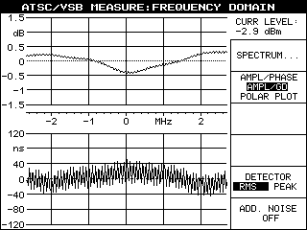
How to Recognize Linear Distortion ?
Notes:
Here we see a magnitude and group delay response for an 8VSB system. The magnitude response is pretty good at better than +/- 0.5dB across the Nyquist bandwidth. Most transmitters are not this good through a mask filter. The group delay is pretty good at +/- 40nS. The high frequency variations are most likely due to a SAW filter somewhere in the system probably in the modulator or demodulator. These graphs are made using an 8VSB demodulator from Rohde & Schwarz.
If we look at the frequency response and group delay we don't see anything too exciting. Now let's look at the constellation diagram produced by this system.

Slide 11
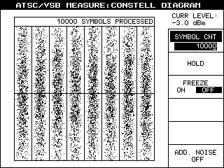
How to Recognize Linear Distortion ?
Notes:
When we turn to our old friend the constellation diagram things look pretty bad. If one of these dots gets outside its bounding box either to the left or right then that represents an error in the 3-bit symbol. The symbols are all over the legal range and some are very close to being over the limit and causing bit errors.
Notice that the 8 columns are straight but fat. Fat columns mean that the I channel is noisy. Because the columns are straight we know that the transmitter is not compressing the envelope. This is a classic case of high linear distortion.

Slide 12
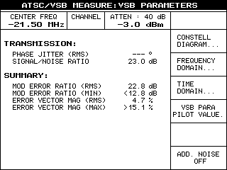
How to Recognize Linear Distortion ?
Notes:
When we look at the SNR or EVM for this system we find our observation about the constellation is confirmed. The SNR is pretty bad at 23.0dB and MER is about the same. EVM is almost 5%. Normally SNR and EVM track each other except is some rare cases where the signal has undergone linear changes in the Q channel only.

Slide 13
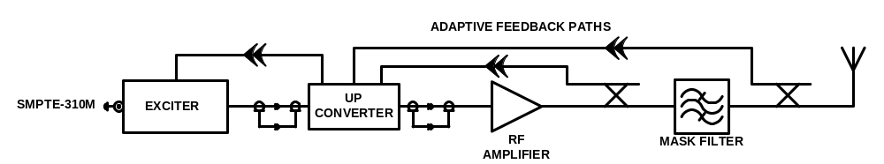
How Can Linear Distortion be Controlled?
Linear distortion can be reduced or eliminated by measuring signal to noise (SNR) degradation and compensating for the transfer function of RF system through predistortion
Notes:
We can reduce linear distortion in an 8VSB transmission system by measuring the SNR degradation and building a linear predistortion filter. To do that we need to use a receiver that can measure linear distortion. Once we have the receiver we can adjust the predistortion filter until the receiver confirms that we have lowered the linear distortion as much as possible. Because RF system performance changes due to time, temperature, humidity and other environmental conditions we must constantly receive the signal, measure the distortion and adjust the predistortion filter as required. Systems that do this are referred to as "Adapative" in nature because they adapt to external changes.
It is important to remember that we cannot just measure the frequency reponse of the system once and preset the predistortion. In an adaptive equalization system we measure the actual SNR and make our adjustment accordingly. This ability to constantly respond to changing conditions is why adaptive systems are so useful.

Slide 14
Adaptive Equalization to Correct Linear Distortion
Adapative Equalization Process
  Capture output of exciter
  Capture output of mask filter
  Demodulate transmitter output to same domain as exciter
  Subtract both versions and adjust predistortion filter for least error
Notes:
The basic concept of a typical adaptive equalizer is fairly straightforward. First, capture the output of the exciter into some sort of memory. The easiest way is for the exciter to just have some extra memory and save a perfect copy of what was transmitted. We refer to this copy as the "ideal" signal.
At the same time we need to capture the output of the mask filter. Then, demodulate the output of the mask filter into the same mathematical representation as the ideal signal. Typically this is I and Q format but other formats have been used. Subtract both versions to form an error vector.

Slide 15
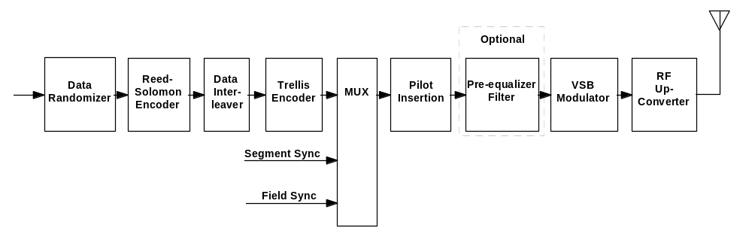
Adaptive Equalization to Correct Linear Distortion
PREDISTORTION FILTER
Notes:
Then we manipulate the predistortion filter in such a way that the magnitude of the error vector is minimized. This just involves some educated guessing until we hit the right filter. A popular guessing algorithm is the LMS technique but other algorithms exist. In this way we achieve minimum transmitted linear distortion and maximise the SNR.
We put this predistortion filter in the middle of the 8VSB modulator between the transition from discrete symbols to the continuous world of VSB. From a block diagram standpoint this has the same effect as placing a compensating filter in the receiver just before the symbols are decoded thus compensating for the linear distortion in the RF system.
The concept is simple enough but a practical implementation is more difficult than this explanation would seem to indicate. DTV has been around for a number of years and still there are very few transmission system manufacturers that provide full adaptive equalization. Some of the problems relate to having a quality demodulator because the precorrection will only be as good as the demodulator. Some modulators don't have a good way to capture their ideal output.
You really have to design the modulator, transmitter and RF system with adaptive in mind. Otherwise it's a hard thing to add it after the fact.

Slide 16
What is Nonlinear Distortion?
Nonlinear distortion exists when a system does not have the following characteristics:
  Constant gain vs. output power
  Constant phase vs. output power
Notes:
Having given a quick overview of linear adaptive correction we now turn to the somewhat more interesting (and more difficult) task of adapting to nonlinear distortion. Nonlinear distortion is created when the gain or phase of an amplifier is not constant vs. power output.
8VSB is a modulation type that creates an infinite number of different power levels from the transmitter. One might think that since we are talking about a digital system that the transmitter would produce a few discrete power levels. But the process of converting the digital levels into a 6MHz bandwidth also causes the signal to become entirely analog in nature.
Each position on the constellation diagram represents a different power level. Even a given symbol can be represented by an infinite number of power levels.
Linear distortion is caused by imperfections in the frequency response of the transmission system. Specifically, a distortionless system will have constant amplitude vs. frequency and linear phase vs. frequency. Another way of saying linear phase is to say the group delay is constant vs. frequency.
Here we see a frequency reponse and group delay measurement if a transmission system with severe linear distortion. This system is so badly distorted that without adaptive equalization no 8VSB receiver we tested could demodulate the transmitted signal. In fact, we have found no 8VSB signal analyzer that could demodulate a signal from this system either. Without adaptive equalization techniques we could not even measure how bad the 8VSB distortion is.

Slide 17
The Most Common Causes of Nonlinear Distortion in 8VSB
Active circuits
  AGC amplifiers
  Solid state power devices
  IOT amplifiers
Notes:
Nonlinear distortion is produced by active devices such as AGC amplifiers, solid-state power devices and IOT amplifiers. Typically the final output device of a DTV transmitter is the most likely cause of nonlinear distortion but any active amplifier can cause nonlinear problems.
Sometimes amplifiers that work well into a perfect load become nonlinear when terminated in a higher VSWR. This can be true for IOT or solid-state finals.

Slide 18
Why is Nonlinear Distortion Bad?
Nonlinear distortion eats up the signal to noise margin of digital systems
  No receiver can correct for nonlinear distortion
  Causes spectral regrowth both inside the channel and outside the channel
  Reduces coverage area
Notes:
Nonlinear distortion chews up signal to noise margin in the digital system. Unlike linear distortion that we have been talking about, there is nothing an 8VSB receiver can do to compensate for a significant amount of nonlinear distortion.
Nonlinear distortion is the source of most of the out of band emissions from DTV transmitters. Those of you that operate DTV transmitters are probably familiar with the difficulties involved in getting a transmitter to meet the FCC mask specifications.
The bottom line is that linear distortion reduces the effective coverage area of a DTV signal and increases adjacent channel interference.

Slide 19
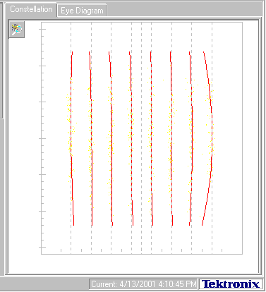
How to Recognize Nonlinear Distortion ?
Notes:
Here we see a constellation diagram of a system with an SNR of about 28dB. The lines are nice and straight until we get to the last two columns on the right. Notice how the right most column is curved in at the top and bottom. That's because the instantaneous power output at the top and bottom of the column are the maximum of the 8VSB signal. In analog terms we would say that this amplifier compressed at the sync tips.
So we can use a constellation diagram to see whether an SNR problem is related to linear or nonlinear distortion. Linear distortion causes fat straight lines and nonlinear distortion causes the outermost lines to curve in at the top and bottom.

Slide 20
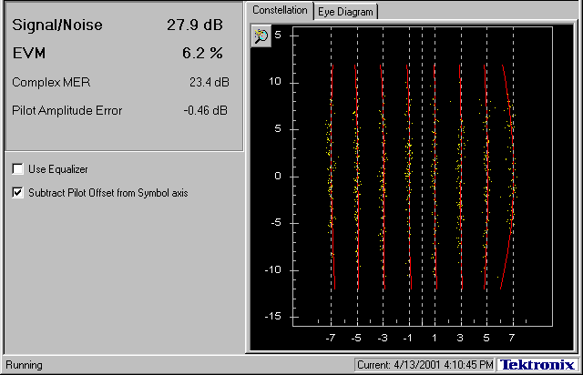
How to Recognize Nonlinear Distortion ?
Notes:
Here we see the same constellation diagram and we can see that the system SNR is about 28dB. We also see an error in the pilot amplitude of about a half dB.
Pilot amplitude error is another type of error that causes a lot of problems for certain types of receivers. Depending on the algorithm used in the receiver to find the 8 levels (sometimes called the slicer) the pilot error really eats up the SNR margins. In other receivers the slicer works from the 8 levels and the pilot error is not as critical. Receiver manufacturers don't want to give away their secrets but you can line up 3 8VSB signal analyzers and give them this particular signal and you will get wildly different estimates of the SNR because of the pilot error.

Slide 21
How Can Nonlinear Distortion be Controlled?
Nonlinear distortion can be reduced or eliminated by measuring the error in the constellation as a function of output power and creating a predistortion system to compensate
Notes:
We can reduce nonlinear distortion in an 8VSB transmission system by measuring the curvature in the constallation and building a nonlinear predistortion network. To do that we need to use the same receiver that we used to measure linear distortion but instead of looking at the final output of the RF system we look instead at the output of the RF amplifier. This works because a properly designed passive RF system does create nonlinear distortion.
Now we come to a "secret" of nonlinear adaptive equalization. While a few transmitter manufacturers design adaptive linear equalizers only one or two have designed adaptive nonlinear equalizers. Nonlinear equalizers work on the same principle as analog differential gain and phase precorrectors. They predistort the signal going into the amplifier in such a way that the distortion produced in the amplifier is "cancelled". The predistortion circuit produces the nonlinear cancellation energy at the exact same instant in time as the desired signal is produced. Likewise the distortion causing amplifier produces it's distortion at the exact same instant as the desired signal is produced. If there were some time delay between the desired signal and either the predistortion component or the distortion component there would be less than perfect cancellation. If enough delay were present the two distortions might even add and make things worse.
The predistortion signal has significant energy outside the 6MHz DTV bandwidth. It must have or else it could not cancel any out of band energy produced by the amplifier distortion. If this out of band energy is delayed by an amount of time that is different from the in band energy we also get unequal cancellation. IOT amplifiers have time delay that varies across the 6MHz channel and beyond (that's why they have tuning cranks on them). Solid-state amplifiers usually don't have this problem. This is why solid-state amplifiers are easier to compensate than IOT amplifiers. So we have to use some "tricks" to coerce the IOT amplifier into having an almost equal time delay across the 6MHz channel and beyond. This is one of several reasons why all IOT transmitters are not created equal.

Slide 22
Adaptive Equalization to Correct Nonlinear Distortion
Adapative Equalization Process
  Capture output of exciter
  Capture output of RF amplifier
  Demodulate transmitter output to same domain as exciter
  Compute phase and gain error at all envelope levels and adjust predistortion system for least error
Notes:
Along the same lines as the linear adaptive system we first capture the output of the exciter into some sort of waveform memory. Simultaneously capture the output of the RF amplifier. Then, demodulate the output of the transmitter into the constellation. Subtract both versions to form a set of error vectors. Manipulate the predistortion curve in such a way that the error vectors are minimized. In this way we achieve minimum transmitted nonlinear distortion. Both the in band noise and the out of band shoulders will go down.

Slide 23
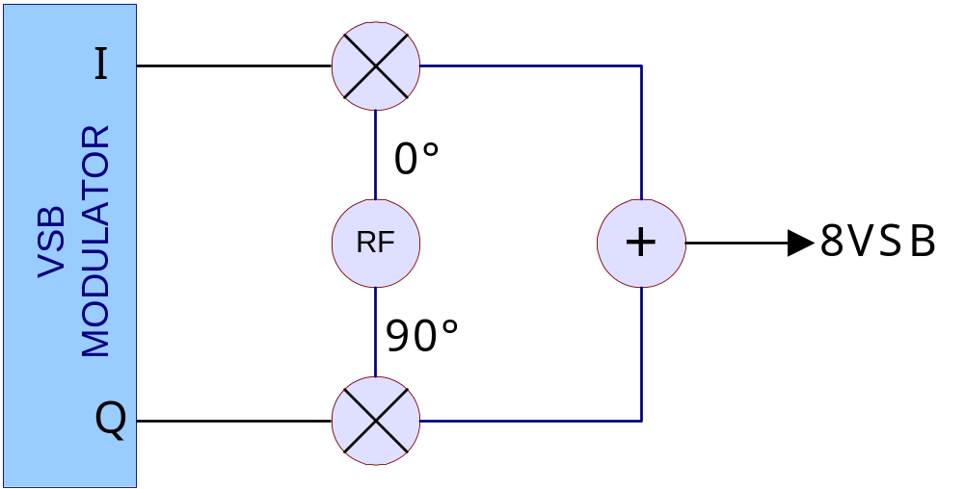
How To Correct Nonlinear Distortion
Notes:
To give a little more detail we turn once again to our old friend the vector modulator. We see that the VSB modulator produces the I and Q signals we need to combine to make the complete VSB signal.
The location of the constellation points is entirely determined by the I and Q signals. If we could somehow manipulate them in real time we could reposition the constellation anywhere we like.

Slide 24
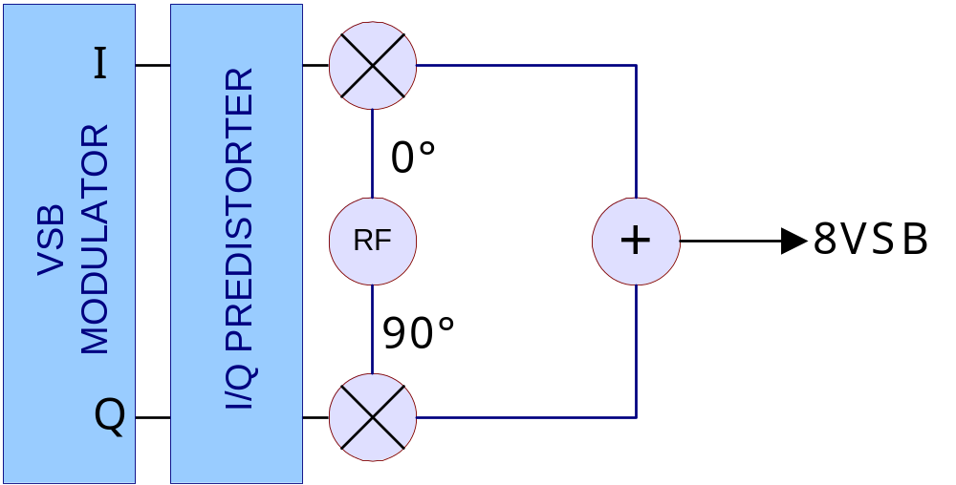
How To Correct Nonlinear Distortion
Notes:
So using the error vectors from the computations we discussed previously we can predistort the I & Q signals to force the constellation back to where we want it.
The exact technique for manipulating the vectors is pretty complex so for the purposes of this talk you'll have to take my word for it that this is possible and works very well.

Slide 25
Maximizing Performance of Adaptive Systems
Eliminate as much VSWR as possible
Reduce temperature variations of mask filter
Maintain the quality of the adaptive sample points and cabling
Notes:
VSWR is the enemy of adapative equalization systems. Reflected power that is reradiated out of the transmitter sometimes obscures the transmitted signal and an adaptive system can become confused by these reflections. Special software can be written to deal with VSWR and does work under most conditions. However, it's still best to maintain a low VSWR of < 1.1:1 if at all possible.
Adaptive systems will compensate for changes in the mask filter due to temperature variations. This is one of the big benefits of an adaptive system. Because of this one might think that controlling the environment of the mask filter is not required when using adaptive techniques. However, we have to think about another equalizer in the overall system. The receiver equalizer has to follow along with the adaptive equalizer. If the adaptive equalizer is chasing a mask filter that wanders around a lot then the receiver equalizer has to do some chasing of its own to keep up. This can lead to problems if the mask filter variations are large or fast. It's better to maintain the temperature of the mask filter as constant as practical and always try to prevent sudden temperature changes.
We must not forget that the adaptive system is only as good as the samples we provide to it. We need to pay attention to the directional couplers and cabling used to send the RF samples back to the adaptive system. If these components vary from the ideal then the adaptive system will push the transmitter to compensate at the expense of the quality of the radiated signal.

Slide 26
Understanding Adaptive Equalization for Digital Television Transmitters
Presented by
Dan Dickey
April 21, 2001
ADC Broadcast Systems Division
102 Rahway Road, McMurray, PA 15317
(724) 941-1500; (800) 215-2614
Notes:
The adaptive techniques we have described can be implemented entirely in digital signal processing circuitry. Gone are the screws and knobs for doing linearity correction. Now we can have a computer that measures and adjusts the performance of the entire RF system. Some of these techniques are not all that new but the application to DTV is something that will make manually tweaking transmitters a thing of the past.
Hopefullly we have explained how adaptive systems work, and how you can maximize their performance in DTV transmission system.
Questions?

