Slide 1
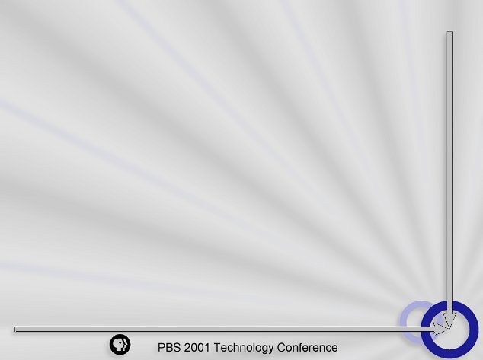

e-CRM in a Nonprofit World
Michael Cervino
Director, Nonprofit Strategy
Catherine Twohill
Nonprofit Strategy Consultant
Commerce One Global Services
Arlington, VA

Slide 2

CRM Definition (business perspective)
CRM is:
  a multi-year, phased business strategy
  a consistent set of customer-centric behaviors
  a process that supports interactions across channels
  understanding and anticipating customer’s needs
  tactics designed to optimize revenue and loyalty
Key drivers of a successful CRM strategy are:
  value delivered to the customer
  an improved customer experience

Slide 3
CRM Definition (technology perspective)
CRM involves:
  Capturing customer data from across the enterprise
  Consolidating all internally and externally acquired customer related data in a central database
  Analyzing the consolidated data (e.g. internal ROI on functions and activities; customer profitability analysis)
  Distributing the results of that analysis to various customer touchpoints

Slide 4
CRM Definition (technology perspective)
CRM involves:
  Using this information when interacting with customers via multiple touchpoints:
      Website
      online and/or on-air pledge
      direct marketing via mail and e-mail
      inbound and outbound call centers
      underwriting sales in the field
  Enabling fully interactive personalized web experiences
  Enabling seamless coordinated customer interactions throughout all channels and across all departments

Slide 5
Why do e-CRM?
Value proposition from a marketing perspective
    Increase donor retention
    Increase average gift size
    Increase donor lifetime value (LTV)
    Decrease the cost of fundraising
    A 5% increase in donor retention rate could mean a 50% to 100% increase in donor LTV

Slide 6
Why do e-CRM?
Value proposition from an IT perspective
    Centralize customer data
    Streamline campaign processing
    Set processes for electronic communications
    Improve call center/fulfillment efficiency
    Improved data hygiene through online collection and modification

Slide 7

Benefits of e-CRM
The Web is just one of many ‘tools’ to:
    Support a larger e-CRM strategy
    Improve communications with donors
    Enhance ability to learn about donor needs
    Increase responsiveness to donors
    Reduce donor transaction costs

Slide 8







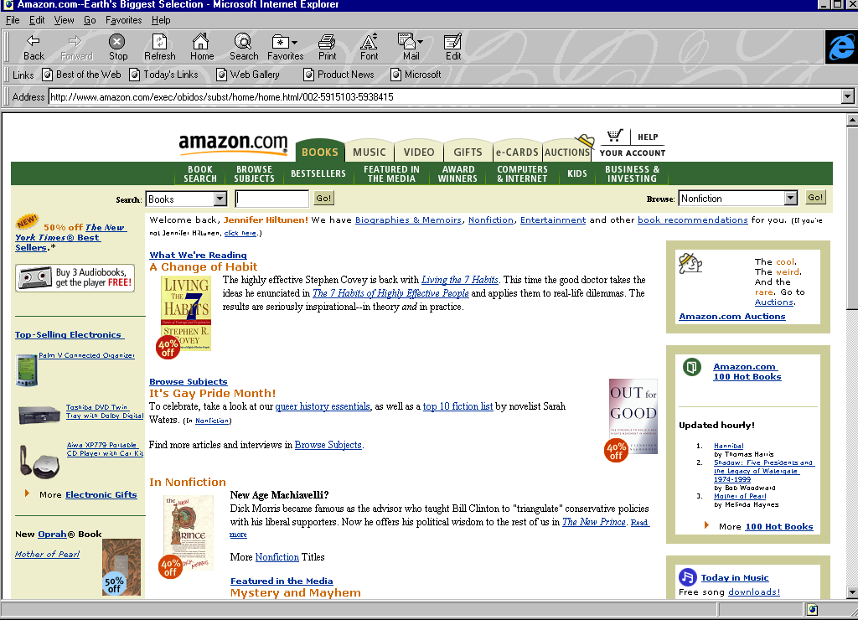






Turning Customer Information into
Bottom Line Profit
Personalized customer interactions
Better marketing, sales, service decisions
Store
fronts
E-commerce and
online content
Direct
sales
Donor interactions
Transactions
Click streams
Support feedback
Direct
mail
Sales
Donor demographics
Marketing programs
Sales/service
encounters
Internet
Intranets
Extranets
Understand the Customer
Call
centers
Websites
Marketing
Email
Online
service
Customer
Service

Slide 9
The e-CRM Universe
Interactive experience
Shop
online
Search for interests
Basic brochure
Customer Experience
Technology
Requirements
Integrate Legacy
Applications
Security
Push
Personalization
Knowledge
Management
Customer Service
& Support
Chat
Problem Resolution
Universal Queuing
Voice Over Internet
Authentication
Middleware
Tracking Escalation
Workflow
Email Response
Email
Scripting &
RDBMS Software
Search
Engine
Text
Retrieval
Authoring Software
Content
Site
FAQ
Site
Knowledge
Base Site
Trouble
Ticket Site
Interactive Site/
Proactive eCRM
Creative
Design
Systems Integration
Hosting
Outsourcing
ROI
Consulting (business)
Consulting (Strategy/Internet Business models)

Slide 10
Constituent/Donor Experience:
A Functional Framework
Donor Database
Security Protocol
Transaction Management
Segmentation
Profiling
Customization
Dynamic Content Generation
Reporting and Measurement
Content
Channels
Communication

Slide 11
Donor Database
Objective: provide donor’s access to manage their information
Market Size
Approach
Options
Major
Powerful RDBMS allowing interactive access for data review and modification
Real time Oracle-driven solution w/XML
Midsize
Provide view-only access and batch updates
Batch import/export
Small
Provide means for donors to share address changes and make inquiries
Web-based forms,automated email generation

Slide 12
Transaction Management
Objective: efficient and timely processing of online contributions
Market Size
Approach
Options
Major
Seamless processing across all enterprise channels
PaymentsPlus, direct integration with back-office
Midsize
Enable online credit card verification
CharityWeb, Verisign
Small
Provide basic, secure transaction collection
Encrypted data, desktop processing

Slide 13
Content Management
Objective: store valuable content in easily-accessible format
Market Size
Approach
Options
Major
Custom deployment of CMS software marrying content with marketing plans
Fatwire, Expressroom
Midsize
Application Service Provider
Convio
Small
Create HTML (or DHTML) pages for display of content
Dreamweaver

Slide 14
Communication
Objective: utilize electronic media to build strong relationships
Market Size
Approach
Options
Major
Push relevant content to donors and allow for direct response – 2-way dialogue
Brighware, E.piphany, Delano
Midsize
Customized messaging, ROI tracking
ClickAction, FloNet
Small
“mass,” e-mail newsletters, fundraising and program updates
Lyris

Slide 15
How will you be successful?
It’s all about trust
Earn the trust of your constituents. Through superior use of data, make the most of every contact. Endeavor to create relevance and build relationship with:
    Trust through images
    Trust through experience
    Trust through customized relationships
    Reduce risk through site security
    Inform and educate on your policies
    Ensure site accessibility/tech computability

Slide 16
Questions?

