Slide 1
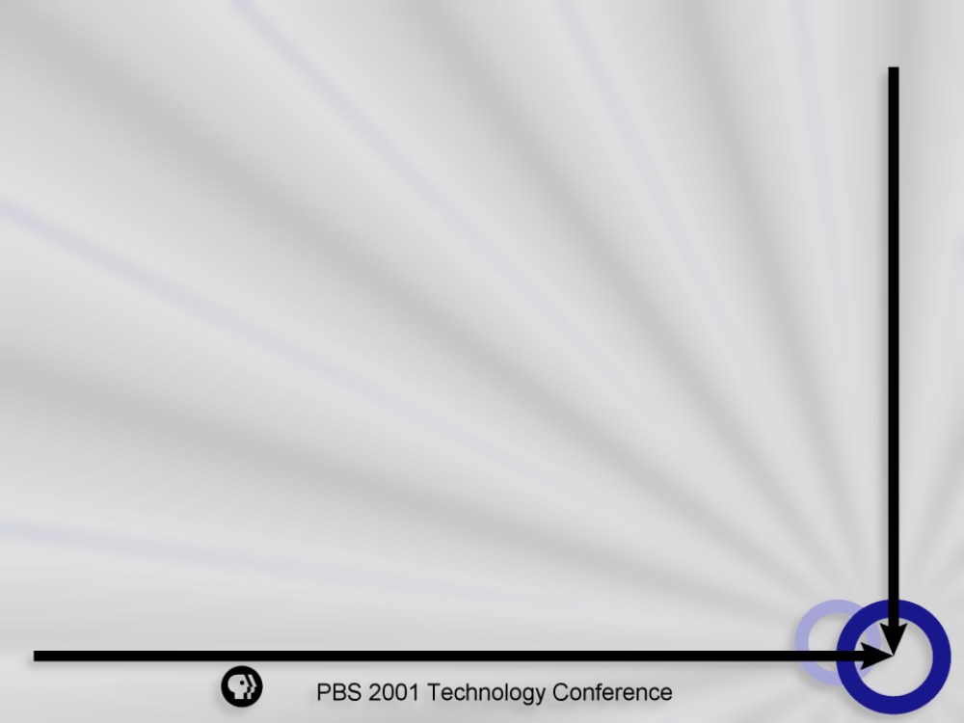
ASP Pros and Cons
David Shomette
PBS, INFORMATION TECHNOLOGY

Slide 2
ASP Definition
Delivers Application Functionality
Across a Network
Multiple Customers
Pay-as-you-go Payment Model

Slide 3
ASP Value Proposition
Provide End-to-end Services
Encompasses Implementation, Customization, and Support
Internet-Enabled Packaged Software
Flat Monthly Fee
Notes:
What is the value that ASPs provide?
Essentially, ASPs provide end-to-end services which encompasses the implementation, customization and support of internet-enabled packaged software for a flat monthly fee.

Slide 4
By Any Other Name
Application Service Providers
Managed Service Providers
Network Service Providers
Netsourcers
Total Service Providers
Notes:
According to the counters, there are somewhere around 300 ASPs, and they’ve coined almost as many descriptions of themselves.They’ve called themselves:

Slide 5
By Any Other Name
Software Rental Providers
Network Applications Providers
Application Sourcers
Application Dial Tone Providers

Slide 6
Why All The Hype?
Great Expectations
Lavish Financing
Media Coverage
Notes:
So why all the hype?
ASPs are an unique, Internet Phenomenon which has had great expectations
The expectation for the ASP model was it would evidently become the default delivery mechanism for application services for all small to mid-size organizations.
The great expectations were fueled by lavish financing and pervasive media coverage.

Slide 7
Evolution of an Industry
Mainframe Timesharing Model
Race for Internet “Mindshare”
After the Crash
Fortune 1000s
Notes:
Today’s ASP model is derived from the old mainframe timesharing model.This model evolved rapidly as the .com boom took off in the mid-nineties.
During the .com boom, ASPs were popping up all over the place to provide instant IT services to new economy businesses that were racing to grab Internet “Mindshare. Mindshare is why today I still think of Yahoo when I need a search engine and Amazon when I need a bookseller.
After the .Com Crash the market has weeded out ASPs with weak business plans and inadequate funding. Now we have begun to see more stability in the ASP market with more compelling business models and a maturation of the market space. And because of this maturation…
Fortune 1000s- are now are looking to leverage the ASP model.

Slide 8
ASP Model
Shared Technical Operations
Pay-as-you-go
Limited Customization
Access to Skilled IT Personnel
Notes:
I keep referring to the ASP model. Let’s talk a little about the attributes of this model.
Shared Technical Operations-Leverages a large data center infrastructure including network services, software and hardware provisioning, infrastructure integration and support services, and business continuity services.
Pay-as-you-go-gets back to our definition; this payment method charges customers based on concurrent usage.
Limited Customization-Model lends itself to more generic out-of-the-box application rollouts.
Access to Skilled IT Personnel-I like to think of this as leveraging the economies of skill.

Slide 9
Enterprise Challenges
Cash Constraints
Rapid Implementation
Rapid Growth
Fluctuating Head Counts
IT Skills Shortage
Notes:
Now why don’t we take a look at some of the challenges our enterprises are facing today. As a result, in a relatively short period of time, the ASP model has surfaced as a possible solution for enterprises of any size that are facing one or more of the following challenges:
Cash Constraints-self explanatory-If you don’t have cash constraints then you probably work for the federal gov’t.
Rapid Implementation-Business units and business requirements often determine project timetables; sometimes IT is the last to know.
Rapid Growth-Maybe more applicable a year ago however in certain fields such as Biotech we still see tremendous organizational growth. Also companies involved in merger and acquisition activities have to deal with this issue.
Fluctuating Head Counts-US companies are now quicker than ever in reacting to economic news and staff accordingly.
IT Skills Shortage-Will persist even through downtimes because of the nature of certain positions.

Slide 10
Reasons to Seek ASPs
High Availability
Complexity Reduction
Focus on Core Competencies
Reduce Upfront Investment
Economies of Skill
Notes:
High Availability-Is 99.999% uptime. When I think in terms of high availability I consider all the redundancies necessary. These redundancies include hardware, software, network and human resources.
Complexity Reduction-By contracting with an ASP, you relieve yourself of the complexity in the planning, implementation and administration of an application.
Focus on Core Competencies-Perhaps the most fundamental justification for the ASP model, in any industry, is that allows a business to focus time, energy and resources on activities that sets you apart from your competition.
Reduce Upfront Investment-And this gets back to HA. If you do not already possess the technical infrastructure and necessary technical human resources required for HA.This ASP payment model amortizes costs over the life of the contract making costs predictable.
Economies of Skill-By leveraging the economies of skill you can obtain technical skills that ordinarily would not be available to your organizati.

Slide 11
ASP Challenges
Rapidly Changing Business Models
Poorly Written SLAs
Cost
Limited Customization
Organizational Biases
Notes:
Rapidly Changing Business Models-Due to the fall in the market, ASPs are under more pressure then ever to demonstrate profitability. Because of this we have seen ASPs quickly change service offerings.
Poorly Written SLAs-A lot of SLAs that do not reflect a highly available environment.
Cost-If you already have a highly available data center and the necessary technical resources for certain applications you might find the ASP model expensive.
Limit Customization-If your organization always needs to have every template or form customized, the ASP model might not be for you.
Organizational Biases-IT Managers often will focus on the perceived loss of control, security and support inherent in these kinds of outsourcing arrangements. The lack of understanding of why IT can’t or shouldn’t do it is not always easy to communicate to senior management.

Slide 12
ASP Types
Instant Application Providers
Specialized Application Providers
Cookie Cutter Application Providers
Notes:
For the purpose of better understanding the ASP market let’s go ahead and identify a couple of different classifications of ASPs.
Instant Application Providers-Volume driven. Don’t expect much if any customization. Applications tend to be less complex. Enterprises doing business with them should not expect much individual attention.
Specialized Application Providers-Tend to do just that, specialize in a particular segment of the application market-for example, Human Resource, Accounting, Legal, etc.
Cookie Cutter Application Providers-Deals with High-end applications but deploys them in a cookie cutter fashion. These organizations use a lot of standardized templates marketed to enterprises that have no legacy investment in these applications.

Slide 13
Instant Application Leaders
Intuit
eAlity
Intacct
Interliant
Notes:
Intuit-Offers QuickBooks for the Web for small business for $14.95 per month. Another offering they have is called Quickbase which is a low-end web-based database which provides easy to use predesigned templates.

Slide 14
Instant Application Leaders
FutureLink Distribution
Telecomputing
Critical Path Software
Salesforce.com
Notes:
Telecomputing- launched a global Service Provider Software business, which provides infrastructure and consultative solutions to companies who wish to provide ASP services to their own customer base.

Slide 15
Specialized Application Leaders
VeriSign
Casecentral.com
DigiBuy
TitleLink
Aristasoft
Notes:
CaseCentral.com-Targeted primarily to the legal community. You can instantly store, search and share secure case-related information via the web.

Slide 16
Specialized Application Leaders
Capstan Systems
Applicast
Meridian Technology
World Technology Solutions
Notes:
Capstan- provides an Internet Business Infrastructure that links buyers, suppliers and logistics service providers into a collaborative global trading network.

Slide 17
Cookie Cutter Apps Leaders
Usinternetworking
Oracle
Qwest Cyber.Solutions
Corio
eOnline
rSP
Notes:
USInternetworking was launched in April, 1998 and in located in Annapolis, MD. Received $500 million in VC money. The specialize in PeopleSoft and SAP.

Slide 18
Up and Coming ASPs
Exult
Jamcracker
Loudcloud
Notes:
Exult-Runs human-resource software.
Jamcracker-combines products from a handful of software makers into a single offering dished out over the Web. IPO is not imminent.
Loudcloud-Marc Andreessen’s new start-up which manages computer and software operations for e-businesses.

Slide 19
RFP Process
Identify Business Requirements
Identify Technical Requirements
Identify Market Leaders
Communicate Response Timeline
Service Level Agreements
Notes:
Identify Business Requirements-Partner with the business units to fully understand what the business proposition is.
Identify Technical Requirements-
Identify Market Leaders
Create a Response Timeline
Service Level Agreements-SLAs that don’t offer specific remedies for non-performance often fail

Slide 20
Vendor Evaluation Checklist
Determine Hosting Requirements
Proven Track Record-Check References!
Secure, Scalable, Data Center
Stable Business Model
Carrier-Grade Network Infrastructure
Real-Time, Web-Based Reporting
Notes:
Read the Checklist without explanation

Slide 21
Conclusion
ASPs do very well at hosting out-of-the-box applications with little customization that need to be deployed rapidly.This business model will continue to mature and become even more attractive to organizations of all sizes.
Notes:
David

Slide 22
Questions

