Slide 1


Linux -
To Boldly Go Where No Penguin Has Gone Before

Slide 2

Linux History
Linus Torvalds released first kernel in 1991
First released under GNU Public License (GPL) with version 0.02
Progressed to version 1.0 in 1994
Development took off with volunteers and companies collaborating over the internet
Today kernel is version 2.4

Slide 3
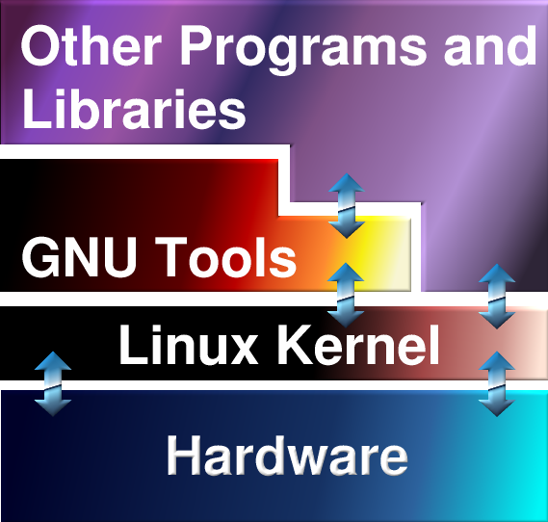

GNU/Linux

Slide 4
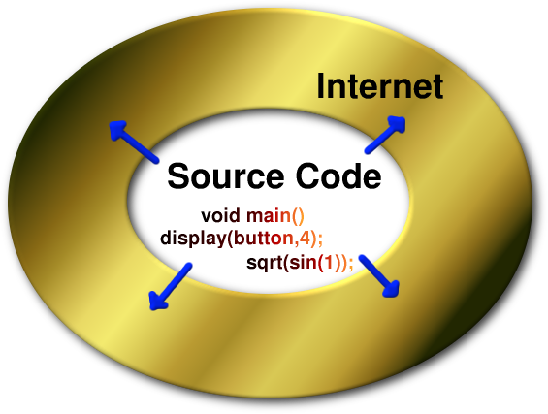

Open Source

Slide 5
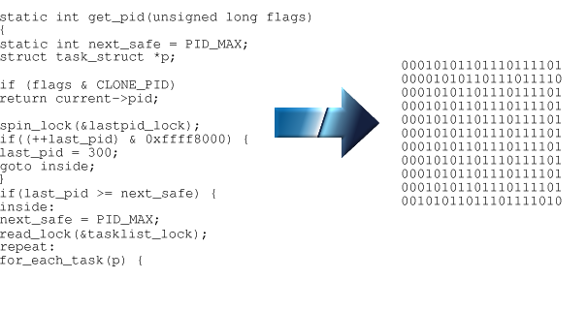

Source Code

Slide 6

Distributions
(Tens more than just those listed here.)

Slide 7
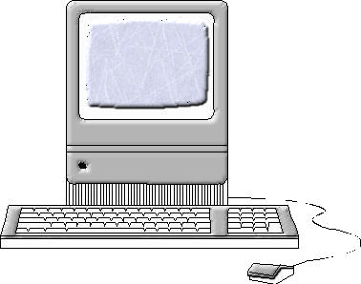
Linux Systems
Alpha
ARM
Beowulf Clusters
Itanium
Intel Compatible 386 and Above
MIPS and MIPS 64
PowerPC
S/390
Sparc and Sparc 64
Kernel Requires a Minimum of 2 Megabytes of RAM,
but other programs may require more

Slide 8
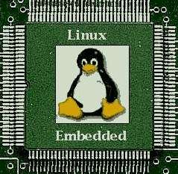

Embedded
100% Reliability
Small Size
Little (if any) Interaction
Customizability
Real Time Versions of Kernel

Slide 9
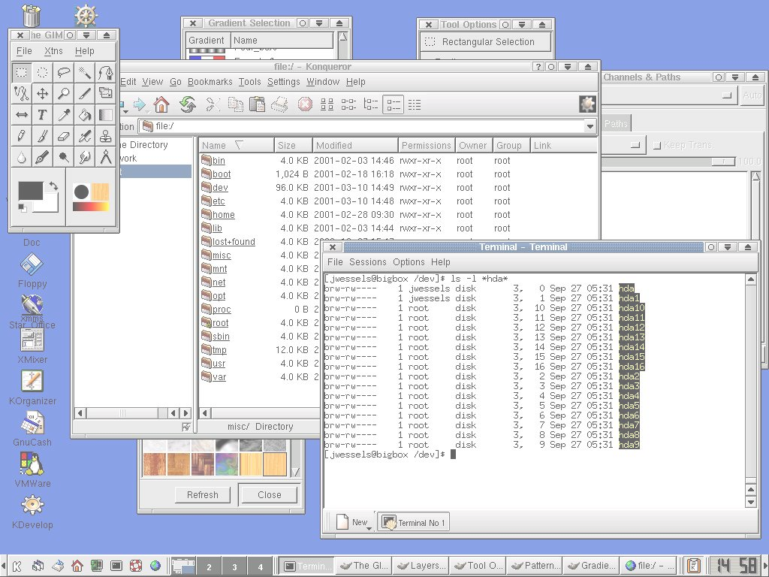
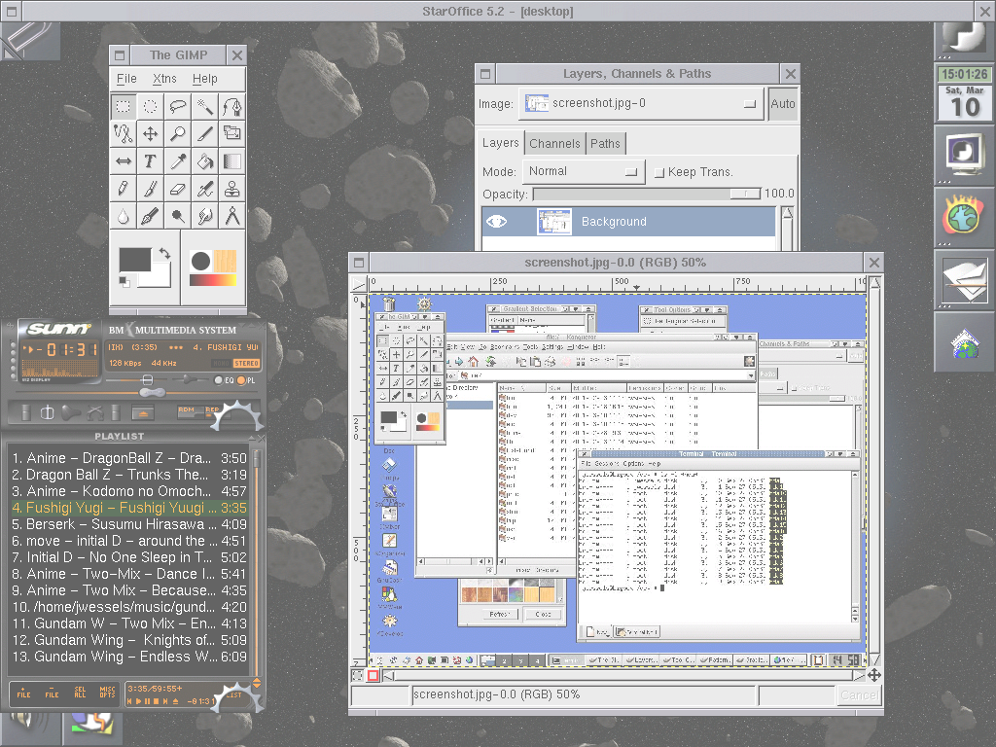
Short Demo

Slide 10

2.4 Kernel
Released on January 5, 2001 after more than two years of development
Addresses many performance and scalability problems present in the 2.2 kernel
Although it includes enhancements across the board, this version of the kernel is aimed at the enterprise

Slide 11

Enhancements
Logical Volume Manager
Raw Device I/O, without caching
Number of simultaneous processes increased
Large memory and terabyte-sized files
Improved multiprocessor support
Specialty and journaling file systems added
Restructuring of kernel source code
Devfs and khttpd

Slide 12

What 2.4 Means
Moves Linux from the small server to larger systems
Expands capabilities to the data center
Source code restructuring makes it easier for outside developers to understand kernel better, and drop unneeded parts with fewer changes
Prepares Linux for faster adoption on the desktop

Slide 13

Kernel Moves On
Source always available, even in development versions
2.5 kernel will include more hardware support, and further section rewrites (SCSI area in particular) are planned
Current stable version passed on, Linus begins working on unstable version

Slide 14

Strengths
Specialty purposes
Customizability
Number crunching on a grand scale
Stability
Open source

Slide 15

Specialty Servers
Firewalls and VPN gateways
IRC, WWW, FTP, DNS, DHCP serving
Network traffic shaping
File serving in heterogeneous networks
Media streaming
Backup storage systems
Database server

Slide 16
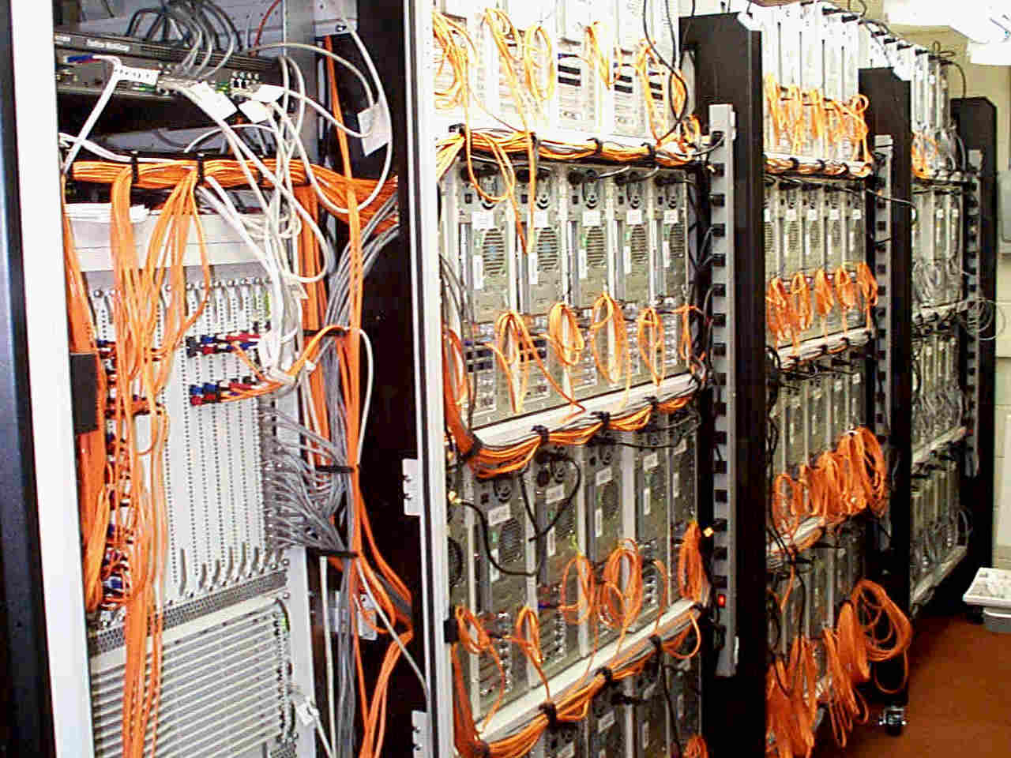
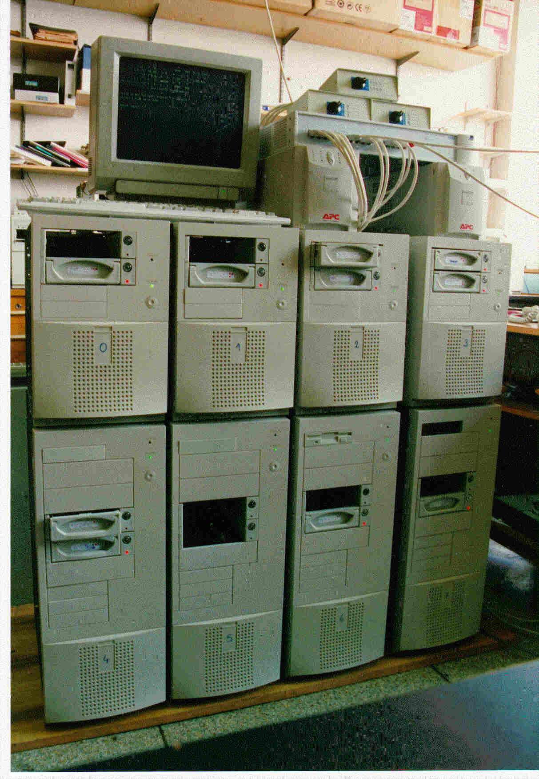
Super Clusters
Number intensive parallel computing
Used for scientific research and video scene rendering - problems that can be broken up
(Relatively) Cheap super computers

Slide 17

Customizable
A Linux distribution is made of different parts which come from several vendors, so it is simple to replace/remove them
Source code to the different programs are often released under the GPL/BSD licenses, allowing you to modify the internals
Linux was originally meant for the power user and administrator, so access to the underlying power is straightforward

Slide 18

Shortcomings
Training staff to use a new system increases expected deployment costs considerably
Commercial applications on the Linux platform are rare
Proprietary data formats hinder moving existing data to open formats which are still young
System hardware is not always supported on Linux

Slide 19

Training Needed
Initial Costs More Than Expected
Linux
Current System
Training
Required for New
Systems
Software
Investment

Slide 20


Commericial
Applications

Slide 21



Data Conversion
#define UIDHASH_BITS 8
#define UIDHASH_SZ (1 << UIDHASH_BITS)
#define UIDHASH_MASK (UIDHASH_SZ - 1)
#define __uidhashfn(uid) (((uid >> UIDHASH_BITS) ^ uid) & UIDHASH_MASK)
#define uidhashentry(uid) (uidhash_table + __uidhashfn(uid))
static kmem_cache_t *uid_cachep;
static struct user_struct *uidhash_table[UIDHASH_SZ];
static spinlock_t uidhash_lock = SPIN_LOCK_UNLOCKED;
struct user_struct root_user = {
__count:
ATOMIC_INIT(1),
processes:
ATOMIC_INIT(1),
files:
ATOMIC_INIT(0

Slide 22

Hardware Compatibility
Same problem as commercial applications, hardware vendors will not support Linux until there is a demand for it
Network support is excellent, but video, modem, sound, and printer support lacks where the open source world doesn't have access to the specifications

Slide 23

Q&A Session
(Stump the Speaker Session)

