Slide 1
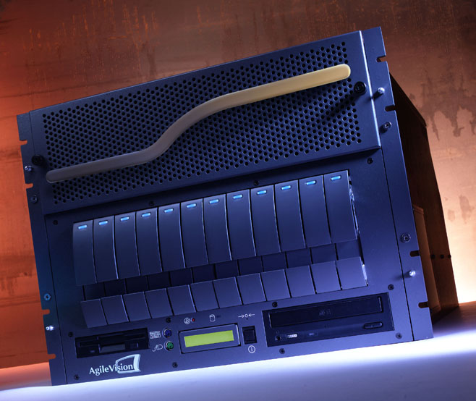
Compressed Video Data Manipulation
Jerry Berger
AgileVision
Terry Smith
Sarnoff Corporation

Slide 2
Outline
Why work in the compressed domain?
Challenges and past attempts
New technology enablers
Compressed domain splicing
Logo insertion
Rate control
Applications
  DTV MPEG master control
  NTSC or DTV central casting

Slide 3
Evolution of Television
Analog NTSC
  Single format
  Single program
  Television only
Discrete architecture
  Dedicated hardware components
DTV
  Multiple formats
  Multiple programs
  DTV + data and enhanced services
  Distribution of compressed content
Multi-function
  Scalable software systems

Slide 4


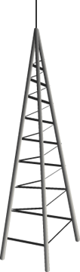



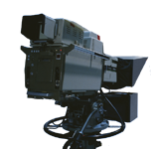



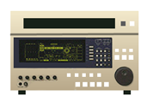
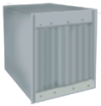
Production Flow
Contribution
Distribution
Emission
STL
Remote
Acquisition
Network
Production
Local
Production
and
Pass-Thru
Transmission

Slide 5
Why Work in the
Compressed Domain?
Quality
  Original network quality delivered to home
Cost savings
  Transponder bandwidth
  Reduced archive storage
Simplify DTV transition
  Greater choices available
  Pass-thru with value added features
  Scalable, upgradable system

Slide 6
Challenges
& Past Attempts
Large collaborative research efforts independently targeted compressed domain processing for DTV
  NIST HD broadcast technology ATP
  Atlantic program
MPEG and SMPTE sought approaches to provide station functionality at transport level
  Splice point insertion and packet countdown
  SMPTE 312

Slide 7
SMPTE 312
Required pre-conditioning of compressed streams
  Identify valid splice points, set flag in transport packet
  Insure that video buffer was well behaved at splice point
Because of buffer constraints and overhead, splice points were to be sparsely spaced
Video buffer constraints could impact MPEG rate control and exhibit “pulsing” in video

Slide 8
Technical Challenges
Precision of splice point
Latency response to splice command
Ability to monitor at splice point
Lack of local branding (logo insertion)
Buffer management must be robust to avoid non-compliant streams and picture freezes

Slide 9
New Enabling
Technology Trends
New software-based products
  Larger level of software integration
Powerful general-purpose processors
  Ride Moore’s law
Lower $/Gb of storage
Better compression efficiencies
Compressed stream manipulation

Slide 10
New Technology and Its Implications
AltiVec
with RACE++
AltiVec™ technology
  Motorola’s parallel vector
  addition to the PowerPC processor
  Performance boost: 4x on
  floating-point to 16x on pixels
RACE++™ switched
interconnect
  Follow-on to ANSI-standard RACEway
  Performance boost:
  over 3x faster
4
Processing
1
1
3
Communications

Slide 11
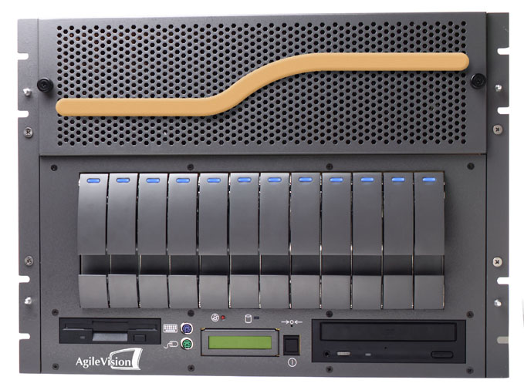
AGV-1000
Hardware Overview
Super computer with parallel processing
Distributed memory architecture
Scalable – Up to 28 Altivec™ PowerPC™ G4 Processors
Up to 90 GFLOPS (90 Billion) calculations per second
16 PCI slots
12 SCSI Hot Swappable HDDs
DVB ASI or SMPTE 310 Inputs/Outputs

Slide 12
AGV-1000
VPES
Logo
Rate
VPES
VPES
APES
Splicer
Insert
Ctrl
APES
VPES
DVB-ASI
VPES
Audio
APES
19.4 Mb/s
APES
APES
Mix
TS Demux
VPES
NETWORK
Transport
APES
VPES
Stream
VPES
VPES
Logo
Rate
APES
APES
Splicer
Insert
Ctrl
VPES
DVB-ASI
APES
VPES
APES
VPES
Audio
19.4 Mb/s
APES
APES
Mix
Transport
VPES
VPES
VPES
DVB-ASI
APES
Logo
Rate
Stream
VPES
APES
Splicer
Insert
Ctrl
APES
19.4 Mb/s
TS Demux
VPES
VPES
APES
LOCAL
Transport
APES
Audio
VPES
APES
Mix
Stream
Pre-Selector
APES
VPES
VPES
Logo
Rate
VPES
APES
Insert
Ctrl
External
VPES
APES
Splicer
servers
APES
VPES
APES
APES
Audio
DVB-ASI
TS STATISTICIAL MULTIPLEXER
VPES
Mix
19.4 Mb/s
Gbit Ethernet
APES
VPES
Logo
Rate
VPES
VPES
Transport
APES
APES
Splicer
Insert
Ctrl
Stream
File
TS Demux
VPES
APES
VPES
Audio
APES
Server
VPES
APES
APES
Mix
VPES
APES
VPES
Logo
Rate
VPES
VPES
Insert
Ctrl
Key
APES
APES
Splicer
VPES
Audio
APES
Control
APES
Mix
Packetized
Video Stream
Logo data
Ethernet
Logo data
Packetized
Audio Stream
PSIP data
Configuration
Manager
EAS
Text to
DATACAST
Control
Graphics
data
PSIP
Data
EAS
Gen
PSIP data
data
Control
DATACAST data

Slide 13
Configuration Manager
Defines the product’s feature set
  Creates all components and data pipes
  Maps components to processor
Single interface to external control automation
  Commands passed to individual components
  Status messages returned

Slide 14
Control Automation
Protocols
New paradigm for control automation
  Multiple functions in single platform
AgileVision components mimic existing industry standard protocols
  Louth VDCP for file server
  Standard switcher for splicing
  Character generator for logo insert

Slide 15
Compressed Domain
Splicing
Ability to switch to or insert program elements is a core station requirement
To assure visually seamless operation, splicing must maintain compliance
  MPEG Syntax
  VBV Buffer Models

Slide 16
VBV Fullness Graph
Fullness depends on input and output processes
Output: instantaneous picture chunks every frame
Input: continuous, or continuous until full, at a bitrate
FULL
8
Startup Delay
Ending Delay
7
First picture removed from buffer
6
Bitstream ends
5
0
Bitstream begins
3
4
Last picture removed from buffer
4
2
5
Buffer Fullness, Mbits
1
6
6
11
9
10
3
5
8
4
7
7
2
3
8
2
9
1
1
10
11
0
0
EMPTY
10 000
20 000
30 000
40 000
50 000
60 000
Time, tics of 90 KHz

Slide 17
Correct Startup Delay
Is Crucial!
FULL
When a decoder begins, the buffer is empty.
Buffer Starts Empty
EMPTY

Slide 18
Correct Startup Delay
Is Crucial!
FULL
The buffer fills without decoding for a time specified in the stream.
Correct Startup Delay
EMPTY

Slide 19
Correct Startup Delay
Is Crucial!
FULL
The startup delay sets the correct initial buffer "bias" or "offset". Correct buffer bias is critical to avoid underflow and overflow!
Correct
Correct VBV Trajectory
EMPTY

Slide 20
Correct Startup Delay
Is Crucial!
If Startup is too short, the buffer may underflow later, causing the decoder to freeze and wait for more data.
FULL
Correct
Startup Delay too short
EMPTY
Underflow! Picture Freezes

Slide 21
Correct Startup Delay
Is Crucial!
Startup Delay too long
OVERFLOW! bits lost
FULL
Correct
If the startup delay is too long, the buffer may overflow and data will be lost. This is much worse than buffer underflow.
EMPTY

Slide 22
Video Splicing
Compressed domain splicing with no degradation to picture quality
Input streams are buffered and continuously evaluated for splice opportunities
  SMPTE 312 splice points can be used - but not required
  Splice out prior to any anchor (I or P) frame
  Splice in on I frame
Video streams constantly monitored to insure VBV buffer compliance

Slide 23
Audio Splicing
Like video, audio splicer operates on frame boundaries
Video splicer acts as master in responding to splice commands - audio slaved to video
Splice command and synchronization information are passed to splice audio and other associated services
PTS/DTS are restamped to preserve video/audio time relationship

Slide 24
Seamless Splicing Architecture
Message
Handler
SD or
HD
Splice
Points
Splice Now
V PES
Video Input
Video Splicer
VBV
Model
Video Output
V PES
V PES
Video Input
Slave
Splice Now
Compliant
A PES
Audio Input
Audio Splicer
Audio Output
A PES
A PES
Audio Input

Slide 25


Seamless Splicing

Slide 26
Logo Insertion
Architecture
Full
Decode
with
Bit
Stream
Info
Extract
Insert
Logo
&
Rate
Control
Smart
Recoder
Video
Video’
Bit Stream
IN
Bit Stream
OUT
Bit Stream
INFO
Bit Stream
INFO’
Logo and
Control
Bit Rate
Retains Original Bitstream Info to Preserve Picture Quality
Like “Mole”, but keeps all coding parameters inside one box
Provides “Bug” Insertion and Text Message Crawl
Allows High-Quality Bit Rate Reduction for “Grooming”

Slide 27
Logo Insertion and Rate Control
Decoder Delivers Pixel and MPEG Coding Info to Logo Insertion Component
R
Macroblocks that Reference the Logo/EMS Region are also Tagged for Recoding
R
R
R
R
R
R
Macroblocks in the Logo/EMS Region are Tagged for Recoding
R
R
R
R
R
Rate Control may also Modify MPEG Coding Info Prior to Smart Recoding Component

Slide 28

Logo Insertion

Slide 29
Broadcast Product Roadmap
AGV-3000 - ->
Advanced PSIP
Error Monitoring
Multi Transport Streams
Transcoding
Format Conversion
AGV-1000 – Encoding, Insertion & Branding
Input Encoding
Multi-Program Splicing
Data Services
Logo Insertion
On Board Storage
PSIP
Multiple Interfaces

Slide 30
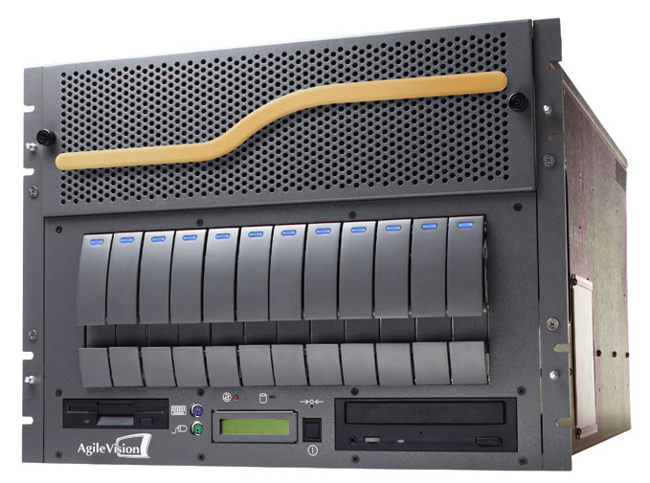
MPEG-2 Bitstream Manipulation
Input
Bitstream
Output
Bitstream
GOP, bit rate, VBR/CBR, chroma format conversion
Splices, wipes and dissolves
Image size and frame rate conversion
Logo and Message/Alert Insertion

Slide 31
Transcoding Architecture
Full
Decode
with
Bit
Stream
Info
Extract
Trans-
coder
Smart
Recoder
Any bit rate
4:2:2/4:2:0
Bit Stream In
Video
Video’
Any Bit Rate
4:2:2/4:2:0
Bit Stream Out
Bit Stream
INFO
Bit Stream
INFO’
Video Format
Parameters
Output Bitstream
Parameters
Architecture allows modifications to
  Video format
  Chroma format (4:2:2 to 4:2:0)
  GOP structure
  Bit rate with high-quality rate control

Slide 32
Capitalize on DTV’s Opportunities
HDTV
SDTV
Enhanced SDTV
6 MHz DTV
TV Channel
SDTV
SDTV
Enhanced Data

Slide 33
Applications
DTV MPEG Master Control
Achieve highest image quality
Enhance your programming
Reduce costs
Multi-functional, scalable, software systems provides flexibility for CHANGE

Slide 34
AgileVision AGV-1000
Software Overview
ATSC compressed DTV Transport Stream Processing
Seamless Splicing in the Compressed Domain
High-quality logo insertion
HD/SD Source Content
Datacast Services
PSIP Insertion
Application Control Software
3rd party Automation/Server Interface

Slide 35
AGV-1000
VPES
Logo
Rate
VPES
VPES
APES
Splicer
Insert
Ctrl
APES
VPES
DVB-ASI
VPES
Audio
APES
19.4 Mb/s
APES
APES
Mix
TS Demux
VPES
NETWORK
Transport
APES
VPES
Stream
VPES
VPES
Logo
Rate
APES
APES
Splicer
Insert
Ctrl
VPES
DVB-ASI
APES
VPES
APES
VPES
Audio
19.4 Mb/s
APES
APES
Mix
Transport
VPES
VPES
VPES
DVB-ASI
APES
Logo
Rate
Stream
VPES
APES
Splicer
Insert
Ctrl
APES
19.4 Mb/s
TS Demux
VPES
VPES
APES
LOCAL
Transport
APES
Audio
VPES
APES
Mix
Stream
Pre-Selector
APES
VPES
VPES
Logo
Rate
VPES
APES
Insert
Ctrl
External
VPES
APES
Splicer
servers
APES
VPES
APES
APES
Audio
DVB-ASI
TS STATISTICIAL MULTIPLEXER
VPES
Mix
19.4 Mb/s
Gbit Ethernet
APES
VPES
Logo
Rate
VPES
VPES
Transport
APES
APES
Splicer
Insert
Ctrl
Stream
File
TS Demux
VPES
APES
VPES
Audio
APES
Server
VPES
APES
APES
Mix
VPES
APES
VPES
Logo
Rate
VPES
VPES
Insert
Ctrl
Key
APES
APES
Splicer
VPES
Audio
APES
Control
APES
Mix
Packetized
Video Stream
Logo data
Ethernet
Logo data
Packetized
Audio Stream
PSIP data
Configuration
Manager
EAS
Text to
DATACAST
Control
Graphics
data
PSIP
Data
EAS
Gen
PSIP data
data
Control
DATACAST data

Slide 36
Central Casting Application
Regional groups are identified within the organization for the Central Casting plan
Broadcasting organizations are building larger groups of stations scattered across the country

Slide 37
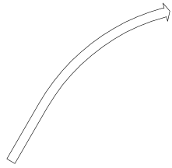



Central Casting Application
Groups are established, many times within a geographical region
Within each group a hub is established
The hub originates programming for itself and it’s satellite stations

Slide 38
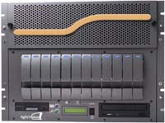

Established Technology
Repackaged for New Application
Splicer
File Server
Splicer
Logo Inserter
Rate Control
AGV-1000
CentralCaster
Satellite
CentralCaster

Slide 39
“CentralCaster” System
Local
Studio
TV station #1
In City “A”
To Xmtr
Leased
Lines
TV station #2
In City “B”
Local
Studio
To Xmtr
CentralCaster
Local
Studio
TV station #3
In City “C”
To Xmtr
Local
Studio
TV station #4
In City “D”
To Xmtr
Local
Studio
TV station #5
In City “E”
CentralCaster for the Hub
To Xmtr
Local
Studio
TV station #6
In City “F”
CentralCaster Satellite for each satellite station
To Xmtr
CentralCaster Satellite

Slide 40
CentralCaster
Network #1
(i.e. “WB”)
TS w/ 1 SD MPEG-2 & AC-3
Demux
Splicer
Mux
CentralCaster
Network #2
(i.e. “Fox”)
TS w/ 1 SD MPEG-2 & AC-3
Demux
Splicer
Mux
Demux
Up to 12 transport streams at from 6-12 Mb/s
Splicer
Mux
Demux
File Server
Pre-Selector
External
Servers
Demux
Splicer
Mux
Demux
Splicer
Mux
Demux
Demux
Splicer
Mux
VO audio data
Control
Configuration
Manager
Logo data
Logo data
PSIP
Gen (x6)
DATCAST data
PSIP data
DATCAST data

Slide 41
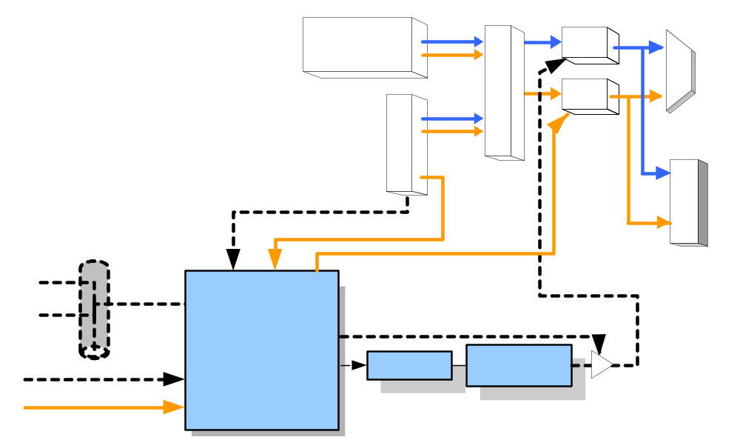
CentralCaster Satellite
4-6ru
From
Local
Studio
SMPTE 259
AES Audio
Encoder
Logo
Insert
Splicer
Mux
Audio
Mix
Network feed
From CentralCaster
Demux
TS to DTV xmtr
TS w/ 1 SD MPEG-2 & 2 AC-3 audio
2nd
Audio
For VO
SMPTE 259
Control data
VO/EAS
Audio
Decode
AES Audio
Local Control
to NTSC xmtr
Logo data
Configuration
Manager
Logo data
EAS data
EAS
control
Text to
Graphics
EAS audio (AES)

Slide 42

DTV or Central Casting
Just One Box
Booth L141

