Slide 1

PBS Projects Update: Closed Captioning, XDS, and V-Chip
Gregory Forbes
Transmission System Engineer
Public Broadcasting Service
PBS Technology Conference, 04/21/01

Slide 2
Outline
I. Closed Captioning
II. XDS
III. V-Chip

Slide 3
Outline
I. Closed Captioning
  Conversion to Smart Encoders
  DTVCC requirements for stations
  Local insertion
II. XDS
   XDS inserters to be provided to member stations
III. V-Chip
   V-chip insertion capability installed at PBS (with some automation bugs)

Slide 4
PBS NTSC Captioning
Converted from analog to SDI for Captioning in 2000
4 @ Evertz 8074 digital cc encoder to do NTSC captioning with ProCap servers
3 @ Evertz 8084 dedicated to live encoding
24 @ Evertz 8084 connected to SDI router to clean up captions and insert V-chip

Slide 5
Regulatory Requirements
708-compliant decoders due 7/1/02
Program captioning for ATSC tracks NTSC schedule starting 7/1/02

Slide 6
Regulatory Reqirements
Schedule in FCC Rules - 47CFR 79.1(b)
  New programming phased in, up to 100% by 01/06
    “New” is after 1/98 for NTSC; all ATSC is new starting 07/02
  Legacy programming (NTSC before 01/98)
    30% by 01/03
    75% by 01/08
  Captioning for Spanish
    New programming phased in by 01/10 (currently 450hr/qu)
    30% of legacy by 01/05, 75% by 01/12
DVS passthrough required

Slide 7
PBS ATSC Captioning
608 captions on SDTV (708 req’d for SDTV as well)
708 caption capability in HD

Slide 8
DTVCC CLOSED-LOOP TEST PBS, 3/13/01
LTC
ProCap
Caption Server
Evertz 8075
DTV
Caption Encoder
SMPTE 333 RS-232 port
Digital Vision
Bitlink
HDTV Encoder
Sencore 987
8VSB Modulator
ASI
HD SDI
RF
Analog Composite Video (with 608 captions)
Sony DTR-HD1
ATSC Decoder
HD SDI
Baseband Video with derived 708 captions

Slide 9
Caption Encoding Protocols
XML-based authoring file format
SMPTE 333 – Pull Protocol
SMPTE 334 – Push Protocol with data embedded in VANC
Payload (708 caption data)
  CDP’s
  Enhanced .TDS

Slide 10
XDS
3 XDS encoders tested at PBS.
Evertz smart encoders (8084AD) to be deployed at member stations.
8084 vs 8085
Video inputs include analog composite and SDI (SMPTE 259M). Time code via LTC.
Notes:
Transport stream distr

Slide 11
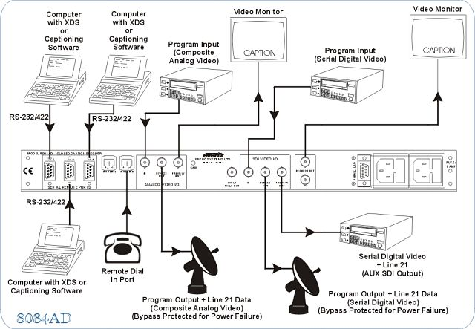
Evertz 8084AD

Slide 12
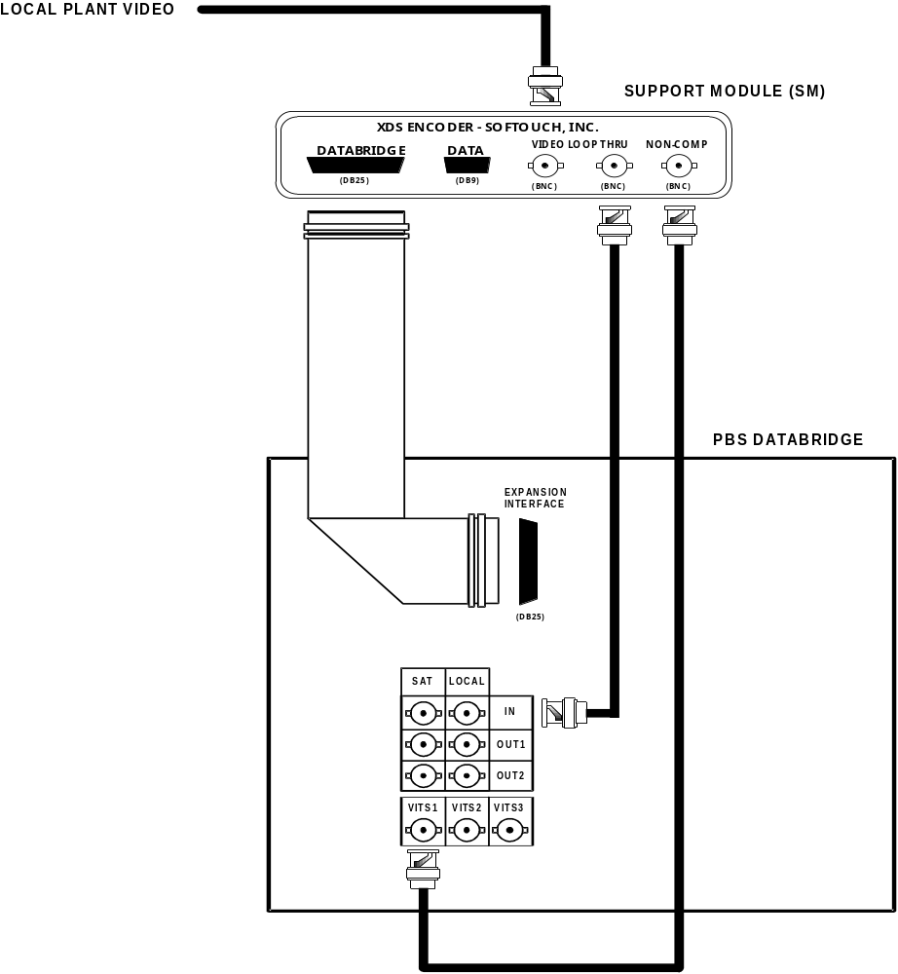
SoftTouch XDS Encoder

Slide 13
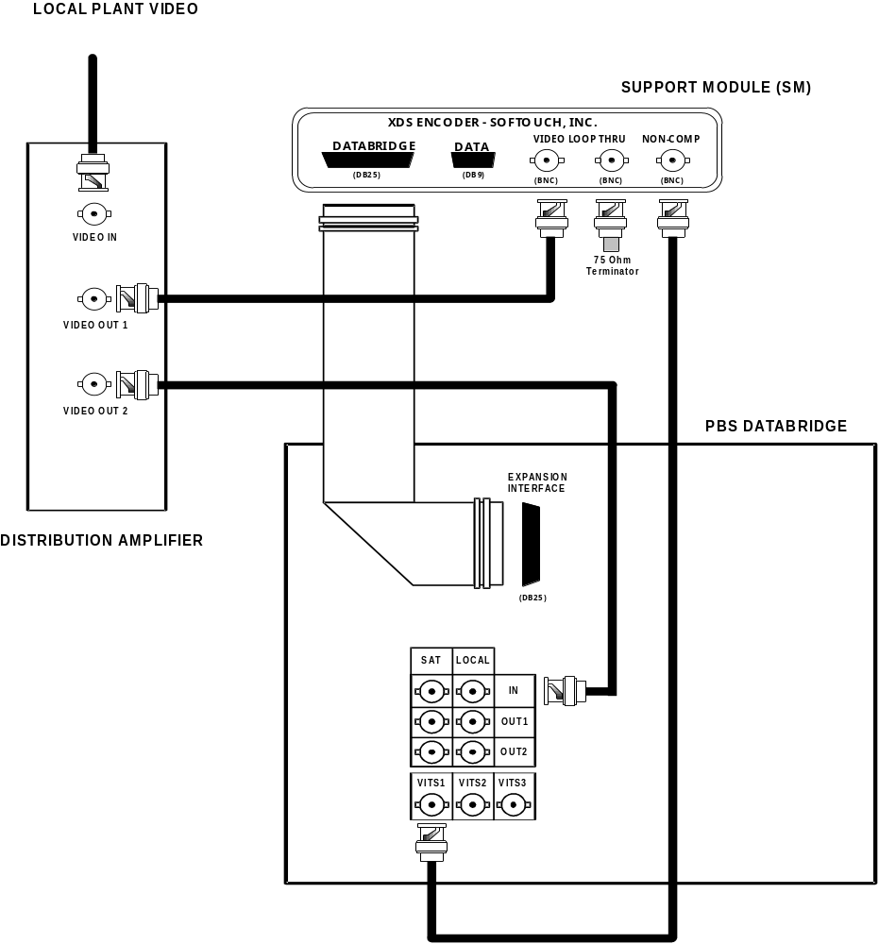
SoftTouch XDS Encoder

Slide 14
Program and NDI Data Flow -
Local Analog Plant
NDI Databridge
VITS 200
Evertz 8084AD
Overscan Data
Regenerator
STL

Slide 15
Program and NDI Data Flow -
Local Digital Plant
Evertz 8084AD
NDI Databridge
STL
VITS 200
Overscan Data
Regenerator
Tx

Slide 16
V-Chip Encoding at PBS
9 Evertz 8084 encoders to take CR output and feed digital router.
Monitoring capability installed 04/01
Leitch Logomotion for logos and icons
Some automation bugs are preventing RE rating
Notes:
Transport stream distr

Slide 17


Slide 18


Slide 19
Local V-Chip Insertion
Local v-chip insertion capability via smart encoders, such as Evertz 8084AD
Should work in serial with NDI databridge
Notes:
Transport stream distr

Slide 20
Summary
Closed Captions
XDS
V-Chip
Notes:
Transport stream distr

Slide 21
Summary
Closed Captions
  Digital encoders installed at PBS
  708 captioning on the horizon
XDS
  Encoders to be supplied to 175 station plants
V-Chip
  PBS ready to go on-air (shortly)
  Local insertion via smart encoders
Notes:
Transport stream distr

Slide 22
Contact Info
Gregory Forbes
  gforbes@pbs.org
  703 739-5459
www.evertz.com
NCAM
  www.dtvaccess.org
ATSC IS/S3 AHWG on DTVCC - http://www.atsc.org/meetings.html
Notes:
Transport stream distr

