Slide 1
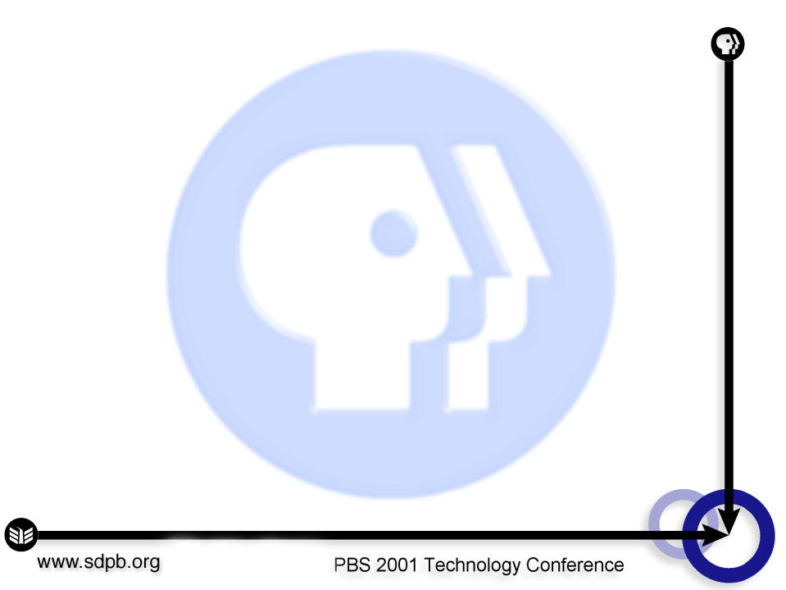
Streaming @ PBS.org
Jeremy Roberts - PBS

Slide 2
Streaming @ PBS.org
Best use theory, and case study of searchable streaming video.

Slide 3
Contextualization
PBS has information dense video
User benefits when publisher identifies and contextualizes relevant chunks of video into web content

Slide 4
Challenges
Editorial evaluation of web content
Editorial evaluation of video content
Video editing
Publishing
Seamless display

Slide 5
Searchable Streaming Video
Metadata design and generation
Encoding/indexing process
Site design and functionality
Site implementation
Publishing tools

Slide 6
Metadata Design
What video content is offered?
What other web content is offered?
How will the user search for what they want?
What do I want to display to the user as a search result?
What other functionality will I need to support?

Slide 7
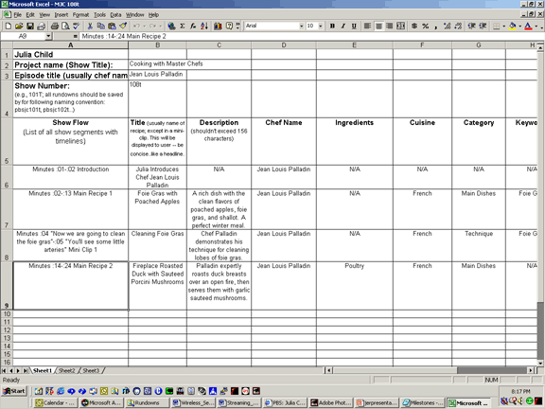
Example Metadata

Slide 8
Metadata Generation
Editorial style guide
Clipping conventions
Data entry lists
Metadata transfer
XML PBS video metadata standard in the future (possibly)

Slide 9
Encoding/Indexing Process
Encoding and indexing take place simultaneously
Closed Captioning text marked up against video time-code
Records populated with metadata (including temporal data)
Index file and video files uploaded

Slide 10
Site Design and Functionality
Search interface
Feature clips template
Results page template
Clip result template
Player template

Slide 11
Site Implementation
12 to 15 week timeline
Edit and dub video to Beta SP takes 1 to 4 weeks
Finalize metadata spec takes 2 weeks
Finalize site design and functionality spec takes 4 weeks
Build-out takes 4 weeks
QA takes 1 week

Slide 12
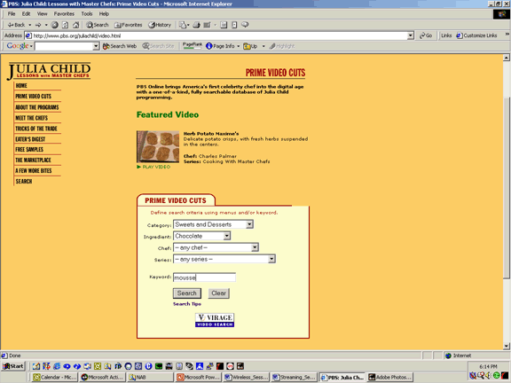
Search

Slide 13
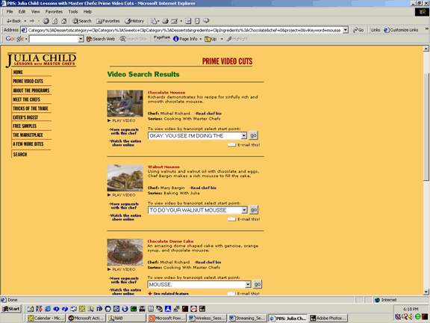
Results

Slide 14
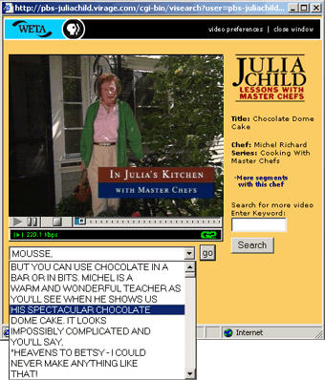
Player

Slide 15
Video Publishing Tools
Same search capabilities as GA site
Results geared towards publishing
3 or 4 publishing possibilities
  Text link
  Thumbnail link
  Video Info Box
  (Feature clip)

Slide 16
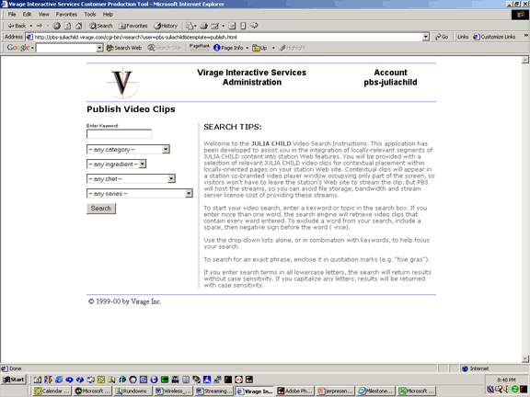
VPT Search

Slide 17
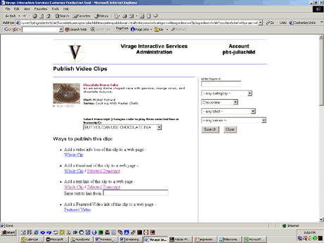
VPT Results

Slide 18
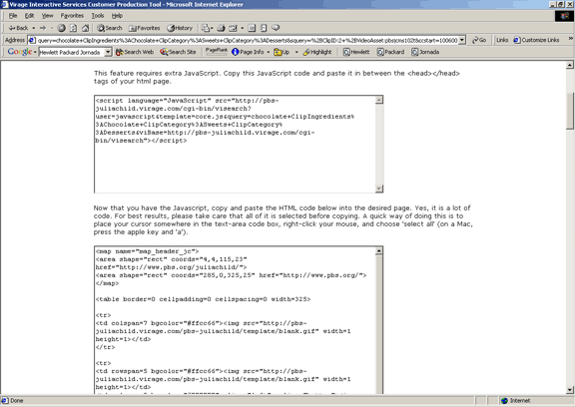
VPT Exposes Code

Slide 19
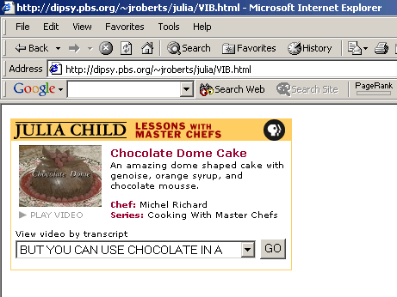
VPT Video Info Box

Slide 20
Kent Osborne
Streaming Media
Small Station Perspective
Webmaster@sdpb.org

Slide 21
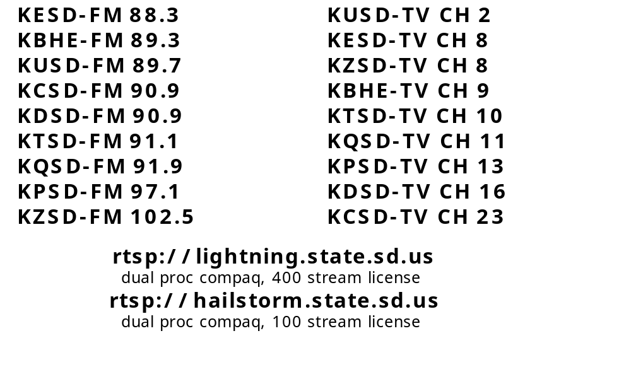
Small Station Perspective
Our philosophy:
Notes:
This slide really goes to the core of our philosophy… our streaming media servers are treated like transmitters. When one goes down, it is like a station being off the air.

Slide 22
Small Station Perspective
Why we stream our media:
  Web 'stickiness'
  'Cool factor'
  Expand our audience (global)
  Generate tape sales
  On demand = convenience
Notes:
Web stickiness… we have seen the amount of time people spend on our web pages go from 3 minutes to 4, to 5, and during our last legislative session we were at 7 minutes(!).
The COOL FACTOR is for both consumer and management… the more management thinks things are cool… the better funding goes or projects.
Why not talk to the folks in development and tell them you want to help with tape sales??? It just might get you your first streaming media server… or more capacity on the one you have, or better bandwidth… SHOW THE VALUE - it will be accepted.
The other points are fairly obvious…

Slide 23
Small Station Perspective
Case Studies
  http://www.sdpb.org/statehouse
    ALL committee and floor debate streamed live
    ALL content available on demand in long form, or indexed by bill number
    75,000 clips viewed in 40 days of session
  http://www.dakotacast.org
    gov’t, community and school involvement
Notes:
Here are a couple of case studies…
Making the legislative project work was KEY to upgrading our servers and getting us on some decent bandwidth. >$$$<

Slide 24

Innovations
Codecs
Realserver8
Windows Streaming Media
Streaming Quicktime

Slide 25
Considerations - Legal
Production Music
  sdpb.org pays an additional percentage to DeWolf music for the rights to stream the production music that is used in local productions
ASCAP, BMI, AP
  Rate schedules are calculated as a portion of site revenue. Calculations based on subscription revenue for a site or sponsor revenue in the case of ad sales.
  For sites like sdpb.org that include music programming but don't meet those, fees are based on the number of users sessions or on web development costs. In both calculations, Sdpb.org pays a minimum license fee of $264 annually to ASCAP and $390 to BMI.
Rights (performance)
  AGREEMENT FOR APPEARANCE - NO MONETARY COMPENSATION - was modified to include webcasting
Notes:
South Dakota Public Broadcasting has had license agreements with BMI, ASCAP and the Associated Press for the last 2 years. For the same reason we copyright content and seek to protect our programming from unauthorized use, we support writers and musicians with the same concerns.
The agreement with the Associated Press is part of our regular wire service membership fee and was agreed to with the following stipulations.
The site's primary focus is on local news and information. This doesn't preclude national or regional information, but the site's main intent will be on local interests.
Information on the site is intended for the users personal interest, not for re-marketing AP content.
The Associated Press may charge separately for content use on the Internet in the future.
The Agreements with ASCAP and BMI are similar in intent and contract. The intention is to share in revenue from web sites that offer a subscription music service or sites generating significant advertising revenue.
Rate schedules are calculated as a portion of site revenue. Calculations based on subscription revenue for a site or sponsor revenue in the case of ad sales.
For sites like sdpb.org that include music programming but don't meet those, fees are based on the number of users sessions or on web development costs. In both calculations, Sdpb.org pays a minimum license fee of $264 annually to ASCAP and $390 to BMI.

Slide 26
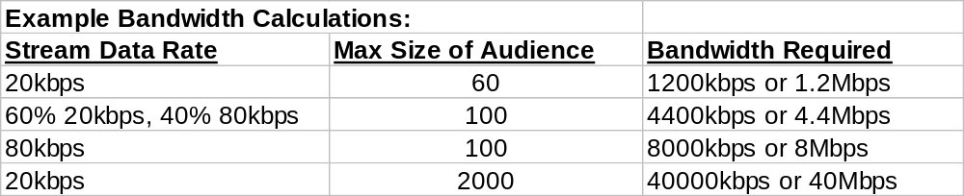
Considerations - Technical
Can your bandwidth and server support it?
Outsourcing vs. Service Relationship
Stand-alone server vs HTTP streaming from webserver
Budget Concerns
Notes:
This is right off the RealNetworks website.

Slide 27
Tools - Hardware, Software, Workstation
Encoding from Media Devices - SureStream:
Minimum Recommended
Operating Systems Windows 95/98/NT 4.x/2000 Windows 95/98/NT 4.x/2000
Linux 2.2 or better Linux 2.2 or better
Processor Pentium 200 MHz with MMX Pentium II 400 MHz with MMX
Memory 32 MB RAM 64 MB RAM
Hard disk space (software) 8 MB
Hard disk space (data) 1 GB 1 GB
Sound Card 16-bit sound card or better 16-bit sound card or better
Color Display 16-bit 24-bit (True Color)
Network Connection Direct IP connection to RealServer Direct IP connection
Video Capture Card Any native Video for Windows capable capture card
Notes:
This stuff is SOOOOOOO BASIC (technically)… of course, more is always better … more processor, more ram….. But you CAN get into this with really basic gear.

Slide 28
Editing Workstation
sound card
video capture card
mass storage
editing software - (Adobe Premiere, etc)
Existing editors
Media 100's and Avid's CAN export!
Notes:
If you don’t have the knowledge within your department, or you just don’t want to do it…. Leave it to the folks that do the editing…. They can just port it out for you.
Make sure they save a node for you on the new router and video server in ops.

Slide 29

Notes:
Q & A :
Had questions about RealServer8… cannot stream quicktime as promised… we have not upgraded yet.
Also… free log processing goes away when going from earlier versions to 8. The current choices are Lariet Stats and Webtrends Enterprise edition. We recently purchased Webtrends… it was an upgrade for us we have had the log analyzer for years… we are very happy with the product. Enterprise is EXPENSIVE, but it has some nice features.
We were out of time after a couple of questions. Email me if you have any others… webmaster@sdpb.org.

Slide 30

Lunch Break!
Sponsored by
THOMCAST COMMUNICATIONS
12:30 - 1:45pm
Parthenon Terrace
(upstairs)

