Slide 1
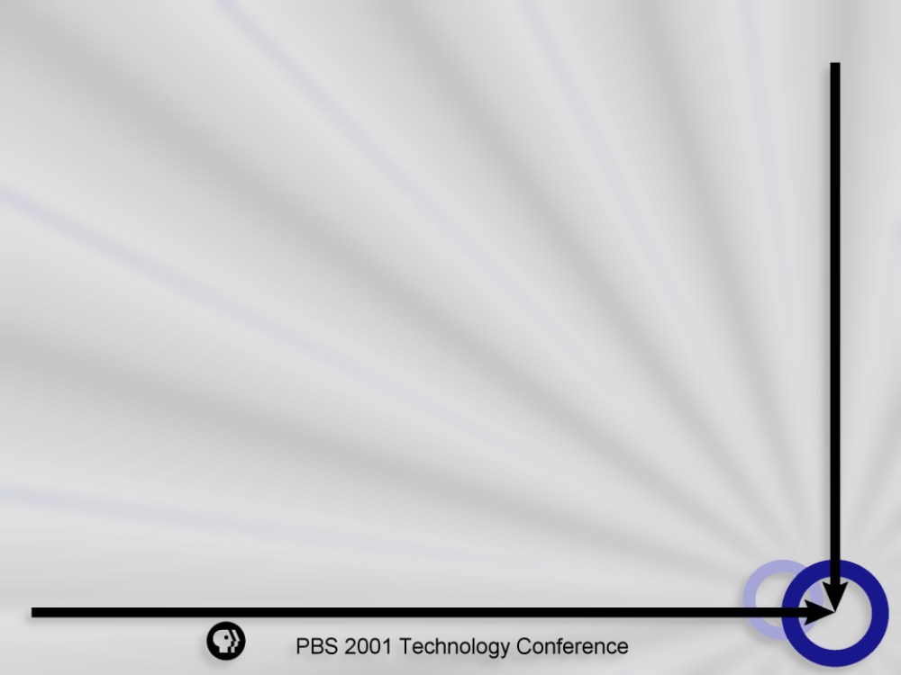
Backup and Storage Management Strategies
  David Creekmore
  Director, Information Technology
  Corporation for Public Broadcasting
Notes:
Backup Strategies
David Creekmore, CPB
Data storage requirements are steadily exceeding the capacity of backup solutions in many network environments. How do IT managers cope with this reality and provide stable, reliable and efficient backup solutions? What role will emerging network technologies play in storage structures and storage management architectures? In an age of mobile users and continued reliance on desktop applications, how do IT managers implement backup solutions across the entire enterprise? This presentation will explore technologies and strategies for extending and unifying backup services across the entire enterprise. Topics covered will include matching infrastructure to strategy; exploring technologies such as Network Area Storage (NAS) and Storage Area Networks (SANs), identifying industry trends and outlining potential sourcing options.
The specialty-technology category continued to bleed. In fact, specialty-technology funds lost nearly a third of their value in the quarter after dropping 36% in the fourth quarter of 2000. Storage-technology stocks, the lone strong-performing tech sector in 2000, finally crumbled, taking down EMC EMC and Brocade Communications Systems BRCD.

Slide 2
Overview
Context
Challenges
On-line storage
Near-line storage
Strategies
Old problems and new solutions

Slide 3
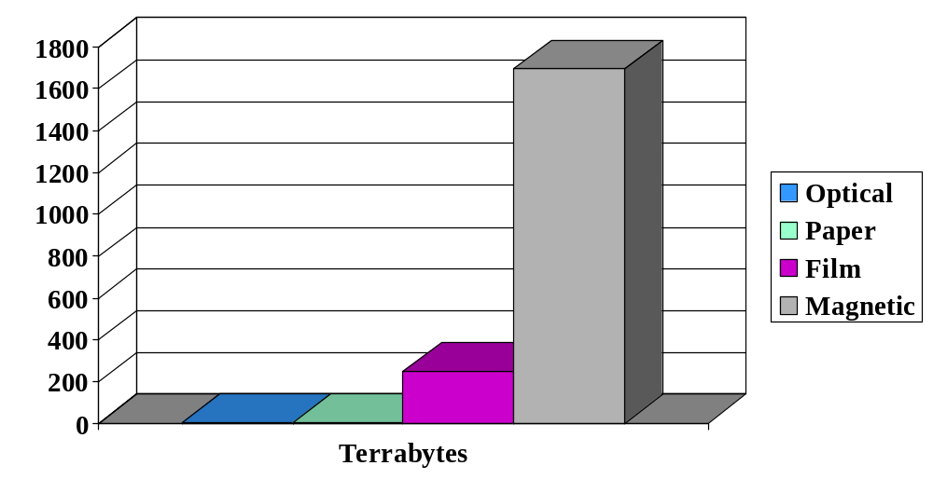
All the information in the world…
(over 2 billion Terabytes)

Slide 4
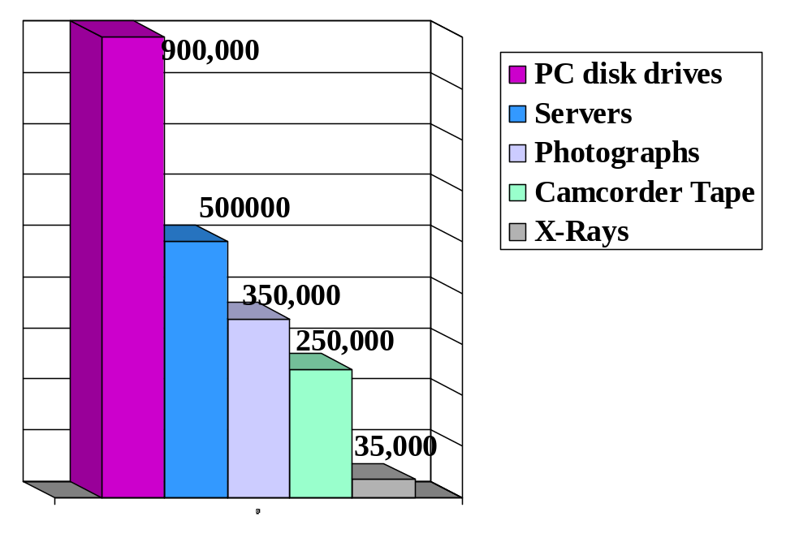
Where is the data stored?
All Paper products 240
All Music CD’s 8
All Cinema 2,000
Notes:
All Paper products 240
All Music CD’s 8

Slide 5
Challenges: Availability
Mobile workers
e-business
multi-time zone collaboration
There is no acceptable time to be closed.
IT must consider down time in event of a failure. What is the risk of data loss?

Slide 6
Challenges: Scalability
e-business
Data warehouses (esp..HOLAP)
File size bloat / E-mail
Most technology provides economical access for large number of customers.
Success breeds success.

Slide 7
On-line Storage
Servers with RAID
Storage Area Networks
Network Attached Storage
CD-ROM servers

Slide 8
Servers with RAID
Storage is local with hardware redundancy
Use: ubiquitous. Main point of contact for most LAN users.
Almost every server has to have some form of local operating system.

Slide 9
Server with RAID
Advantages:
Easier file restoration
Least expensive on-line storage
Reliable old technology
Disadvantages:
Most expensive near-line storage
Difficult to scale
Results in many unalterable volumes (poor use of storage resources)

Slide 10
Network Attached Storage
Network attached storage devices contain their own intelligence so they don’t need to be connected via a server.
Communicate with IP but with latency (except EMC style Fiber connected)
Use: Content caching for static content and streaming media. Not good for high-end transactional systems.
Notes:
Where NAS fits in
NAS communicates through the ubiquitous IP protocol (Ethernet and Gigabit Ethernet), so it doesn't require expensive host bus adapters, which are required for Fibre Channel, and is thus a good solution for providing general-purpose storage services to low-end clients as well as high-performance servers.
The addition of Fibre Channel storage subsystems gives EMC Corp.'s and Network Appliance's enterprise-class NAS systems high performance and scalability.
For the most part, enterprise-class NAS systems have been useful as content caching appliances for static content and streaming media, as well as some high-performance file serving. But high-end databases and server clusters primarily use SANs for their storage needs.
The major bottleneck in NAS products is the thin-server processing unit, which manages the file system and TCP/IP operations. Thin servers have highly optimized operating systems that are designed to deliver files as quickly as possible, but the software processes that sit between clients and their data introduce a large amount of latency compared with SAN systems.

Slide 11
Network Attached Storage
Advantages –
Easy way to add storage without requiring a server
Appropriate for storage
Low maintenance
Disadvantages –
Backup difficult (time and cost)
Shares traffic with rest of network

Slide 12
SAN
Entire disk subsystems linked directly to a server or servers by high-speed connections.
Multiple physical volumes appear as SCSI single logical volumes.
Use: House entire enterprise in a single repository with strong economies of scale.
Notes:
The SAN approach
Because sans work almost like directly attached storage (RAID arrays appear as SCSI devices), they can provide high-performance storage for enterprise-class applications.
A typical SAN consists of Fibre Channel storage units (tape or RAID) that are networked to servers via Fibre Channel switches (from vendors including Gadzoox Networks Inc.)
The primary benefit of a SAN setup is its ability to provide device sharing, which allows storage resources to be consolidated. With a SAN in place, an IT manager can make single storage purchases instead of buying separate external storage units for each hardware platform.
A few weeks ago, Nishan

Slide 13
Storage Area Networks
Advantages –
Remove backup traffic from LAN and overnight window
Potential reduced storage expenses, ease of scale
High performance
Disadvantages –
Multiple vendors make implementation difficult
Sophisticated skills required for maintenance.

Slide 14
Optical ROM servers
Multi-CD or DVD-ROM high capacity servers
4.7GB or 15.9GB for DVD-ROM
Use: Low performance, high latency static data like archival data and files.

Slide 15
Optical ROM servers
Advantages
High-capacity
Reliable storage
Low maintenance
Disadvantages
Writing DVD is unreliable
Performance unreliable
Not very scalable
Native file system
Notes:
Some very large (Multi-terra byte) enterprises can afford to make mag

Slide 16
Near-Line storage
Tapes
Optical
Disk
Notes:
Either not directly accessable or difficult to access

Slide 17
Digital Tape
Inexpensive magnetic tape can store the most data per dollar.
Use: ubiquitous, general purpose
Painfully slow over a network (backup window long and network traffic high 5 mb/sec)
Very expensive per server to do locally (35/70 DLT from Compaq $4000)
Notes:
Compaq Proliant Servers have 35/70 GB AIT drives
Dell PowerEdge 2400 have either 12/24 or 20/40 GB DAT drives
Compaq Proliant 3000 servers:
BI
51 GB Storage
49 GB Available (96%)
GRPLAINS
34 GB Storage
15.5 Available (45.5%)
CPBMAIL
51 GB Storage
39 Available (76%)
CPBFILE
68 GB Storage
37.5 Available (55%)
Spare
up to 68 GB Storage Available
Dell PowerEdge 2400 servers:
DB1SERVER
17 GB Storage
16 GB Available (94%)
OIG
N/A (reserved for OIG)
CPBRACCESS
N/A
SGMS
3 production
2 staging
3 at Noblestar
LINUX (BEGOT & BEGET)
N/A
Spare

Slide 18
Optical
Storage of backup on DVD or CD ROM
Costly per megabyte
Use: Final storage place of data
Long shelf life
Near replica of file system
Low storage capacity (15 GB) per disk

Slide 19
Magnetic Disk
Hard disks to back up other hard disks
Use: Rare except in multi-terabyte enterprise systems
Reliability is very high provided they are handled properly
Cost very expensive, especially for a rotation with depth

Slide 20
Conventional strategies
Online vs. Near-line
Windowed vs. Real-time
Rotation depth vs. media cost
Local vs. remote
Notes:
Libraries
Raid
Local hard operating system vs.
Server connected
Single head - difficult
Can be cost effective

Slide 21
Advanced Strategies
Hybrid Schema
  Small company use
  Use traditional tape over a network for a better but inexpensive solution
  Local Operating system backup with daily incremental of data
  Remote Data backup of weekly full data to Library

Slide 22
Advanced Strategies
Hierarchical management
  Large company use
  Systematic movement of data from online to archival
  On-line snapshot (Magnetic)
  Near-line tape backup (shallow rotation)
  Off-line DVD storage

Slide 23
Old problems
Desktop/Remote/mobile backup
Operating system linkage
Legal Liability
Data corruption

Slide 24
New solutions
ISCSI
Linear Tape Open
Hybrid Fiber Channel/Gigabit Ethernet switches
Outsourcing
Notes:
A few weeks ago, Nishan Systems began shipping switches that have the ability to convert Fibre Channel traffic into Gigabit Ethernet traffic and vice versa. As Fibre Channel and networking vendors continue to grow, we should expect to see more hybrid systems like these in the future.
(Internet Engineering Task Force standard first probably from Emulex in adevelopment kit this summer)
The target markets for the GN9000/SI include remote backup and disaster recovery and remote access to block-level storage on Fibre Channel storage area networks.
iSCSI, the IP networking community's answer to Fibre Channel for storage networking, will be an important protocol for IT managers to learn and implement when it is ratified next month. However, at least in the short term, eWEEK Labs believes it won't be a Fibre Channel killer.
In fact, IP over SCSI, which can link pools of storage across IP networks, will likely promote and expand the adoption of Fibre Channel as the dominant storage architecture. The first iSCSI devices are expected to be significantly slower than Fibre Channel products, which will limit iSCSI's appeal in high-performance environments.
The iSCSI transport protocol allows SCSI commands to travel through IP networks, which in turn will allow IT managers to use high-speed IP networking technology such as routers, switches and Gigabit Ethernet to carry data from storage units (built of Fibre Channel hardware or SCSI hardware) to servers anywhere throughout a corporate network.
It is important to note, however, that a commitment to iSCSI doesn't necessarily mean that IT managers should be thinking about a full-scale convergence of storage and data networks. Until proper storage management and quality-of-service bandwidth management are developed for iSCSI, it would be best to keep these networks separate.
The most important use for iscsi technology will be for site-to-site mirroring of data. Although Fibre Channel is an excellent medium for clustering and data mirroring through campus networks, iSCSI can carry data across the country (provided the latency introduced by TCP/IP is acceptable to the applications run).
A new high-density tape format, Linear Tape-Open (LTO) Ultrium, will give midrange systems the storage density and data throughput previously found in high-end mainframe storage.
IBM Corp., Hewlett-Packard Co. and Seagate Technology Inc. of Scotts Valley, Calif., jointly developed the LTO technology. They sought a highly reliable, physically small cartridge that would last about 10 years in midsize storage setups, Whitner said.
The LTO tape standards are Accelis, a dual-hub, fast-access tape, and Ultrium, a single-hub, high-capacity variety. Both formats share some common components, but the cassettes are not interchangeable.
In native, uncompressed mode, LTO Ultrium tapes store 100G per cartridge and have a peak throughput of 15 megabytes/sec, Whitner said. Both those figures double under 2-1 data compression rate.
Libraries are custom-built, but prices start around $250,000 for a full-size model.

