Slide 1
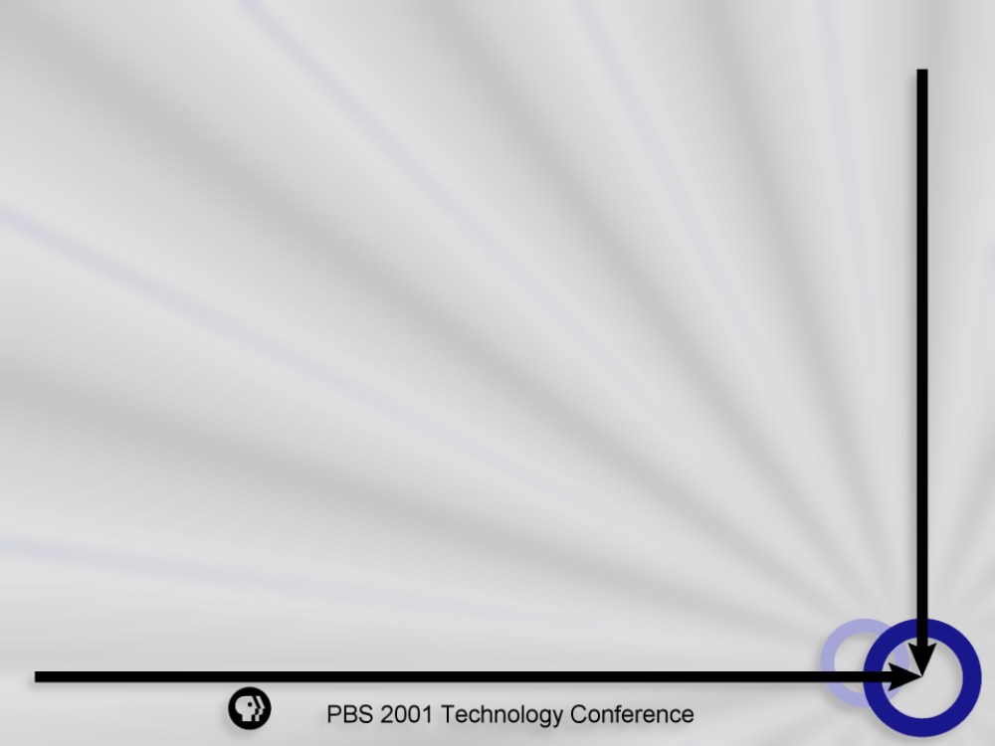
Enterprise Storage Networking
Could a SAN or NAS Solve Your Storage Problems?
Ken Walters, PBS Information Technology
Notes:
Welcome to the 2001 Technology Conference
Familiar faces
Thanks for coming
I am going to cover a lot of ground, there should be time for questions at the end
Today I am will try and give you a brief introduction to storage networking:
The different technologies
The differences between them
How you might go about backing them up

Slide 2
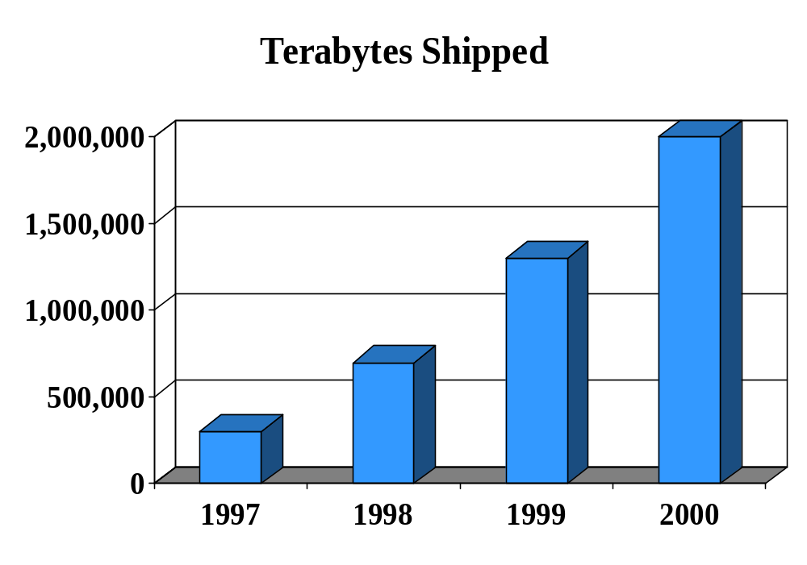
The Storage Explosion
Notes:
Corporate America has an insatiable appetite for data and they are spending a lot of money on it – the cost per MB is down, but 50% of IT spending allocated to storage - could reach 75% by 2003
Even in pre-Internet boom days the rule of thumb for growing businesses was that demand for storage doubled every year.
Many e-commerce companies were expecting to about a 500% increase.

Slide 3
What is Fueling the Growth?
The Internet and e-Commerce
Data Warehousing
Digital Media Assets
Paper to Digital Conversion
Notes:
E-Commerce is one culprit
E-tailers like Amazon
click-stream data
customer histories for personalization
Data Warehousing
Data once archived or purged is now mined, denormalized, and kept for posterity
Digital Media Assets
Streaming Video
Streaming Audio
Images
Paper to digital conversion
invoices
expense reports
marketing materials

Slide 4
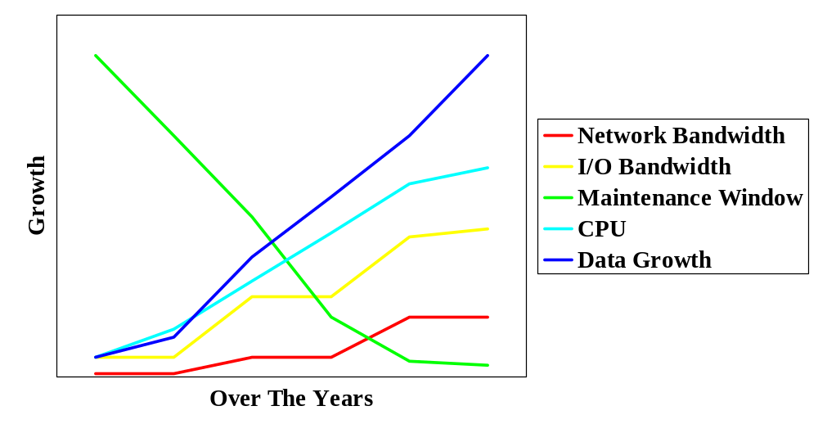
Storage Growth vs. Supporting Technologies
Notes:
Network bandwidth
growing less quickly
less frequently upgraded
Ethernet 10Mb/sec then 100Mb/sec, only now starting to see Gigabit
I/O bandwidth
’92 to ’96 SCSI only went from 20MB/sec to 40MB/sec and Ultra in ’98 to 80MB/sec
Maintenance Windows
Shrinking
Moore's law
says that semiconductor power doubles every 18 months
Data Growth
According to IDC storage capacity will increase by nearly 80%/yr
Our ability to process and move data has not kept up with the growth in data
Just to summarize this slide
Long periods of stability follow bandwidth increases in disk device, channel, back plane and network segments
Data ascribes a linear path, bandwidth plateaued

Slide 5
Traditional Storage
Server Attached
  Held hostage
  Colocated
  Decentralized management
SCSI Attached
  Scalability limits
Notes:
Server Attached
Host Captive
Located right next to the server
Decentralized management and backups – unwieldy
SCSI has its limitations
distance
number of devices per chain
In 1999 over 90% of storage was traditional server attached

Slide 6
Challenges
Where to store it
How to protect it
How to move it faster
How to share it
How to manage it
Notes:
Challenges
Store It
Protect it
back it up / restore
Make it highly available
93% with significant loss out of business in 5 years (US Bureau of Labor)
43% never reopen after a disaster (U. of Wis.)
29% close within a year (U. of Wis.)
Move it from disk, to server and back quickly
Share it in a heterogenous environment
Remove management complexities and inefficiencies
**************************************
TRANSITION TO ENTERPRISE STORAGE NETWORK
So, how might we accomplish these things
**************************************

Slide 7
The Enterprise Storage Network
An ESN Requires
Storage device
Dedicated network
Resulting in
Standard way to manage, protect, and share data
Notes:
One good solution would be to create some sort of Enterprise Storage Network
This kind of storage network consist of:
a mass strorage device
a dedicated network for the I/O traffic and device sharing
The result is
easier management
better protection
better sharing
This technology is replacing traditional storage
The network–attached storage market is growing at about a 66%/yr rate - IDC

Slide 8
The Storage Device
NAS
  A server with attached storage tuned for file sharing and network performance
SAN
  Large, scalable, highly available disk array
  Stand alone with heterogeneous connectivity
  High throughput
Notes:
Whether you have a SAN a NASor a combination you need a robust data storage device
If you have a NAS the device will is
usually server attached
tuned for sharing and network based transfers
If you have a SAN the device will be:
Large and scalable
Highly available
Consistent high speed transfer rates
Heterogeneous host environment – Windows, UNIX, S/390

Slide 9
The Dedicated Network
NAS
  Shared IP network
  Dedicated IP network
SAN
  Completely separate Fibre Channel Network dedicated to storage I/O
Notes:
In the SAN environment the network consists of
a fibre channel network consisting of cabling, switches and hubs that when put together create what is called a Fabric
For a NAS either
The general purpose TCP-IP LAN
or more preferably a dedicated TCP-IP LAN

Slide 10
What Is A NAS?
Turnkey file server
File system based storage
TCP/IP provides the networking protocol
Objects transferred are complete files
  http, nfs,Cifs
Tuned thin OS
Notes:
A NAS is
Turnkey fileserver
File system based
Uses the Ethernet
One of the most important differences between a NAS and SAN is that
a NAS transfers complete files
Most commonly used for
HTTP
NFS
CIFS
Low-end to midrange market

Slide 11
NAS
Three Types
Entry level
Workgroup
Department/Enterprise
Notes:
Three Types
Entry level
Workgroup
Departmental
******************
No definitions, next slide
******************

Slide 12
Entry Level NAS
One or two hard disk drives
Limited RAID functionality, expandability, and fault tolerance
Examples: Quantum, Maxstor
Price: approximately $2000
Serves: about 12 users
Notes:
entry-level
Just one or two drives
limited RAID functionality, expansion, fault tolerance
examples of entry level NAS appliances – Quantum’s Snap, offerings from Maxstor
Cost a couple of thousand
12 users

Slide 13
Workgroup NAS
Up to seven hard disk drives typically with RAID 5 protection
Hot swappable components
Example: Compaq
Price approximately: $50,000
Supports more users and larger files
Notes:
Workgroup
Are those having up to seven hard disk drives
RAID 5 protection being typical
Example: Compaq TaksSmart
$50,000+,
more users,
larger files,
hot swappable components

Slide 14
Departmental/Enterprise NAS
More than seven hard drives - up to 12TB
Various-levels of RAID and fault tolerance
Dual Controllers, dual-servers, fail-over
Examples: Network Appliance, EMC
Price: $100,000 and up
Serves: thousands
Notes:
The departmental/enterprise NAS products
more than seven drives,
multiple storage controllers,
various-levels of RAID and fault tolerance.
Dual servers
Fail-over
[Network Appliance, EMC] $100,000 and up
Can serve thousands of users.

Slide 15
NAS Advantages
Simple installation & administration
Ideal for ASP/ISP model
Perfect for content delivered by Internet or Intranet
Centralized point of management
Good for sharing same data by many hosts
Notes:
NAS Advantages
Easy to install
Simple to administrate
Ideal for ASP/ISP Model
Perfect for content delivery over Inter(45Mbit = 6MB/sec) or Intranet (100Mb = 13MB/sec)
The bottle neck is the pipe, not the storage subsystem
Centralized management
Good for sharing the same data between many hosts using NFS/CIFS

Slide 16
What Is A SAN?
Dedicated storage network that traffics in serial SCSI I/O
Storage connection is via Fibre Channel
Objects transferred are device blocks
Notes:
What is a SAN?
A SAN is a dedicated storage resource network
The storage is via Fibre Channel
Objects transferred are device blocks

Slide 17
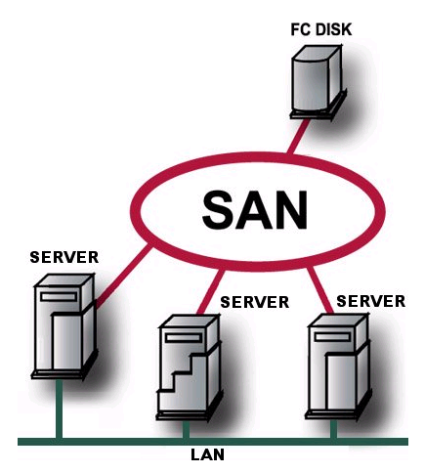
SAN
Servers
Host Bus Adapters
Storage Devices
FC Switches & Hubs
Tape Devices
FC to SCSI routers
Notes:
Components that make up a SAN
Servers
servers have host bus adapters
dual paths(adapters) are a must for high availability situations
Storage Devices
FC switches and/or Hubs
Tape devices
Possibly FC to SCSI routers to leverage no FC tape and disk resources
*************************
TRANSITION to SAN ADVANTAGES
Now lets talk about some of the advantages of using a SAN
*************************

Slide 18
SAN Fault Tolerance
System design is Fault Tolerant
  Disks
  Controllers
  Cache
  Data is not locked into a server
Notes:
Fault Tolerance
All the components should be fault tolerant
In the Storage Device
DISKS
CONTROLLERS
CACHE
CPU
Fabric
SWITHCES
HBAs
The design is also fault tolerant
If a server fails the data can still be accessed by other servers via the Fabric

Slide 19
SAN Disaster Recovery
Backup and recovery much faster
Can take place over greater distances
  10 to 20 km
Remote Copy and Replication become possible
Flash Copy
Notes:
Backup and Recovery
Higher data transfer rates than Ethernet
Result in faster backups and lower mean time to recover
Remote Copy and Replication – both synchronous and asynchronous become possible
Flash Copy
Instant LUN copying for testing or backup purposes

Slide 20
SAN Network Performance
SAN network moves only I/O data
100MB/sec, 200MB/sec Full Duplex
2 Gbit FC starting to ship
Data only uses the Ethernet to serve the client
Notes:
As mentioned before a SAN is a Storage I/O dedicated high speed network
Currently most FC is 100MB/sec 200MB/sec aggregate if Full Duplex
2Gbit FC is already shipping which is twice as fast
In a SAN, unlike a NAS, the data does not need to move between the server and the storage devices on the Ethernet

Slide 21
SAN Scalability
SCSI distance limitations eliminated
With a SAN you put the storage where it fits
Most mass storage devices allow for substantial expansion
Notes:
Physical distance limitations greatly extended from a few meters with SCSI to 10 to 20 kilometers
Maybe you don’t have room where your servers are, so you put it down the hall or across the campus
Start with a Terabyte or two and scale up to 10 or more in a single frame

Slide 22
SAN Manageability
Storage Resource Management
  Configuration
  Monitoring
  Administration
Notes:
SANs let you manage storage in a way that was not possible with server attached storage
A storage administrator can configure, monitor, and administrate data resource centrally
which improves quality, uptime, allocation

Slide 23
SAN Cost Effectiveness
Economies of scale
Less orphaned space
Supports heterogeneous environment
Capacity can be redistributed as needed
Unused space is centrally pooled
Notes:
If you have a lot of data to store a SAN can be Cost Effective, WHY?
Economies of scale
Less Orphaned Space
You do not need to dedicate extra space to a server
Supports a heterogeneous environment
You do not need different subsystems for each platform
You can associate data with the server that needs it
Space relocation becomes easier
Unused space is pooled

Slide 24
In Summary
A SAN is a dedicated storage network providing the channel between a server and its data
A NAS is a plug & play server tuned for serving files over TCP/IP
Notes:
SANs provide a dedicated storage network that connects servers to shared storage devices like disk and tapes
A NAS is a plug and play file server tuned for handing over entire files on and Ethernet LAN
Enterprise Storage Networking is an Inclusive technology that includes SAN technology, NAS technology, and even direct attachment where appropriate.

Slide 25
NAS and SAN Backup
Traditional
Local backup
Network backup
New Backup Options
LAN-less
Server-less
Notes:
This is just an intro page, do not give details
Local Backup will work with a both NAS and SANs
Network Backup will work with a both NAS and SANs
LAN-less (SAN primarily, NAS if connected to the Fibre)
Veritas BackupExec w/SSO comes bundled with some NAS solutions
Server-less (for SAN storage only)

Slide 26
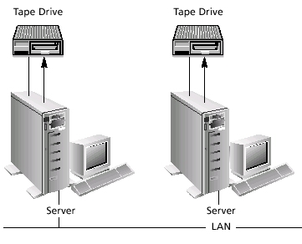
Local Backup
Low network utilization
Good performance
But…
Management headache
High failure rate
Notes:
The old fashioned way:
Did not utilize the network
Good performance because SCSI bus attached.
May be your only NAS backup solution if you NAS is large and you Network is not Gbit Ethernet
But…
All the old management problems and inefficiencies return

Slide 27
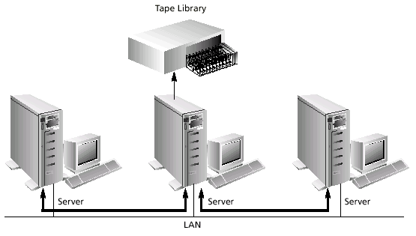
Network Backup
Notes:
If you NAS and SAN are not terribly big, you might be able to get away with Network backups
Data flows from server over LAN to central backup server and from there to tape library or stacker

Slide 28
Network Backup Pros
Greater automation
Centralized administration
Lower administrative costs
Result: More reliable backups
Notes:
Greater Automation
Administration and maintenance performed at a single location
Greater Automation
Lower Administrative costs

Slide 29
Network Backup Cons
Data moves across IP network
Which requires…
Significant network bandwidth
Resulting in…
Poor performance
Notes:
But data still movers over the Ethernet resulting in poor performance for both the backup and applications
100Mbit/sec LAN maybe 3-5 MB/sec transfer rate
DLT maybe 10MB/sec best case
Network is the bottleneck.

Slide 30
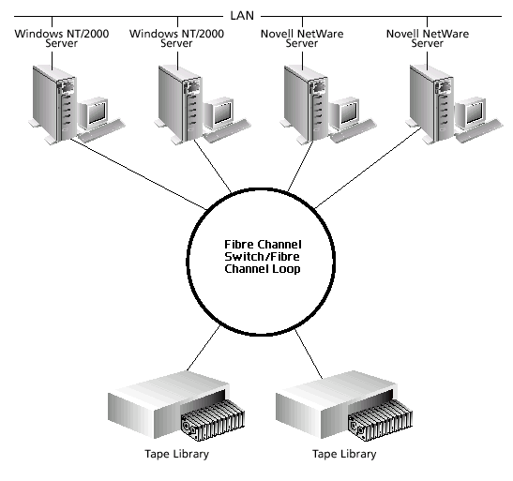
LAN-less Backup
Notes:
This generally a SAN only backup option.
Data moves from the storage device to the server and then back to the tape device completely over the SAN
A fibre channel connection could realistically see 50-80MB/sec.
The tape drive is the bottle neck.

Slide 31
Backing Up a NAS
Too much data to backup over LAN in most cases
What are your choices?
  Local Backups
  Add an Host Bus Adapter to NAS server and go LAN-less
Notes:
You will find that as you start load up your NAS Network backups become unmanageable.
Choices?
Perform local backups and give up the benefits of centralized backups.
Attach your NAS to your SAN with a FC HBA and start taking LAN-less backups

Slide 32
Backing Up a SAN
Network backups become unmanageable
Local backup of many servers unmanageable
Leverage your SAN investment
Go LAN-less as soon as possible
Move to LTO or FC based tape technology
Notes:
Same deal as with the NAS, you will find that as populate your SAN, data network based backups become unmanageable.
Choices?
1 Perform local backups and give up the benefits of centralized backups.
2 Start taking advantage of LAN-less backups move to newer non DLT tape technology and see a dramatic improvement.

Slide 33
The Future of SAN Backups
Integrated Media and Devices
  Add performance & capacity policies into tape device selection
Server-less Backups
  Data moves between storage device and tape device
  This is the one to wait for
Notes:
SAN backups will go through 3 stages
LAN-less
Integrated Media and Devices – Adding performance and capacity policies to tape drive selection
3 Server-less – The data pretty much goes from the storage device to server without hitting the server
This will use things called Data Movers and 3 Party Copy that have not matured yet

Slide 34
Future Directions
Improved SAN management
iSCSI
  Ubiquitous IP Protocol
  Currently slow compared to FC
Gigabit Ethernet
2 and 4Gb FC, 10Gb FC and Ethernet by 2005
Notes:
Improved SAN management, “SAN Operating systems”, basically moves a volume manager to the SAN and off the server. This combined with something called virtualization and SAN will have truly matured.
iSCSI
IBM and CISCO both have introduced iSCSI components
Still slower that FC
iSCSI uses the ubiquitous TCP/IP networking
as iSCSI matures it may replace FC in storage networking
Gigabit Ethernet is already here
In the future both FC and Ethernet are going to get much faster

Slide 35
Resources
Books
  Building Storage Networks, Marc Farley
White Papers
  veritas.com, jni.com, qlogic.com, emulex.com, inrange.com
Periodicals
  wwpi.com, infostore.com
Gartner Group

Slide 36
kwalters@pbs.org
Questions

