Slide 1
The ABC’s of
Enhanced Television
Bruce Jacobs
Twin Cities Public Television

Slide 2





Local Enhancement Collaborative
Corporation for Public Broadcasting
KCSM - San Mateo
Twin Cities Public Television - St. Paul
Milwaukee Public Television
WGBH - Boston
In collaboration with
PBS

Slide 3
Define “Enhanced Television”.
LEC Mission
Identify enhanced developments that have certain or potential roles for stations.
Develop practical steps for station involvement.
Enhance local programs
Localize enhancements to national shows
Techniques to pass national enhancements
Tell the world what we learn.

Slide 4
ETVCookBook.org
First Edition
More Recipes in June

Slide 5
ETV
ATVEF Spec
ATVEF Execution

Slide 6
What is ETV?

Slide 7

In the Beginning,
there was “Television”.
s

Slide 8


Then, we “Enhanced” Television.
Better Pictures
Multi-Channel Sound
Multi-Channel Sound
Closed Captioning for the Hearing Impaired,
and for bars.

Slide 9



We also added lots of “Channels”...
s
?
and we made it “Interactive”.
?
Cable
DBS
Closed Captioning for the Hearing Impaired, and for bars

Slide 10
This is now “Normal” Television, or
Plain Old Television (POT)
We call everything else “Enhanced” TV.
Closed Captioning

Slide 11
Why ETV Now?

Slide 12
Convergence or Invasion?
TV
Cable
Digital
Cable
Enhanced
Cable
PlayStation
2
Movies
Satellite
DBS
Enhanced
DTV
WebTV
VCR
DTV
Pong
Radio
VOD
Broad-
band
Internet
PVR
Phone
AOL
PC
Computer
Sound Space
Video Space
Data Space

Slide 13
Merger/Investment Mania
AOL <> Time Warner $184 Billion
AT&T <> MediaOne $54 Billion
Gemstar <> TV Guide $9.4 Billion
OpenTV <> Spyglass $2.1 Billion
Liberate <> MoreCom $521 Million
Microsoft > AT&T $5 Billion
AOL > DirecTV $1.5 Billion
NBC* > Tivo

Slide 14
Media Market Profit =
Technology Control +
Content Control +
User Value (Advertiser)

Slide 15
Compelling Forces - 3Cs
Captivation
  Surf reduction
  Keep audience glued
  Carry audience through commercials
Commerce
  Sell Pizzas and soap opera clothes
Cultivation
  Educate the audience

Slide 16
The ETV System

Slide 17
Types of ETV
New Control, Convenience, Choice - “Appetizers”
  EPG/IPG (DBS, Cable, DTV)
  PVR (Tivo, Replay, Cable ...)
  VOD (Cable, Broadband …)
  Video ala MP3 (VivX, Video Napster)
New “Web” Content on the TV - “TV Dinners”
  TV HTML (Cable & DBS Walled Garden)
New “Web” Content with TV Shows
  PC Synchronous (ABC) - “PC Dinners”
  TV Synchronous (Cable) - “TV Dinners”

Slide 18
Provider
User
Author, Network
“TV”

Slide 19
Early Television
Provider
User
Author, Network
TV
Station
RF Transport
Deployment - All NTSC

Slide 20
Cable
Provider
User
Author, Network
TV
(Station) Head-End
STB
Cable Transport
Deployment - NTSC & Digital

Slide 21
Enhanced TV
Provider
User
Author, Network
Content
(Application Service)
Application
(Middleware Server)
Middleware
STB
(Station) Head-End
“Platform”
Digital Transport
Deployment - What Standards? Who Controls?

Slide 22
Enhanced TV
Provider
User
Author, Network
Content
Application Service
Application
Middleware Server
Middleware
Look
Here
Station / Head-End
Platform
Transport
Deployment

Slide 23








Two Main Platforms for ETV
The “Mobile” Experience
Low Detail
The “Couch” Experience
Moderate Detail
The “Chair” Experience
High Detail
Mobile
Media Device
PC
POT
TV With Enhanced
Set Top Box

Slide 24
Two Screen Enhancements
Regular TV and PC with Internet
Doable Today!
Lots of Type
  Up to 60 rows plus scrolling
Cannot overlay enhancements on video
Requires both boxes to be adjacent

Slide 25
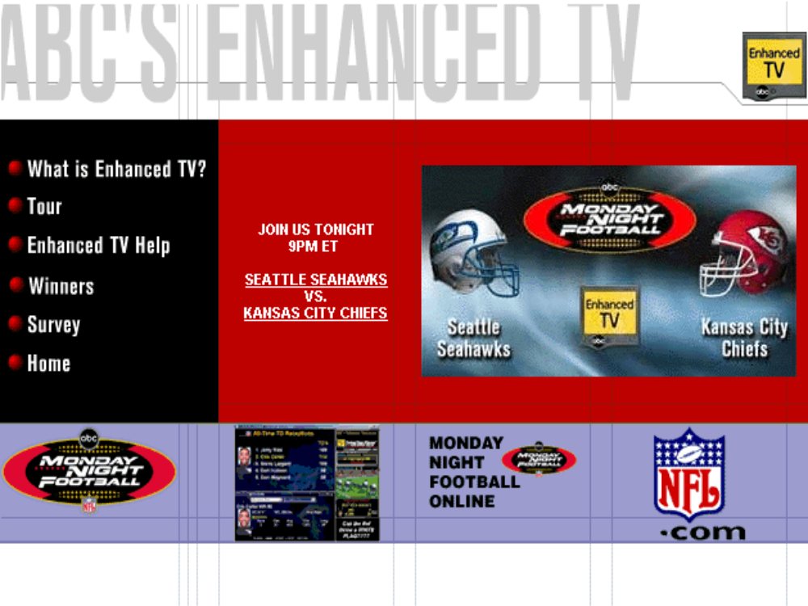

Slide 26
PC Enhancements
Eliminate the TV
PC Tuner Card - ATVEF
  Hauppauge
  Broadlogic
Streaming
  QuickTime
  Windows Media Player

Slide 27
TV Enhancements
Cultivate the “TV” Experience
Not much type
  Up to 20 rows - no scrolling
  1/10 the information of a PC window
WebTV Plus = 500,000
Other platforms coming
POT

Slide 28


Slide 29
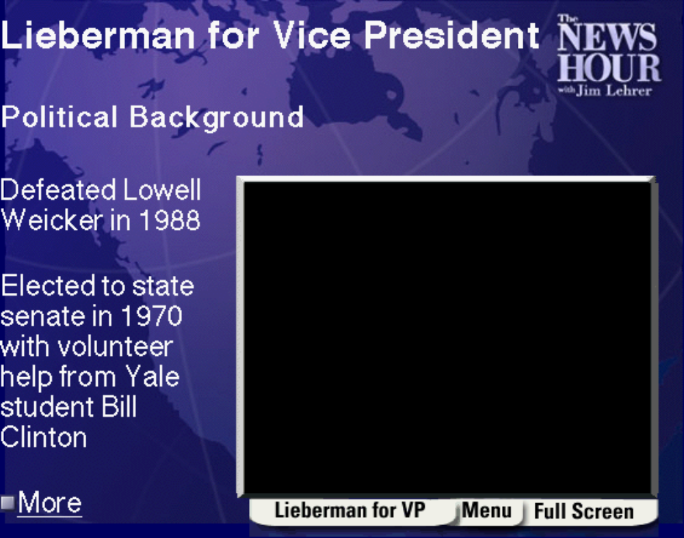


Slide 30
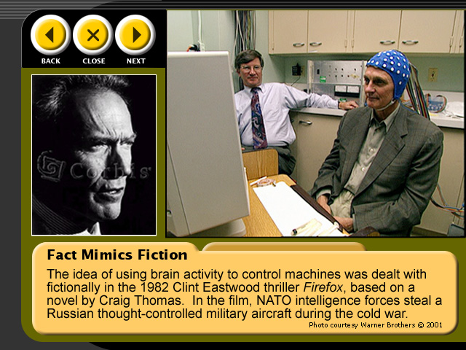

Slide 31
Enhancement Standards
but first…

Slide 32
CONTENT
Essence
Meta-Data
Video
Aspect Ratio...
Audio
Language...
Closed Captions
SAP
Language...
Enhancements
Standard...

Slide 33
ETV Standards - Two Tracks
Procedural
  XML + Java
  DVB MHP (Europe)
  ATSC DASE (Under Development)
  SCTE ?
  Java Code + Java Author + Java Hardware = $$$
Declarative
  HTML + JavaScript
  ATVEF > SMPTE DDE
  HTML Free + HTML Author + HTML Hardware = $

Slide 34
Technology
SMPTE
ATSC
DVB
SCTE
Markup Essence
HTML4
XDML
XHTML
Script Essence
ECMA2
ECMA3
ECMA3
Host Objects
Navigator,
Navigator,
Window, Locator
Window, Locator
Procedural Essence Bridge
Y
Style Sheet Essence
CSS1
CSS1+
CSS2+
Active Object Essence
-
-
JVM
Y
Y
java.*
Y
Y
com.sun.util.*
Y
-
javax.tv.*
Y
Y
javax.media.*
Y
Y
org.havi.ui.*
Y
Y
org.davic.*
Y
Y
org.atsc.*
Y
-
org.dvb.*
-
Y
org.w3c.dom.*
Y
Y
Graphics Essence
png, jpeg
png, jpeg
gif, png, jpeg
mpeg-iframe
Streaming Video Essence
analog
mpeg
mpeg
Streaming Audio Essence
analog
ac3
mpeg
Font Essence
pfr
pfr
Trigger Essence
tve-trigger
(atsc)
DOM Events
Naming Model
tv:,lid:
tv:, lid:
tv:, lid:
Display Model
OSD
OSD w Alpha
OSD w Alpha
Input Model
-
Keyb, RC
Keyb, RC
Transport Assumptions
IP Multicast
ATSC A/90
MHP OC
Return channel
-
-
Y

Slide 35
ATVEF

Slide 36
ATVEF Founders
CableLabs
CNN Interactive
DIRECTV
Discovery Communications, Inc.
Intel Corporation
Liberate Technologies
Microsoft and WebTV Networks
NBC Multimedia
NDTC Technology, Inc.
Public Broadcasting Service (PBS)
Sony Corporation
Tribune
The Walt Disney Company
Warner Bros.

Slide 37
ATVEF Platforms
WebTV Plus
  500,000?
  Soon to add Analog Transport B?
AOL-TV
  ?
Digital Cable?
  X
Transport B TVs?

Slide 38
ATVEF Tutorial
Content Specification 1.0
  What can I send?
Transport
  Pull (and) or push the content?
Bindings
  How does it work on various networks?

Slide 39
CONTENT SPECIFICATION 1.0
Formats
  HTML 4.0, CSS 1, EcmaScript, DOM 0
Types
  text/..., /png, /jpg (No Flash)
TV Integration
  “tv:” just like any image
Trigger Receiver Object
Trigger
  URL, Name, Script, …
Local ID Scheme
  “lid:” instead of “http:”
Content Caching
  1 MB

Slide 40
CONTENT TRANSPORTS
Transport A
  Internet Pull
Transport B
  Broadcast
Transport A and Transport B

Slide 41
CONTENT BINDINGS
NTSC
  Transport A Triggers Via Text Channel 2
  Transport B Data is via IP over VBI (medium speed)
IP
  Announcement notifies receiver of available programming

Slide 42
ATVEF EXECUTION
How do we author it?
How do we get it there?

Slide 43




Legacy NTSC
Author
Storage
NTSC Transport
Receive
Satellite
Video + Audio
Broadcast
Cable

Slide 44

ATVEF Transport A
Author
Storage
NTSC Transport
Receive
Any Line 21 Recorder
Satellite
Video + Audio
Broadcast
ATVEF Box
Line 21 Trigger
(URL Only)
Cable
kas flas llasflasdfaf
aslkj lkas;l lasdf
afdl;kjalkdj fl ls lk a
OK
Enhanced Content
TV HTML
Web Server
Forward
Internet
Return

Slide 45
3 Problems With Transport A
Speed
  Critical for TV synchronous enhancements
  Slow backbone
  Slow connection
Scalability
  Server crash with millions of simultaneous hits
Reach
  No Internet connection to ETV device
  Modem line occupied
  No modem line

Slide 46
ATVEF Transport B
Author
Storage
Transport
Receive
Digital Satellite
Video + Audio
Digital Broadcast
Enhanced Box
Digital Cable
Transport B
TVHTML Enhancement Content
kas flas llasflasdfaf
aslkj lkas;l lasdf
afdl;kjalkdj fl ls lk a
OK
Enhanced Content

Slide 47
ATVEF Transport B
Author
Storage
Transport
Receive
Digital Satellite
Video + Audio
Digital Broadcast
Enhanced Box
Digital Cable
Transport B
kas flas llasflasdfaf
aslkj lkas;l lasdf
afdl;kjalkdj fl ls lk a
OK
Enhanced Content
Transport A
Back Channel - Optional
TV HTML
Enhancement Content
IP Server
Internet

Slide 48
Transport B: Boon
Speed
  As fast as a DTV channel - 100X?
  Infinite speed, with cache pre-load
Scalability
  Infinite users
Reach
  No Internet needed (transaction-less content)
A Role for DTV!
  No one does it like a digital broadcaster!

Slide 49
Transport B: Bane in Authoring
Off-Line Authoring
  Essence must be sent right before access allowed.
  Data bandwidth must be known.
  Requires station/network agreements!
Live Authoring
  Data arrives late, unless bandwidth sufficient
  Anticipate clicks with regular cache load?

Slide 50

Transport B: Bigger Bane
Author
Storage
Transport
Receive
Video + Audio
Digital Broadcast
Enhanced Box
Digital Cable
kas flas llasflasdfaf
aslkj lkas;l lasdf
afdl;kjalkdj fl ls lk a
OK
Enhanced Content
175 Unique PBS Stations
??? Cable Systems

Slide 51
Bypass!
Good for Trial - Unacceptable Long Term!
Network Stations
Producer/
Network
Master
Control
Encoder/
Mux

Slide 52
Station Synchronization
Added Components
Network Stations
Producer/
Network
Master
Control
Traffic/
Automation
Encoder/
Mux
Transport B
Data Server
Essence,
Triggers
XML Schedule,
Essence,
Triggers

Slide 53
Station Synchronization
Advantages
  No change in master control or video network
  Accommodates local enhancements
  Last minute changes
  Pre show cache load possible
Disadvantages
  Complex system at all stations
  High implementation and operating cost
  Enhancements not easily browsed
Challenges
  Numerous standards needed
  New automation systems/features needed

Slide 54
Producer Synchronization
Added Components
Network Stations
Producer/
Network
VANC
Embed
Network &
Master
Control
VANC
De-Embed
Encoder/
Mux
SDI Conversion?
Transport B
Data Server

Slide 55
Producer Synchronization
Advantages
  Lower cost
  Simpler to operate
  Easy to browse
Disadvantages
  Data rate limited to 300 Kbps (not a problem?)
Challenges
  Recommended practice for use of VANC
  SDI conversion may be required
  No equipment yet available for testing

Slide 56
Which Synchronization?
At Producer
  For start for sure
  For smaller stations
At Station
  For local
  For national later?

Slide 57

Conclusion
Lots of work to do.
Should be fun!
ETVCookBook.org

