Slide 1
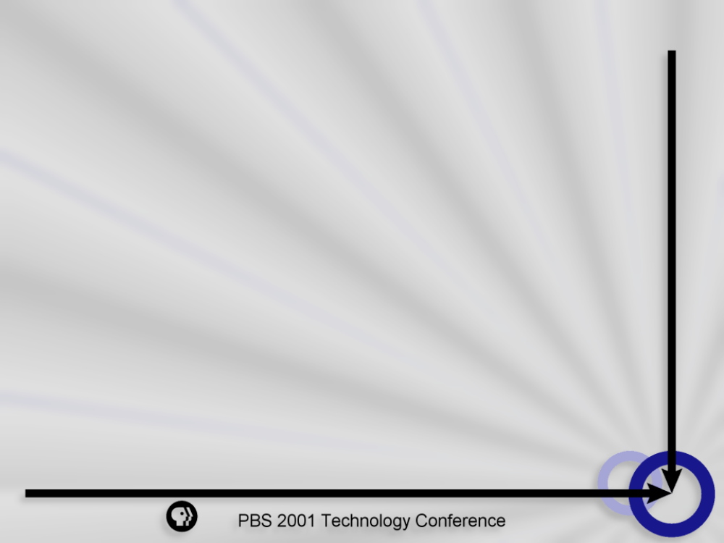
FirstClass Messaging
Lisa Robertson
Director of Technology Systems
Maine Public Broadcasting

Slide 2
FirstClass Gold Features
Calendaring
  Personal calendars, resource calendars, PALM conduit
Mirrored Post Office - hot backups
Rapid Application Development Tool (RAD) - unlimited users
Supports Unified Messaging
Cost to upgrade is low
  from 5.x - $377 (50 users)
  from 2.x & 3.x - $754 (50 users)

Slide 3
MPBC Highlights
Custom forms
MPBC Intranet
Live Chats/Conferences
RAD Tool
Unified Messaging
Calendaring
Security

Slide 4
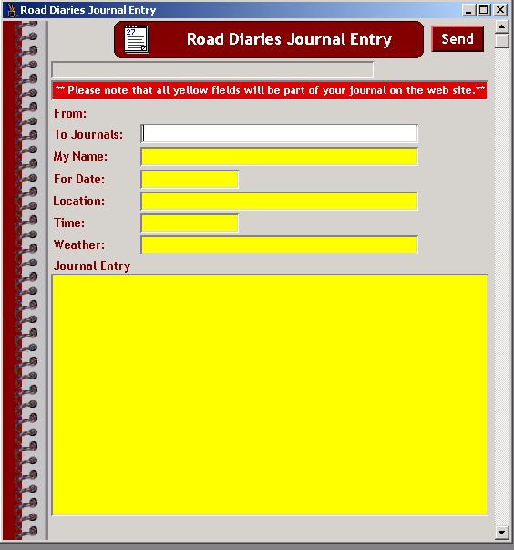
Custom Forms - FC Designer
Create forms with Designer
Add images, sounds to forms
Add to settings.fc file
Distribute via email updates
Use as stationery for conferences
Forms become user interface
for RAD applications

Slide 5
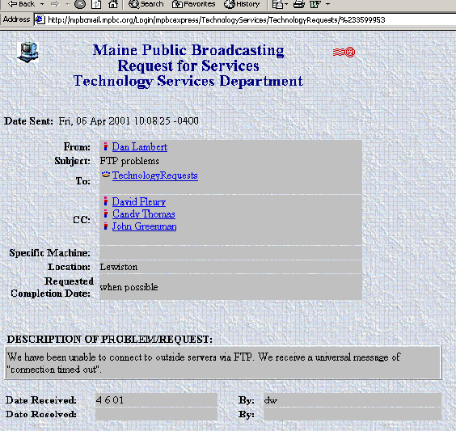
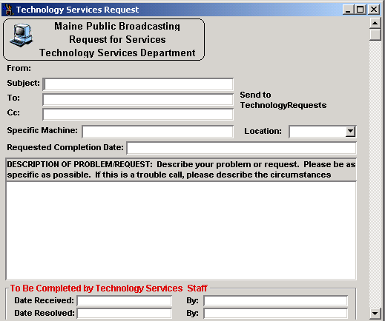
Form Examples
FC Client View
standard browser view

Slide 6
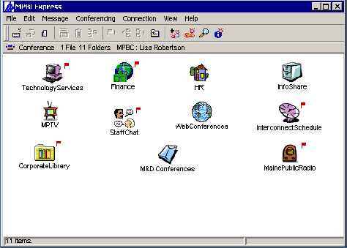
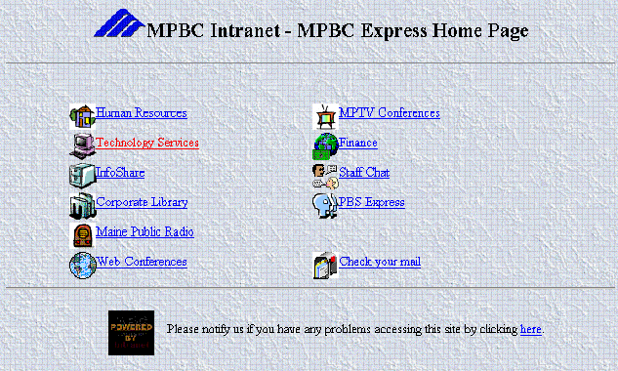
Create a Corporate Intranet
Use FC client
Use a browser

Slide 7
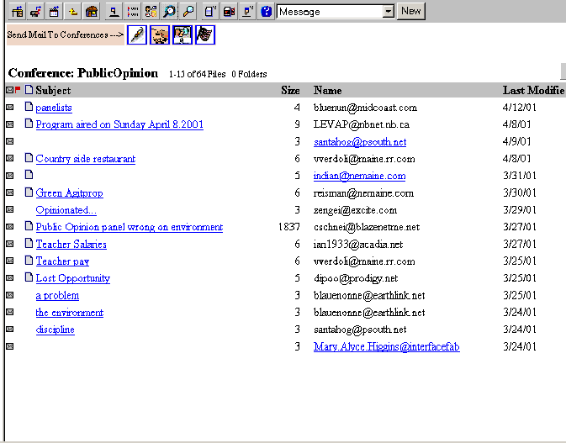
Live Chats & Conferences
Customize the toolbar to allow access to public conferences without an account
Live chats available via browser (Java) or FC Client
Transcript of chat available with summarize menu item
FC Client chat works well over slow links
Chat can be limited to certain users through FC group restrictions

Slide 8

RAD Tool
Uses standard ODBC connections
Packaged with FC Gold at no extra cost
Allows controlled access to sensitive databases
Provides a unified interface for user applications
Allows for easy customization of application interfaces
Increases flexibility of access for mobile users
Useful as a system integration tool between disparate applications
Can use groups and account attributes from the mail system to control levels of access
Runs effectively on lower end computer equipment
Easy to use, turn around time for applications minimal

Slide 9
Application Development Process
Create forms in FC Designer
Create database(s) or identify existing target database(s)
Set up ODBC connection on the mail server to the database(s)
Import forms and ODBC info into a RAD project
Program the forms and database manipulation
  Visual Basic-like language
Compile application code
Distribute forms with settings update or via automatic download

Slide 10
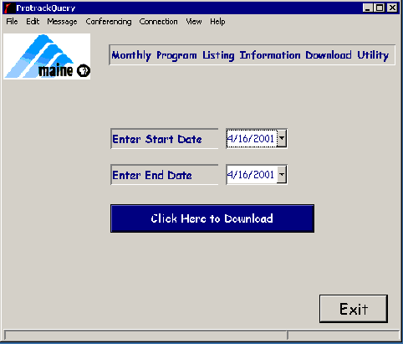
RAD Examples
Protrack Download
User selectable date ranges to extract program information from Protrack
Benefits
Reduces dependency on Technology staff to perform routine tasks
Increases flexibility for users
Facilitates appropriate access to database

Slide 11
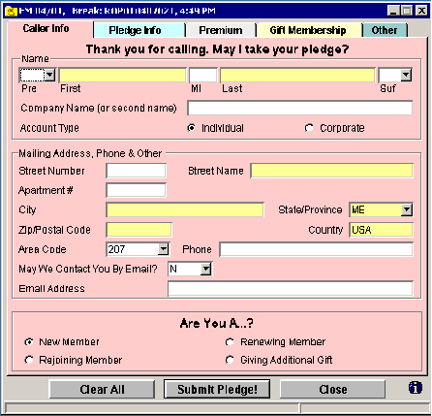
RAD Examples
Pledge Tally
Pledge input and reporting system
Benefits
Gather pledge data live
Use data during pledge
Import/export data for analysis and Team Approach processing
Eliminate duplicate entry
Process pledges faster
Use email acknowledgment
Easy to use for volunteers and staff

Slide 12
Unified Messaging
Integrates voice and email systems
Reasonable hardware costs
  Brooktrout card, PBX Link
  Separate server (NT)
Reasonable application costs
  10-99 users - $236/user, 100+ users - $187/user
  Negotiating better pricing for PBS stations
Access any messages, any time
Written by the developers of Meridian Mail

Slide 13
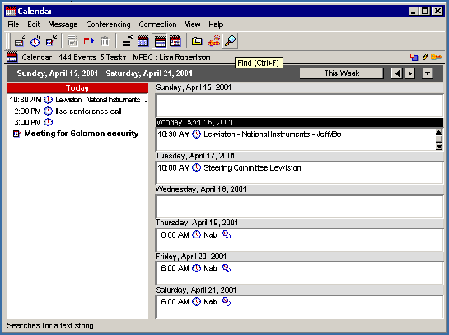
Calendaring & Palm Hot-Sync
Invite others to meetings via email
Auto send reminders via email at predetermined times
Hot-sync with Palm for calendar, memos and task lists
Resource calendars accessible to groups
Multiple views available - monthly, weekly, etc.
Increased calendar accessibility

Slide 14

Security
Innately secure system
  packet level encryption used
  client provides secure connection
  user id, name & password distinct
  not vulnerable to Outlook address book attacks
  Post Office files stored on locked volumes accessible only by authenticated users

Slide 15

Why FirstClass?
One interface, many uses
Moderately priced
Easy to Use, Easy to Administer
Secure system
Robust functionality
Works well over any link, with less powerful hardware
Maximizes accessibility of company resources for mobile users and telecommuters

