Slide 1
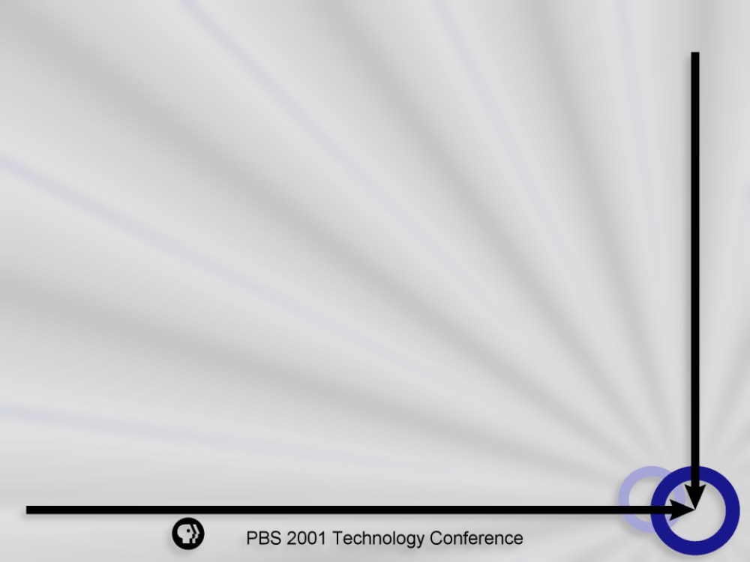
Microsoft Exchange
Ken Winston
Director, Network Technologies
Thirteen/WNET New York

Slide 2
Introduction
Three Choices…
  First Class or First Class Portal
  MS Exchange, Lotus Notes, etc.
  Combination of Both

Slide 3
MS Exchange
Exchange 5.5
Exchange 2000

Slide 4
MS Exchange
Basic Benefits
  Solid Messaging Foundation
  Common, Familiar Tools for Collaboration
  Connectivity and Co-Existence

Slide 5
MS Exchange
Solid Messaging Foundation
  Scalable
  Reliable
  Secure

Slide 6
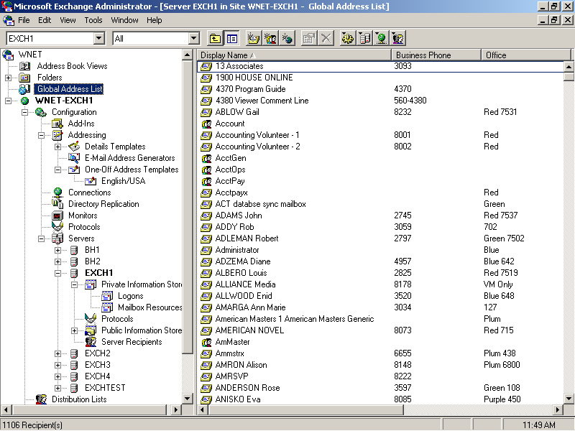
Exchange Administrator

Slide 7
MS Exchange
Common, Familiar Tools for Collaboration
  MS Outlook
    Private Folders
    Public Folders
    Personal Folders

Slide 8
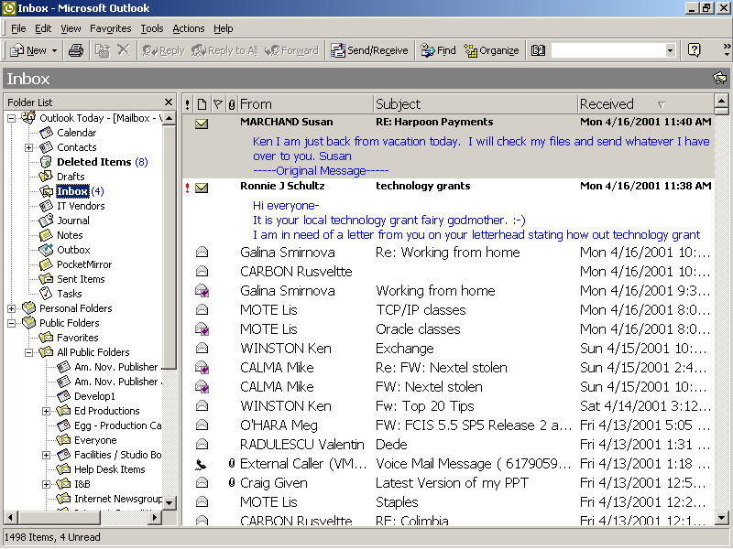
Outlook

Slide 9
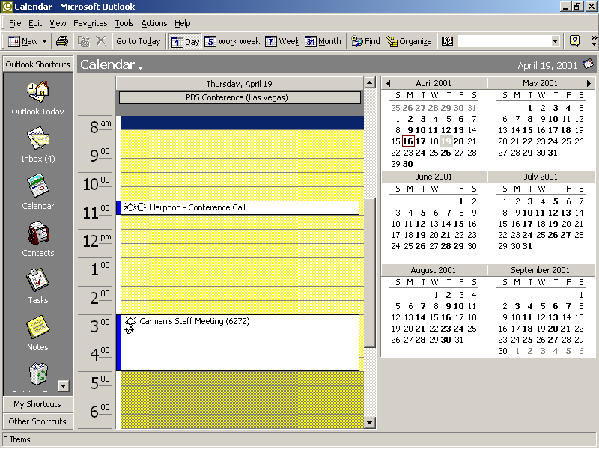
Outlook

Slide 10
Outlook
Email
  Inbox
  Sent Items
Calendar
Contacts
Notes
Tasks
Deleted Items

Slide 11
MS Exchange
Connectivity and Co-Existence
  Choice of protocols
    SMTP
    LDAP
    NNTP

Slide 12
Exchange at Thirteen
Exchange 5.5
1100 Mailboxes
Norton AntiVirus for Exchange

Slide 13
Exchange at Thirteen
Toys!
  Lucent/Octel Unified Messenger
  RIM/Blackberry Devices

Slide 14
Unified Messenger
Voicemail
Text to Speech
Faxing

Slide 15
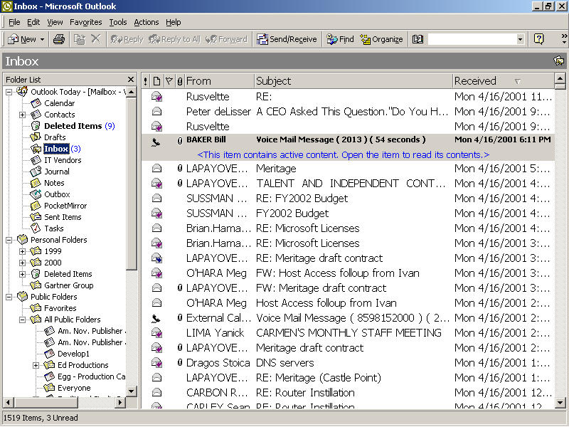
Unified Messenger

Slide 16
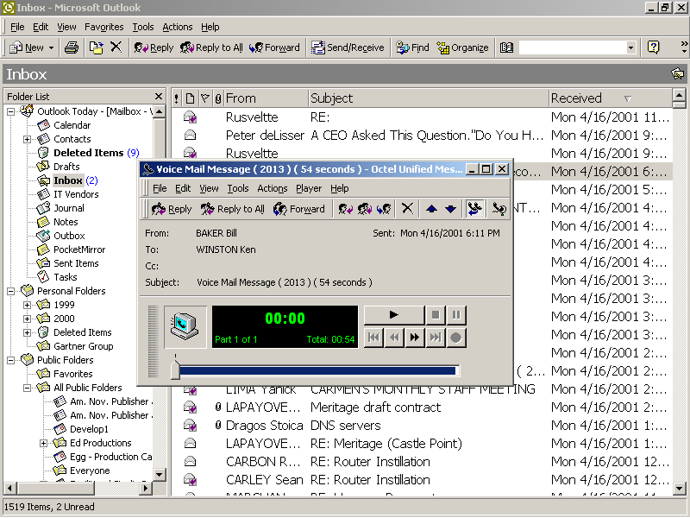
Unified Messenger

Slide 17
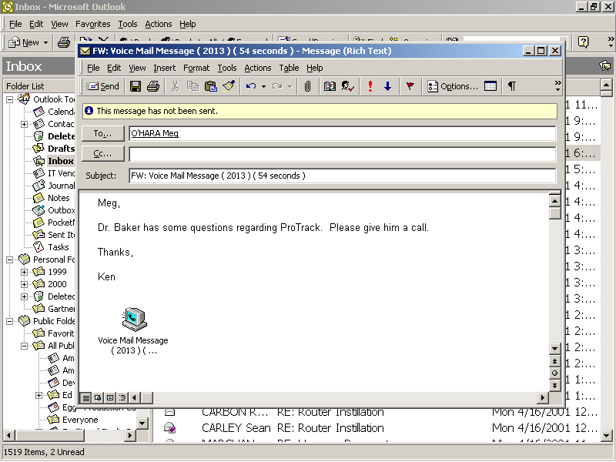
Unified Messenger

Slide 18
RIM/Blackberry Devices
Wireless Email
Wireless Calendar
Consequences!

Slide 19
PBS 2001
Technology Conference

