Slide 1
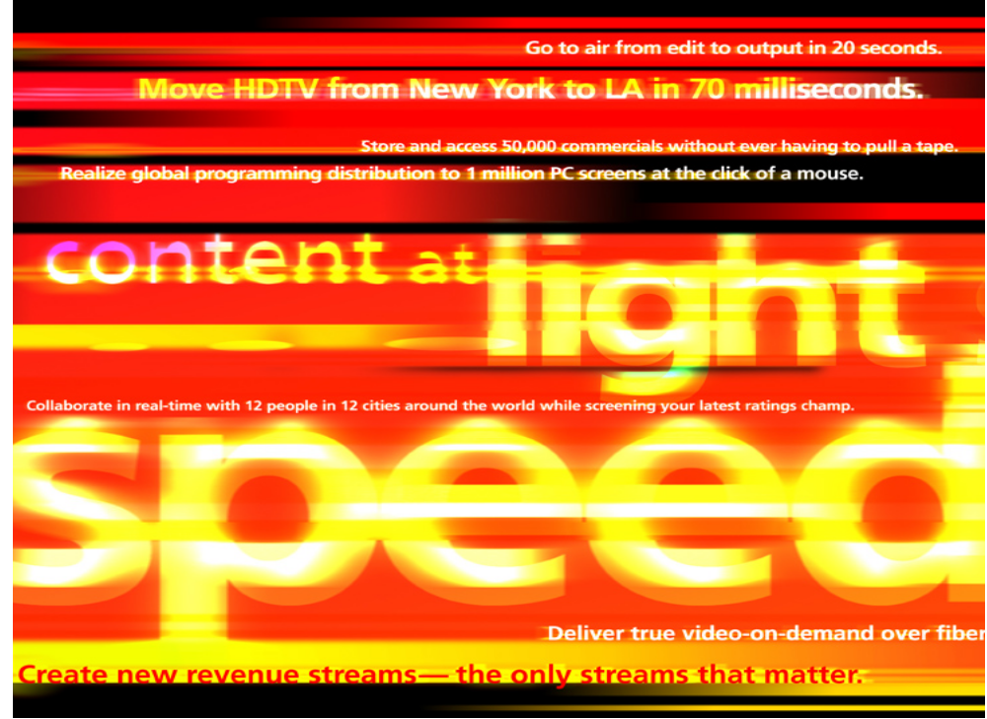

Slide 2
Video at Speed of Light:
The Optical Revolution Delivers True Convergence
Dr. Sid Ahuja
Multimedia Communications Research Vice President,
Bell Labs, Lucent Technologies

Slide 3
How should we network everyone in the world?
Today’s Networks (separate highways!)
  Voice network for interactive conversations
  Video broadcast network for entertainment
  Data network for information access
  Radio networks for audio entertainment
Tomorrow’s Network (One Information Highway)
  Always-On
  Every user wants multimedia traffic
  Every user wants ‘custom’ traffic
  Enough bandwidth for different types of content
  Specific bandwidth for different users
Virtual Networks
  Content provider/user groupings
  On-demand and media specific

Slide 4
User’s Bandwidth Needs:
HDTV program (19.2 Mbits/sec.)
Multiple(1 - 5) MPEG2 streams (4 –6 Mbits/sec. each)
Multiple(1 - 5) CD quality audio streams (1.5Mbits/sec each)
Multiple(1 - 5) voice connections (64Kbits/sec each)
Fast Internet service (10Mbits/sec.)
Total < 100Mbits/sec
Bandwidth for 10 Billion people – 1Million Terabit (10**18)
OPTICS : The Only Way To Go

Slide 5
The Ultimate Optical Switch
User 1
User 1B
10 Billion Node
Optical Switch
100 Mbit connections
User 10B
User 1M

Slide 6
Multi-Stage Network
Terabit Connections
Users
1 Million Node
Terabit Optical Switch
10,000 Node
Optical Switch
100 Mbit connections
Multistage Optical Networks can be built economically
Large bandwidth needed only in the backbones
Fibers can support Terabits

Slide 7
Virtual Fiber to User ( A Color of Light per User)
Virtual Fiber to User High-Speed LAN
  managed bandwidth unmanaged bandwidth
  guaranteed bandwidth no bandwidth guarantees
  multiple streams, each with guarantees no bandwidth guarantees
  no routing routers, hubs
  no intermediate buffering intermediate buffers
    low delay buffering delays
    lower expense buffer expenses
  no large storage (data pass-through)
  for large files (e.g., video)
  session controls no sessions
    supports billing
    supports events and associated services
  more reliable
  more accountability
  better maintenance

Slide 8



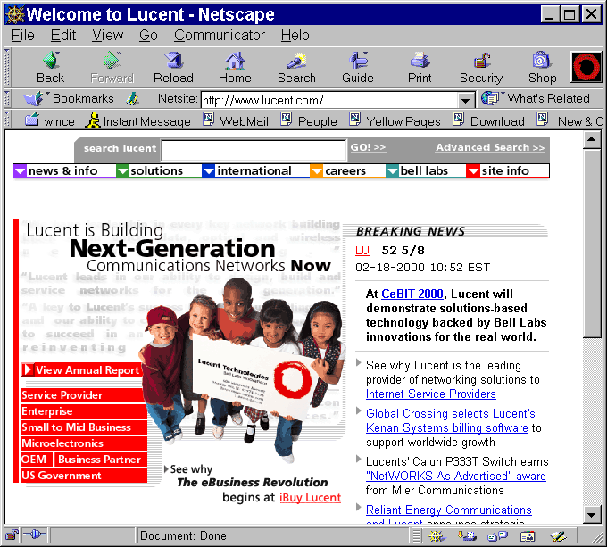




Virtual Fiber to User
User Control and Display
Distribution
Media Sources
Session Managers
Media Control Managers
Network Resource Managers
Media Servers
Data
Cache/Storage
……..
……..
……..
……..
……..
……..
……..
……..
……..
……..
……..
……..
……..
……..
……..
……..
……..
……..
……..
……..
……..
……..
……..
……..
Data
Warehouse
Switch/Router Complex
Notes:
Application/Service Environment
Provide users with “real-time” access to large amounts of data (in several media)
Provide each user with 100Mbps guaranteed bandwidth
Emphasis on Specific Types of Applications
Focus on visual information
Communities of interest: local sources of video, local content production, e.g., surveillance
Application Examples
Video on demand, both data streaming and fast movie downloads
Custom advertisements, e.g., ads for a neighborhood or for people with special interests
Shopping programs, e.g., on-line shopping with still images, videos and 3D models
Access to high-quality content, e.g., contribution quality material from Disney
Specialized video feeds, e.g., Swedish tennis matches
Community video programs, e.g., local high-school plays, dance recitals, choral performances
Always-on video feeds, e.g., community cameras, surveillance (buildings, apartments, etc.)
Meetings/conferences, e.g., sharing audio, video, data
Multimedia chat rooms, e.g., chat rooms with audio, still images, video
Multimedia bulletin boards, e.g., bulletin boards with audio, still images, video
Distributed game playing, e.g., players talking with each other while playing
Synthetic worlds, e.g., walkthroughs of video, 3D graphical models

Slide 9
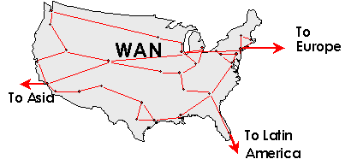
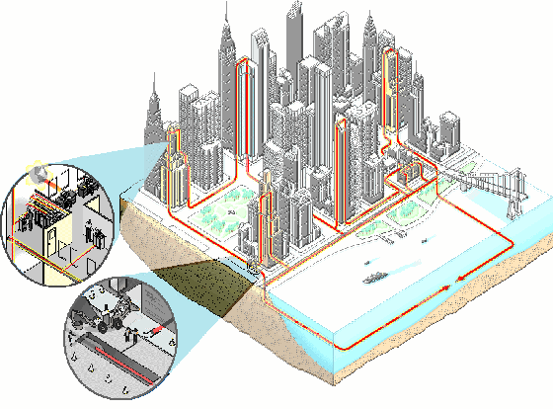
Optical Infrastructure
MFN and others MANs
Metro POPs
Router
Traffic Manager
Video Server

Slide 10
User’s Programming Needs
Select live content from 1000’s of channels
Video connect to ‘billion’ web sites
Voice calls to any one in the world
Join in any of ‘millions’ of video chat rooms
Watch events in small to ‘whole world’ groups
Receive targeted Ads and Discounts
On-line enrollment in services
Control Nightmare

Slide 11
Virtual Theaters to the Rescue!
Each service is a separate Virtual Theater
  Has a number of seats..end points
  Has particular lighting and sound .. MPEG1 Video/Audio, etc.
  Has its own distribution of media ..multicast, VOD, etc.
Virtual Theaters are network overlays on common optical fabric
Each ‘Program’ can be a separate instance of a virtual theater
  Targeted to its specific users
  Has its own interaction model
  Has its own advertisements
  Can be an interactive class
A user can in realtime buy a ticket and electronically join a theater
Content in a Virtual Theater can come from real-time sources or stored

Slide 12
What’s Needed to Implement Virtual Theaters
Network Protocols to allow Program creators to reach specific consumers with the required Quality of Service
Network hosting of ‘Virtual Theaters’
Network help in efficiently distributing content (multicasting)
Network help in collecting events and record keeping
User/network interaction model for on-line provisioning

Slide 13
Service Example--Chat Room
User Access and Display
Distribution
Media Sources
Directory Server
Chat Room Server
Network Resource Mgr.
Content Servers
Audio Bridge
……..
……..
……..
……..
……..
……..
……..
……..
Data Caches/Stores
Switch/Router Complex
Notes:
Application/Service Environment
Provide users with “real-time” access to large amounts of data (in several media)
Provide each user with 100Mbps guaranteed bandwidth
Emphasis on Specific Types of Applications
Focus on visual information
Communities of interest: local sources of video, local content production, e.g., surveillance
Application Examples
Video on demand, both data streaming and fast movie downloads
Custom advertisements, e.g., ads for a neighborhood or for people with special interests
Shopping programs, e.g., on-line shopping with still images, videos and 3D models
Access to high-quality content, e.g., contribution quality material from Disney
Specialized video feeds, e.g., Swedish tennis matches
Community video programs, e.g., local high-school plays, dance recitals, choral performances
Always-on video feeds, e.g., community cameras, surveillance (buildings, apartments, etc.)
Meetings/conferences, e.g., sharing audio, video, data
Multimedia chat rooms, e.g., chat rooms with audio, still images, video
Multimedia bulletin boards, e.g., bulletin boards with audio, still images, video
Distributed game playing, e.g., players talking with each other while playing
Synthetic worlds, e.g., walkthroughs of video, 3D graphical models

Slide 14
Contents Holders
(anybody/anywhere)
Euro
Asia
International Backbone
Africa
South America
Corporate Media
GVN NETWORK
GeoVideo
Media Hubs
TV Production
Medical/Pharmaceutical
Education K-12
Cable TV Networks
Film Dailies
Sports/Convention
Centers
Universities
Broadcast TV Networks
Internet
High Capacity Video Content Gateway

Slide 15
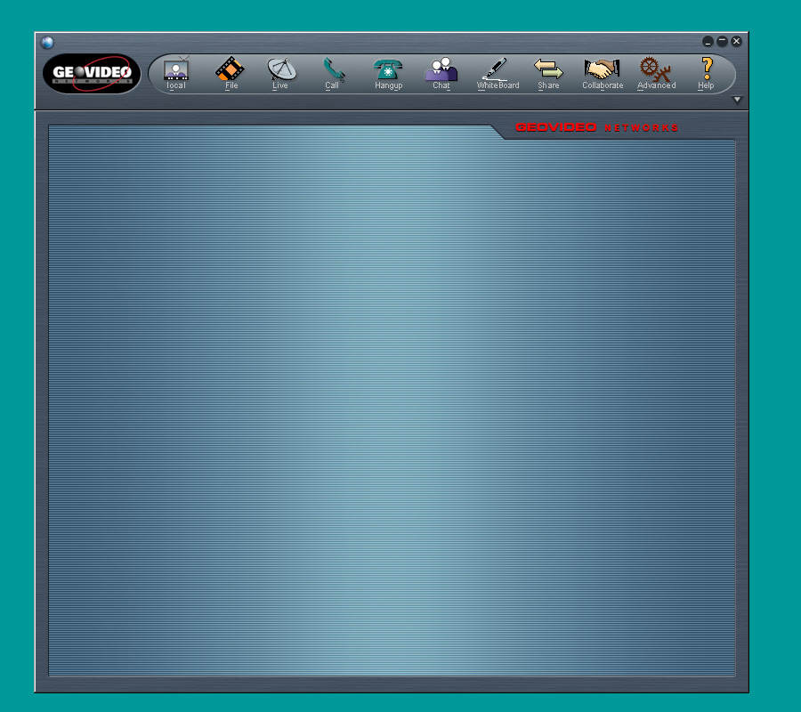
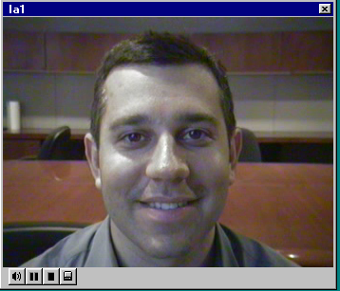
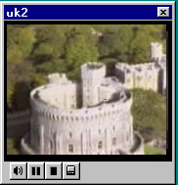
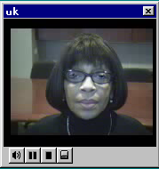
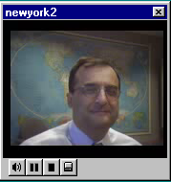
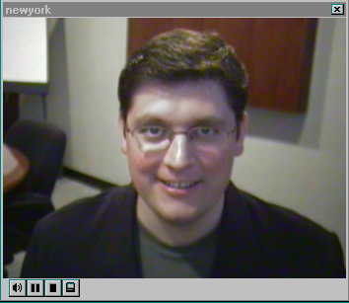
The GeoVideo Browser
IP video to the desktop PC
High quality video - 30 fps
16⁺ simultaneous windows
Integrated functionality
  Real Time
  Video On demand
  Conferencing/collaboration

Slide 16
What does this offer you?
Optics will allow users to be flooded with video just as they are with information on the net
Rich video distribution models will become available
Each program can be distributed differently and marketed separately
Rich interactive programming allows easier creation, distribution and subscription to new video services

