Slide 1

What TV Can Be
Ed Graczyk
Director of Marketing Microsoft TV

Slide 2

TV Can Be …
Interactive
Agenda
Defining Interactive TV
How the TV landscape is changing
Value propositions for Interactive TV
Revenue opportunities
Standards
Microsoft’s role and strategy
Notes:
Agenda slide

Slide 3
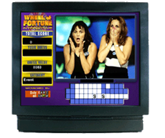
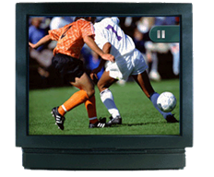
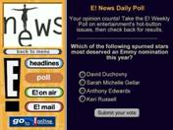
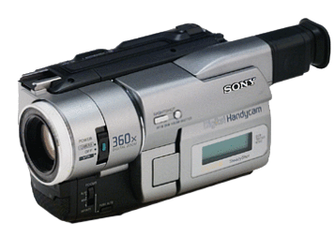

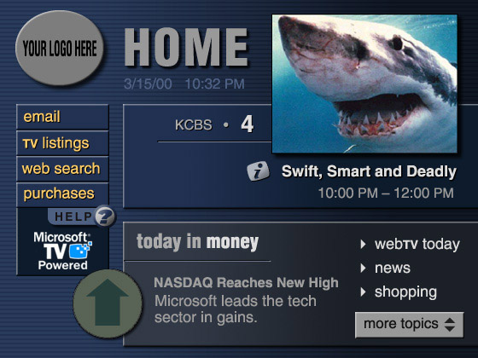
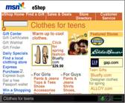
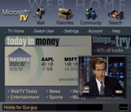


Enhanced TV
What is
Personal
TV
“Interactive TV”
?
Internet on
TV
Connected
TV

Slide 4

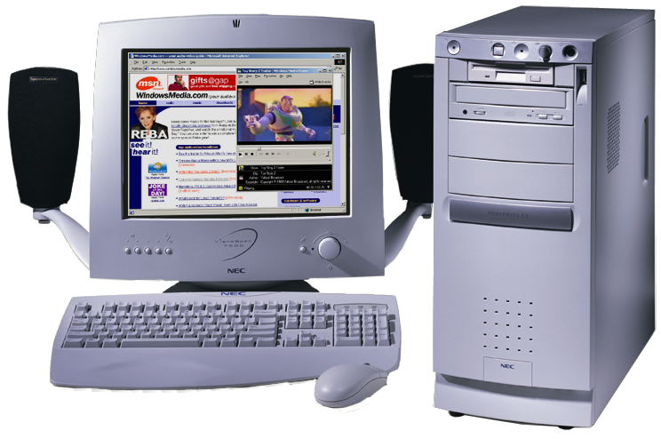



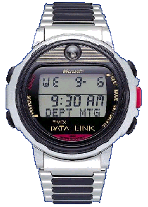
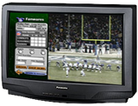


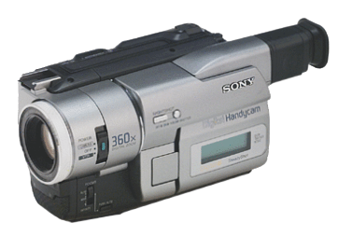

Defining Interactive TV
Convergence drives Interactive TV
Internet is the common denominator
Anytime, any place, on any device
Broadband access
Media
Information
Services
Multimedia information

Slide 5








The ITV Marketplace
Consumers
Services
Enabling
Technology

Slide 6

Changing TV Landscape
Setting the Interactive TV Stage
There are 1.5 billion TVs in use worldwide
  Single most powerful information & entertainment appliance ever invented
TV programming services are at the fulcrum
  Differentiate and create new revenue streams
  Transmission-path independent (cable, satellite, terrestrial)
Web technology + broadband connectivity + low cost silicon = Interactive TV opportunity

Slide 7
Changing TV Landscape
U.S. Audience
 | TV Generation Born ’40 – ’59 71 mill. | PC Generation Born ’60 – ’77 64 mill. | Net Generation Born ’78 – ’99 80 mill.
WEB | What is it? | It’s a tool | It’s life
COMMUNITY | Personal | Extended Personal | Virtual
PERSPECTIVE | Local | Multi-National | Global
CAREER | One Career | Multiple careers | Multiple reinventions
LOYALTY | Corporation | Self | Soul
Source: internal Microsoft research
The Net generation comprises ~ 30% of today’s TV audience … and number will grow steadily over the next five years

Slide 8

Changing TV Landscape
The Audience is Interacting
The Net Generation’s Web lifestyle
  Passive experiences (watch and listen) are supplemented with “actionable” ones (communicate, play, shop)
  Surf, communicate and shop … endlessly
TV households want interactive TV
  Almost 80 percent of digital-cable
  subscribers and 55 percent of
  analog-cable customers say they
  would like to iTV
  Source: CTAM study (12/00)

Slide 9

Changing TV Landscape
The Audience is Fragmenting
Adults during an average week
  TV viewing = 14 hours
  Online usage = 11 hours
TV viewing is trending up for older age groups, down for younger ones
Online usage affects TV viewing of the largest age group during the most valuable day part
  Adults 25-54 tend to go online during primetime (8-10pm)
  Source: Nielsen Media Research

Slide 10
Value Propositions
Why Enhance TV?
As TV usage grows more interactive, enhanced programming and advertising become more …
  Relevant - programmers can deepen viewer interest and loyalty
  Effective - advertisers can target audience interests and responses with more granularity
  Monetizable – TV service providers can deliver more services … and charge more for them, on both premium and basic tiers
  Sticky – viewer participation and interaction drives frequency and duration

Slide 11
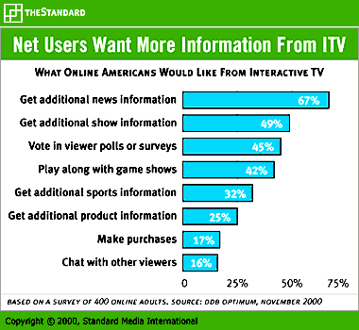
Value Propositions
Consumers Want ITV

Slide 12

Value Propositions
Programmers Get More “i”s
Technology will not replace talent
  TV will always be a “hit driven” business
  Brand loyalty will remain an asset
“Viewers” get closer to the experience
  Join: help the Stargate crew on its mission
  Play: be a game show contestant at home and win a prize
  Share: Discuss Friends with friends while watching, rather than at the water cooler tomorrow

Slide 13

Value Propositions
Lessons from WebTV
Interactive programming builds viewer loyalty
  Play-along game shows draw a steady crowd
  Fans want more sports information – stats, scores, player profiles
  Viewers use up-to-the-minute news, weather and sports regularly
  E!’s audience gets more from favorite shows & stars
The more the audience is engaged …
  The longer it stays
  The more it keeps coming back

Slide 14
Value Propositions
Not Just About Interactive
Web content finds audience in TV households
  Deeper information sources
  More up-to-date news & weather
  Voting & Polling
  Chat/Email/Buddy Lists
Viewers want more convenience and control
  Instant replay - record and playback live programming
  Video and music on demand

Slide 15

Value Propositions
Advertisers Improve Metrics & Focus
Replace frequency & reach with qualified leads and real time interaction
Integrate messaging with programming
  Embedding the plug or call to action within the content lets advertisers evolve into co-marketers
Target the audience with more granularity
  Audiences can “self-select” the information they want - about which products and at what times
  Advertisers will pay more to reach “qualified leads”

Slide 16

Revenue Opportunities
How the $$ Will Flow (By 2004)
TV service providers
  $6.6 billion in incremental subscription revenue
  $2.6 billion from walled garden services
  $1.8 billion from interactive programming guides
T-commerce
  $7.8 billion from interactive video
  $9.4 billion from walled garden services
  $300 million from interactive programming guide
  Source: Forrester Research 7/2000

Slide 17

Revenue Opportunities
Lessons from Europe
Comparison to U.S. market potential
  Lower online usage
  Higher digital cable penetration
  Longer experience with interactive services (e.g., Teletext in UK, Minitel in France)
Key Learnings
  50% of digital TV subscribers use interactive services at least once a week
  UK Woolworths sells more via TV than in some stores
  2/3 of Credit Agricole customers bank on TV
      Sources: ING Barings 9/2000; Forrester 2/2000

Slide 18










Standards
Open Standards Benefit Everyone
Microsoft Supports Open Standards
  Interactive TV content creation formats:
    AAF, XML+ECMAScript
  Interactive TV content emission formats:
    SMPTE DDE-1, ATVEF
  Interactive TV environments:
    DASE, MHP, BML, OCAP
  Digital TV Transmission:
    ATSC, DVB (-T, -C, -S), ARIB,
    OpenCable

Slide 19
What to Expect from Microsoft
Two TV Businesses
UltimateTV:
Be the industry’s showcase implementation of Interactive TV, showing what TV can be and providing an invaluable base of experience and understanding of consumer behavior
Microsoft TV:
Provide the best, open software platform for the TV industry worldwide to deliver new Interactive TV services to consumers, enabling new revenue streams and facilitating broad industry innovation

Slide 20
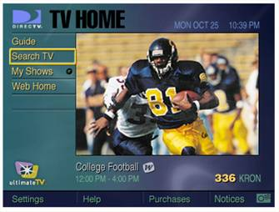

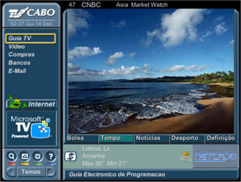
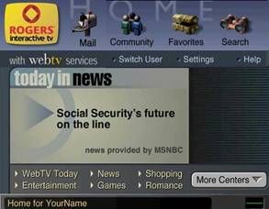
What to Expect from Microsoft
Microsoft TV Commitments
Open platform for innovation
Open content authoring
standards
Build on customer success
  Now deployed
    Rogers (Canada, cable)
    TV Cabo (Portugal, cable & satellite)
    Thomson TAK integrated TVs with interactive services (Europe, cable/telco)
    UltimateTV DirecTV service (US, satellite)
  Coming soon
    AT&T (US, cable)
    UPC (Europe, cable)

Slide 21

What to Expect from Microsoft
The Best Interactive TV Services
Available now for DIRECTV subscribers
Entertaining, personalized and powerful
  Digital video recording for live TV
  Dual tuner lets you watch one channel while recording another
  Email, chat and community web services
  Full support for interactive programming (ATVEF Transport A)

Slide 22


