Slide 1

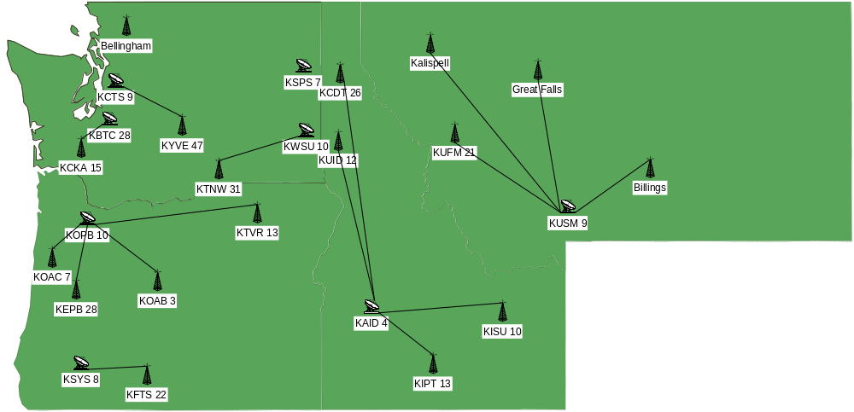
Advanced Digital Distribution Entity (ADDE)
Northwest Participating Station Physical Map
Notes:
Northwest Participating Station Physical Locations. Dish symbols indicate transmitter and studio locations. Tower symbols indicate transmitter only locations.

Slide 2
Northwest ADDE Participating Station Logical Map
Phase I - Distributed Model
KBTC 28
KCTS 9
KCKA 15
Bellingham
KYVE 47
KSPS 7
KWSU 10
Kalispell
Great Falls
KTNW 31
KUFM 21
KSPS
KAID 4
KUSM 9
Billings
KOPB 10
KSYS 8
KCDT 26
KUID 12
KISU 10
KIPT 13
KFTS 22
KOAC 7
KTVR 13
KOAB 3
KEPB 28
Notes:
Phase I – Distributed Model. Develops relationships within small geographic regions to share master control facilities and operations. Tie hubs together for distributed content storage. Timeframe for implementation – starting now.

Slide 3
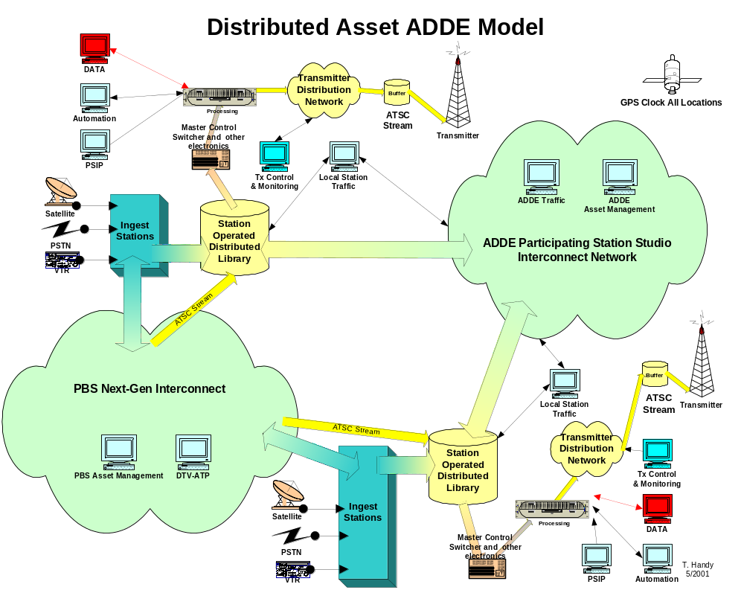

Slide 4
Northwest ADDE Participating Station Logical Map
Phase II - Store and Forward Model
KBTC 28
Other ADDE
KCTS 9
KCKA 15
Bellingham
KYVE 47
KSPS 7
KWSU 10
Kalispell
NW ADDE
Great Falls
KTNW 31
KUFM 21
KSPS
KAID 4
KUSM 9
Billings
KOPB 10
KSYS 8
KCDT 26
KUID 12
KISU 10
KIPT 13
KFTS 22
KOAC 7
KTVR 13
KOAB 3
KEPB 28
Other ADDE
Notes:
Phase II – Store and Forward Model. Adds a central storage facility to distributed model for content warehousing and distribution.

Slide 5
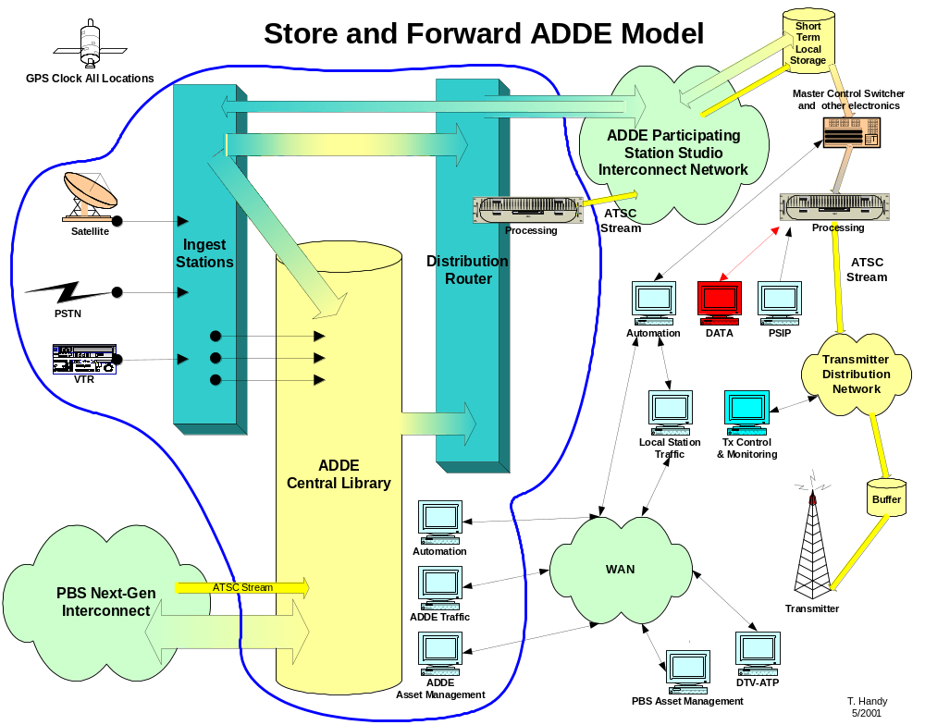

Slide 6
Northwest ADDE Participating Station Logical Map
Phase III – Centralized Model
KBTC 28
Other ADDES
KCTS 9
KCKA 15
Bellingham
KYVE 47
KSPS 7
KSPS 7
Kalispell
KWSU 10
NW ADDE
Great Falls
KTNW 31
KUFM 21
KAID 4
KUSM 9
Billings
KOPB 10
KSYS 8
KCDT 26
KUID 12
KISU 10
KIPT 13
KFTS 22
KOAC 7
KTVR 13
KOAB 3
KEPB 28
PBS
Notes:
Phase III – Centralized operations. Adds master control facilities to central store and forward facility. Allows stations to have fully dark or nonexistent master controls at the studio facility. Will provide direct connectivity to transmitters where appropriate and desired.

Slide 7
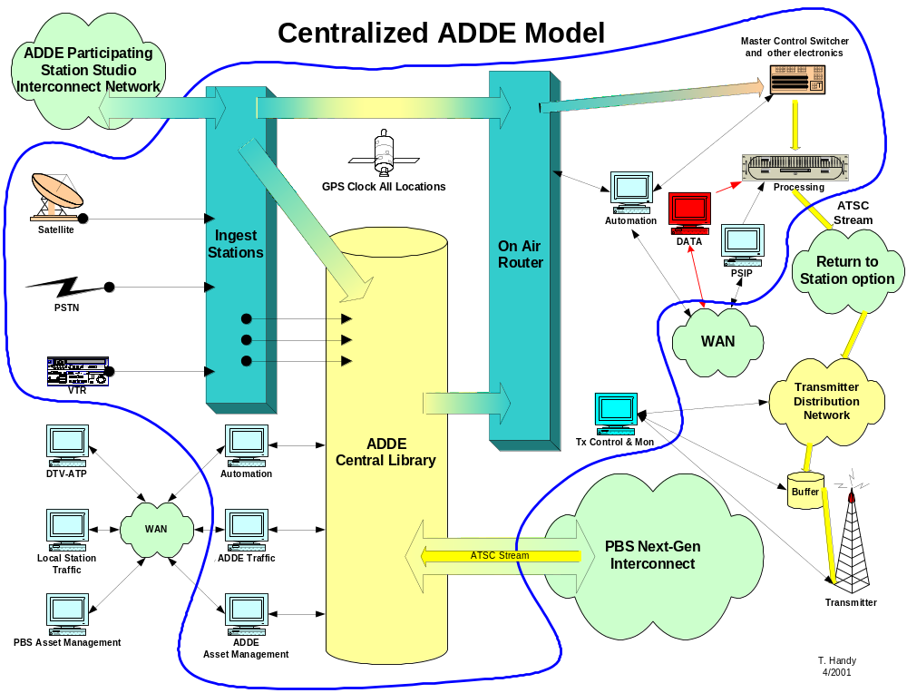
Notes:
Block diagram depicting major functions of the Centralized ADDE facility.

Slide 8
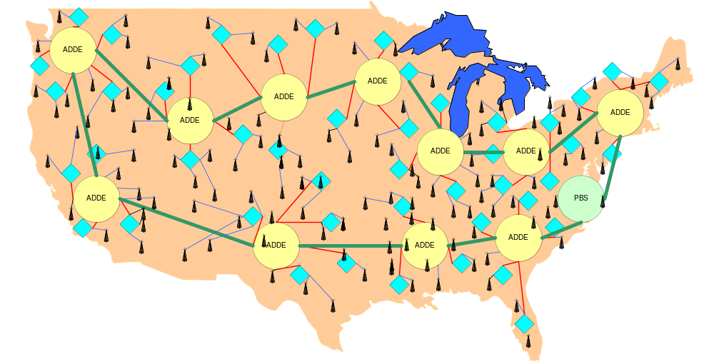
Northwest ADDE Participating Station Logical Map
National Rollout
NOTE: The symbols on this map are for representation of the concept and do not represent the locations or numbers of actual facilities.
Notes:
National Rollout of ADDE models. Can be rolled out on differing timetables without impacting the overall system.

Slide 9
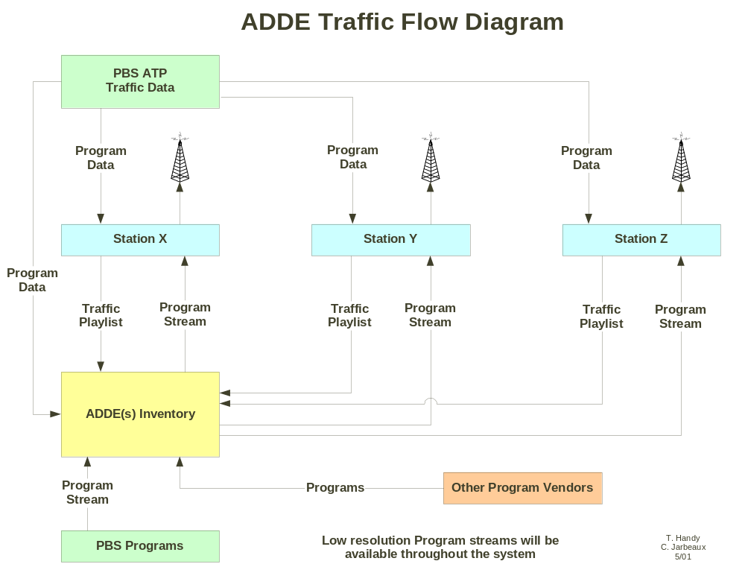
Notes:
Traffic flow for Store and Forward facility

Slide 10
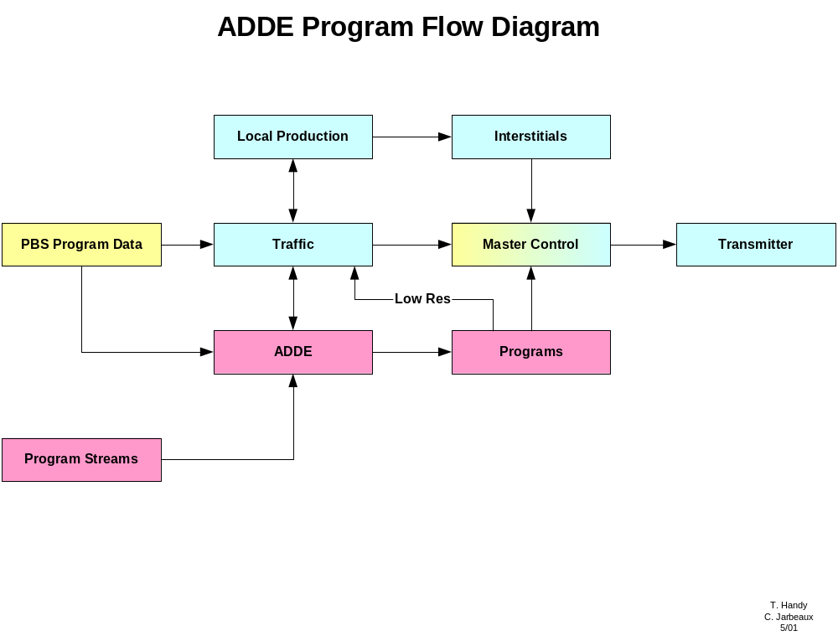
Notes:
Program flow for Store and Forward Facility.

