Slide 1

PBS Technology Conference DTV-ATP Progress Report
April 2001
Digital Television - Advanced Traffic
& Programming Project (DTV – ATP)

Slide 2
This session has the following three key objectives:
Objectives
Session Objectives
Provide an update on where we are in both the DTV-ATP project lifecycle and the Validation phase timeline
Deliver information on the progress made to date
Reiterate the problem statement and show how this initiative intends to address the issues around program trafficking and scheduling for Member Stations

Slide 3
Agenda
DTV-ATP Project Overview
Solution Scope
Implementation Approach
Wrap Up

Slide 4
To develop a solution to address the key issues and requirements raised by PBS and the Member Stations associated with the Programming, Scheduling, Promotion/Underwriting, and Broadcast Operations Automation functions
Project Overview -
DTV-ATP Imperative
Current Environment
Future Environment
Separate, non-integrated databases
Manual Scheduling using spreadsheets
No integration with member station solutions
Numerous contacts to producers for similar information
Unified database available to member stations
Automated support for schedule development
Integration between DTV-ATP solution and member stations’ trafficking and programming solutions
Direct Access to programming database by producers
Notes:
Current Environment
1. Separate, non integrated databases for various types of related information (PDB, NOLA, LICO, etc.); re-keying of information between databases
2. Manual scheduling using spreadsheets
3. No integration with member solutions means time spent re-keying information from PODS and PBS Express into station solutions
4. Numerous contacts to producers: difficulty in finding accurate and timely information on programs, producers are hassled by different people for same information
Future Environment
1. Unified database means no re-keying
2. Schedule information cascades from seasonal planning to detailed daily logs automatically
3.DTV-ATP pushes information directly to stations; provides searchable access to PBS main programming database directly by stations. Stations can also search using portals directly in PBS main database for up-to-the-second information
4. Producers have direct access to their own program information. Once into database, available for use by all PBS departments.

Slide 5
The project consists of four phases spread over two years: Validation, Design, Implementation and Deployment
Project Overview –
Phased Approach
Phase I - Validation
  Validate solution requirements
  Identify process change opportunities
  Select a qualified Software Vendor
  Update the high-level business case
  Develop go-forward Project Plan
Phase III - Implementation
  Production-Ready Development, Execution, and Operations Architectures
  Participants and Instructor Training Guides
  System Test Model
  Application Built and Tested
Phase II - Design
  Business Model Requirements
  Refinement of Business Case
  Create System / Application Architecture
  Create Prototype
  Create Change Plan
  Create Deployment Plan
Phase IV - Deployment
  Application Deployed within PBS and all User Groups
  Train Users
  Begin Measurement of Success Metrics
  Confirmation of Business Capability

Slide 6
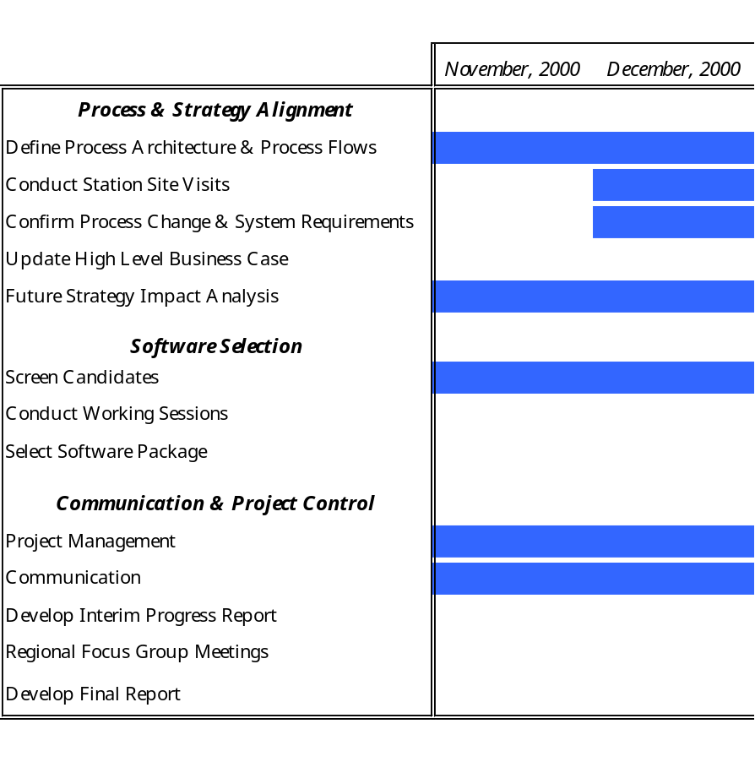
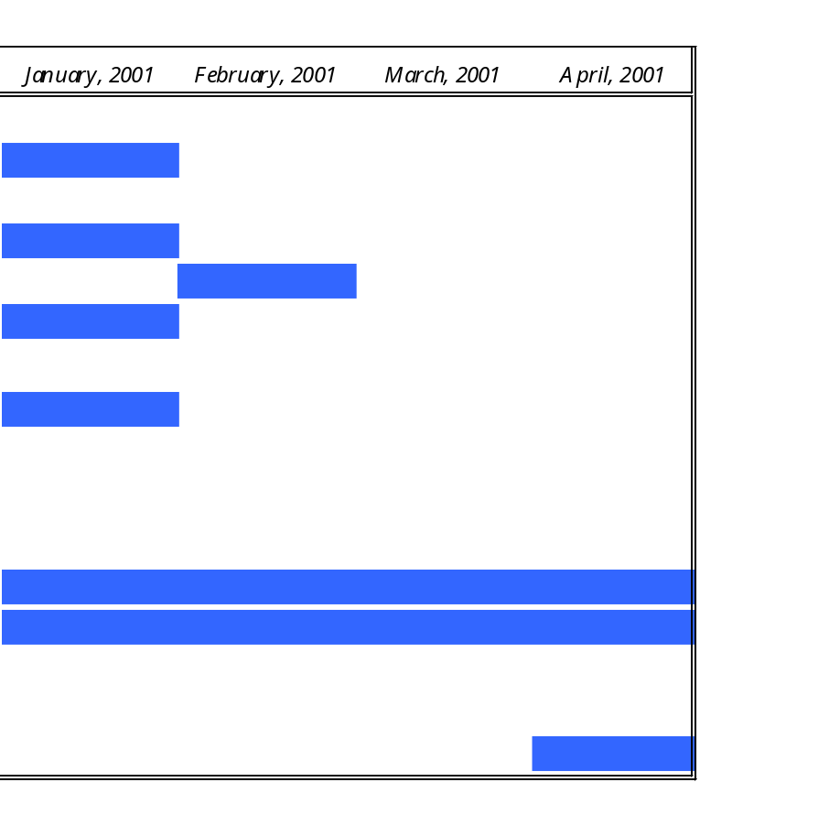
Key activities for Phase I – Validation
- over the six month period from November 2000 until April 2001.
Project Overview -
High Level Timeline
Today
Member Stations in Phase I include:
December 4th, PPTN Hershey, PA
December 7th, WHRO Norfolk, VA
December 14th, KOPB, Portland, OR
December 18th, IPTV, Des Moines, IA
January 4th, WGBH, Boston, MA
January 5th, APT, Boston, MA
January 8th, Sponsorship Group, New York, NY
3 Regional Focus Groups:
March 26th, KCET, Los Angeles
March 29th, WTTW, Chicago
April 5th, WETA, Washington D.C.

Slide 7
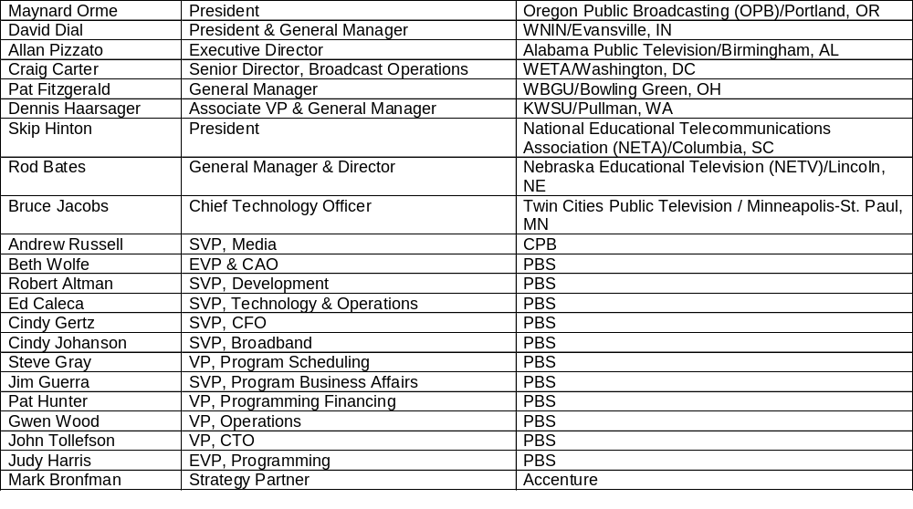
The pervasive nature and funding requirements of this project emphasized the critical need for Member Station guidance
Project Overview -
Executive Steering Committee
Executive Steering Committee
Name
Title
Organization
Notes:
Roles & responsibilities
Review and supervise the project.
Provide input from the station and the national organization level, especially in the area of requirements with regard to education, state networks, program production, service to stations, interactive initiatives and broadband.
Assist in matching PBS and station resources to meet project needs.
Address issues across “silos.”
Align this project’s scope and requirements to key Public Television strategic initiatives and efforts.
Approve final scope of the project in terms of schedule and budget.
Advocate PTV funding and support for the project.
Serve as ambassadors, generating enthusiasm and helping to ensure all sectors of Public Television feel confident this unfolding initiative serves their interests, reflects their needs and achieves their goals.

Slide 8
The Core Team consists of representatives from key PBS business areas and subject matter experts from Accenture
Project Overview -
Core Team
Accenture Core Team
Name
Title
Mark Bronfman
Project Partner
Geraldine Evans
Project Manager
Mark Daniel
Process Manager
Cynthia Ho
Process Consultant
Matthew Boggie
Technology Consultant
PBS Core Team
Name
Title
Organization
Michael Hunt
Project Lead
Information Technology
Steve Scheel
Senior Director
Technical Services
Andy Butler
Senior Director
Engineering
Christine Beinhacker
Senior Manager
DTV Strategic Services
Glenn Clatworthy
Director
Program Data & Analysis
Lauren Kalos
Director
Programming Services
Marilyn Gonzalez
Associate Director
Broadcast Operations
Jim Kutzner
Consultant to PBS
ATTC
*Various PBS and Station Subject Matter Experts were consulted on an as needed basis.
Notes:
Roles & responsibilities
Process and Strategy Alignment.
Software Selection.
Communication and Project Control.
Setting standards for information exchange formats.
Developing the final recommendations on the scope of this project for submission to the Executive Steering Committee.

Slide 9
Agenda
DTV-ATP Project Overview
Solution Scope
Implementation Approach
Wrap Up

Slide 10
Conducted extensive set of interviews with PBS, Member Stations and Non-PBS Distributors
Solution Scope -
Approach
Site Visits
5 Member Stations:
PPTN, WHRO, KOPB, IPTV,
WGBH
1 Non-PBS Distributor: APT
Determine
Solution Scope
16 PBS Departments:
Programming Services, Distribution Services, Syndicated Services, ALS, FRP (formerly SIP), Program Business Affairs (PBA), Broadcast Operations, Program Information, Research, Technical Services, Media Library, PBS Interactive, Program Finance, Brand Management & Promotions, Program Data & Analysis, Program Underwriting Policy (PUP)
Key Findings
& Observations
DTV-ATP
Solution
Requirements
Original DTV-ATP Scope Definition
PBS Operational Processes
Best
Practices
Gather Industry
Best Practices
Conduct
Focus Groups
PBS Sponsorship Group
21 Member Stations
3 Non-PBS Distributors
Notes:
To determine the scope of the project, a thorough and extensive set of interviews were conducted with PBS, Member Stations and Non-PBS Distributors. A version of solution requirements and related issues from a previous review was used as the starting point and enhanced with the results of the interviews, and findings from a review of industry best practices, to develop a robust set of requirements that define the scope of the DTV-ATP solution.

Slide 11
Several fundamental challenges were confirmed during the Validation Phase
Solution Scope -
Key Findings
Non-timely delivery of inaccurate, poor quality data
Need for multi-channel support
Producers are frustrated by the process
Underwriting is becoming more complex
Requires manual tracking of ancillary revenue, music rights, and producer payments
Rights usage not audited
Current systems are not extendable
Lack of standard workflow
Notes:
Need for multi-channel support
Antennas, towers, transmitters, tape machines, and video servers are all very important in making the transition to digital broadcasting, but how do we handle the increased volume and enhanced program information that will need to be tracked in this multi-channel environment?
Current systems are not extendable
Near-term and long-term PTV requirements for future Interconnection, Advanced Digital Distribution Entity (ADDE), Digital Asset Management (DAM), and Interactive/Enhanced TV will necessitate changes in the way schedules are created and maintained at PBS; PBS cannot support these future initiatives without a major overhaul of existing systems and processes
Producers are frustrated by the process
Producer’s complaints about unnecessarily frustrating, time-consuming, and cumbersome processes associated with getting a program on the air.
Lack of standard workflow
Data flow is dependent on informal means of communication with its inherent high risk of lost data and delays in distributing key information about programs to member stations.
Underwriting is becoming more complex
When the structure of the Program Database (PDB) was defined in the early 1980's, underwriters were solicited and credited for a program's entire broadcast rights period. That original design cannot handle the details of an increasingly sophisticated funding landscape Requires manual tracking of producer payments.
The lack of robust automated tracking systems, results in manually tracking producer payments, and introduces the possibility for human error
Rights usage not audited
The current process of collecting contract information leaves no opportunity for effective audits of program rights usage.
Current systems have no fail-safe measures to prevent broadcast of a program outside negotiated rights window
Non-timely delivery of inaccurate, poor quality data
Existing system inefficiencies proliferate inaccurate and late information downstream. This results in never-ending workarounds, with a propensity for even further corruption as bad data is manually re-keyed at the member stations.
Requires manual tracking of ancillary revenue
No automated way of tracking the collection of ancillary revenue, as negotiated with producer.
Tracking of Music rights
Lack of ability to electronically track cue sheets associated with music rights. Lacking the necessary program information needed to associated the broadcast schedule with music usage.

Slide 12
Recurring themes, hunter / gatherers navigating through the “black hole”
Solution Scope -
Recurring Themes
Duplication of Effort
No Ad-hoc Reporting
Data is inaccurate and not timely
Producers are frustrated with the process
Notes:
Duplication of Effort
Within PBS, the current system / processes for entering program, schedule, funding / underwriting,and media information requires duplicative entry of the same information into different, non-integrated systems. This duplication of effort is time consuming, prone to error and prevents the necessary data being provided to downstream recipients in a timely manner.
No Ad-hoc Reporting
Once the data has been manually entered into the various information repositories, to obtain a consolidated view of this information for ad-hoc querying, e.g. ROI, requires significant manual effort which is started anew for each new request.
Data is inaccurate and not timely
The data provided to Member Stations and Non-PBS Distributors is often inaccurate and arrives at the last minute, in an inflexible data format which requires manual re-entry of all the provided information. This produces a ripple effect of inefficiency in their processes as costly workarounds are employed.
Producers are frustrated with the process
Producers have no single point of contact within PBS and as such are required to complete paper-based forms requesting the same information many times for different departments within PBS. A single view of all the information would greatly simplify the data capture associated with the “Red Book” process.

Slide 13
Solution Scope -
The current system is broken
Member Stations,
Non-PBS Distributors,
Program Producers







Program Descriptions,
Funding Information,
PAAs, Rights Information
Schedules
& Feeds
Program
Offers
Extant Rights
Nielsen
Ratings
Invoices
& Payments
TV Data
To Stations
Program Offer Generator
From Distribs.
Program Development
Pipeline
(MS Access,
MS Excel, PC)
PDB
(Ingres, HP/UX)
PBS
Express
(Program
Information)
Extant Rights Generator
ERP System
(Oracle
Financials)
(Payment Requests)
(Payment, Invoice Requests)
(Program Information)
NOLA
(Ingres, HP/UX)
PBS
Inline
PBS
PBA Contracts
Database
(Omnis, Ingres DB)
Louth
Automation
LICO
(Media Library Mgmt.)

Legend
PODS (Program Offer
Distribution Service)
FTP Site
Invoice Request

Manual Interface
(e.g. re-keying)
Inline Program Description Generator
(4D, PC)
Graphics
Automated Interface
(NOLA Codes, Program Titles)
Overnight Application
(Visual Basic, Win95)

Document

Broadcast
(NOLA Codes, Program Titles)
Common Carriage
App (ASP)
Program Development / Program Business Affairs
Program Scheduling
Broadcast Ops / Media Library
Tech Ops Center / Info Tech
Research / Billing
Notes:
The current solution is a combination of many function-specific applications. These applications often communicate only by manual processes and do not share information well. The result of this fragmentation and manual processing leads to poor quality data which is hard to access and is not available in a timely manner.

Slide 14
Solution Scope -
DTV-ATP Target Solution
Provide an integrated database
Seamless content flow
Cater to a complex underwriting world
Flexible access to information by Stations
Common standards for data interchange
Improve data quality
Ubiquitous access
Notes:
The Target Solution has the following goals and objectives to ensure that the DTV-ATP project delivers the expected value.
Provide an integrated database
There will be one source for retrieval of all program/series information.
Seamless content flow
The next generation traffic and programming system will enable content and metadata to flow in a seamless manner through PTV even as content requirements become increasingly complex.
Cater to a complex underwriting world
Integrated design must be capable of accommodating an increasingly sophisticated structure for tracking underwriting.
Flexible access to information by Stations
Stations must be provided with the ability to access, extract, and locally manipulate all program-related data.
Common standards for data interchange
A set of common data standards will be defined for use among PBS, distributors, producers, and stations.
Improve data quality
Use this opportunity to define improved quality control methods and metrics for the information PBS distributes.
Provide a source of information to the member stations that offers more timely, more accurate data in a more useable format.
Ubiquitous access
Use of web technology to provide easy access to centrally held information

Slide 15

Solution Scope -
DTV-ATP Target Solution
Member Stations,
Non-PBS Distributors,
Program Producers
Member Station Other Systems
Viewers / Web Users

Member Station
Trafficking
Systems



Producer
Portal
Distributor
Portal
Member Station
Portal
Schedules
& Feeds
Invoices &
Payments
Nielsen
Ratings
TV Data
Authentication (Active Directory)
Legend
Manual Interface(e.g.
re-keying)
ERP System
(Oracle
Financials)
Automated Interface
Schedule and Program Information: Myers Format
PBS
Schedules, Program Offers
Automated Interface (In the scope of DTV/ATP)
Schedule and Program Information: Scout Format
PBS
Connect
Schedule and Program Information: Generic XML
Schedule and Program Information: Generic XML
Schedules, Program Offers, Re-feed Requests
Program Information
Payment Request
System Added
/ Modified by Other Initiatives
Louth Automation
In the scope of the DTV/ATP Project
Playlists
ScheduAll

Document
Translator
Invoice Request

Broadcast
Overnight Application
(Visual Basic, Win95)
PBS NextGen: Advanced Traffic
and Programming System
Web Interface
Greenlighting
(ASP, SQL Server)
Common Carriage
App (ASP)
Content
Management
System
(engenda)
Program Scheduling / Program Business Affairs
Program Development
Broadcast Ops / Media Library
Tech Ops Center / Info Tech
Research / Billing
PBSi
Notes:
To fix today’s problems and prepare to support future initiatives, the DTV-ATP target solution employs a integrated, cross-functional application, allowing shared access to up-to-the-minute information by PBS, the Member Stations and Non-PBS Distributors.
Note -- Discuss PBS Connect and what it provides.

Slide 16
The DTV-ATP solution provides functionality in the following eight core areas:
Solution Scope -
Requirements
Solution Functionality
Security
Program Acquisition
Interfaces
Portals
Programming
Scheduling
DTV-ATP
Architecture
Manage
Underwriting
Trafficking -
Broadcast Ops
Media Management /
Technical Services

Slide 17
Solution Scope -
Requirements
Requirements Overview
Member Station Impact
User Groups
Single data repository for program information AND metadata
Availability of information - ON DEMAND
Improve efficiencies - Eliminate Manual re-keying and workarounds needed to compensate for current system deficiencies
Direct, interactive, controlled access to the most recent data and information on programs, content and schedules
More timely, accurate information eliminates manual re-keying and time wasted searching for key information
ALS
Distribution Services
Program Business Affairs
Program Data & Analysis
Program Information
Programming Services
(NPS, FRP, Syndicated)
Member Stations
Content Producers
Program Acquisition
Information level playing field. All schedule information, regardless of distributor, stored in one place
Flexible. Easily searched, standardized format
Multi-channel and automated Timezone Scheduling
Alerts and warnings based on business rules
Remote-access scheduling for Non-PBS distributors
Alerts/warnings to information changes
Uniform Access to all schedule information - regardless of distributor
User Friendly. Easily searched, standardized format
Increased information delivery speed allowing for advanced planning
ALS
Distribution Services
Non-PBS Distributors
Programming Services
(NPS, FRP, Syndicated)
Member Stations
Content Producers
Non-PBS Distributors
Program Scheduling
Manage
Underwriting
Single data repository for National underwriting contracts information, Sponsorship Group sales and PUP information
Standardized format that allows for easy analysis and manipulation for reports generation
Ability to track unsold underwriting credits
Access to timecoded information on underwriting credits for broadcast
Single data repository for national underwriting information allowing for better advanced local underwriting sales
Program Data & Analysis
PBS Program Underwriting Policy
Programming Services
(NPS, FRP, Syndicated)
Sponsorship Group
Member Stations
Media Management
/ Technical Services
Media & space management - Ability to track the physical location, status and broadcast attributes for all program media acquired by PBS
Missing media - Ability to generate status reports on asset location and attributes
Improved notification to producers and member stations
  for missing or late program tapes
  regarding technical issues related to program tapes
Media Library
Technical Services
Broadcast Operations

Slide 18
Solution Scope -
Requirements
Requirements Overview
Member Station Impact
User Groups
Trafficking &
Broadcast Ops
Management of satellite inventory
Generation of logs into multiple, printable formats
Automated export of information to automation systems
Alerts and warnings based on business rules
Interactively view all satellite schedules
Generate traffic logs in multiple, printable formats
Make re-feed requests
Broadcast Operations
Member Stations
Consolidation of platforms - reduce risk associated with support
Provides a fault resilient, stable architecture
Ubiquitous access. Provides standard web browser access for stations to enter, search, view and print data related to program information, program schedules and program underwriting.
ALL PBS Departments
Member Stations
Content Producers
Non-PBS Distributors
Architecture
XML-based, web-enabled interface capability
Automated system to system interfaces. Information needed by external applications will be provided automatically
Ingestion capability. The solution accepts information from a variety of sources, including the program pipeline DB and third-party content producers.
Eliminate manual re-entry. No re-keying of information between systems is needed
On demand information availability. Documents like program offers and preliminary schedules previously exported manually from PDB and NOLA will be provided upon request via a web interface.
ALL PBS Departments
Member Stations
Content Producers
Non-PBS Distributors
Interfaces
Portals
Single sign-on.
  Using PBS Connect Authentication functionality to allow registered PTV personnel access to the application based on unique username and role.
  Users will not need to remember an additional username and password to access the system.
Controlled Access. Access to the solution based on unique username and role, facilitated by single sign on
All PBS Departments
Member Stations
Content Producers
Non-PBS Distributors
Security

Slide 19
DTV-ATP is one of the components which will help transform the future landscape of public television in the digital world
Solution Scope -
DTV-ATP Scope within the “Bigger Picture “
Scope
Purpose
DTV-ATP Benefits
DTV-ATP
Reliability
Accurate, Quality, Timely Data
Foundational element for current business operations
Fix Today
Digital
Transition
DTV-ATP
Enable Digital Transition
Scale
New services supported
Digital
Transition
DTV-ATP
Future
Initiatives
Support Future Transformation of Public Television
Foundational element for future business operations
Enables linkages & interfaces with other initiatives
Inter-
connection
ADDE
DAM
Notes:
FIX TODAY
PDB
NOLA
Contracts Database
LICO
Program Offer Generator
Program Offer Data Services (PODS)
Extant Rights Generator
Inline Program Description Generator
PBS Express & PBS Inline (as the primary means for distributing program information)
The need to manually request invoices / payments
Enable Digital Transition
Support for PSIP, Metadata and other DTV/ETV requirements.
Provide scale through support of multi-channel scheduling.
Improved quality of data and information flow to transparently support increased scale
Support Tomorrow
Interconnection / ADDE: Supports the capture of data to enable program scheduling to be independent of media and distribution mechanism. Facilitates the communication, through XML interfaces, with any number of external traffic / distribution / automation systems for transition to future on demand (push / pull) distribution.
Digital Asset Management (DAM): Supports integration with a central DAM system that manages the storage and retrieval of finished program units (as opposed to the individual components that were generated / archived as part of the production process).

Slide 20
Agenda
DTV-ATP Project Overview
Solution Scope
Implementation Approach
Wrap Up

Slide 21


DTV-ATP solution will use leading edge technologies and adhere to industry standards
Implementation Approach -
Conceptual Architecture
XML to HTML
Internet
Web Browsers
DTV-ATP
(Custom or Package)
PBS Connect
(Authentication)
Client Applications
Direct Client Communication
XML to PDF
XML Transfer via ICE Protocol
Member Station Systems
Report
Notes:
DTV-ATP solution will make use of XML standards at all levels of data interchange.
XML is transformed into PDF for custom generation of reports and documents
XSL Stylesheets transform XML into HTML to make design of portals simple and customizable
Information and Content Exchange (ICE) guarantees delivery of files to member stations
In addition to the “known” uses, XML could also be used for:
Custom development of a client (using XML as the markup for data transfer)
New interfaces with listing services (TV Guide, etc.)
Future integration with PSIP and metadata (MHEG-7 standard uses a modified XHTML format for non-program information in the broadcast stream)
In case anyone asks,
TVB is using EDI for automated ad sales. Talk of using XML “soon”, but no real direction.
Industry has no standards for description of content outside the stream, XML or otherwise. Project will develop its XML standards with an eye toward becoming the industry standard.
PDF transformation can occur by the XSL:FO spec, FO stands for formatting objects. Software tools exist (I.e. Cocoon for Apache) to automatically transform the FO-based XML into a PDF on the fly. Alternatively, custom dev could use these specs to create our own way of doing it.
XML can also be transformed conditionally based on browser type, so WAP delivery is just a matter of detection and proper handling.

Slide 22
To determine the appropriate implementation approach, the following benefits and tradeoffs of each approach need to be considered
Implementation Approach -
Custom Vs. Packaged
Fully Custom Built
Package Solution with Customizations*
Pros
Pros
Complete flexibility and coverage of requirements
Zero reliance on capabilities provided by external application software product Vendor
In-house application support
Full source code ownership
Lower potential one time cost
Reduced implementation timeline
Provides standard industry required leading edge functionality with Future R&D in Vendor best interests
Not reliant on maintaining in-house development resources
Reduces the number of dedicated PBS human capital resources required to participate in the implementation
Cons
Cons
Additional need for internal PBS human capital resource commitment
Extended timeframe.
Potential for additional scope creep over elongated implementation timeframe
One time cost is high
Support - Vendors are non-US based
Source code ownership. Future customizations require Vendor involvement and additional cost
Requires compromises to be made in how the requirements are satisfied
* Assumes 60-70% of requirements met by the off-the-shelf product. 30-40% of requirements require a degree of customization

Slide 23
Implementation Approach -
Software Selection Process Overview
Survey of
Industry Products
10 Product Candidates
RFI Generation and
Distribution
Scenarios
& Sample
Data
5 Product Candidates
RFI Response
Scoring, Review,
and Analysis
Vendor Working
Sessions
3 Product Candidates
RFQ Generation and
Distribution
High Level
Product Gap Analysis
Working
Sessions
RFQ Response
Scoring, Review,
and Analysis
Preferred Vendor

Slide 24
An initial industry survey revealed ten products whose functionality and target clients matched Public Television’s requirements and needs
Implementation Approach -
Software Selection Process: RFI
10 Vendor Candidates
Survey of
Industry Products
Encoda
PCI
RFI Generation &
Distribution
Lysis
Myers
Pilat Media
Scout
Sintec Media
SunUp
MediaGeniX
MSA Focus
Notes:
A Request for Information (RFI) was created and distributed to the product vendor candidates – generating baseline information used to eliminate those Software Vendors who could not meet the DTV-ATP high-level criteria.

Slide 25
The RFI was distributed to each of the ten Vendors
Implementation Approach -
Software Selection Process: RFI
RFI Criteria
Company Size
And Experience
Support and
Training
Company
Financial Stability
Solution Functionality
- Key Product Strengths
Technical Architecture
Platform
Security
Traffic & Distribution
Tech Svcs
Web Enabled
XML
Underwriting
Rights
APIs
Media Mgmt.
Drag & Drop
ETV/DTV
Programming
Revision Tracking
Contracts
Product Install
Base
Notes:
The initial criteria used to eliminate some of the vendors focuses on 6 key topic areas

Slide 26
Vendor responses were evaluated and five were eliminated. The remaining five were invited to participate in a working session
Implementation Approach -
Software Selection Process: Working Sessions
5 Vendor Candidates
Encoda
RFI Response
Scoring, Review,
and Analysis
Myers
Vendor Working
Sessions
Pilat Media
Sintec Media
MediaGeniX
Notes:
Responses to the RFI were compiled, scored, and ranked. Each vendor was evaluated using a weighted scorecard based on PBS requirements. Five candidates were chosen based on rank to continue to the next phase.

Slide 27
After the working sessions, the top five were pared down to three candidates
Implementation Approach -
Software Selection Process: RFQ
5 Vendor Candidates
Encoda
Vendor Working
Sessions
RFQ Generation &
Distribution
Pilat Media
Scenarios
Sample
Data
MediaGeniX
High Level
Gap Analysis
RFQ Responses
Submitted
Notes:
The top five were pared down to three candidates using a rigorous process. At this stage, Myers were eliminated from the process due to the technical, functional and future capability limitations of their package, preventing it from being able to meet PBS’ unique needs

Slide 28




The three final candidates’ RFQ responses are being evaluated to select a preferred Vendor
Implementation Approach -
Software Selection Process : Final Candidates
Encoda Systems
MediaGenix
Pilat Media
Founded in Q3, 2000 from the merger between Enterprise Systems and Columbine. Encoda has 1000 full time employees of which 600 are US based. Office locations are in: Denver, Colorado Springs, Memphis, NY, NJ, UK, Canada, Australia
Founded in 1992 as OO Partners and then formed MediaGenix after VC round in 1997. Currently has 70 employees based in two locations: Brussels, Belgium and London, UK
Founded five years ago, parent company Pilat Technologies founded in 1975. Pilat Media has 100 full time employees. Office locations are: UK, Tel Aviv, USA - NJ (Year 2001)
Notable Clients of the Vision
product are:
Universal Studios, UK
Turner Broadcasting Systems, Europe
TV3, Television Network, UK
Disney Channel, CA
AFRTS, USA
USA Presence
US support location
No US development location
Notable Public Service Broadcasting
Clients of the What’s On product are:
NRK (Norway)
TV2 and DR (Denmark)
WDR and BR (Germany)
YLE (Finland)
Kanal 5 (Sweden)
FlexTech / Telewest (UK)
USA Presence
No US support location
No US development location
Notable Clients of the IBMS
product (Integrated Broadcast
Management System) are:
BSkyB, UK
SkyLatin America
Yes, Israel
MTV Europe
Fox Sports
USA Presence
No US support location
No US development location

Slide 29
Agenda
DTV-ATP Project Overview
Solution Scope
Implementation Approach
Wrap Up

Slide 30
The Core Team has completed the scope of work for the Validation phase
Wrap-Up
The purpose of the
Validation phase was to:
Validate the original scope, issues and assumptions
Develop Solution Scope
Revise the cost and benefits associated with the new validated scope
Select a qualified Vendor to help implement this scope in a timely manner
Phase I - Validation
  Validate solution requirements
  Identify process change opportunities
  Select a qualified Software Vendor
  Update the high-level business case
  Develop go-forward Project Plan
Phase III - Implementation
  Production-Ready Development, Execution, and Operations Architectures
  Participants and Instructor Training Guides
  System Test Model
  Application Built and Tested
✓
✓
✓
✓
✓
Phase II - Design
  Business Model Requirements
  Refinement of Business Case
  Create System / Application Architecture
  Create Prototype
  Create Change Plan
  Create Deployment Plan
Phase IV - Deployment
  Application Deployed within PBS and all User Groups
  Train Users
  Begin Measurement of Success Metrics
  Confirmation of Business Capability

Slide 31
The final task for this phase is to present the findings and final recommendation to:
Wrap-Up
DTV-ATP Executive Steering Committee
  4pm April 22, Las Vegas
CPB & All interested parties
  Final report due April 30

Slide 32
For additional information on the project, please contact...
Wrap-Up
Michael Hunt
PBS DTV-ATP Project Manager
703.739.5052

