Slide 1

Multibrowser Support for Oracle Financial Services Analytical Applications

Slide 2
Enterprise Modeling Framework
Provides facility for users to create Analytical Models of Data and use them for prediction and analysis.
Contribution:
Design of the User Interface for the framework.
Integration of new features like PMF.
Coding API associated with the features.

Slide 3

HTML5 and Multi Browser Enabling

Slide 4
HTML5
HTML5 is a markup language used for structuring and presenting content on the World Wide Web. It is the fifth and current version of the HTML standard.
It was published in October 2014 by the World Wide Web Consortium (W3C) to improve the language with support for the latest multimedia, while keeping it both easily readable by humans and consistently understood by computers and devices such as web browsers, parsers, etc.

Slide 5
Need for Update
The need to update to HTML5 arises from the following reasons.
Many tags do not behave the same as before as browsers are being updated to support HTML5.
Certain tags like <center> have been replaced by css modifiers like text-align.
HTML5 headings like <header>, <footer>, <nav>, <section>, <aside> make the code more accessible.

Slide 6
Rendering Modes
2 rendering modes
Quirks mode (the older rendering mode)
Standards Mode (the newer standards which imposes stricter rules)
IE or any Browser cannot render both of the above modes. Only one mode can be adopted for a page.

Slide 7
HTML5 Updates Implemented
DOCTYPE Declaration
This directs the browser to render the page in standards mode.
<!DOCTYPE html> goes at the top of every HTML5 page.
In addition, in order to enforce Standards Mode in IE, the following <meta> Tag is added.
<meta http-equiv="X-UA-Compatible" content="IE=edge">

Slide 8
Case Sensitive ID
Id and other attributes are now Case Sensitive.
Previously the following would work.
<label for=“example”></label>
<input type=“text” id=“Example”>
Now it must match the case for the label to match the input box.
<label for=“Example”></label>
<input type=“text” id=“Example”>

Slide 9
Alt and Title
The “alt” attribute no longer displays the image tooltip in browser with IE Standards mode.
It is however needed by screen readers, hence title is added with the tag.
Quirks Mode:
<img alt=”tooltip string” />
Standards Mode:
<img alt=”tooltip string” title=” tooltip string” />

Slide 10
Definition of units
Previously the default unit for specifying size was px.
Now it is necessary to specify the unit of the size.
It can be px or %.
Quirks Mode:
<img src=”images/add.gif” alt=”add” title=”add” width=”20” height=”20”/>
Standards Mode:
<img src=”images/add.gif” alt=”add” title=”add” width=”20px” height=”20px”/>

Slide 11
Display:block
It is noticed that if the “display:block” attribute is applied, the elements gets converted to a Block Element.
To avoid this, instead of using .display = ‘block’ it should be made either as, .display = ‘’ or .display = ‘inline-block’.
Quirks Mode:
Obj.style.display = “block”; //converts the element to a block element
Standards Mode:
Obj.style.display = “inline-block”;
Or
Obj.style.display = “”;

Slide 12
window.showModalDialog
window.showModalDialog is not supported in Chrome from the recent update of Chrome 37
Quirks Mode
window.showModalDialog('url', 'Title', 'win properties');
window.showModelessDialog('url', 'Title', 'win properties');
Standards Mode:
window.open('url', 'Title', 'win properties')

Slide 13
parent.frames
Using parent.frames without referring to the window object results in undefined error.
Quirks Mode
parent.frames["fr1"].document.getElementById("cField ");
Standards Mode:
window.parent.frames["fr1"].document.getElementById("cField");

Slide 14
Process Modeling Framework Integration

Slide 15
Process Modeling Framework
PMF is a workflow design module that facilitates
built-in tooling for orchestration of human and automatic workflow interfaces as well as various OFSAA Processes.
enables process developers to create process-based applications.
enables process analysts and developers to model business processes.

Slide 16
Integration of Process Modeling Framework
In order to monitor and automate the process of Model Deployment we integrate the Process Modeling Framework to our model deployment procedure.

Slide 17
Integration of Process Modeling Framework
There are two types of users, model users and model administrators.
Model Users can create and test models but cannot deploy them. In order to deploy the model they can request deployment, which can only be authorized by a model administrator.
Model Administrators can Approve or Reject the deployment of a model.

Slide 18
Integration of Process Modeling Framework
Need for Integration of PMF:
If an analytical model created by a user was to be deployed, the user would have to request for deployment and manually ask a model authorizer to allow the deployment of the model.
There was no method to go check the progress of the request other than to check the model directly from the model screen.

Slide 19
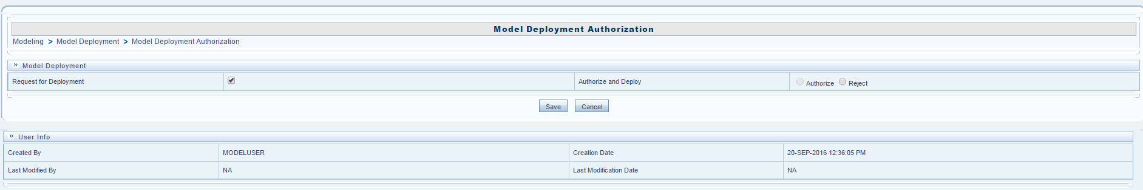
Model Deployment Process with PMF
1. The Modellers create the model and request to deploy.

Slide 20
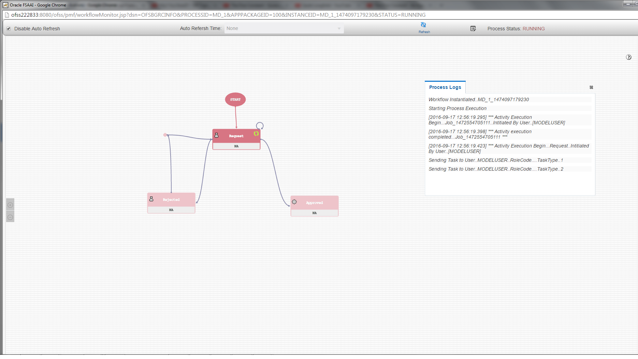
Model Deployment Process with PMF
2. The progress of the Model Deployment can be viewed with the process monitor.

Slide 21
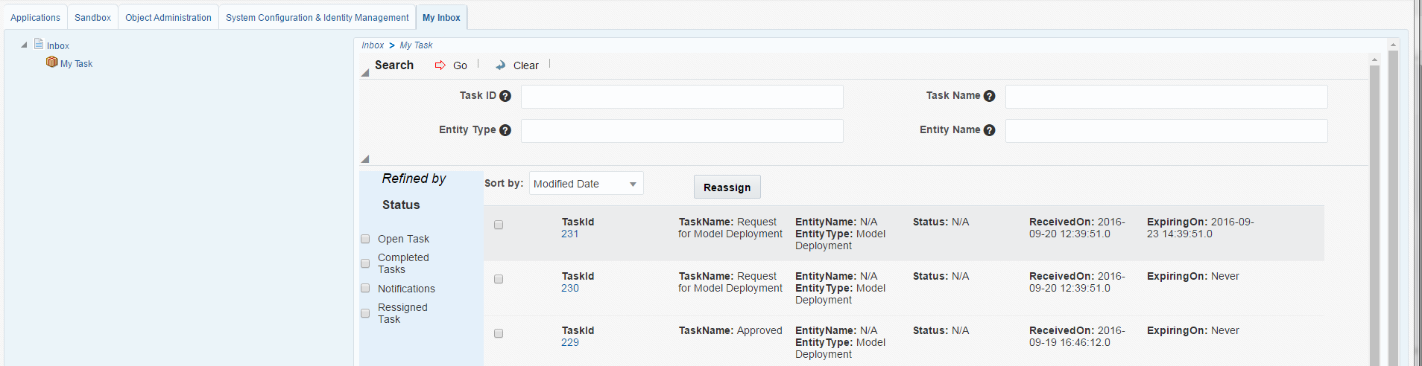
Model Deployment Process with PMF
3. Model Administrator will receive a notification in their Inbox.

Slide 22
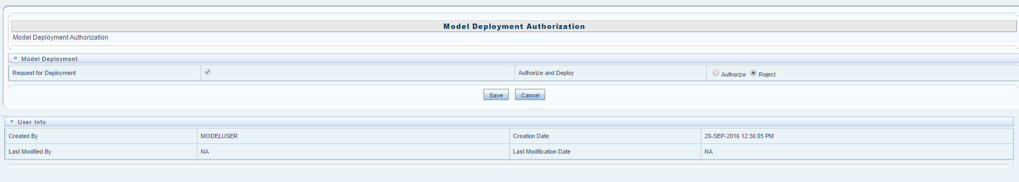
Model Deployment Process with PMF
4. The administrator would then approve or reject the model.

Slide 23
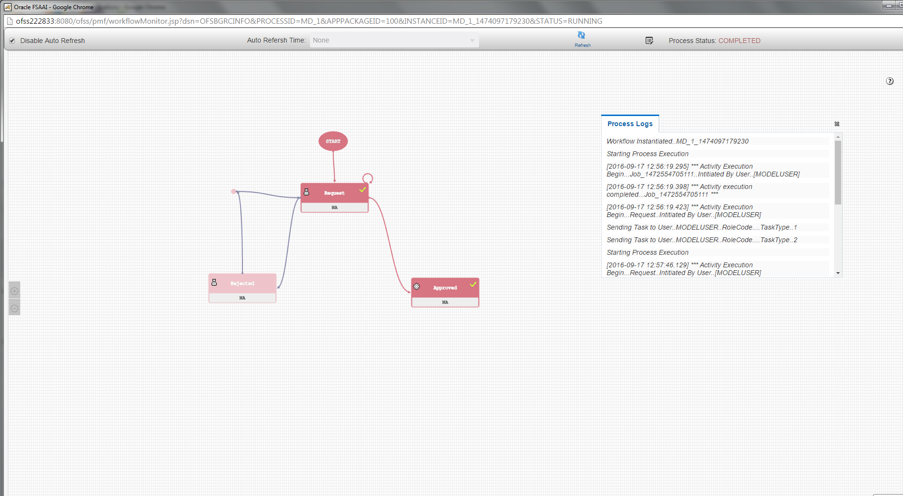
Model Deployment Process with PMF
5. The state of the model when approved.

Slide 24
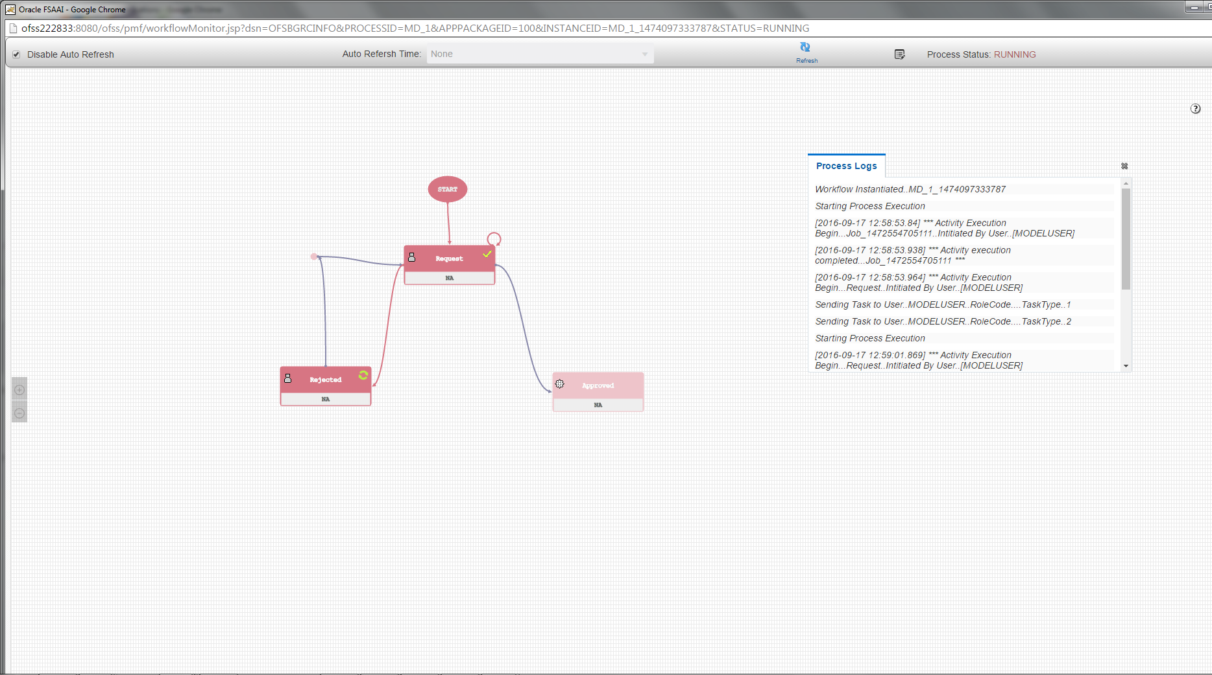
Model Deployment Process with PMF
6. The state of the model when rejected.

Slide 25
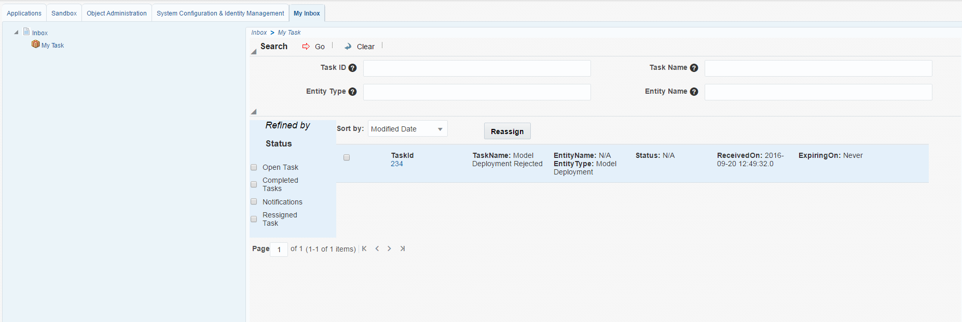
Model Deployment Process with PMF
7. The Model Users will receive a notification regarding the state of the model.

Slide 26
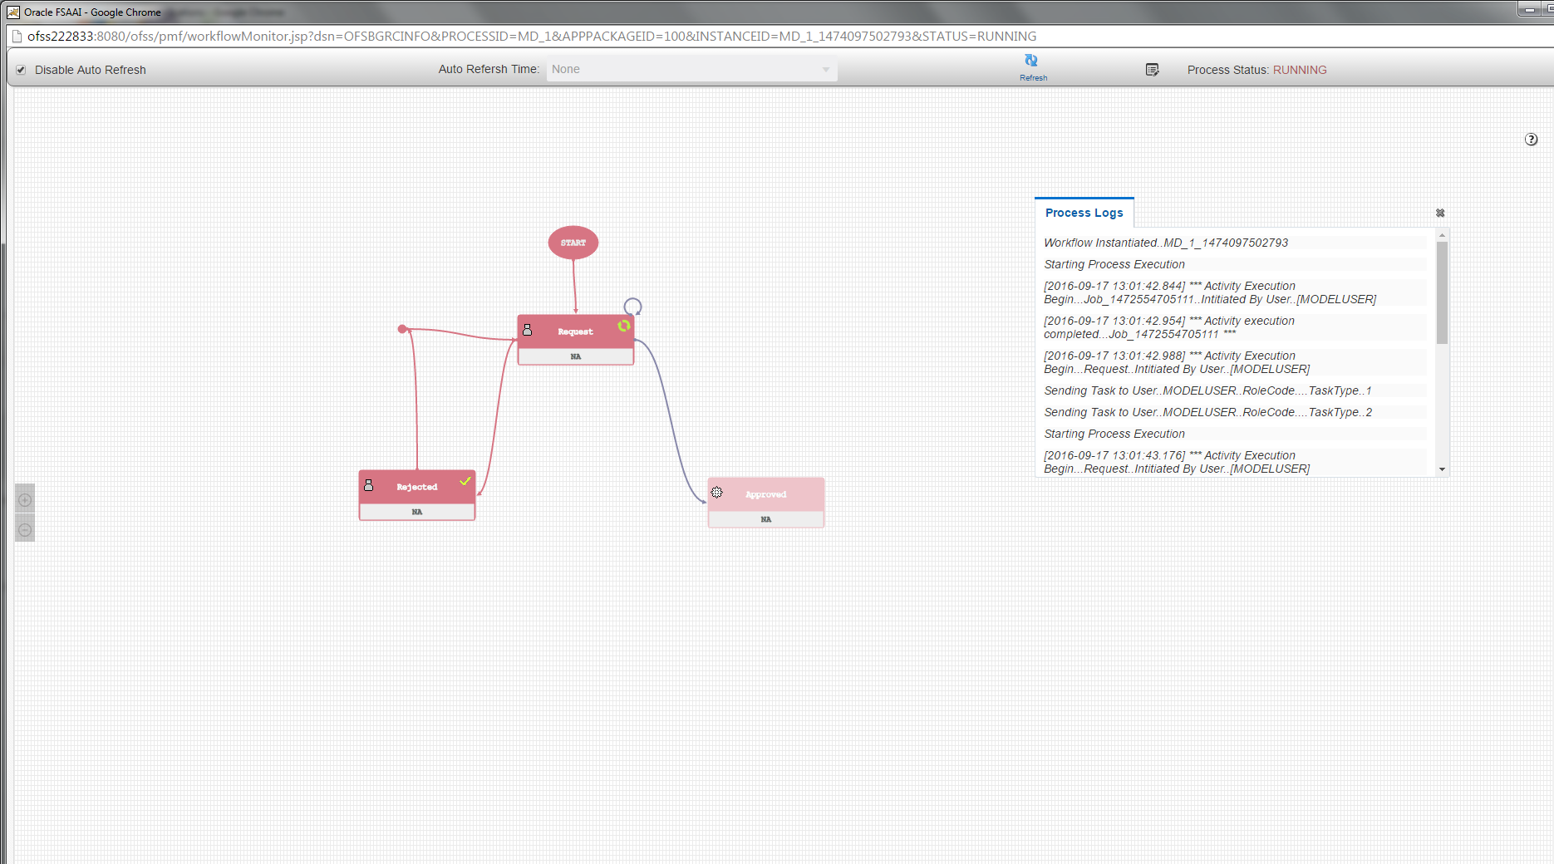
Model Deployment Process with PMF
8. The Model Deployment State if the model is requested for deployment again.

Slide 27
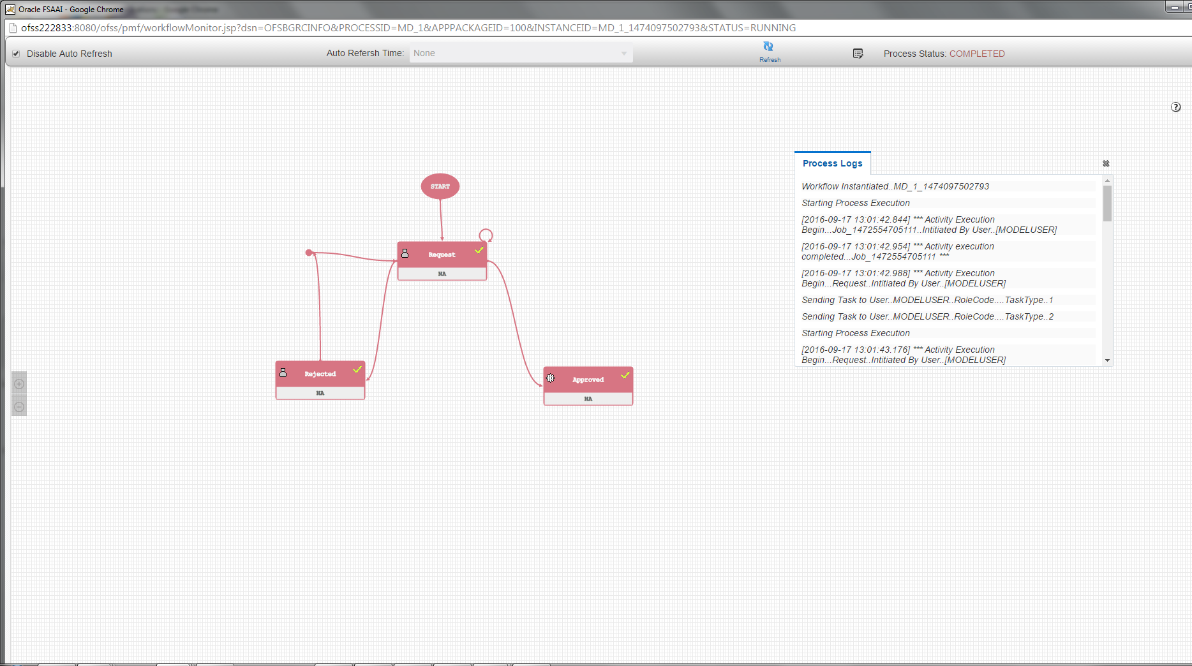
Model Deployment Process with PMF
9. The Model Deployment State if the model is approved for deployment.

Slide 28
The Integration Process
The integration process took 1 week
The Process Modeling Framework is maintained by the PMF Team.
In order to introduce the PMF into the model deployment process we needed to create a Model Deployment Process in the Process Modeler Screen.

Slide 29
The Integration Process
In order to introduce the PMF into the model deployment process we needed to create a Model Deployment Process in the Process Modeler Screen.
Once the process is created we add the different tasks associated with the different states.
Request
Approved
Rejected

Slide 30
The Integration Process
We add Data Fields associated with the process which we pass to the API.
We add transitions between the states so that we can move between states.
In order to determine the transitions, the parameters passed during API call are used to determine the rules for transition.
These rules are then saved as Expressions Rules and each transition is allocated a rule.

Slide 31
The Integration Process
In order to notify the concerned users we need to set up a notification in the tasks.
Notifications are then addressed to User Groups,
Request Task: Model User Group.
Approved Task: Model Admin Group.
Rejected Task: Model User Group.
Notifications are then received by the User Groups in the inbox.

Slide 32
Upcoming Tasks
As the project is still in progress a lot of the components of the project are yet to be implemented
Using Oracle Jet and
Up taking ALTA theme,
which will be implemented in the coming weeks.

Slide 33
Conclusion
Since OFSAA is a large scale software, rigorous testing will be a part of the development process. The code committed so far has been tested and works with the rest of the product.

