Slide 1
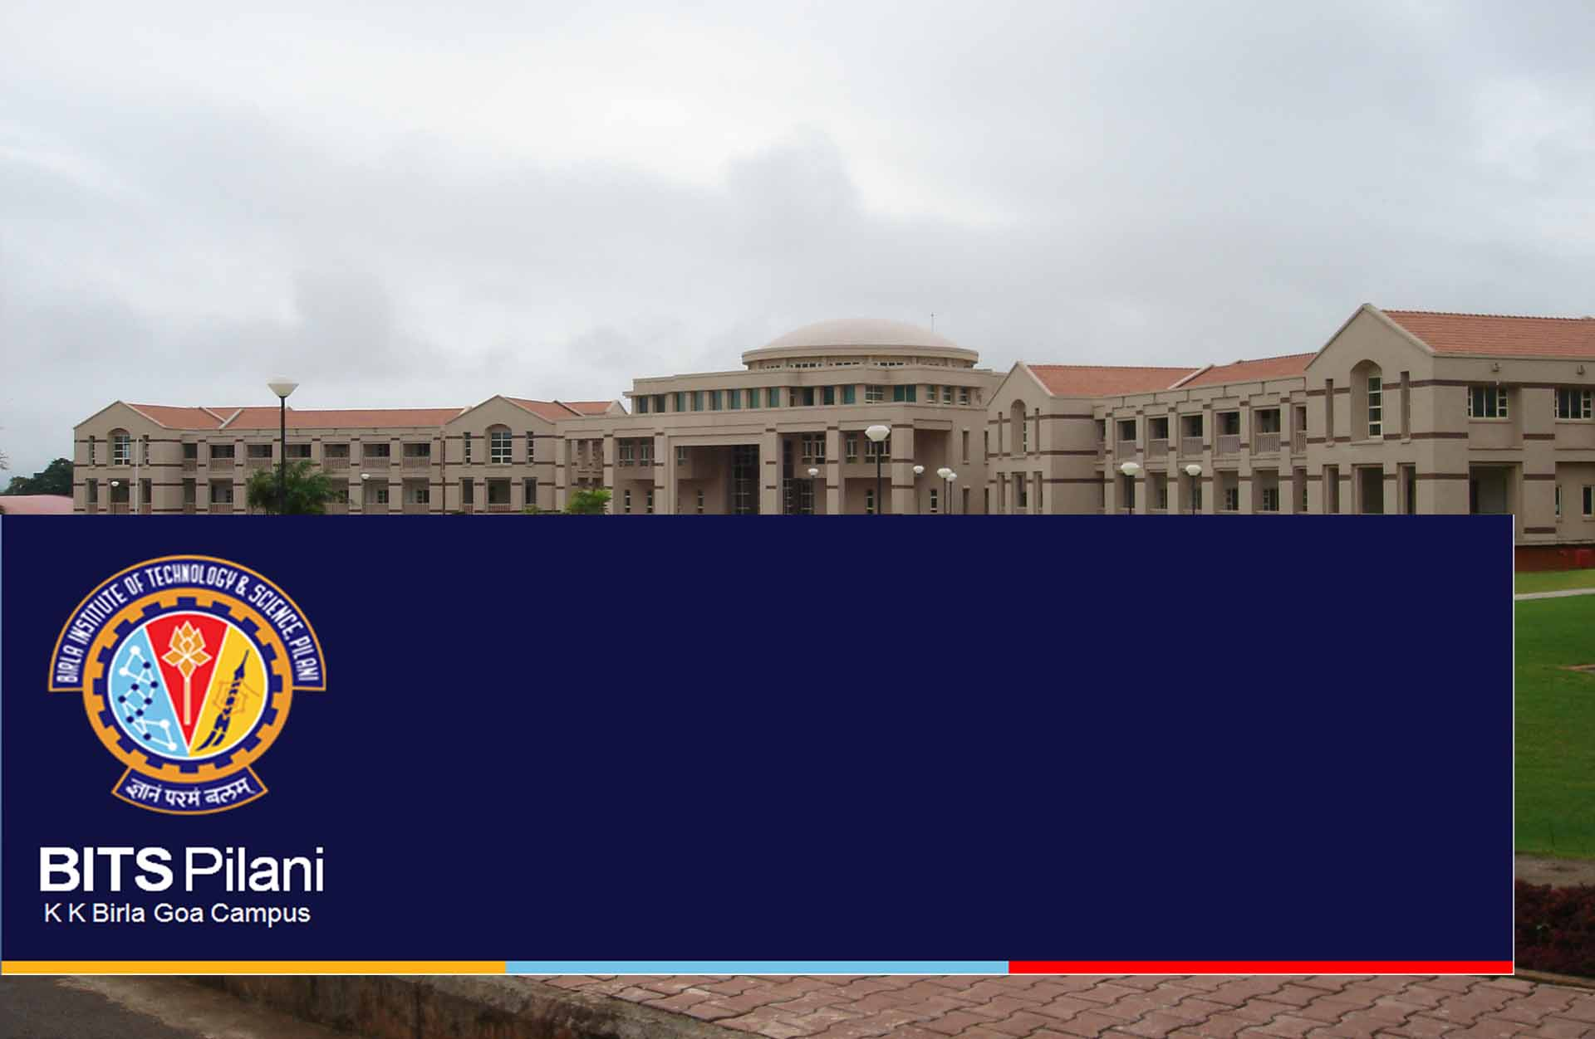
Multibrowser Support for Oracle Financial Services Analytical Applications

Slide 2
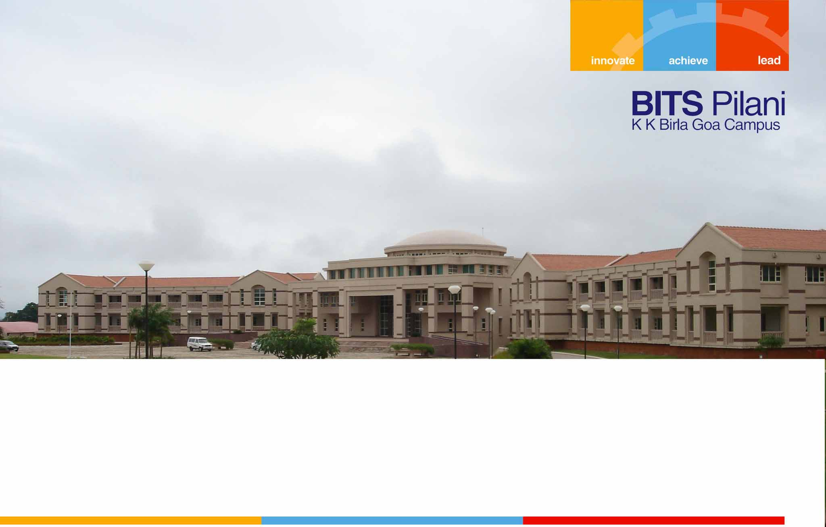
HTML5 and Multi Browser Enabling

Slide 3
Need for Update
The need to update to HTML5 arises from the following reasons.
Many tags do not behave the same as before as browsers are being updated to support HTML5.
Certain tags like <center> have been replaced by css modifiers like text-align.
HTML5 headings like <header>, <footer>, <nav>, <section>, <aside> make the code more accessible.

Slide 4
Rendering Modes
2 rendering modes
Quirks mode (the older rendering mode)
Standards Mode (the newer standards which imposes stricter rules)
IE or any Browser cannot render both of the above modes. Only one mode can be adopted for a page.

