Slide 1
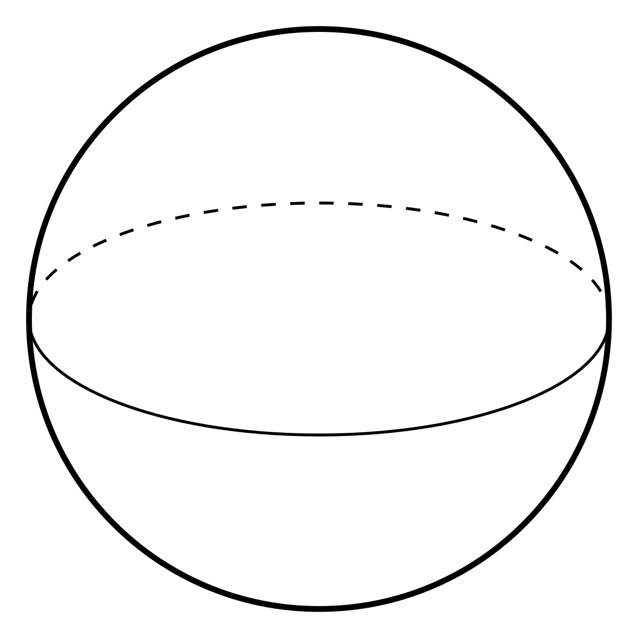

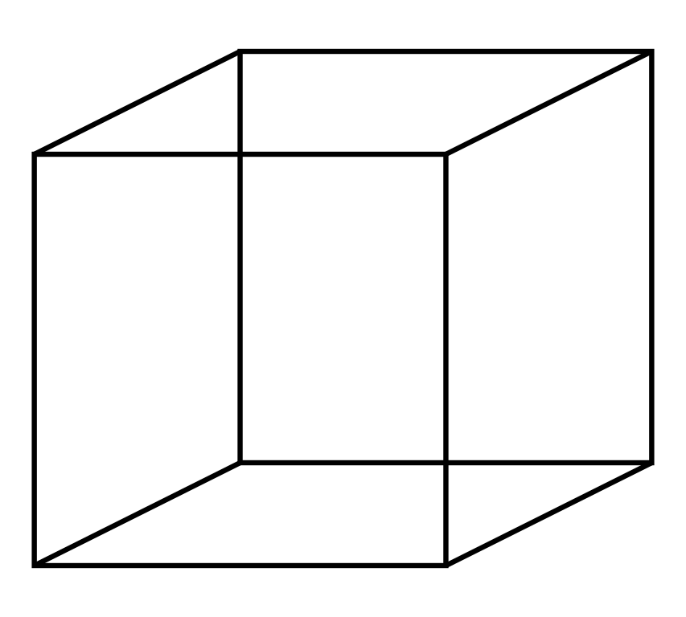
SCRIPTS
Bash scripts for jobs on HPC cluster
C++ scripts for running simulations
C++/Python scripts for testing, plotting & analysis
FRAMEWORK
SprinkledCauset
EmbeddedCauset
Causet
Spacetimes
Shapes

