Slide 1
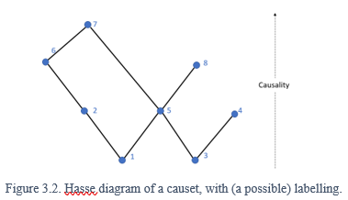
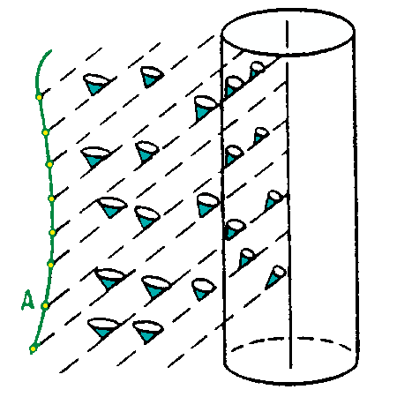
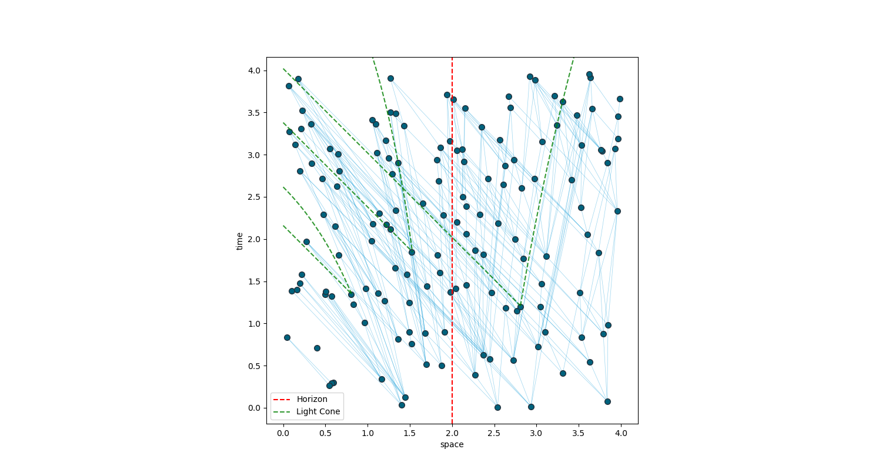
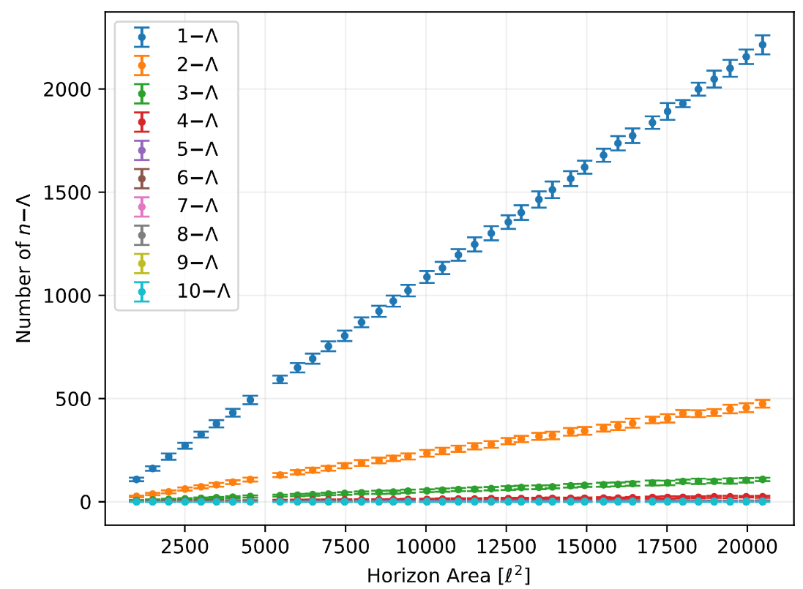
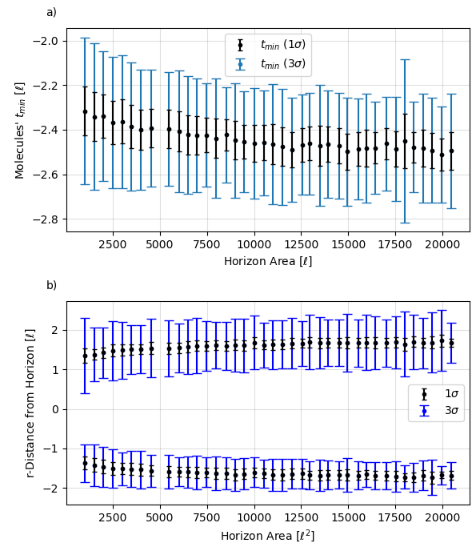
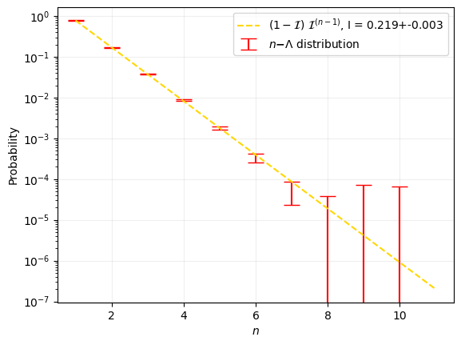


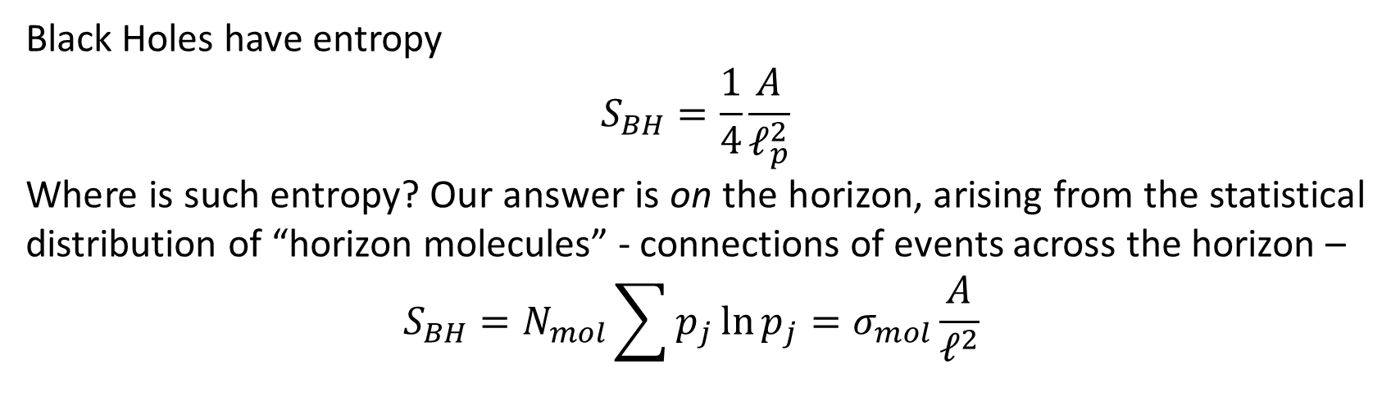
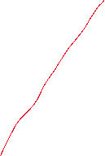
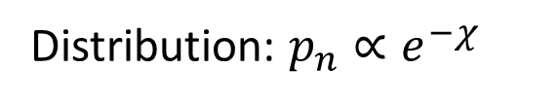
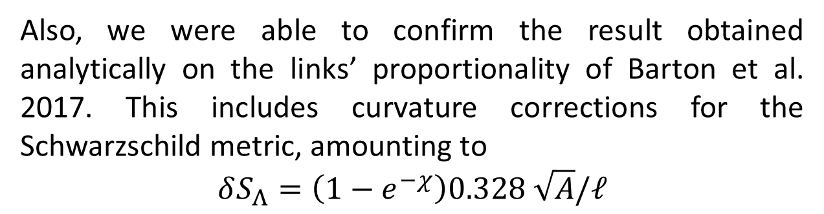


Black Hole Entropy in a Discrete Scwharzt Spaceti
Imperial
Logo
Vid Homsak, Stefano Veroni
Supervisor: Fay Dowker
Research Group: Theoretical Physics
Local
deterministic
Fixed background
Linear
Infinities
Singularities
Relativity VS Quantum
Non-linear
Dynamic Background
probabilistic
Non-local
Non-commutative
The Causal Sets Approach to Quantum Gravity
GEOMETRY = ORDER + NUMBER!
Causal structure and discreteness measure uniquely define the spacetime.
Causal Set Theory: Spacetime is a causal set, i.e. a discrete partially ordered set of points x \prec y, satisfying
Transitivity
Acyclicity
Local finiteness
How to study it? Poisson Sprinkling
To realise a causet underlying a certain spacetime region:
Pick density \rho and spacetime region of volume V.
Distribute N = Poiss(\rhoV) points uniformly, where
$$Poiss\left(n;v\right)=\frac{{\left(ρ v\right)}^{n}}{n!}e^{−ρ_{c}v},$$
Note: the volume is proportional to \sqrt(-g_\mu\nu).
Connect them according to the causal structure of spacetime (if inside each other’s light cone)
Black Holes : testing arena of quantum gravity
From Entropy to Horizon Molecules
Black Holes are a region of spacetime bounded by an event horizon, such that everything inside the horizon is doomed to eventually hit the singularity, i.e. the centre of the black hole, in which curvature and density are seemingly infinite.
“If your theory is found to be against the 2nd law of thermodynamics, I can give you no hope; there is nothing for it but to collapse in deepest humiliation” – Arthur Eddington, 1915.
Black Holes have entropy
$$S_{BH}=\frac{1}{4}\frac{A}{ℓ_{p}^{2}}$$
Where is such entropy? Our answer is on the horizon, arising from the statistical distribution of “horizon molecules” - connections of events across the horizon –
$$S_{BH}=N_{mol}\sum{p_{j}\ln{p_{j}}}=σ_{mol}\frac{A}{ℓ^{2}}$$
Black Holes arise from General Relativity, and combined with Quantum Theory, a full set of Thermodynamic Laws was derived.
Objectives
Results
Molecules localized around horizon
Distribution: $p_{n}∝e^{−χ}$
• Simulate for the 1st time a large enough causet for kinematic analysis into Schwarzschild spacetime
• Simulate lambda molecules for a statistical model of BH entropy
• Test the molecule model
• Test Rindler analytic predictions
$$N_{Λ}∝A/ℓ^{2}$$
Further Work Suggestion
The entropy in the continuum limit amounts to
$$S_{Λ}=\left(0.0929± 0.0006\right)\frac{A}{ℓ^{2}}$$
Deriving the unit of discreteness, this would be
$$ℓ=\left(0.610± 0.002\right)ℓ_{p}$$
The current universe’s volume would be V=${10}^{+240}ℓ^{4}$ .
Even if speculative, assuming $p_{n}∝e^{−E_{n}/k_{B}T}$, leads to
$$E_{n}=χk_{B}T\sim \frac{3}{2}k_{B}T$$
as in free monoatomic gas.
Also, we were able to confirm the result obtained analytically on the links’ proportionality of Barton et al. 2017. This includes curvature corrections for the Schwarzschild metric, amounting to
$$δS_{Λ}=\left(1−e^{−χ}\right)0.328 \sqrt{A}/ℓ$$
Further models of Entropy:
Spacetime Mutual Information
Sorkin Entanglement Entropy
Entropy in more general BH metrics, with charge and rotation.
Exploit the 1st non-conformally flat spacetime causal sets to investigate:
- Ricci tt component and scalar
Proper time and geodesic
References
1
2
3
4
5
6
Code available at
https//etc
QR
CODE

Slide 2

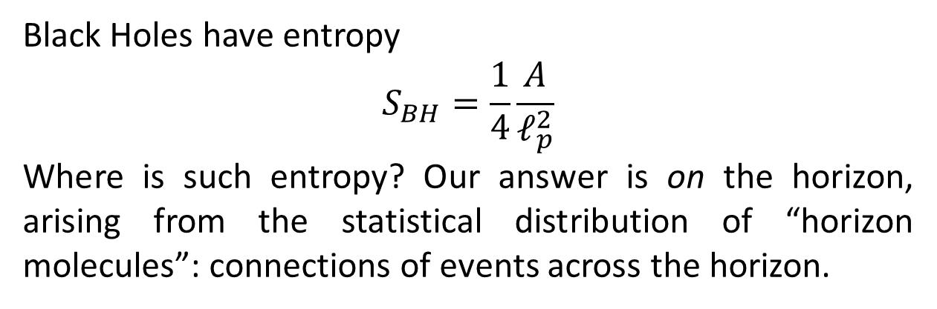
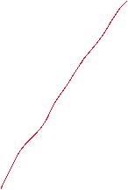

Black Hole Entropy in a Discrete Scwharzt Spaceti
Imperial
Logo
Vid Homsak, Stefano Veroni
Supervisor: Fay Dowker
Research Group: Theoretical Physics
Local
deterministic
Fixed background
Linear
Infinities
Singularities
Relativity VS Quantum
Non-linear
Dynamic Background
probabilistic
Non-local
Non-commutative
The Causal Sets Approach to Quantum Gravity
The HKMM theorem showed that the causal order of spacetime defines its metric g_munu up to a conformal factor – that is 9/10 in 4D!
In a discrete spacetime, that conformal factor is set by their number, allowing for full 10/10 retrieval. Result:
GEOMETRY = ORDER + NUMBER
Causal Set Theory: Spacetime is a causal set, i.e. a discrete partially ordered set of points x \prec y, satisfying
Transitivity
Acyclicity
Local finiteness
How to study it? Poisson Sprinkling
To realise a causet underlying a certain spacetime region:
Pick density \rho and spacetime region of volume V
Distribute N = Poiss(\rhoV) points uniformly, where
$$P\left(n;v\right)=\frac{{\left(ρ v\right)}^{n}}{n!}e^{−ρ_{c}v},$$
Note: the volume is proportional to \sqrt(-g_\mu\nu).
Connect them according to the causal structure of spacetime (if inside each other’s light cone)
Black Holes : the testing arena of quantum gravity
Black Holes a region of spacetime bounded by an event horizon, such that everything inside the horizon is doomed to eventually hit the singularity, i.e. the centre of the black hole, in which curvature and density are seemingly infinite.
Black Holes arise from General Relativity, and combined with Quantum Theory, a full set of Thermodynamic Laws was derived.
0. A static horizon has constant surface gravity $κ$ everywhere.
I. dE = kappa*dA/(8\pi) (neglecting charge and angular momentum).
II. dS_tot =dS_BH + dS_ext >= 0
III. Kappa > 0
From Entropy to Horizon Molecules
“If your theory is found to be against the 2nd law of thermodynamics, I can give you no hope; there is nothing for it but to collapse in deepest humiliation” – Arthur Eddington, 1915.
LINEAR PLOT
Black Holes have entropy
$$S_{BH}=\frac{1}{4}\frac{A}{ℓ_{p}^{2}}$$
Where is such entropy? Our answer is on the horizon, arising from the statistical distribution of “horizon molecules”: connections of events across the horizon.
Boundaries
Sketch of a 2-Lambda Molecule. The upper vertex is inside the horizon and maximal below Sigma. The lower vertices are outside and, below Sigma, only connected to the upper vertex.
Computational Methods/Conclusion
Further Work Suggestion
Explore Curvature
Proper time
Ricci Scalar & 00 component
SMI approach
References
1
2
3
4
5
6
Code available at
https//etc
QR CODE

Slide 3
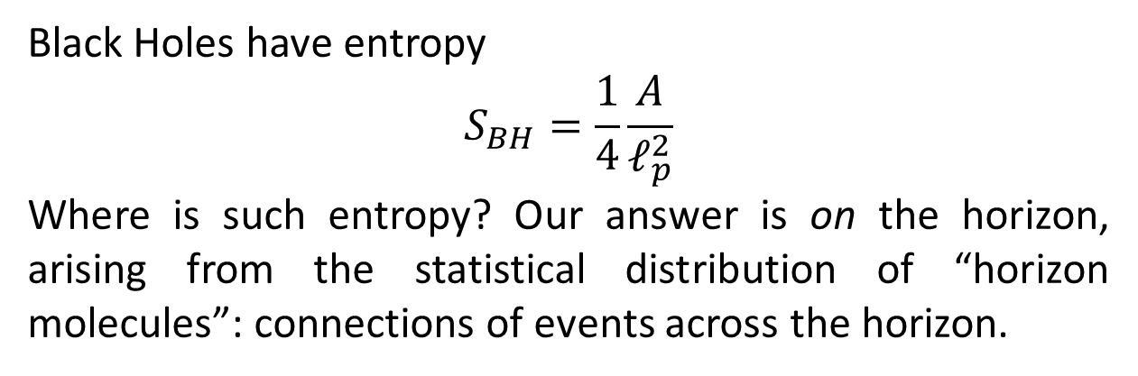
From Entropy to Horizon Molecules
“If your theory is found to be against the 2nd law of thermodynamics, I can give you no hope; there is nothing for it but to collapse in deepest humiliation” – Arthur Eddington, 1915.
LINEAR PLOT
Black Holes have entropy
$$S_{BH}=\frac{1}{4}\frac{A}{ℓ_{p}^{2}}$$
Where is such entropy? Our answer is on the horizon, arising from the statistical distribution of “horizon molecules”: connections of events across the horizon.
Boundaries
Sketch of a 2-Lambda Molecule. The upper vertex is inside the horizon and maximal below Sigma. The lower vertices are outside and, below Sigma, only connected to the upper vertex.
Results
Further Work Suggestion
Explore Curvature
Proper time
Ricci Scalar & 00 component
SMI approach

Slide 4

The Causal Sets Approach to Quantum Gravity
The HKMM theorem showed that the causal order of spacetime defines its metric g_munu up to a conformal factor – that is 9/10 in 4D!
In a discrete spacetime, that conformal factor is set by their number, allowing for full 10/10 retrieval. Result:
GEOMETRY = ORDER + NUMBER
Causal Set Theory: Spacetime is a causal set, i.e. a discrete partially ordered set of points x \prec y, satisfying
Transitivity
Acyclicity
Local finiteness
How to study it? Poisson Sprinkling
To realise a causet underlying a certain spacetime region:
Pick density \rho and spacetime region of volume V
Distribute N = Poiss(\rhoV) points uniformly, where
$$P\left(n;v\right)=\frac{{\left(ρ v\right)}^{n}}{n!}e^{−ρ_{c}v},$$
Note: the volume is proportional to \sqrt(-g_\mu\nu).
Connect them according to the causal structure of spacetime (if inside each other’s light cone)
(no example plot needed here, because BH plot will show)

Slide 5
Black Holes : the testing arena of quantum gravity
Black Holes a region of spacetime bounded by an event horizon, such that everything inside the horizon is doomed to eventually hit the singularity, i.e. the centre of the black hole, in which curvature and density are seemingly infinite.
Black Holes arise from General Relativity, and combined with Quantum Theory, a full set of Thermodynamic Laws was derived.
0. A static horizon has constant surface gravity $κ$ everywhere.
I. dE = kappa*dA/(8\pi) (neglecting charge and angular momentum).
II. dS_tot =dS_BH + dS_ext >= 0
III. Kappa > 0
From Entropy to Horizon Molecules
“If your theory is found to be against the 2nd law of thermodynamics, I can give you no hope; there is nothing for it but to collapse in deepest humiliation” – Arthur Eddington, 1915.
LINEAR PLOT
Black Holes have entropy
$$S_{BH}=\frac{1}{4}\frac{A}{ℓ_{p}^{2}}$$
Where is such entropy? Our answer is on the horizon, arising from the statistical distribution of “horizon molecules”: connections of events across the horizon.
Boundaries
Sketch of a 2-Lambda Molecule. The upper vertex is inside the horizon and maximal below Sigma. The lower vertices are outside and, below Sigma, only connected to the upper vertex.

