Slide 1
NAME : ANAMALA SILPA
ROLL NO:228P1A0206
BRANCH : ELECTRICAL AND ELECTRONICS ENGINEERING
NAME: A.VIDHARSHAN KUMAR
ROLL NO:228P1A0494
BRANCH: ELECTRONICS & COMMUNICATION ENGINEERING

Slide 2
Classifying Fabric Patterns Using Deep Learning
SlideMake.com

Slide 3
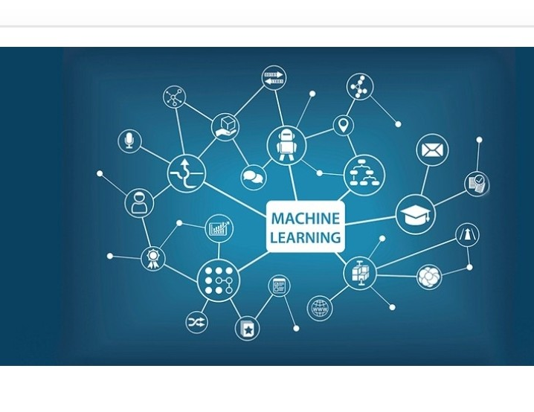
Introduction to Fabric Pattern Classification
Fabric pattern classification involves identifying and categorizing various textile designs using computational methods.
Deep learning has emerged as a powerful tool to improve accuracy and efficiency in pattern recognition tasks.
This presentation explores how deep learning techniques can be applied to classify fabric patterns effectively.

Slide 4
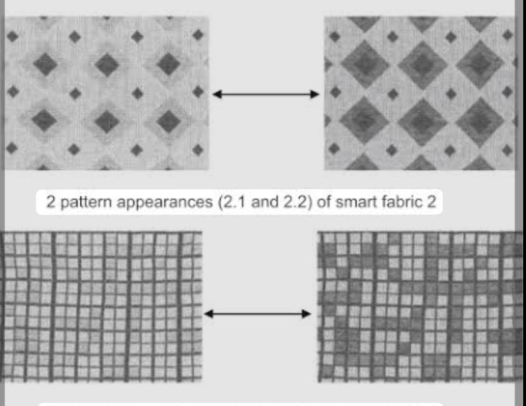
Importance of Fabric Pattern Classification
Accurate pattern classification aids in quality control and inventory management in textile industries.
It enhances customer experience by enabling personalized recommendations based on fabric patterns.
Automated classification reduces manual effort and minimizes human error in pattern identification.

Slide 5
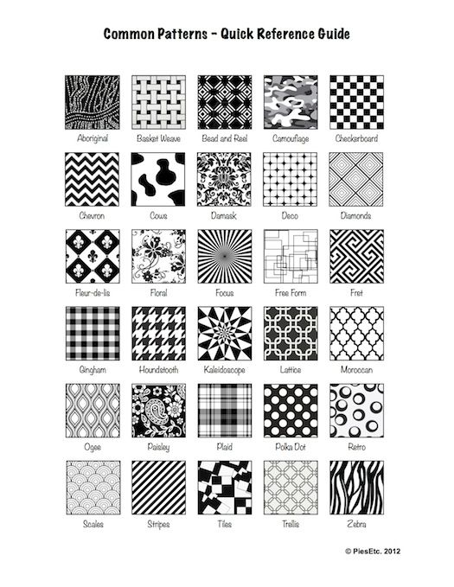
Common Fabric Patterns and Challenges
Popular fabric patterns include floral, striped, plaid, paisley, and abstract designs.
Variations in fabric texture, lighting conditions, and image quality pose challenges for accurate classification.
Overlapping pattern features can lead to misclassification, requiring robust algorithms to distinguish them.

Slide 6
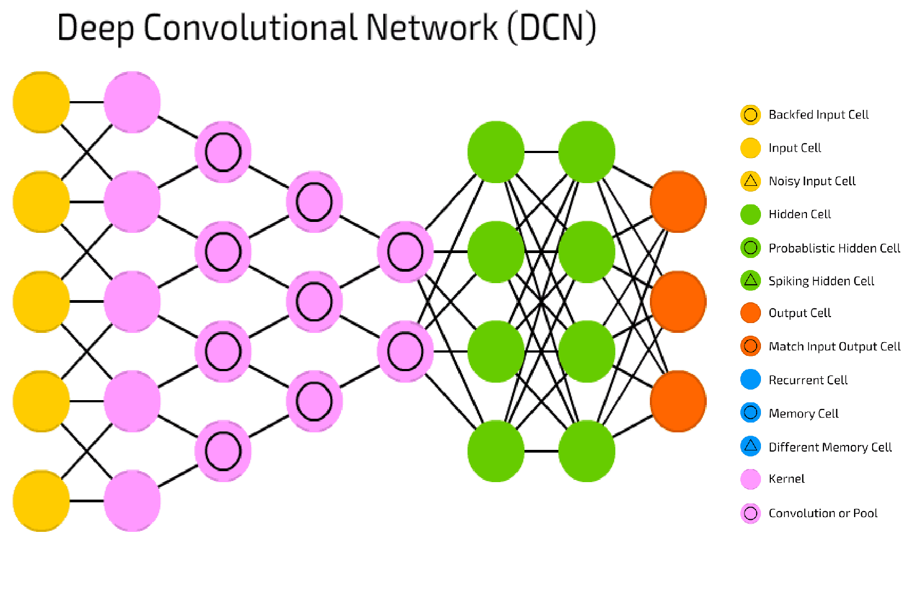
Deep Learning in Image Recognition
Deep learning models, especially Convolutional Neural Networks (CNNs), excel in extracting features from images.
CNNs automatically learn hierarchical features, making them suitable for complex pattern recognition.
Their ability to handle large datasets improves the robustness of fabric pattern classification systems.

Slide 7
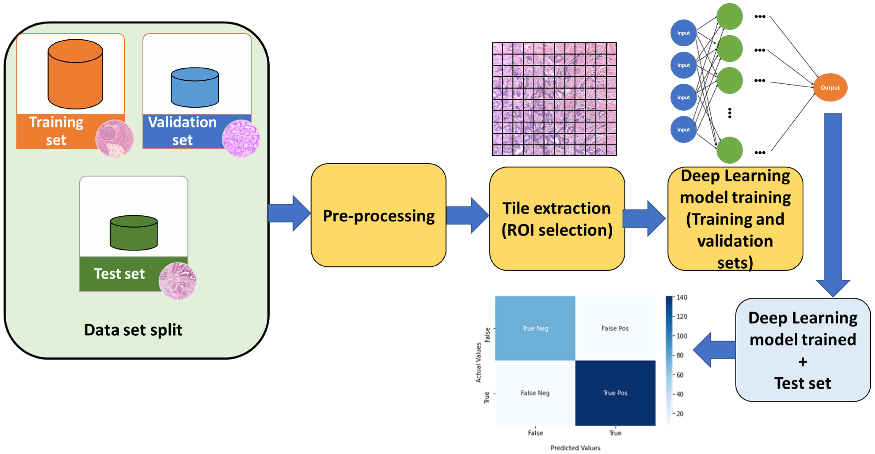
Data Collection and Preprocessing
A diverse and well-labeled dataset of fabric images is essential for training effective deep learning models.
Preprocessing steps include resizing images, normalization, and data augmentation to enhance model performance.
Data augmentation techniques such as rotation, flipping, and scaling help address class imbalance and variability.

Slide 8
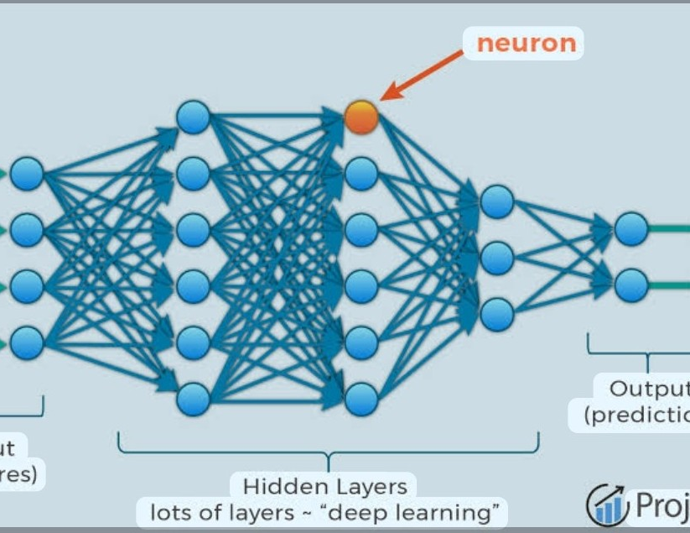
Model Architecture and Training
Popular CNN architectures like VGG, ResNet, and Inception can be employed for fabric pattern classification.
Transfer learning allows leveraging pre-trained models to improve accuracy with limited datasets.
Model training involves optimizing parameters using techniques like backpropagation and stochastic gradient descent.

Slide 9
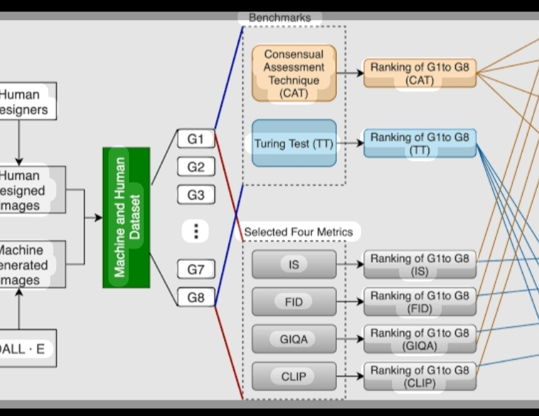
Evaluation Metrics and Results
Accuracy, precision, recall, and F1-score are common metrics used to evaluate model performance.
Confusion matrices help identify specific pattern classes that are often misclassified.
Achieving high performance requires careful tuning of hyperparameters and validation strategies.

Slide 10

Practical Applications and Benefits
Automated fabric pattern classification can be integrated into manufacturing, retail, and e-commerce platforms.
It enables quick sorting, inventory management, and quality assurance processes.
The technology supports innovative applications like virtual try-ons and personalized fabric recommendations.

Slide 11
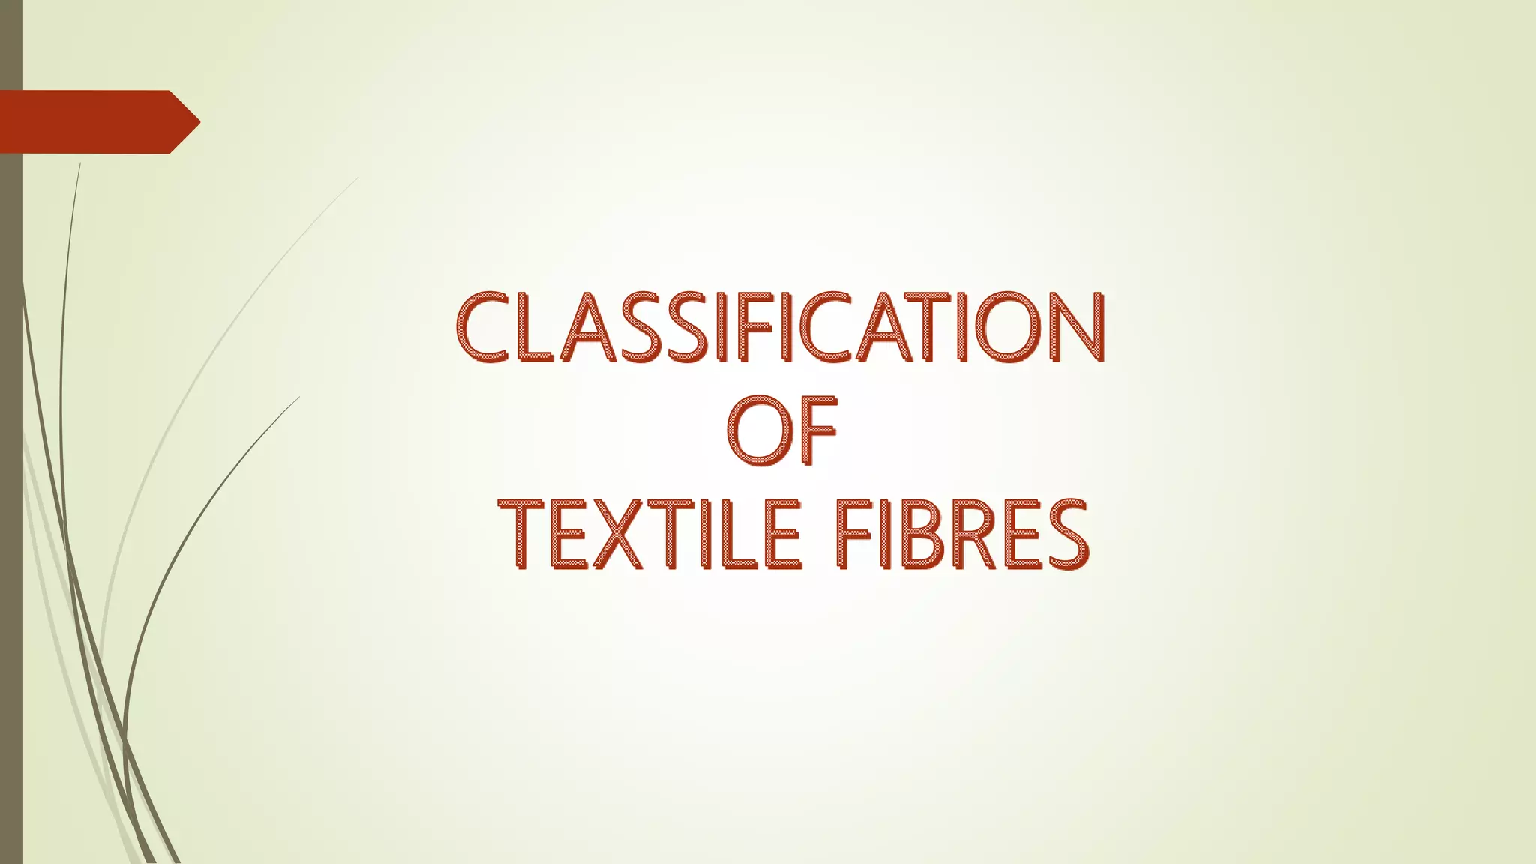
Future Directions and Challenges
Developing models capable of handling complex, multi-pattern fabrics remains an ongoing challenge.
Integrating multimodal data, such as texture and material properties, can enhance classification accuracy.
Addressing data privacy and ensuring model interpretability are important considerations for deployment.

Slide 12
References
Relevant literature and resources on deep learning and fabric pattern classification.
Key publications include research articles on CNN applications in textile analysis.
Additional resources include online tutorials, datasets, and open-source code repositories for further exploration.

