Slide 1





PROGRAM
NASSCOM
COSMETICS TRENDS
& Consumer Insights
A data-driven look at pricing, ratings, brand performance, and consumer skin-type preferences
PRESENTED BY
Ghanesh saini
Vidhi gupta
Prepared from Tableau · Cosmetics Sales & Consumer Insights Dashboard
Notes:
1.7.2013
1.7.2013
1.7.2013
1
‹#›
‹#›
‹#›

Slide 2
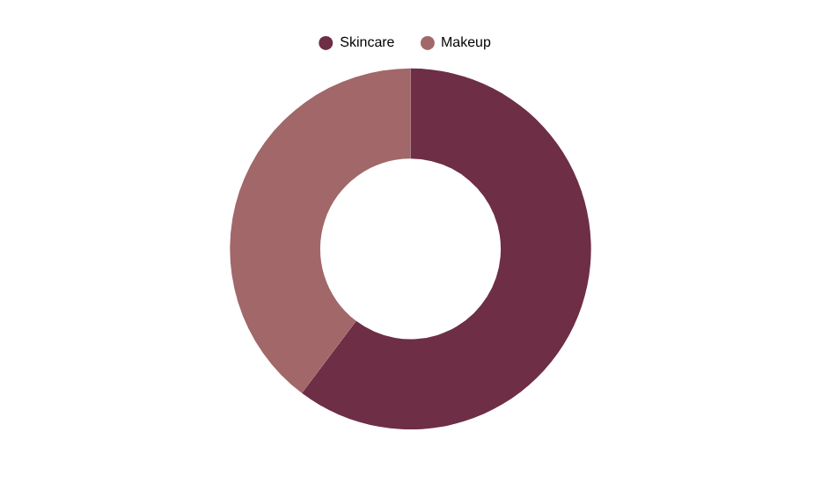
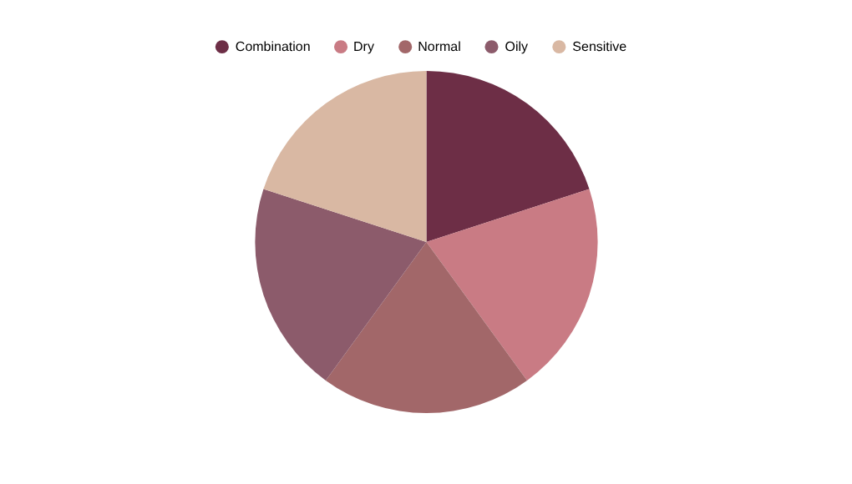
Dataset Overview
Brands, categories, pricing and ratings across the full cosmetics catalog
120
₹564.0
4.45
36,906
TOTAL PRODUCTS
AVERAGE PRICE
AVERAGE RATING
SKINCARE SALES
Product Mix by Category
Skin Type Distribution
Cosmetics Trends & Consumer Insights
2
Notes:
1.7.2013
1.7.2013
1.7.2013
2
‹#›
‹#›
‹#›

Slide 3
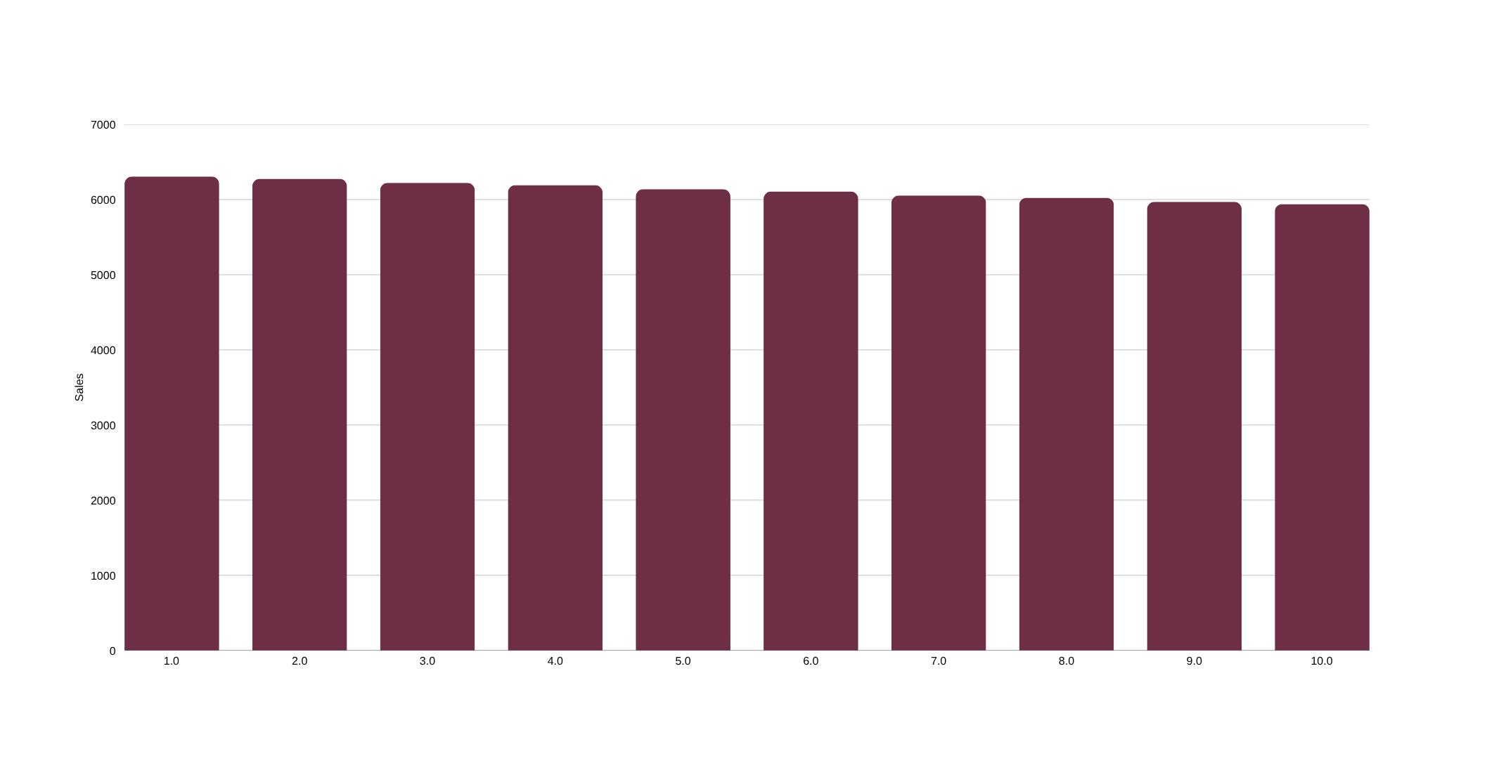
Sales Performance by Brand
Nivea leads sales volume; the top 10 brands stay within a tight 5,940–6,306 unit band
Cosmetics Trends & Consumer Insights
3
Notes:
1.7.2013
1.7.2013
1.7.2013
3
‹#›
‹#›
‹#›

Slide 4
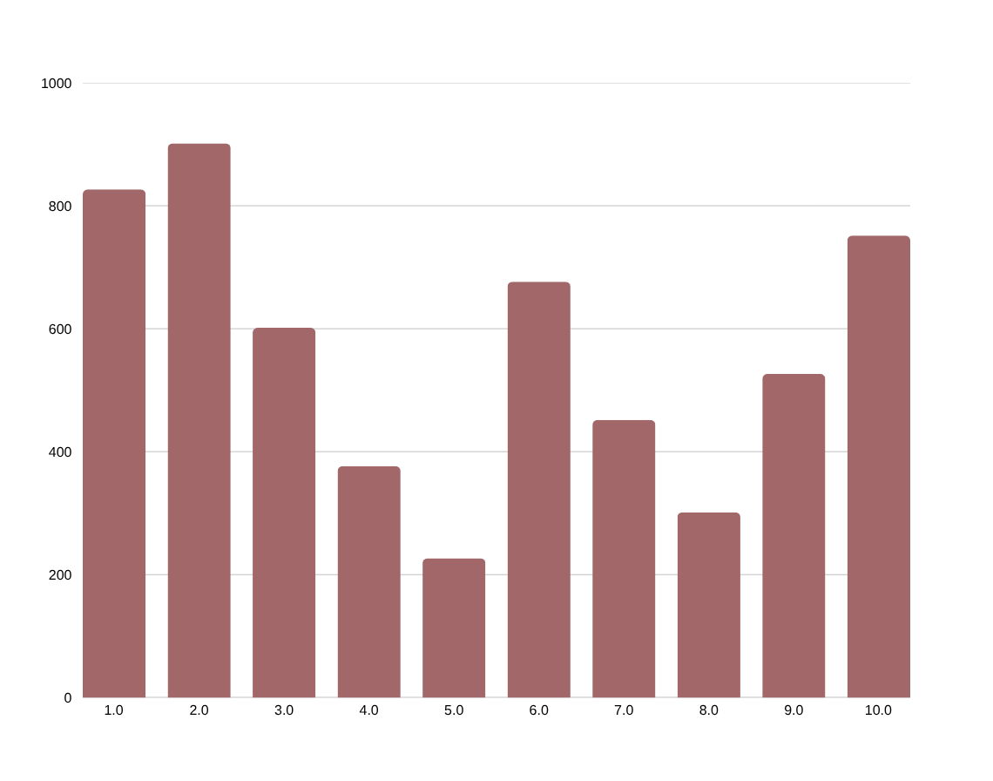
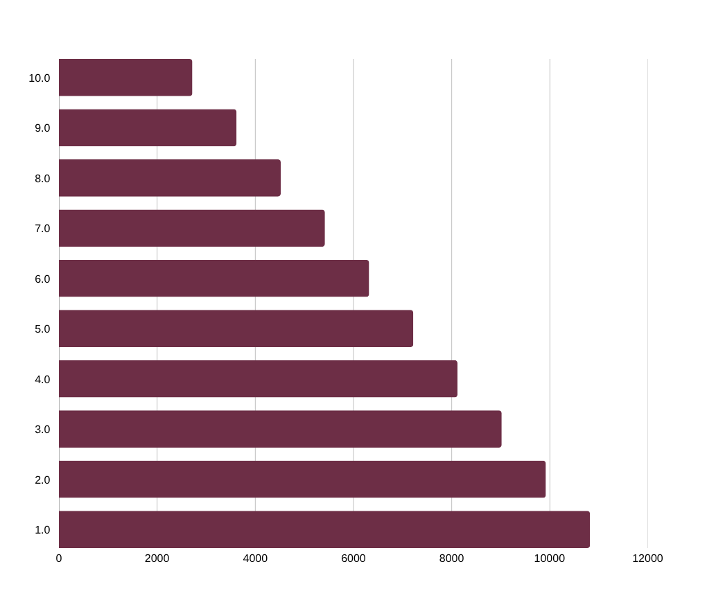
Price Analysis
Pricing trends across brands and the products commanding the highest price points
Average Price by Brand
Top 10 Most Expensive Products
Cosmetics Trends & Consumer Insights
4
Notes:
1.7.2013
1.7.2013
1.7.2013
4
‹#›
‹#›
‹#›

Slide 5
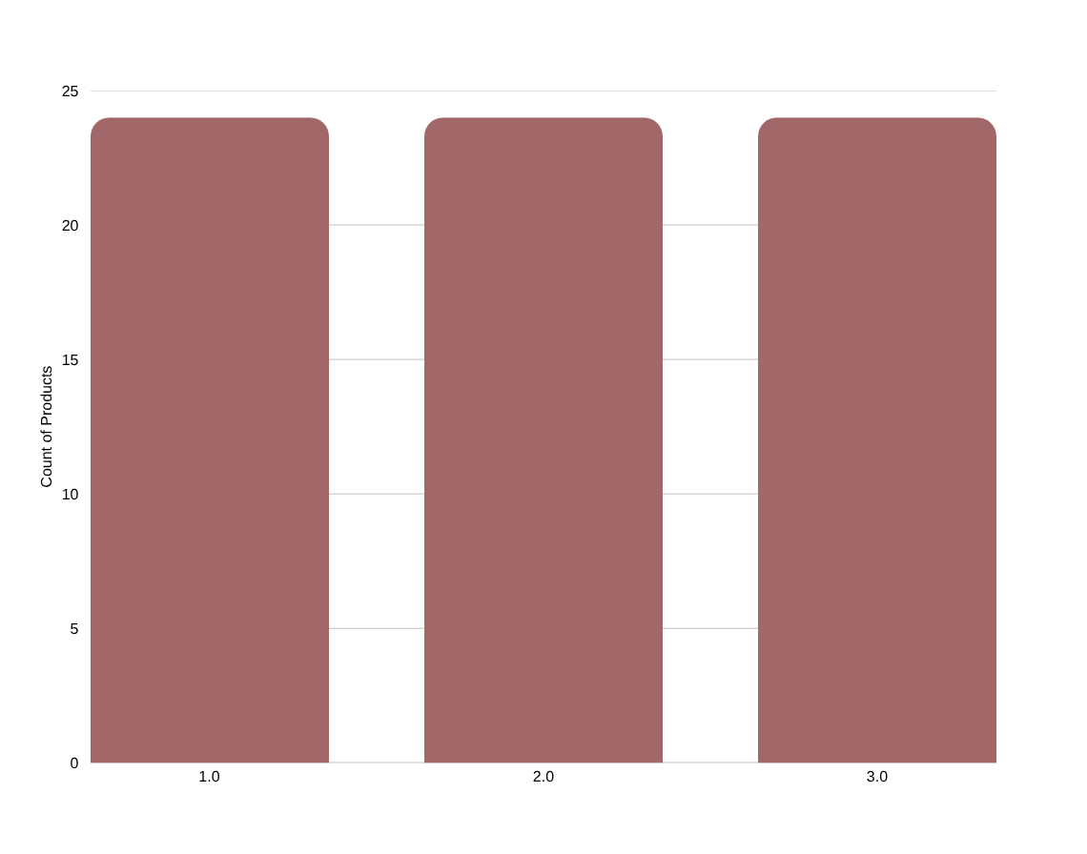
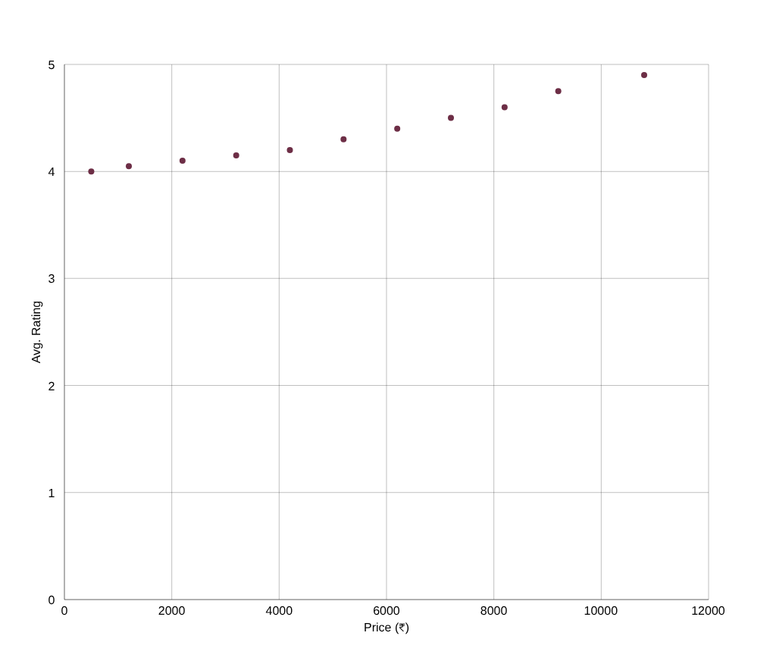
Ratings & Price Relationship
How customer ratings are distributed, and how price correlates with satisfaction
Rating Distribution
Price vs. Average Rating
Cosmetics Trends & Consumer Insights
5
Notes:
1.7.2013
1.7.2013
1.7.2013
5
‹#›
‹#›
‹#›

Slide 6
Key Insights
Skincare dominates the catalog
Higher price tracks higher ratings
Skincare accounts for 36,906 units sold vs. 24,324 for Makeup — roughly 60% of total volume.
The price-vs-rating trend rises steadily from ~4.0 at lower price points to ~4.9 for premium items like Serum and Mascara.
Brand sales are tightly clustered
Wide brand price gap
Top 10 brands sell within a narrow 5,940–6,306 unit range — no single brand dominates the market.
Average price by brand spans from ₹226.5 (L'Oreal) to ₹901.5 (Colorbar) — a 4x difference in positioning.
Consistently high satisfaction
Skin type demand is balanced
Overall average rating sits at 4.45/5, with no products rated below 3.5.
Combination, Dry, Normal, Oily and Sensitive skin types each represent an equal ~20% share of preference.
Notes:
1.7.2013
1.7.2013
1.7.2013
6
‹#›
‹#›
‹#›

Slide 7



EXPERIENCE FITVIT TODAY
REPOSITORY
LIVE DEMO
https://drive.google.com/file/d/1ic8DEOR_zEq-BlWinu9QtiAzFPPebEaj/view?usp=drivesdk
https://github.com/vidhgupta4-sketch/Cosmetics-Tableau-Project
THANK YOU!
Notes:
1.7.2013
1.7.2013
1.7.2013
11
‹#›
‹#›
‹#›

